Slide 1
Update on Danish activities within the convention
TFMM, Madrid 2019
Thomas Ellermann, Jesper H. Christensen, Per Løfstrøm, Matthias Ketzel, Ingeborg E. Nielsen, Rossana Bossi & Steen S. Solvang
DCE – Danish Centre for Environment and Energy
Aarhus University, Denmark

Slide 2
Content
Danish Air Quality Monitoring Program
Ship emissions and long term trend in SO₂
Air quality at your home adress
N – deposition to Danish ecosystems on local scale
Pesticides in air and precipitation

Slide 3
Danish Air Quality Monitoring Program
5.5 million people and 42.000 km²
One single national air quality monitoring program:
EU
National
EMEP
Integration of measurements and models
DCE – Danish Centre for Environment and Energy at Aarhus University
Daily management, measurements and modelling
National data host and responsible for reporting
National reference laboratory
Ministry of Environment and Food

Slide 4
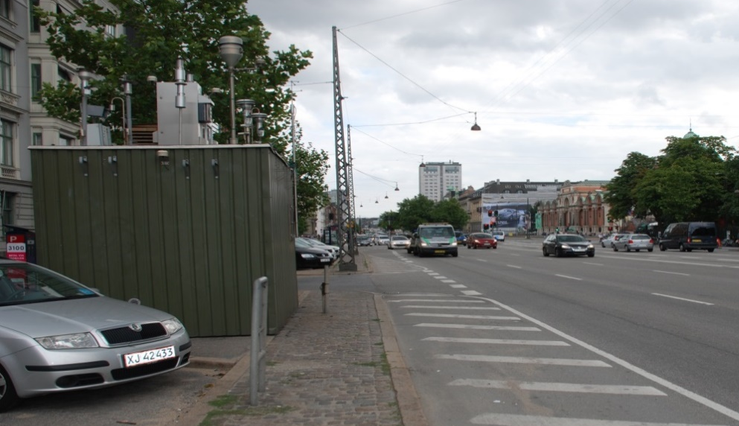
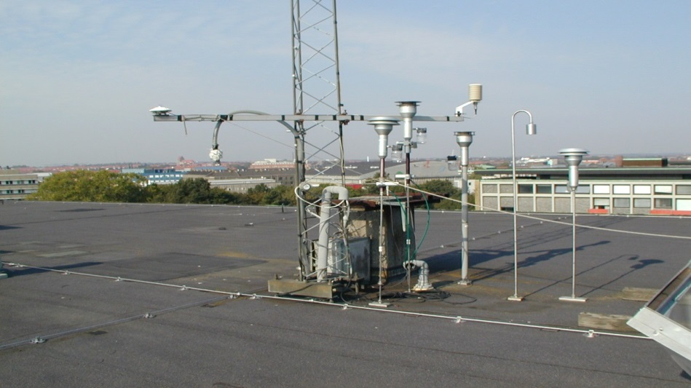
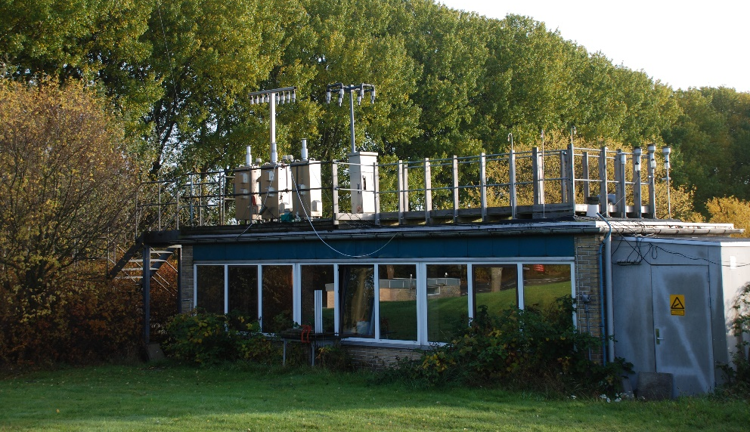
Street contribution
Urban background
Regional background
Urban area

Slide 5
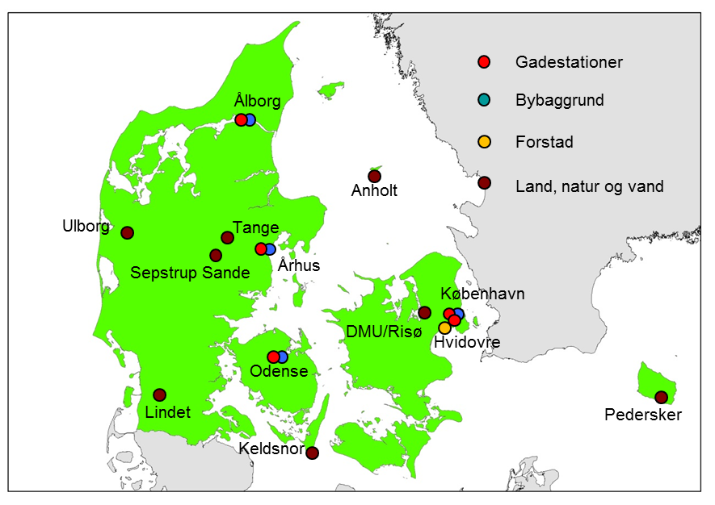
Danish measurement stations

Slide 6
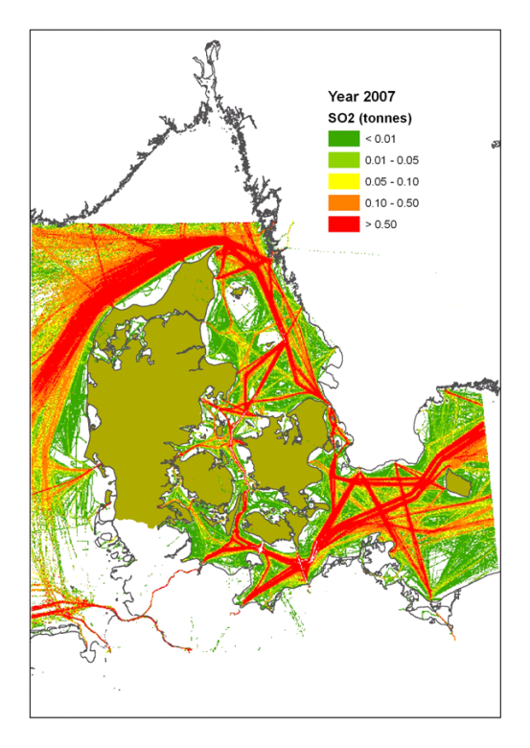
Ship emissions and long term trends in SO₂
Ship emissions in 2007
1 km x 1 km

Slide 7
Ship emissions and long term trends in SO₂
Sulphur emission control area (SECA)
Change from 1% to 0.1% sulfur in shipping fuel from 01.01.2015

Slide 8
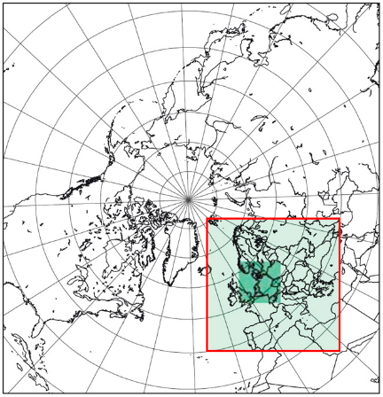
Danish Eulerian Hemispheric Model, DEHM
Two way nested model
Four domains
Denmark 5.6 km x 5.6 km

Slide 9
Ship emissions and long term trends in SO₂
Sulphur emission control area (SECA)
Change from 1% to 0.1% sulfur in shipping fuel

Slide 10
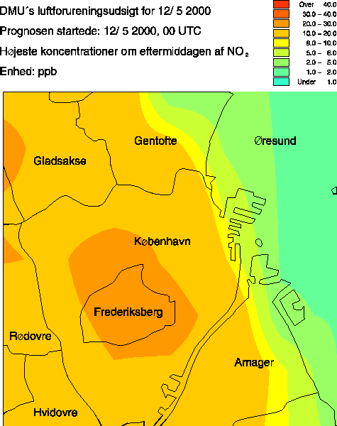
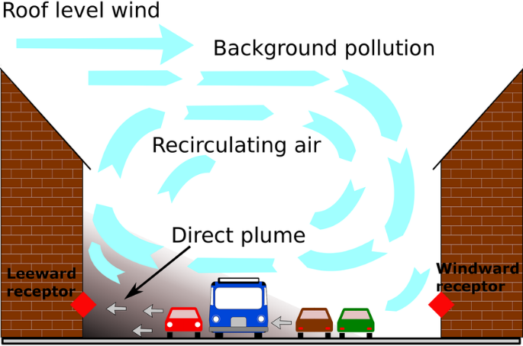
Model calculations at adress level – three steps
Regional model - DEHM
Urban background model - UBM
Street level model - OSPM
Emissions, meteorological data, chemical and physical processes, deposition of air pollutants
OSPM linked to AirGIS that enables ud to carry automated valvulation for many addresses

Slide 11
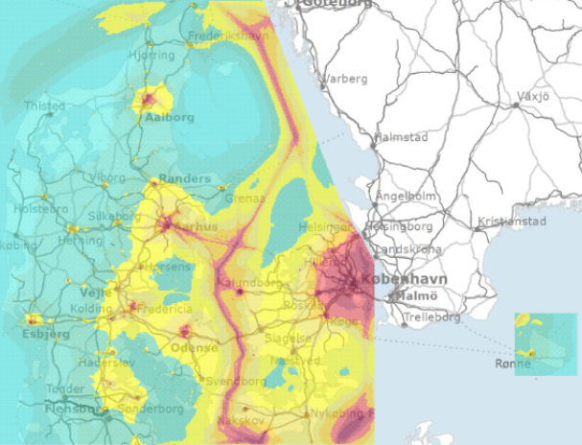
Air quality at your home address
http://lpdv.spatialsuite.dk/spatialmap

Slide 12
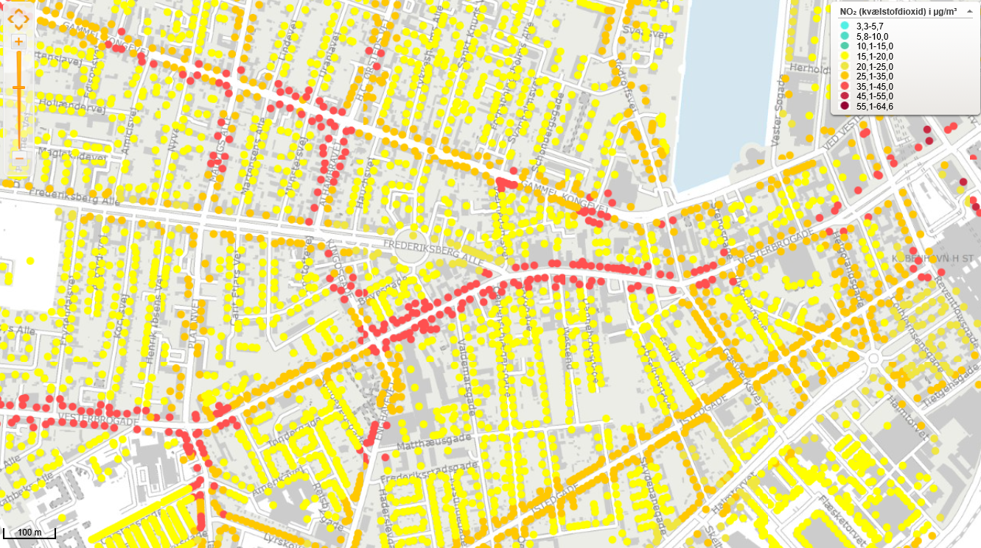
Air quality at you home adress

Slide 13
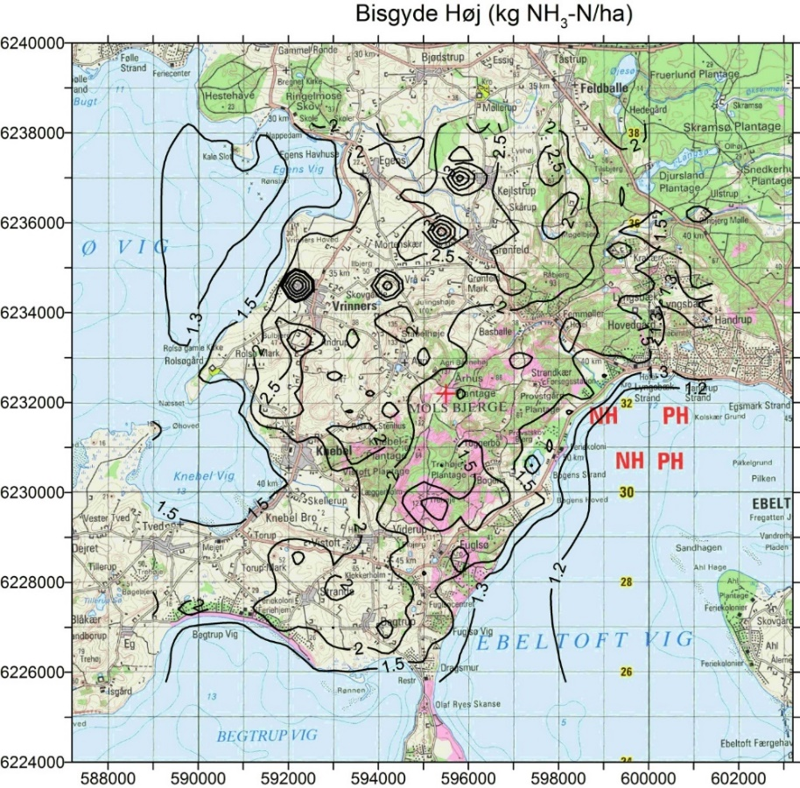
Nitrogen deposition to terrestrial ecosystems
Regional model
OML-DEP 400 m x 400 m
DEHM: non-local souces of nitrogen depsition
OML – DEP: Gaussian plume model adapted to calculate nitrogen deposition in a model domain of 16 km x 16 km with resolution of 400 m x 400 m

Slide 14
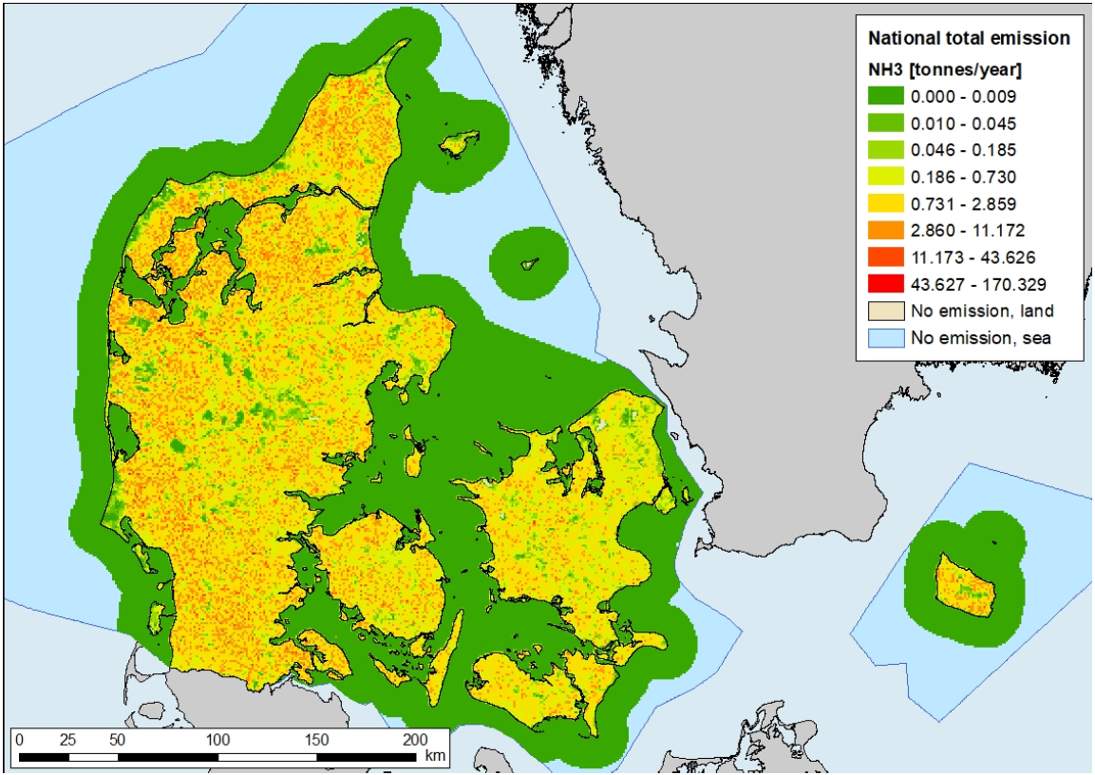
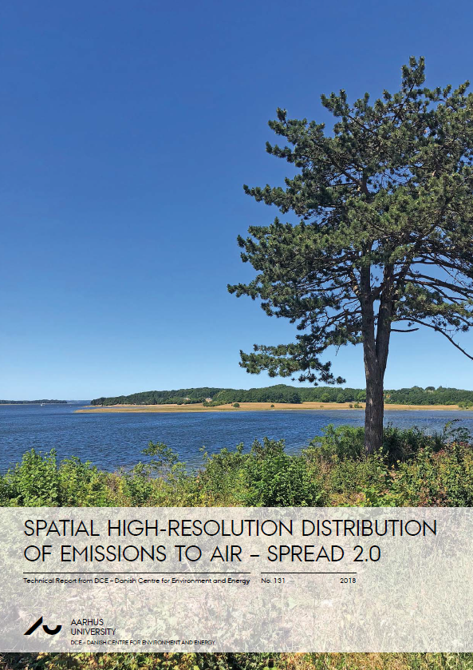
Emission inventory on 1 km x 1 km
Special version for NH₃ on100 m x 100 m
https://dce2.au.dk/pub/TR131.pdf

Slide 15
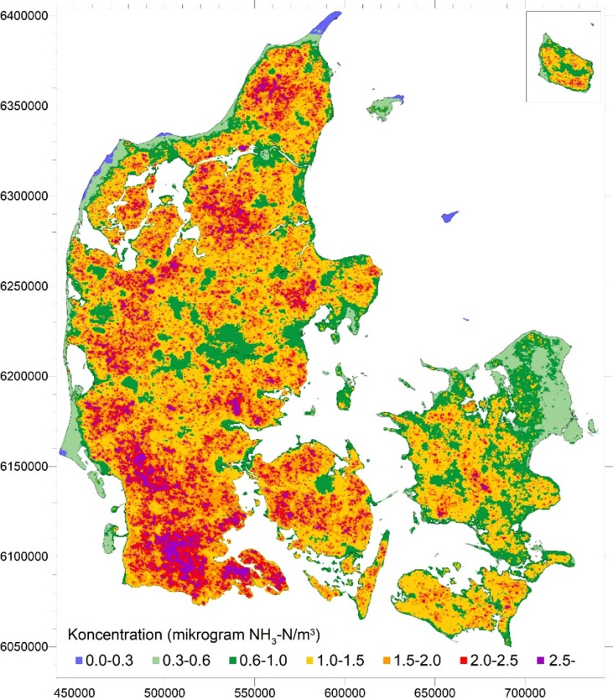
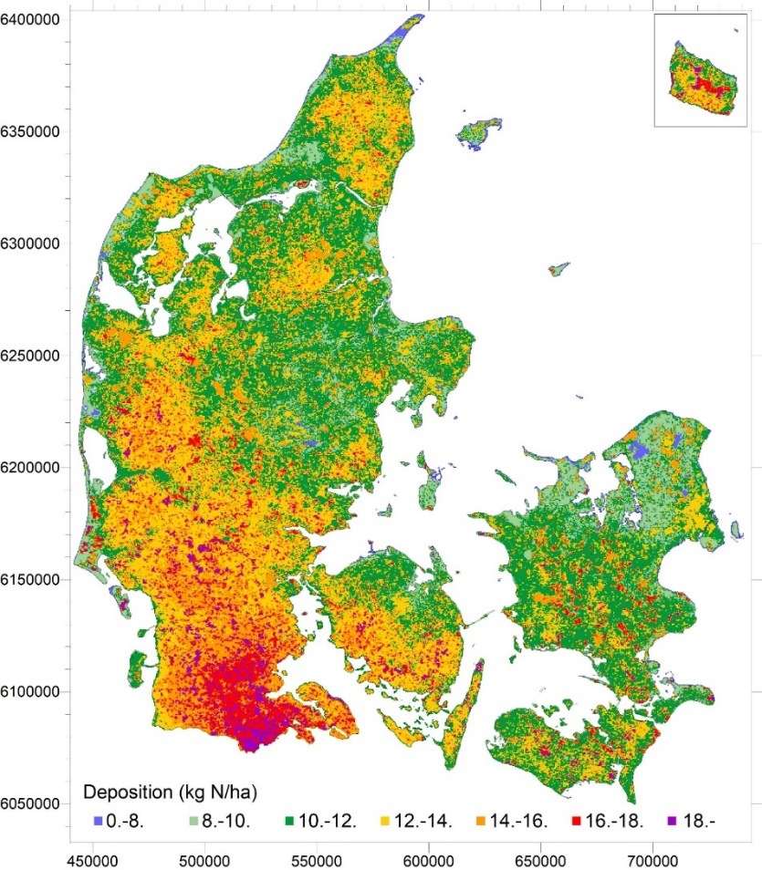
NH₃ concentration and nitrogen deposition, 400 m x 400 m
NH₃
Total N

Slide 16
Pesticides in air and precipitation
Prosulfocarb found on organic apples produced in Denmark.
Prosulfocarb is used on winter crops and is applied mainly in October
Risø, Roskilde
2 monthly sampling
2017

Slide 17
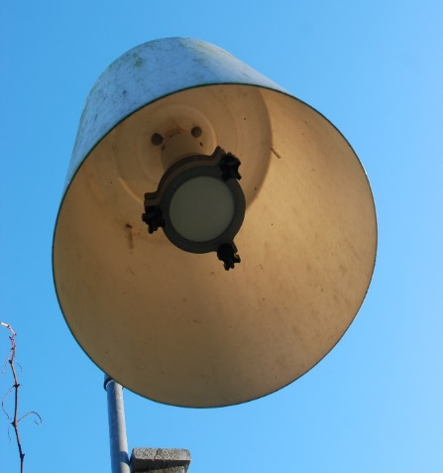
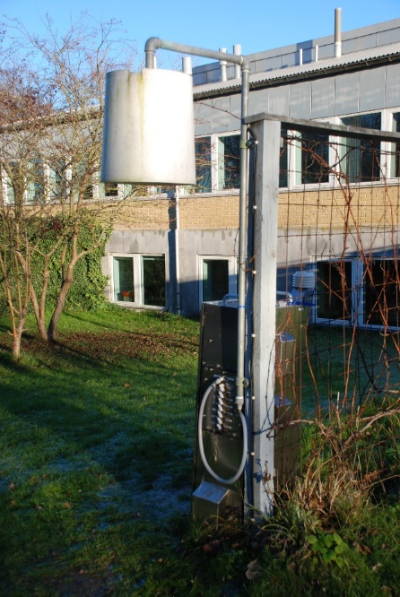
Concentration of prosulfocarb in air
Risø, Roskilde, weekly sampling 2017. Filter and PUF/XAD
Analysis by LC-MS-MS

Slide 18
Summary
Monitoring program that links from regional to urban
Large impact on SO₂ from reduction in ship emissions
Local scale air quality at home adress
Emission inventory 1 km x km resolution and NH₃ 100 m x100 m
Local scale N-deposition to ecosystems
Prosulfocarb on organic apples most likely from local sources – an emerging problem at least in Denmark

Slide 19
Filter material used
Huk at få disse informationer fra Christian eller Ingeborg

Slide 20
Integration of measurements and modelling
Measurements
Air quality and depositions at measurement stations
Long term trends
Sources
Validation of model results
Modelling
Extrapolation to cover Danish land and aquatic areas
Long term trends
Sources
Impact assessment – human health
Official reporting to EU in 2017

Slide 21
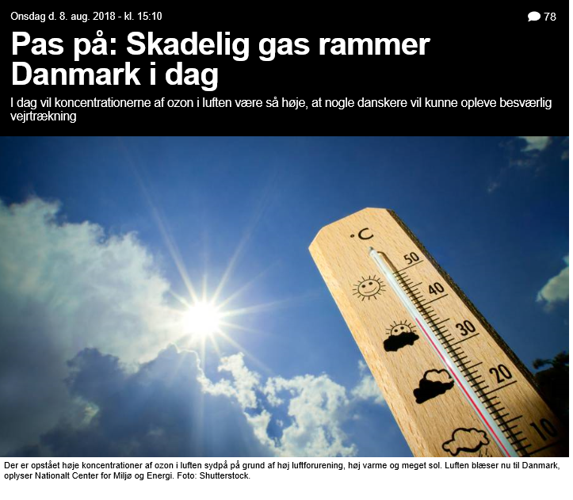
Ozonvarsling

Slide 22
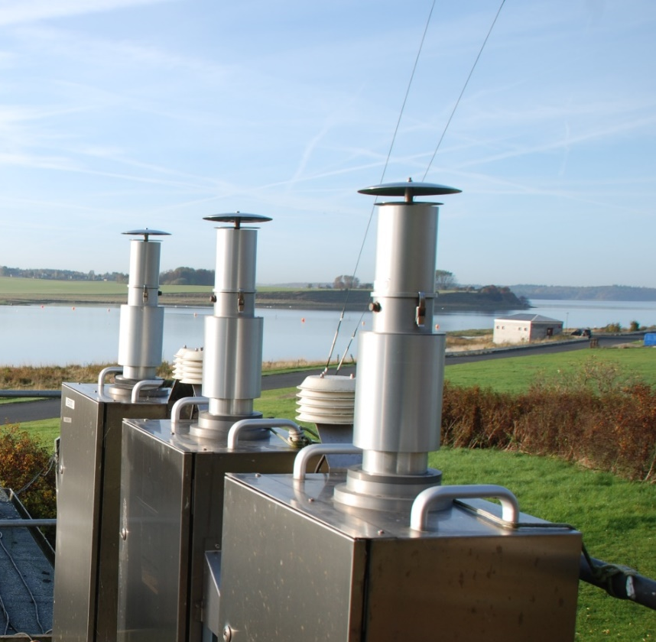
Partikler – nøglebegreber
Total suspended particulate (TSP) diameter < ca 20 µm
PM10 – mindre end 10 µm

Slide 23
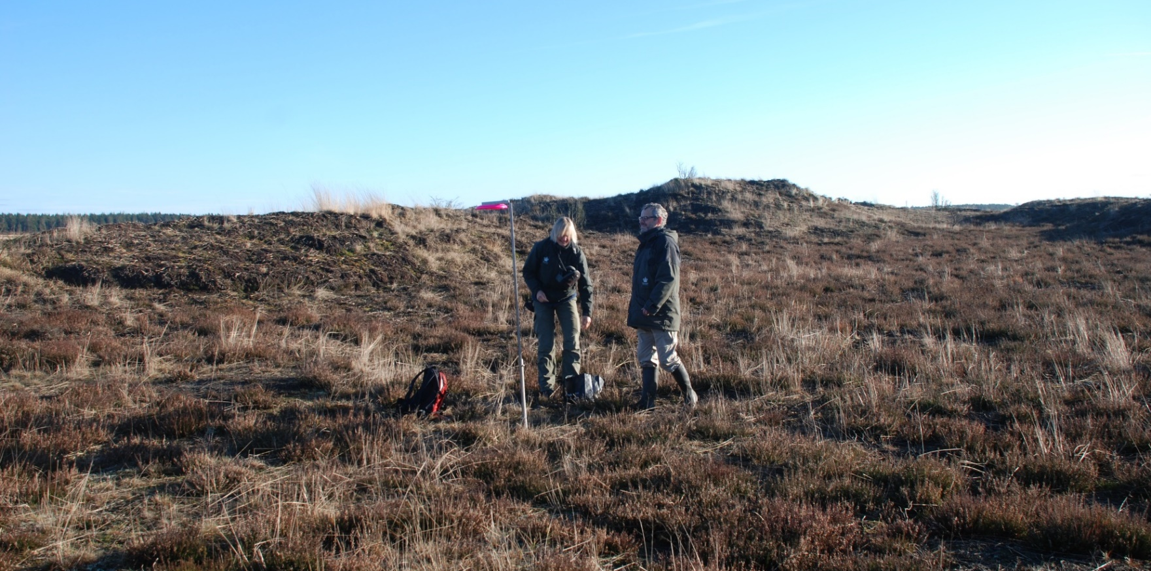
Nyt program for måling af ammoniakkoncentrationer

Slide 24
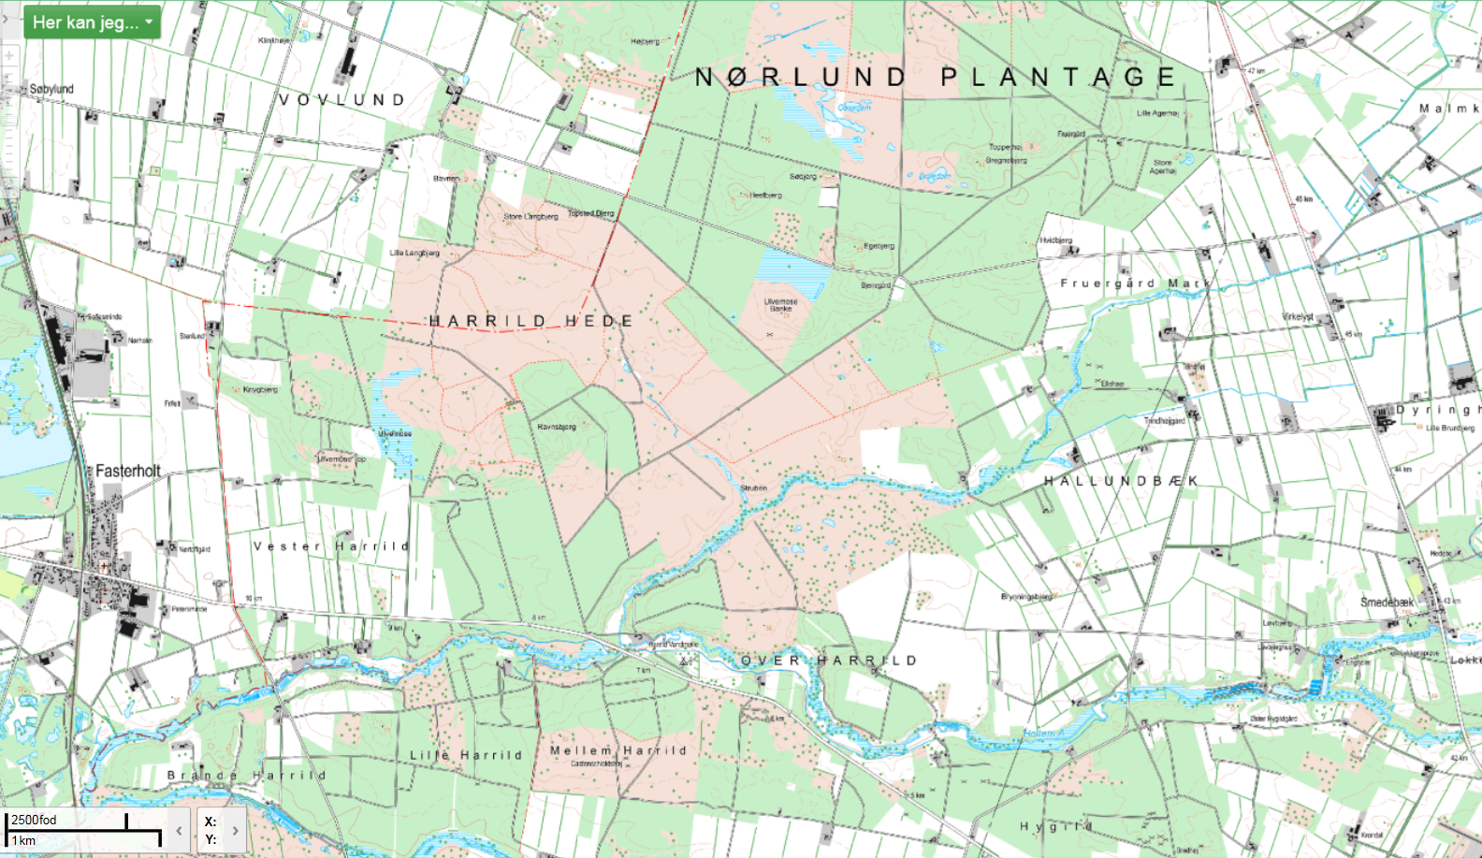
12
2
3
5
11
4
9
15
8
14
7
1
10
6
13

