Slide 1
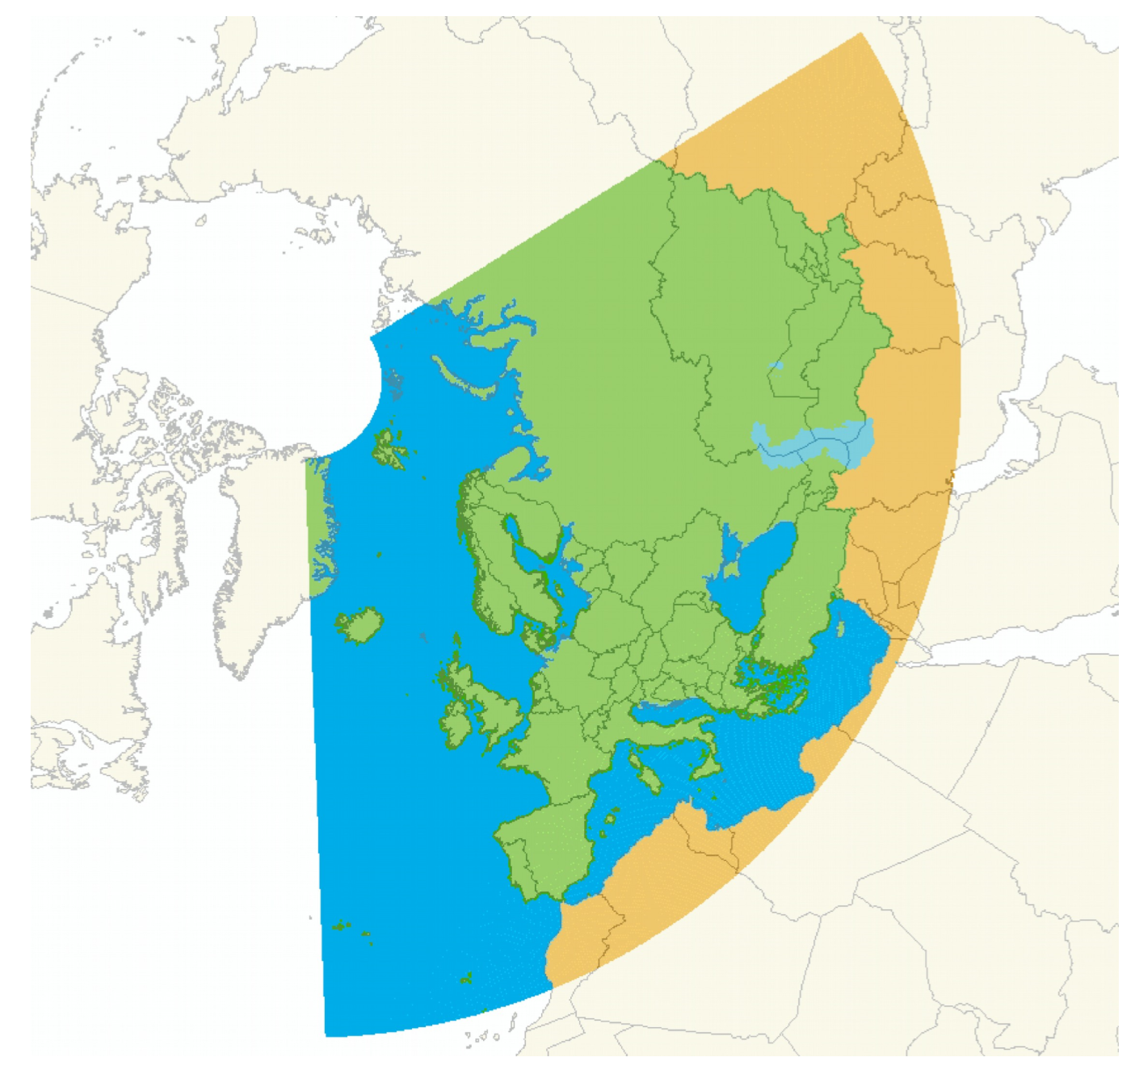
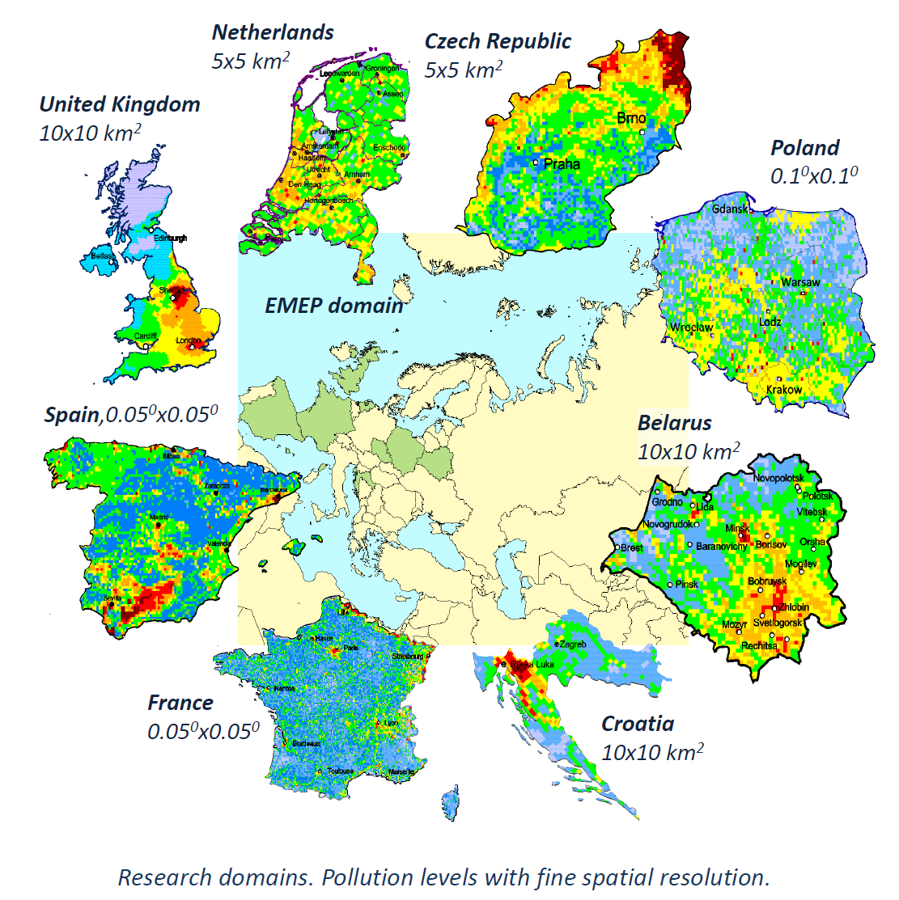
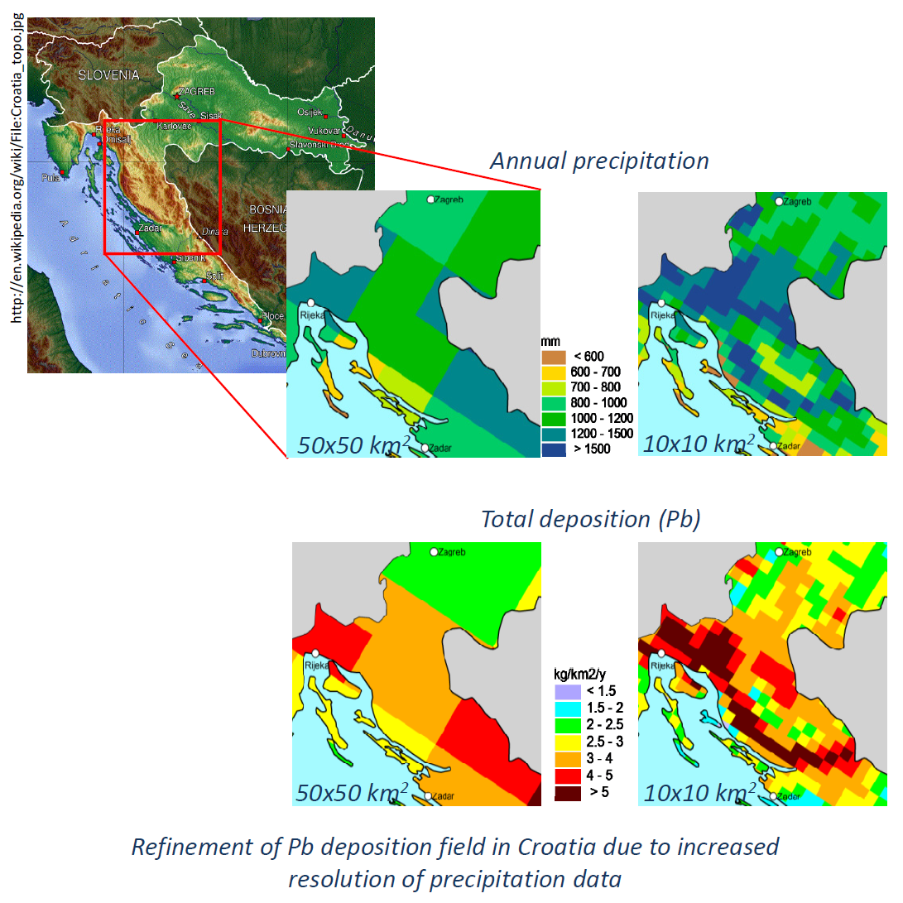
Sonja Vidič
Meteorological and Hydrological Service Croatia
emep
monitoring and modelling
of long-range transboundary pollution
in Europe and beyond
20
years
OF TASK FORCE
ON MEASUREMENTS AND MODELLING

Slide 2

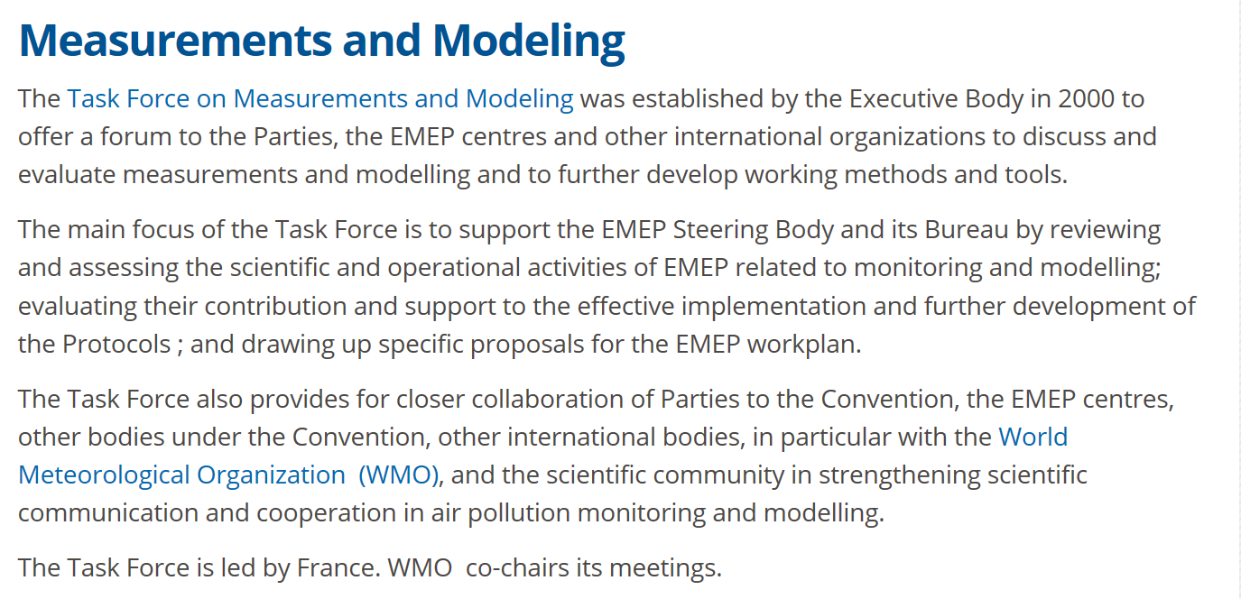

Slide 3
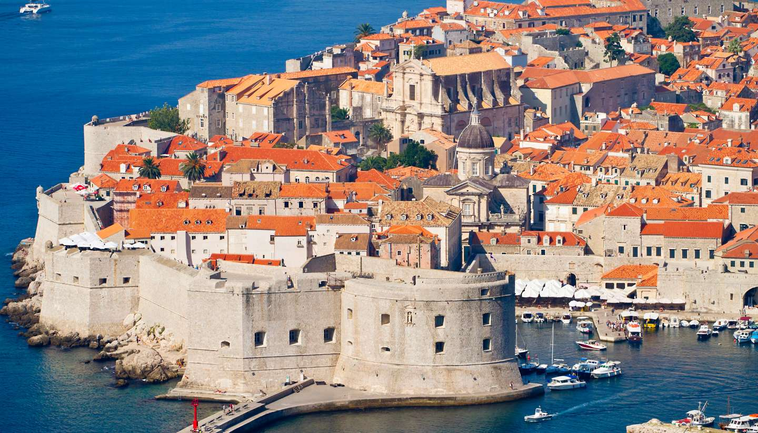
When, Where and Why the idea on TFMM was born ?
1999 at EMEP workshop on data analysis and interpretation, Dubrovnik, Croatia

Slide 4
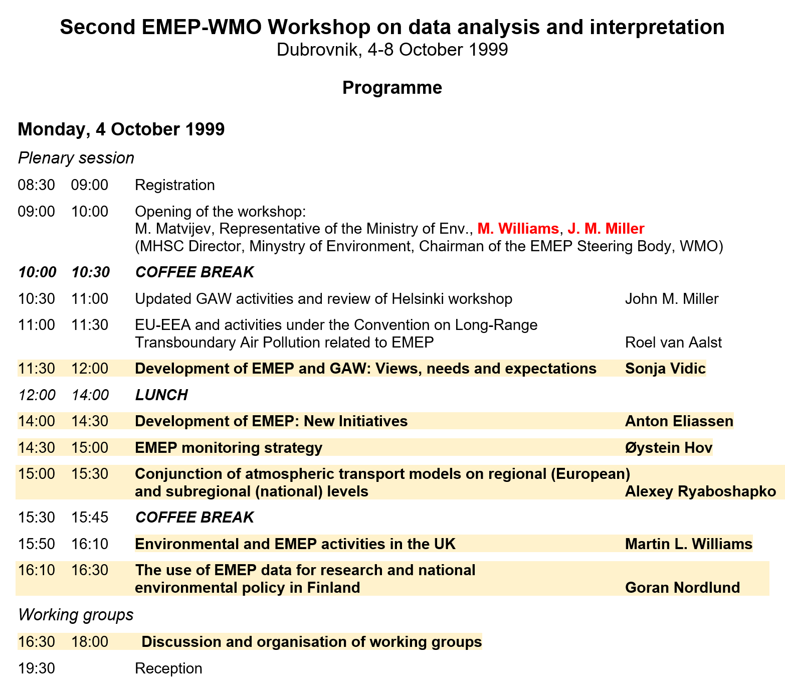
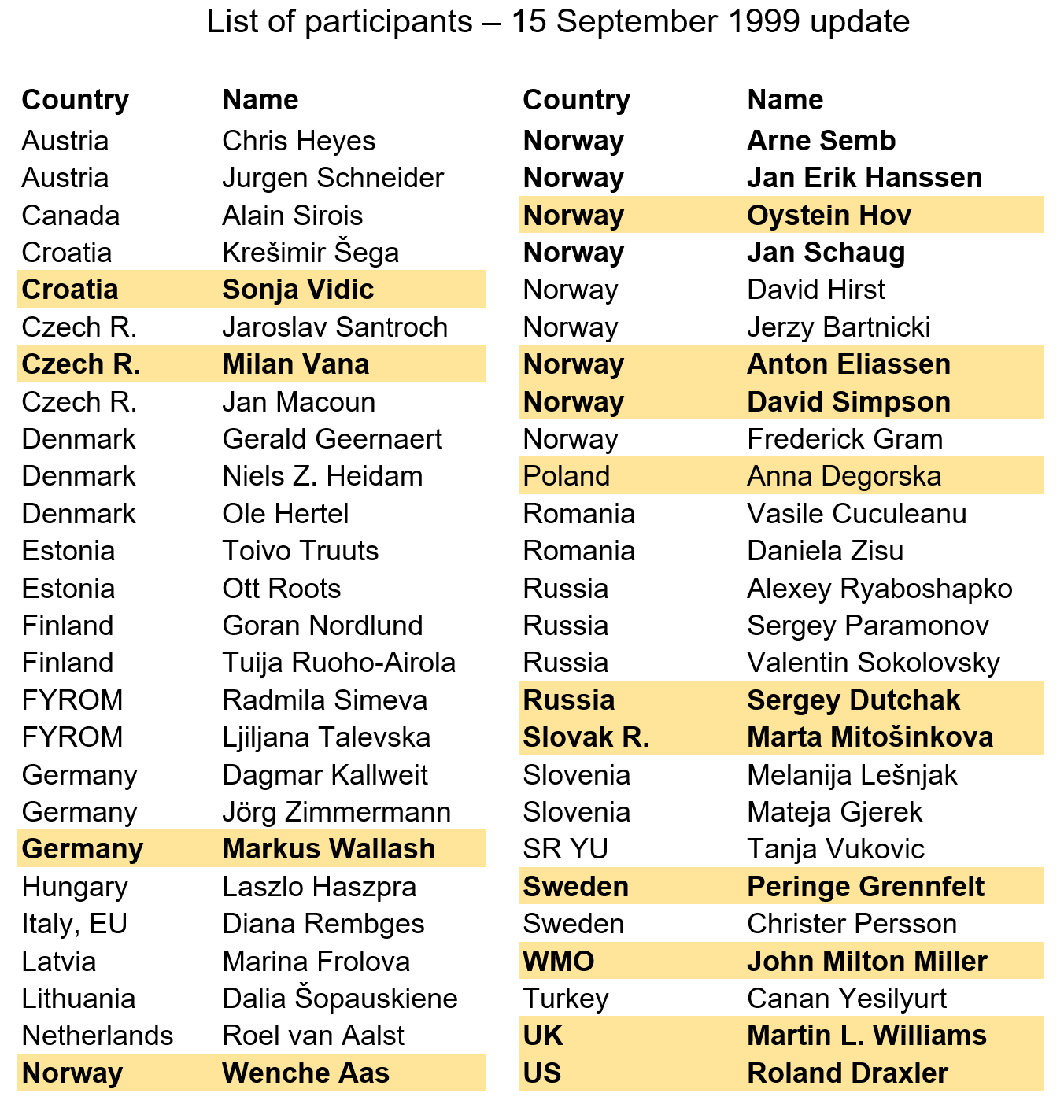

Slide 5
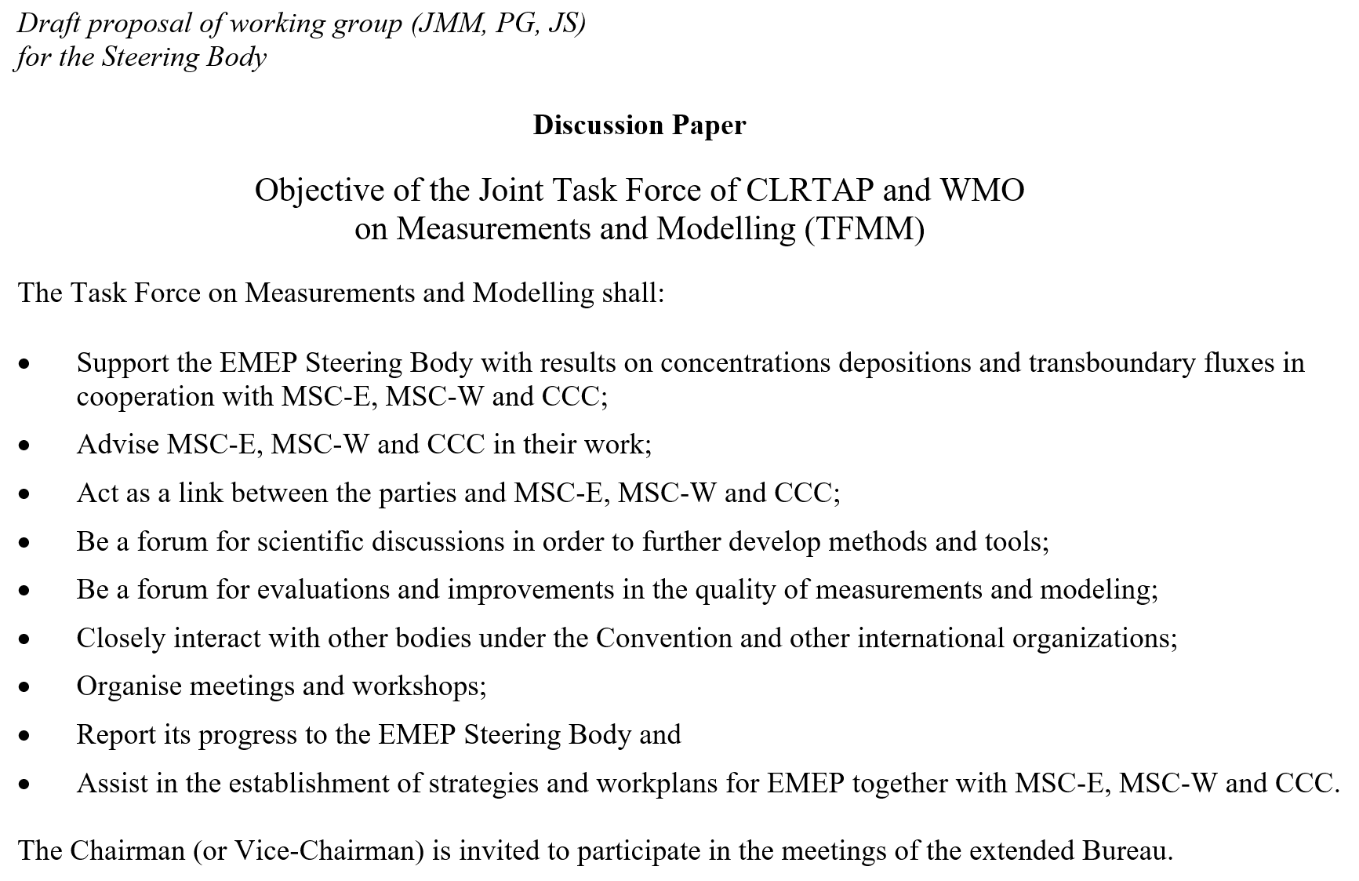

Slide 6
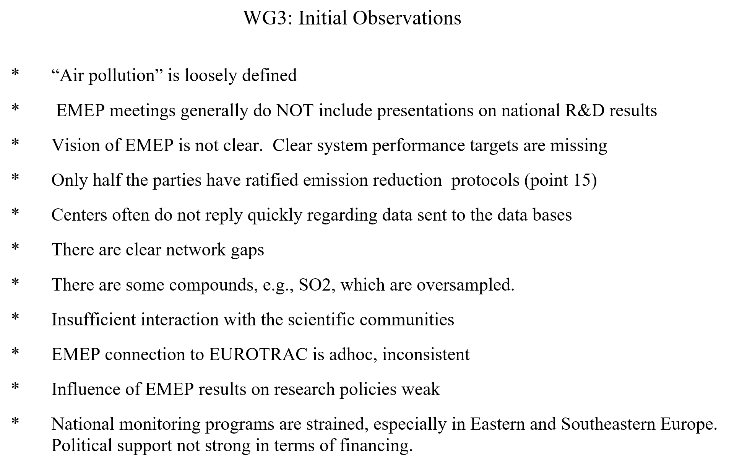

Slide 7
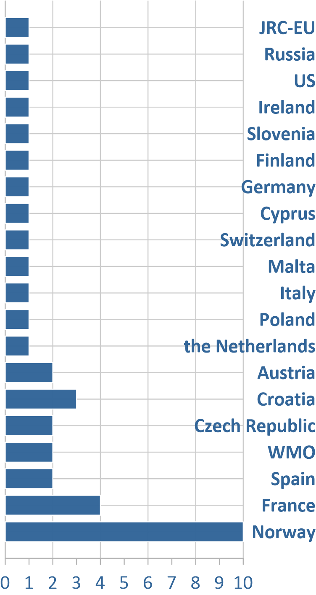
20 Countries supporting TFMM meetings and
Workshops between 2000 and 2019
37
meetings
Location of Task Force meetings and workshops between 2000 and 2019

Slide 8
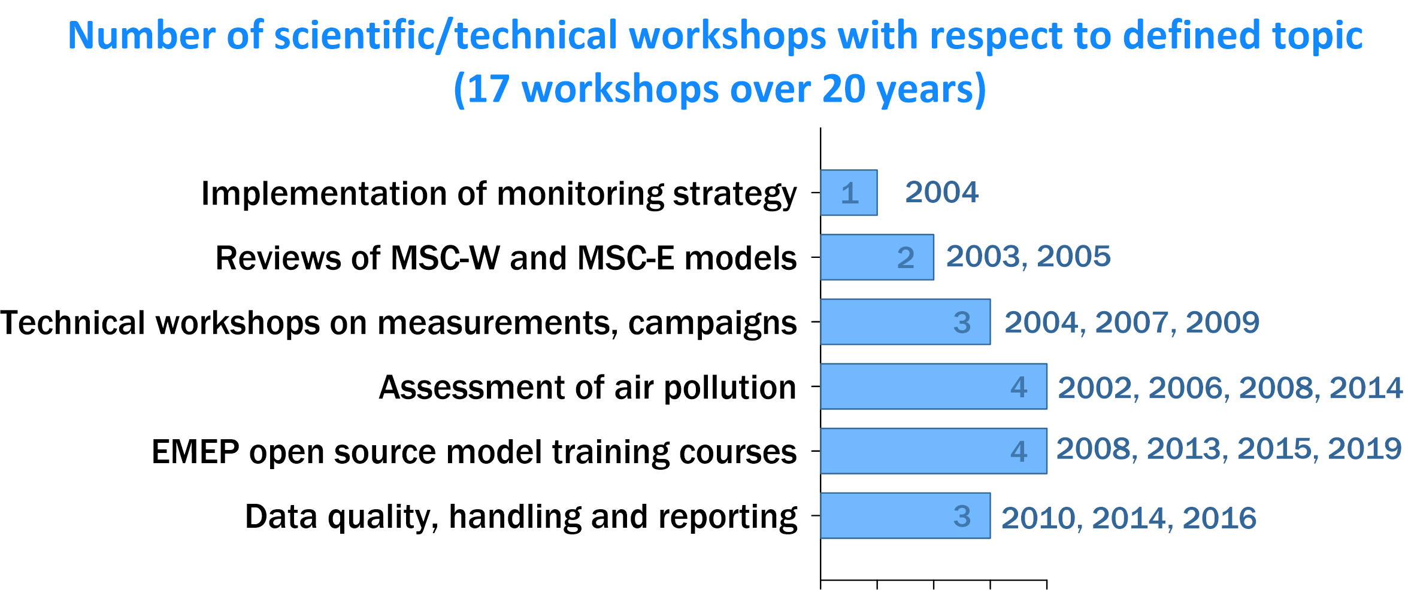

Slide 9
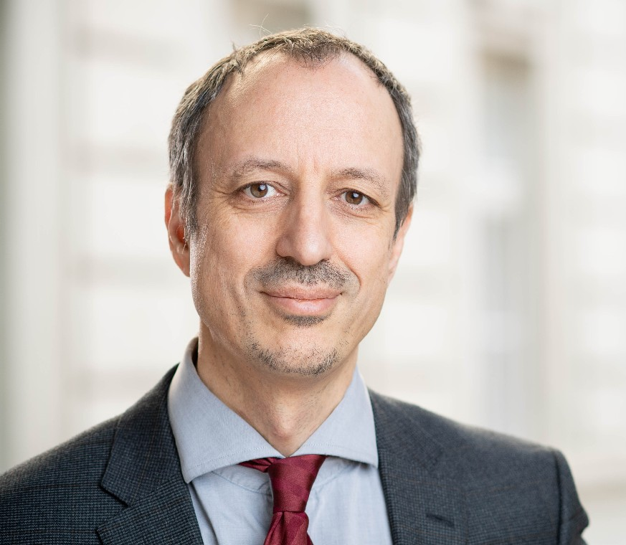
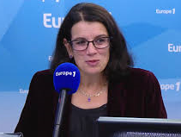
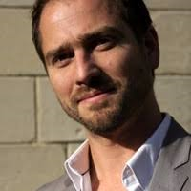
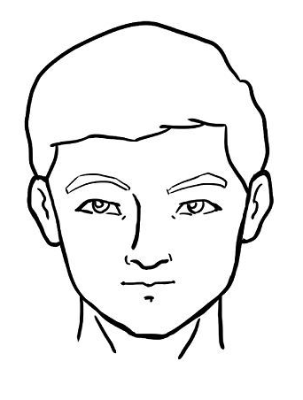
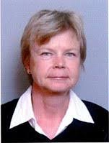
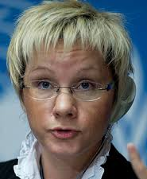
Chairpersons of TFMM
Jürgen Schneider
2000-2003
Richard Derwent
2003-2008
Laurence Rouil
2008-2014
Augustin Colette
2013 -
John Miller
2000-2002
Liisa Jalkanen
2003-2009
Oksana Tarasova
2009 -

Slide 10




