Slide 1
Dispersion modeling at an urban scale: a case study
S.Kakareka, S.Salivonchyk
Institute for Nature Management,
Minsk, Belarus
20th Task Force on Measurement and Modelling Meeting
7 - 9 May 2019. Madrid, Spain

Slide 2
Rationale
outdated methodological basis of air impact assessment and dispersion modelling (local scale) in the former SU countries;
approved dispersion models are too laborious for application at a city level, poorly account meteorology, do not account many emission sources;
other models application is necessary.
Last year results of AERMOD application for modelling of PM₁₀ dispersion for a medium-size city of Belarus (appr. 70 thous. inhabitants) were presented.

Slide 3
Goal
Further improvement of air impact assessment of anthropogenic emission sources using AERMOD (on an example of PM₁₀)
Area
Zlobin - a medium-size city of Belarus (appr. 70 thous. inhabitants)
Model
AERMOD model of US EPA
Tasks
PM₁₀ emission sources parameterization improvement for Steel Works as main source of PM₁₀ emission
Meteorological parameterization improvement
Background concentrations accounting
Verification vs measured and EMEP modelled concentrations

Slide 4
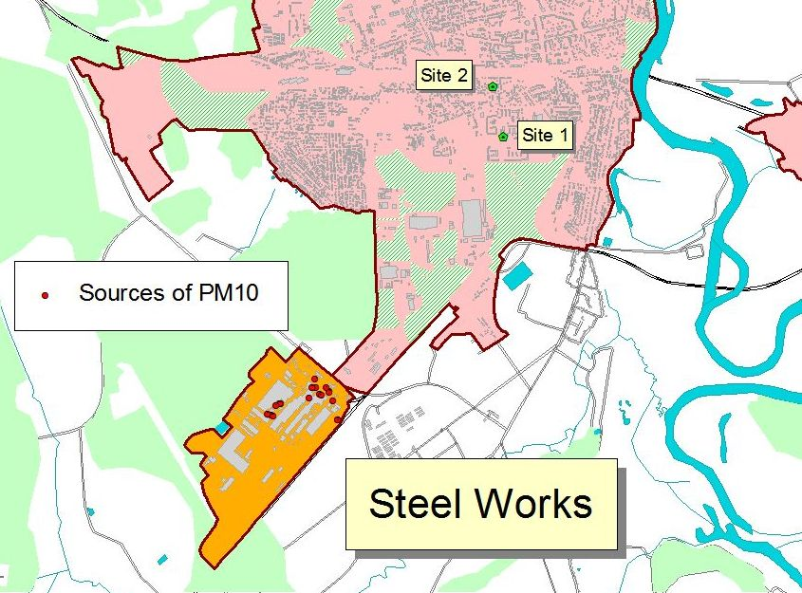
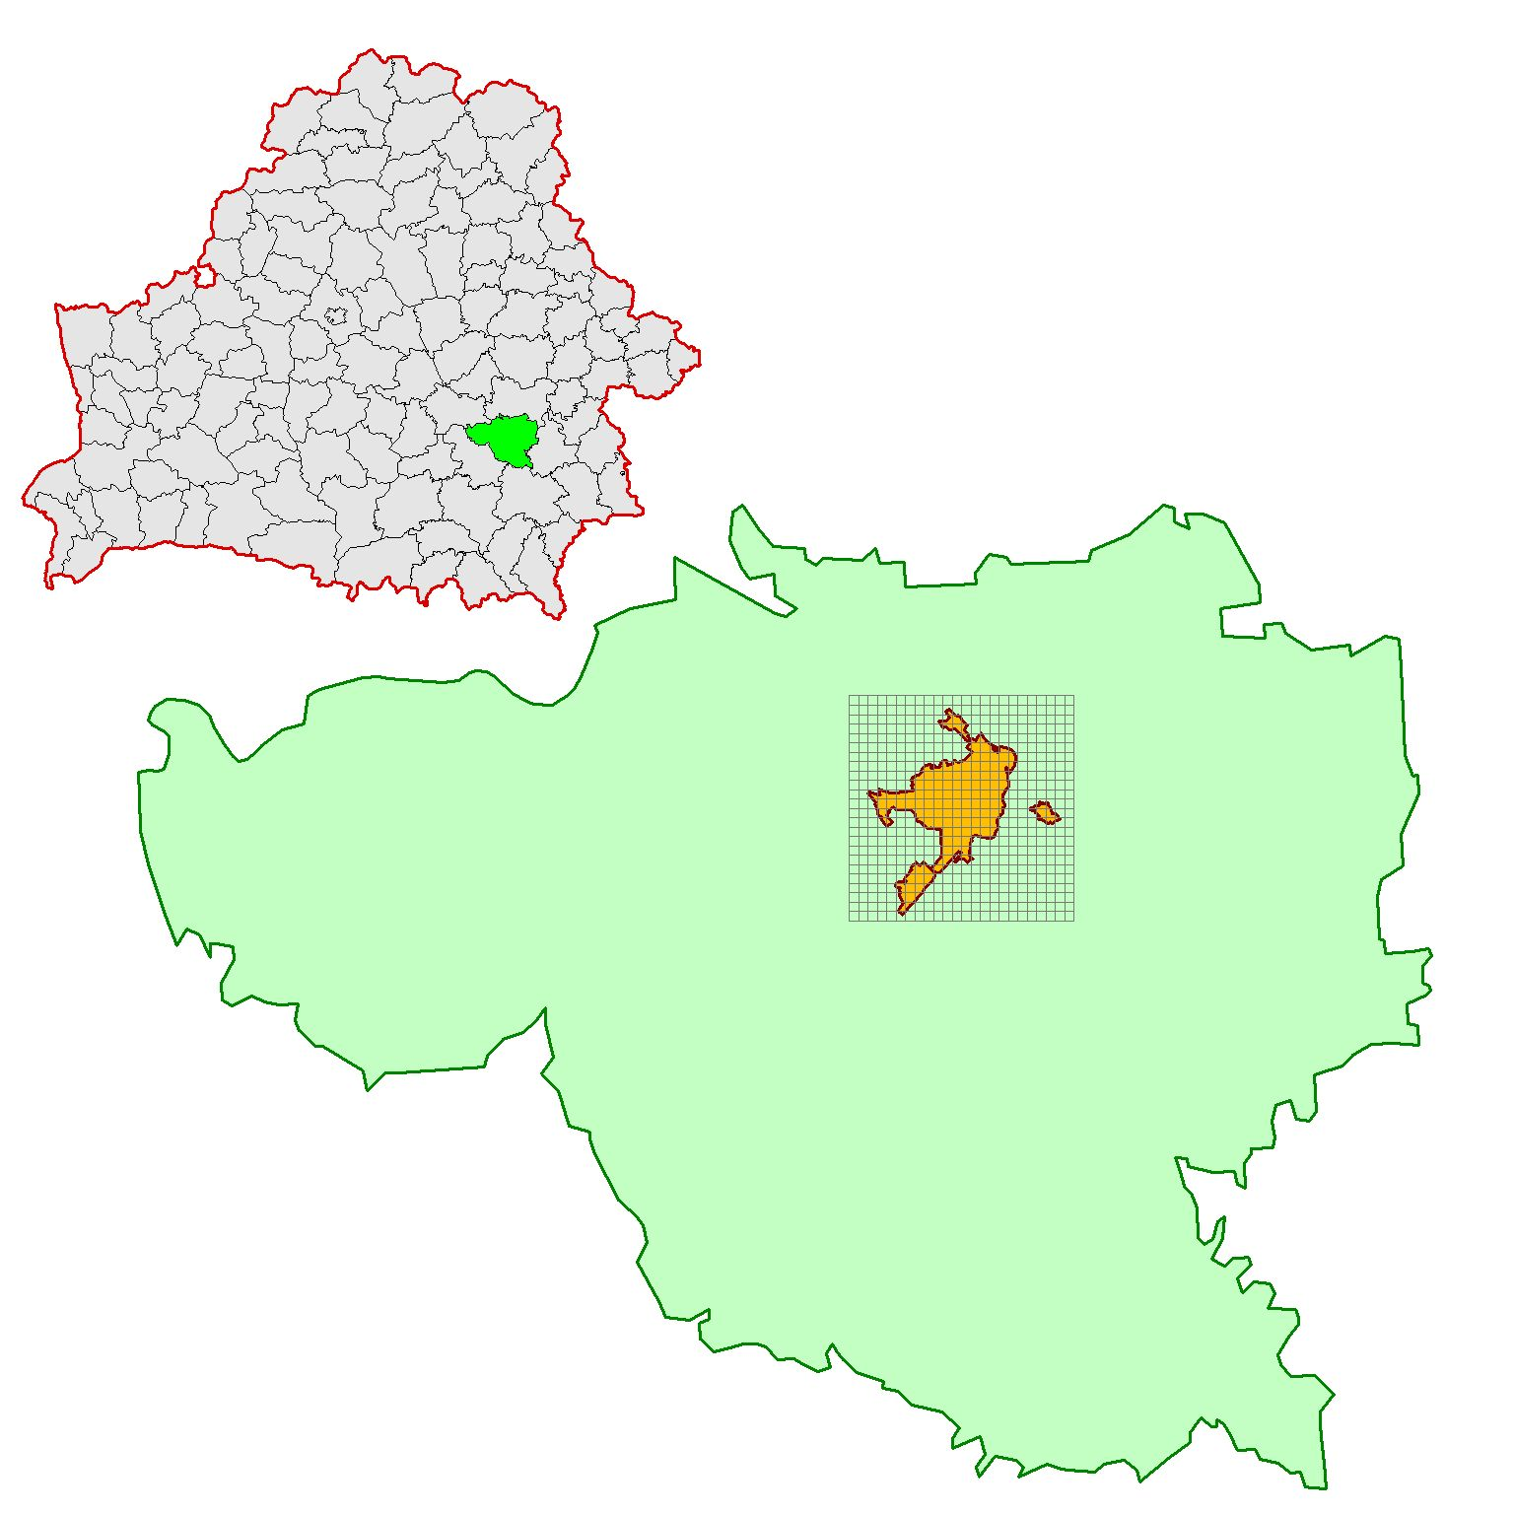
Location of modelling domain
BELARUS
Zhlobin city
Zhlobin district

Slide 5
Earlier modelling results
According to the calculation results, the highest concentrations of PM10 are more likely in the southern part of the city. The zone of the highest concentrations of PM10 in the annual calculation cycle stretched there NW and is apparently associated with low wind speeds, which are most often caused by winds of the SE direction. The location of the zones varies in different periods of the year and is determined by the combination of the meteorological conditions of a particular month, which determine the conditions for scattering of pollutants. Of the several 2015 periods for which calculations were made, the worst situation was recorded in March. In July and January 2015, conditions for dispersion of PM10 were more favorable.

Slide 6
Plant contribution into PM10 air pollution vs other sources
Estimation of input of other anthropogenic sources into PM₁₀ ambient air concentrations. Contribution of the plant comprised 58.5% of total input of anthropogenic sources into air pollution of the model domain and 62.2% of industrial sources input. Contribution of the plant exceeds mobile sources input 2.7 times.

Slide 7
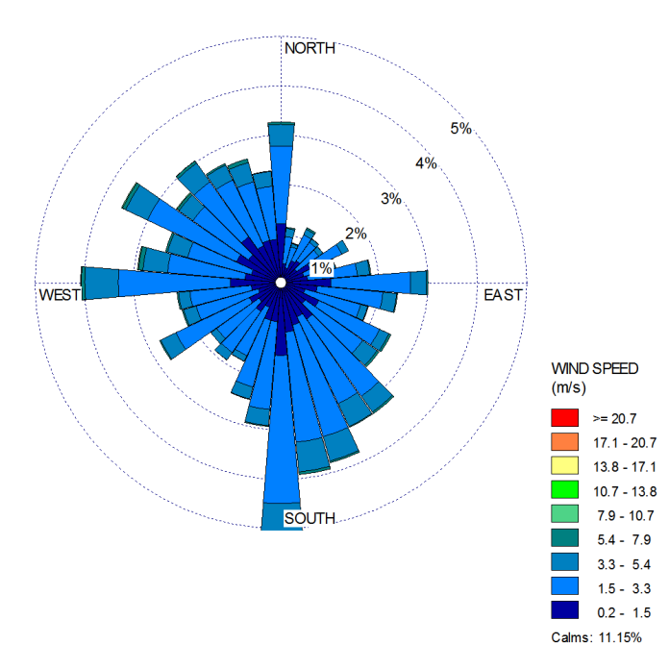
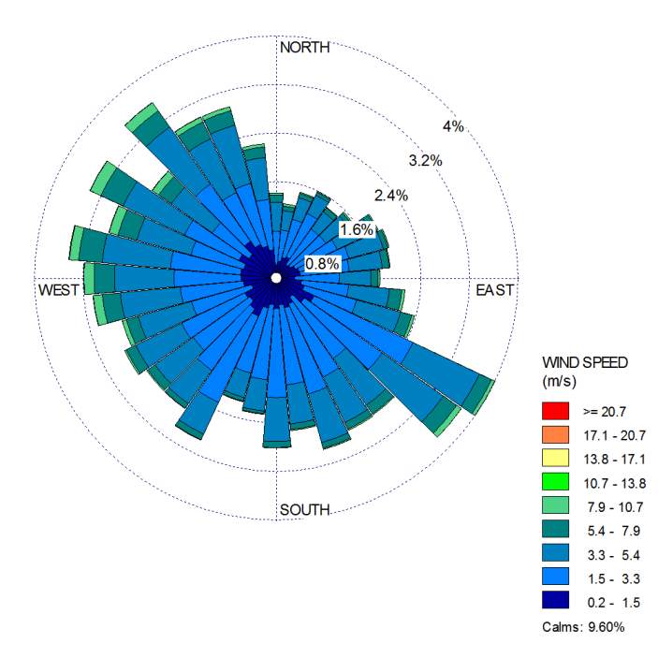
Meteorology
Two sets of surface and meteorological data and 1 set of upper air sounding data were used:
SURFACE data for Minsk (WMO 268500) and Zhlobin (WMO 268500) meteorology station from Integrated Surface Hourly Data Base (3505) ftp://ftp.ncdc.noaa.gov/pub/data/noaa/
UPPER AIR SOUNDING data for Gomel station (WMO 330410) from Radiosonde Database Access https://esrl.noaa.gov/raobs/
Meteorological files were obtained with AERMET over a 10 year period (from 2009 to 2018).
Zhlobin
Minsk
Figures are built using WRPLOT ViewTM,Lakes Environmental Software

Slide 8
Background PM₁₀ concentrations
MSC-W modelled PM₁₀ daily air concentrations (EMEP01_L20_rv4_17a_day) for a 0.1x0.1 grid cell were used as background values. For their input in AERMOD, they were presented in 2 variants:
as an average value depending on the month of the year and day of the week (table below) and
in the form of hourly values for each day of the year.
Distribution of PM₁₀ background concentrations in the area of Zhlobin by days of the week and months
Day of the week | Month
 | 1 | 2 | 3 | 4 | 5 | 6 | 7 | 8 | 9 | 10 | 11 | 12
Mon | 8.32 | 10.2 | 8.39 | 6.97 | 6.85 | 10.4 | 7.48 | 6.08 | 5.53 | 9.77 | 10.4 | 10.7
Tue | 8.22 | 11.1 | 8.75 | 6.63 | 7.74 | 5.98 | 6.00 | 6.13 | 6.28 | 9.05 | 11.5 | 11.2
Wed | 9.04 | 10.8 | 8.52 | 7.27 | 8.05 | 6.37 | 5.65 | 6.48 | 6.2 | 7.95 | 11.1 | 10.6
Thu | 9.32 | 10.0 | 10.2 | 8.49 | 7.93 | 5.49 | 5.45 | 7.81 | 6.70 | 9.84 | 9.88 | 10.9
Fri | 8.18 | 10.9 | 8.35 | 8.12 | 9.32 | 4.4 | 6.75 | 6.09 | 6.93 | 9.87 | 12.3 | 9.7
Sat | 8.54 | 9.78 | 6.13 | 8.36 | 13.3 | 4.91 | 7.98 | 5.13 | 7.72 | 8.28 | 13.7 | 9.66
San | 7.37 | 10.4 | 6.24 | 7.31 | 10.3 | 10.6 | 6.22 | 5.76 | 5.93 | 10.1 | 12.6 | 10.2

Slide 9
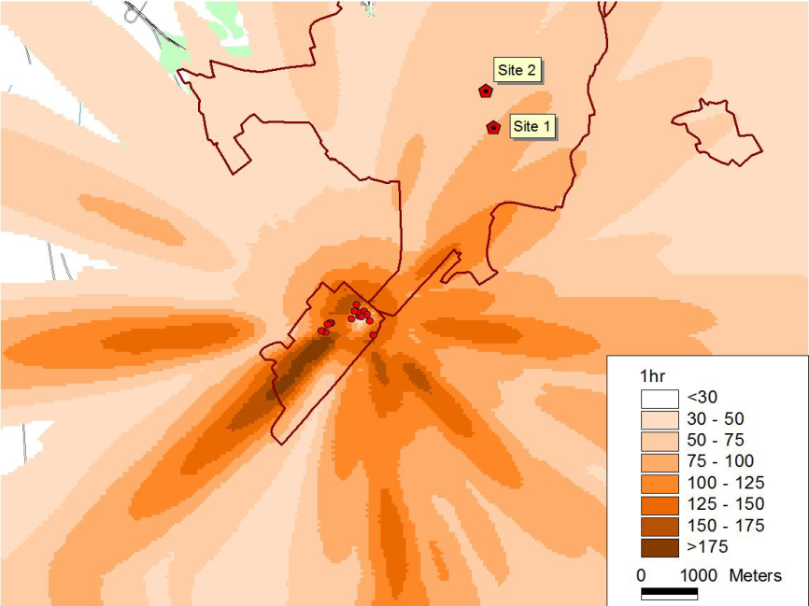
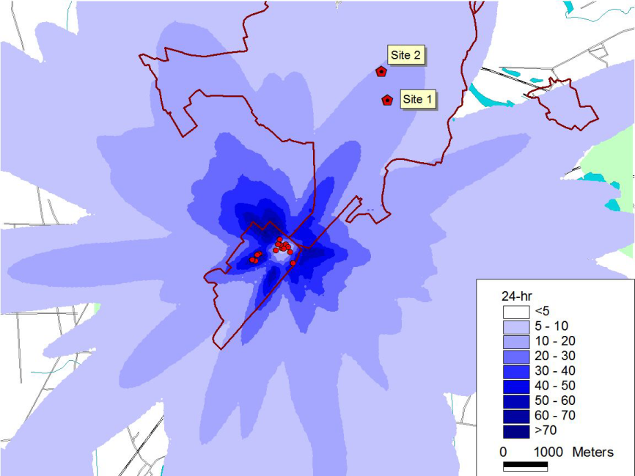
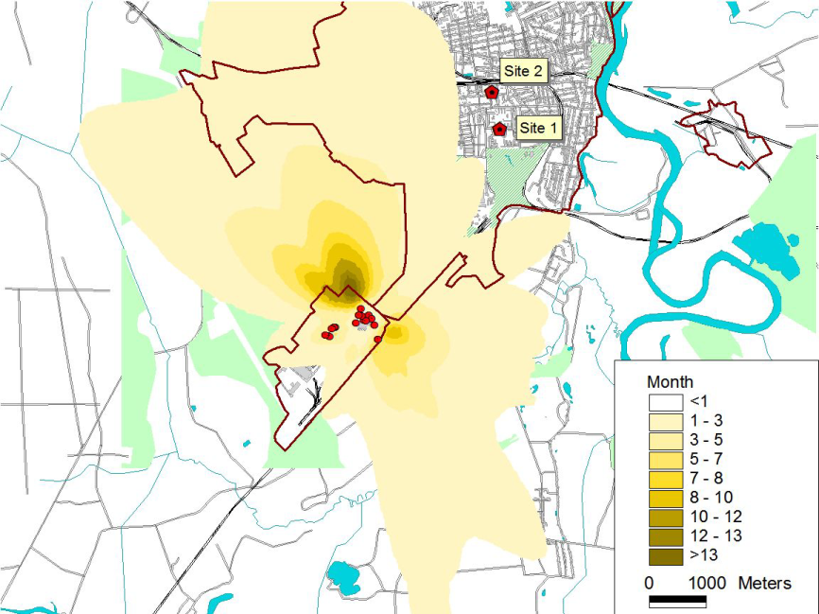
Results
PM₁₀ air concentrations
max1-hour concentrations
Maximum concentrations and depositions of PM₁₀ were estimated with averaging 1 hour, 24 hour and month
The results showed that the maximum hourly concentrations of PM₁₀ can increase up to 202 µg/m³, 24-hourly up to 74 µg/m³, maximum monthly up to 15 µg/m³
The highest concentrations of PM₁₀ from Steel Works sources are formed outside of the city.
max 24-hour concentrations
max monthly concentrations

Slide 10
PM₁₀ air concentrations at receptor points
The concentrations in receptor points were calculated for each hour of constructed meteorological files. Than for comparison all the data were reduced to maximum monthly and average monthly values.
According to the results of the correlation analysis, an insignificant and, in most cases, negative relationship was found between the observations in the posts and the results of model calculations.
Significant positive correlation is found only between the data of an automatic analyzer and model calculations for meteorological series of st. Minsk.
Correlation coefficients between PM₁₀ monthly average concentrations at monitoring sites and calculated by the AERMOD model, n=48, df=46)
 | Site 1 (AERMOD) |  | Site 2 (AERMOD)
 | Zhlobin meteorology | Minsk meteorology | Zhlobin meteorology | Minsk meteorology
Site 1, 2 (manual), month avg | -0.041 | -0.264 | -0.104 | -0.072
Site 1, 2 (manual), month max | -0.140 | -0.140 | 0.118 | -0.080
Site 2 (aut. analyzer), month avg | -0.249 | 0.524* | -0.274 | 0.274
Site 2 (aut. analyzer), month max | -0.051 | 0.436 | -0.180 | -0.002
EMEP, month avg | 0.019 | 0.113 | -0.002 | -0.066
EMEP, month max | -0.107 | -0.158 | 0.053 | -0.202
*Significant correlation coefficients are highlighted in bold (for n = 48 and P = 0.05)

Slide 11
PM₁₀ monitored concentrations
There is a significant positive correlation between the measured values at the two observation posts obtained by the manual sampling method. A significant, but negative correlation can be traced between the monthly mean values of PM₁₀ concentration at the posts and the monthly average results of the EMEP modeling.
The correlation coefficients between the concentrations of PM₁₀ data of different observation series (n=48, df=46)
 | monthly mean values |  |  | maximum monthly values
 | Site 1 | Site 2 (manual) | Site 2 (aut. analyzer) | Site 1 | Site 2 (manual) | Site 2 (aut. analyzer)
Site 2 manual sampl | 0.943* |  |  | 0.825
Site 2 aut. analyzer | 0.238 | 0.181 |  | -0.077 | -0.222
EMEP | -0.435 | -0.485 | -0.280 | 0.049 | 0.219 | -0.371
*Significant correlation coefficients are highlighted in bold (for n = 48 and P = 0.05)
The EMEP absolute value data has the lowest values. Short-term maximum peaks associated with local industrial and motor vehicle emissions are practically not distinguished in them.
Therefore, taking them as background seems to be the most optimal.

Slide 12
Analysis of PM₁₀ concentration at the monitoring sites accounting the frequency of certain meteorological conditions in Zhlobin
Calculated repeatability of observations with:
1) wind directions between 215 to 235° (from the facility towards observation posts);
2) wind speeds <3 m/s;
3) wind directions of 215 - 235° and wind speeds <3 m/s.
The correlation coefficients between the data of the PM₁₀ concentration at the observation posts and the frequency of certain meteorological conditions at st. Zhlobin
 | 1) WD 215-235° | 2) WS <3m/s | 3) WS <3m/s and WD 215-235°
Site 1, month avg | 0.392* | 0.374 | 0.480
Site 1, month max | 0.268 | 0.259 | 0.310
Site 2, month avg | 0.386 | 0.407 | 0.499
Site 2, month max | 0.211 | 0.243 | 0.311
*Significant correlation coefficients are highlighted in bold (for n = 48 and P = 0.05)
Between the repeatability of the SW (215-235°) winds of low speeds (<3 m/s) and elevated concentrations at observation posts in the city of Zhlobin, both monthly and maximum, a significant correlation is found.
The repeatability of the selected weather conditions is more correlated with the monthly average concentration values at the posts than with their maximum levels.
Up to 39% of all cases of high concentrations at monitoring sites occur at SW (215-235) wind directions, when it blows from the Steel Works to the location of monitoring points; up to 37-41% of cases of elevated concentrations - at low wind speeds; almost half of the increased concentrations - with a combination of predetermined directions with low wind speeds.

Slide 13
PM₁₀ monitored concentrations distribution by wind directions
Observed differences of measured PM₁₀ concentrations depending of wind direction is not high. Maximum concentrations are registered more often at S, SW and SE winds thus at such winds more high average PM₁₀ concentrations are observed. Most low concentrations of PM₁₀ are observed at NW, W and N winds. Variation of PM₁₀ concentrations at N wind direction is the most high.
Avg, min and max PM₁₀ concentrations distributed by wind directions
PM₁₀ concentration histograms for 8 different wind directions

Slide 14
EMEP modelled vs monitored background concentrations
 | Berezinsky reserve |  | Zhlobin city
 | Observed | EMEP | Observed | EMEP
Avg | 14.45 | 7.41 | 25.66 | 9.49
Min | 0.00 | 0.60 | 2.40 | 1.20
Max | 56.00 | 72.10 | 85.90 | 89.60
MSC-W modelled PM₁₀ concentrations are lover than registered at continuous monitoring sites at Beresinsky reserve and in Zlobin. Diffrerences between modelled and observed concentrations are lower at background site (2.7 times difference).
Correlation coeff. is 0,40 for Berezinsky Reserve and 0,33 for Zlobin.

Slide 15
Conclusions and ways forward
no significant discrepancies between measured and modelled concentrations though correlations are not high yet;
account of background levels using MSC-W modelling results is valuable;
problems to be solved for more effective dispersion modelling:
gaps in meteorology and measurement results;
time profiles of emission;
speciation of PM₁₀
further modelling/measurement exercises incl. non-steady state models;
proposals for MNREP authorities on wider air pollutants dispersion modelling.
Acknowledgements: to Belhydromet for air monitoring data

Slide 16
Thank you for your attention!

