Slide 1
Country wide high-resolution modelling in Norway and its impact on exposure
Bruce Rolstad Denby, Heiko Klein, Peter Wind, Matthieu Pommier, Alvaro Valdebenito, Michael Gauss, Hilde Fagerli, Agnes Nyiri
TFMM, Madrid, May 2019

Slide 2
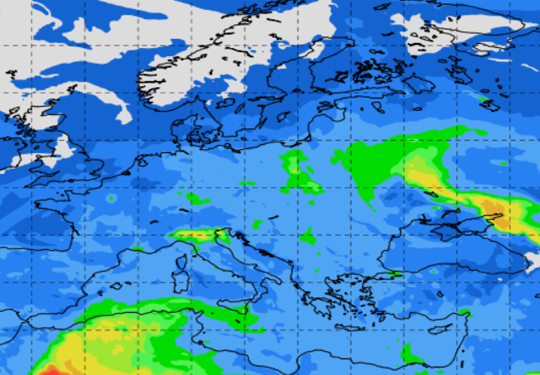
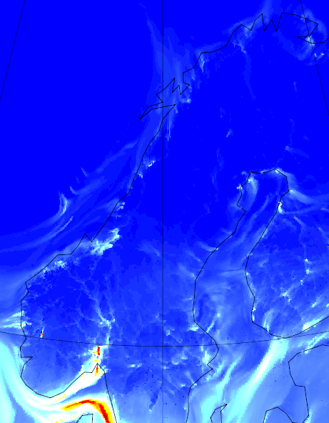
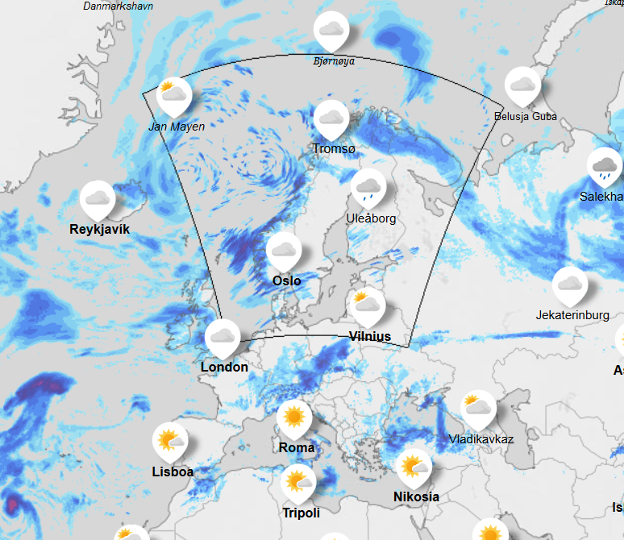
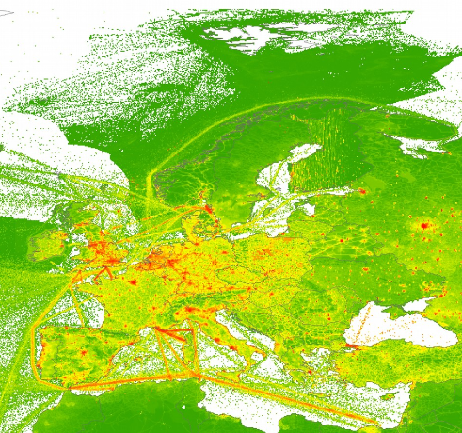
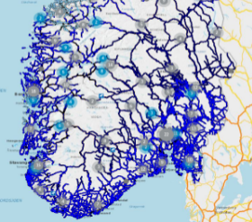
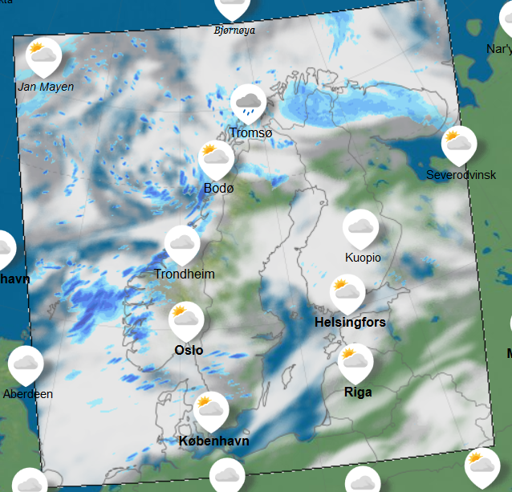
Overview of the modelling system
2.5 km
250 m
50 m
EMEP Europe
EMEP4NO
uEMEP
ECMWF global meteorology
CAMS European emissions
Local emissions
AROME meteorology

Slide 3
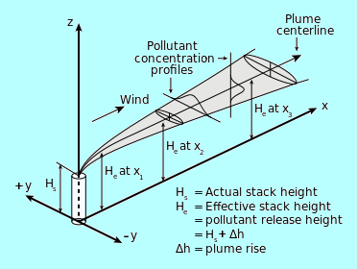
The uEMEP model
uEMEP is based on Gaussian plume modelling
It places emissions into sub-grids and calculates each sub-grid emission contribution to all other sub-grids within a 10 x 10 km² region
Sub-grids are 100 m for this application
Sources are calculated separately
A chemistry scheme is used only for NO_{x}/O₃/NO₂
uEMEP sub-grid concentrations are combined with EMEP grid concentrations in a special way to include local and non-local sources and avoid double counting

Slide 4
How uEMEP sub-grids are combined with EMEP grids
uEMEP sub-grid (100 m)
Sub-grid emission
Dispersion
uEMEP sub-grid
Non-local
Local
Local
Combine local sub-grid with nonlocal EMEP
Non-local
Non-local
EMEP grid (2.5 km)
EMEP grid concentration
Local fraction
EMEP
Notes:
The EMEP model provides concentrations on 2.5 km grids
This consists of concentrations from nearby ‘local’ grids (5 x 5 grids surounding each grid) and the ‘non-local’ contribution beyond these nearby grids
EMEP keeps track of these local nearby grid contributions and can seperate the two
uEMEP calculates concentrations on sub-grids
Using sub-grid emissions
To produce sub-grid concentrations
To avoid double counting from EMEP and uEMEP the local contribution is removed from EMEP and only the non-local part of EMEP is combined with the uEMEP sub-grid concentrations

Slide 5
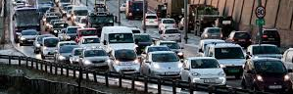
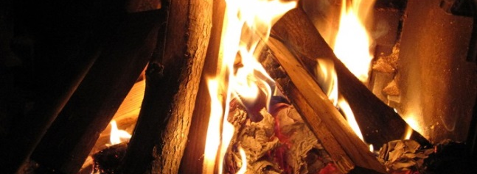
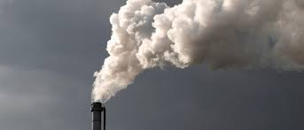
Emissions in uEMEP
uEMEP calculates the most important emissions sources in Norway for high resolution modelling. These are:
Traffic exhaust (per road segment)
Traffic non-exhaust (road, tyre, brake wear, sand and salt)
Shipping emissions (250 m grid)
Residential wood burning emissions (250 m)
Industrial emissions (per industry)
All other source sector contributions are calculated on the larger scale using EMEP

Slide 6
Example forecast map
Direct link to web site luftkvalitet.miljostatus.no Direct link to maps luftkvalitet.miljostatus.no/kart/59/10/5/aqi

Slide 7
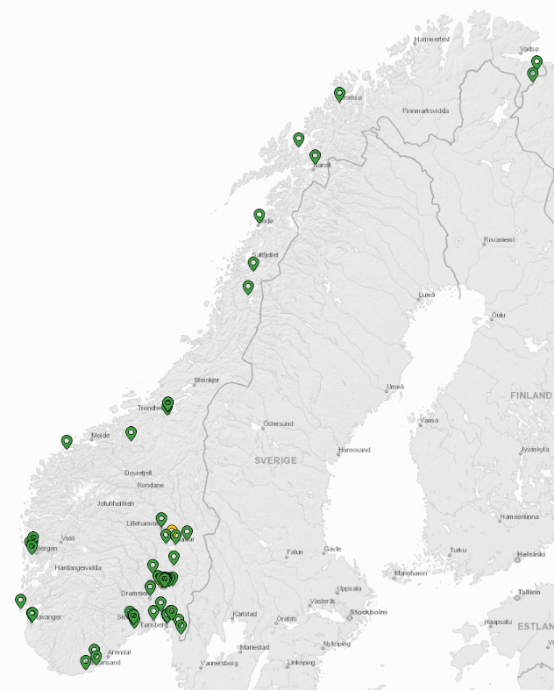
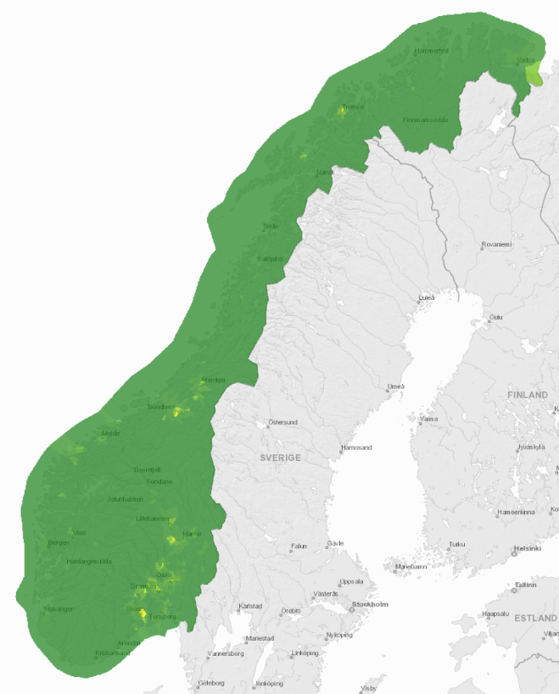
Model region and measurements:
72 measurement stations in Norway
70 million model calculation points in Norway

Slide 8
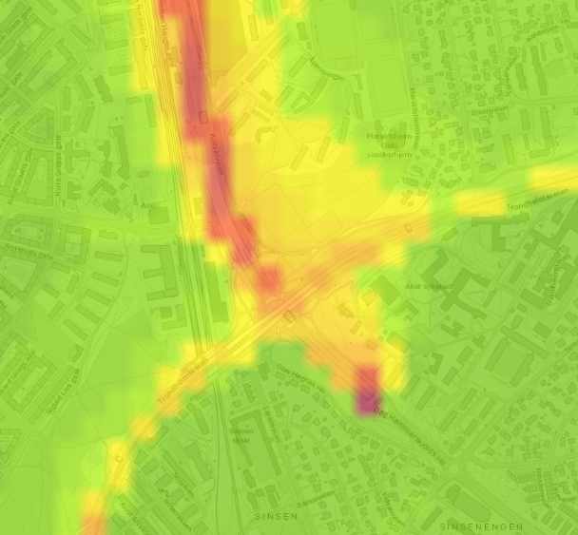
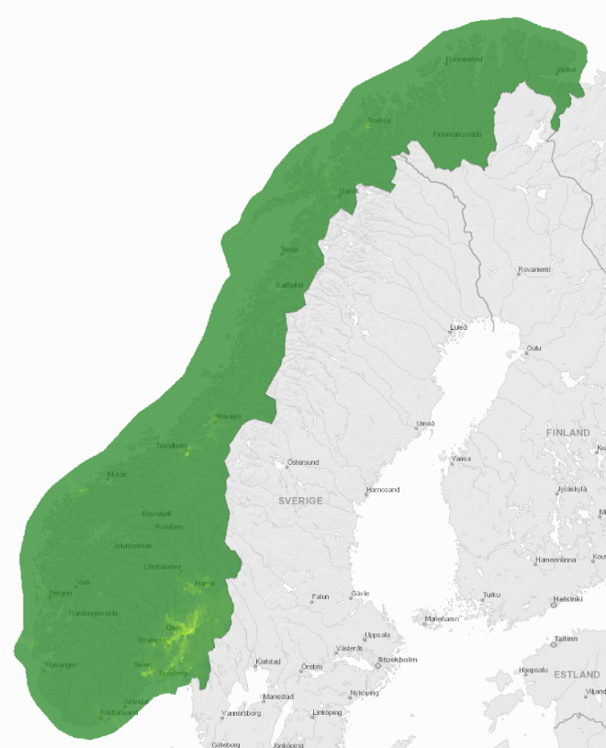
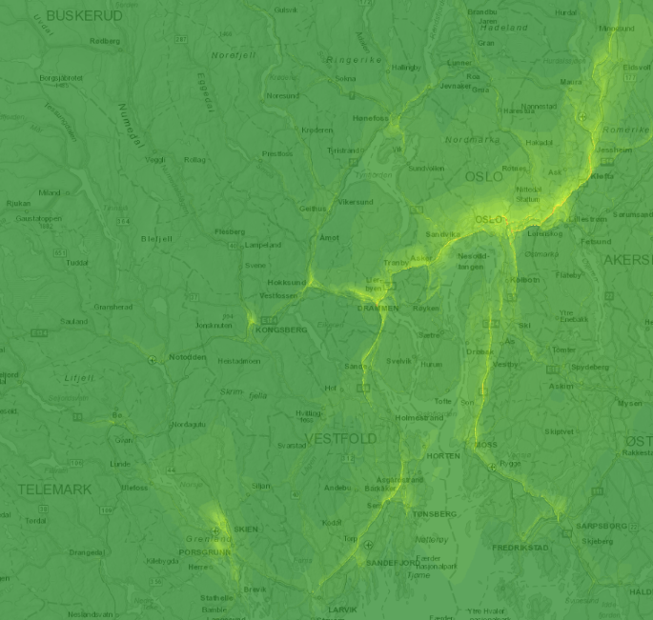
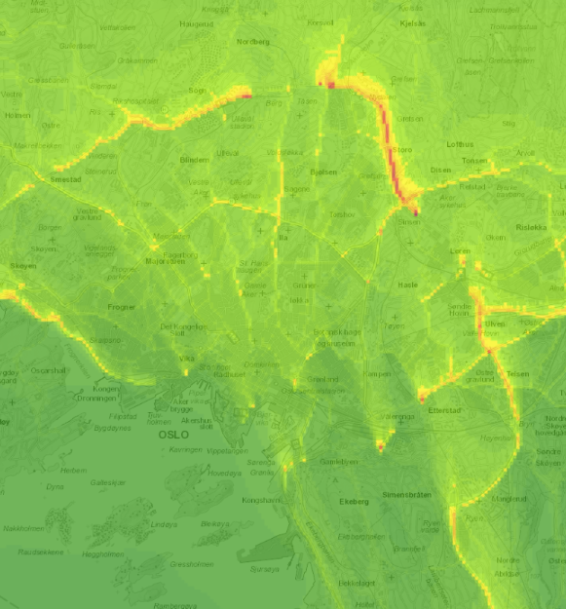
Forecast maps NO₂: mostly from traffic
8:00 pm 08.02.2019

Slide 9
A quick comparison to measurements

Slide 10
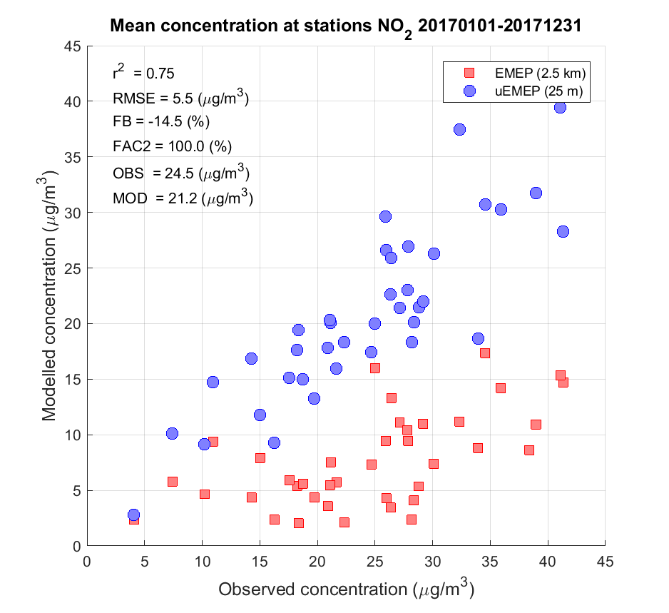
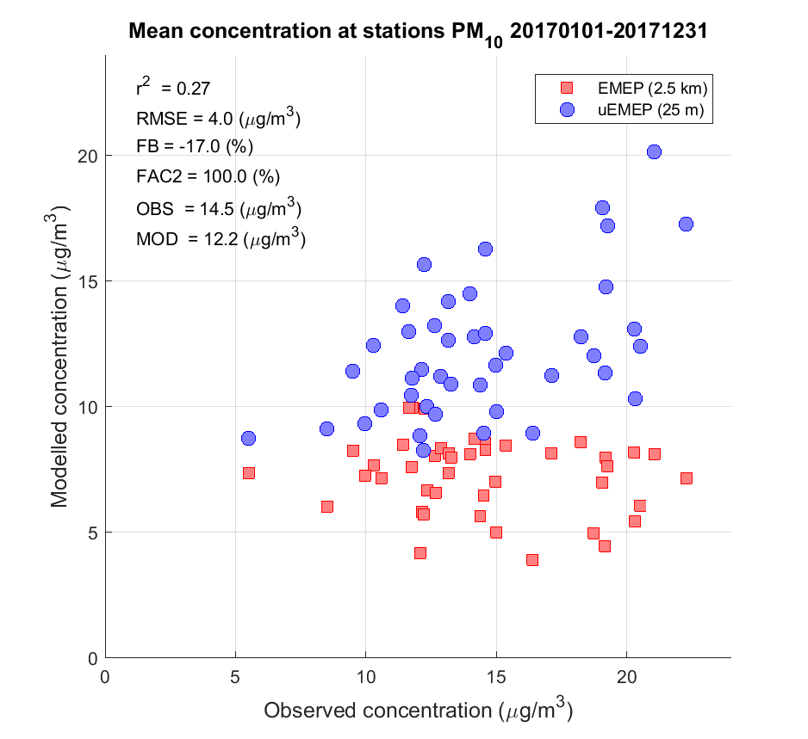
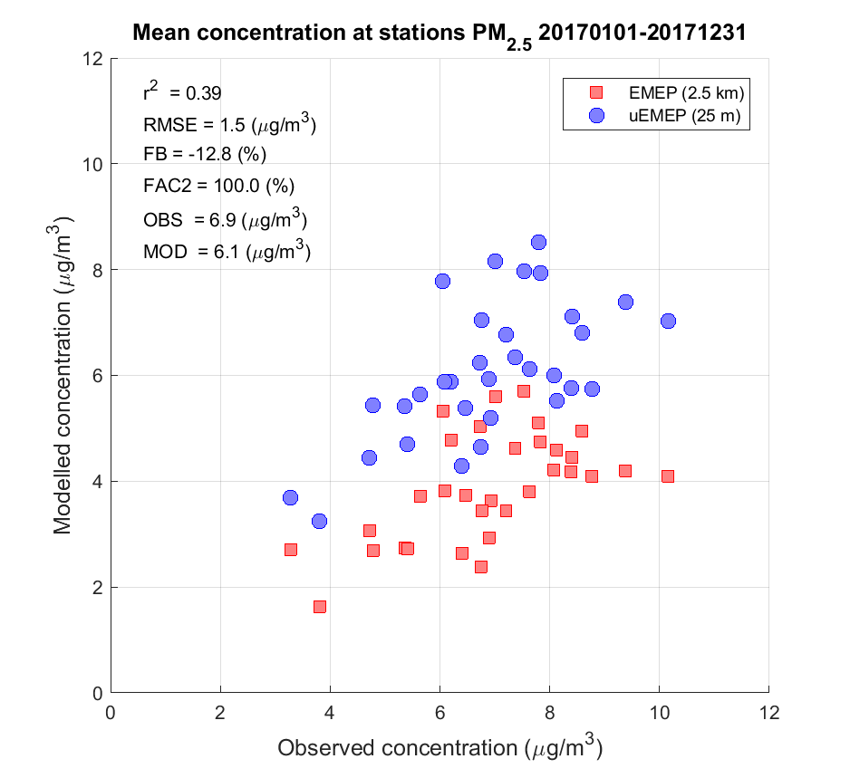
Comparison of uEMEP (25 m) and EMEP4NO 2017: annual mean scatter plots
NO₂
PM₁₀
PM_{2.5}

Slide 11
Exposure

Slide 12
Exposure calculations
EMEP4NO is run for a year at 2.5 km (2017)
uEMEP is run per municipality (422) for a year and combined with EMEP4NO using the local fraction at 100 m resolution
Home address data, aggregated to 100 m, is used for the exposure calculations
Frequency distribution of exposure and population weighted concentration (PWC) are calculated for both EMEP4NO and uEMEP
We look at PM₁₀, PM_{2.5} and NO₂

Slide 13
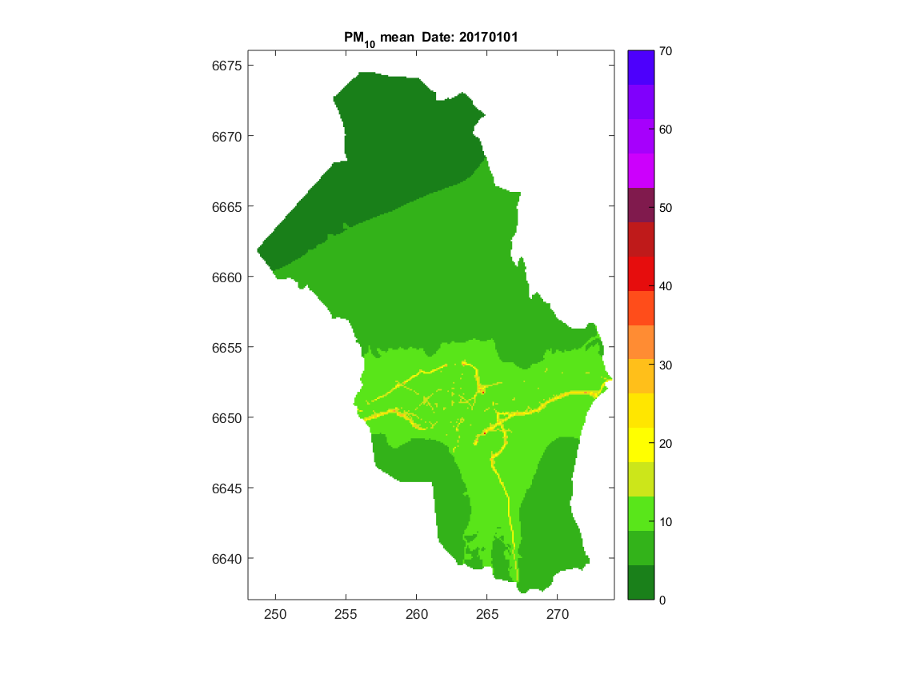
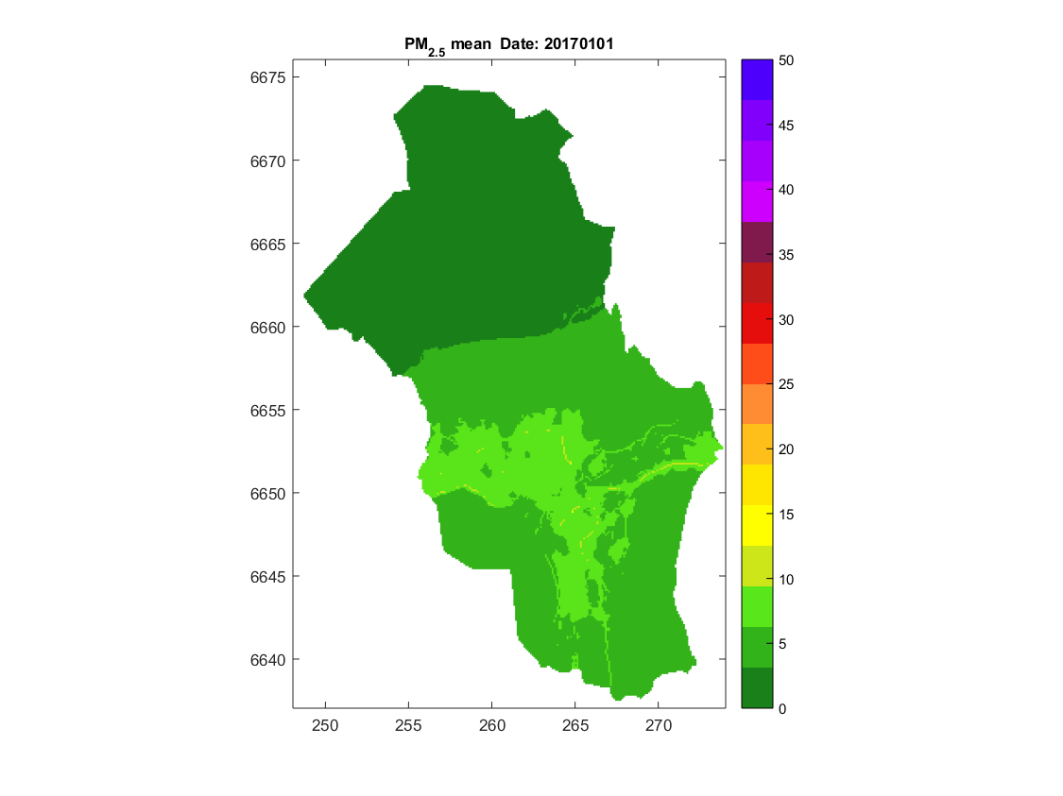
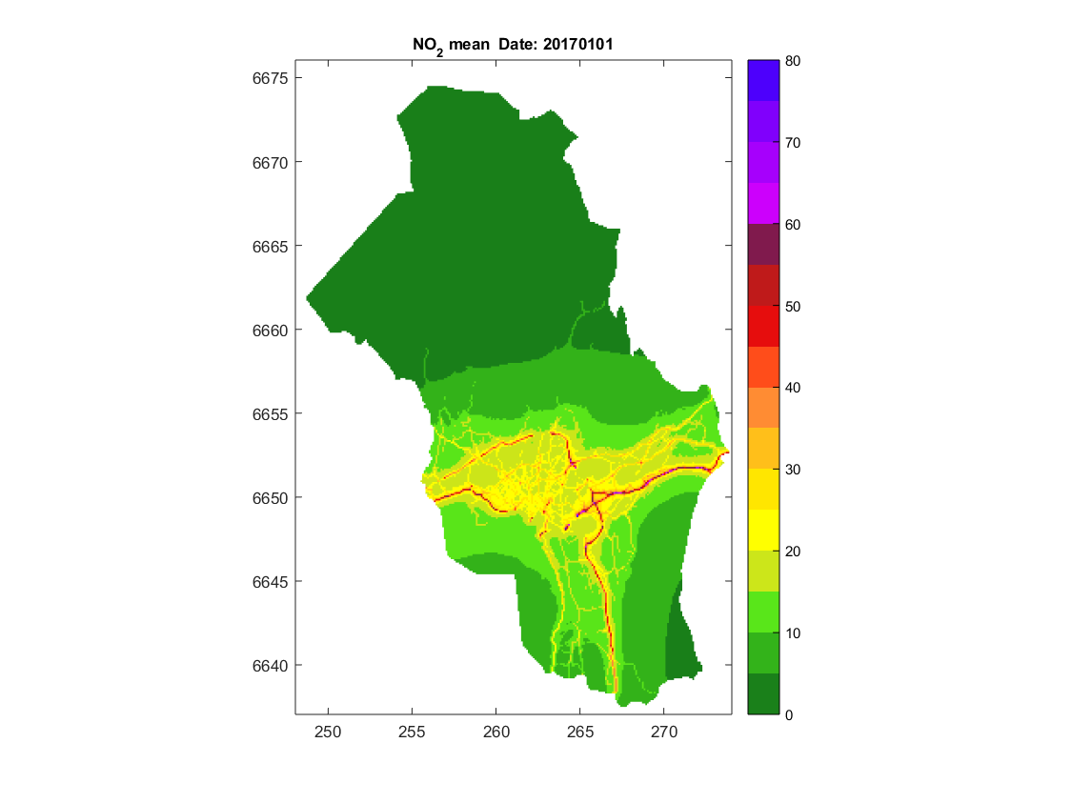
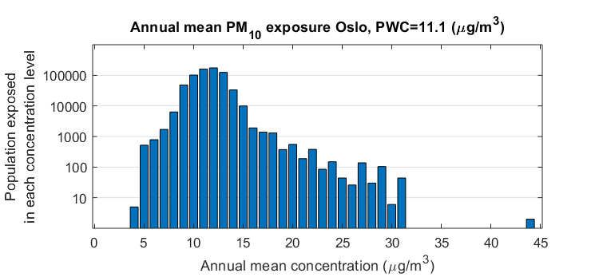
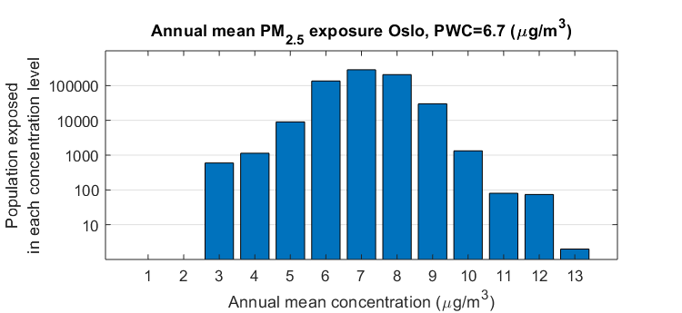
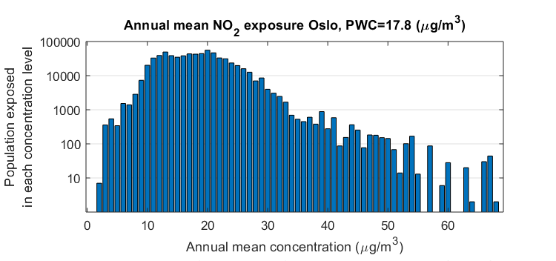
Exposure calculations using uEMEP in Oslo (50 m)
PM₁₀
PM_{2.5}
NO₂

Slide 14
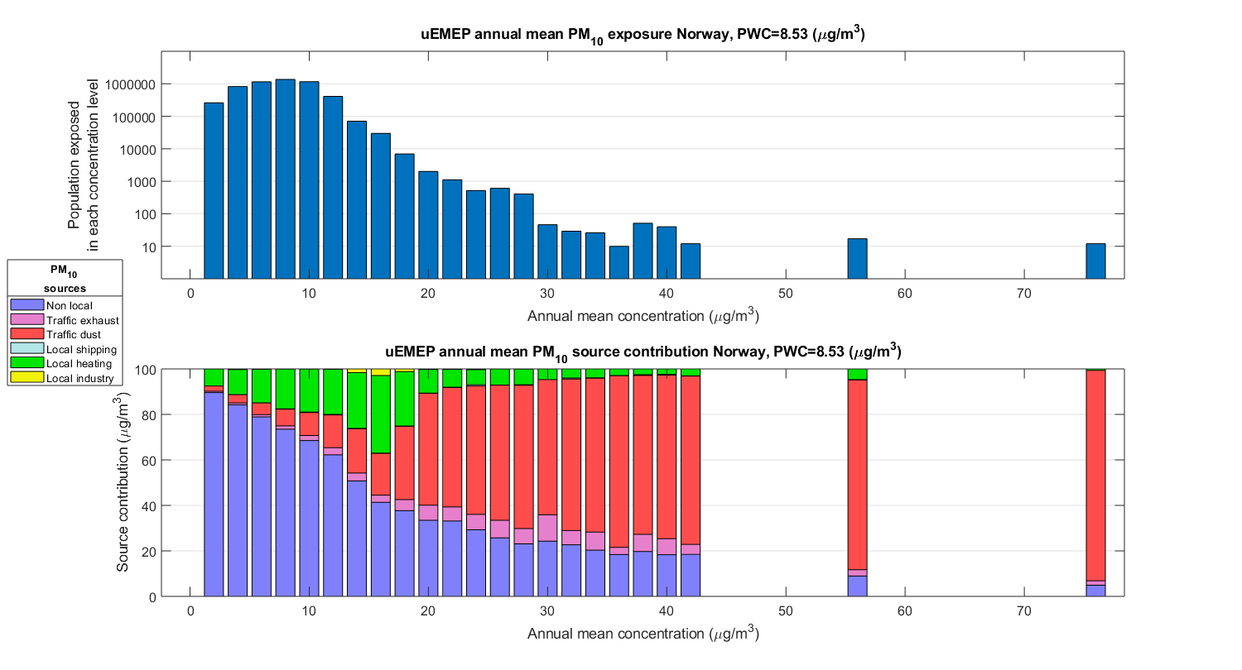
PM₁₀ exposure 2017 Norway: Total population Norway = 5.3 million
Population above WHO guideline value = 4894
Population weighted concentration = 8.5 µg/m³

Slide 15
PM₁₀ exposure 2017 Norway: uEMEP (100m) and EMEP4NO (2.5km)
Population above WHO guideline value = 4894
Population weighted concentration = 8.5 µg/m³
Population above guideline value = 0
Population weighted concentration = 6.4 µg/m³

Slide 16
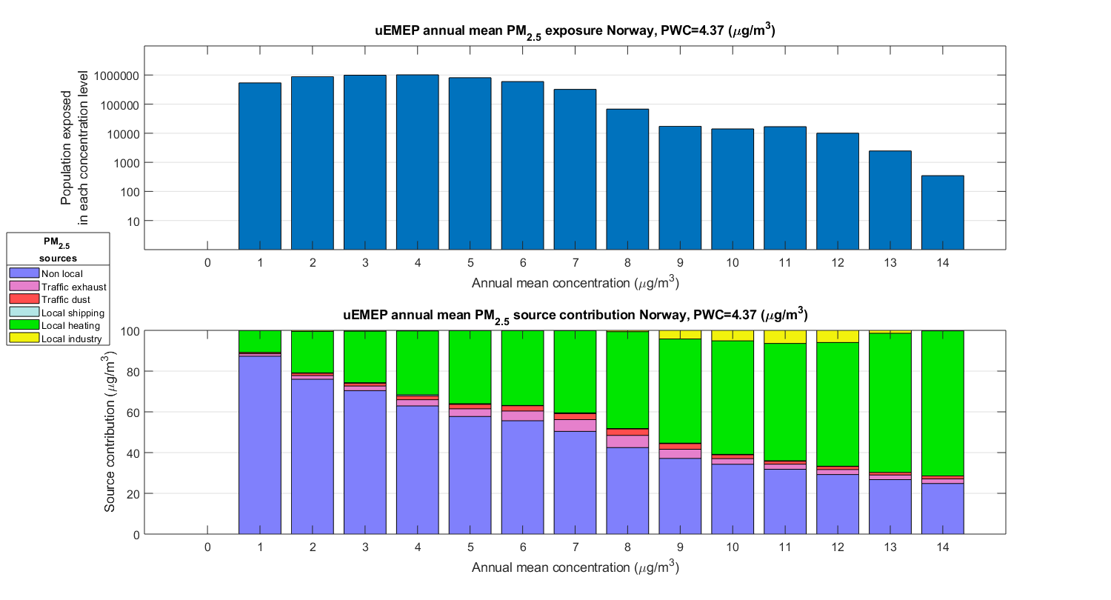
PM_{2.5} exposure 2017 Norway: Total population Norway = 5.3 million
Population above WHO
guideline value = 43719
Population weighted concentration = 4.4 µg/m³

Slide 17
PM_{2.5} exposure 2017 Norway: uEMEP (100m) and EMEP4NO (2.5km)
Population above WHO
guideline value = 43719
Population weighted concentration = 4.4 µg/m³
Population above WHO
guideline value = 0
Population weighted concentration = 3.1 µg/m³

Slide 18
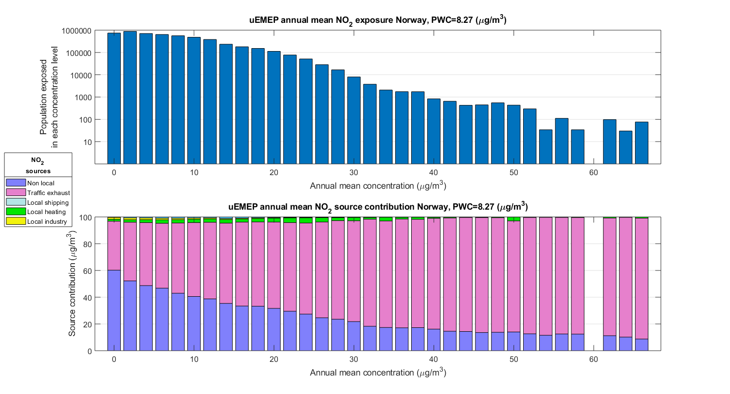
NO₂ exposure 2017 Norway: Total population Norway = 5.3 million
Population above WHO
guideline value = 4022
Population weighted concentration = 8.3 µg/m³

Slide 19
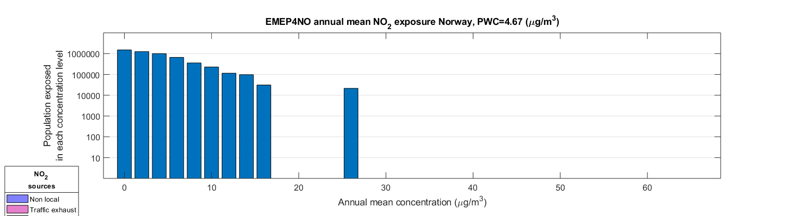
NO₂ exposure 2017 Norway: uEMEP (100m) and EMEP4NO (2.5km)
Population above WHO
guideline value = 4002
Population weighted concentration = 8.3 µg/m³
Population above WHO
guideline value = 0
Population weighted concentration = 4.7 µg/m³

Slide 20
Summary modelling
uEMEP extends the modelling capabilities of the EMEP model from global scales down to very local scales
It is now implemented in all of Norway for air quality forecasting and assessment
It has been verified against all available measurement data for several years
Calculated concentrations at measurement sites with uEMEP are significantly higher than calculations with EMEP at 2.5 km

Slide 21
Summary exposure
In Norway high resolution exposure calculations give 35% higher population weighted concentrations for PM and 90% higher for NO₂, compared to EMEP at 2.5 km
High resolution exposure calculations for Norway show significantly higher exposure levels for a small portion of the population, compared to EMEP at 2.5 km
Given strategic efforts to gather detailed emission data then high resolution exposure calculations are possible for all of Europe
This will remove the need for urban deltas and statistical downscaling methods

Slide 22
Additional slides

Slide 23
Representativeness of monitoring
sites for population exposure

Slide 24
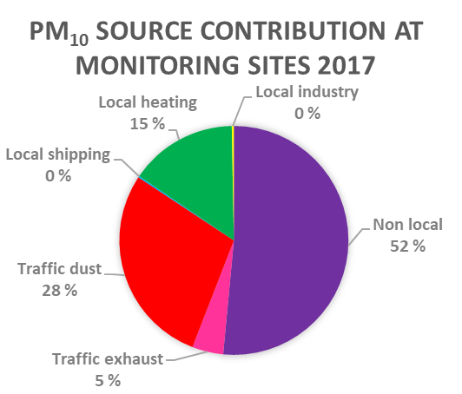
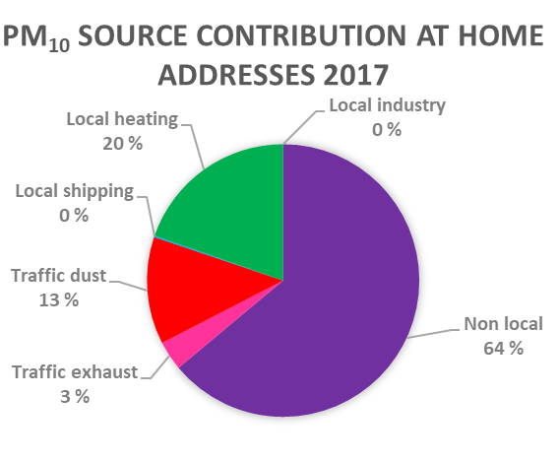
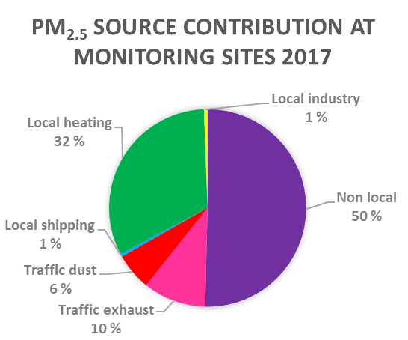
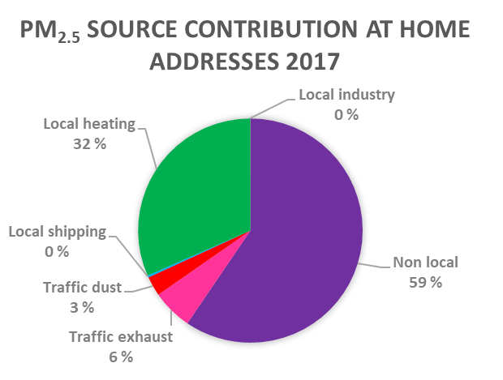
Source contributions to PM 2017: representativeness of measurement sites for exposure

Slide 25
Exposure scenarios

Slide 26
PM₁₀ exposure 2017 Norway: Total population Norway = 5.3 million
Population above WHO guidline value = 4894
Population weighted concentration = 8.5 µg/m³

Slide 27
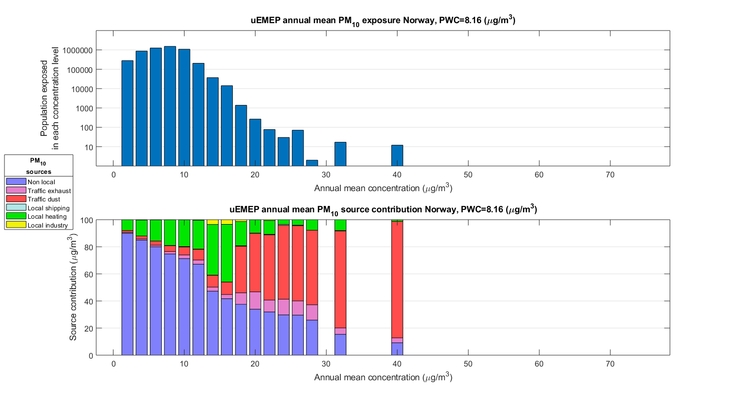
PM₁₀ exposure 2017 Norway: 50% reduction in non-exhaust emissions
Population above WHO guidline value = 474
Population weighted concentration = 8.2 µg/m³

Slide 28
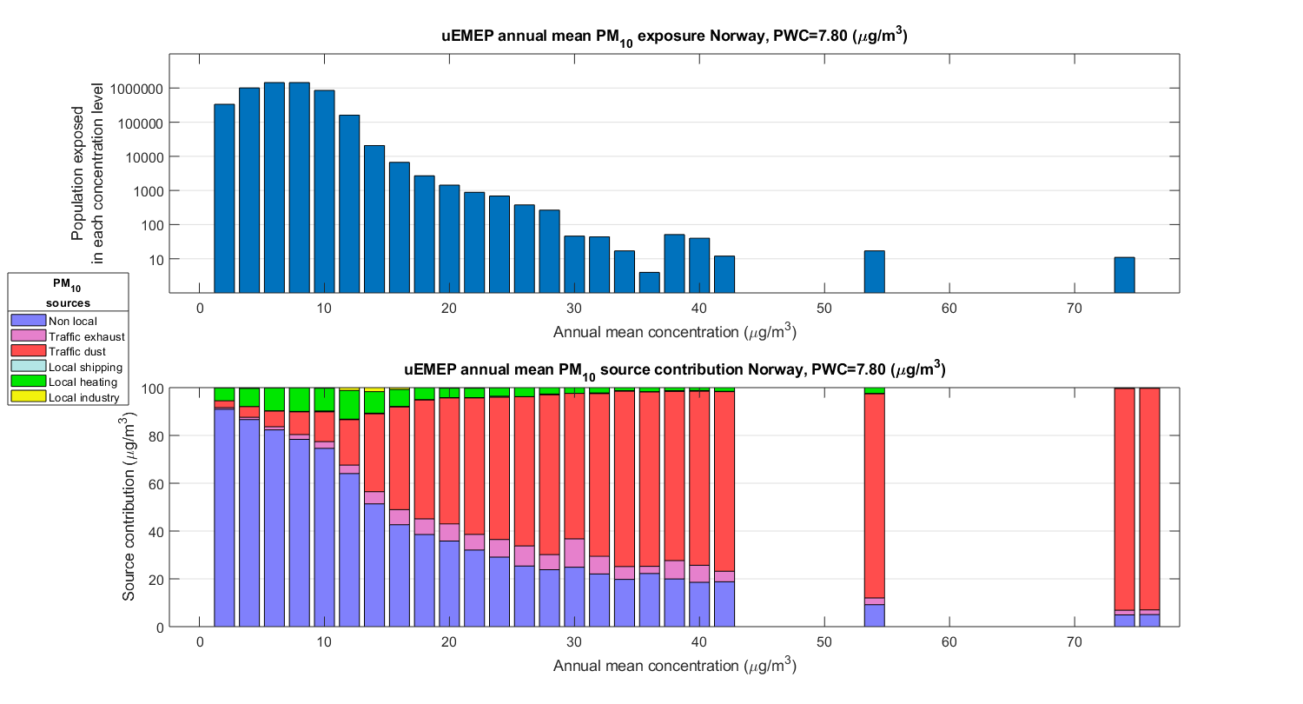
PM₁₀ exposure 2017 Norway: 50% reduction in residential heating emissions
Population above WHO guidline value = 3891
Population weighted concentration = 7.8 µg/m³

Slide 29
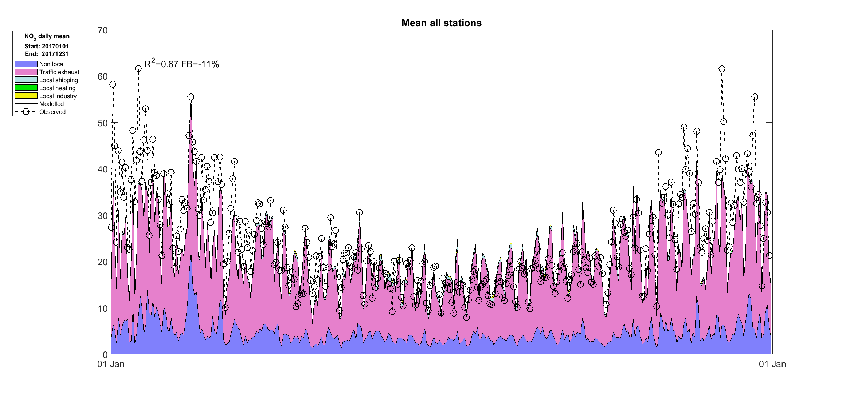
Validation NO₂ 2017: mean all stations, daily mean time series

Slide 30
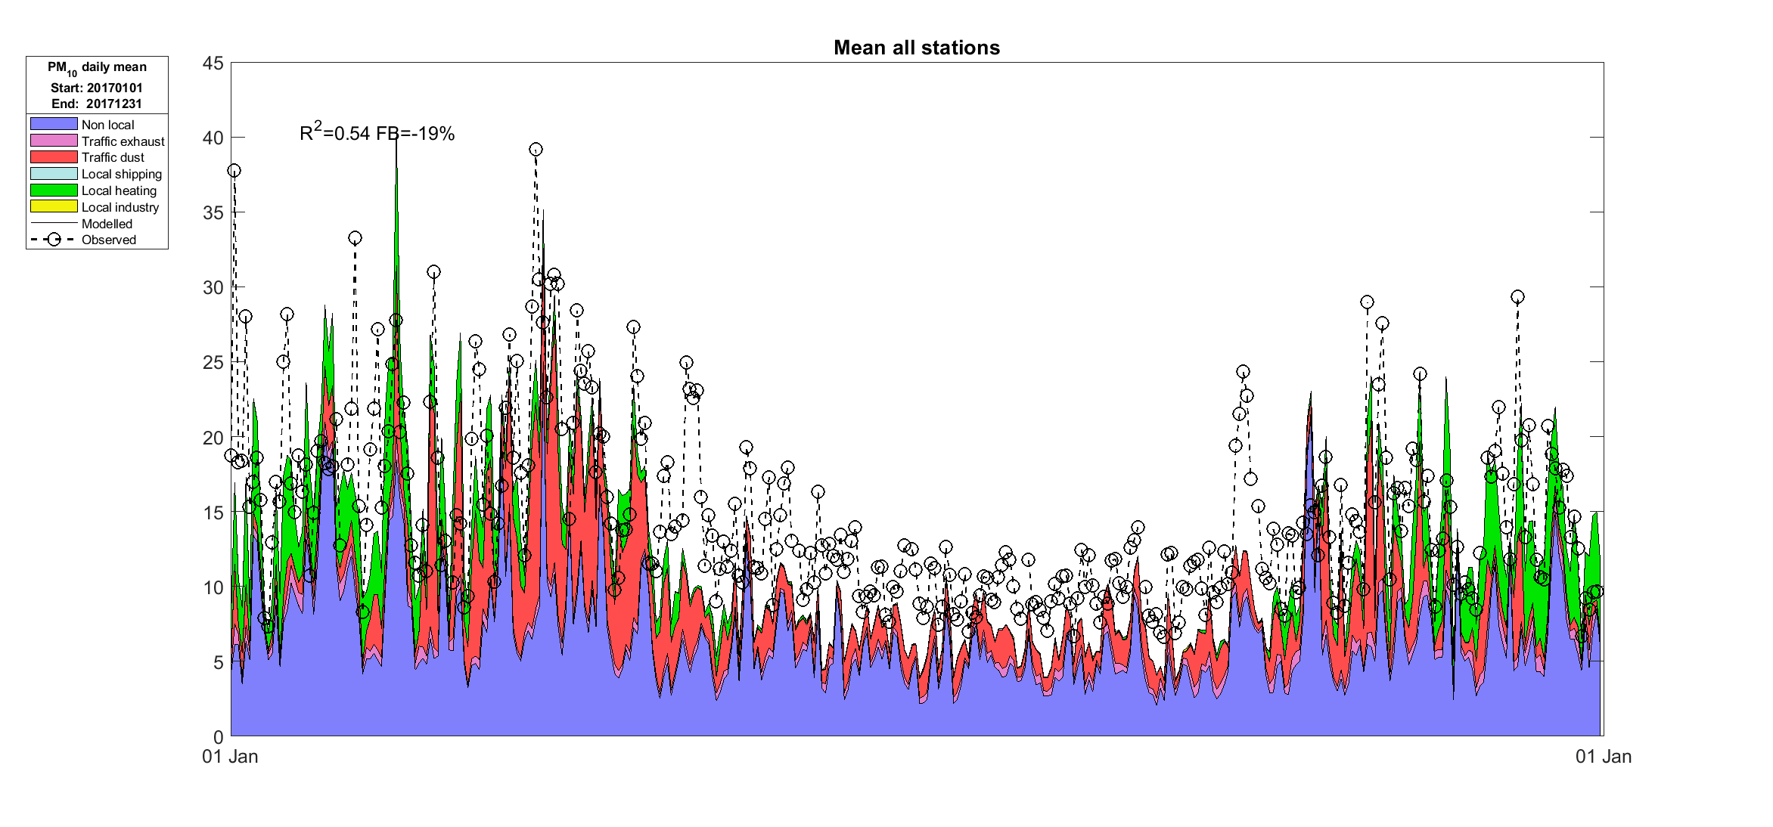
Validation PM₁₀ 2017:
mean all stations, daily mean time series

Slide 31
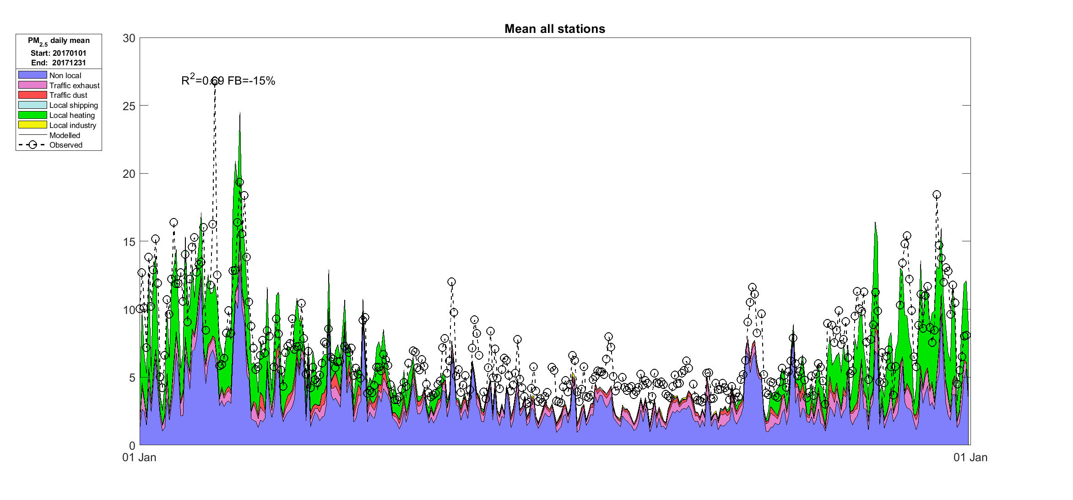
Validation PM_{2.5} 2017: mean all stations, daily mean

Slide 32
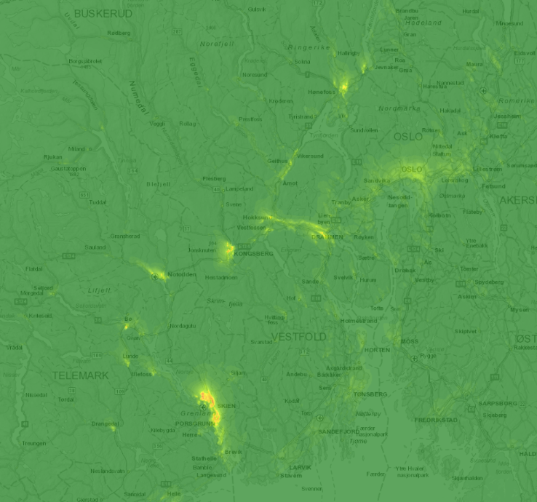
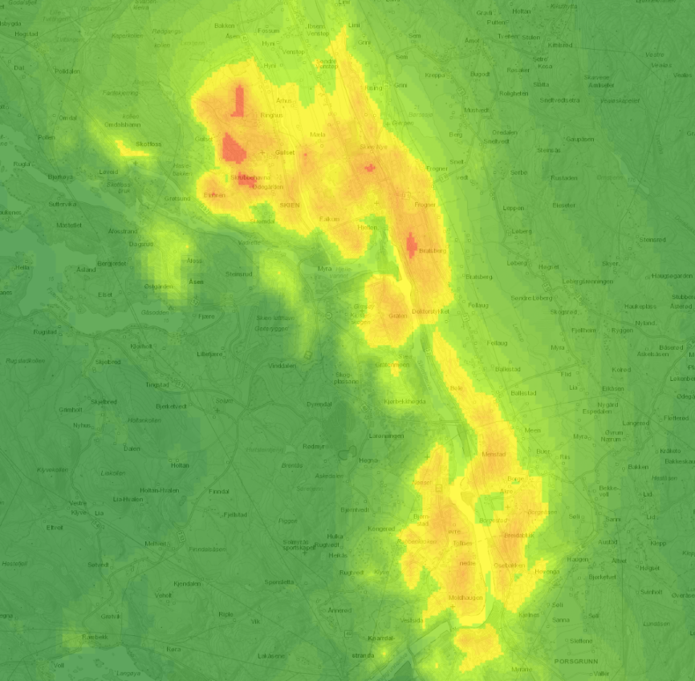
Forecast maps PM_{2.5}: mostly from wood burning
8:00 pm 08.02.2019

Slide 33
2017: PM₁₀ annual mean and exceedance days

Slide 34
2016 and 2017: PM_{2.5} annual mean

Slide 35
NO₂ annual means 2017 all stations

