Slide 1
Eurodelta-carb
Augustin Colette (INERIS), TFMM co-chair
20th TFMM Meeting, Madrid 7-9 May, 2019

Slide 2
Eurodelta
2007
2010
2014
2016
2019
CityDelta / EuroDelta
model intercomparison at local/European scale
response to future emission scenarios
EuroDelta-II
sensitivity to national/incremental emission reductions
EuroDelta -III
EMEP Field campaigns
EuroDelta-Trends
1990-2010 Hindcast over Europe
Policy Effectiveness
EuroDelta-Carb
Black Carbon / Condensable / BaP

Slide 3
Eurodelta-Carb
Main motivation: improve the modelling of
Tagged Elemental Carbon (coll. CAMS)
SOA (Condensables)
BaP
Tracers (Levo)
Take stock of
new developments in emission inventories (BC, condensables)
Winter 2018 field campaign

Slide 4
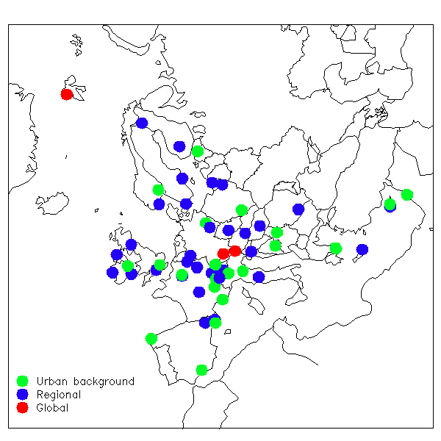
Winter 2018 campaign EMEP/ACTRIS/COLOSSAL
Scope:
Black Carbon
Separating EBC into EBCbb and EBCff
Levoglucosan, BaP
Highlights:
Wide European coverage
Include EMEP + urban sites

Slide 5
Black Carbon
LRTAP Black Carbon inventory
In 2017, 31 out of 37 countries submitted BC emission over 2000-2016 period
BUT:
« Although gridded BC data is requested by the modelers, the quality of the reported data is still not sufficient across most of the countries, therefore CEIP cannot provide these data.” EMEP Status Report, 2017
CEIP, 2018 EMEP Steering Body

Slide 6
Tagged EC: CAMS
CAMS_50 (Regional Forecast Production) will implement tagged EC in Fall 2019.
Participating RCTMs:
Chimere, EMEP, Eurad-IM, Lotos-Euros, MATCH, MOCAGE, SILAM, DEHM, GEM-AQ, MINNI, MONARCH
Emission inventories
Level of Tagging (tbd)
Fossil fuel / Wood burning versus Traffic / Residential
Reference (tbd)
CAMS-REG-AP (based on EMEP: no consistency in Condensables)
CAMS-REF2 (« science based »)
Tests to be performed in the summer 2019, likely target: winter 2017/2018 (field campaign)
CAMS_81 (TNO, J. Kuenen)
PM_split_for_CAMS-REG-AP_v2_2_1_rev_20190326

Slide 7
SOA: Condensable
TFEIP/TFMM Action on Condensable
Executive Body requested in 2018
Parties […] explain in their IIR whether they are reporting emissions that include or exclude the condensable component for each source (for example by presenting this information and the corresponding emission factors in a table).

Slide 8
Condensables

Slide 9
Benzo[a]pyrene
Collaboration between MSC-E and several countries in BaP Modelling
Could extend over Europe + compare with field campaing
Also include more tracers (levoglucosan, Potassium, ..)
F. Couvidat, A. Gusev TFMM 2018

Slide 10
Climate impact
Consolidate modelled optical properties
Comparison with observations
Elemental Carbon or Absorption coefficient
(direct) radiative forcing
Gurci et al., ACP 2019 (AQMEII-3)
single scattering albedo is calculated using external mixing assumption (EXT).
BC absorption enhancement is the ratio of absorption optical depths of simulation CSBC (core-shell internal mixing) to EXT. The core mass fraction is that calculated in the CSBC simulation

Slide 11
Eurodelta-CARB
Joint TFMM/EMEP – CAMS model intercomparison
Scope:
EC, SOA, BaP modelling
Tagging (residential/traffic)
LRTAP inventory: BC + Condensable
BC field campaign + climate impact
Time line
By Fall 2019 CAMS will complete a first inter comparison
After that,
TFMM/TFEIP will work on BC + Condensable emissions
Need volunteers !!
Implementing/running the model
Common input data: Emissions
Analysis:
comparison with field campaign
climate impact

