Slide 1
Ongoing and recent works on the modeling of organic aerosols
Thoughts on the state of SOA modeling
Florian Couvidat, INERIS
With participation of:
Grazia Lanzafame, Victor Lannuque, Olivier Favez, Alexandre Albinet (INERIS)
Marie Camredon, Bernard Aumont (LISA)

Slide 2
Set-up of the simulations
Use of the H²O mechanism (Couvidat et al., 2012)
Simulation over Europe for year 2013 (results in Couvidat et al., GMD, 2018)
Biogenic emissions from MEGAN
Anthropogenic emissions from EMEP but corrected to take into account SVOC emissions from residential sector according to TNO underestimation factor.
The model take into account the aging and the partitioning of the SVOC

Slide 3
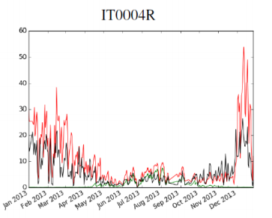
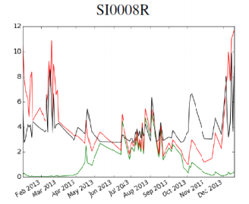
Results on stations with a strong anthropogenic influence
OC (µg/m³)
Red: Model Black : Measurement Green: Biogenic SOA

Slide 4
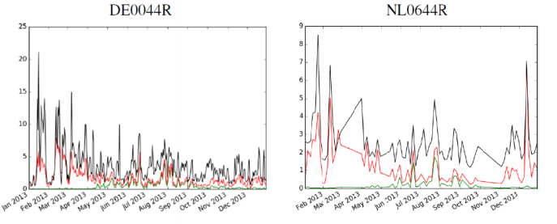
Results on stations with an anthropogenic influence
OC (µg/m³)
Red: Model Black : Measurement Green: Biogenic SOA

Slide 5
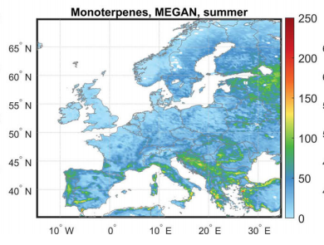
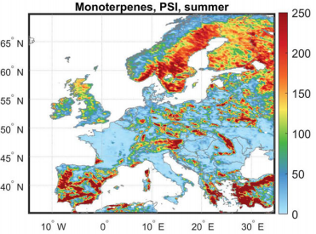
Conclusions of the implementation of the H²O mechanism inside CHIMERE
« Good » results for areas with strong biogenic emissions
« Underestimation » of concentrations for areas with strong anthropogenic emissions
Taking into SVOC from biomass burning in winter leads to a good representation of organic concentration in winter.
In summer, underestimation that could be due to :
Problem in mechanism
Lack of anthropogenic emissions???
Underestimation of biogenic emissions on part of Europe
Figures from Jiang et al. (2019)
Very different pattern and level of emissions between the two inventories

Slide 6
IVOC: missing emissions?
Robinson et al. (science, 2007) introduced the notion of IVOC (Intermediate Volatility Organic Compounds)
There is a gap of volatility between the VOC identified by GC-MS and SVOC captured as condensable in the American emission inventory
=> some emissions with intermediate volatility are missing : IVOC
Robinson et al. estimated a ratio IVOC/POA=1.5 (based on results from american medium-duty diesel trucks). This ratio is widely used in models using a VBS.
IVOC are often presented as missing emissions. Emissions of VOC which are missing from the inventory.
However, Robinson et al. explained that only part of VOC can be identified by GC-MS and IVOC part of the unresolved complex mixture of VOC.
=> Problem of the speciation of VOC used inside air quality models.

Slide 7
Developping a mechanism VBS-Gecko
Mechanism of Lannuque et al. (ACP, 2018)
Objectives :
Develop a SOA mechanism not from experimental data inside chambers but from an explicit mechanism GECKO-A taking into account aging and the main SOA precursors (Lannuque et al, ACP, 2018)
Take into account SOA from IVOC emissions from trafic
Estimations of IVOC Zhao et al.
60% of NMHC for diesel vehicles
Between 4% (Hot start) and 14% (Cold start) for gasoline vehicles
Several IVOC/VOC ratio were tested. Results with IVOC/VOC=0.3 (mixture gasoline/diesek fleet)

Slide 8
Evaluation
« biogenic »
« anthropogenic »
Close results between H²O and VBS-Gecko (Without IVOC)

Slide 9
9
IVOC = 30% VOC of road traffic
IVOC représented by a mixture of C14 et C18 (alkenes and linear alkanes)
« biogenic »
« anthropogenic »

Slide 10
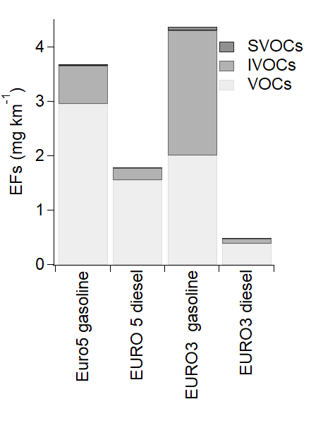
EVORA projects: estimating emissions of SVOCs and IVOCs
Project aiming at estimating IVOC emissions by applying the method of Zhao et al. (method separating emissions by volatility bins) for European vehicles
Very low IVOC emissions with diesel vehicles
More IVOC emissions with gasoline
IVOC should not represent more than a few percents of VOC emissions
Are IVOCs really a significant SOA precursors?
>= 7 carbons

Slide 11
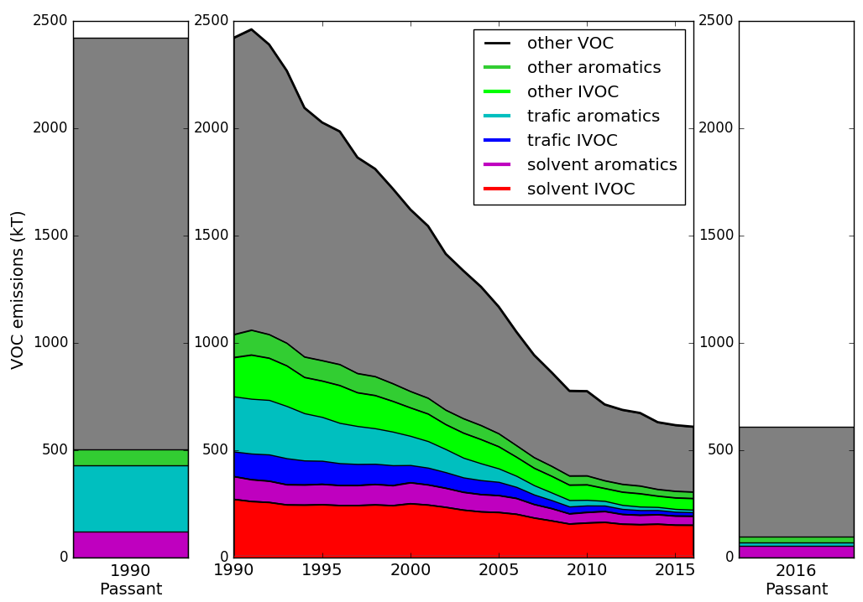
Use of a SNAP level 3 speciation
SNAP3 speciation based on littérature from CITEPA (French Centre on emissions)
IVOC considered here as « non-identified » VOC
Solvent sector is the main source of aromatics
Solvent sector could be a major source of IVOC (or at least of badly allocated precursors)
From 18% to 38% of VOCs could be IVOC
MacDonald et al. (Science, 2018), around 20% of VOC from the solvent sectors are IVOC
Speciation used in Chimere for year 1990
Speciation used in Chimere for year 2016

Slide 12
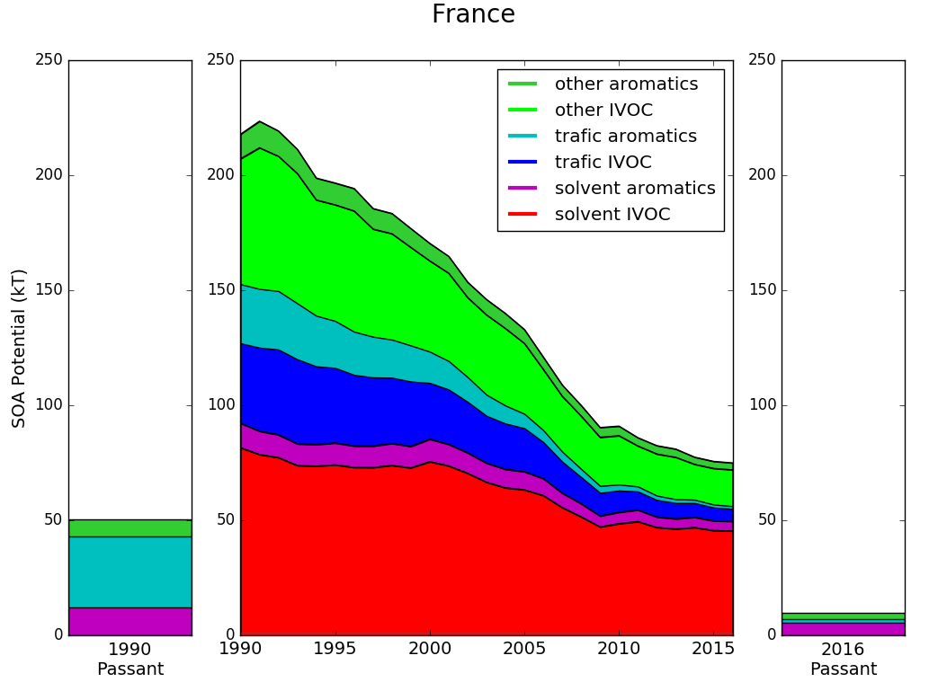
SOA potential
Solvent sector potentially the main contributor for SOA potential
MacDonald et al. (2018): solvents could represent 60% of the SOA potential for Los Angeles

Slide 13
Simulating markers to understand organic aerosols
A mechanism of markers Lanzafame et al. (in prep) have been developped for several markers:
Primary biomass burning: Levoglucosan
Secondary biomass burning: Nitrophenols, nitroguaiacols
Secondary anthropogenic: DHOPA, phthalic acid
Secondary from monoterpenes: pinonic acid, pinic acid, MBTCA
Secondary from isoprene: methyltetrols, methylglyceric acid
Simulating markers in 3D air quality models can be used as a diagnostic tool for OA modeling
Evaluate the gas-particle partitioning
Evaluate contribution from different sources
Observations of levoglucosan at the CARA french Network

Slide 14
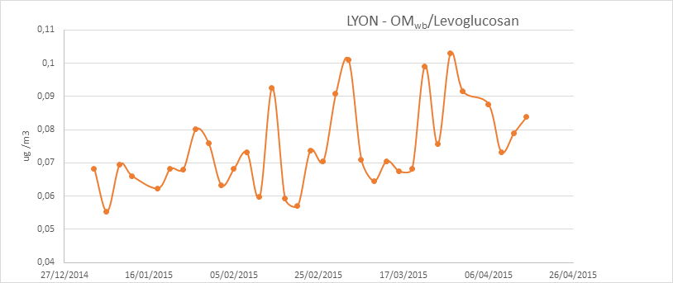
Case of Levoglucosan
Saturation vapor pressure from literature: Psat of 10⁻⁶ torr at 298K
Gas-phase degradation with OH
Levoglucosan taken as part of residential wood burning SVOC emissions based on several studies (but could depend on the type of wood used)
Simulated contribution of levoglucosan to biomass burning OA

Slide 15
Simulating Levoglucosan
Blue Measurements
Orange Model
OM
Levoglucosan

Slide 16
Simulating Levoglucosan
Blue Measurements
Orange Model
OM
overestimation of emissions during this day
Or problem in the meteorology

Slide 17
Simulating Levoglucosan
Blue Measurements
Orange Model
OM
Levoglucosan
Levoglucosan well represented but not OM
=> Problem in the model?

Slide 18
Simulating Levoglucosan
Blue Measurements
Orange Model
OM
Levoglucosan
Probable underestimation of emissions over Bordeaux

Slide 19
Conclusions
Some interrogations:
Low contributions of IVOC for european vehicles?
Solvent an important source of SOA precursors?
Are biogenic emissions realistic enough? Very different emissions with different models
Marker modeling could bring very interesting results but would need lot of measurements over Europe

