Slide 1
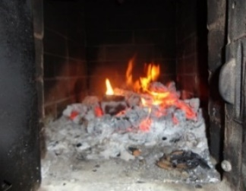
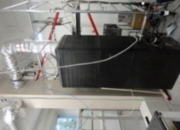
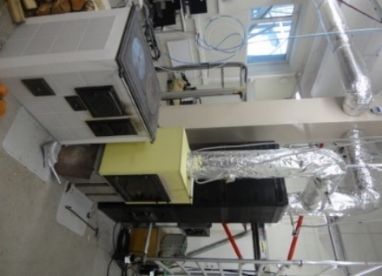
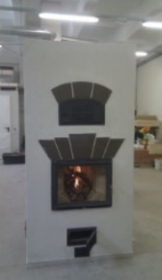
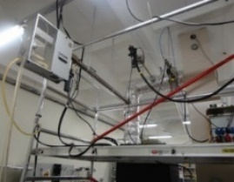
Carbonaceous aerosols in typical residential heating area in Estonia
E. Teinemaa¹, H. Keernik^{1,2,4}, M. Maasikmets^{1,3}, H-L. Kupri^{1,2}
¹Estonian Environmental Research Centre; ²Tallinn University of Technology; ³Estonian University of Life Sciences; ⁴Tartu Observatory

Slide 2
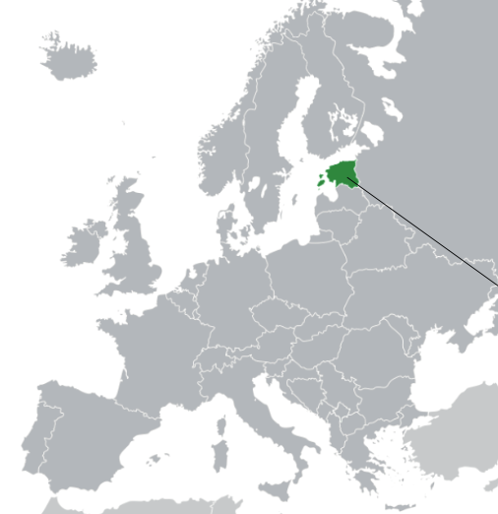
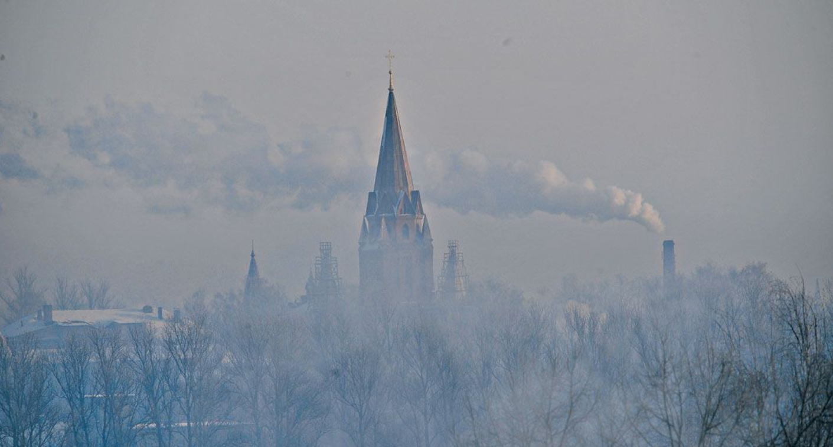
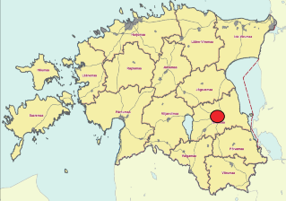
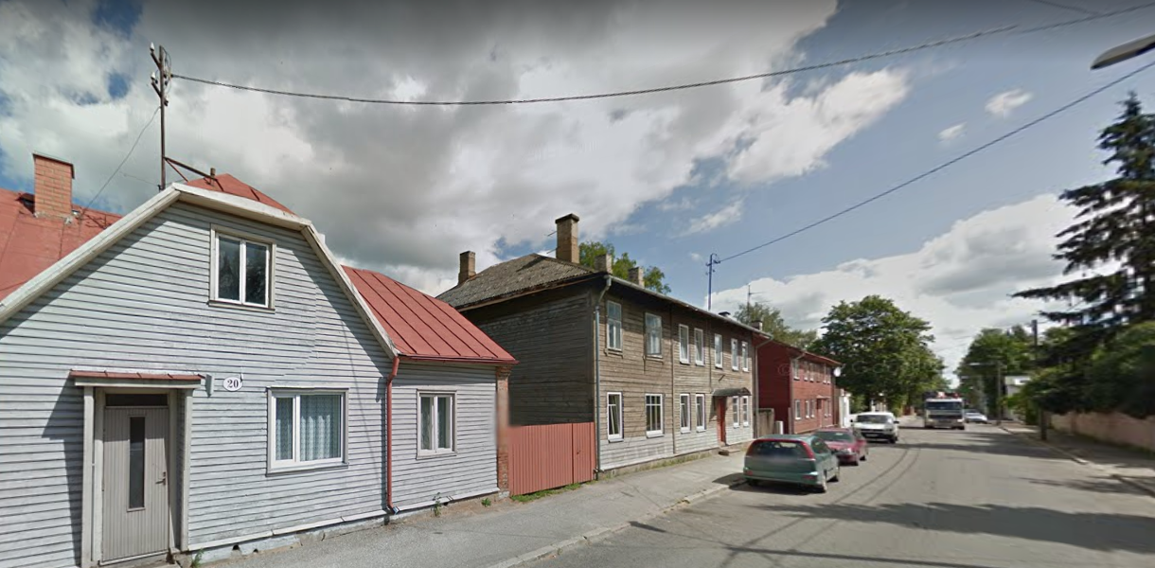
Introduction
In Tartu (2nd largest city in Estonia) the annual level of B(a)P have been exceeding target value 1 ng/m³
Tartu has residential heating areas typical for Estonian towns
Wood logs and wood chips account >90% of the fuel used for residential heating
Notes:
It is also an ACTRIS site

Slide 3
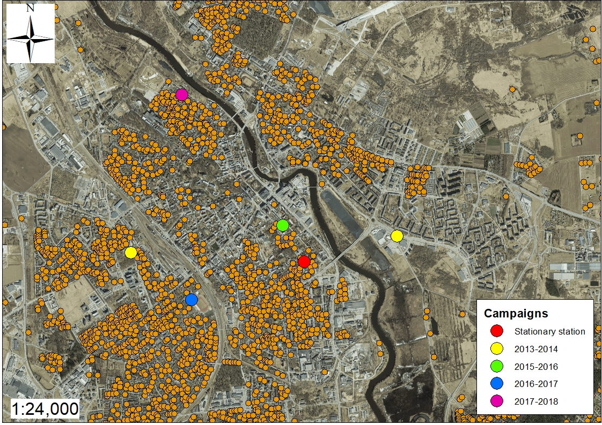
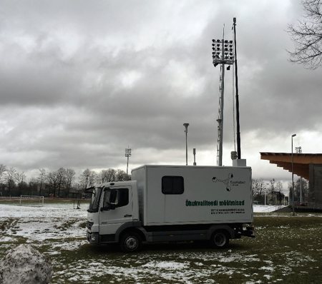
Four measurement campaigns in typical residential areas in Tartu has been carried out using mobile stations

Slide 4
Measurements
Filter analysis
EC/OC (Sunset lab)
BC (Magee SootScan OT21)
Heavy metals - Al, As, Sb, Cd, Co, Cr, Mn, Mo, Ni, Pb,
Se, V, Fe, Zn, Cu (ICP-MS)
PAH - acenaphthene, acenaphthylene, anthracene, fluoranthene, fluorene, naphthalene, phenanthrene, pyrene, benz[a]anthracene, benzo[b]fluoranthene, benzo[k]fluoranthene, benzo[ghi]perylene, benzo[a]pyrene, chrysene, dibenz[a,h]anthracene, and indeno[1,2,3-cd]pyrene (GC-MS)
Levoglucosan (GC-MS)
Terephtalic acid
Stationary station
BC (ethalometer AE33)
ACSM (Aerodyne)
EC/OC (Field Sunset)
PM10 sampling Digitel DHA-90
PM10/PM2.5 with BAM 1020
CO, NOx, SO2, O3
Ambient air measurements with mobile stations
BC (ethalometer AE33)
PM10 sampling Digitel DHA-90
Heavy metals, PAHs
PM10/PM2.5 with BAM 1020
CO, NOx, SO2, O3

Slide 5
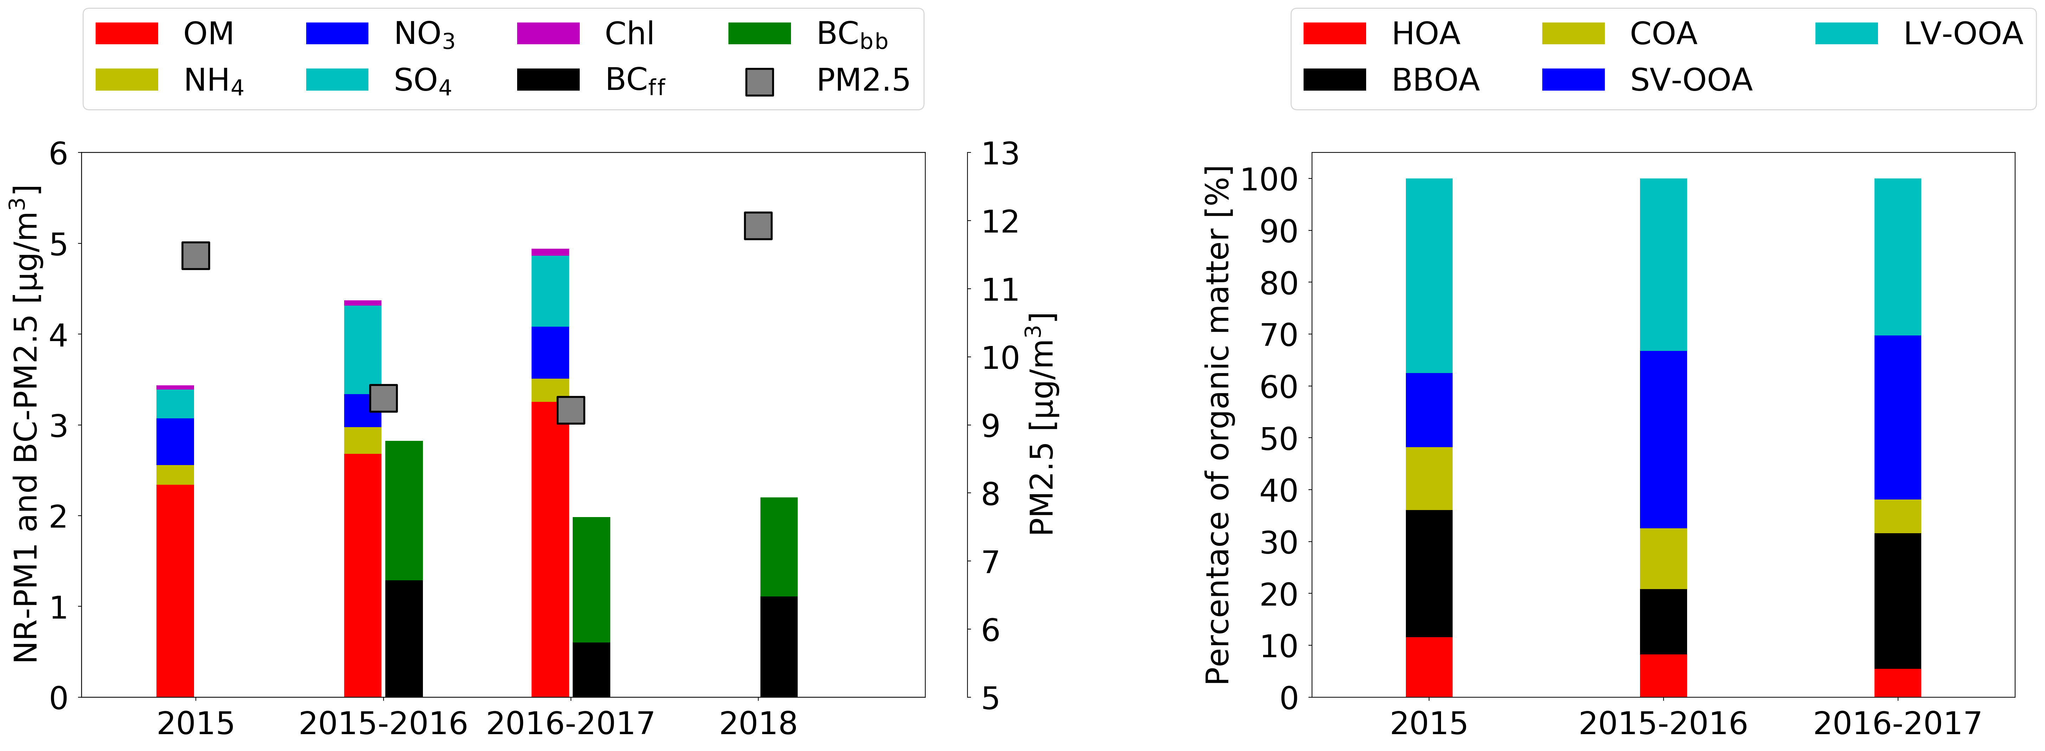
Carbonaceous fraction
During 2018 heating season BC contributes about 20% of the PM2.5 mass
EC/OC contributes about 45% of PM2.5 mass
During all periods and using different methods this value varies

Slide 6
EC/OC and BC
Comparison between Sunlab EC/OC and Magee aethalometer BC values
Strong correlation between both EC and OC with BC
For 2018 winter in Tartu station:
EC vs BC 0.944
OC vs BC 0.918

Slide 7
Sootscan OT21
Magee Sootscan OT21 was used to analyse filter samples
The correlation with online aethalometer BC was good, the problem was with high BC levels (issue with high-vol samplers, should not be issue with low-volume sampler filters)
Pearson 0.768
Pearson 0.700

Slide 8
Levoglucosan
Good correlation between levoglucosan and BC_{wb} with BaP
Mobile station 2018 winter
BaP vs levoglucosan 0.543
BaP vs BCwb 0.858
Levoglucosan vs BCwb 0.824
Tartu station 2018 winter
BaP vs levoglucosan 0.804
BaP vs BCwb 0.866
Levoglucosan vs BCwb 0.918

Slide 9
PAHs

Slide 10
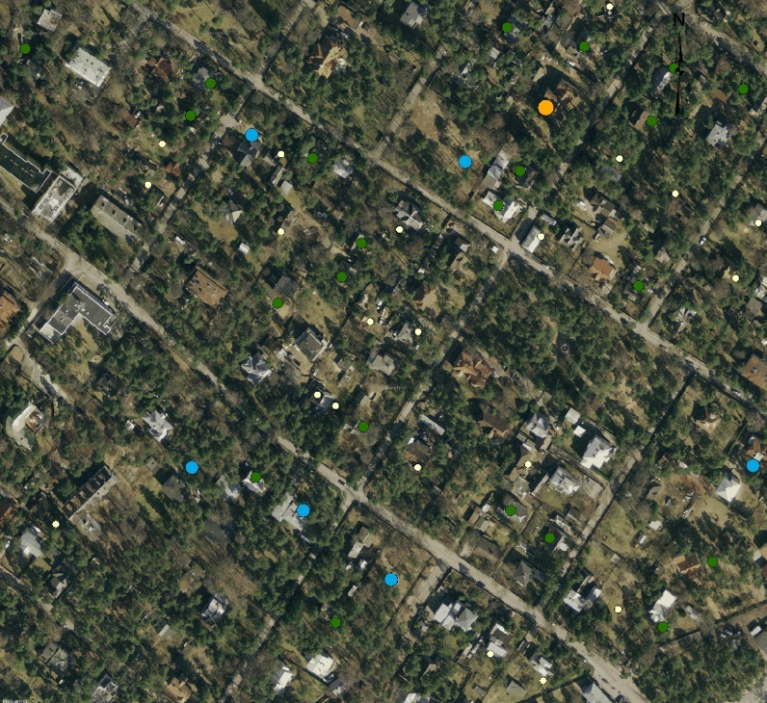
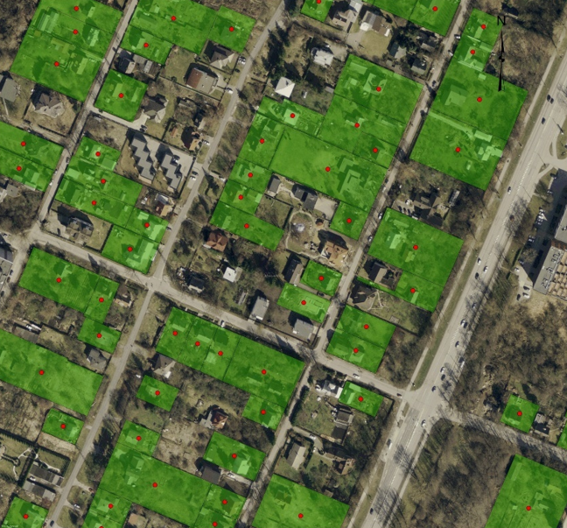
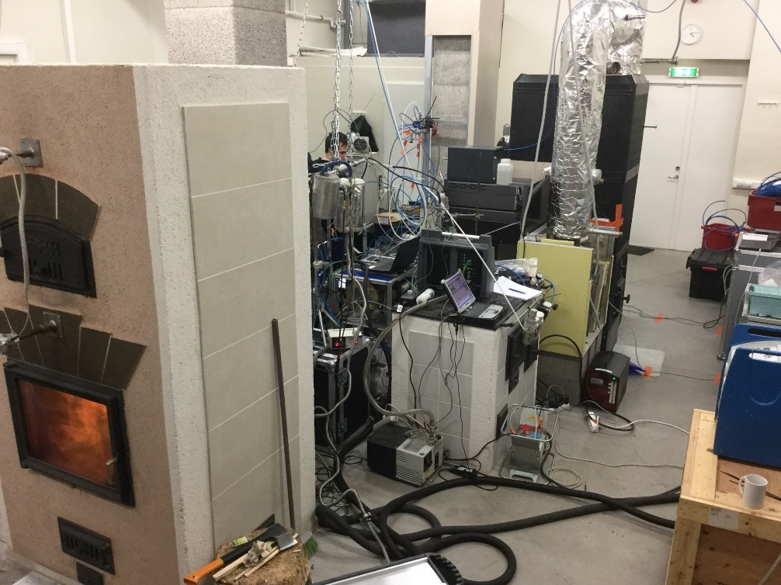
Residential emissions
Data from construction register (heated area and heating system) and cadastral registry (coordinates) was used to compile emission database
PM2.5, BC and BaP emissions (g/s) were calculated for each household based on energy consumption and emission factors from earlier laboratory studies (Maasikmets et al. 2016, Teinemaa et al. 2013)
Emission measurements did not encompass condensables

Slide 11
Dispersion modelling
Diurnal and monthly variation of the emissions was based on measured BC_{wb} results – both for PM2.5 and BaP emission databases
Dispersion modelling was used to calculate levels of PM2.5, BC and BaP using ensemble of two different dispersion models in Airviro modelling environment (SMHI Gauss, SMHI Grid).
The dispersion modelling results were compared against BCwb measurements in stationary and mobile stations
The average concentrations were in good agreement, which was not case for hourly variation – activity data is issue
Tartu station
2016
Tartu station
2017

Slide 12
Activity data
Issues with correct activity data
Simple time variation
Heating days based on ambient temperature
Variation based on ambient BCwb levels
Temperature sensors in chimneys

Slide 13
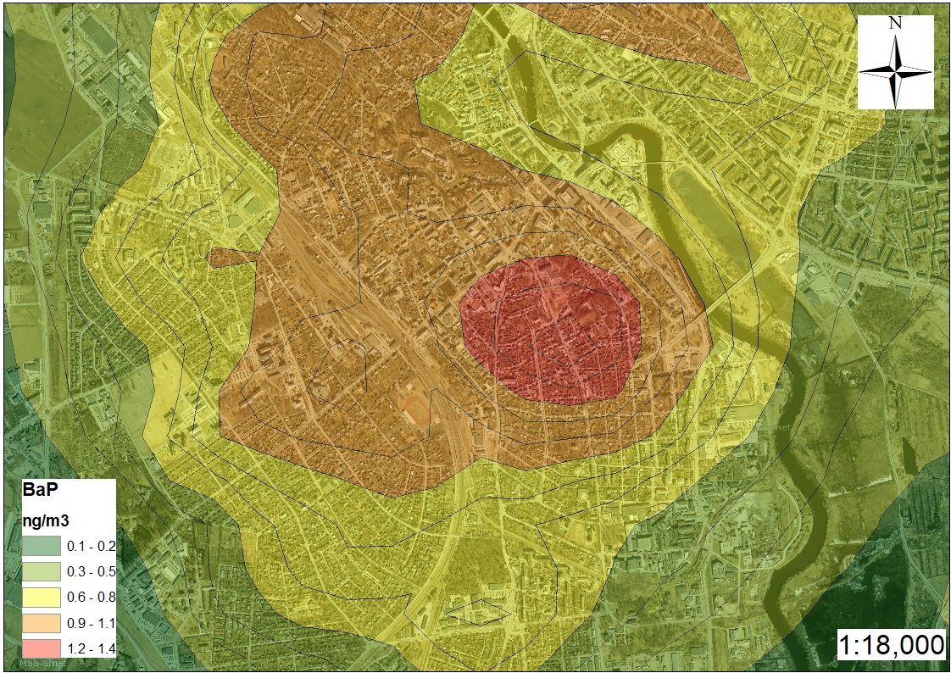
Modelled BaP levels
Based on PM2.5 and BCwb emission measurements the BaP emission database was compilated and used to model ambient BaP levels
2017 data | BCwb and BaP Correlation R²
January | 0.93
February | 0.90
March | 0.94
April | 0.75
May | 0.75
June | 0.73
July | 0.56
August | 0.81
September | 0.80
October | 0.99
November | 0.98
December | 0.88
Gas-phase BaP attributes approximately 7-9% of the total BaP

Slide 14
Conclusions
Elevated levels B(a)P are mainly related to the local emissions from the residential heating in Tartu
City draw action plan to reduce BaP levels and which was publicized last month
Ethalometer BC_{wb} can be used to predict BaP and PAH concentration in residential areas
Very good correlation between PAH’s, PM2.5, PM10 and BC, EC/OC and levoglucosan concentrations
BaP emission database compiled for Tartu and modelling (hourly) was validated through BCwb online measurements

Slide 15
Ongoing activities
Time variation for the residential heating
Temperature probes are installed to chimneys in Tartu to register actual heating times
Emission factors for condensable PM – current national emission factors don’t include condensable fraction
What to do with positive gaseous artefact in EC/OC analysis in OC part
should it be deducted from total OC?
Compiling BCwb and BaP emission databases for other Estonian towns with residential heating

Slide 16
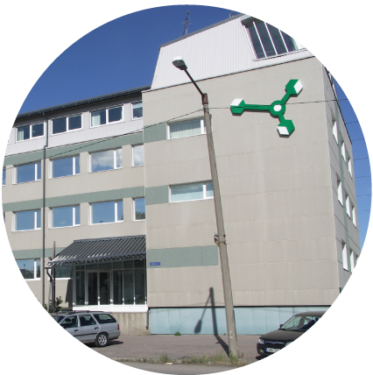
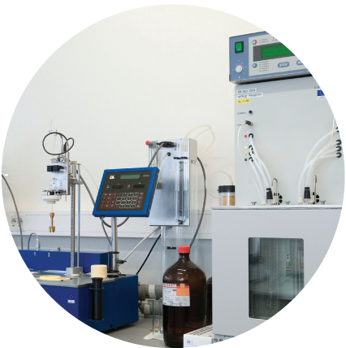
Thank you for your attention!

