Slide 1


Update of MSC-E research activities on POPs.
Case study on B(a)P pollution
Alexey Gusev, Victor Shatalov, Olga Rozovskaya (MSC-E, EMEP)
Florian Couvidat (INERIS, France)

Slide 2
Outline of MSC-E research activities on POPs
Exploring factors affecting quality of PAH pollution modelling: case study of B(a)P pollution (1.1.3.1, 1.2.1)
  Testing different parameterizations of processes
  Modelling with scenario emissions for selected countries
Contribution to evaluation of PAH adverse effects (1.1.3.1)
  Exceedances of B(a)P AQ guidelines in the EMEP countries
  BaP-equivalent concentrations of 4 PAHs
Update of multi-media modelling with focus on HCB secondary sources (1.1.4.2)
  Long-term modelling of HCB accumulation in soil and re-volatilization
  Comparison of HCB model results with PAS campaign data (CCC) for 2016
Co-operation with international organizations (AMAP/HELCOM/SC)
Future activities

Slide 3
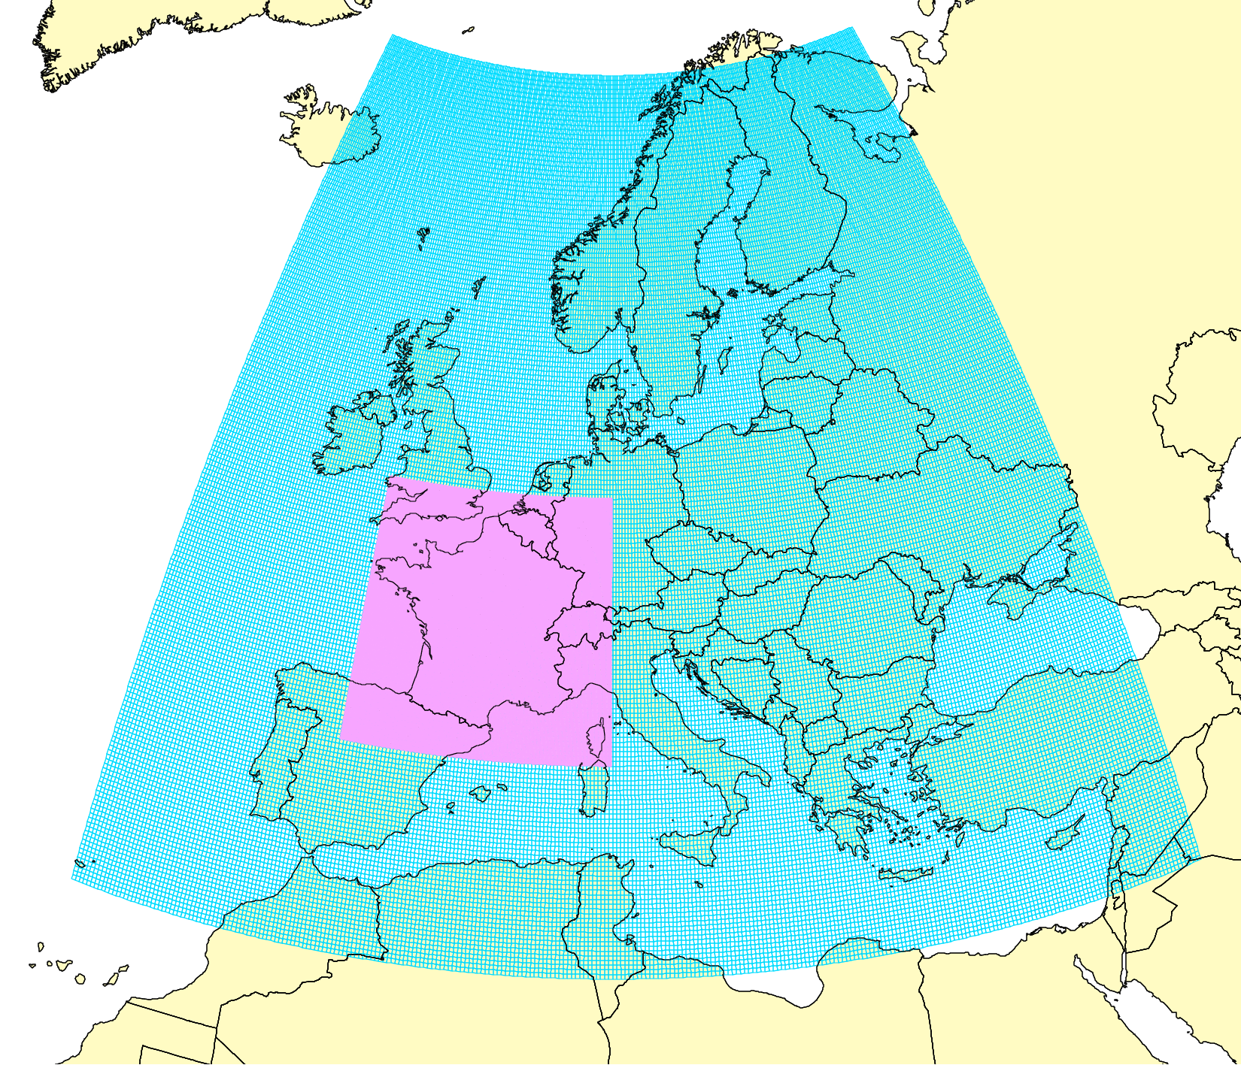
Case study on B(a)P pollution in Europe and France (2018-2019)
Objective of the case study:
Analysis of uncertainties and improvement of assessment of B(a)P pollution levels in co-operation with national experts
Participated:
Experts from MSC-E, INERIS (France), CIEMAT (Spain)
Models: GLEMOS (MSC-E), CHIMERE (France)
Case study activities:
Analysis of national B(a)P emission data
Analysis of sensitivity of model results to changes of parameterizations of B(a)P processes
Scenario modelling and analysis of sensitivity to changes of national B(a)P emissions
Fine resolution, sector-specific, and source-receptor modelling
FR01 (0.1x0.1)
EU02 (0.2x0.2)
Model domains

Slide 4
Model parameterizations for B(a)P processes
Main processes affecting B(a)P/PAH transport and concentrations:
Gas-particle partitioning (GPP)
Degradation in gaseous phase due to reactions with OH, NO₃, and O₃
Degradation due to heterogeneous reactions with O₃
Air surface exchange
Gas-particle partitioning schemes:
Adsorption Junge-Pankow scheme (Pankow, 1987) :
based on subcooled liquid vapor pressure pº_{L}
Absorption Harner-Bidleman scheme (Harner & Bidleman, 1998) :
based on octanol-air partition coefficient K_{OA}
Dual absorption to OM and adsorption to BC scheme (Dachs and Eisenreich, 2000)
added adsorption to BC in the aerosol particles
Poly-parameter Linear Free Energy Relationships scheme (PPLFER) (Shahpoury et al., 2016)
differentiates between various organic/inorganic components of PM
Testing of GPP schemes (Efstathiou et al., 2016; Mu et al., 2017) showed better performance of PPLFER model followed by Dual OM&BC model

Slide 5
Model parameterizations for B(a)P processes
Degradation in gaseous phase
Reactions with OH (k=1.5 e⁻¹⁰),
NO₃ (k=5.4 e⁻¹¹), and O₃ (k=2.6 e⁻¹⁷) (Mu et al., 2018)
Degradation in particulate phase (ROI-T model)
Reactive oxygen intermediates (ROI-T) model describes heterogeneous reactions with O₃ following (Mu et al., 2018)
Considers several layers in particles, surface and bulk reactions of B(a)P with O₃
Degradation rate is function of temperature and relative humidity
Air-surface exchange
Based on (Gusev et al., 2005; Jacobs and van Pul, 1996), processes considered:
- gaseous exchange of B(a)P at air-surface interface,
- vertical transport in soil,
- multi-phase partitioning (gaseous, dissolved, solid phases),
- degradation.

Slide 6
GLEMOS and CHIMERE parameterizations for B(a)P
Model configuration for reference simulations:
 | CHIMERE | GLEMOS
Gas-particle partitioning | Secondary organic aerosol processor (SOAP) (Couvidat and Sartelet, 2015); no adsorption to EC | Dual absorption to OM/ adsorptionc to BC scheme: (Dachs and Eisenreich, 2000); adsorption to BC following (van Noort, 2003)
Degradation in gas phase | Reaction with OH | Reaction with OH
Degradation in particle phase | Heterogeneous reaction with O₃ | Heterogeneous reaction with O₃; different rates for B(a)P on OM and BC
Air surface exchange | None | None*
* Original GLEMOS model version includes gaseous exchange with underlying surface (Gusev et al., 2005; Jacobs and van Pul, 1996)

Slide 7
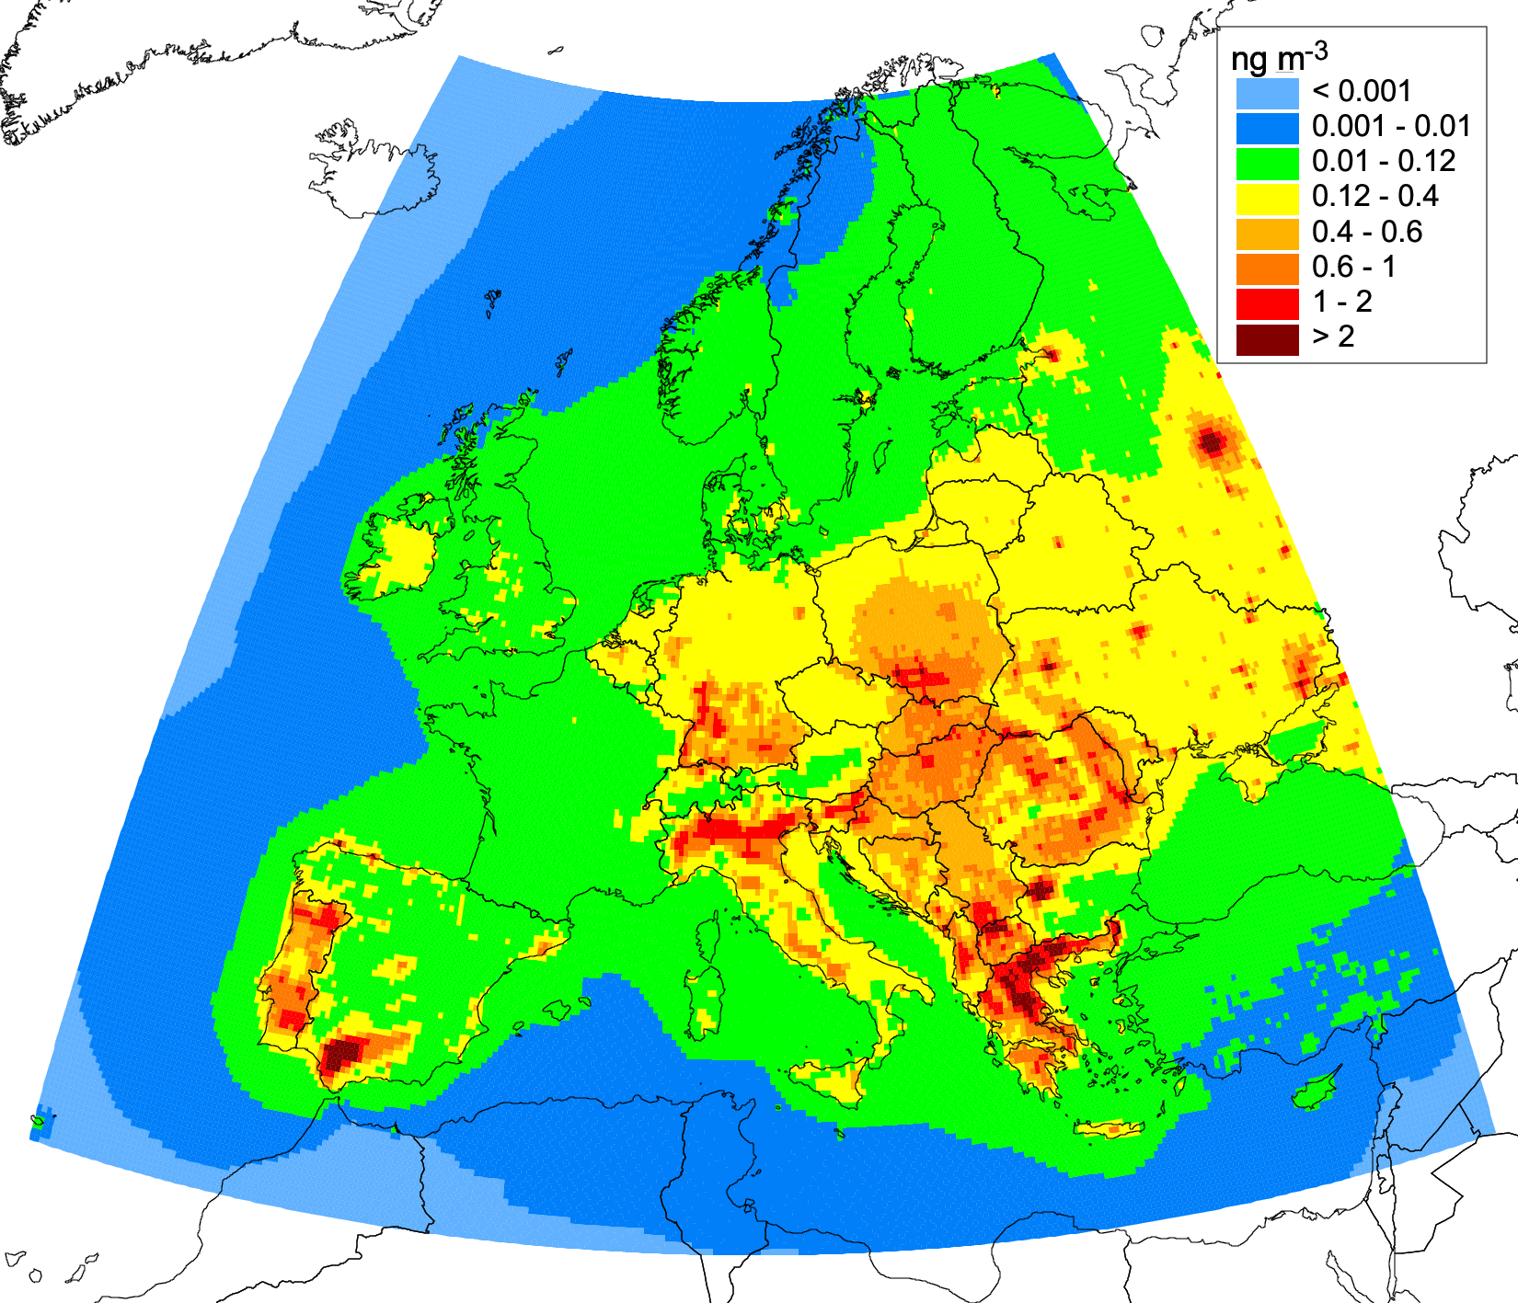
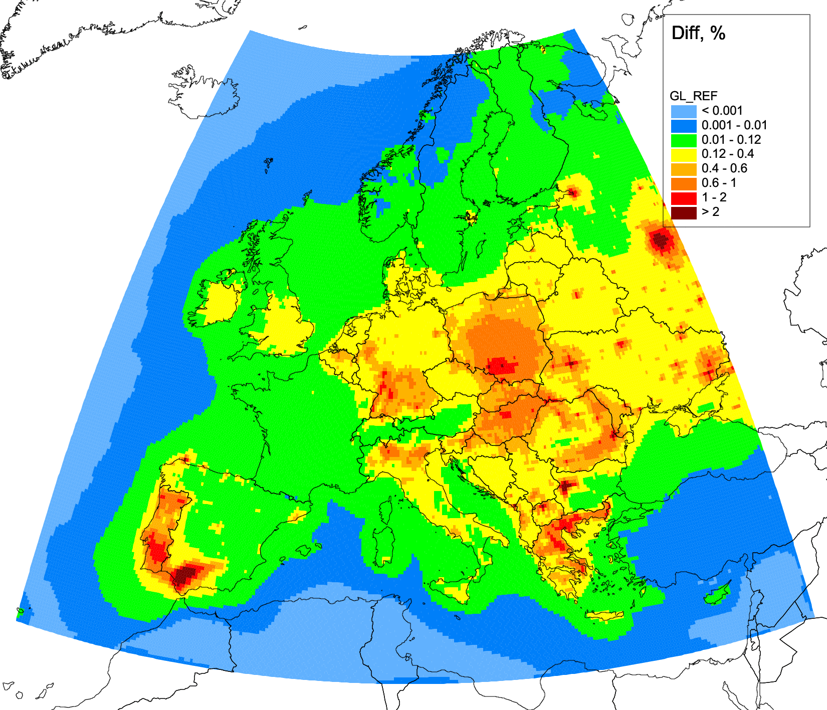
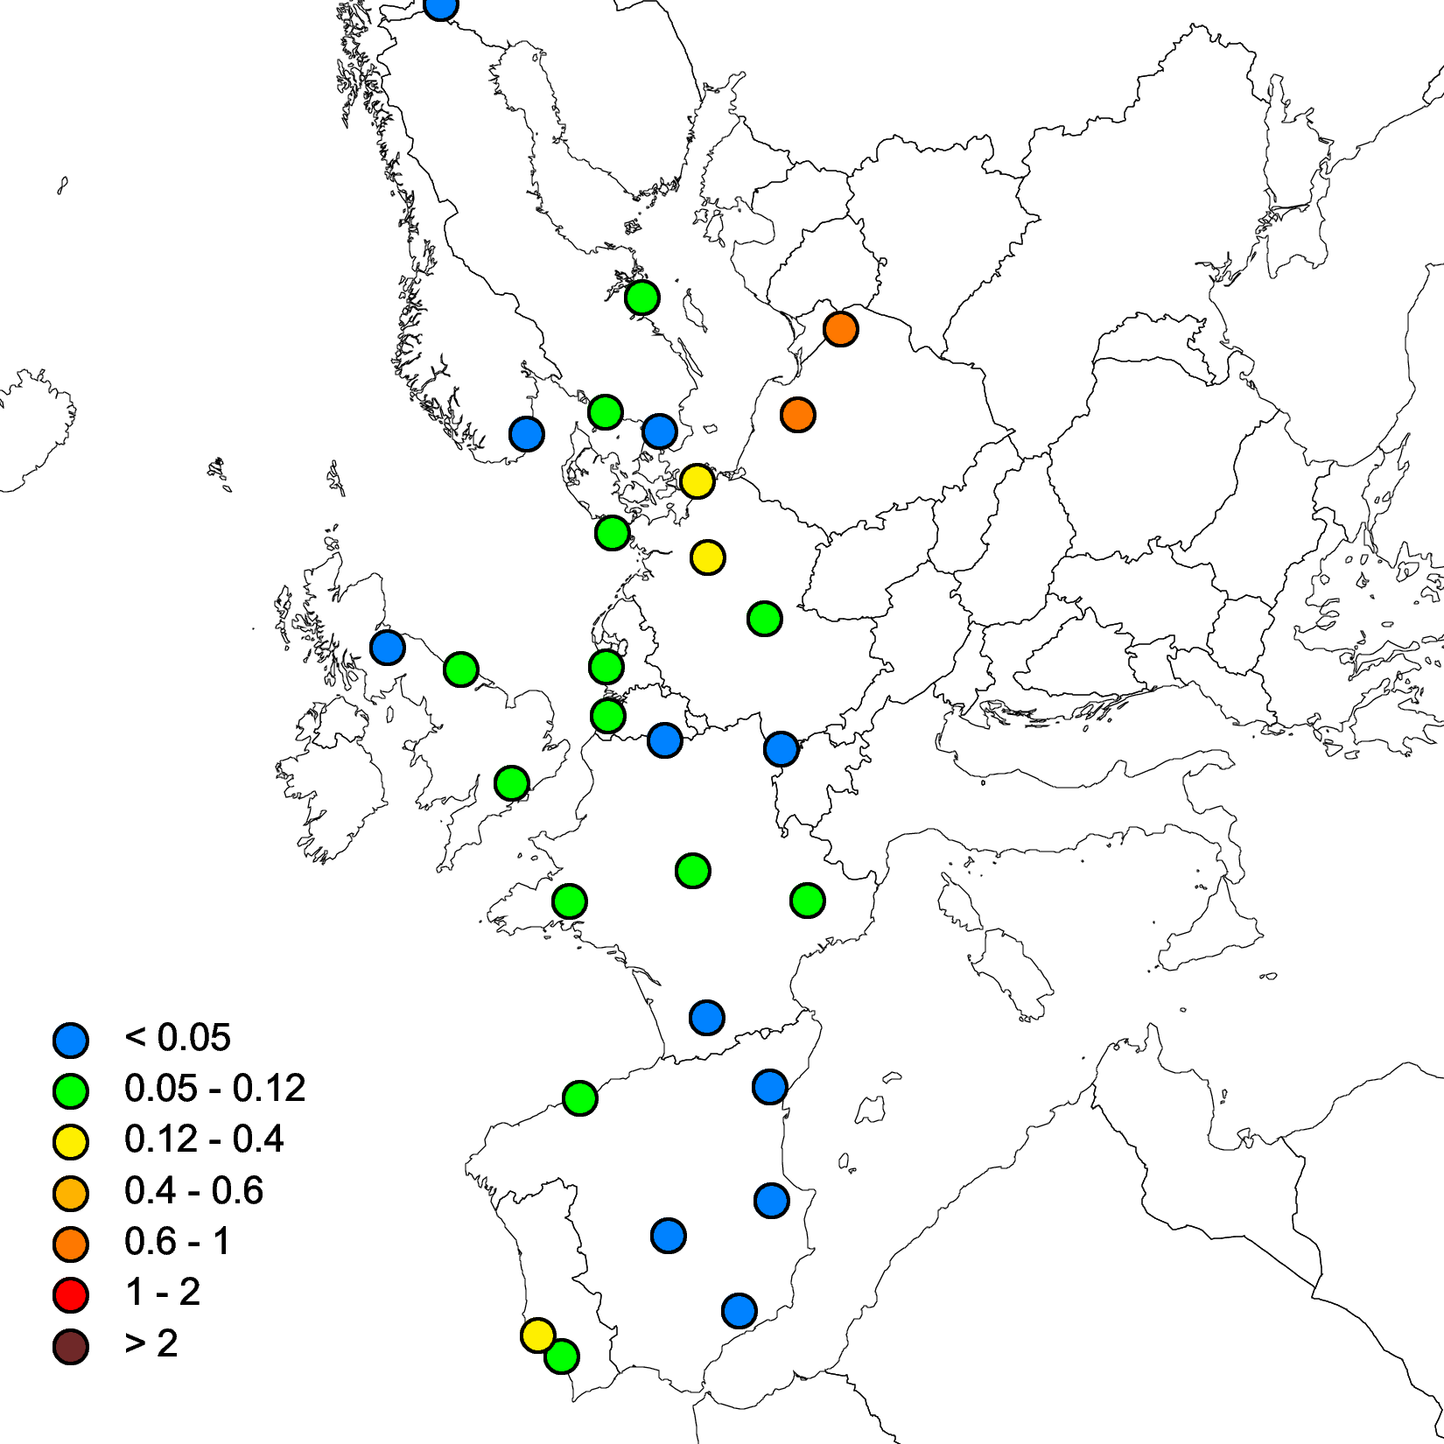
Test B(a)P simulations using CHIMERE and GLEMOS models
Reference model runs
Model run | Description
Reference | Base case parameterizations
Air Surface Exchange | Inclusion of B(a)P air-surface exchange
Degradation | Degradation of B(a)P in gaseous phase – reactions with OH, O₃, NO₃, Degradation in particulate phase - ROI-T model, Mu et al., 2018
Partitioning | Dual OM&BC GPP scheme (Dachs and Eisenreich, 2000), Adsorption to BC following (Lohmann and Lammel, 2004)
No adsorption to EC | Testing importance of adsorption to BC - Dual OM&BC GPP scheme excluding adsorption to BC
CHIMERE
GLEMOS
EMEP B(a)P measurements

Slide 8
Test B(a)P simulations using CHIMERE and GLEMOS models
Gas-particle partitioning scheme (GPP)
Air-surface exchange
Degradation in gas and particle phases
Exclusion of adsorption to BC
Air-surface exchange and change of GPP scheme show relatively small effect
Dual OM&BC model showed better agreement with measurements for both models
High sensitivity is shown to the inclusion of degradation (O₃, NO₃ and ROI-T)
Exclusion of adsorption to BC in GLEMOS ands CHIMERE shows different results and requires further analysis
Inter-comparison of B(a)P models using data of EMEP/ACTRIS intensive measurement period can be important for models validation

Slide 9
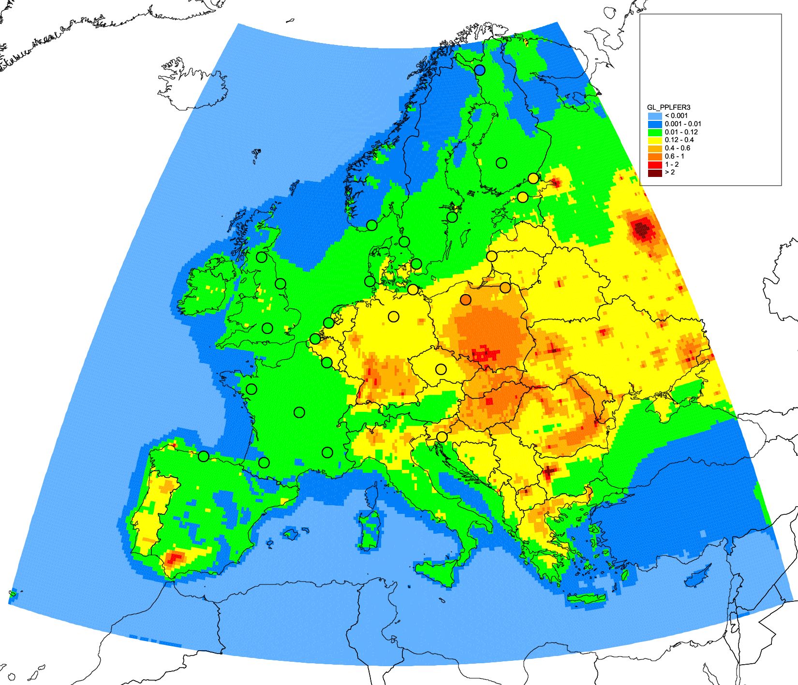
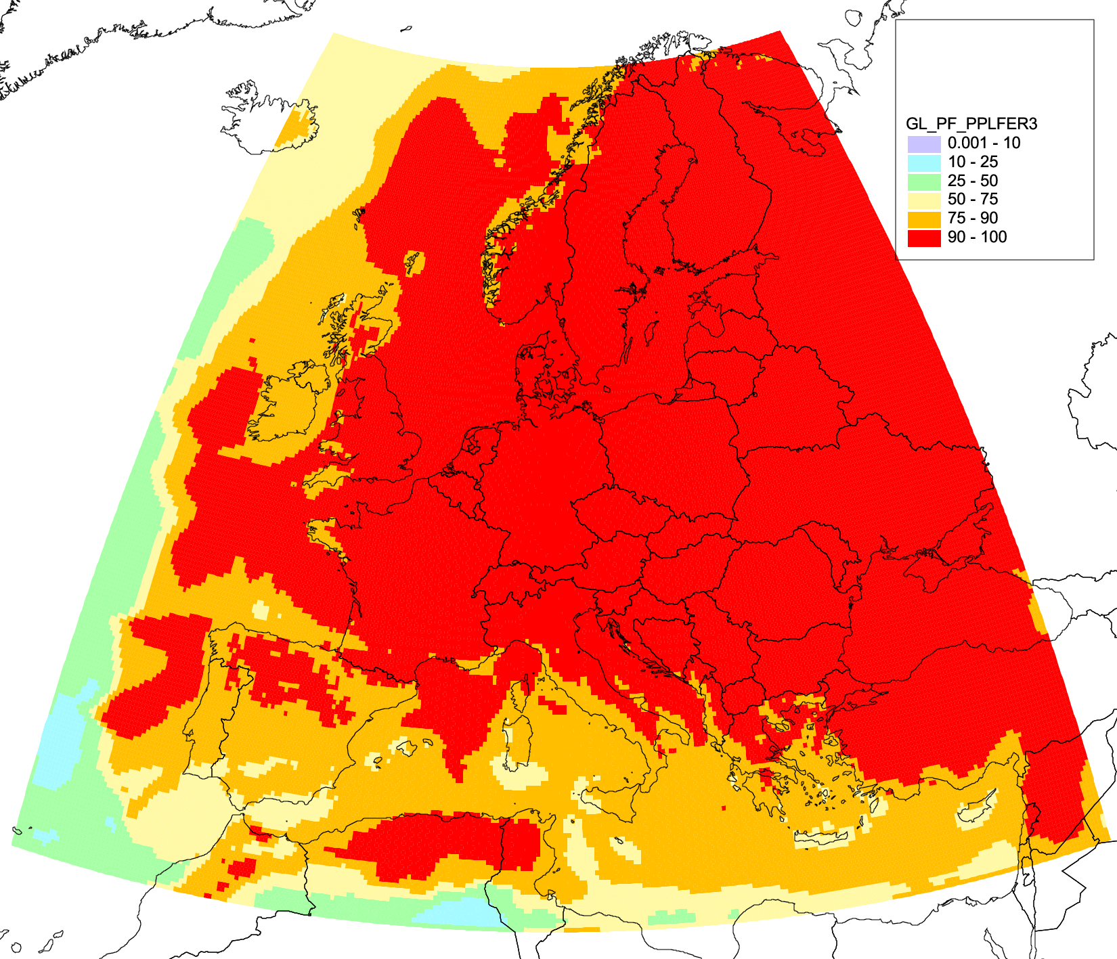
Testing of PPLFER gas-particle partitioning using GLEMOS
GPP scheme based on poly-parameter linear free energy relationships (Shahpoury et al, 2016)
Main features:
differentiates between various organic and inorganic phases of PM
includes both absorption to OM and adsorption to BC processes
analysis of PPLFER results suggested that absorption to various OM phases could dominate in overall partitioning process
Statistical parameters of agreement with EMEP measurements
Typically observed fraction of B(a)P in particulate phase > 80%
Substance | Reference | PPLFER scheme
NMB, % | -3.08 | 31.0
Correlation | 0.84 | 0.88
Fraction of B(a)P in particle phase
B(a)P air concentrations (ng m⁻³)

Slide 10
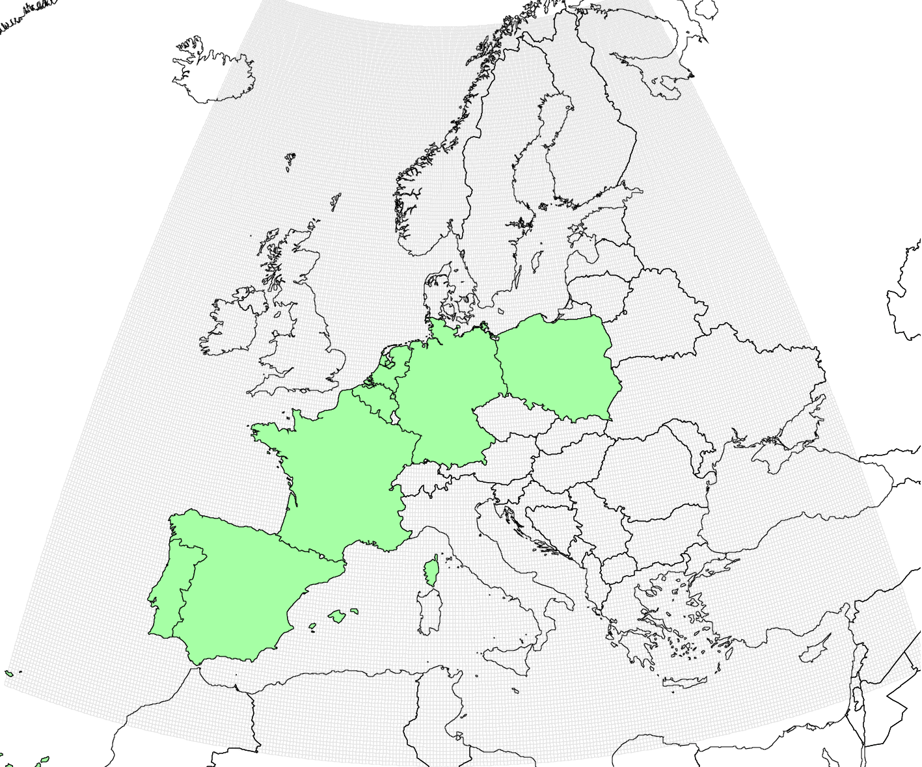
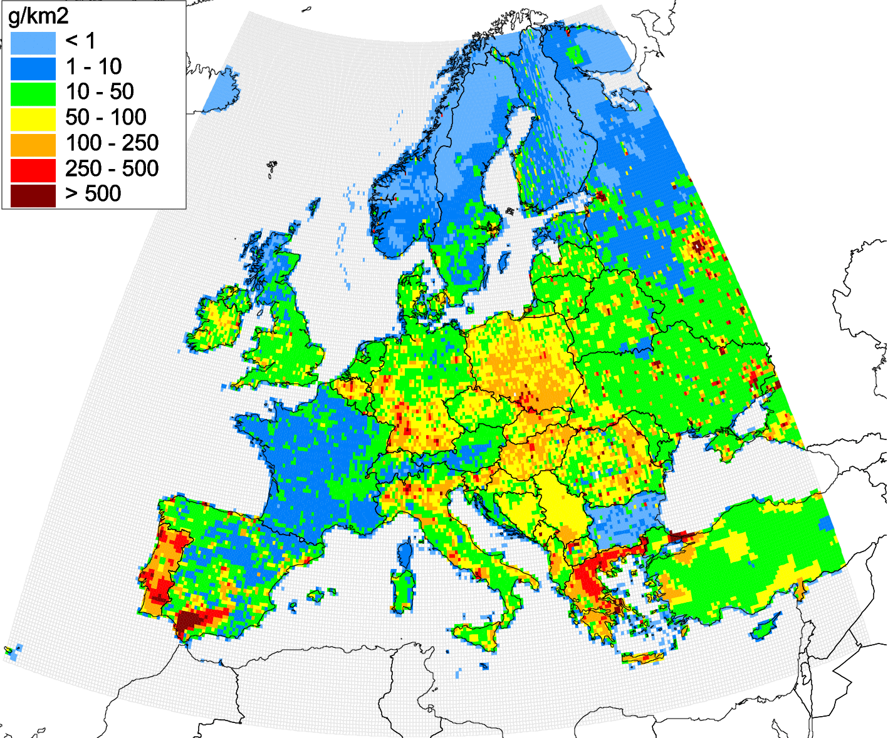
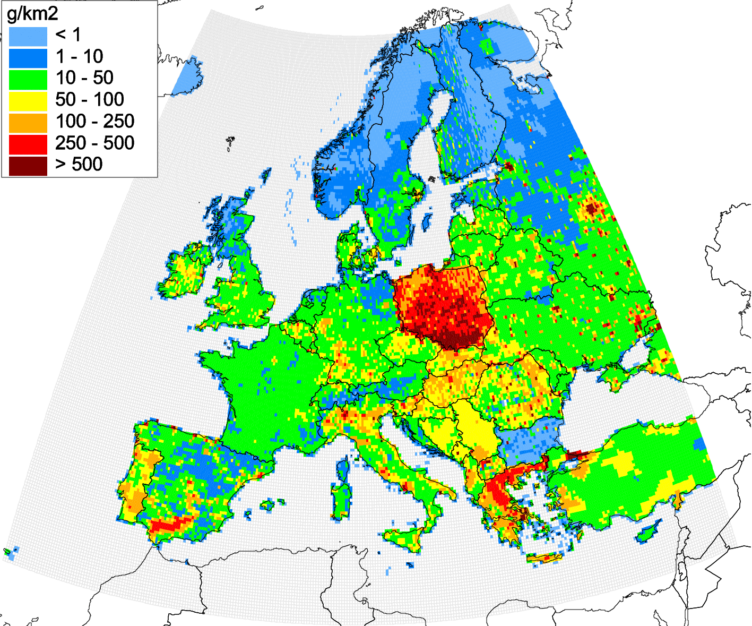
Case study on B(a)P pollution: scenario modelling
Aim:
Explore possibility to improve B(a)P pollution assessment using experimental emission scenario
Main features:
Sectors considered: Residential combustion (PL, FR, DE, BE, NL) and Agriculture (ES, PT)
Scaling coefficients were based on difference with TNO inventory for PL, ES, PT and expert estimates for FR, DE, BE, NL
Selected countries
BASE CASE
Increased
SCENARIO
Decreased
138 t
Annual B(a)P emissions (2015)
Annual B(a)P emissions (2015)

Slide 11
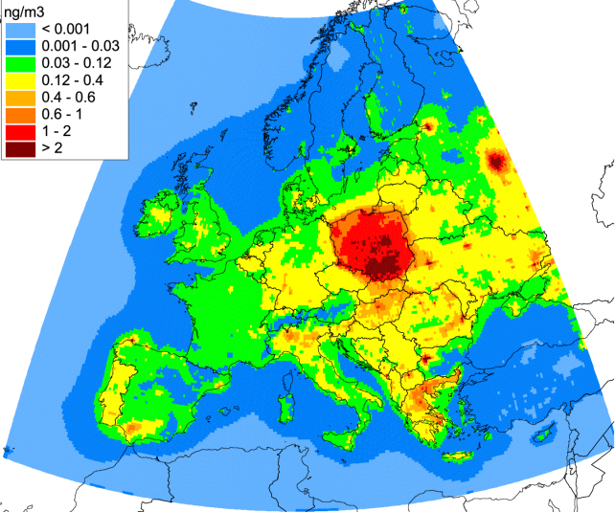
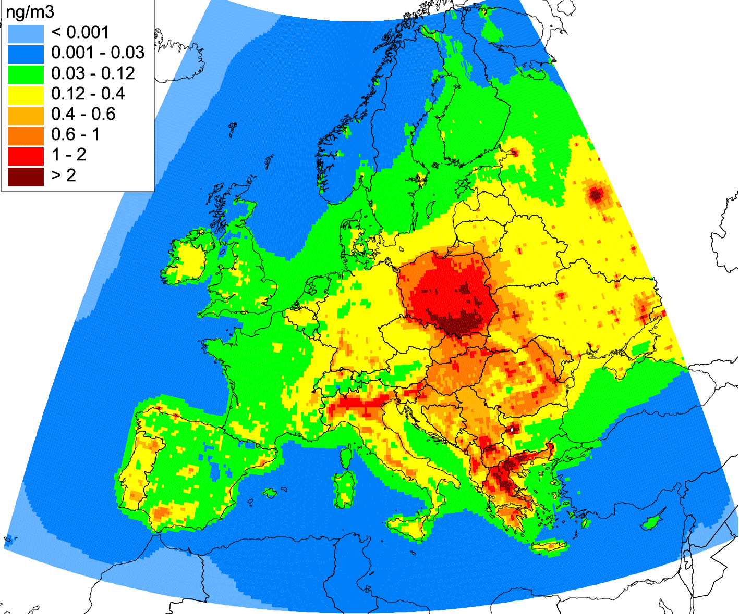
Evaluation of model results for scenario B(a)P emissions
Comparison of modelled and observed concentrations for EMEP monitoring sites
SCEN (GLEMOS)
SCEN (CHIMERE)
Modelled B(a)P air concentrations for 2015
 | GLEMOS |  | CHIMERE
Model run | Reference | Scenario | Reference | Scenario
NMB, % | 4.8 | 29.8 | -5.8 | 29.7
Correlation | 0.40 | 0.90 | 0.62 | 0.94
Modelling with coarse emission scenario showed better agreement with measurements comparing to modelling with official emission data

Slide 12
Evaluation of model results for scenario B(a)P emissions
Comparison of modelled and observed concentrations for EMEP monitoring sites
GLEMOS
CHIMERE
 | GLEMOS |  | CHIMERE
Model run | Reference | Scenario | Reference | Scenario
NMB, % | 4.8 | 29.8 | -5.8 | 29.7
Correlation | 0.40 | 0.90 | 0.62 | 0.94
Modelling with coarse emission scenario showed better agreement with measurements comparing to official emission data

Slide 13
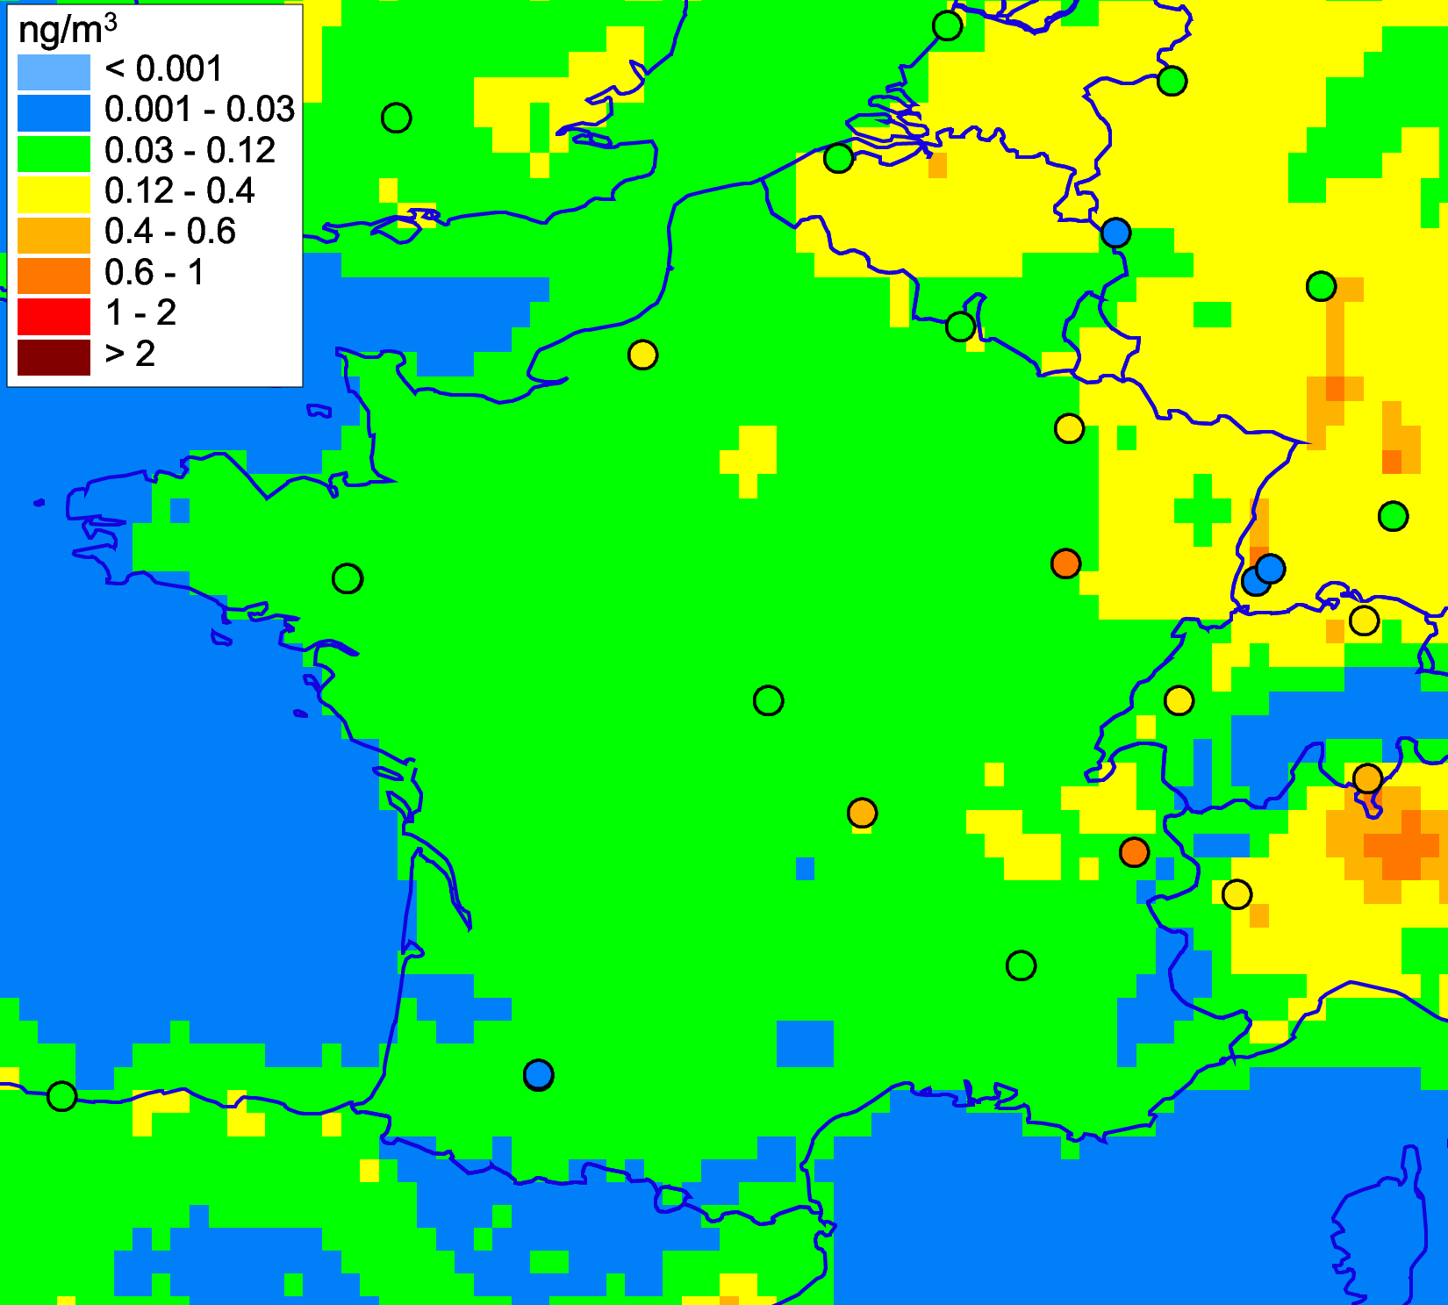
Evaluation of model results for scenario B(a)P emissions
Comparison of modelled and observed concentrations for EMEP monitoring sites in France
SCEN (GLEMOS)
FR9
FR24
FR25
FR23
FR13
Modelled B(a)P air concentrations over France for 2015
Overprediction
Improvement
Modelling with scenario emissions leads to both improvement and over-prediction of observed concentrations in France
Further work is required to analyze and refine spatial distribution of reported B(a)P emission data in co-operation with national experts and TFEIP

Slide 14
Concluding remarks on B(a)P pollution assessment
Analysis of B(a)P model parameterizations indicates importance of updating of model parameterizations for gas-particle partitioning and degradation processes
Scenario modelling shows potential uncertainties in official emissions of selected countries with respect to emission totals and spatial distribution
Model results based on official emissions for 2017 still have overestimation of B(a)P for DE, BE, and NL, and underestimation for PL and FR
Results of B(a)P pollution assessment will be used as contribution to the analysis of the POP Protocol effectiveness in co-operation with TFTEI and be presented at WGSR meeting
Averaged modelled vs observed B(a)P air concentrations at AirBase sites in 2017
(background rural and remote monitoring sites)

Slide 15
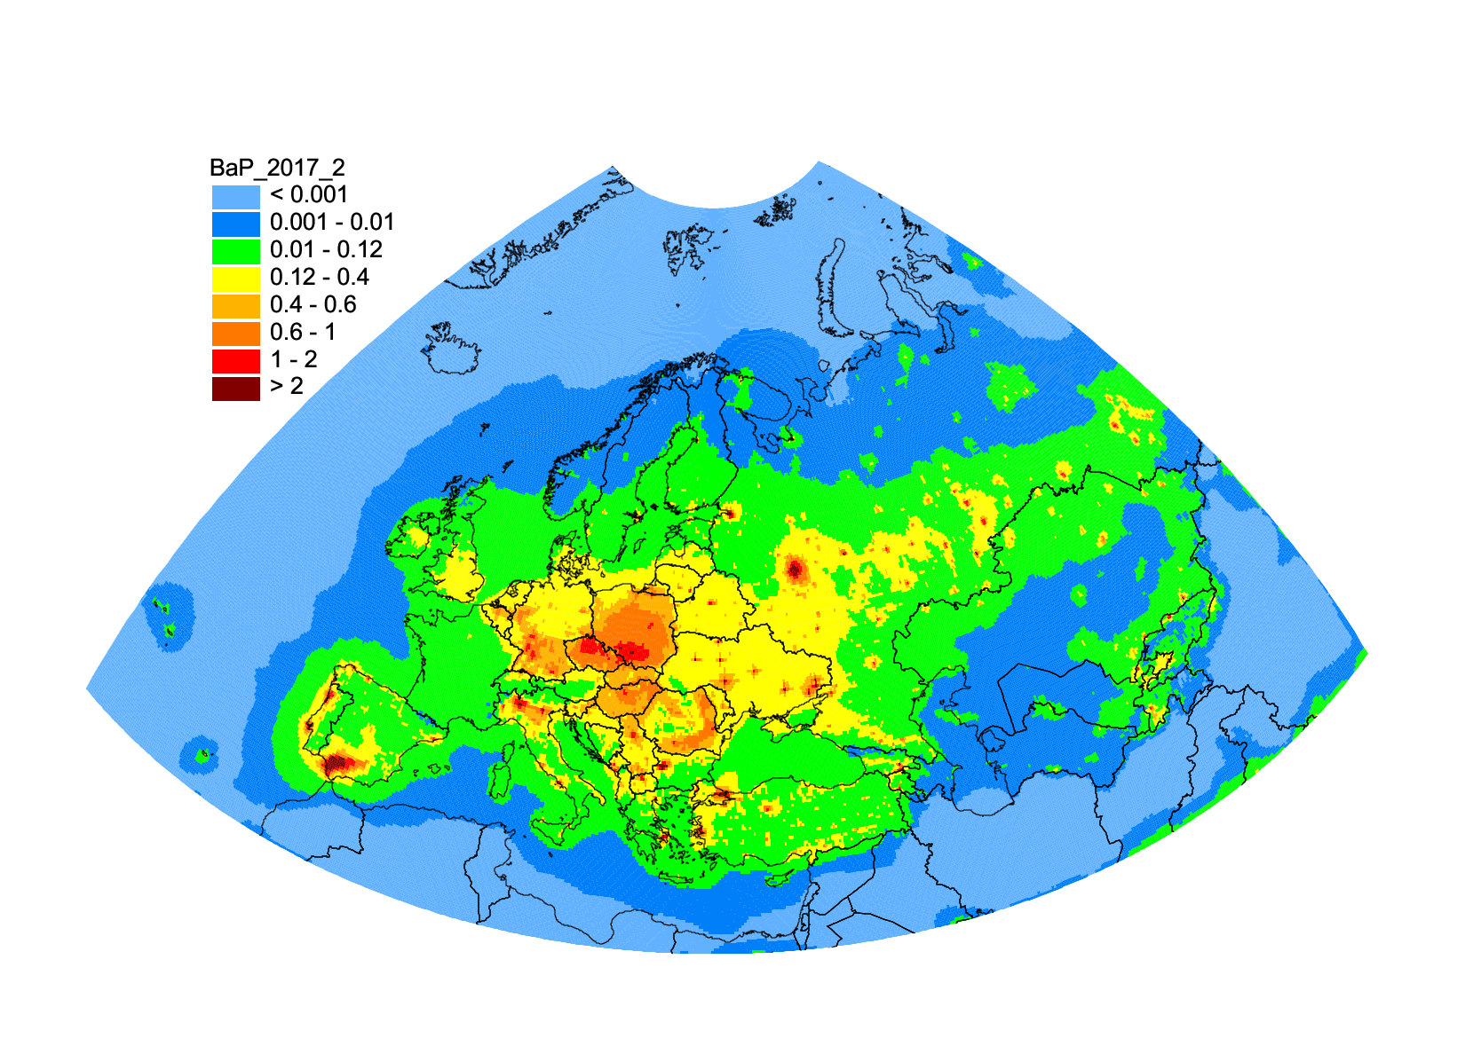
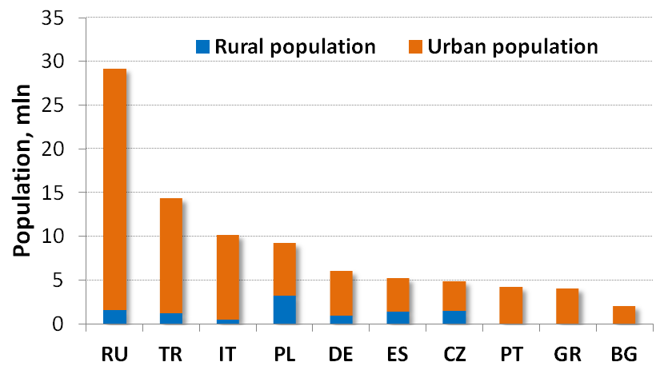
Human exposure to high B(a)P levels
Model assessment of target value exceedances of B(a)P air concentration
B(a)P air concentration (2017)
Population in areas with exceeded EU target value (1 ng/m³) for B(a)P
Exceedances of B(a)P limits in EMEP countries:
EU target value (1 ng/m³) | 18% of urban (11% of total) population
WHO reference level (0.12 ng/m³) | 47% of urban (75% of total) population
Information on exceedances can be delivered to TF Health/WHO PAH group

Slide 16
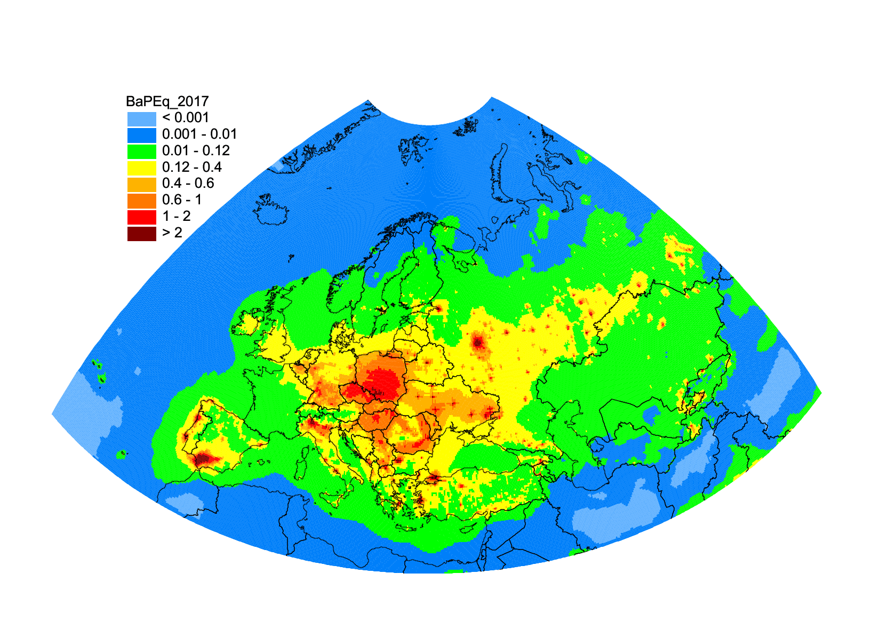
Evaluation of human exposure to mixture of PAHs
Evaluation of human exposure to toxic compounds of PM (PAHs) needs taking into account their joint toxicity and cumulative health risk (Liu et al., 2019; Delgado-Saborit et al., 2011)
Application of B(a)P-toxic equivalent factors (TEF) to PAH concentrations can provide a more accurate risk assessment of exposure to mixtures of PAHs
Calculation of B(a)P-TEQ :
BaP-TEQ_{eq} = Σ PAH_{i} * TEF_{i}
PAH compound TEF
Benzo[a]pyrene 1.0
Benzo[b]fluoranthene 0.1
Benzo[k]fluoranthene 0.1
Indeno[1,2,3-c,d]pyrene 0.1
B(a)P-equivalent air concentrations of 4 PAHs for 2017 (ng m⁻³)

Slide 17
Updates of POP multi-media modelling
Improvement of POP parameterizations with focus on HCB secondary sources
Motivation:
HCB is among priority POPs in the Long-term strategy of the Convention
HCB in air is found to increase at some EMEP sites during the last five to ten years
National inventories of HCB emissions contain substantial uncertainties (e.g. emissions due to presence of HCB impurities in pesticides often missing)
Large contribution of secondary emissions to POP pollution levels within EMEP
High uncertainties of existing estimates of HCB secondary emissions (re-emission )
HCB at the EMEP monitoring sites
HCB air concentration
EMEP secondary sources
EMEP anthropogenic sources
Global anthropogenic sources
Global secondary sources

Slide 18
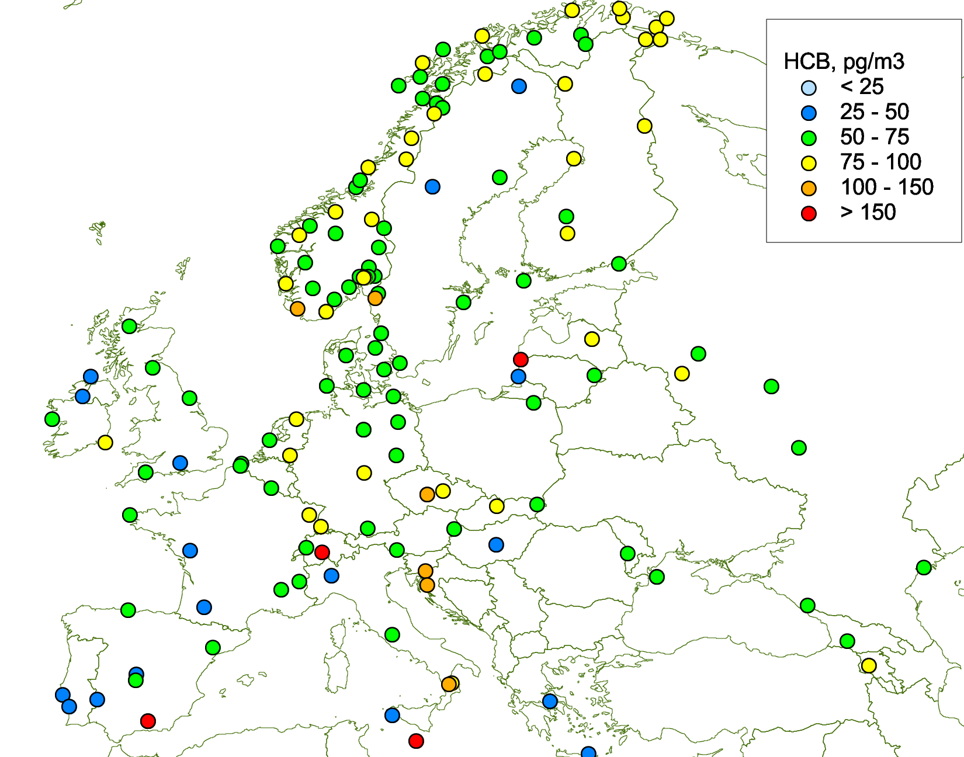
Updates of POP multi-media modelling
Improvement of POP parameterizations with focus on HCB secondary sources
MSC-E/CCC joint study:
Scenario modelling of HCB long-term (1945-2017) accumulation and re-emission
Update of HCB model parameterizations in GLEMOS for soil compartment
Use of data from POP Passive Sampling campaign (CCC) for evaluation of model results
HCB accumulation in media
HCB in air
2016
Passive sampling of HCB in air (preliminary results)

Slide 19
On-going international co-operation
Arctic Monitoring and Assessment Programme (AMAP)
  Contribution to the AMAP Assessment of POP Pollution of the Arctic region (2019)
Stockholm Convention (SC)
  Contribution to the SC effectiveness evaluation regional WEOG and Global assessment reports (2019-2021)
Helsinki Commission (HELCOM)
  Assessment of atmospheric load of HMs and POPs to the Baltic Sea (HMs, PCDD/Fs)
European Chemical Agency (EU regulation “Registration, Evaluation, Authorisation and Restriction of Chemicals”, REACH)
  Information exchange on toxicity of HMs and POPs

Slide 20
Proposals for bi-annual work-plan (2020/2021)
National scale pollution assessments (co-operation with countries)
  Initiate studies on B(a)P pollution in Poland and Croatia (2020-2021)
Contribution to the evaluation of effectiveness of POP Protocol (co-operation with TFTEI)
  Analysis of trends and key sources of B(a)P pollution
Research and model development
  Assessment of POPs multi-media transport and contribution of secondary emissions to pollution of the EMEP countries
  Intercomparison of B(a)P models based on data of 2018 winter period monitoring campaign
  Co-operation with Working Group on Effects
  Data exchange with TF Health on B(a)P/PAH concentration and exceedances of target values
  Potential co-operation with JEG-DM on POP cycling and accumulation in the environmental media
  Co-operation with other international organizations
  AMAP, HELCOM, SC

