Slide 1
Research of heavy metal pollution on regional (EMEP) and national (Germany) scales
Ilyin I, Travnikov O.
EMEP/MSC-E

Slide 2
Outline
Research and development of GLEMOS model
  Mercury chemistry
  Multi-media modelling
Analysis of pollution levels in the hot spots of the EMEP region using observations and modelling results
Investigation of national-scale HM pollution levels
(case study for Germany)
Cooperation with WGE: new model output to support research
on effects for biota and human health
Future plans

Slide 3
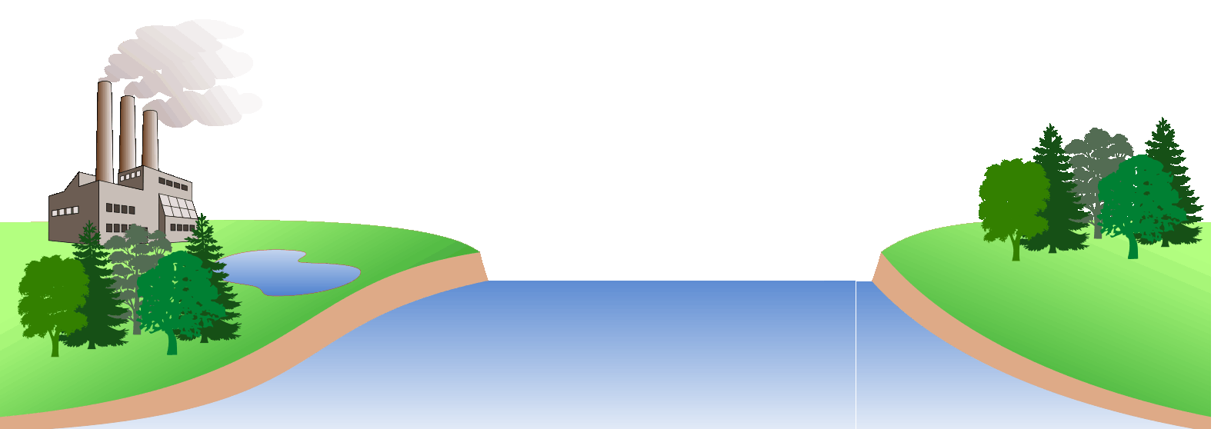

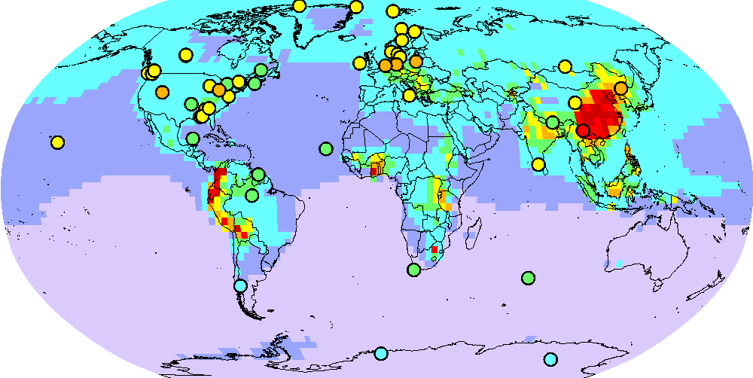
Development of GLEMOS model
Model study of Hg atmospheric chemistry
Br, OH, HO₂, NO₂, …
Hg atmospheric chemistry:
Chemistry is critical for Hg atmospheric cycle
Important role of Br-initiated oxidation of Hg in the atmosphere (but still uncertain)
Two-step reaction with formation of unstable intermediate (HgBr)
Pure oxidation of Hg⁰ leads to large underestimation of observations
A mechanism of Hg^{II} reduction should exist
Br
oxidation
Hg^{II}
Hg⁰
Hg^{I}Br
?
emission
deposition
Hg⁰ concentration (no reduction)
Notes:
3

Slide 4
Development of GLEMOS model
Model study of Hg atmospheric chemistry
Study of a new photo-reduction mechanism
Br, OH, HO₂, NO₂, …
Hg⁰
Br
Hg^{I}Br
Hg^{II}BrX
hν
hν
pathway II
pathway I
International research group (EMEP/MSC-E, Spain, France, Canada, USA, UK)
Theoretical calculations (Spain) show possibility of 2 photo-reduction pathways
MSC-E performed model evaluation (GLEMOS) of the new mechanism
Results published in Nature Communications (Saiz-Lopez et al., 2018)
Notes:
4

Slide 5
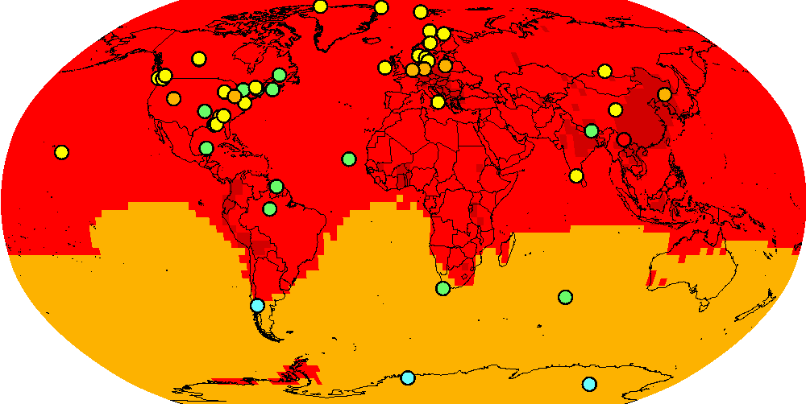
Development of GLEMOS model
Model study of Hg atmospheric chemistry
Study of a new photo-reduction mechanism
Br, OH, HO₂, NO₂, …
Pathway I
Hg⁰
Br
Hg^{I}Br
Hg^{II}BrX
Hg⁰ concentration
hν
pathway I
International research group (EMEP/MSC-E, Spain, France, Canada, USA, UK)
Theoretical calculations (Spain) show possibility of 2 photo-reduction pathways
MSC-E performed model evaluation (GLEMOS) of the new mechanism
Results published in Nature Communications (Saiz-Lopez et al., 2018)
Hg⁰ concentration
Hg wet deposition
Notes:
5

Slide 6
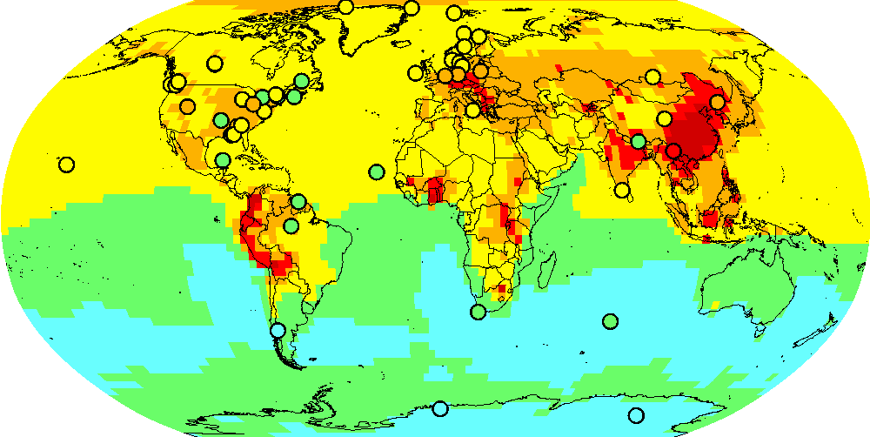
Development of GLEMOS model
Model study of Hg atmospheric chemistry
Study of a new photo-reduction mechanism
Br, OH, HO₂, NO₂, …
Pathway II
Hg⁰
Br
Hg^{I}Br
Hg^{II}BrX
Hg⁰ concentration
hν
pathway II
International research group (EMEP/MSC-E, Spain, France, Canada, USA, UK)
Theoretical calculations (Spain) show possibility of 2 photo-reduction pathways
MSC-E performed model evaluation (GLEMOS) of the new mechanism
Results published in Nature Communications (Saiz-Lopez et al., 2018)
Hg⁰ concentration
Hg wet deposition
Notes:
6

Slide 7
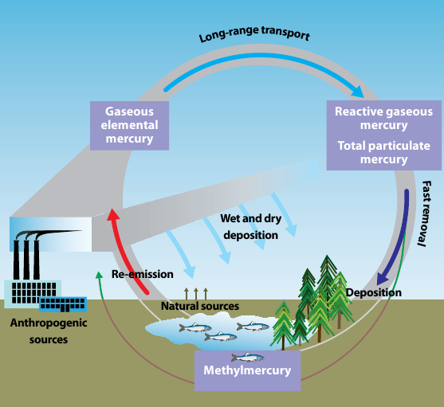
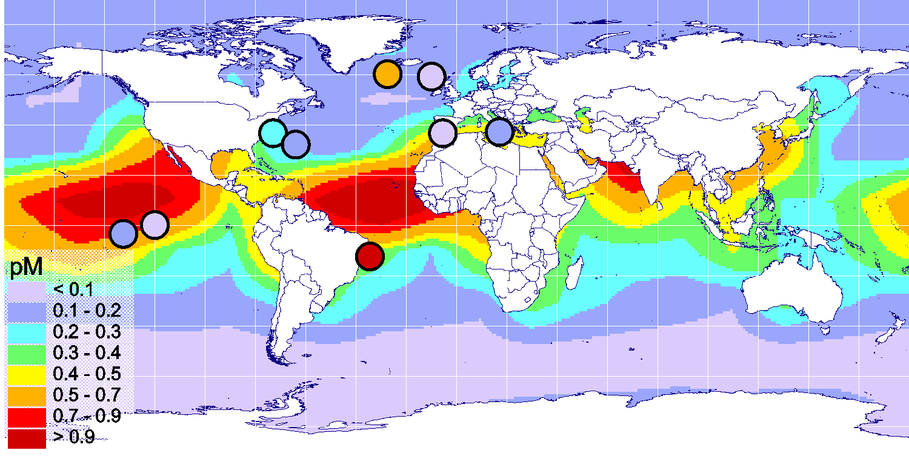
Mercury multi-media modelling
Development of GLEMOS model
Initial development of multi-media modelling approach for Hg
Hg cycling in the environment
Motivation:
Mercury easily cycles between the atmosphere and water/soil/vegetation
Legacy/natural sources make up 65% of Hg deposition within EMEP
Time lag between Hg emission reduction and response of Hg media levels and exposure
UNEP/AMAP, 2008
On-going work:
Development of Hg media modules for GLEMOS (ocean, soil, vegetation)
Assessment of long-term Hg accumulation in media since pre-industrial times
Evaluation against observations
Hg⁰_{aq} in seawater (pilot results)
Notes:
7

Slide 8
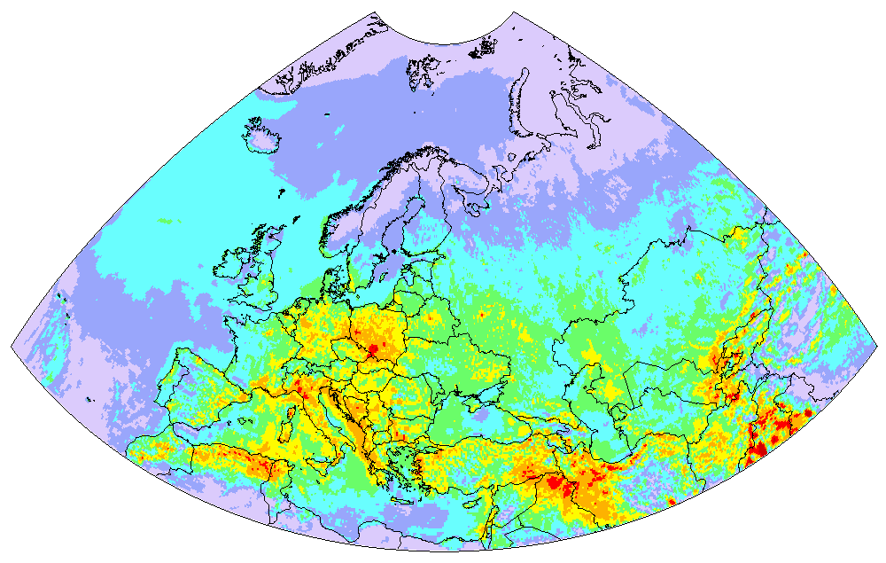
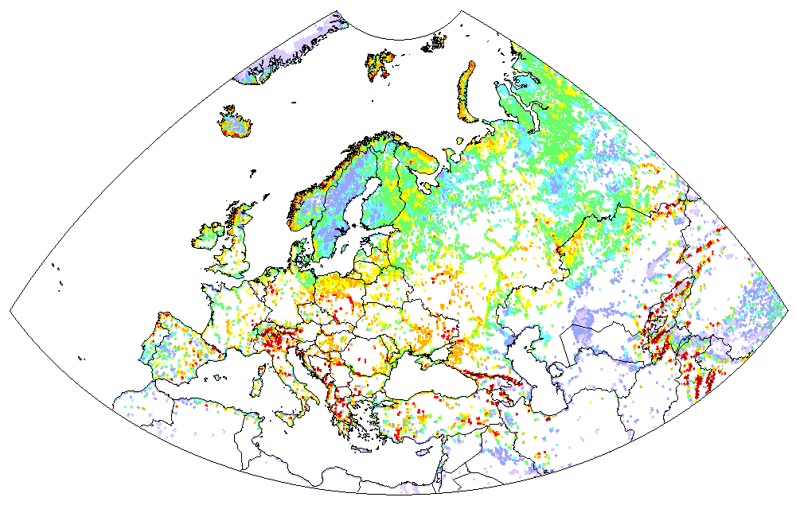
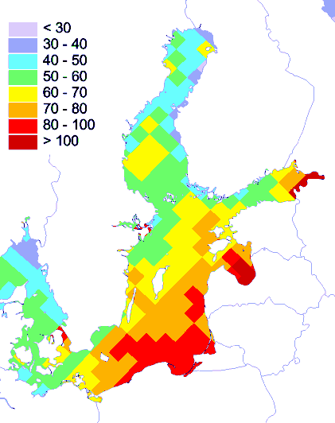
Operational modelling: output results for EMEP
Standard EMEP output (new grid):
Pb deposition (2017)
Concentration/deposition maps
Cd deposition to Austria
Austria
PCDD/Fs deposition to the Baltic sea
Country-to-country transboundary transport
Others
Hg deposition to inland waters
Slovenia
Slovakia
ng TEQ/m²/y
Italy
Deposition to various LC types
Germany
Deposition to marginal seas and special regions (e.g. Arctic)
Poland

Slide 9
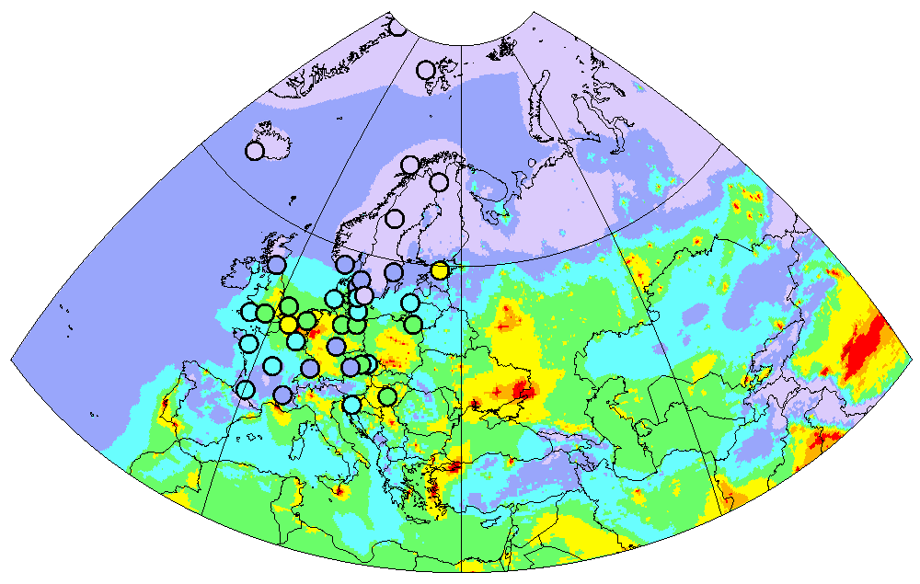
Analysis of hot spots
Analysis of hot-spots in the EMEP region
Cd air concentration (2016)
NL8
BE14
Detailed analysis of the results is ongoing

Slide 10
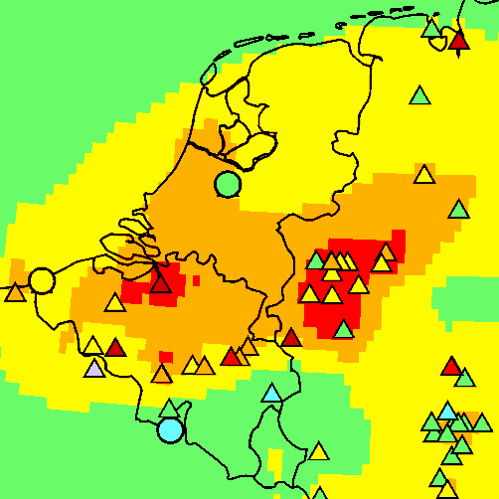
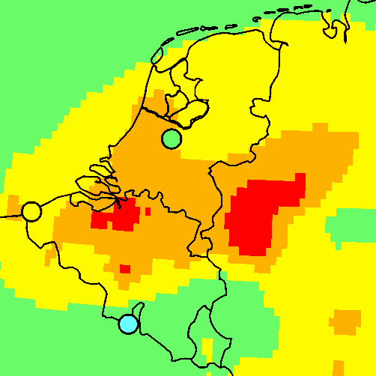
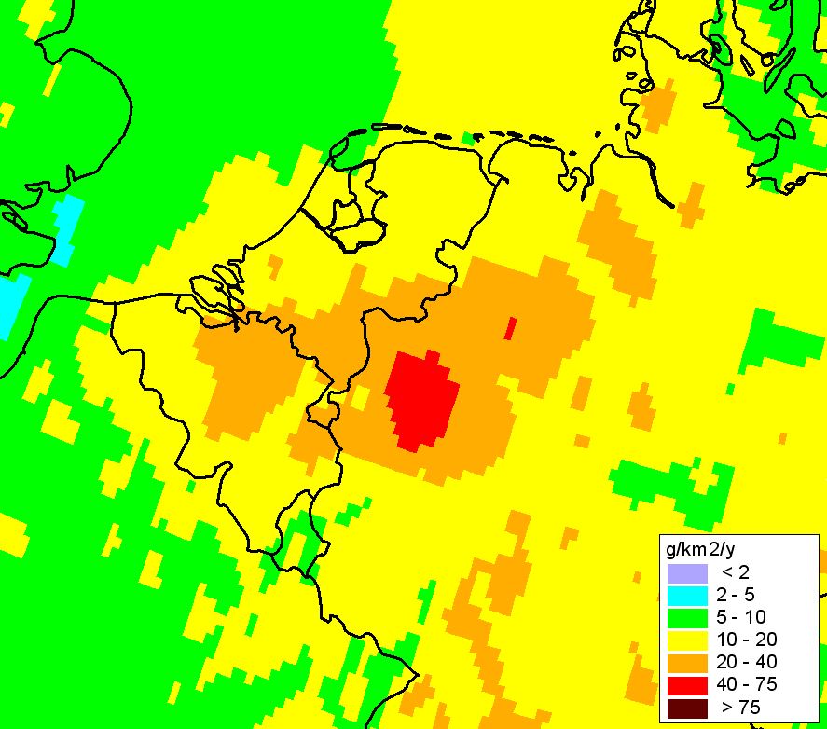
Analysis of hot spots
In-depth analysis of modeling results
Use of modelling and measurements for evaluation of pollution patterns
Cd concentration (Benelux)
Cd air concentration (2016)
NL8
AirBase
BE14
FR9
Cd wet depos.

Slide 11
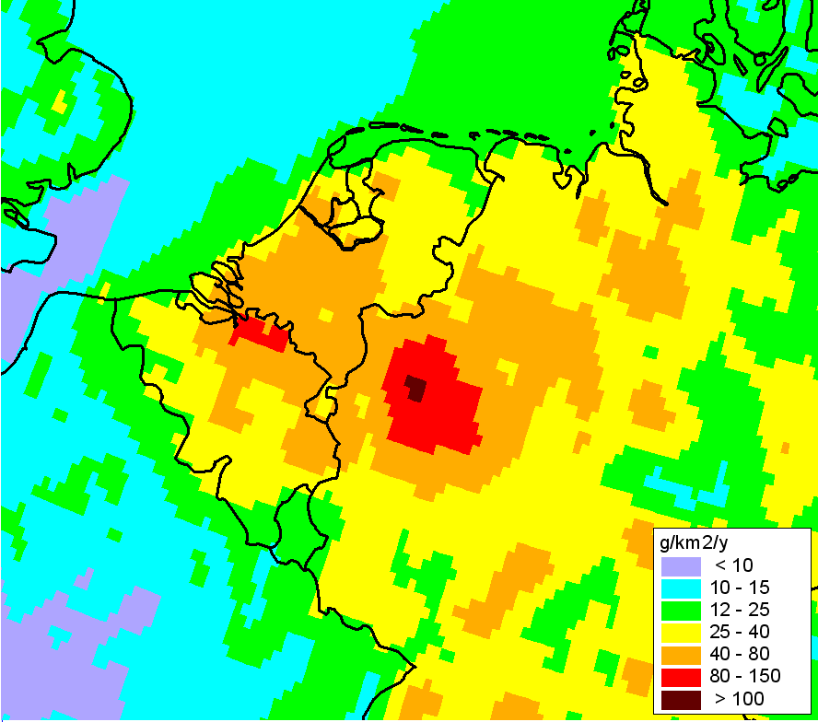
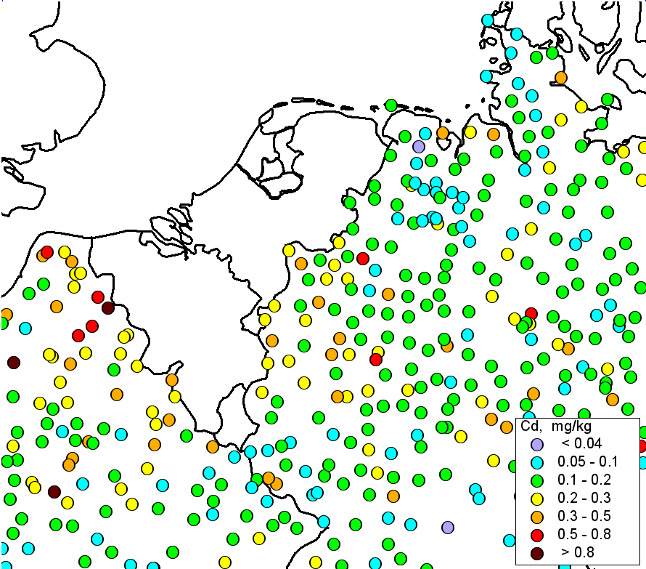
Analysis of hot spots
Modelled deposition vs. observed concentrations
in mosses
Cd total deposition
Cd conc. in mosses
No strong spatial gradients of concentrations in mosses

Slide 12
Analysis of hot spots
Experience from previous studies:
simulations of the LOTUS-Euros model
Cd, mean for 2007-2011
From: Schaap et al, 2018, Report No. (UBA-FB) 002635/E
Measurement
Simulation

Slide 13
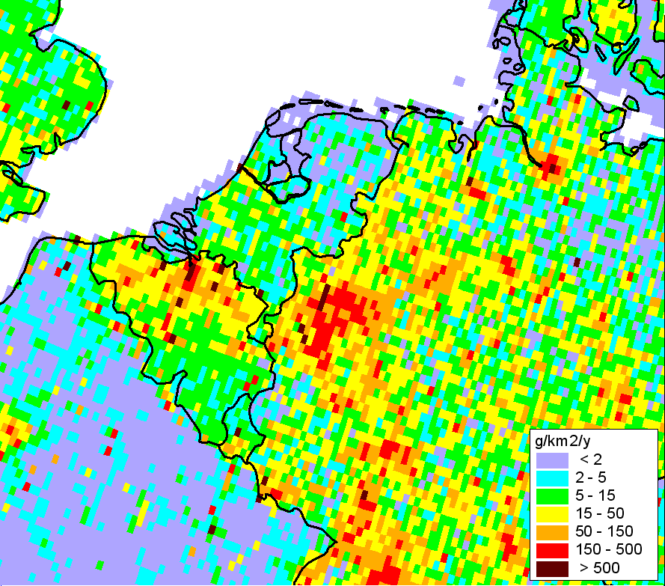
Analysis of hot spots
Main emission sectors in the Benelux / Western Germany region
The Netherlands
Germany
19%
6%
15%
9%
5%
9%
66%
71%
Belgium
Industry
16%
5%
Public power
Resid. combustion
13%
Other
66%
Cd EMEP emissions, 2016

Slide 14
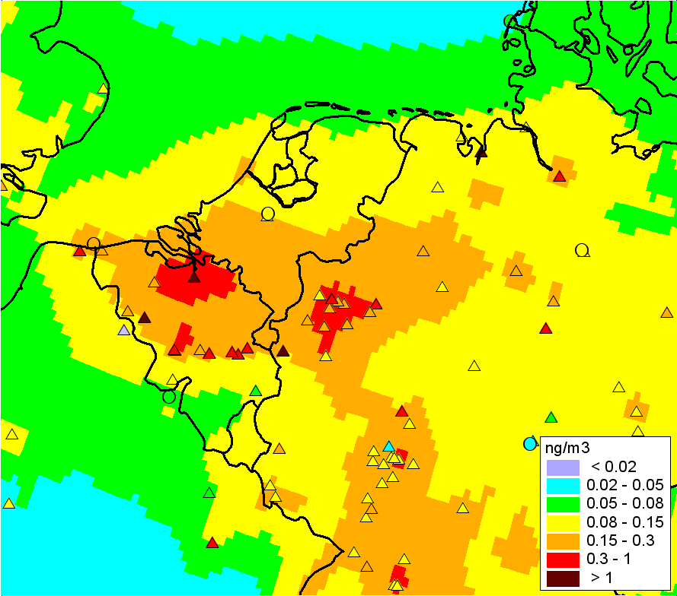
Analysis of hot spots
Contributions of emission sectors to modelled Cd air concentrations (anthrop. component)
Public power
Resid. combustion
Industry
Other sectors
Observed
Sector ‘industry’ – 50-70%;
Sector ‘industry’ – 60-70%;
Emission in the western part of Germany may be overestimated

Slide 15
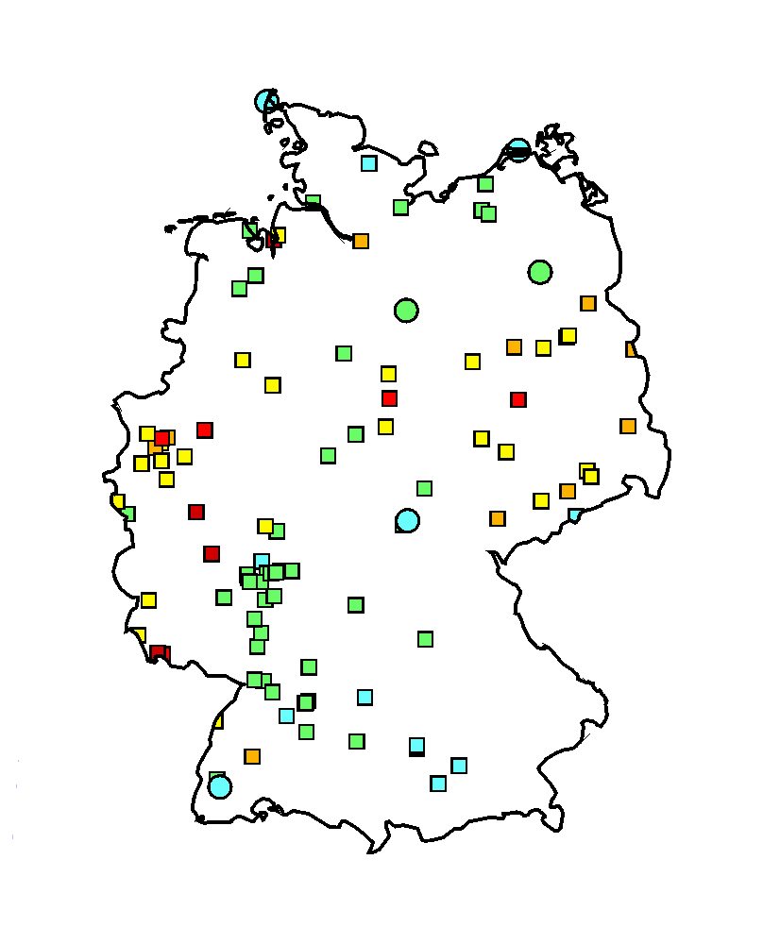

Case study for Germany
Case study for Germany
Case study on heavy metal pollution in Germany
Research program (2019-2020):
Collection of national input information (emissions, monitoring, etc.)
Detailed assessment of Hg, Pb and Cd
pollution in Germany in 2014-2016
Evaluation of modelling results vs. national and EMEP measurements
Analysis of model-to-measurement deviations, recommendations for improvement
Pb measurements in Germany (2016)
The project is partly funded by the country (Germany, UBA)

Slide 16
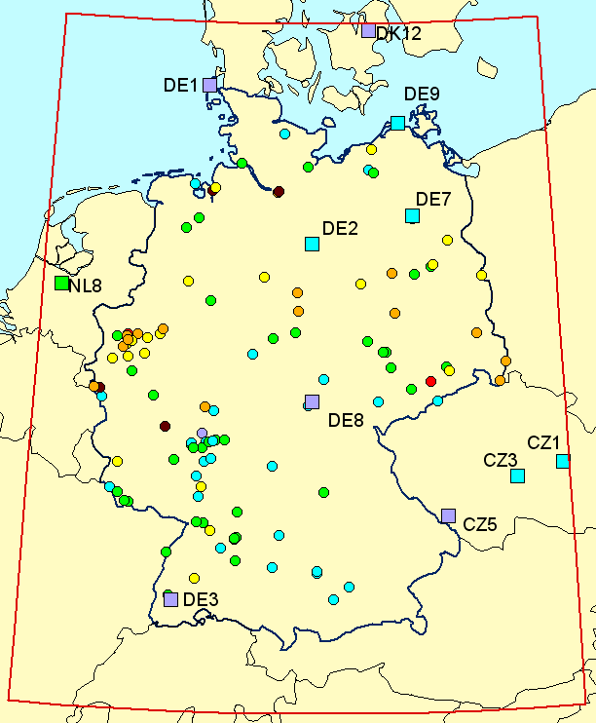
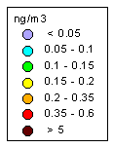
Case study for Germany
Measurement data (conc. in air)
EMEP: 11 stations
National: 119 stations
Industrial
Traffic
Backr. rural
and suburban
Cd concentrations in air, 2016
Backr. urban

Slide 17
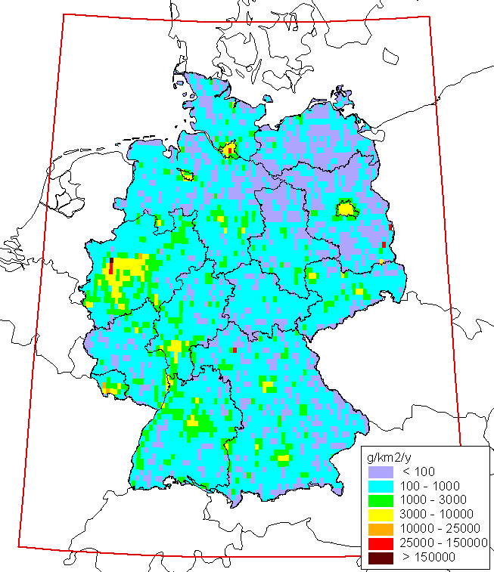
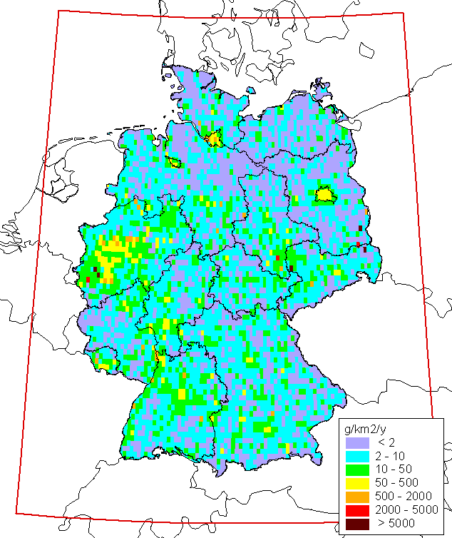
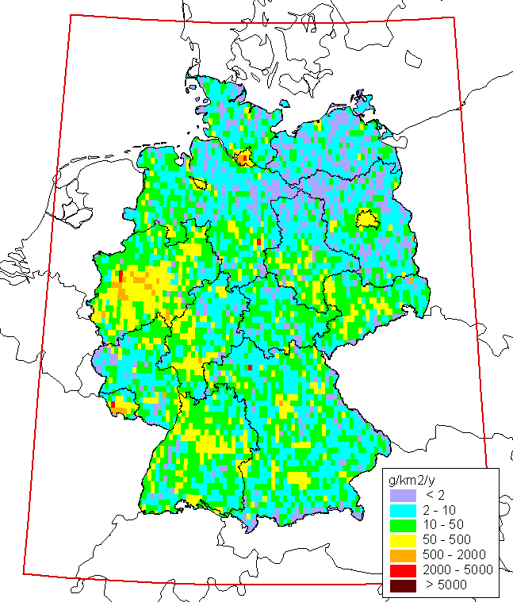
Case study for Germany
National data involved into the study
Emissions of Pb, Cd, Hg (2016)
Pb
Hg
Cd
Spatial resolution 0.1°x0.1°
Produced by DE (GRETA project)

Slide 18
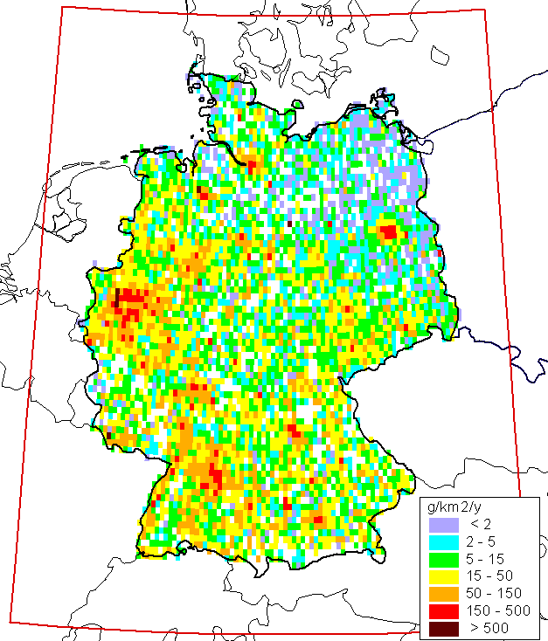
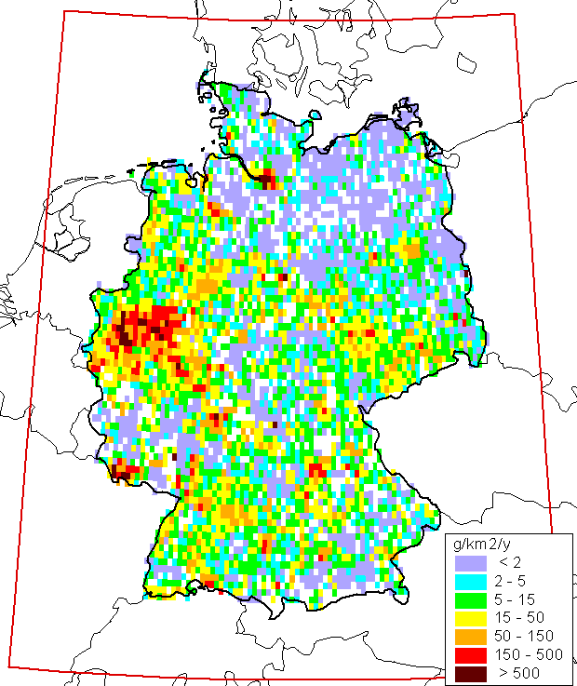
Case study for Germany
National data (Germany) compared to EMEP/CEIP data
Total sector emissions: the same in CEIP and National German data
Spatial distribution is different
Emissions of Cd in Germany, 2016 (sector Industry)
CEIP data
National data (DE)

Slide 19
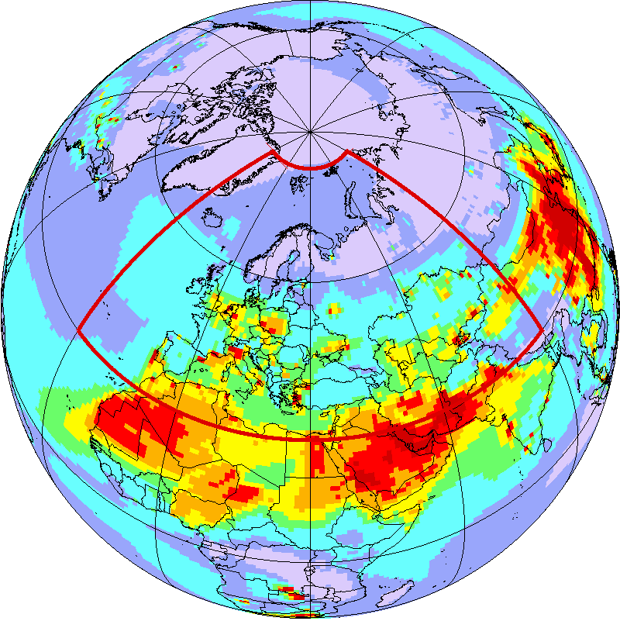
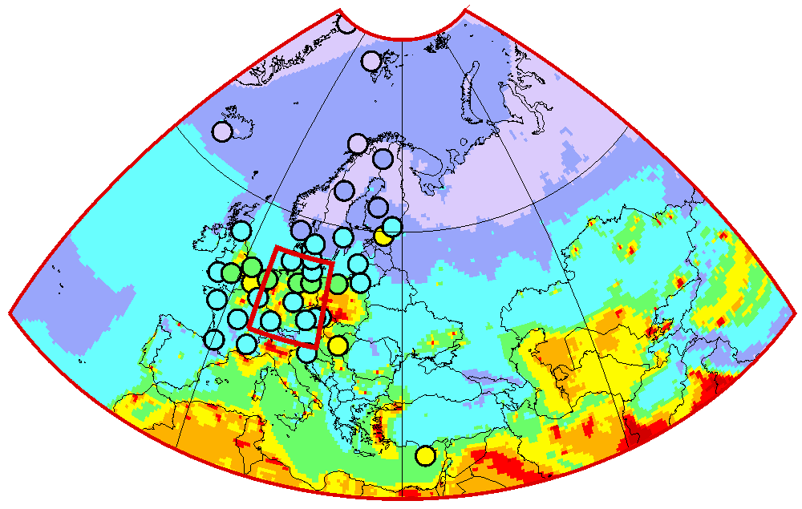
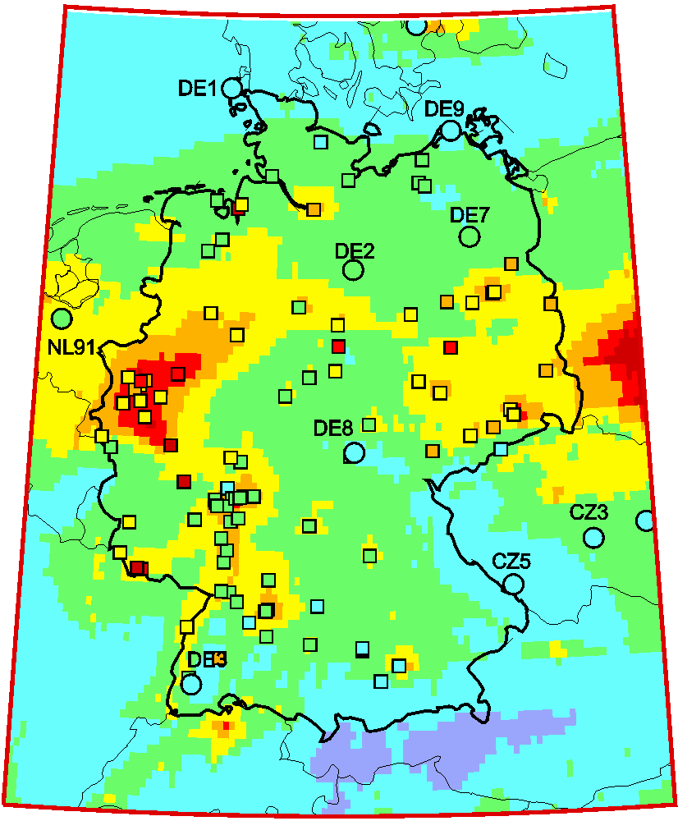
Case study for Germany
Model assessment: pilot results
Pb concentration in air, 2015
Global scale
EMEP region
Germany
National (DE)
Regional (EMEP)
Non-EMEP

Slide 20
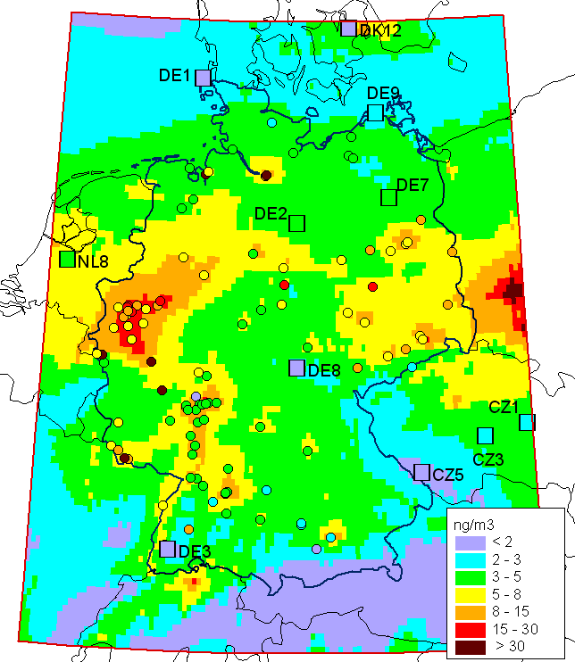
Case study for Germany
Modelled and observed concentrations
Pb air conc. in 2016
Further steps:
Contributions of main emission sectors
Elaboration of emission scenarios
Contribution of secondary sources (dust re-suspension)

Slide 21
Cooperation with WGE
Cooperation with WGE: Toxic effects of HMs and POPs
Classification of heavy metals and POPs as toxic substances in EU REACH *
Substance | Toxicity for humans | Toxicity for aquatic organisms
 |  | Effects | Threshold levels in freshwater **
Cd | Carcinogenic, mutagenic, reprotoxic | Acute and chronic | 0.19 µg/L
Pb | Reprotoxic |  | 2.4 µg/L
Mercury | Reprotoxic |  | 0.057 µg/L
B[a]P | Carcinogenic, mutagenic, reprotoxic |  | 0.89 µg/L
PCBs | Carcinogenic, mutagenic |  | n/a
HCB | Carcinogenic, mutagenic and reprotoxic |  | n/a
* EU regulation “Registration, Evaluation, Authorisation and Restriction of Chemicals” (REACH)
** The REGULATION (EC) No 1272/2008 on Classification, Labelling and Packaging of Substances and Mixtures, commonly known as CLP Regulation, entered into force on 20 January 2009

Slide 22
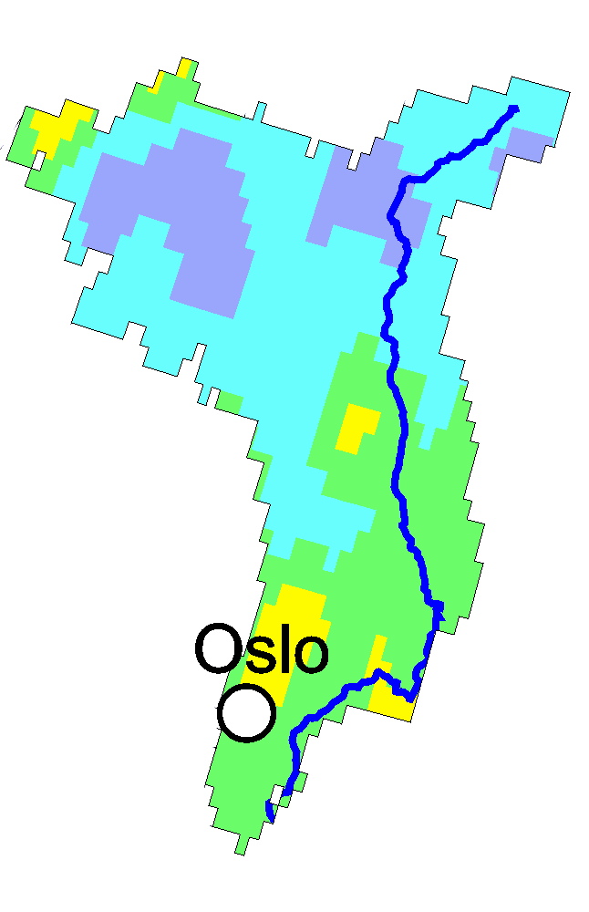
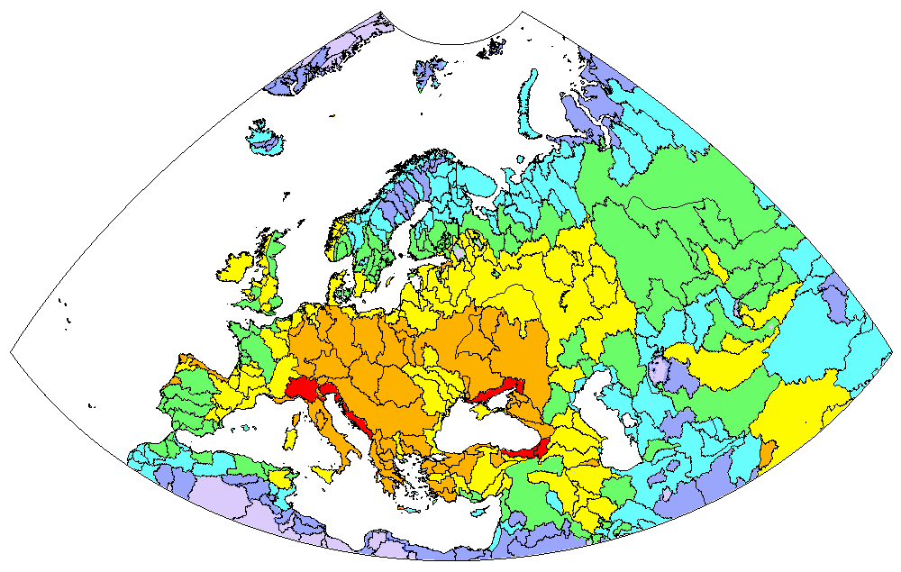
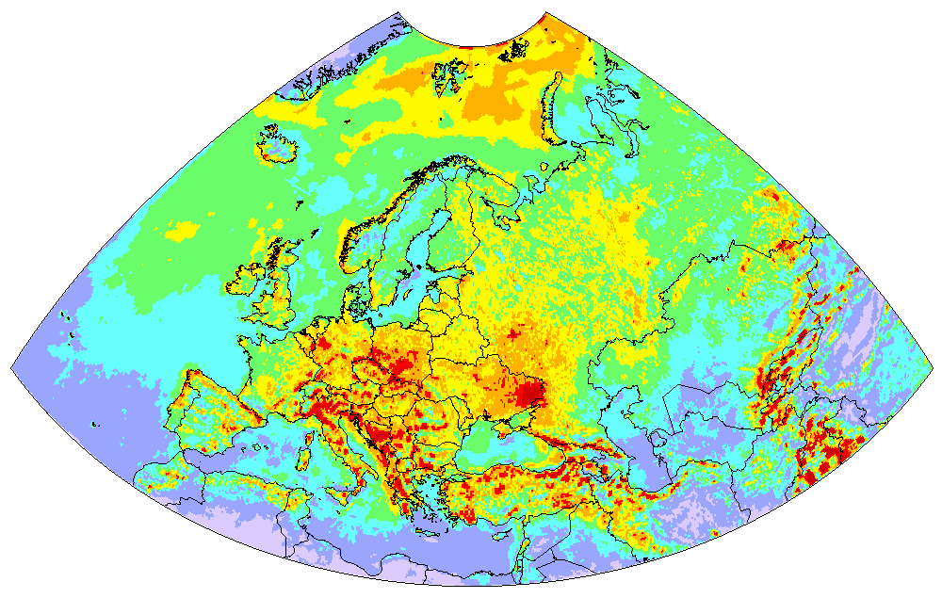
Cooperation with WGE
Effects of atmospheric loads to water ecosystems
Model estimates of HM and POP deposition to watersheds
Glåma watershed
Hg deposition in 2016
Hg deposition to LU categories of Glåma watershed
Mixed forest
4%
Other
8%
Wooden grassland
8%
Coniferous forests
46%
Grassland
8%
Shrubs
26%

Slide 23
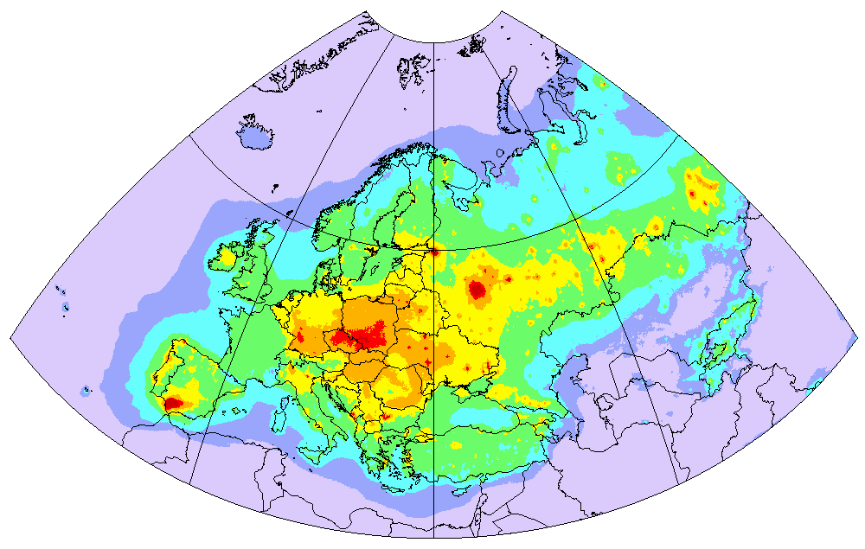
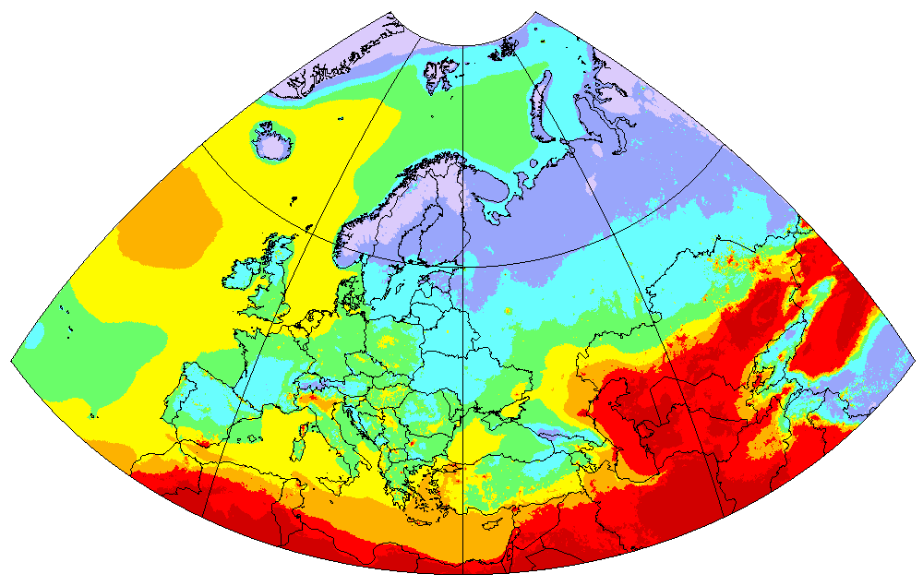
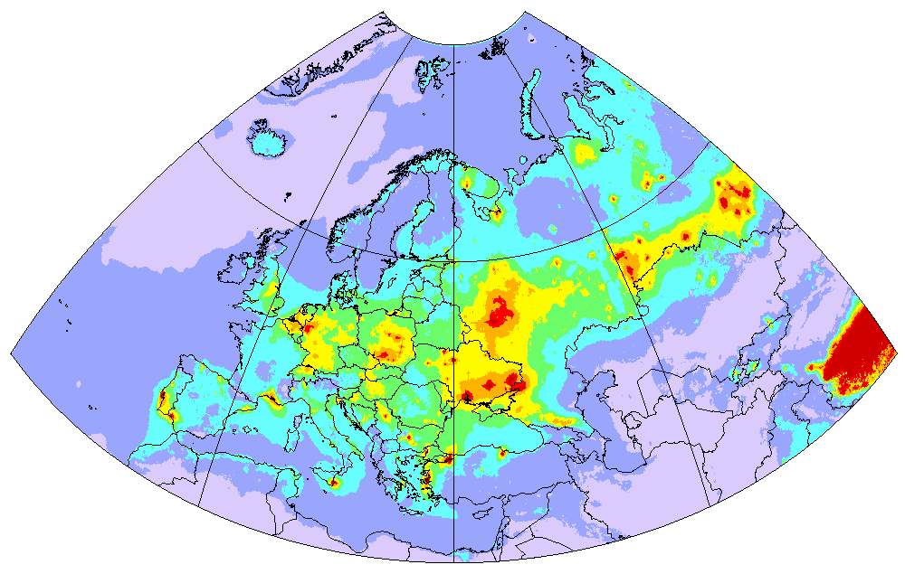
Cooperation with WGE
Toxicity of atmospheric particulate matter
Estimates of PM2.5 enrichment with heavy metals and POPs
PM enrichment with BaP (mg/kg)
PM2.5 concentration in 2016 (MSC-W)
PM enrichment with Cd (mg/kg)
Aerosol enrichment with toxic pollutants may imply additional risks for human health and may require attention of the effect community

Slide 24
Further activities and plans (2020/2021)
Research and model development
  Evaluation of new mechanisms of Hg oxidation and reduction in the atmosphere
  Assessment of Hg multi-media transport and contribution of secondary emissions to pollution of the EMEP countries
  Complex analysis of problem areas of Pb and Cd pollution in the EMEP region involving modelling and variety of measurement data
National scale pollution assessment in Germany
  Evaluation of modelling results vs. measurements and analysis of discrepancies
  Detailed assessment of Pb, Cd and Hg pollution in Germany in 2014-2016
Co-operation with Working Group on Effects
  Joint analysis of HM measurements in moss in co-operation with ICP-Vegetation
  Data exchange with ICP-Integrated Monitoring, ICP-Forests and ICP-Waters on heavy metal concentration and deposition

