Slide 1
Recent EMEP MSC-W model developments
to improve secondary inorganic aerosols
Presented by Svetlana Tsyro
TFMM 20-th meeting
Madrid, May 7-9, 2019

Slide 2
Recent and ongoing activities (which should be) contributing to SIA improvement
Finer model resolution: 0.1x0.1° and 50m lowest layer
Finer resolution of national emissions : 0.1x0.1°
Bi Directional Ammonia fluxes (David Simpson in cooperation with TNO)
EQSAM4clim - new thermodynamic equilibrium model

Slide 3
Bi-Directional exchange of NH₃
David Simpson & Roy Wichink Kruit
χ
a
air concentration
ATMOSPHERE
atmospheric resistance
boundary
layer
resistance
χ
canopy compensation point,
c
stomatal
R_{inc} In-canopy
R_{w} cuticular
resistance
resistance
resistance
CANOPY
χ
s
stomatal
compensation
point
χ
Nemitz et al. 2000
l
soil
compensation
point

Slide 4
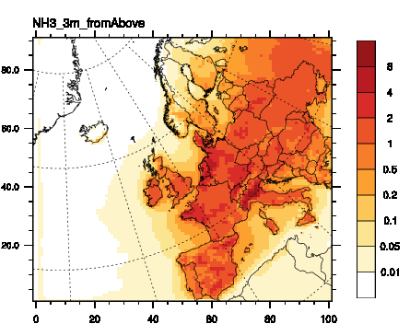
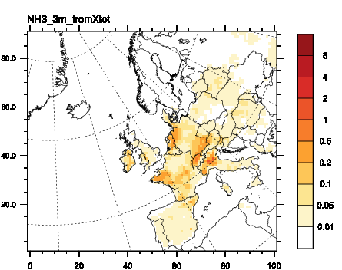
Towards Bi-Directional NH₃
On-going work:
NH3 contributions, from ’above’ (left) and ’below’ (right)
Courtesy of David Simpson & Roy Wichink Kruit

Slide 5
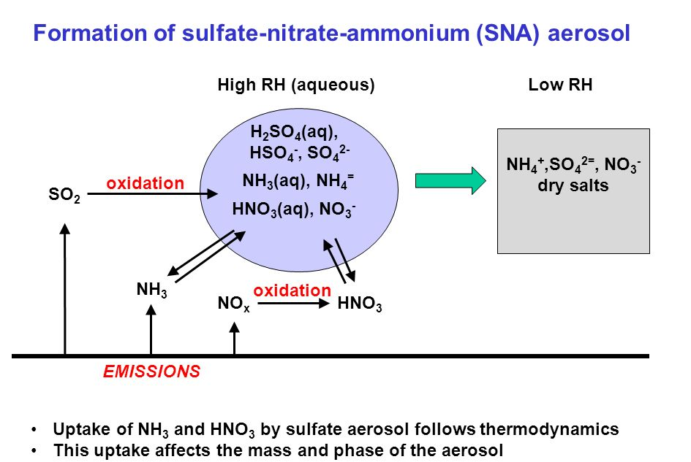
SIA formation & Gas-aerosol partitioning
Thermodynamic equilibrium schemes for sulphate-nitrate-ammonium-water system
«Old» EMEP scheme: (NH₄)_{1.5} SO₄ , simplified Kp = f(Rh, T)
MARS (ARES): two regimes for NH₄ /SO₄, metastable aqueous aerosol
EQSAM-3: parameterized version of ISORROPIA
EQSAM4clim: most recent version

Slide 6
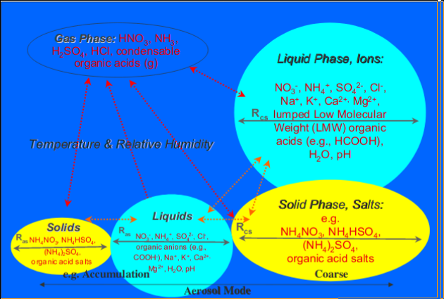
EQSAM4clim
Implemented in the EMEP MSC-W model, in close cooperation with Swen Metzger ( www.researchconcepts.io, www.eco-serve.de)
Thoroughly compared against ISORROPIA, evaluated with in-situ and satellite observations (AOD) on global scale (Metzger et al., ACP (2018, 2016, 2012, 2006)

Slide 7
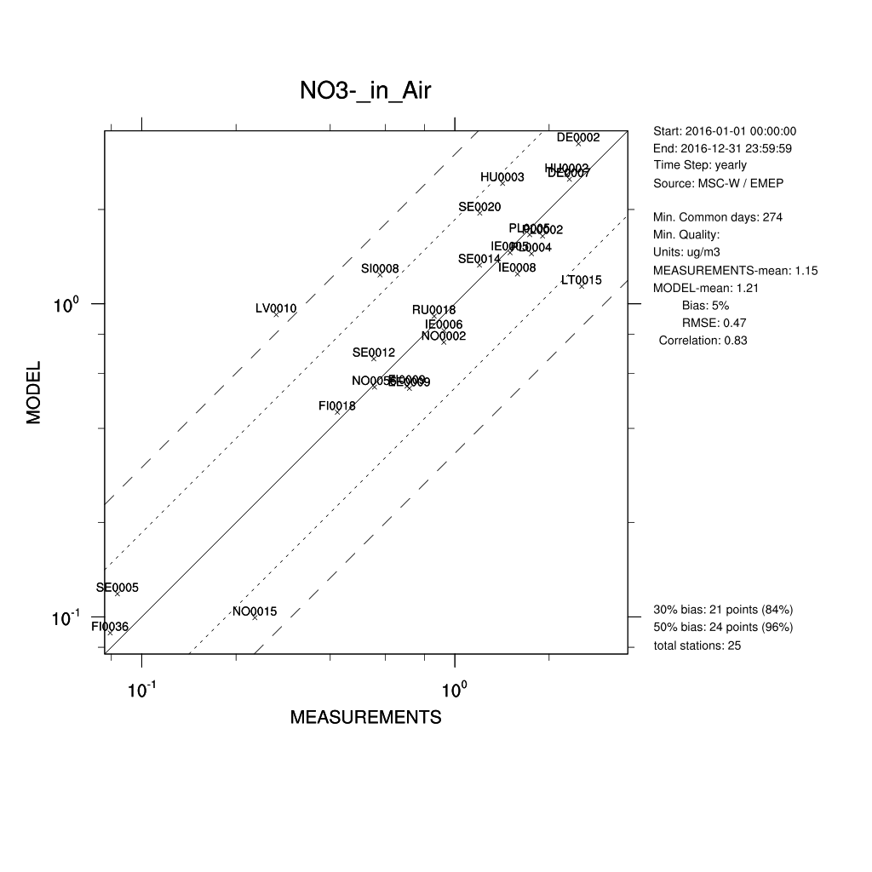
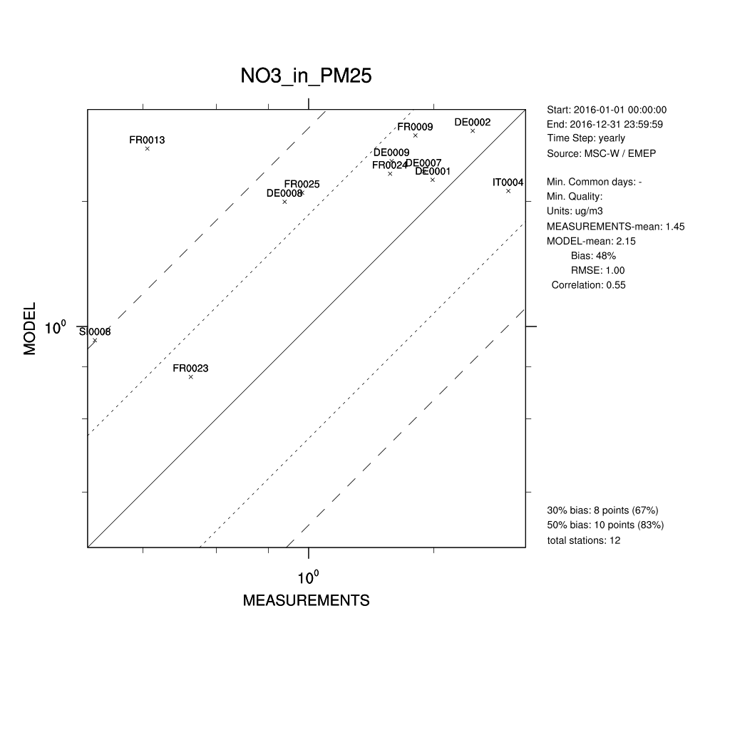
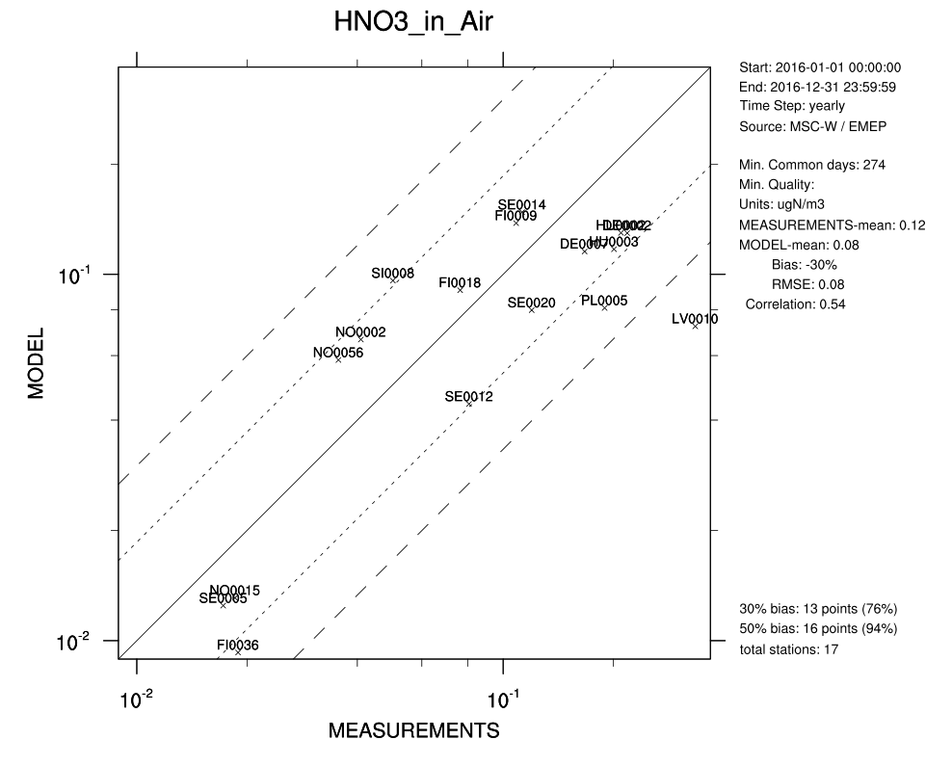
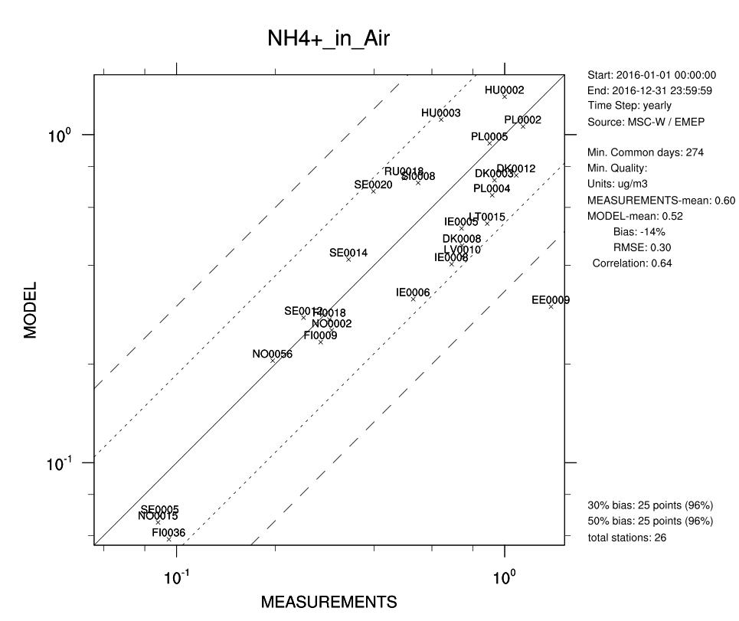
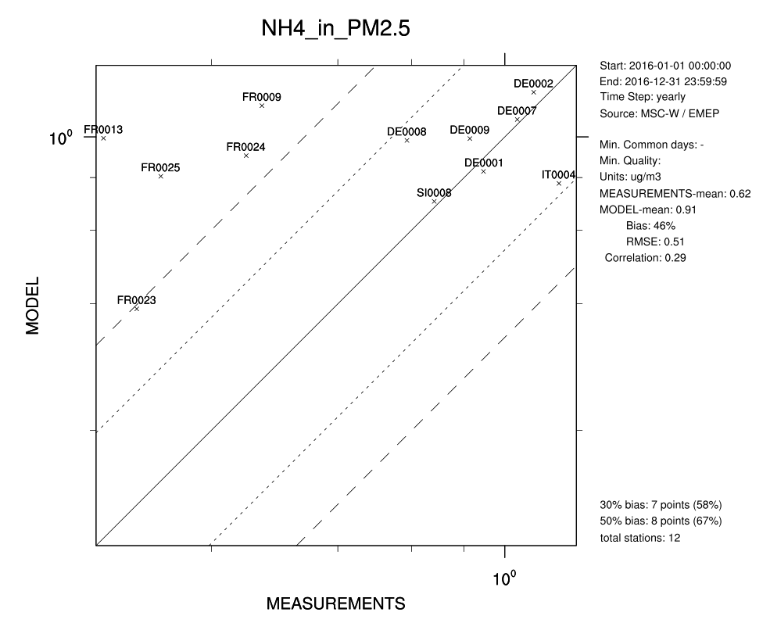
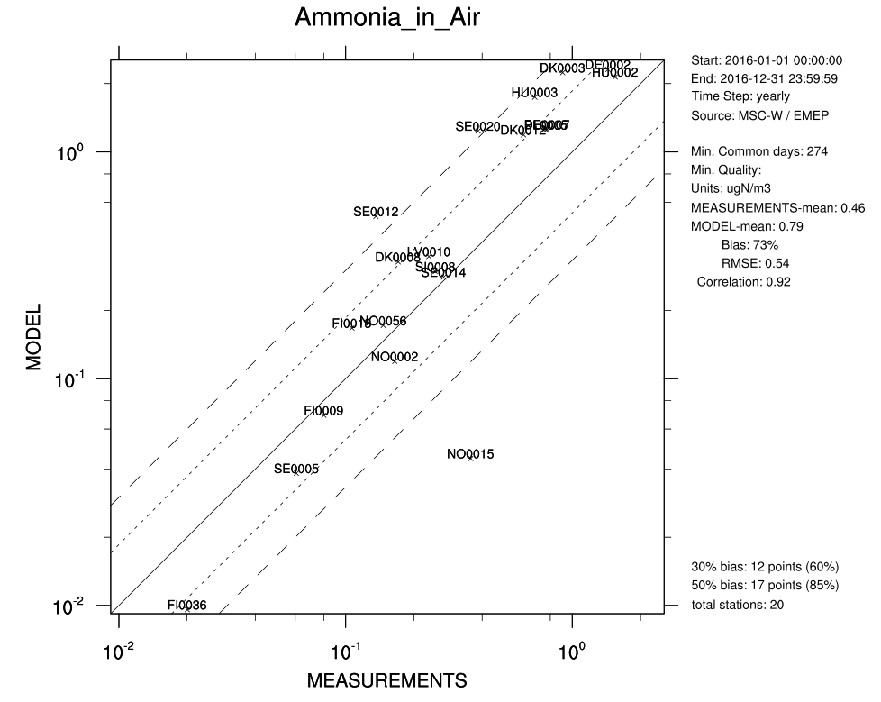
Testing EQSAM4clim for 2016
 | NO3 |  |  | NH4 |  |  | HNO3 | NH3 | PM10 | PM2.5
 | Bias-y | R-y | IOA-yd | Bias-y | R-y | IOA-yd | Bias-y (%)
MARS | 9 % | 0.82 | 0.89 | -12 % | 0.65 | 0.80 | -22 | 66 | -17 | -14
Eq4clim | 5 % | 0.83 | 0.90 | -14 % | 0.64 | 0.79 | -30 | 73 | -24 | -20
Rep18 | 13 % | 0.83 | 0.90 | -11 % | 0.65 | 0.80 | -31 | 68 | -22 | -18
y – yearly, d - daily

Slide 8
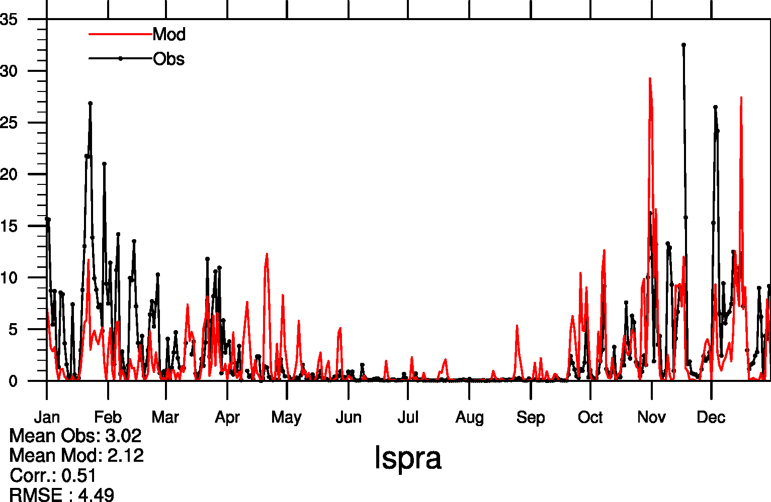
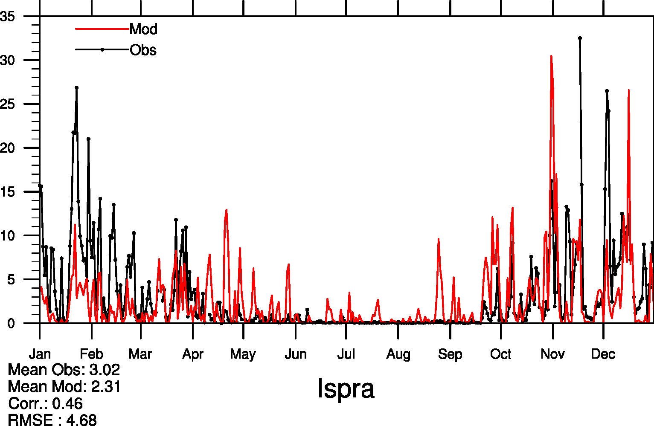
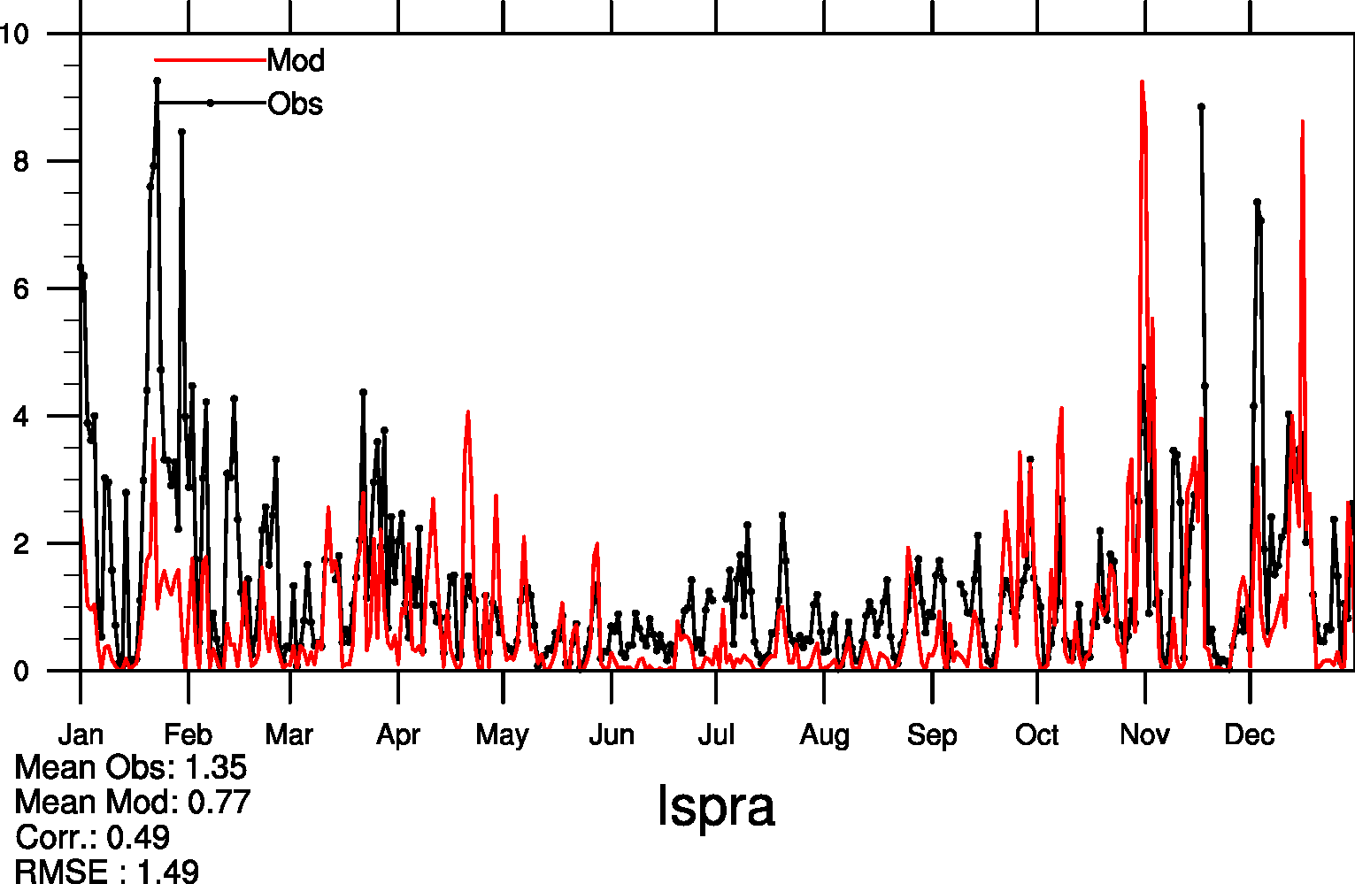
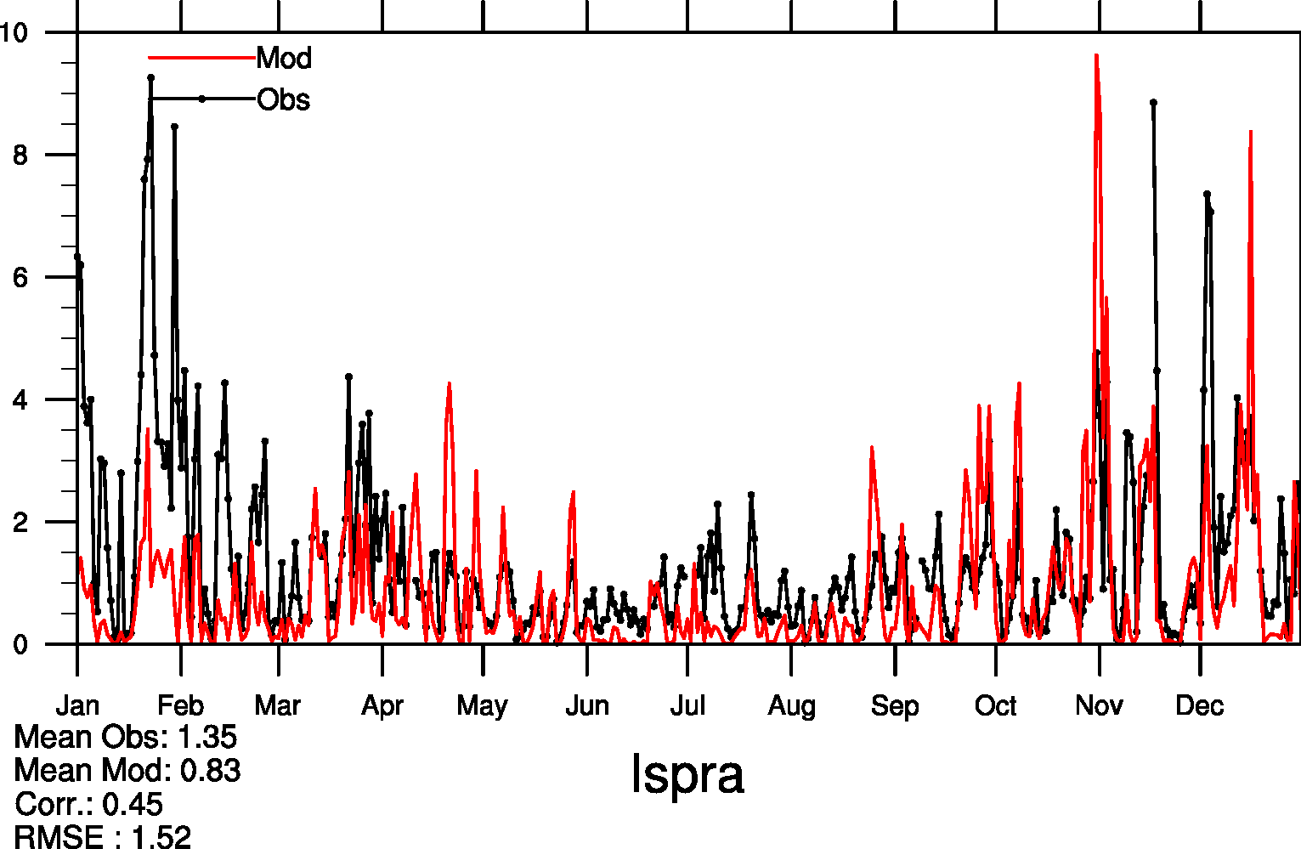
EQSAM4clim MARS
NO3 inPM2.5
NO3 inPM2.5
NH4 inPM2.5
NH4 inPM2.5

Slide 9
NO₃⁻ in PM_{2.5}
 | OBS | eq4cl | mars | R eq4cl | R mars
DE01 | 1.99 | 2.25 | 2.44 | 0.39 | 0.34
DE02 | 2.48 | 2.95 | 3.13 | 0.49 | 0.46
DE08 | 1.58 | 2.50 | 2.69 | 0.41 | 0.37
FR09 | 1.81 | 2.88 | 2.97 | 0.23 | 0.20
FR24 | 1.57 | 2.33 | 2.44 | 0.46 | 0.46
SI08 | 0.31 | 0.93 | 0.93 | 0.49 | 0.48
Similarly, some improvement is found for NH₄⁺ in PM_{2.5}

Slide 10
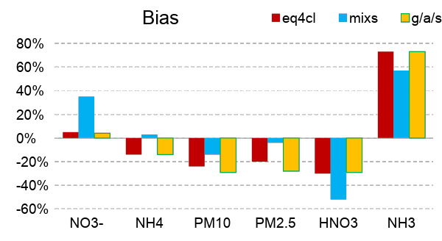
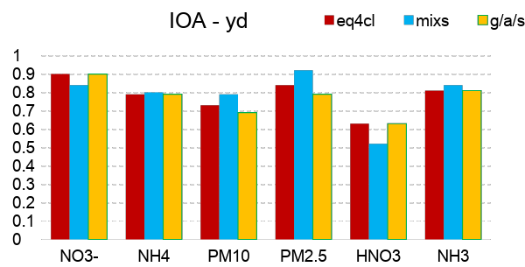
EQSAM4clim: testing setups
EQSAM4clim allows flexibility wrt included processes and gas/aerosol components (cations and anions) and variable degree of complexity..
Ideally, all major cation/anions should be included for best result
Presently, base cations from mineral dust are not accounted for
eq4cl – metastable aqueous aerosols, gas/aerosol partitioning (as in MARS)
mixs – equil. dissociation constant Kp for NH₄NO₃ not only f(RH, T), but also f(composition): decreases with increasing (NH₄)₂SO₄) content
g/a/s – full gas/aerosol/solid equilibrium

Slide 11
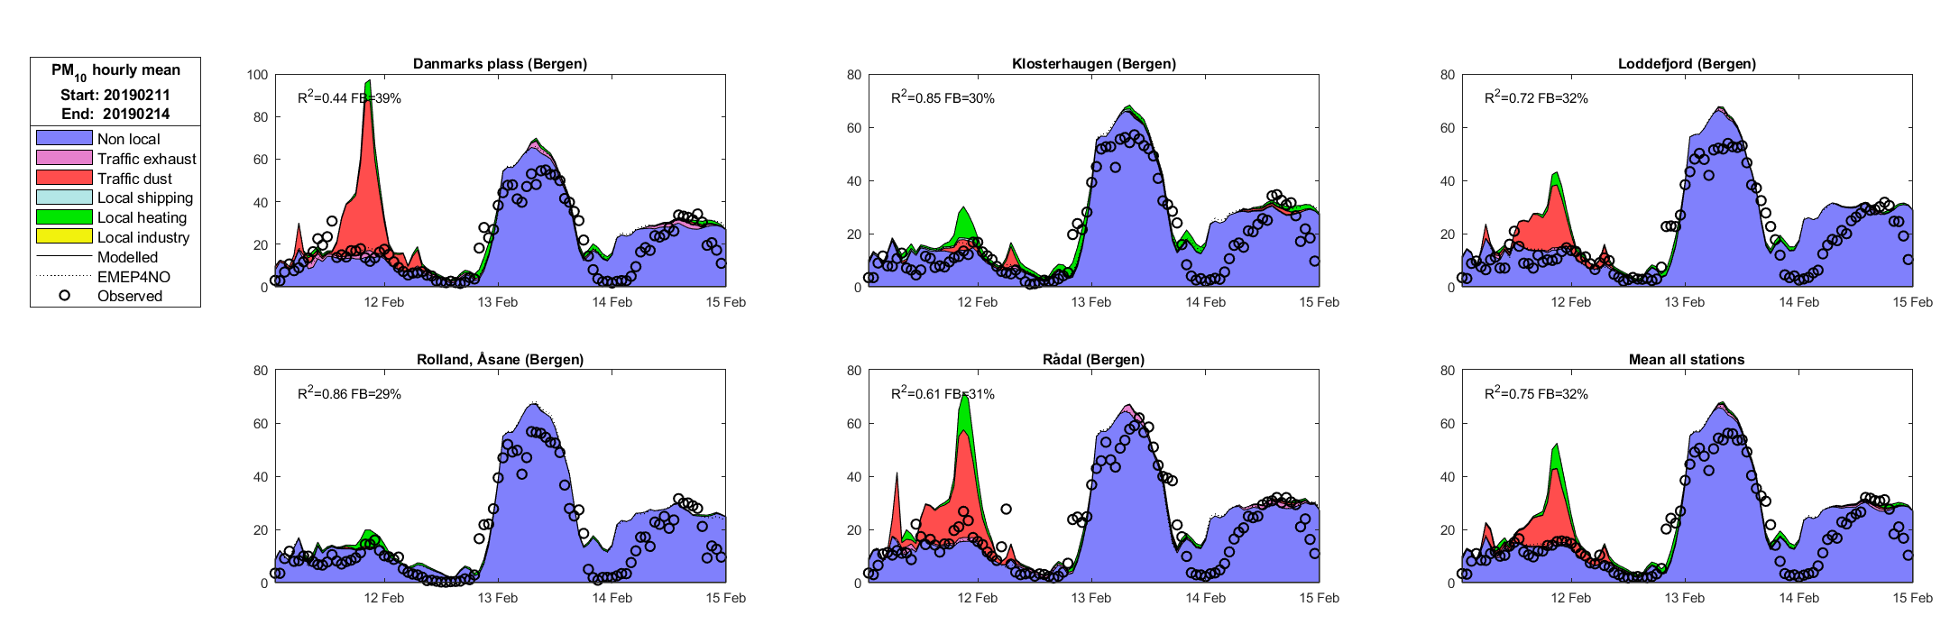
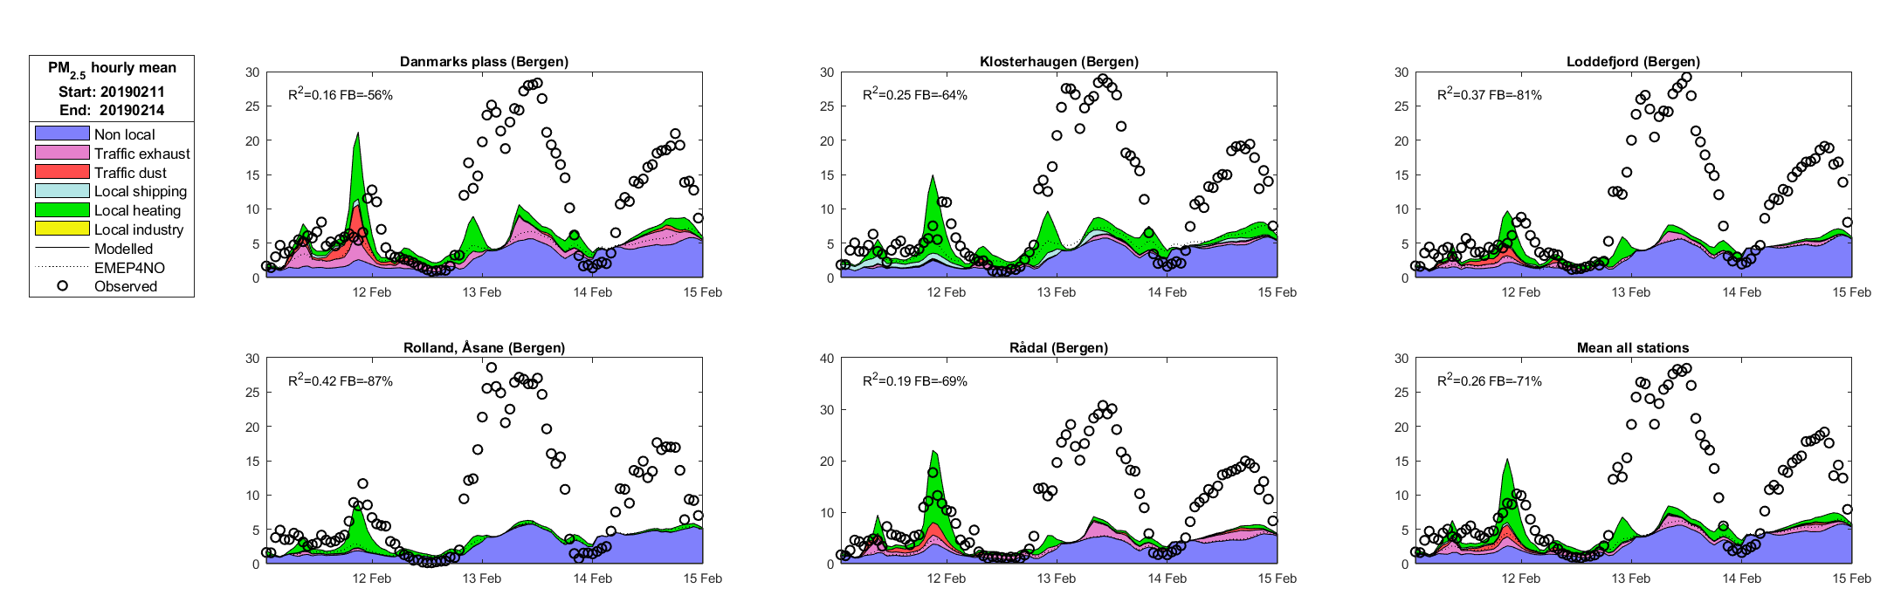
PM episode due to sea salt
in Bergen (Norwegian west coast) 13.02.2019
Model manages PM10
..but not PM2.5

Slide 12
PM episode in Bergen (Norwegian west coast) 13.02.2019
air quality forecast using MARS
Coarse NO₃ (NaNO₃) formation, but not NaNO₃ on fine sea salt
Also Na₂SO₄ is formed (actually preferential wrt (NH₄)₂SO₄)
Could this (partly) explain the model failure????

Slide 13
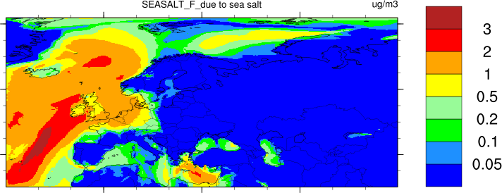
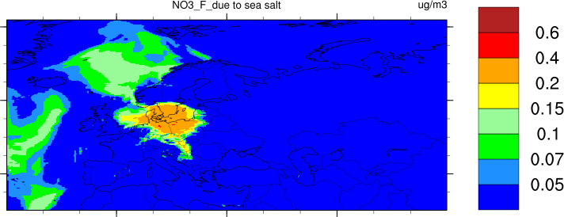
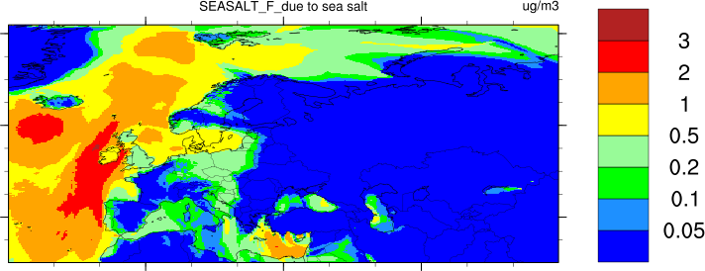
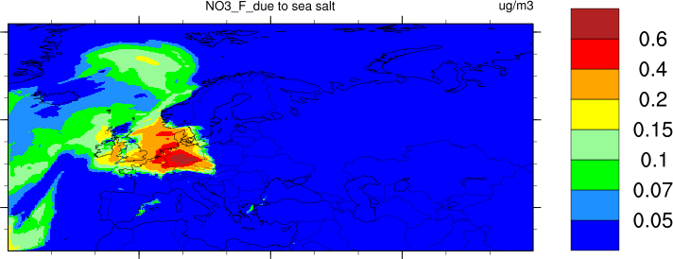
EQSAM4clim
Formation of fine NO₃⁺ due to fine sea salt
Sea salt
NO₃⁺
23-24 January 2016

Slide 14
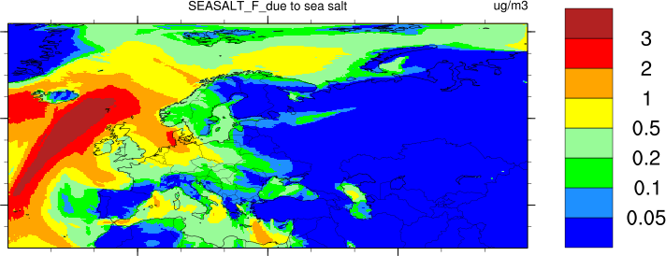
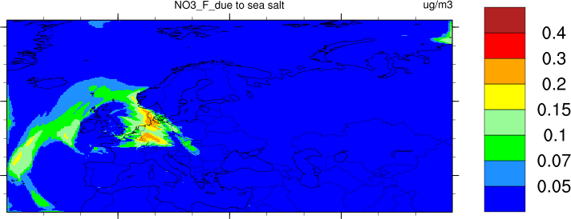
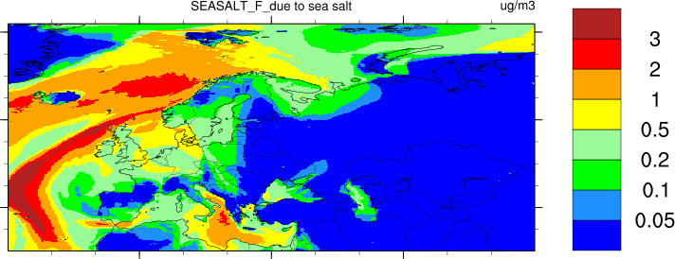
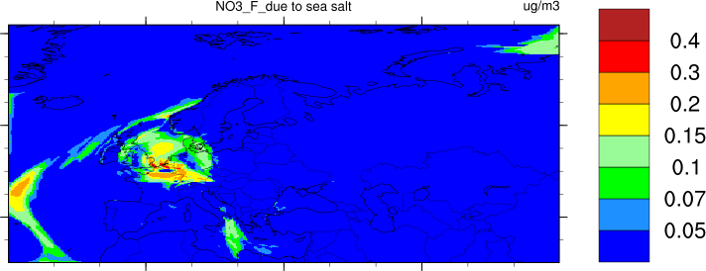
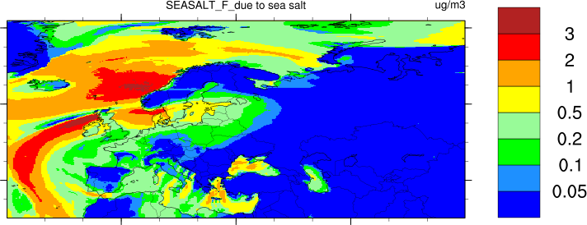
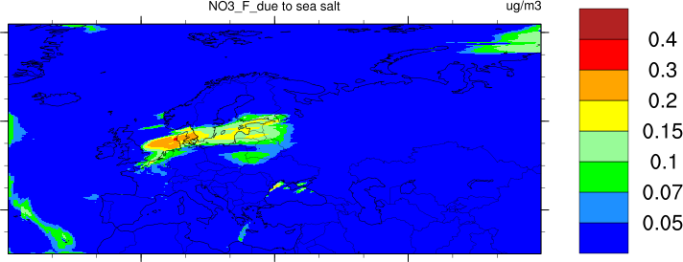
EQSAM4clim
Formation of fine NO₃⁺ due to fine sea salt
Sea salt
NO₃⁺
28-30 December 2016

Slide 15
Summary and outlook
The latest version of EQSAM - EQSAM4clim - has been implemented in the EMEP MSC-W model
Initial tests give positive results:
- evaluation for 2016 - similar compared to MARS
- inclusion of sea spray NaCl in the equilibrium allows formation of Na₂SO₄ and NaNO₃ (which can be important in coastal sea salt influenced regions)
- several setups for equilibrium system complexity are tested - needs more study for diff regions (episodes!!), evaluation with observations (ACSM data, gas/aerosol )
- more accurate calculation of PM water is expected, but depends on the setup (=completeness of cation/anion system)

Slide 16
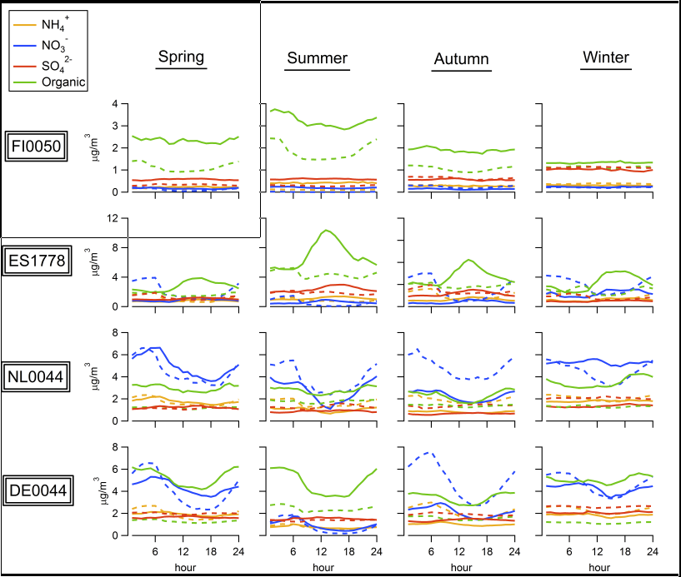
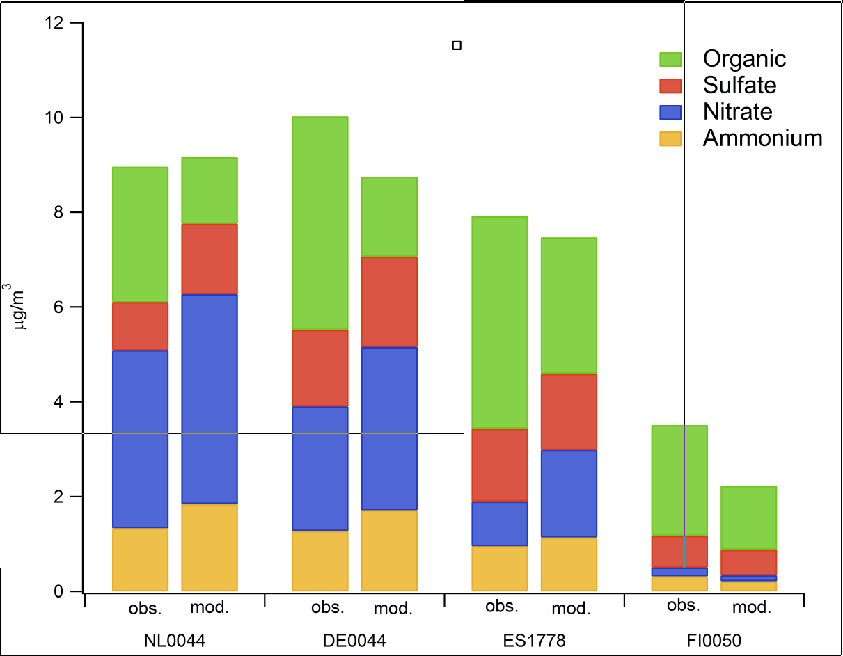
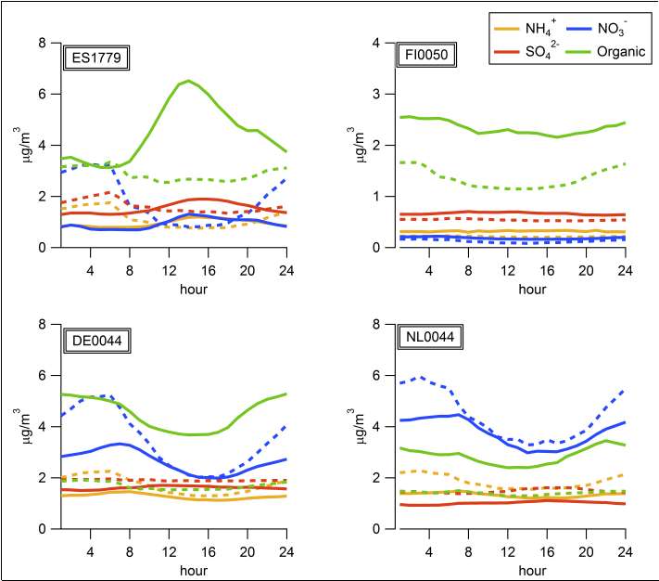
Aerosol evaluation with ACSM (2012-2013)
EMEP Report 1/2017

Slide 17
Summary and outlook
EQSAM4clim will be one of the options to solve SIA in the Open Source (May 2019?) and after some testing next weeks will likely be used in model calculations for Report 2019
Further work
Extending to base cations (Ca²⁺, Mg²⁺, K⁺) from windblown and anthropogenic dust
Testing EQSAM4clim for coarse aerosols??
Many thanks go to Swen Metzger
for his assistance with EQSAM4clim implementation and consultancy regarding thermodynamics

Slide 18
Muchas gracias!

