Slide 1
Progress of MSC-W activities
Hilde Fagerli, Agnes Nyiri, Anna Benedicow, Heiko Klein, Alvaro Valdebenito, Jan Griesfeller, Augustin Mortier, Michael Schulz, David SImpson, Svetlana Tsyro, Jan EIof Jonson, Peter Wind, Michael Gauss

Slide 2
Content
Operational EMEP/MSC-W work, products for Parties
The new EMEP 0.1°x0.1° emissions - quality?
Source receptor runs in reduced resolution
The new trend interface and further developments of web
Other talks from MSC-W:
Recent developments of the EMEP MSC-W model, Svetlana Tsyro
State of SOA: an EMEP modelling perspective, David Simpson
Country wide high-resolution modelling in Norway and its impact on exposure, Bruce Denby
Notes:
Operational EMEP/MSC-W work: every year; Prducts for the countries, not scientific developments

Slide 3
EMEP 0.1x0.1 emissions: Can we say something about their quality from model calculations?
In 2018, 30 countries reported emissions in the new grid (0.1°x0.1° long-lat resolution)
2 was excluded, IT and LT, MT reported to late =>27 countries
6 more than in 2017 (France, FYR Macedonia, Georgia, Greece, Hungary, Netherlands)
Remaining areas: gap filled and spatially distributed by CEIP
How ‘good’ are model calculations when using these EMEP0.1 emissions compared to using TNO-CAMS emissions or the old EMEP 50km emissions?

Slide 4
How?
EMEP/MSC-W model runs (all using 0.1 meteo for 2016):
Using EMEP 0.1°x0.1° emissions for 2016
Using TNO-CAMS 0.1°x0.05° for 2016
Using 50km EMEP for 2015 (SNAP sectors)
Why compare to TNO-CAMS? Widely used. Independent gridding - check if countries that reported did some serious mistakes.
Comparison to EMEP (background) and Airbase measurements (rural, suburban, urban, excluding traffic stations)
Why Airbase data?
- Because we do not expect to see that much change in the background (that is how the EMEP network was designed).
- We need a lot of data to look at the spatial distribution (EMEP not enough).

Slide 5
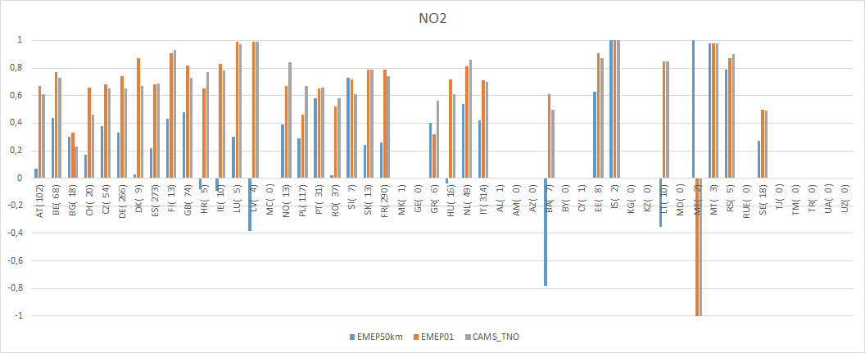
NO₂ – spatial correlation (mod vs Airbase) within each country
Left of the green line: countries that reported in the new grid
Parenthesis: number of sites
Improved spatial correlation for NO₂ from 50km to 0.1
For countries that have reported, corr is generally a little better for EMEP than CAMS_TNO
Some countries should have a second look (e.g. BG, PL, NO, GR)

Slide 6
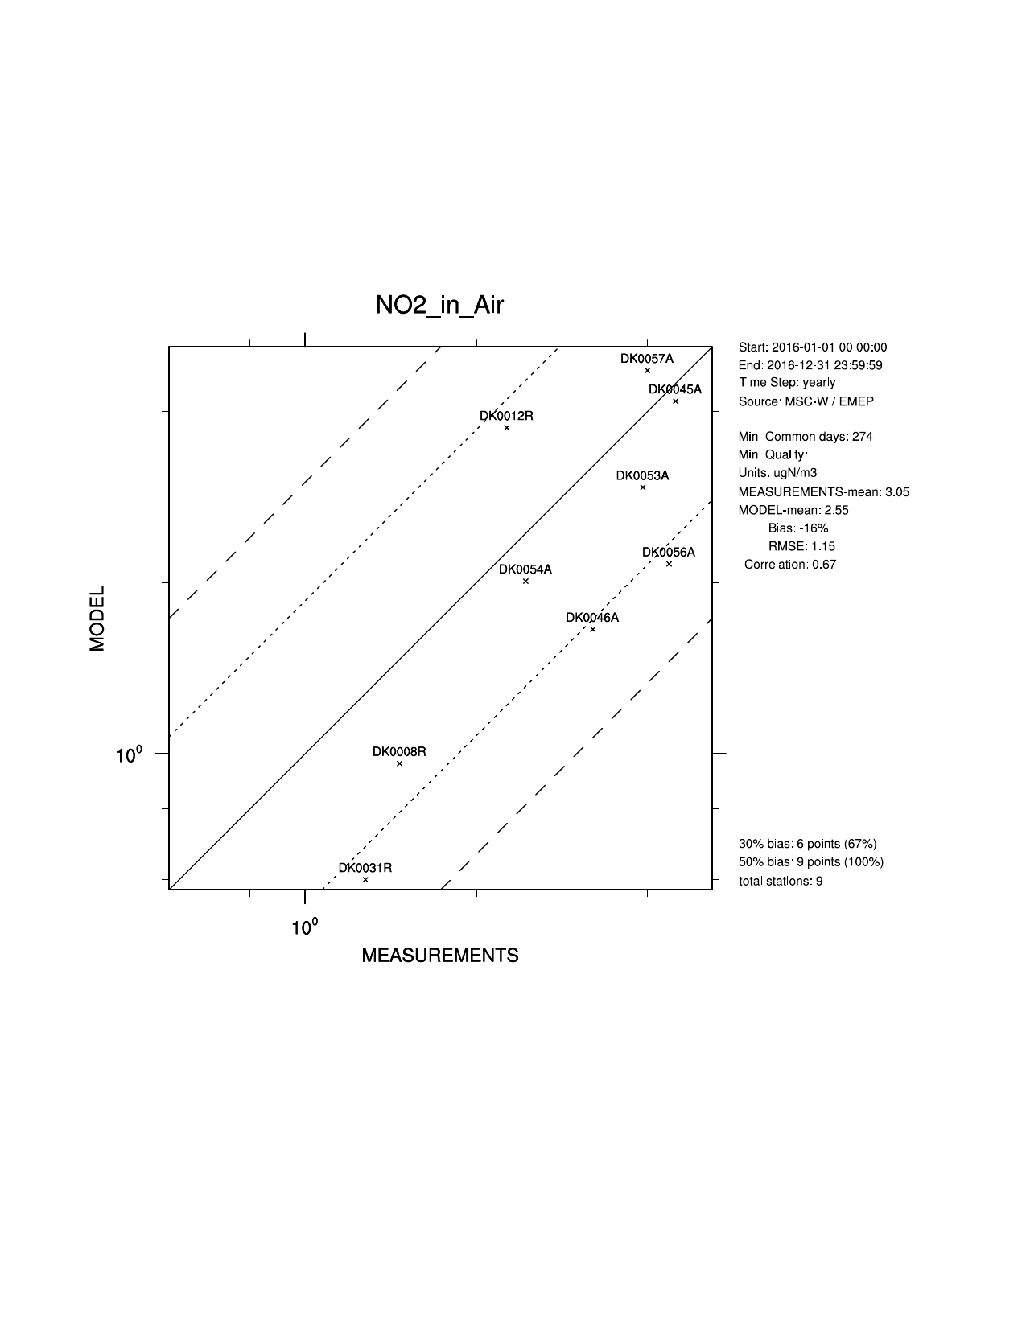
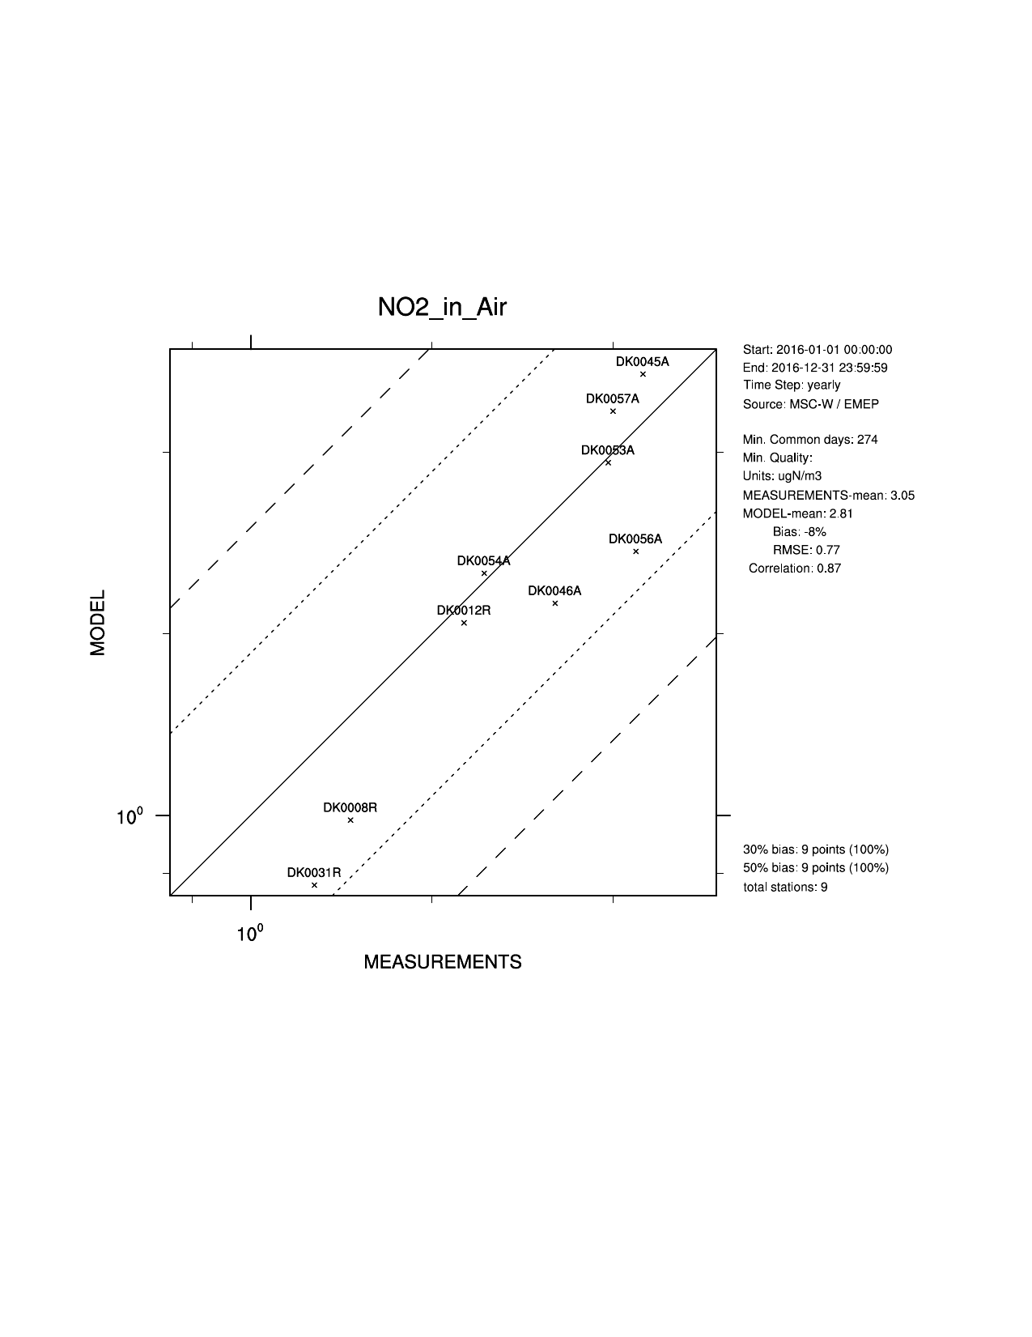
Denmark - a nice example
TNO_CAMS, r=0.67
EMEP 0.1, r=0.87

Slide 7
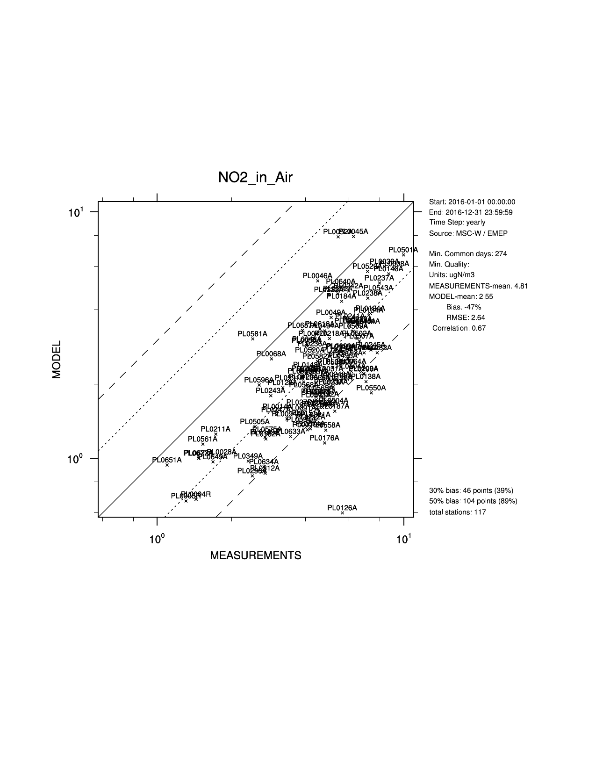
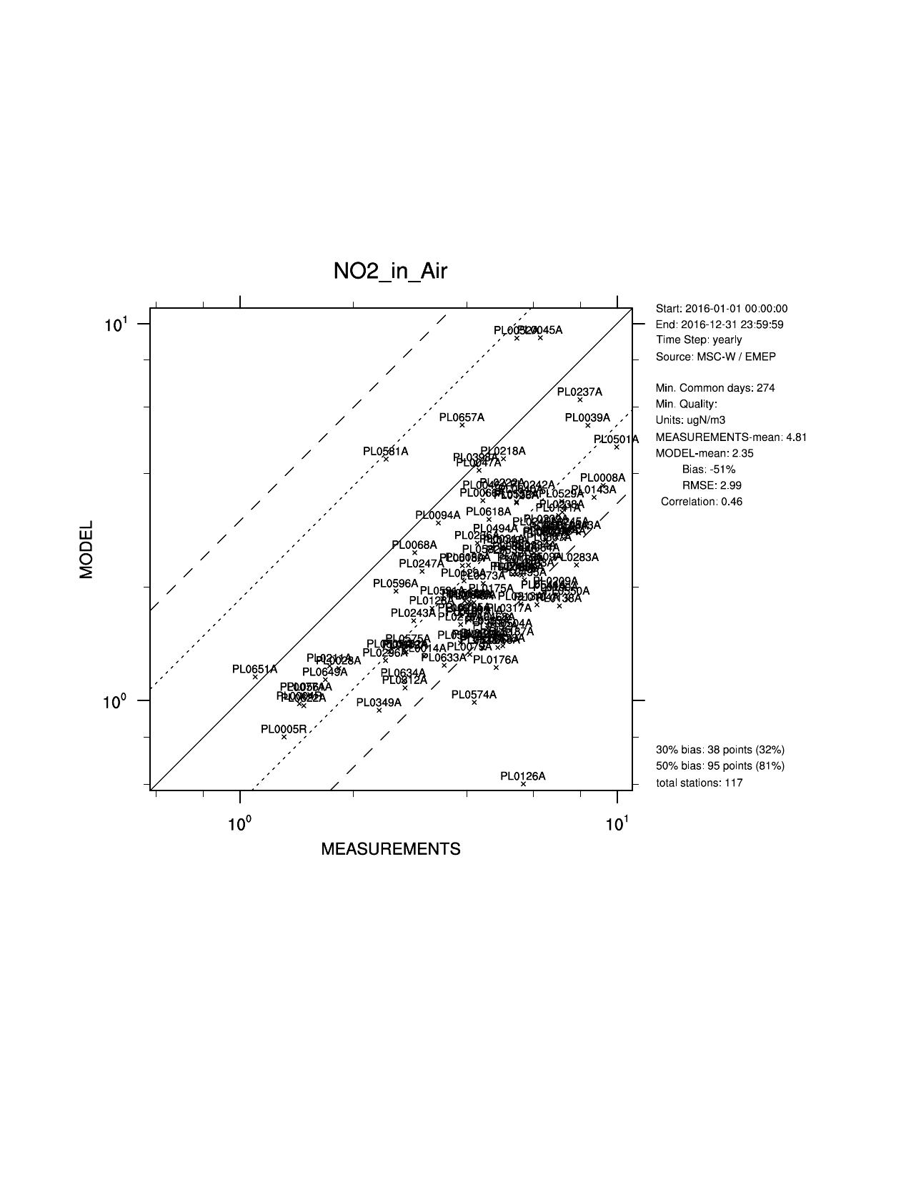
Poland
TNO_CAMS, r=0.67
EMEP 0.1, r=0.46

Slide 8
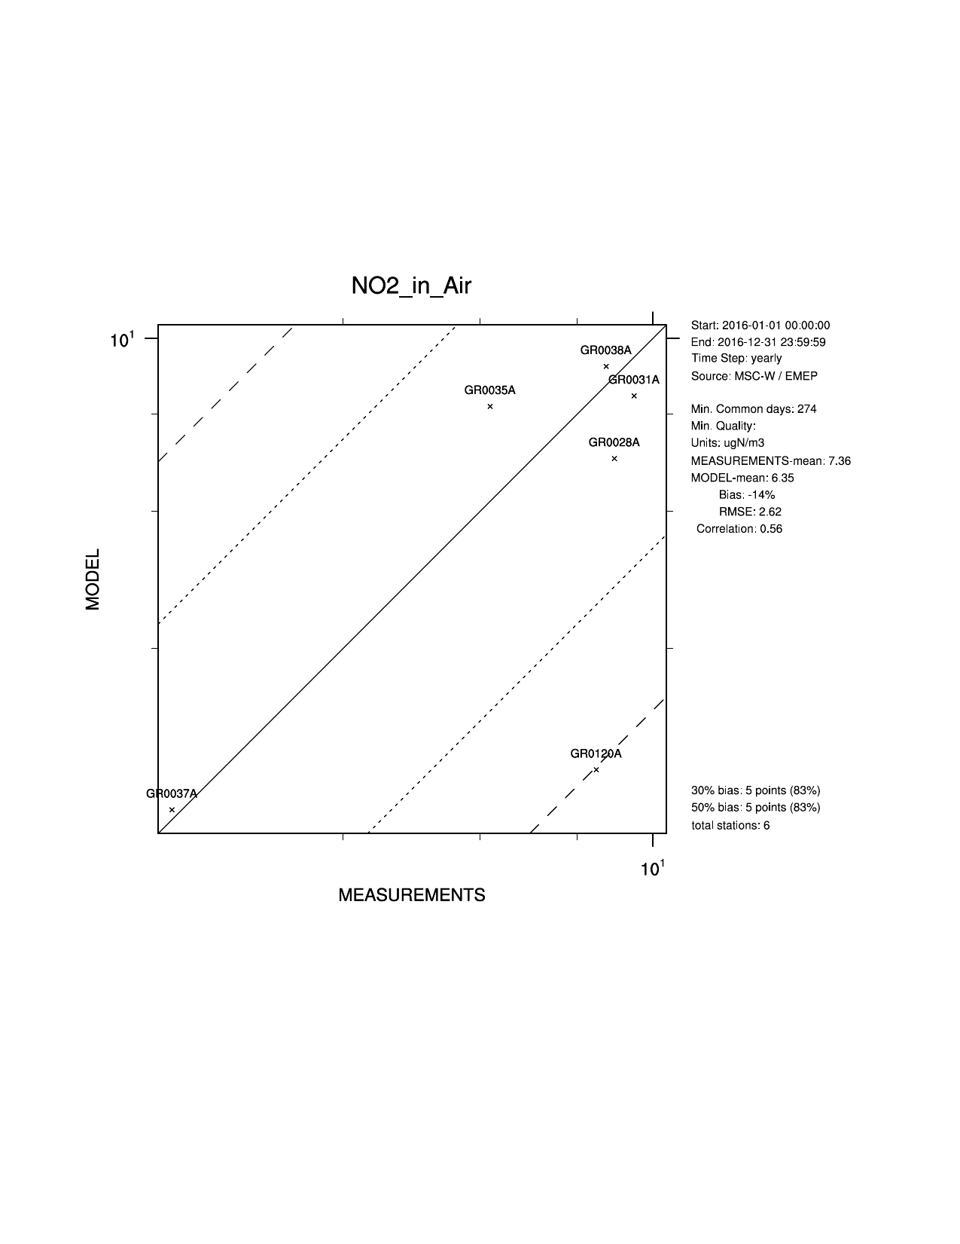
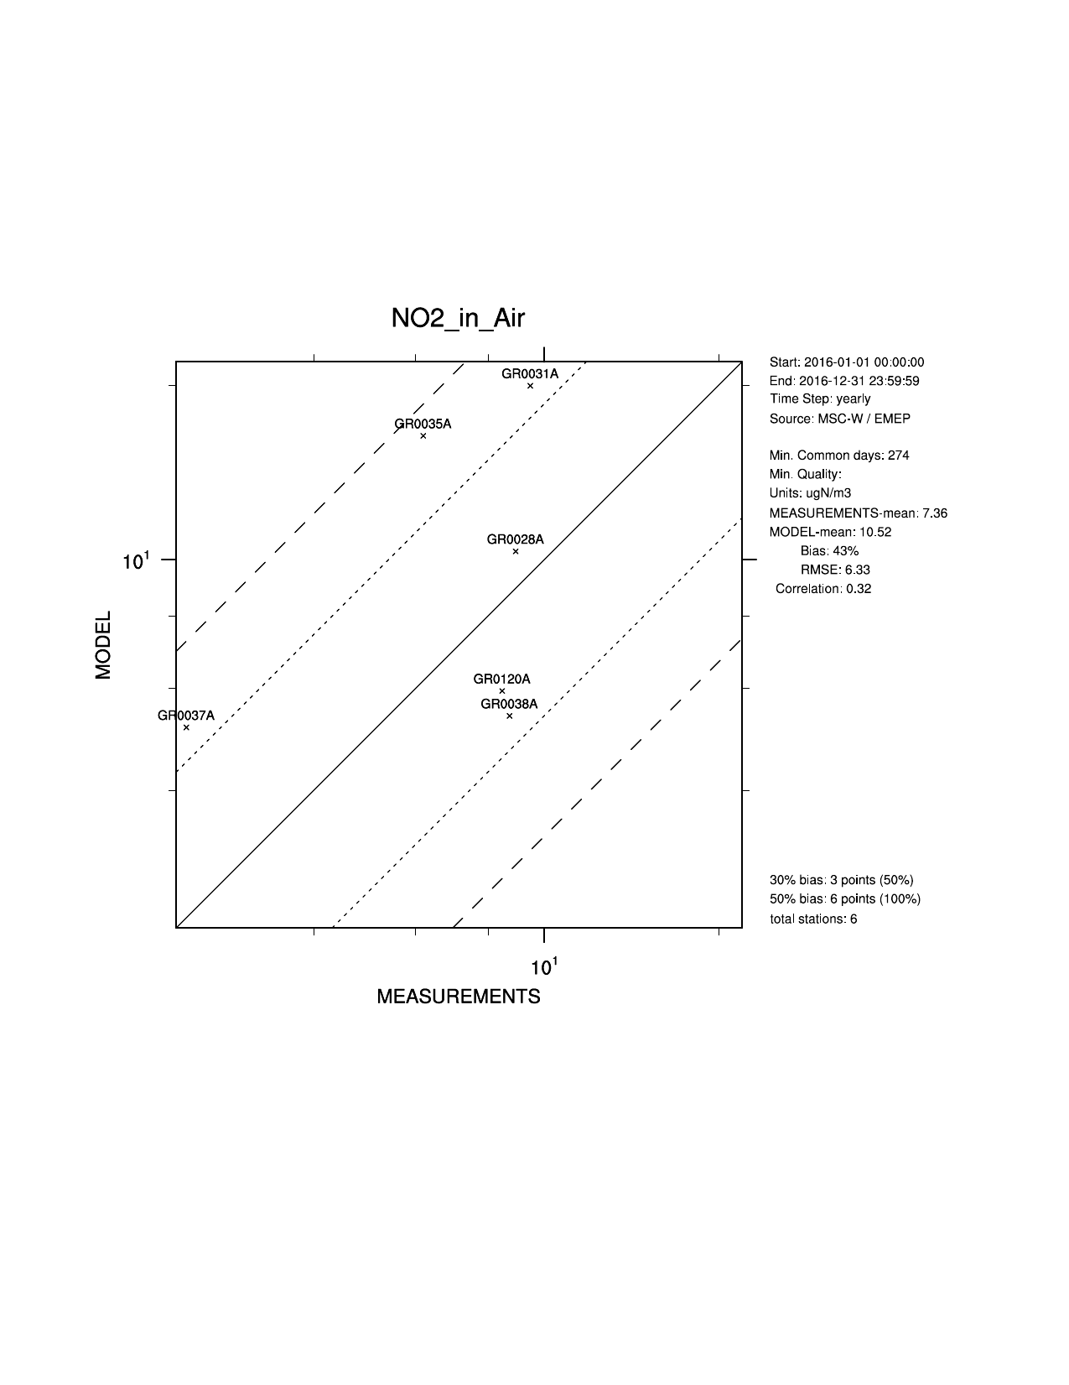
Greece
TNO_CAMS, r=0.56
EMEP 0.1, r=0.32

Slide 9
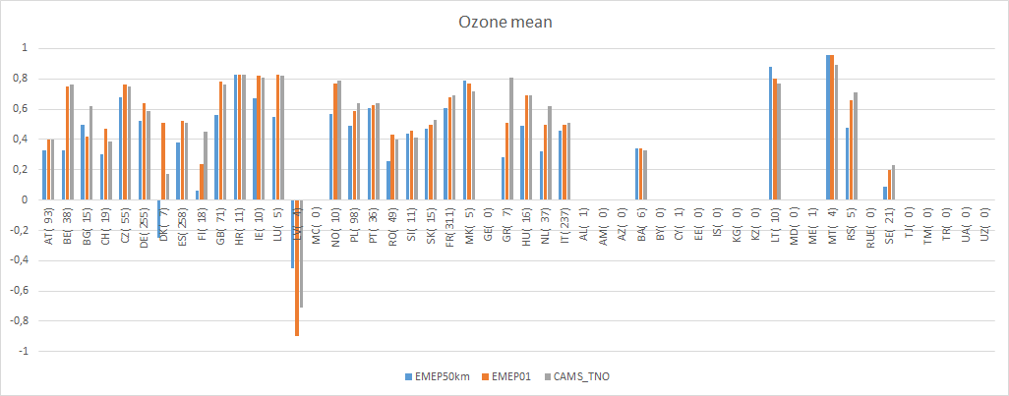
O₃ mean – spatial correlation (mod vs Airbase) within each country
Left of the green line: countries that reported in the new grid
Parenthesis: number of sites
Left of the green line: countries that reported in the new grid
Parenthesis: number of sites
Improved spatial correlation for O₃ from 50km to 0.1
More similar results between EMEP01 and CAMS_TNO (but resembles NO2, e.g. DK, GR)

Slide 10
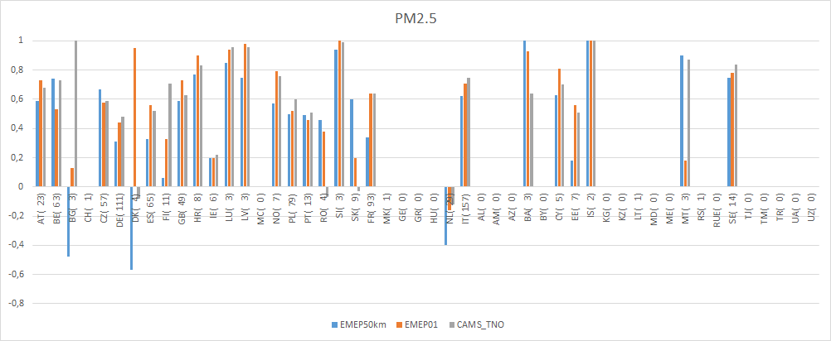
PM_{2.5} – spatial correlation (mod vs Airbase) within each country
Left of the green line: countries that reported in the new grid
Parenthesis: number of sites
Improved spatial correlation in the majority of countries when going from 50km to 0.1 degree, but no significant difference between EMEP01 and CAMS_TNO

Slide 11
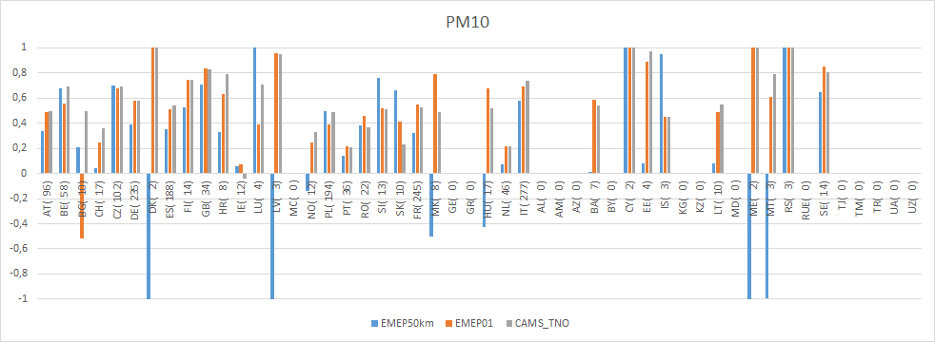
PM₁₀ – spatial correlation (mod vs Airbase) within each country
Improved spatial correlation in the majority of countries when goig from 50km to 0.1 degree, but no significant difference between EMEP01 and CAMS_TNO
Left of the green line: countries that reported in the new grid
Parenthesis: number of sites
Improved spatial correlation in the majority of countries when goig from 50km to 0.1 degree, but no significant difference between EMEP01 and CAMS_TNO

Slide 12
Summary
All the countries that we ‘expect to report’ gridded data have now reported (- SE, IT)
Clear improvement in results going from 50km to 0.1 degree
Use of national data in the gridding is beneficial: EMEP/MSC-W model results (spatial correlation) for NO₂ are somewhat better using EMEP01 than CAMS_TNO
For other components the performance is similar overall
For countries that have few observations it is difficult to interpret whether the new gridding is better than the old/TNO_CAMS
More knowledge about the national observation networks is necessary to judge the performance - countries are encourage to participate in this evaluation
Some countries might benefit from revising their gridding (or the representativeness of measurement stations); Bulgaria, Poland, Norway, Greece (and Italy)

Slide 13
Source-receptor (SR) calculations in the new EMEP grid
For the first time last summer, reported emissions in 0.1°x 0.1° are used in SR
CPU/Time restrictions makes it difficult to make SR in 0.1 (and unnecessary?)
Different resolutions (0.4°x 0.3° 0.3°x 0.2° and 0.1°x 0.1°) tested for 5 countries for SR: BG, IT, NL, NO, PL – which resolution should be used operationally?
New, more detailed, country border data (ESRI map). How does it affect results?

Slide 14
Overview of model data

Slide 15
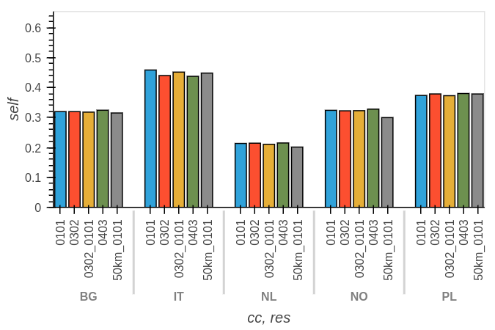
Sulphur deposition: Relative contribution from the country to itself

Slide 16
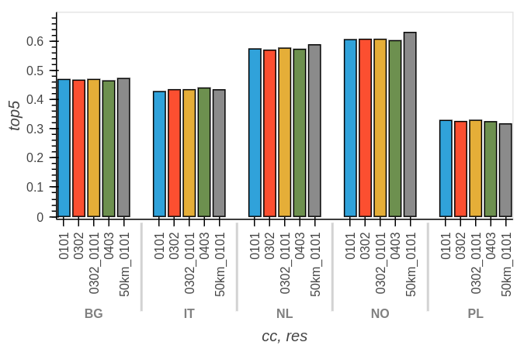
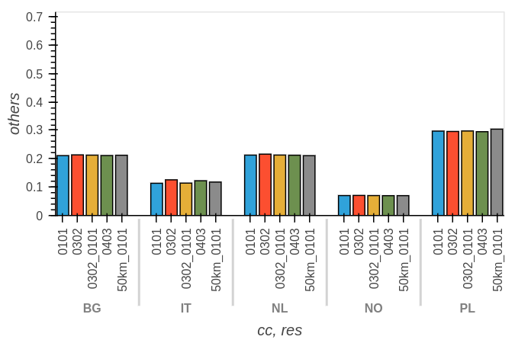
Sulphur deposition: Relative contribution from the country to top5 receptors and others
top5
others
A few percent difference between 0101 and 0302
Largest difference due to the new country border data set

Slide 17
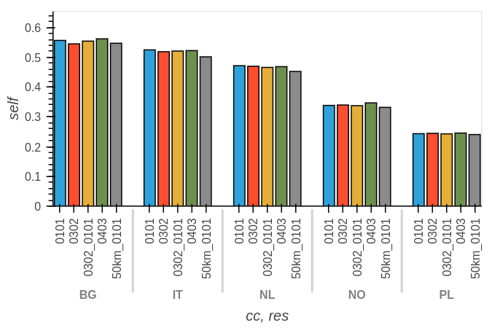
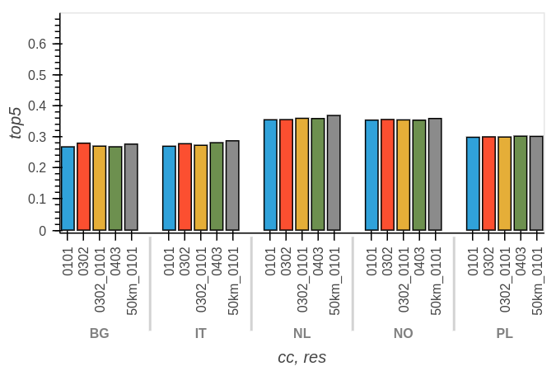
PM_{2.5}: Relative contribution from the country to itself and to the top5 receptors
Self
Top5

Slide 18
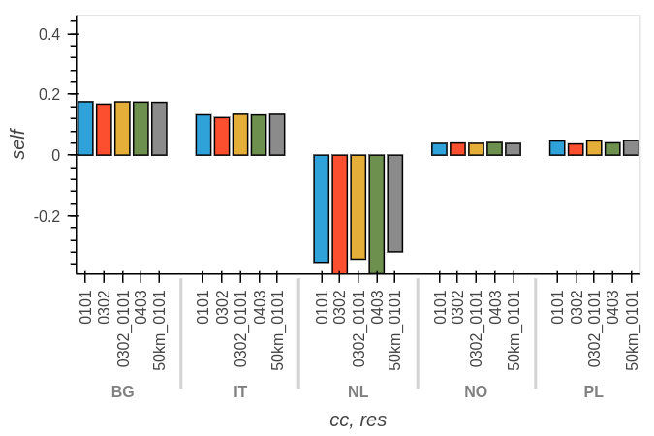
Yearly average of daily max Ozone (contribution in ppb per 15% reductionof NOx) from one country to itself

Slide 19
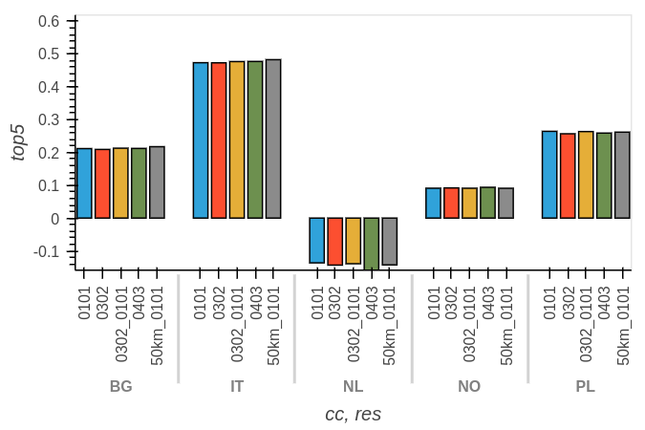
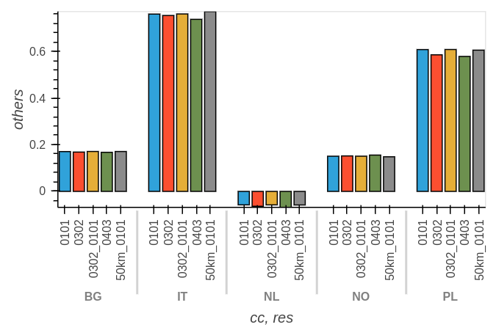
Ozone: contribution from the country to top5 receptors and others
Top5
Others

Slide 20
Choice of SR resolution
Overall difference for depositions/PM within a few percent, larger for ozone (up to 11% for country-to-itself for NL)
Differences in individual transboundary contributions can be larger, especially when pollution is transported across mountain areas and/or is small
The differences caused by using an improved country border data set is as large as differences due to different resolutions
SR in 0.3°x 0.2°, as these results are closer to 0.1°x 0.1°

Slide 21
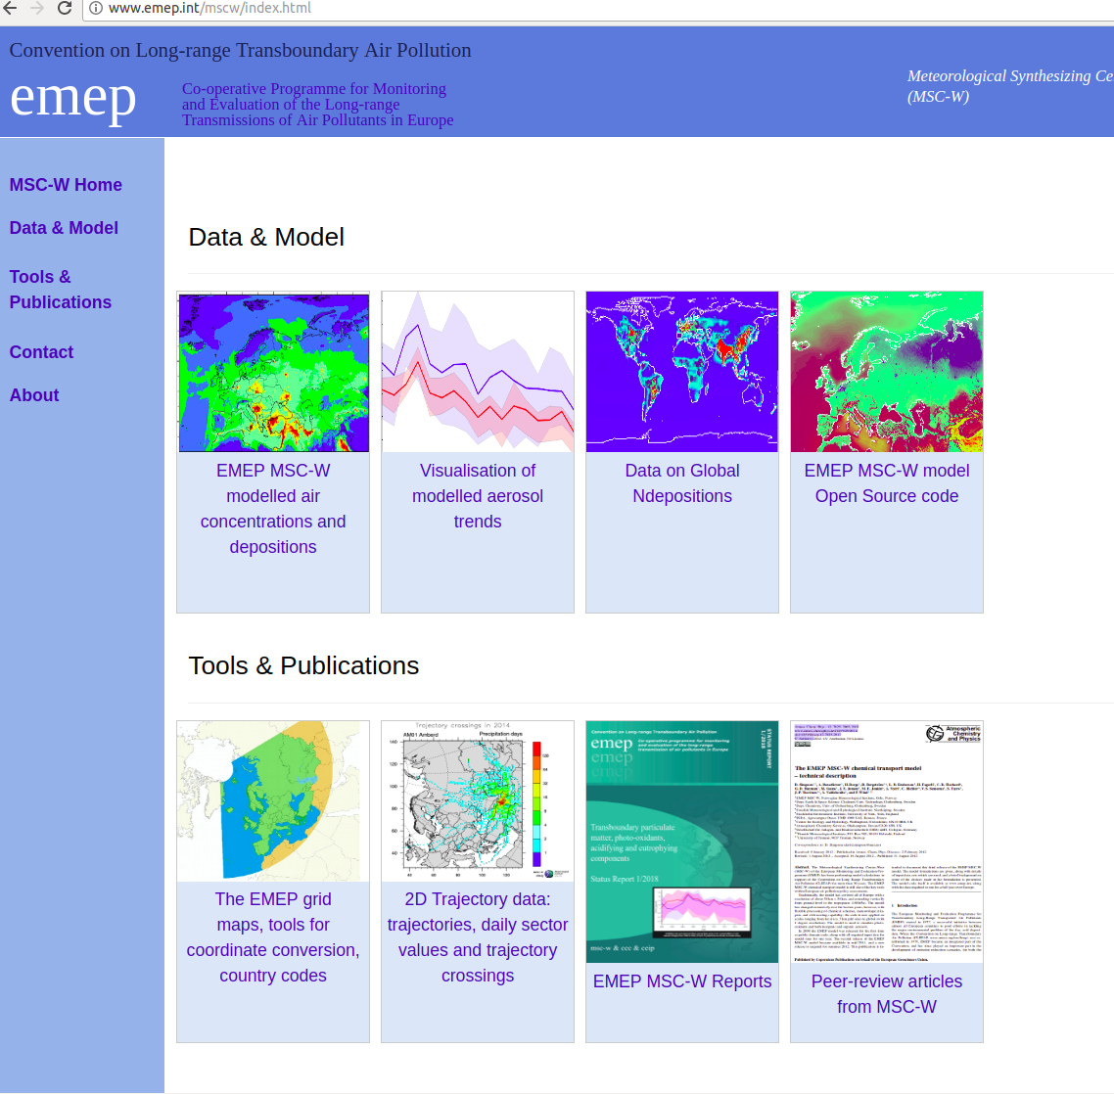
Access to data - visualization of EMEP aerosol trends
Not only data availability,
but also visualization of them
Notes:
-move and update web pages

Slide 22
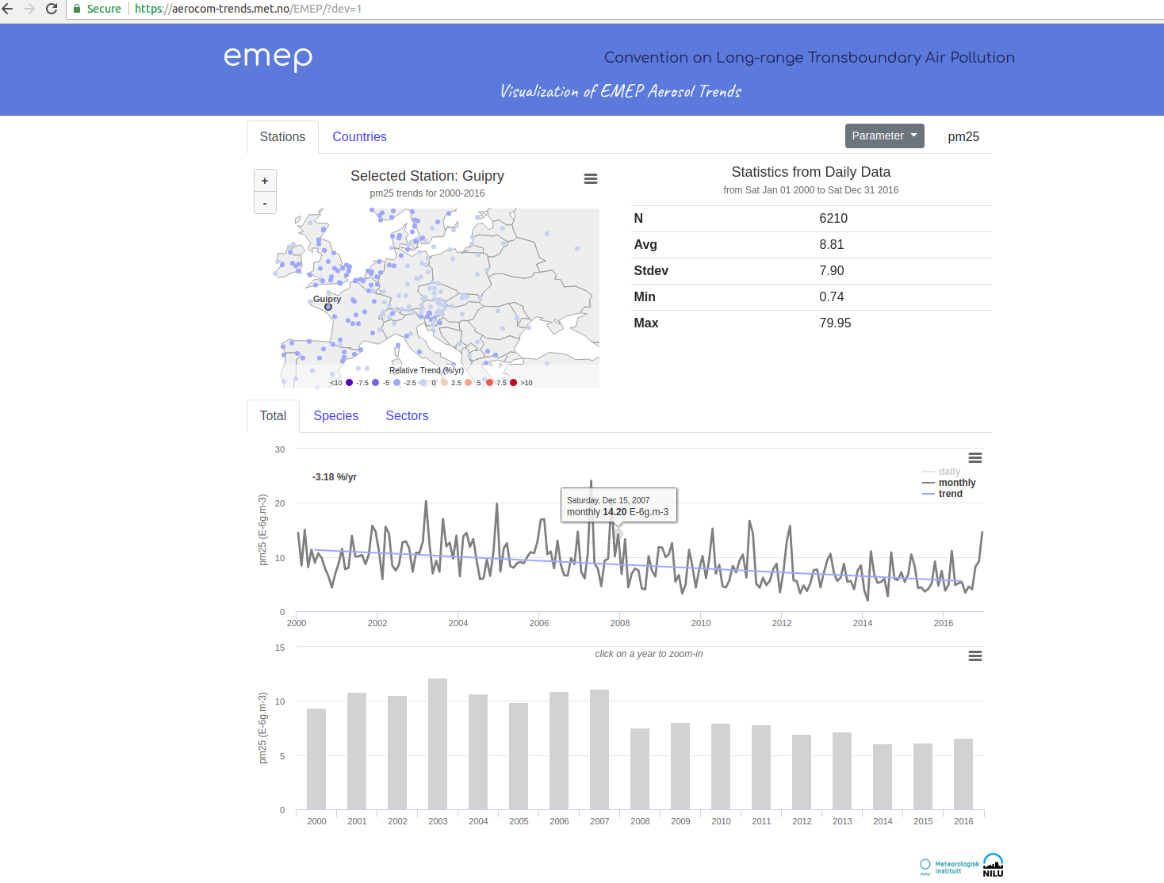
Based on
EMEP/MSC-W
model calculations in
0.1° x 0.1 °

Slide 23
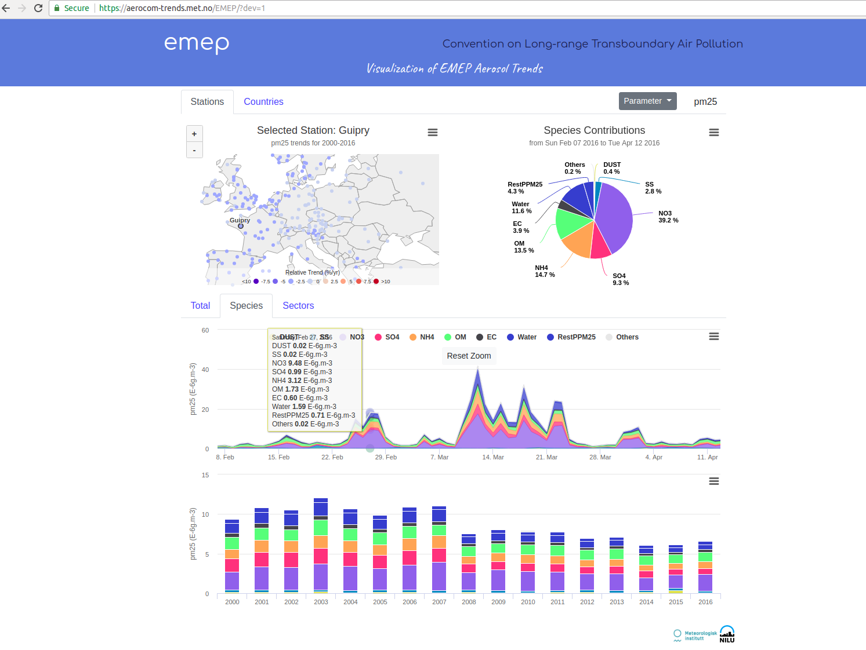
Based on
EMEP/MSC-W
model calculations in
0.1° x 0.1 °

Slide 24
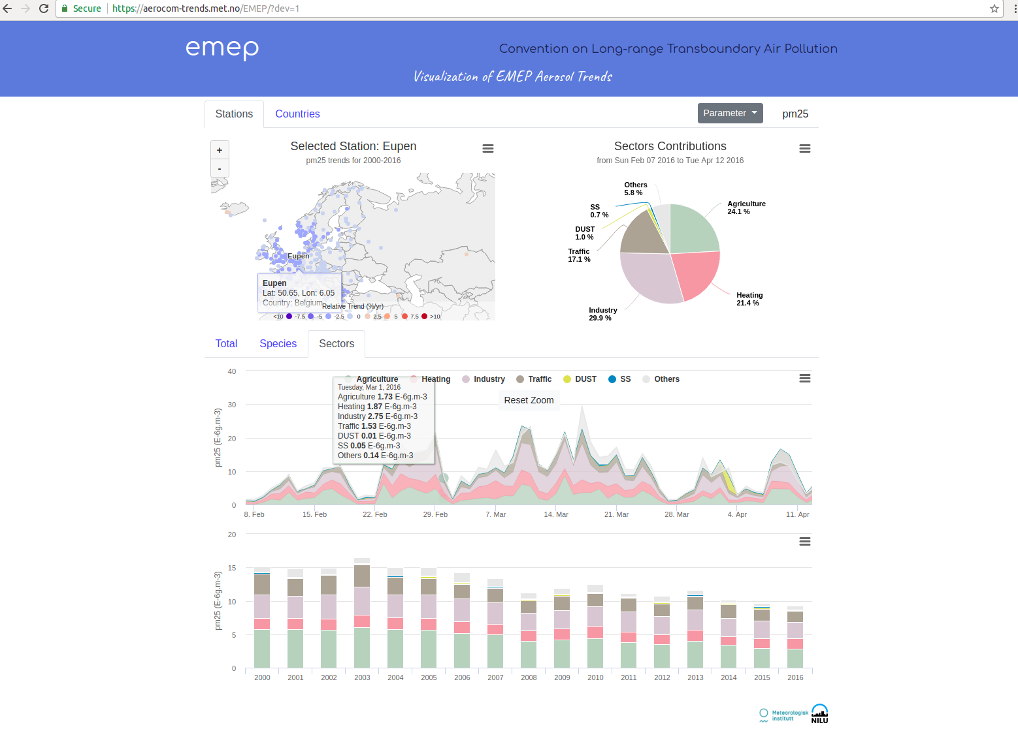
Based on
EMEP/MSC-W
model calculations in
0.1° x 0.1 °
Sector attribution based on calculations where different sectors has been reduced by 15%

Slide 25
Further plans
Now: Data from 2000-2016, chemical species and sectoral contributions (on 0.1x0.1 degree)
Extend to 1990-2017
So far PM25 and PM10 model data, to be populated with
* Observations (directly from EBAS/CCC)
* Other components
Gradually replace model evaluation report and country report with web-tools and data

Slide 26
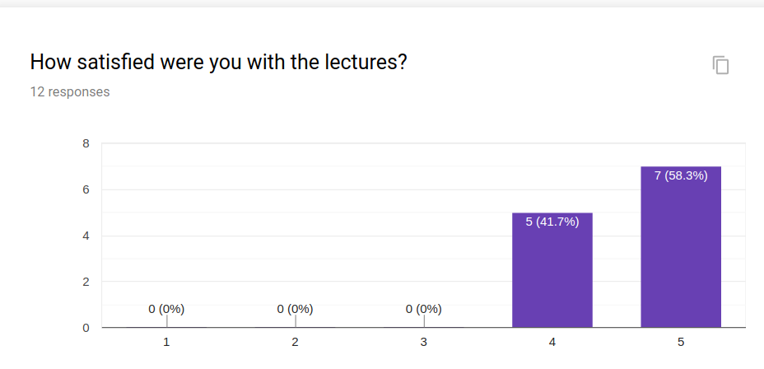
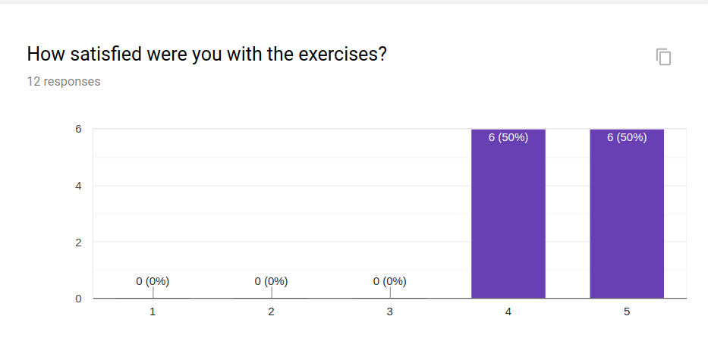
EMEP/MSC-W model Training course 29-30th April 2019
2-day course 29-30th April at MET Norway
Encourage the use of the EMEP/MSC-W model - help to get started
Talks and exercises (beginner and advanced)
24 registrations from Russia, Malta, Germany, Croatia, France, UK, Austria, Norway, JRC, India and China (closed course with 5 more on waiting list)

Slide 28
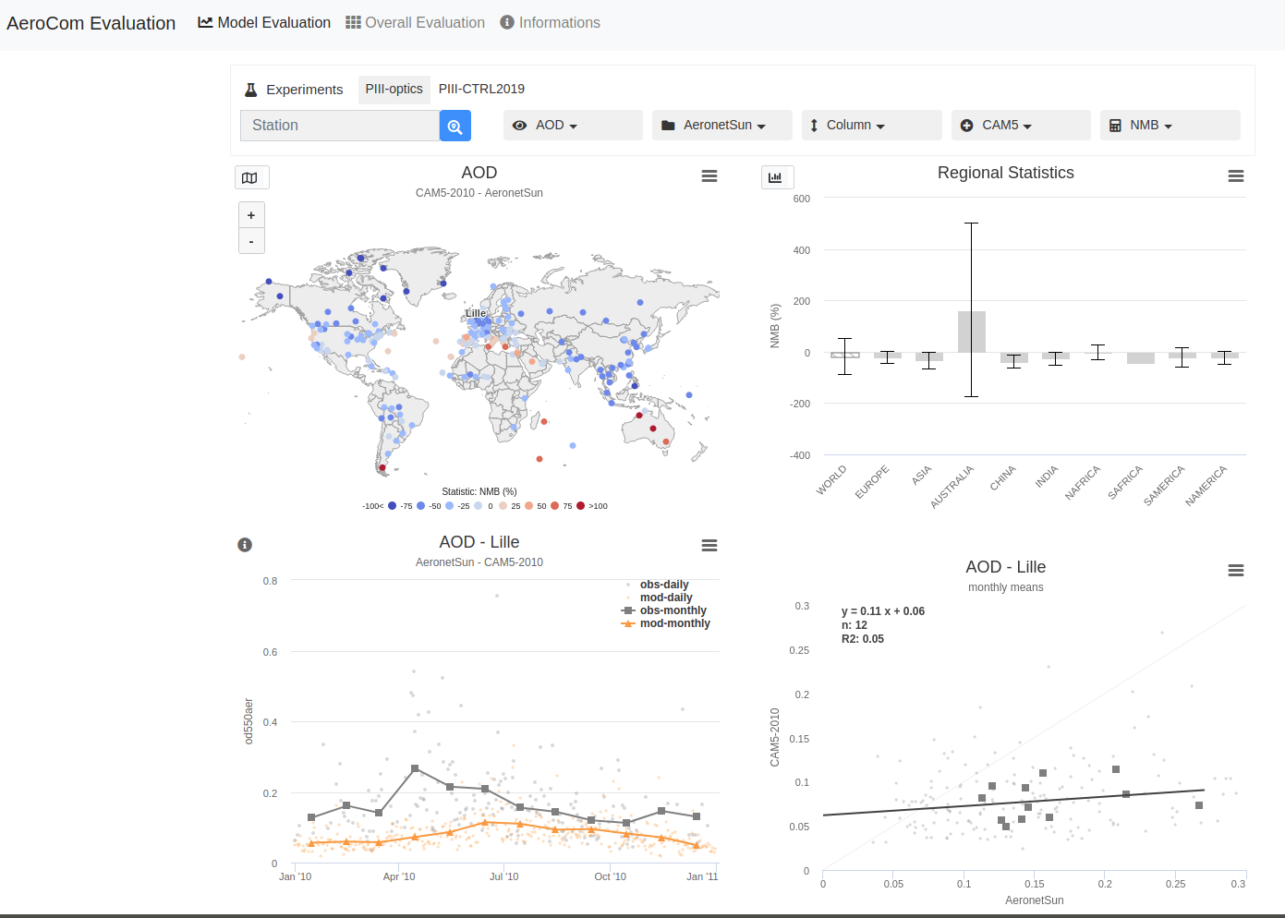

Slide 29
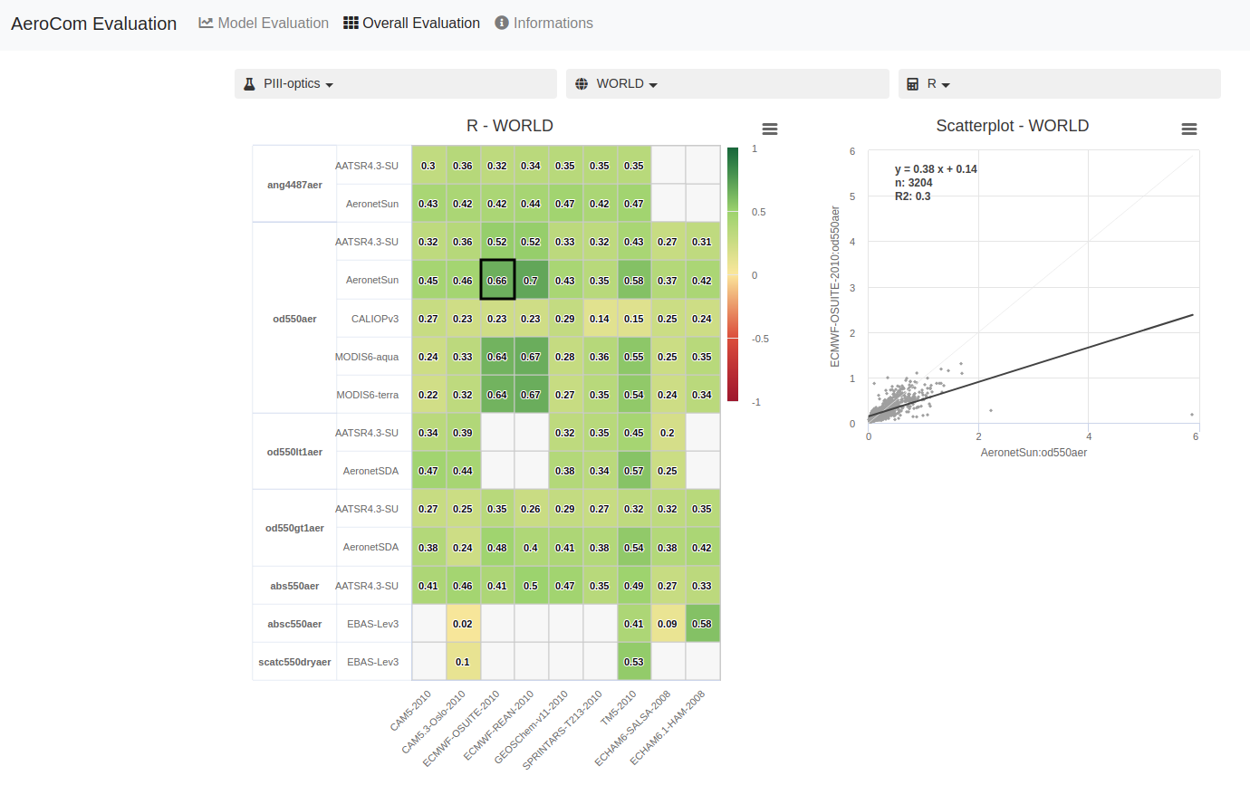

Slide 30
SO₂ – spatial correlation (mod vs Airbase) within each country
Left of the green line: countries that reported in the new grid
Parenthesis: number of sites

