Slide 1
Welcome & introduction TFMM co-chairs Augustin Colette & Oksana Tarasova
20th TFMM annual meeting, 7-9 May 2019
MITECO, Madrid, Spain

Slide 2
Welcome
Agenda of the meeting / Progress in 2018-2019 workplan
Revision of Monitoring Strategy
BC Field Campaign (EMEP/ACTRIS/COLOSSAL)
Twin Sites
Links with WGE
Preparing 2020-2021 workplan

Slide 3
Tuesday 7/5 pm
Meeting Objectives
Welcome of host
LRTAP/EMEP background information

Slide 4
Tuesday 7/5 pm
Emission assessment (1.1.2.2)
HM&POP Country Case Study (1.2.1)

Slide 5
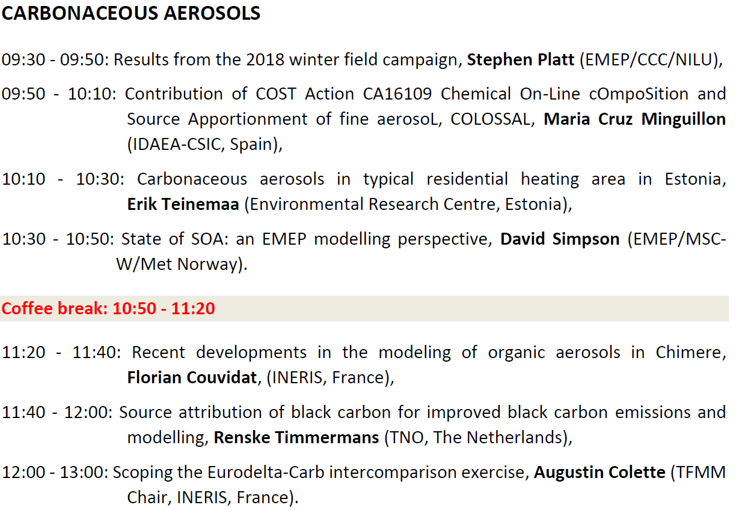
Wednesday 8/5 am
BC Field campaign (1.1.1.2)
Carb. Aerosol factsheet (1.1.1.7)
Condensable emissions (1.1.2.1)

Slide 6
Wednesday 8/5 Pm
Twin sites (1.1.1.2)
Global-regional modelling (1.1.4.1)

Slide 7
Wednesday 8/5 Pm
Country Updates

Slide 8
Thursday 9/5 am
Revision of EMEP Monitoring Strategy (1.1.1.1)

Slide 9
Thursday 9/5 Pm
EMEP/WGE (1.4.2)
Measurement-Model Fusion (1.1.4.1)

Slide 10
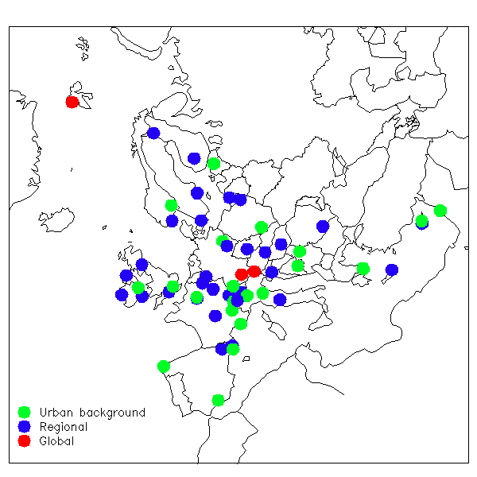
2020-2021 Workplan
Scope
Improve representation of carbonaceous aerosols throughout EMEP activities (Black Carbon & Condensables)
Activities
Monitoring: Winter 2018 EMEP/ACTRIS/COLOSSAL campaign
=> Assess fossil fuel / wood burning in BC
Modelling:
Eurodelta-Carb model intercomparison (inc. BaP wood burning)
LRTAP Emissions: BC / Condensables
Effects : Radiative forcing (climate)

Slide 11
Conference Dinner Wednesday 8/5, 20:00 “El Huerto de Lucas”, 13 San Lucas Street, Madrid

