Slide 1
Data quality of inorganic compounds in air and precipitation
Wenche Aas

Slide 2
Relevant topics to discus
Status of the program
  Coverage and methods used (reference method?)
  Quality
Documentation of the data quality
Revision of Data quality objectives (DQO) ?
Common problems/challenges

Slide 3
Methods used and problems with comparability in time and space
Manual methods in air and aerosols:
EMEP. Filterpack with no size cutof and includes sumN
EU Air quality directive: PM2.5, CEN standard EN 16913:2016
Contuinious methods more frequantly used:
i.e. ToF- and Q-ACSM and MARGA

Slide 4
Challenges for the development of measurements in precipitation
Sampling frequency
  Daily recommend
    Many use weekly and even biweekly and monthly
Bulk contra wet only
Storage –especially an issue in warmer areas
Lack of parallel official rain gauge

Slide 5
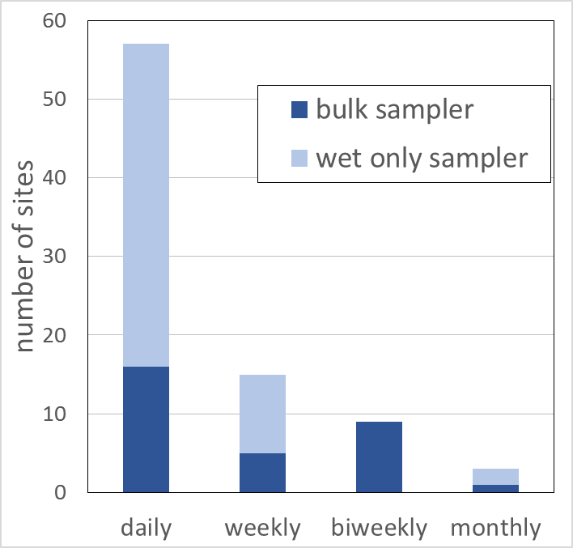
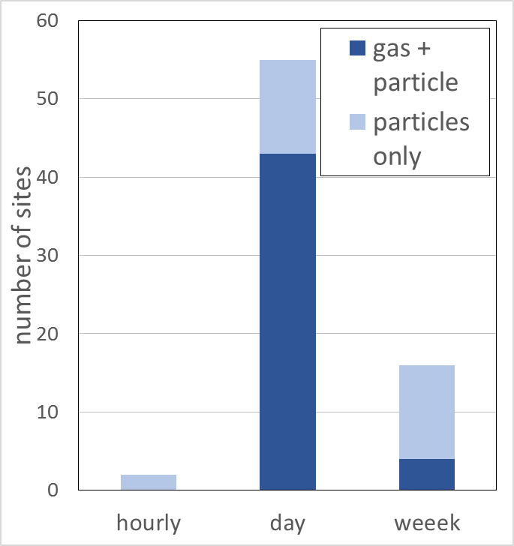
Methods and sampling frequency, EMEP sites in 2014

Slide 6
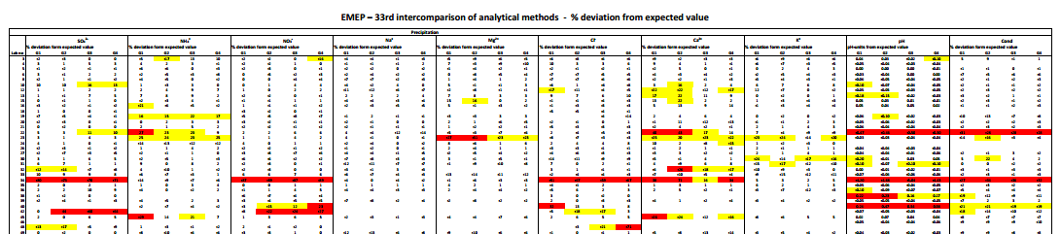
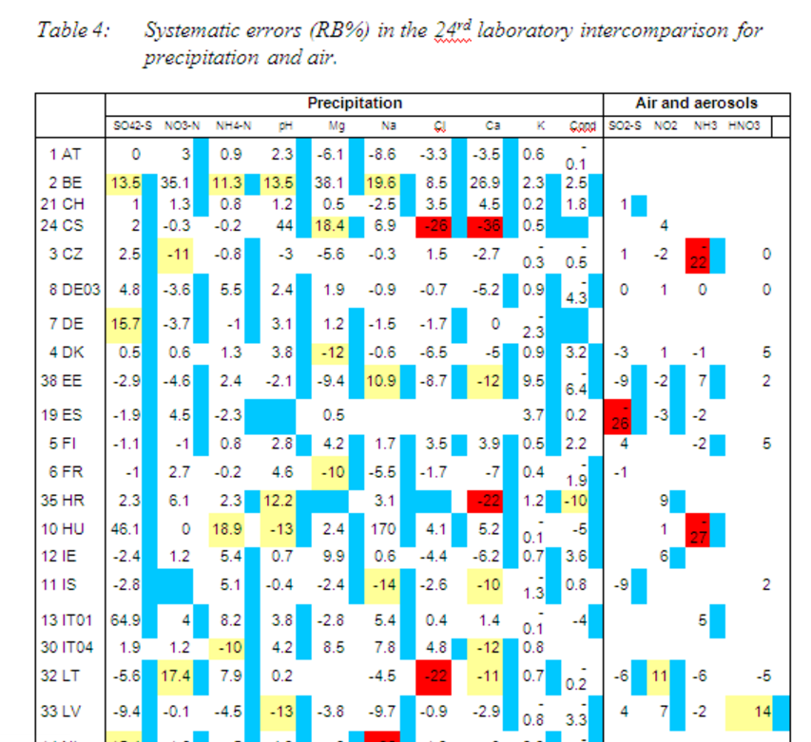
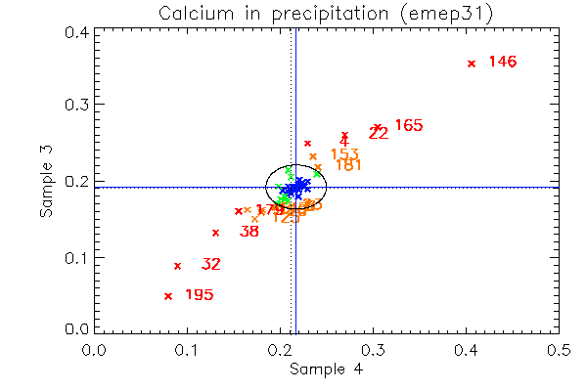
Lab intercomparisons annually
Per cent dev. from expected value
> DQO
> 2x DQO
Per cent relative bias

Slide 7
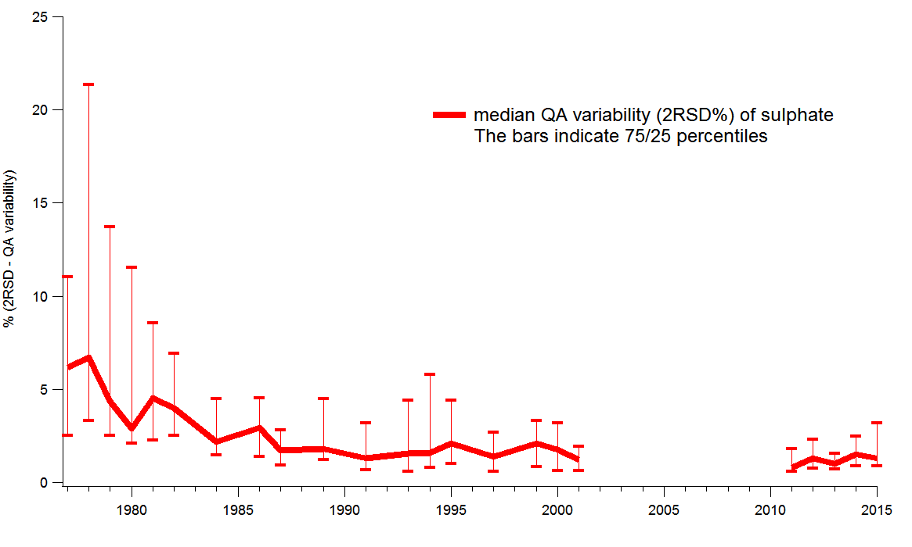
Trends in lab performance (e.g SO₄)
The present DQO level

Slide 8
Data quality objectives
inorganic
10% accuracy or better for oxidized sulfur and oxidized nitrogen in single analysis in the laboratory
15% accuracy or better for other components in the laboratory
0.1 units for pH
15-25% uncertainty for the combined sampling and chemical analysis (components to be specified later)
90% data completeness of the daily values
The DQOs do not necessarily reflect the present need for accuracy
If there a need to update the DQO, how to set the target?
Based on the possibility to detect trends
Based on how well the labs can perform

Slide 9
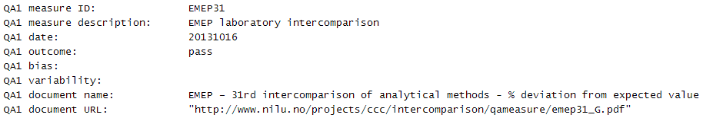
QA measures based on lab int results shall be reported with the data
In the template:
Annual data reporting should include results from two lab intercomparisons, which both cover part of the year. Download results from here:
http://www.nilu.no/projects/ccc/intercomparison/qameasure/

Slide 10
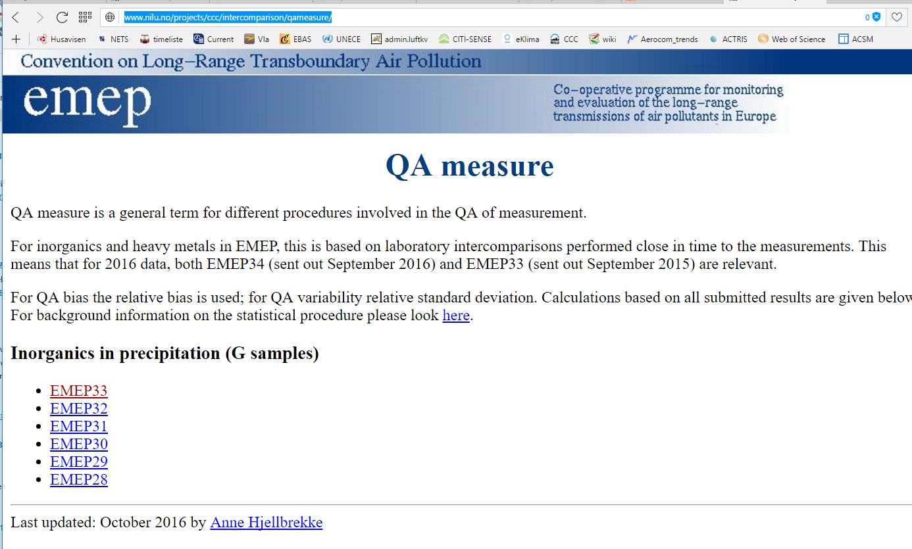

Slide 11
Other things important to include when reporting
Detection limit / quantification limit ?
Details on instrumentation
Filter choice and sample preparation
(Ambient or not)
Method uncertainty??
  If yes –how to calculate this
    GUM test?

Slide 12
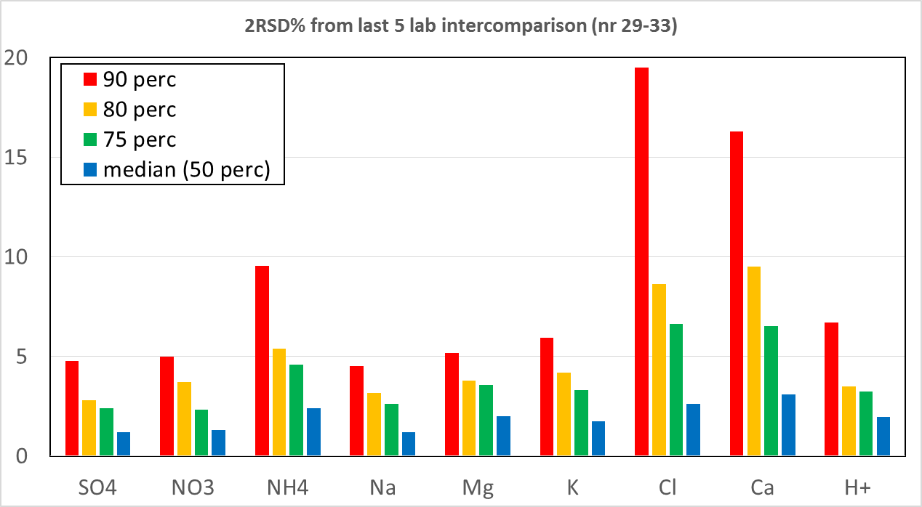
Results from last 5 years as base for new DQO (pass / no pass) ??
10%
5%

Slide 13
Discussion point for this session
How to avoid Parties to measure in accordance to the EU Directive only, at EMEP sites?
How to ensure sufficient sampling frequency
Specific challenges with the measurements ?
  Choice of filters (i.e. contamination of Pall Zefluour)
  Other things?
DQO and QA measure

Slide 14
Data quality of ozone and nitrogen oxides
Wenche Aas

Slide 15
Relevant topics to discus
New guidelines and recomnmendations
  SOP developed in WMO/GAW and ACTRIS
  Methods (Nox monitor vs manual method)
Documentation of the data quality
  New metadata included in the templates
  QA measures
Common problems/challenges

Slide 16
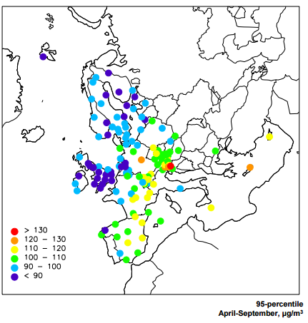
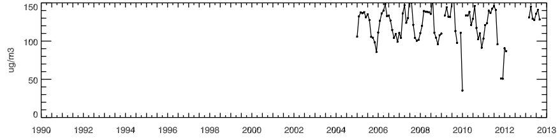
Ozone, Status of DQ in the network
The UV absorption method is the only measurement method in use.
Good coverage
For comparability in time and space. Question regarding
representativity
Calibration frequenzy
General maintainance

Slide 17
Ozone, points to note
Mixing ratio given as [nmol/mol] is the preferred unit
Check Absorption cross-section
Include information of monitor calibration(s)
Include information on filter test, leak tests, ozone scrubber test etc in the "Maintenance description" element
Include information of any kind if drying in the Temperature/humidity control tab.
Data capture > 66% in accordance to SOP GAW (new flag?)

Slide 18
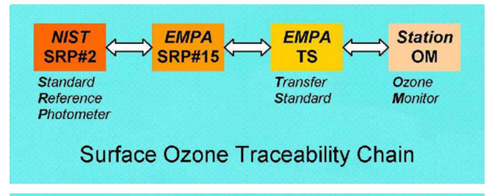
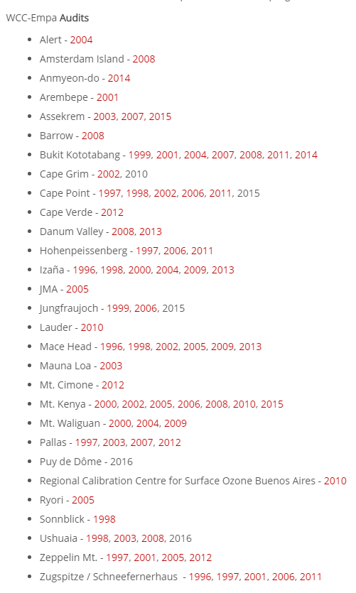
Calibration. EMPA –WCC Audits
QA procedures can either refer to either (or both)
WCC Empa audit
calibrations using a laboratory standard traceable to a national standard

Slide 19
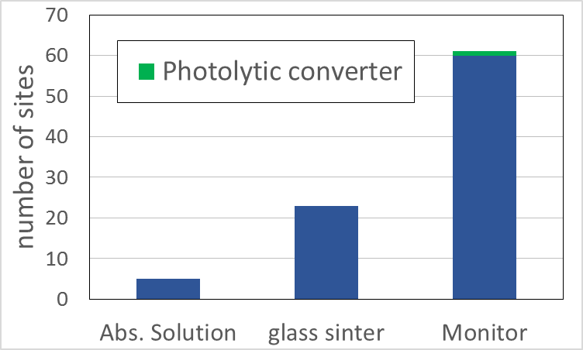
Methods used for NO2 and Nox

Slide 20
New reference method in EMEP
Now: manual glass sinter
Though many use chemiluminescence_molybdenum
(note change in instrument_name)
Change reference to chemiluminescence_photolytic
GAW reference method is being develop (soon to be published)

Slide 21
Briefly on OC/EC measurements within EMEP
Karl Espen Yttri

Slide 22
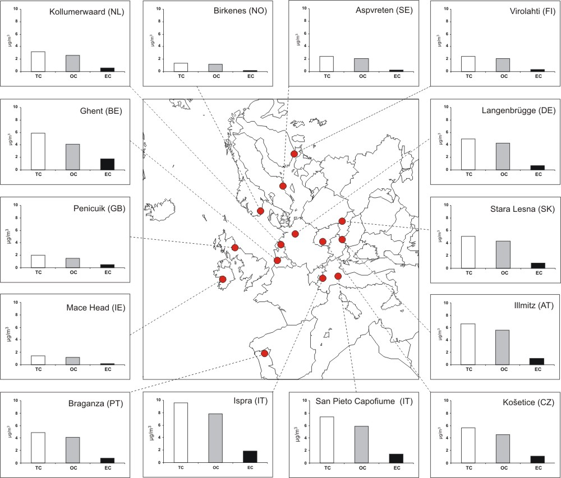
Carbonaceous Aerosol Observations in EMEP - Snapshots
Spatial variability:
Continental Europe 3x higher than North and North/West Europe, on average
Ispra (IT) 10x higher than Birkenes (NO) (EC)
Seasonal variability:
Winter time concentrations higher than during summer for all but the Nordic sites wrt OC
Relative contribution:
27 ± 9% of PM₁₀ attributed to organic matter (OM)
(OM = OC x 1.4-1.8)
OM > SO₄²⁻ for sites reporting both parameters
3.4 ± 1.0% of PM₁₀ attributed to EC
Lower
Higher
The EMEP EC/OC measurement campaign
(2002 – 2003)
(Yttri et al., ACP, 7, 5711–5725, 2007)

Slide 23
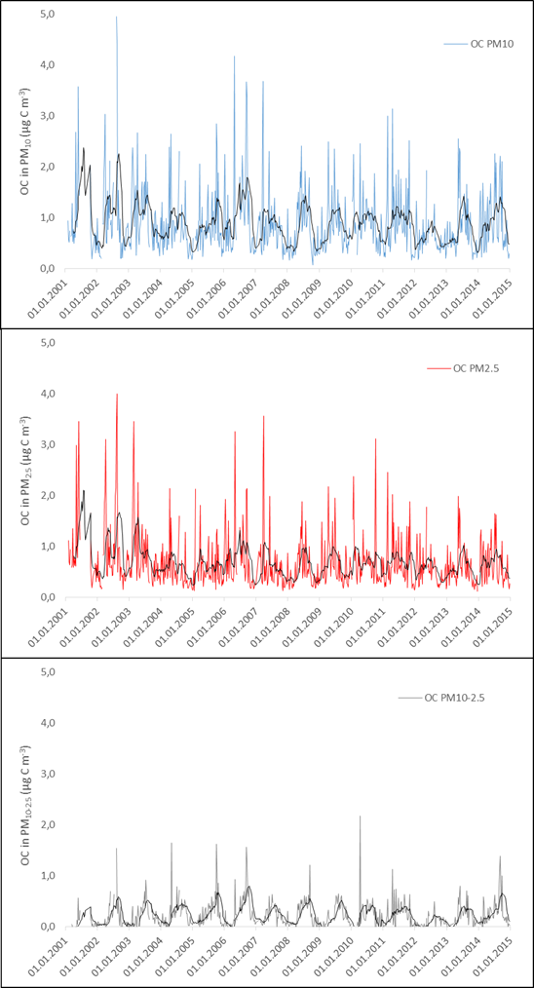
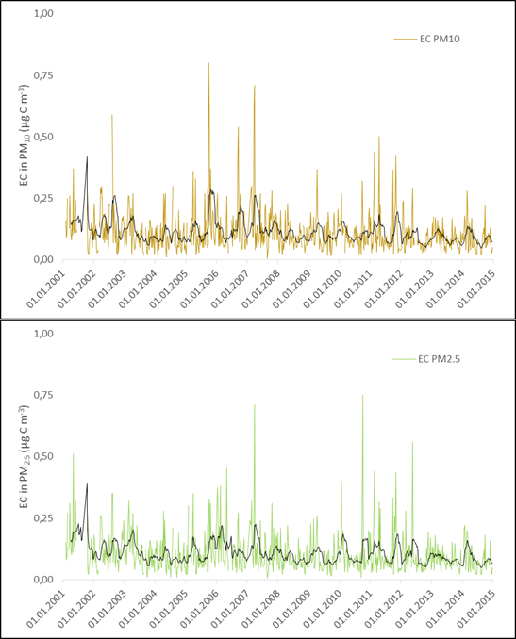
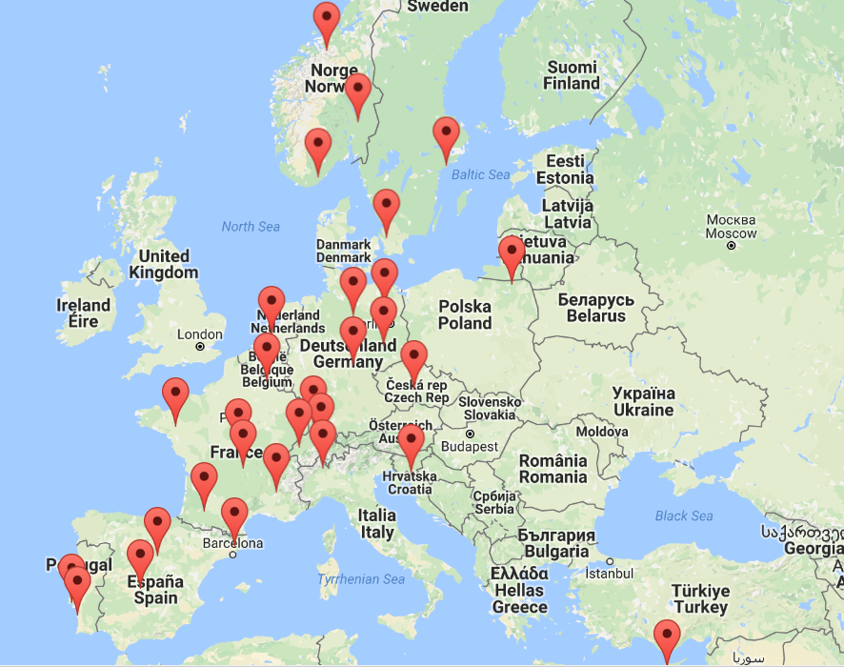
Carbonaceous Aerosol Observations in EMEP - Snapshots
Figure 2: Ambient aerosol concentrations of OC in PM₁₀, PM_{2.5} and PM_{10-2.5}, and EC in PM₁₀ and PM_{2.5} presented as weekly (168 h) mean concentrations for the Birkenes Atmospheric Observatory during the period 2001 – 2014. The black line is the running 10-week mean.
EMEP sites reporting OC/EC in 2014
Regions of poor coverage are emphasized
Yttri et al., in preparation

Slide 24
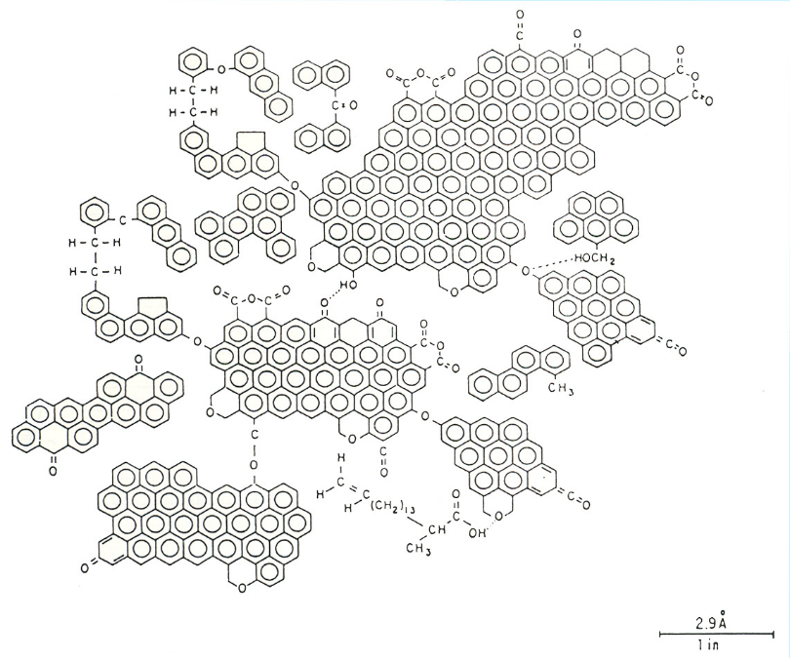
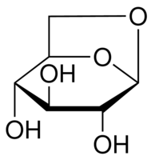

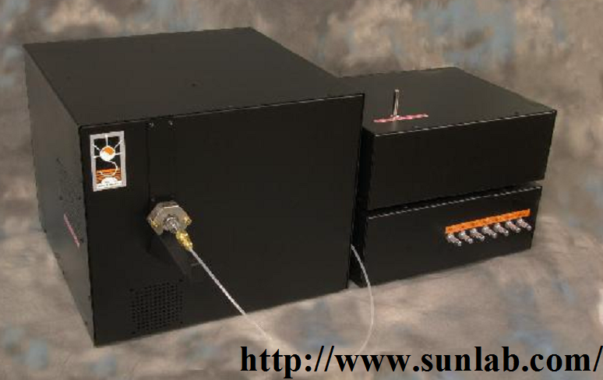
OC and EC - Operational defined
Carbonaceous aerosol originate from a vast number of anthropogenic and biogenic sources, such as:
Vehicular tailpipe emissions
Domestic heating emissions
Industrial emissions
SOA from oxidation of anthropogenic and biogenic volatile precursor gases
Primary biologial aerosol particles
Only a limited fraction of the carbonaceous aerosol mass is identified on a molecular level
Bulk carbonacoues fractions needed
Operational definitions - TOA:
  OC - Organic Carbon
  EC - Elemental Carbon
Proposed structure for hexane soot (Akhter et al., 1985)

Slide 25
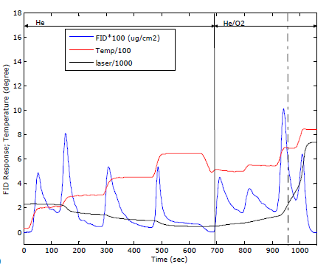
EMEP recommends the EUSAAR-2 protocol for
OC/EC measurements
Major development criteria for EUSAAR-2
Reduce charring
WHY: Difference in α for PC and EC will affect the accuracy of the optical correction and thus the OC/EC split
HOW: Increased duration and lower temperature at initial steps
Complete evolution of OC in He-mode
WHY: To avoid carry over of OC to the He/O₂ – mode, and to prevent LAC EC evolving in the He-mode
HOW: Max temp in He-mode = 650 °C appears as the best compromise
EUSAAR-2 elected as candidate for CEN standard summer 2015. Official vote by national representatives going on these days
Standard operating procedure for OC/EC measurements to be found in the EMEP manual:
  4.22 Standard Operating Procedures for thermal-optical analysis of atmospheric particulate organic and elemental carbon
  (http://www.nilu.no/projects/ccc/manual/index.html)
Ambient aerosol filter sample measured by EUSAAR-2.
Cavalli et al., 2010

Slide 26
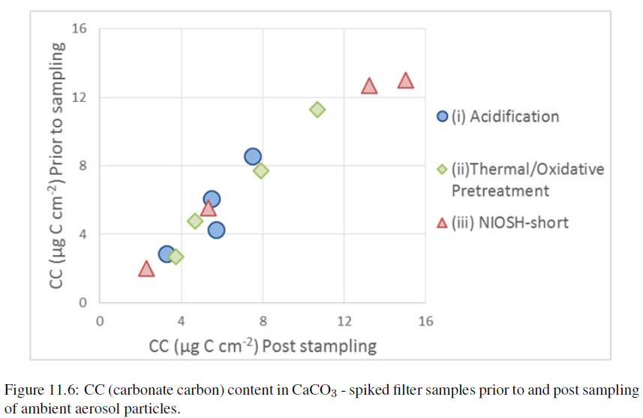
Influence by CO₃²⁻ - Carbon (CC)
on OC/EC analysis
CO₃²⁻ - carbon influence on TOA by EUSAAR-2
CC likely vary from negligible (e.g. Scandinavia) to noticeable (e.g. the Mediterranean ) within the EMEP domain
Potential overestimation of OC and EC if CC is not accounted for
Whether CC evolves as part of the OC or the EC fraction, or both, depends on the actual protocol (e.g. EUSAAR-2; IMPROVE; NIOSH) used
Currently no recommendation in the EMEP manual on how to account for CO₃²⁻ - carbon influence on TOA
Methods applied:
  Acidification
  Thermal-Oxidative pretreatment
EMEP Status Report, 2015

Slide 27
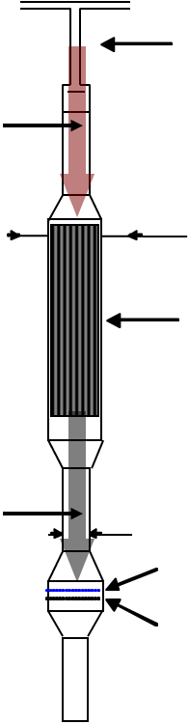
Collection of filter samples for subsequent OC/EC analysis
Positive artefacts: Organic vapor phase components adsorb onto the filter/aerosol particles impacted on the filter
Negative artefacts: SVOC condensed onto aerosol particles trapped by the filter that evaporate during continued sampling
Tandem filter sampling - QBQ
OCp OCg
  Accounting for sampling artefacts
Tandem filter sampling – QBQ
  OCParticulate = OCFront f. – OCBackup f.
  Positive artefact = OC on backup filter
NB: negative artefacts not accounted for!
Denuder
  OCParticulate = OCFront f. + OCneg. – OCpos.
  Positive artefact = OCFront f. * (1 - Denuder eff.)
  Negative artefact = OC on backup filter
  NB: Denuder efficiency and negative artefact are default values based on results from tests
Front filter
OCg
Front filter
Backup filter
Backup filter

Slide 28
Status of reporting - 2014
30 sites in 14 countries reported OC/EC data to EBAS for 2014
Eastern and western parts of the EMEP domain are poorly covered
OC/EC measurements are performed that are not reported to EBAS
Only two sites have a time-series that extend 10 years or more Shift in analytical protocol for both

Slide 29
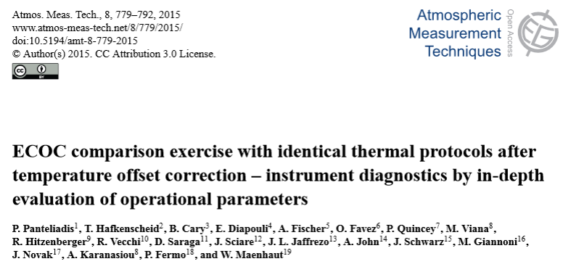
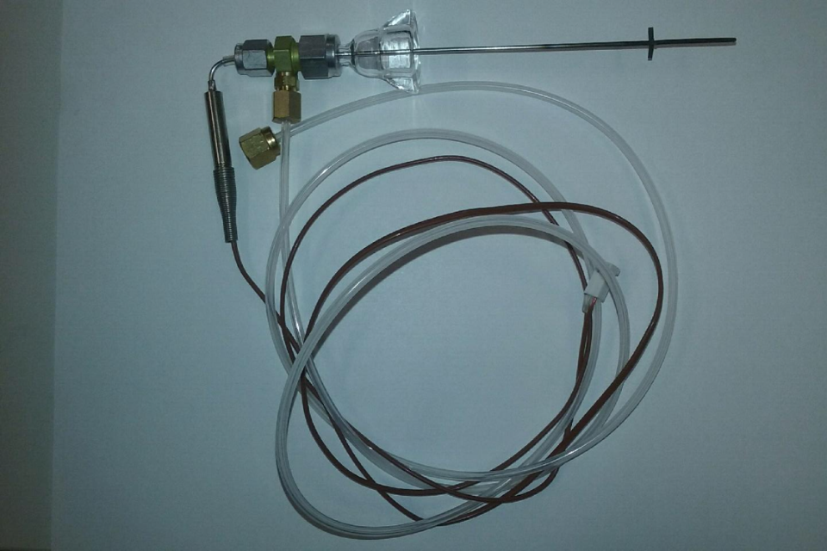
Status of reporting – 2014 II
All sites reported OC/EC data obained by TOA
28/30 reported data based on the EUSAAR-2 protocol
EUSAAR-2 is likely becomming the CEN standard for OC/EC
ΔT (-93 - +100)
Calibration of Temperatur-steps in your TOA instrument:
HIGHLY IMPORTANT!!!!

Slide 30


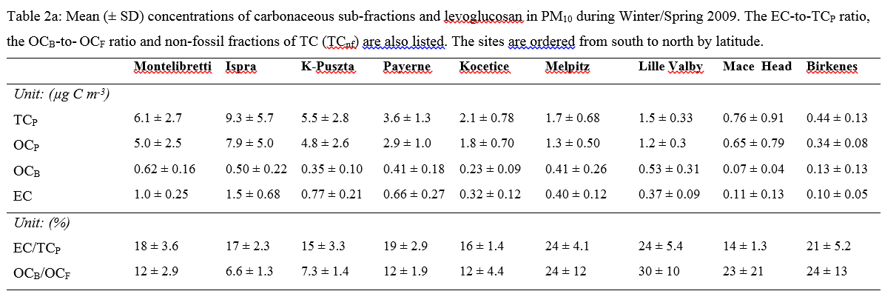
Status of reporting III
Ispra
Aspvreten
Vavihill
3/30 sites account for both pos. and neg. sampling artefacts
Estimates of pos. sampling artefact exist for several sites (e.g. EIMPS). Should be made available via the submission template
Yttri et al., (in prep.)
OC/EC data quality has improved wrt sampling-time and frequency
61% of the sites did not use data quality flags; 0.999 and 0.000 excluded
30% reported OC/EC data according to the EUSAAR format
35% of the sites have a sampling scheme that covers < 75% of the year

Slide 31
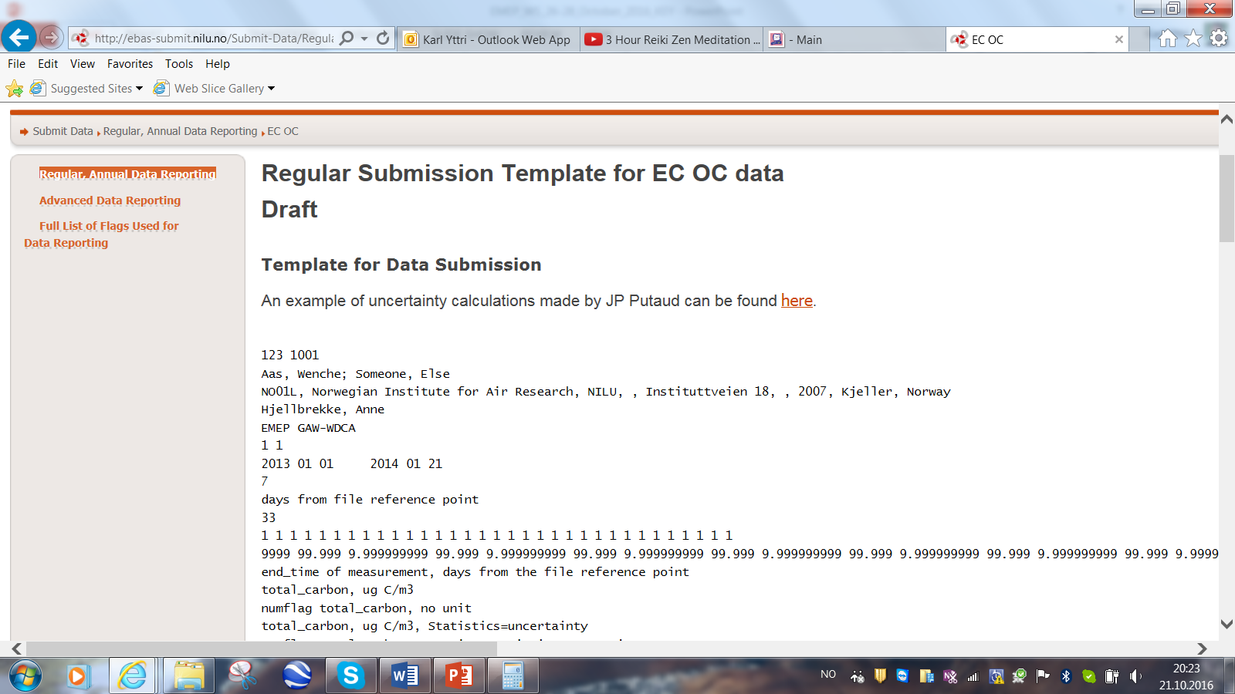

Format Issues – A selection
Copy and paste from the format is never a good idea!
2) Uncertainty: Calculate the uncertainties of your analyses!
http://ebas-submit.nilu.no/Submit-Data/Regular-Annual-Data-Reporting/EC-OC
3) Unit: The unit is µg C m⁻³, not µg m⁻³.
4) Matrix (e.g. PM₁₀, PM_{2.5} or PM₁) must be combined with an appropriate Inlet type (e.g. direct impactor), not hat or hood implying a TSP inlet.
5) Filter face velocity: When calculating the ffv, use the exposed area, not the total area of the filter

Slide 32

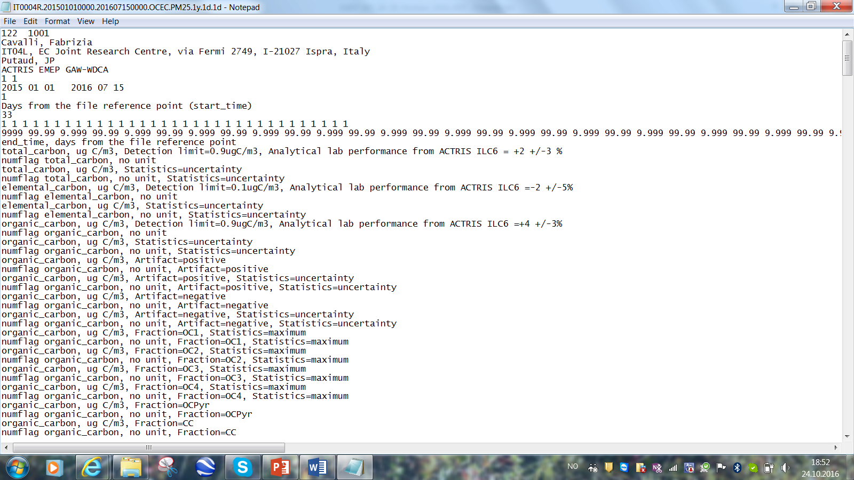
Format Issues – A selection II
6) Filter pre-firing: Temperatures in Kelvin; duration of pre-firing to be included
K
7) Artefact correction description: Describe how you correct for artefacts and how you calculate corrected values for OC (OCp)
Description: Tandem filter sampling by QBQ
Calculating OCp: OCp = OCFront filter – OCBackup filter
8) Detection limit: LOD can be different for TC, OC and EC; there is an option to also include the LOD along with the name of the variable

Slide 33
Format Issues – A selection III
9) Detection limit description:
LOD often calculated as 3*SD of the fieldblanks; which might be challenging
OC: To what extent are field blanks representative?
EC: Field blanks do not contain EC
!!! Important to use this section !!!
Describe how the fieldblanks were obtained, e.g. if they have been inserted into the sampler and ran for e.g. 1 – 2 minutes.

Slide 34
Format Issues – A selection IV
10) QA - Measures
ILC for EMEP sites performing OC/EC measurements is conducted as part of the EU-funded project ACTRIS-2
Time schedule for upcoming ILC on the following page:
http://www.actris-ecac.eu/time-schedule.php
The application procedure is thoroughly described on the following page: http://www.actris-ecac.eu/application-procedure.php
Results from ILC to be included under QA

Slide 35
Heavy Metals and POPs

Slide 36
Heavy metals –discussion itemes
QA measure and DQO
  Now based on low and high concentration samples. High , not realistic level in the network
  Change intercalibration to 4 samples with similar level (as for inorg) representative for the EMEP network and calculate QA bias and variability in similor fashion
Field blanks
  Correction and actions taken when high blanks?

Slide 37
Mercury reporting
Component names presently a mess
elemental_gaseous_mercury
total_gaseous_mercury
gaseous_methyl_mercury
reactive_mercury
reactive_gaseous_mercury
I nedbør: mercury and methyl_mercury
Simplify to only
  mercury (includes both TGM and GEM)
  Gaseous oxidized mercury (RGM, GOM)
  Methyl mercury
  Differentiate between TGM and GEM with metadata (with or withour sodalime)
Quality difficult to assess
  Some labs with detection limit problem
  Include more information on how instrument is treated and ca valibration

Slide 38
POP –new metadata information
Metadata Sample preparation
(extraction+solvent+internal std+cleanup):
Soxhlet+Dichloromethane+13C+Silica
Soxhlet+Dichloromethane+No+Silica
Soxhlet+Dichloromethane+13C+Silica/acid
Soxhlet+Dichloromethane+No+Silica/acid
Soxhlet+Di-ethyl ether/Hexane+13C+Silica
Soxhlet+Di-ethyl ether/Hexane+No+Silica/acid
Soxhlet+Hexane+13C+Silica
Soxhlet+Hexane+No+Silica
Ultrasonication+ Di-ethyl ether/Hexane+13C+Silica
Ultrasonication+ Di-ethyl ether/Hexane+No+Silica
microwave
metadata medium
Quartz+PUF
Quartz+PUF+PUF
Quartz+PUF+XAD+PUF
Glass fiber+PUF
Glass fiber+PUF+PUF
Glass fiber+PUF+ XAD+PUF
Teflon+PUF+XAD+PUF

