Slide 1
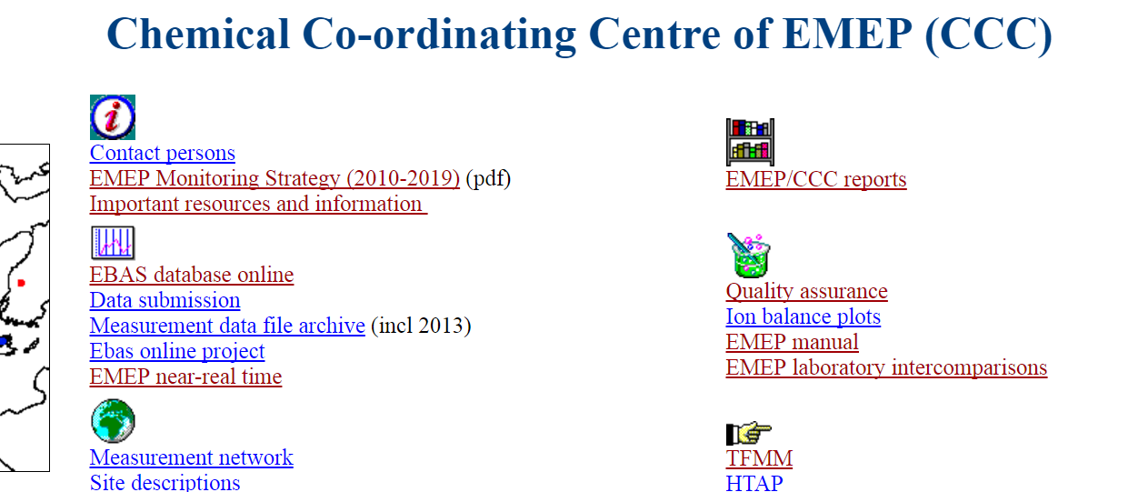
Introduction – workshop on EBAS and Data Quality
Kjetil Tørseth, EMEP-CCC
TFMM-workshop, NILU, 26 Oct 2016

Slide 2
«Data quality and database issues are closely linked»
OECD LRTAP; a new network of sites was established and data collected at NILU, data mainly reported on paper -> LRTAP proven and formed basis for EMEP
EMEP; data reported on paper and later as flat files
EBAS; a relational database, developed around 1995 (EMEP/AMAP)
EUSAAR; funded the web interphase, later developments funded by ACTRIS
EBAS-Online; funded an updated relational database model
EBAS- Online
CREATE/EUSAAR/ACTRIS
Acid rain
EBAS
GAW-WDC
OECD
EMEP (HELCOM, OSPAR, AMAP)
1970
1980
1990
2000
2010

Slide 3
Timeline – frameworks Complexity
History of EBAS
OECD; 72-77
EMEP; 79->
HELCOM; 1989->
OSPAR; 1991->
AMAP; 1995 ->
CREATE/EUSAAR/ACTRIS; 2000
GAW-WDCA; 2010 ->
GAW-WDCRG; 2016 ->
Major inorganics in air and precipitation
Surface ozone, NOx, VOCs
Heavy metals in air and preipitation
POPs in air and precipiation
Aerosol physical and optical properties
Tracers, and long-lived species
Now Global scope, varying DQO…
The most comprehensive atmospheric composition data repository: 78000 datasets, 911 stations, 69 countries, 631 components, 48 frameworks, 101 Instrument types, time series since 1971

Slide 4
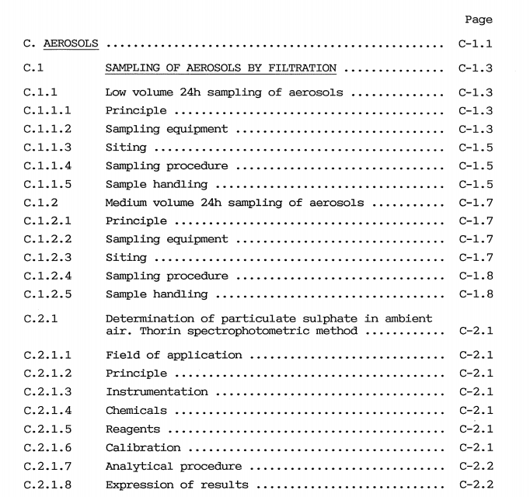

Goal:
«Establish a network of comparable sites performing comparable measurements»

Slide 5


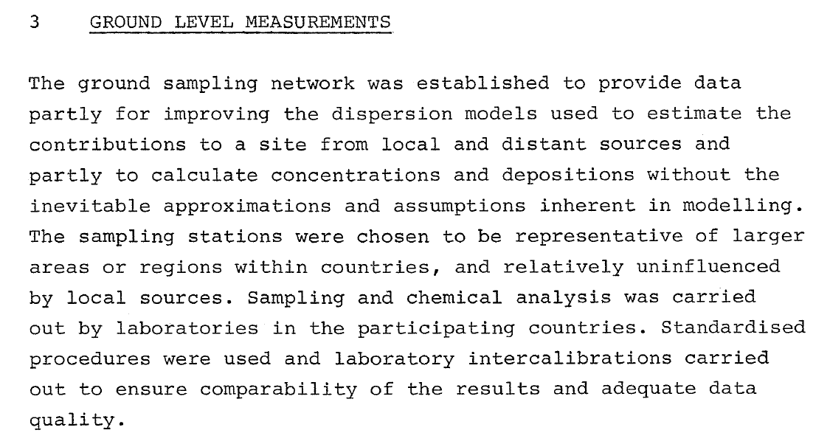
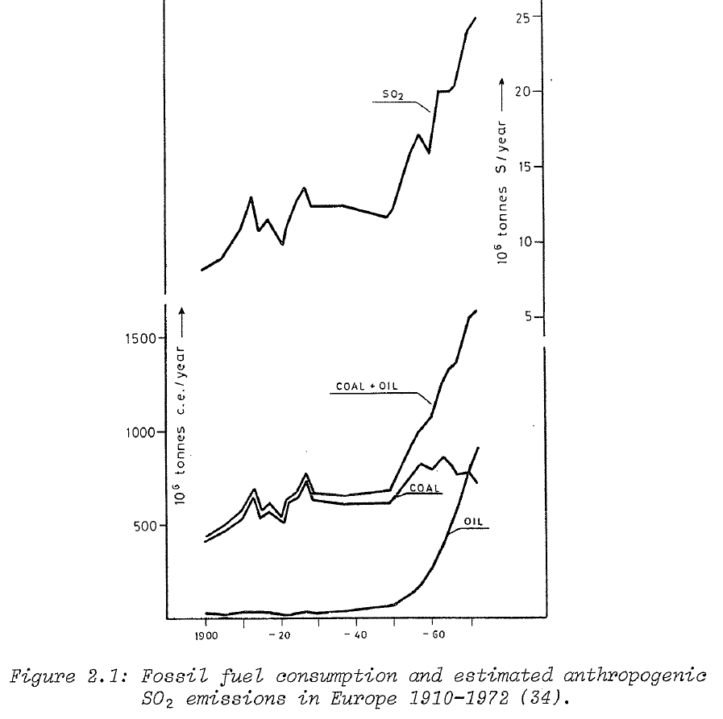
Early days, …1970ies

Slide 6
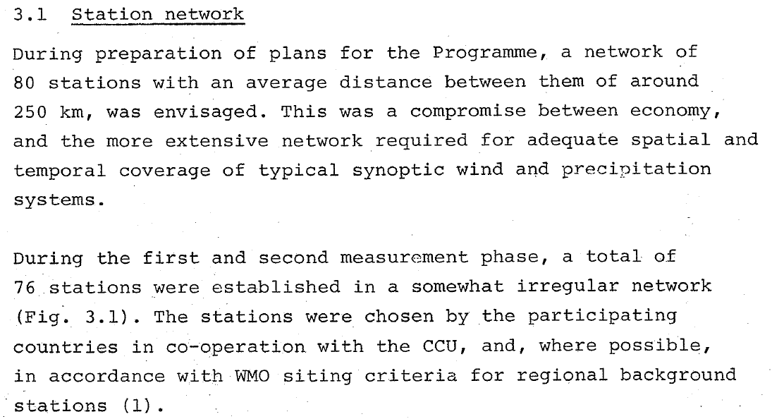
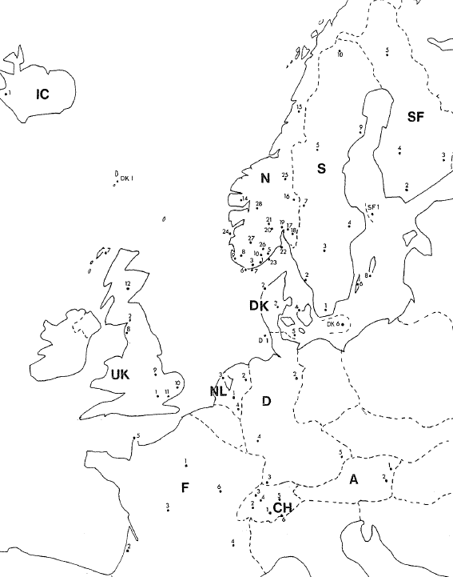
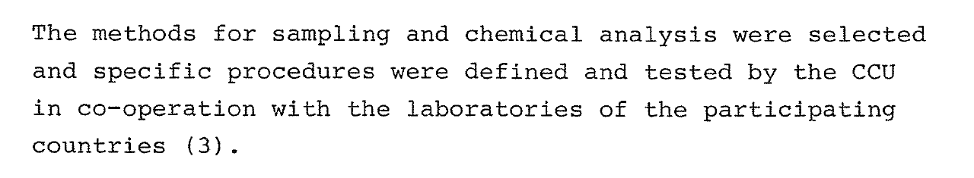

Slide 7
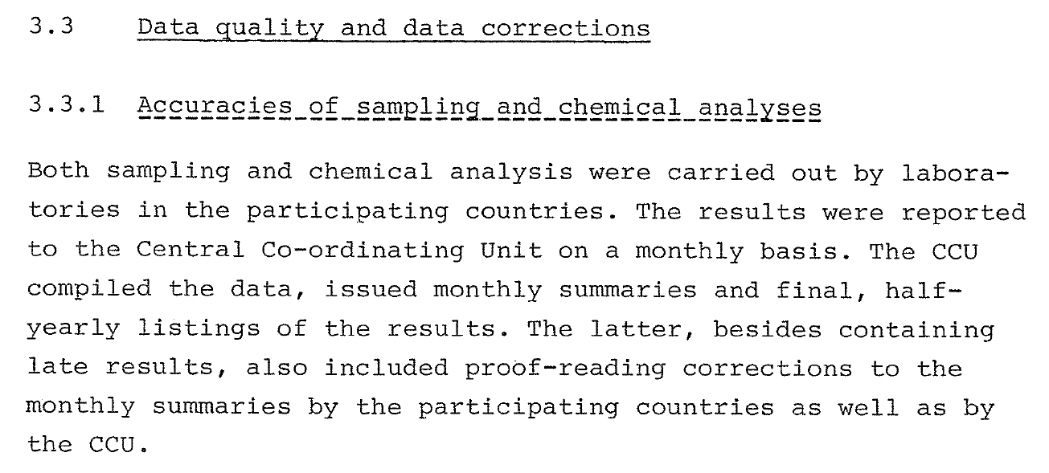
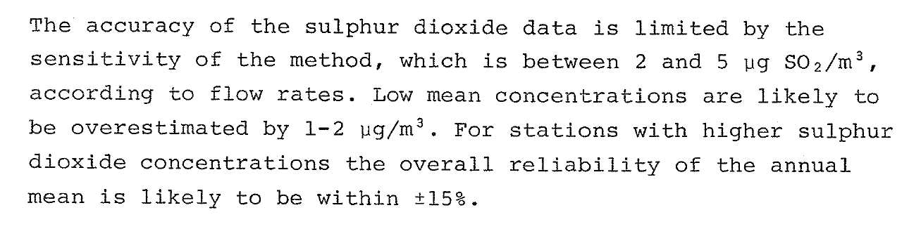

Slide 8
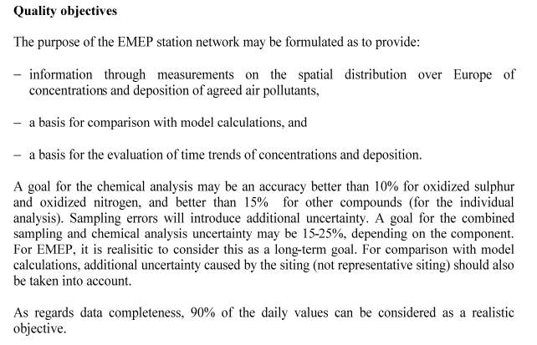
1995: first introduction of «DQOs» (largely influenced by CapMon through discussions in GAW PC-SAG)

Slide 9
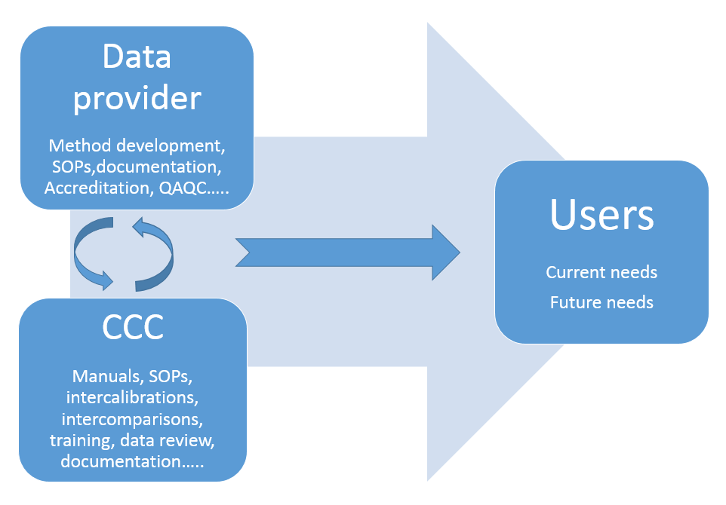
EMEP-CCC QAQC efforts (have) include(d)
More stringent data documentation
Data reviews
Laboratory intercomparisons
Field intercomparisons
Capacity building
Expert meetings
Training courses
Involvement in external efforts (CEN, GAW, etc)
Improved documentation of data and metadata

Slide 10
QAQC info: results from intercomp etc.
IPR, Branding, Versioning, Tracking use, tracking Impact, DOIs….
Data review:
CCC/NILU
External
user
Formats
Standards
Units
Flags Tools
etc.
Validated data
NRT prelim. data
Institution/PI
Authorised body
Manual or automated (on/off line)
EBAS
Aggregates, plots, reports, maps, assessments
Stakeholders
Secondary portals
(WIGOS, GEOSS, IASOA, ACTRIS ++++
Hardware
Software
Licences
Security
User support
Site offering
~10-500 variables
Meta data exchange
Complicating factors: many stakeholders, distributed (and limited) funding , one size fit all…

Slide 11
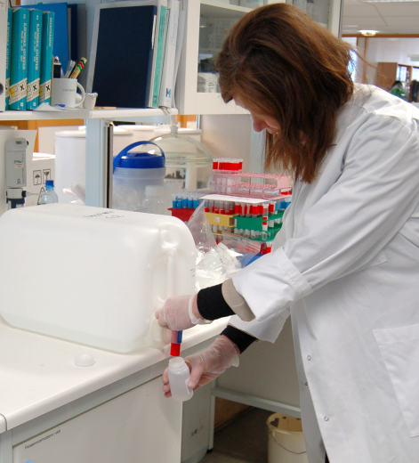
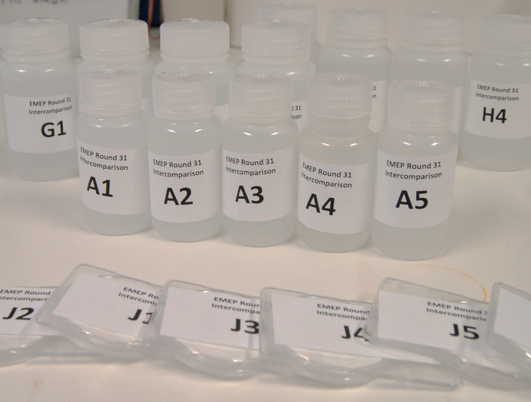
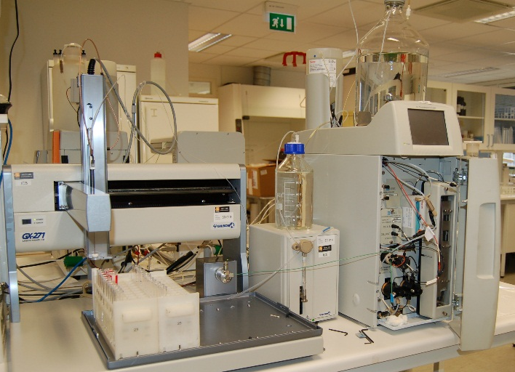
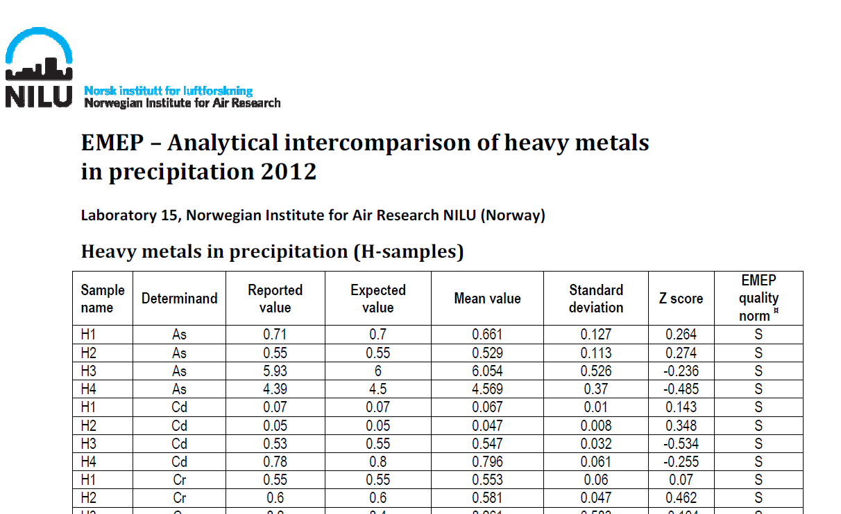
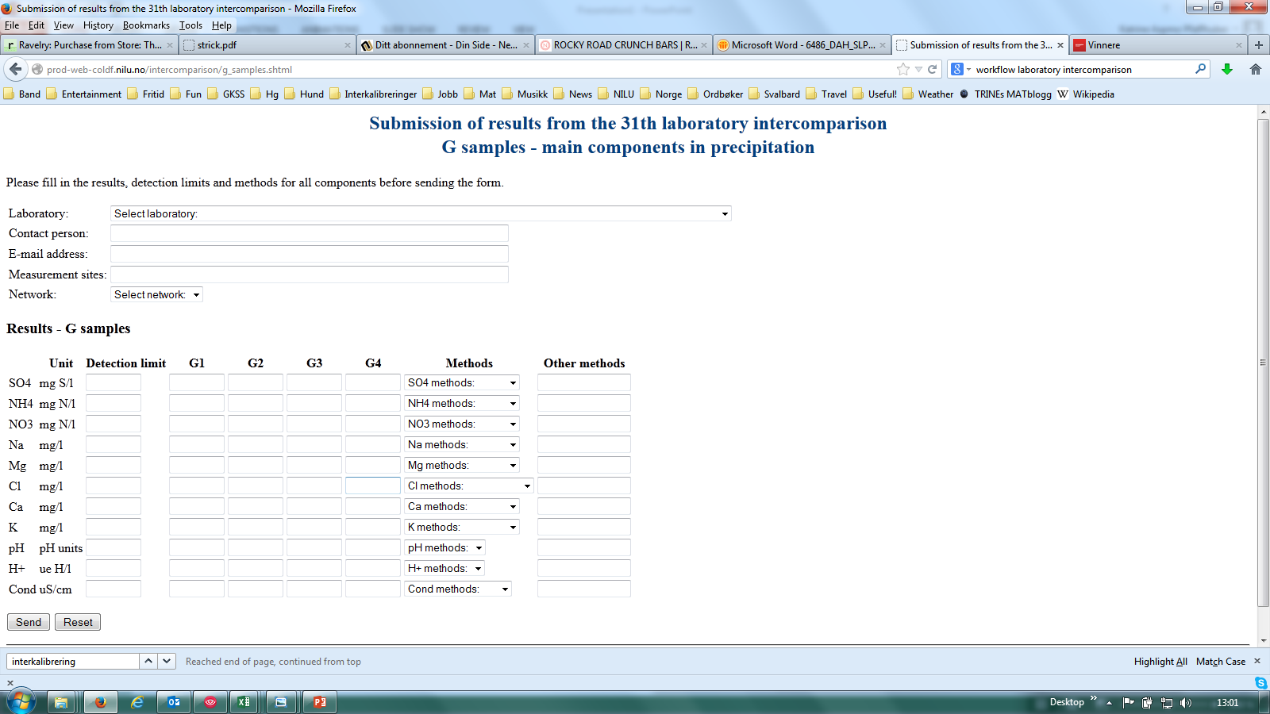
EMEP Laboratory intercomparison – Execution
Prepare synthetic
samples
Pack and dispatch samples to
participation laboratories
Analysis of samples in
the laboratory
Evaluation
of results
Certificates sent to the labs
Submission of results on the EMEP web page

Slide 12
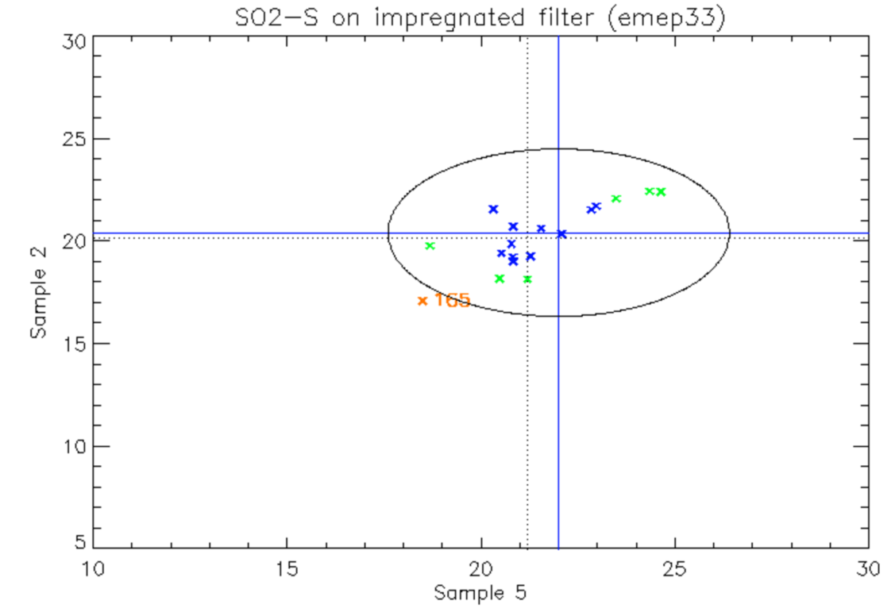
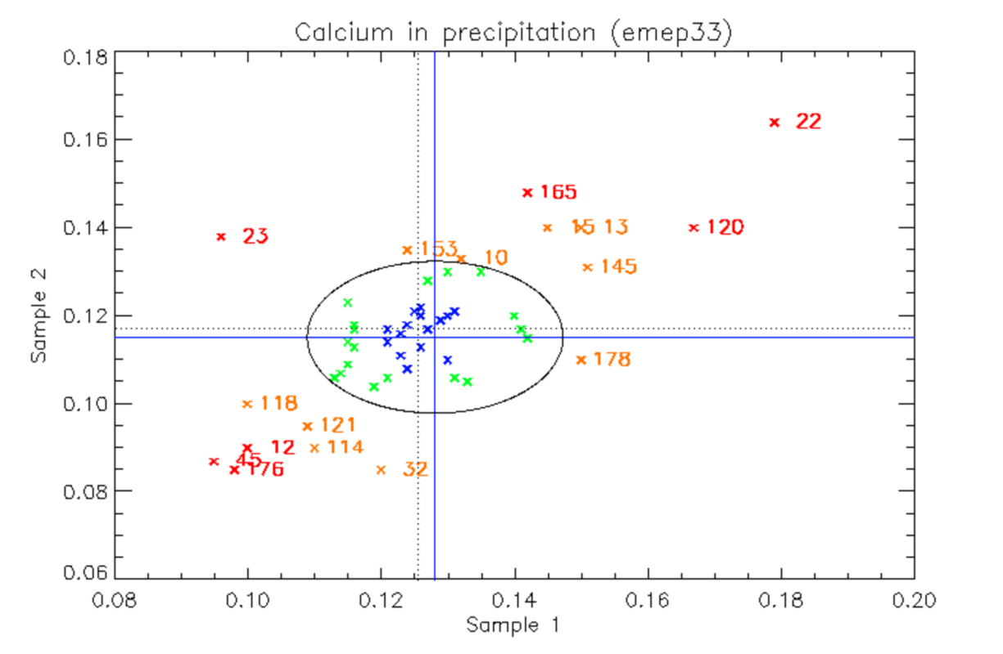
Circle radius: 20%
Circle radius: 15%

Slide 13
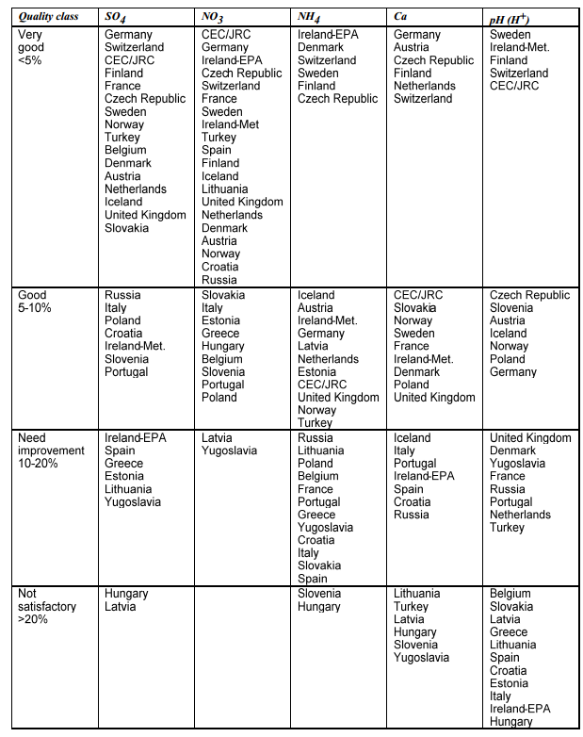

Slide 14
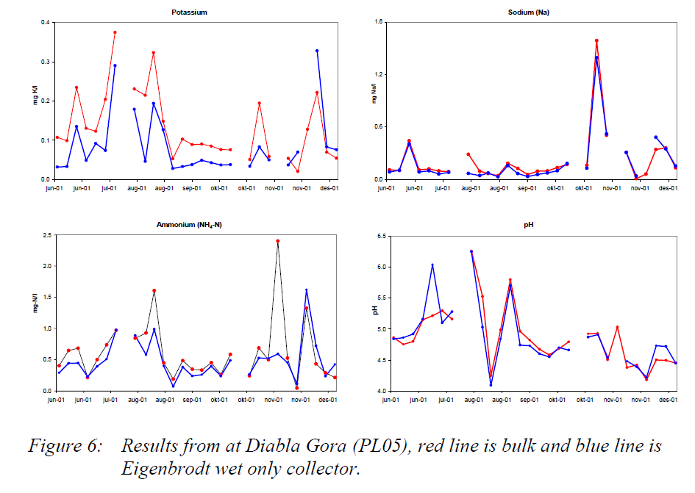

Slide 15
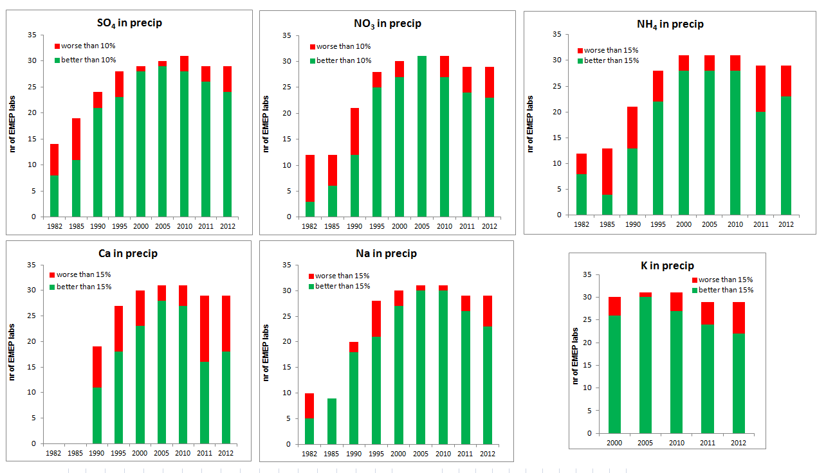
Inorganic in precip

Slide 17
So, why is data quality barely improving?
QAQC regimes have improved significantly
Analytical technology has improved significantly
Scientific understanding has improved significantly
more diversity in efforts?
Work done by «less interested» organizations?
Cost savings and use of commercial labs with mass production?
No internal improvement in participating labs?
Focus changed from CHEMISTRY -> POLICY?

Slide 18
Data provider
Method development, SOPs,documentation, Accreditation, QAQC…..
CCC
Manuals, SOPs, intercalibrations, intercomparisons, training, data review, documentation…..
Users
Current needs
Future needs

Slide 19
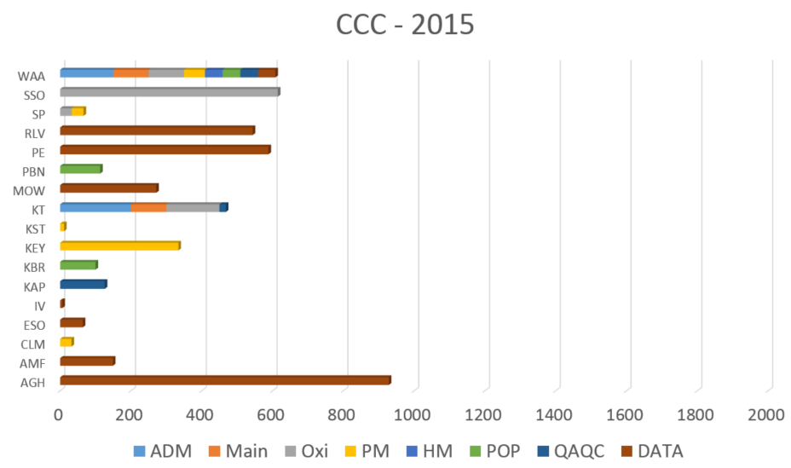

Slide 20
Goal of workshop
Raise attention nationally and within the CLRTAP bodies on uncertainties associated with observations
Strengthen the involvement of the measurement community in the policy work
Define future ambitions wrt data quality (mainly level I)
  EMEP data to also in the future represent state-of-the-art monitoring
    Quality sufficient to resolve policy questions
    Peer review quality
    Get input on CCC efforts required (also beyond the EMEP workplan)
Aim to produce a short EMEP-CCC report
(useful if comments and views can be expressed also as short text statements)

Slide 21
