Slide 1



Progress in assessment of POP pollution in EMEP region.
Case study on B(a)P pollution in Spain/France
Alexey Gusev, Victor Shatalov, Olga Rozovskaya (MSC-E, EMEP)
Florian Couvidat (INERIS, France)
Marta Garcia Vivanco (CIEMAT, Spain)

Slide 2
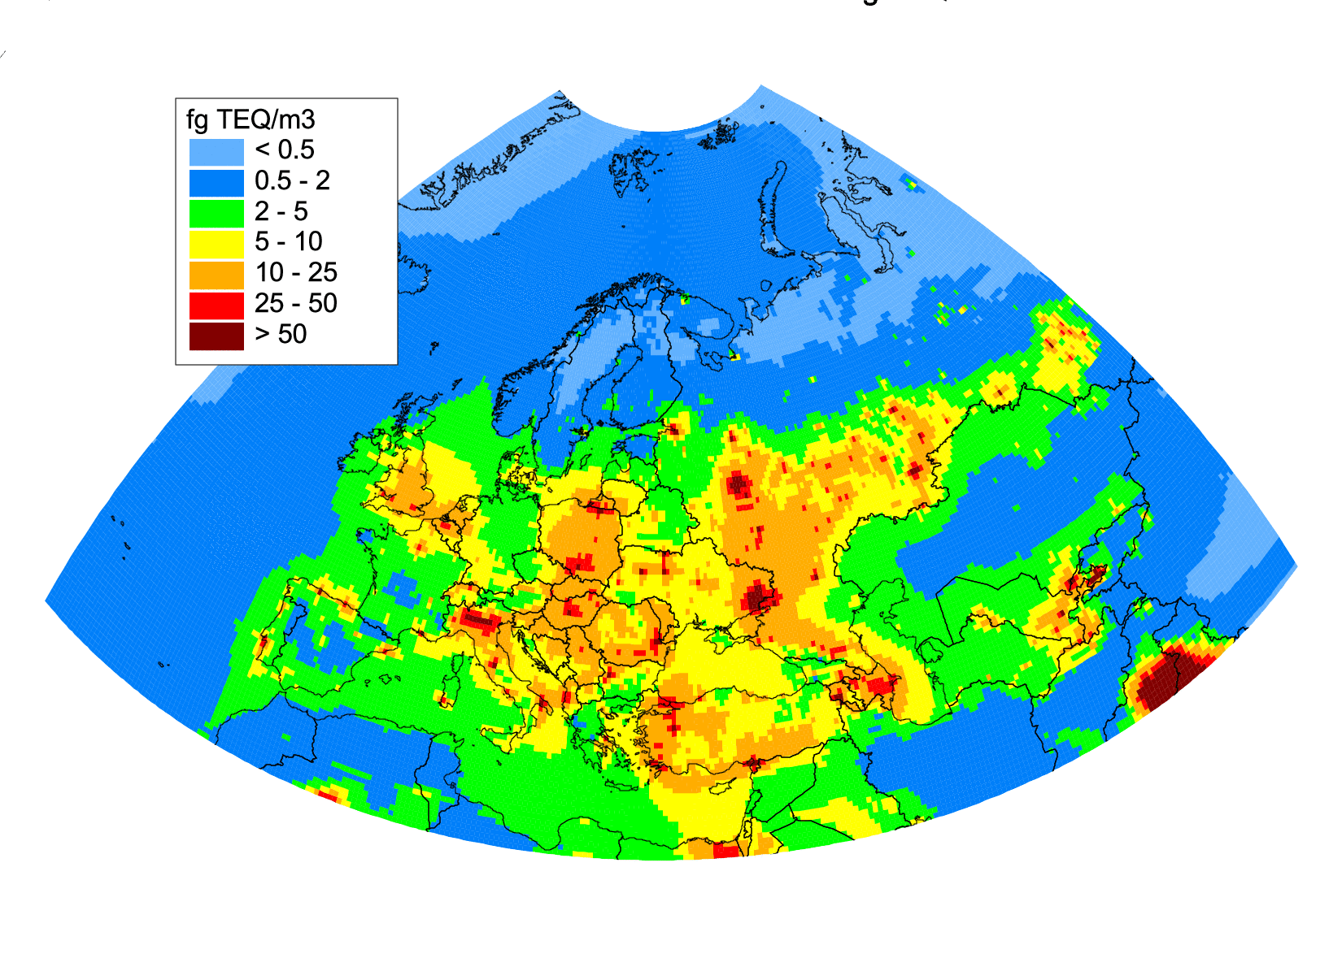
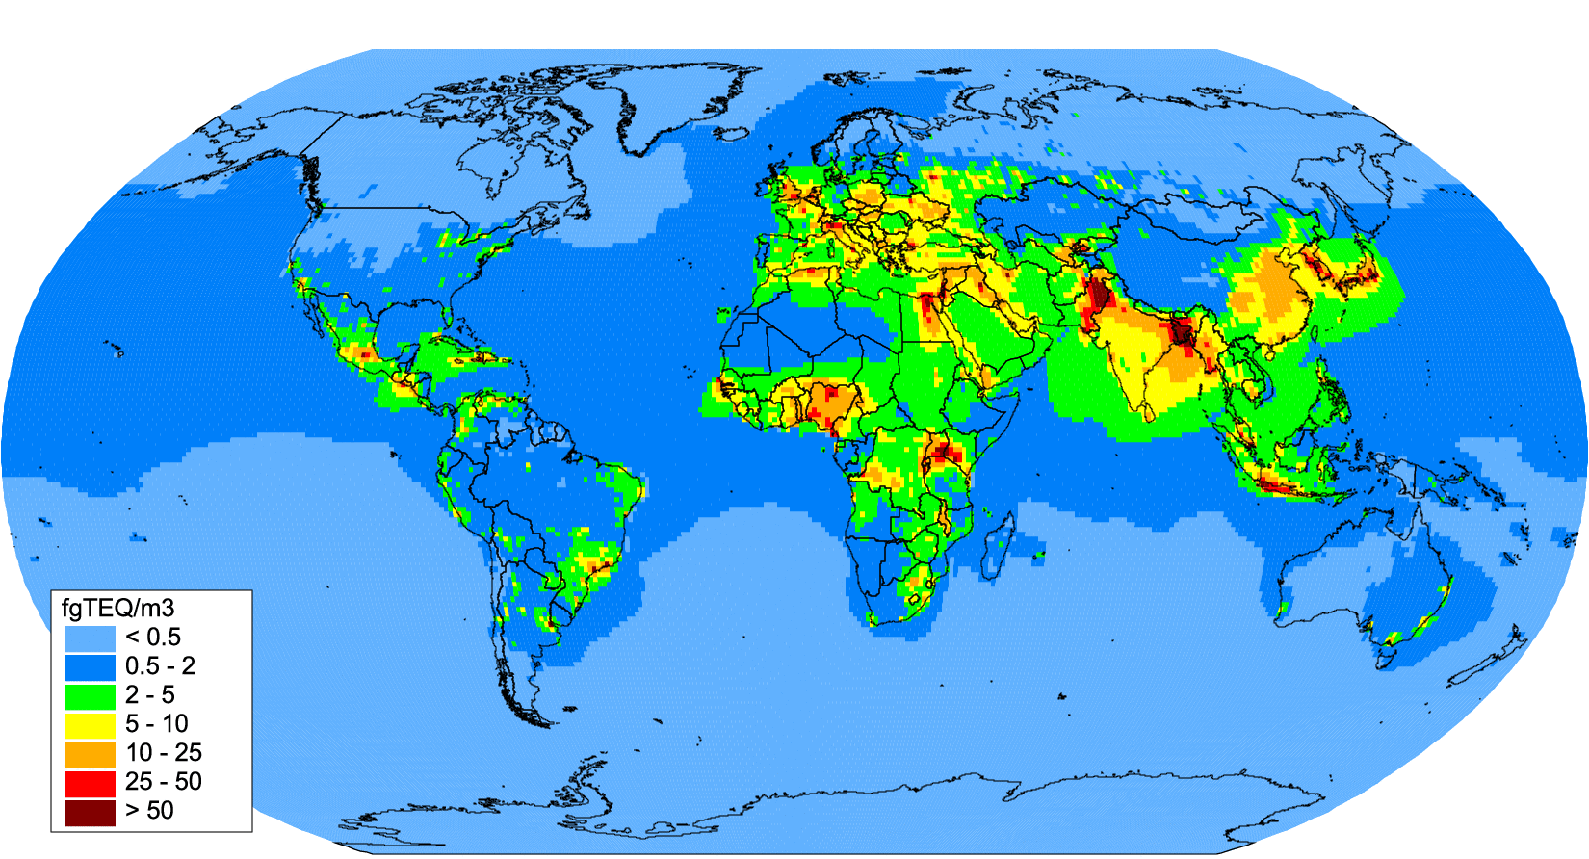
Model assessment of POP pollution of EMEP region for 2016
Model simulations of PAH, PCB, PCDD/F, HCB pollution in the new EMEP grid
Emissions of EMEP countries in the new EMEP grid (0.1°x0.1°) from CEIP
Boundary and initial conditions from global model simulations
Analysis of agreement between modelled and measured POP concentrations
Source-receptor matrices for the new EMEP grid
Measurements of PCDD/Fs in Spain 2008-2015 [Muñoz-Arnanz et al, 2018] (provided by Ramon Guardans)
PCDD/F annual mean air concentrations in EMEP region (2016)
Global PCDD/F annual mean air concentrations (2016)

Slide 3
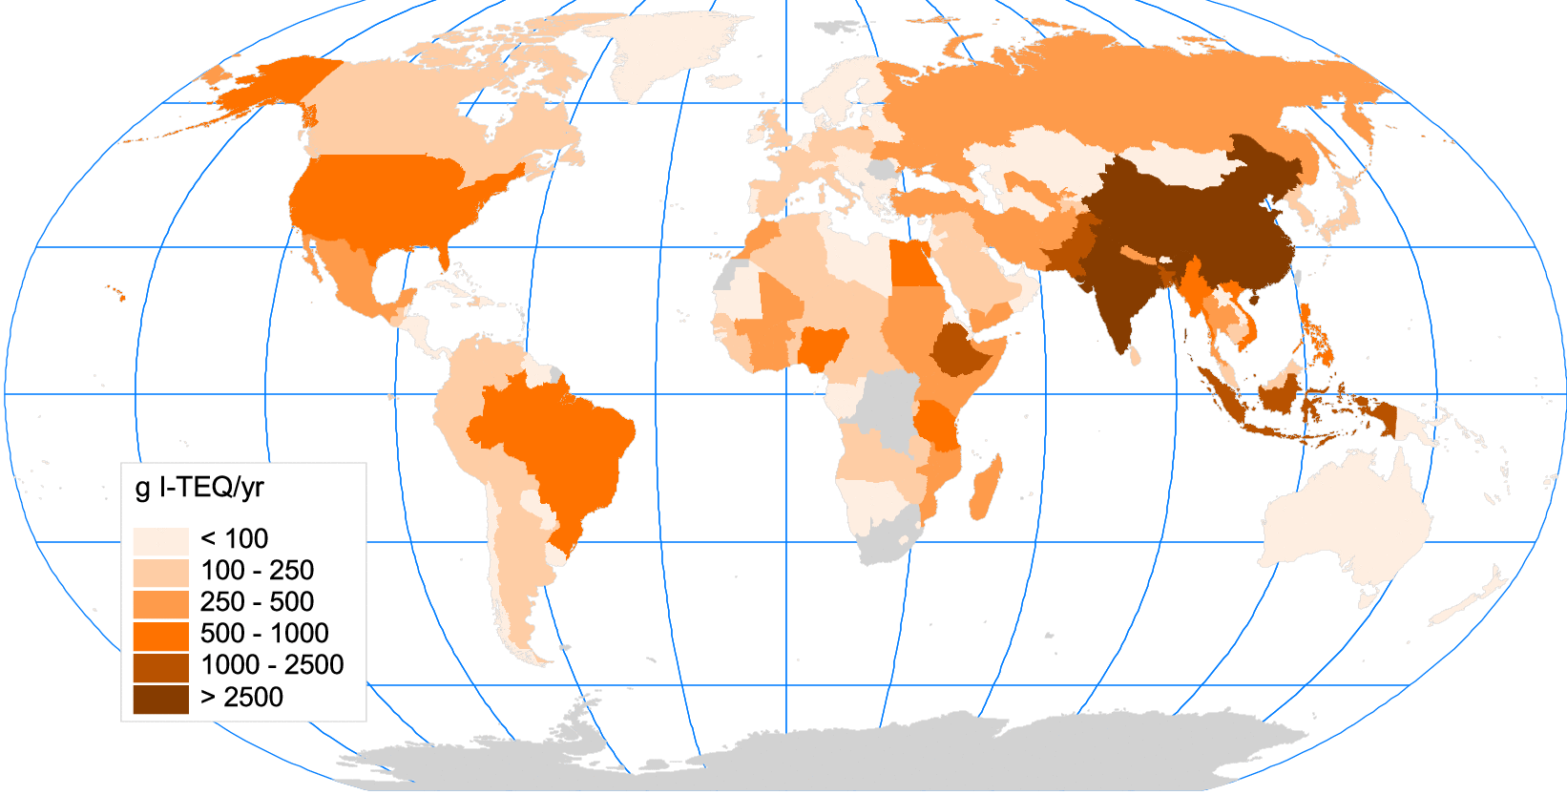
Development of updated scenario of global PCDD/F emissions
Goal:
Develop scenario for evaluation of global and regional (EMEP) PCDD/F pollution levels
Perform model simulations and provide information for the analysis of exposure
  Methodology is based on study of global PCDD/F emissions (Wang et al., 2016):
  Regression analysis of data on PCDD/F emissions (Stockholm Convention), gross domestic product (GDP) and gross national income (GNI), CO₂ emissions, etc.
Emissions to air (E_{air}) and soil (E_{soil}):
log(E_{air}) = 0. 77 log(GNI) + 0.04 log(Area) – 1.15 log(GNI per capita) – 0.03 log(E_{CO2} per GDP) + 2.43
log(E_{soil}) = 0.71 log(E_{air}) + 0.70 log(GNI) - 0.12 log(Area) – 0.33 log(GNI per capita) –0.49 log(E_{CO2} per GDP) – 0.52
regression coefficients
Americas, 9%
EMEP, 9%
Africa, 33%
South and East Asia, 49%
Global scale PCDD/F annual emissions to air (2012)
Co-operation required with TF HTAP, Stockholm Convention and national experts

Slide 4
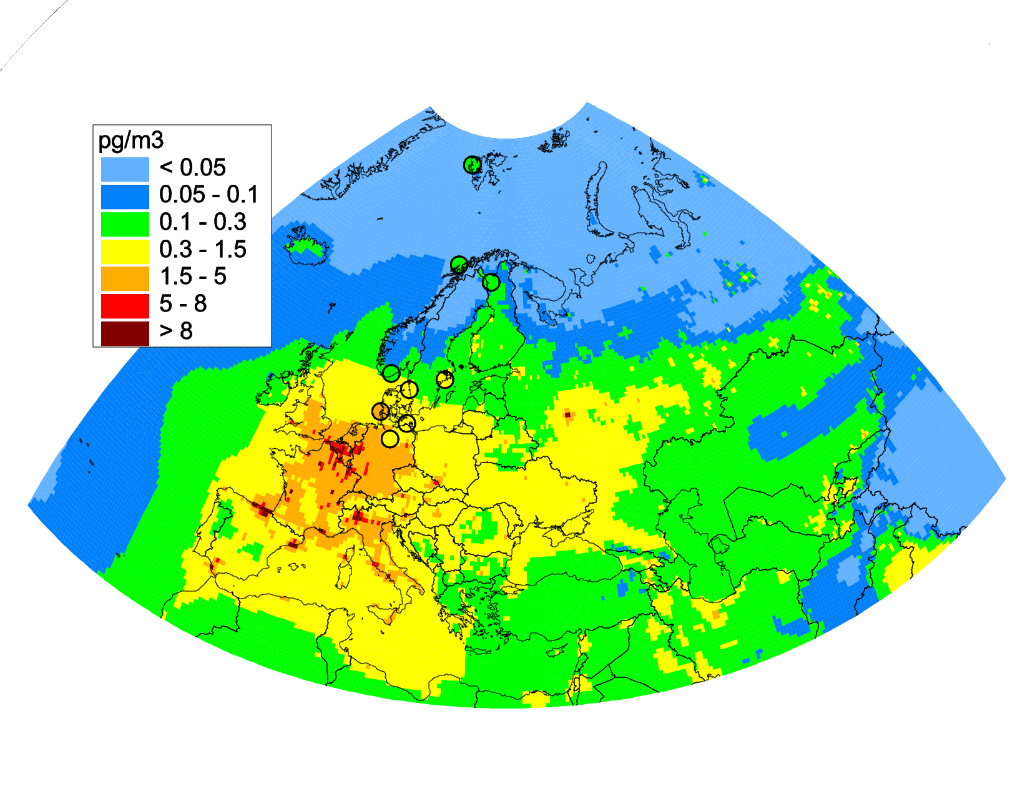
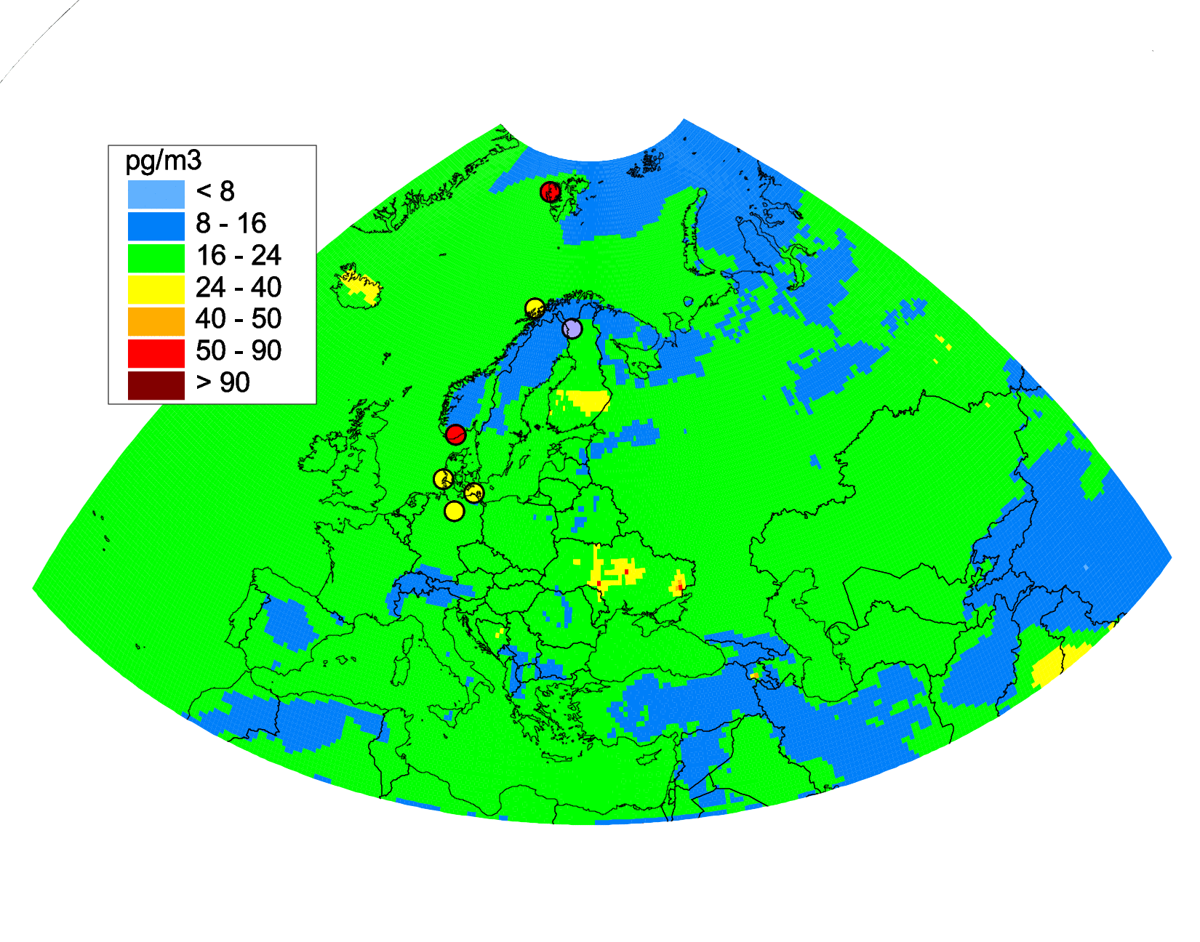
Analysis of agreement between modelled and measured PCB-153, HCB concentrations (2016)
PCB-153
PCB-153
HCB
HCB
Underestimation for HCB: unaccounted sources of national emissions, non-EMEP sources, uncertainties in measurements ?
Further analysis of pollution requires co-operation with national experts and CCC
For most of the EMEP monitoring sites agreement is within a factor 2
Underestimation of observed air concentrations for NO42, NO90, and NO2

Slide 5
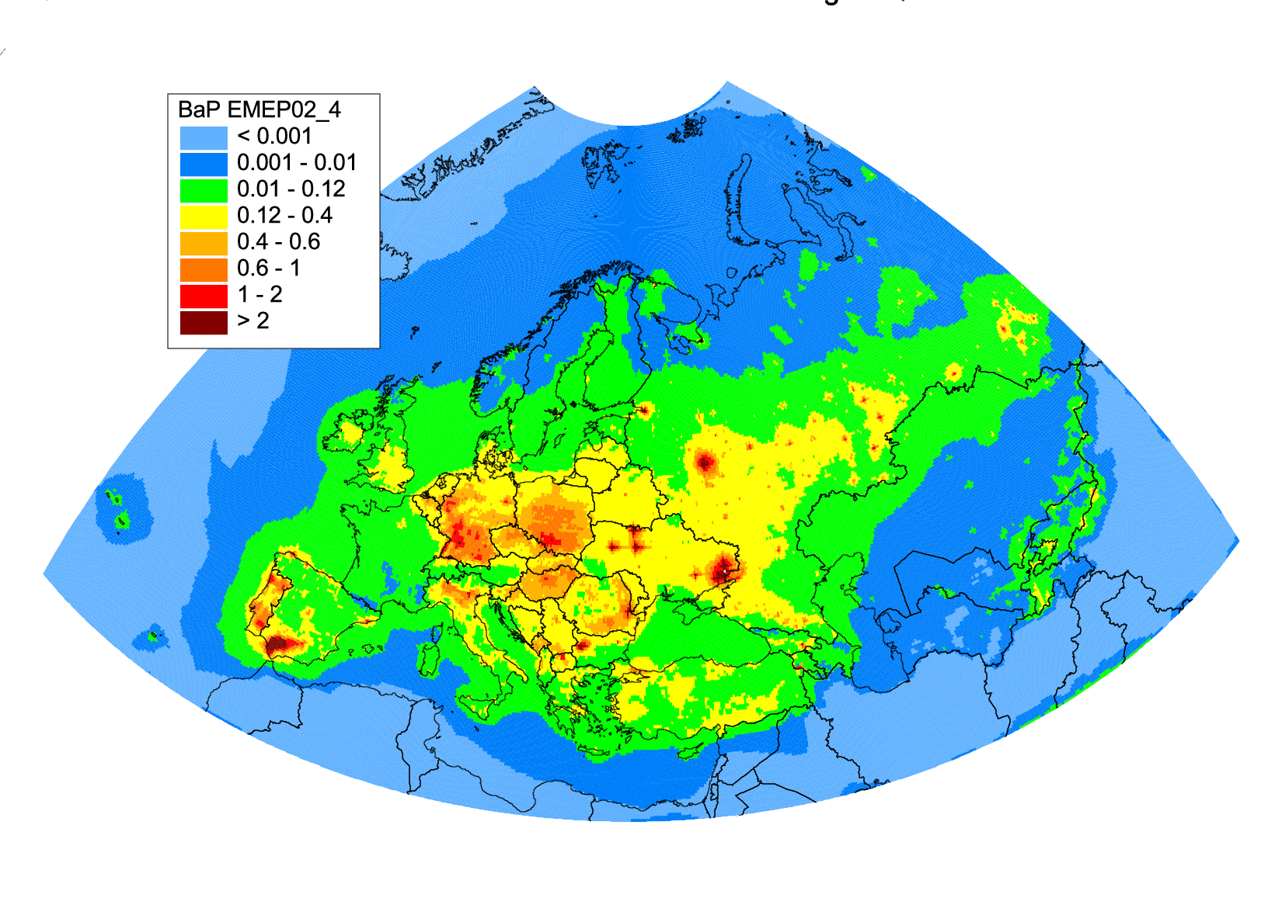
Model assessment of B(a)P pollution of EMEP region for 2016
Air pollution by B(a)P is indicated as an important issue by thematic session on B(a)P during the 2nd joint session of the WGE and the SB to EMEP
Domestic heating (wood/coal burning) and burning of agricultural wastes are among the main sources of B(a)P. However, these emissions are subject of significant uncertainties
Model assessment of pollution based on official emissions provides unsatisfactory results for some of the EMEP countries (FR, ES, DE, PL)
To improve accuracy of pollution assessment, analysis and reduction of uncertainties in reported emissions is needed in co-operation with national experts
x3
x2
Annual mean modelled B(a)P concentrations (2016)

Slide 6
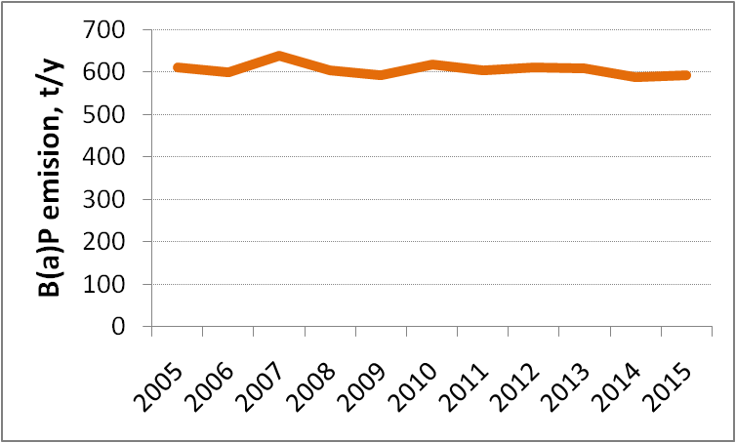
EMEP B(a)P emission data for 2005 vs TNO inventory
TNO inventory of B(a)P emissions for 2005, EU TRANSFORM project
(data provided by Hugo Denier van der Gon, TNO)
Significant difference between TNO and EMEP emissions for PL, FR, ES, and PT
EMEP countries

Slide 7
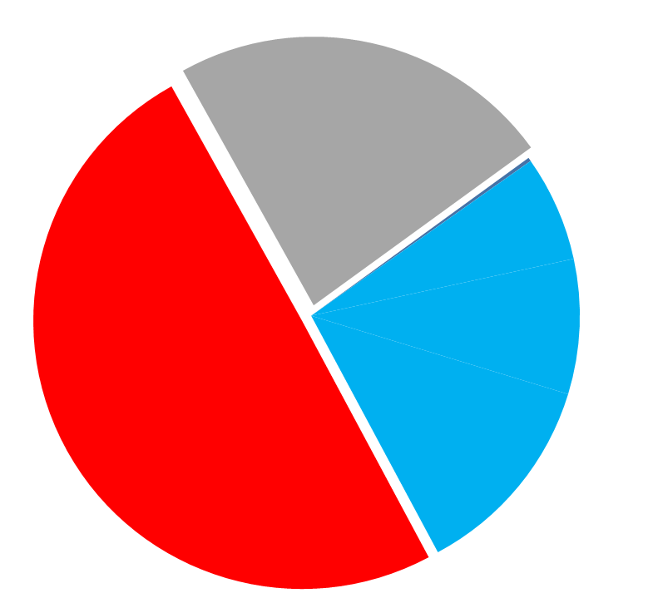
Analysis of reported B(a)P emissions
Uncertainties in sector-specific emissions of selected EMEP countries for 2016
Emissions from Residential combustion sector are typically 80-90% of total emissions
Emissions from burning of agricultural wastes in Spain, Portugal, Greece amount to 27% of total B(a)P emissions of EU28
Uncertainties (overestimation) of PAH/B(a)P emissions from burning of agricultural wastes in Spain are being refined by national experts
Other sectors
23%
Other, <1%
GR, 6%
Burning of agr wastes
27%
PT, 8%
Residential combustion
50%
ES, 12%
B(a)P emissions for 2016
B(a)P emissions of EU28 for 2016

Slide 8
Analysis of reported B(a)P emissions
Emissions from Residential combustion of selected EMEP countries for 2016
B(a)P/PM2.5 ratios of DE, NL, DK, FR are out of typical range over EU countries
The reason might be difference in the applied emission factors
Further analysis and harmonization of applied emission factors is needed

Slide 9
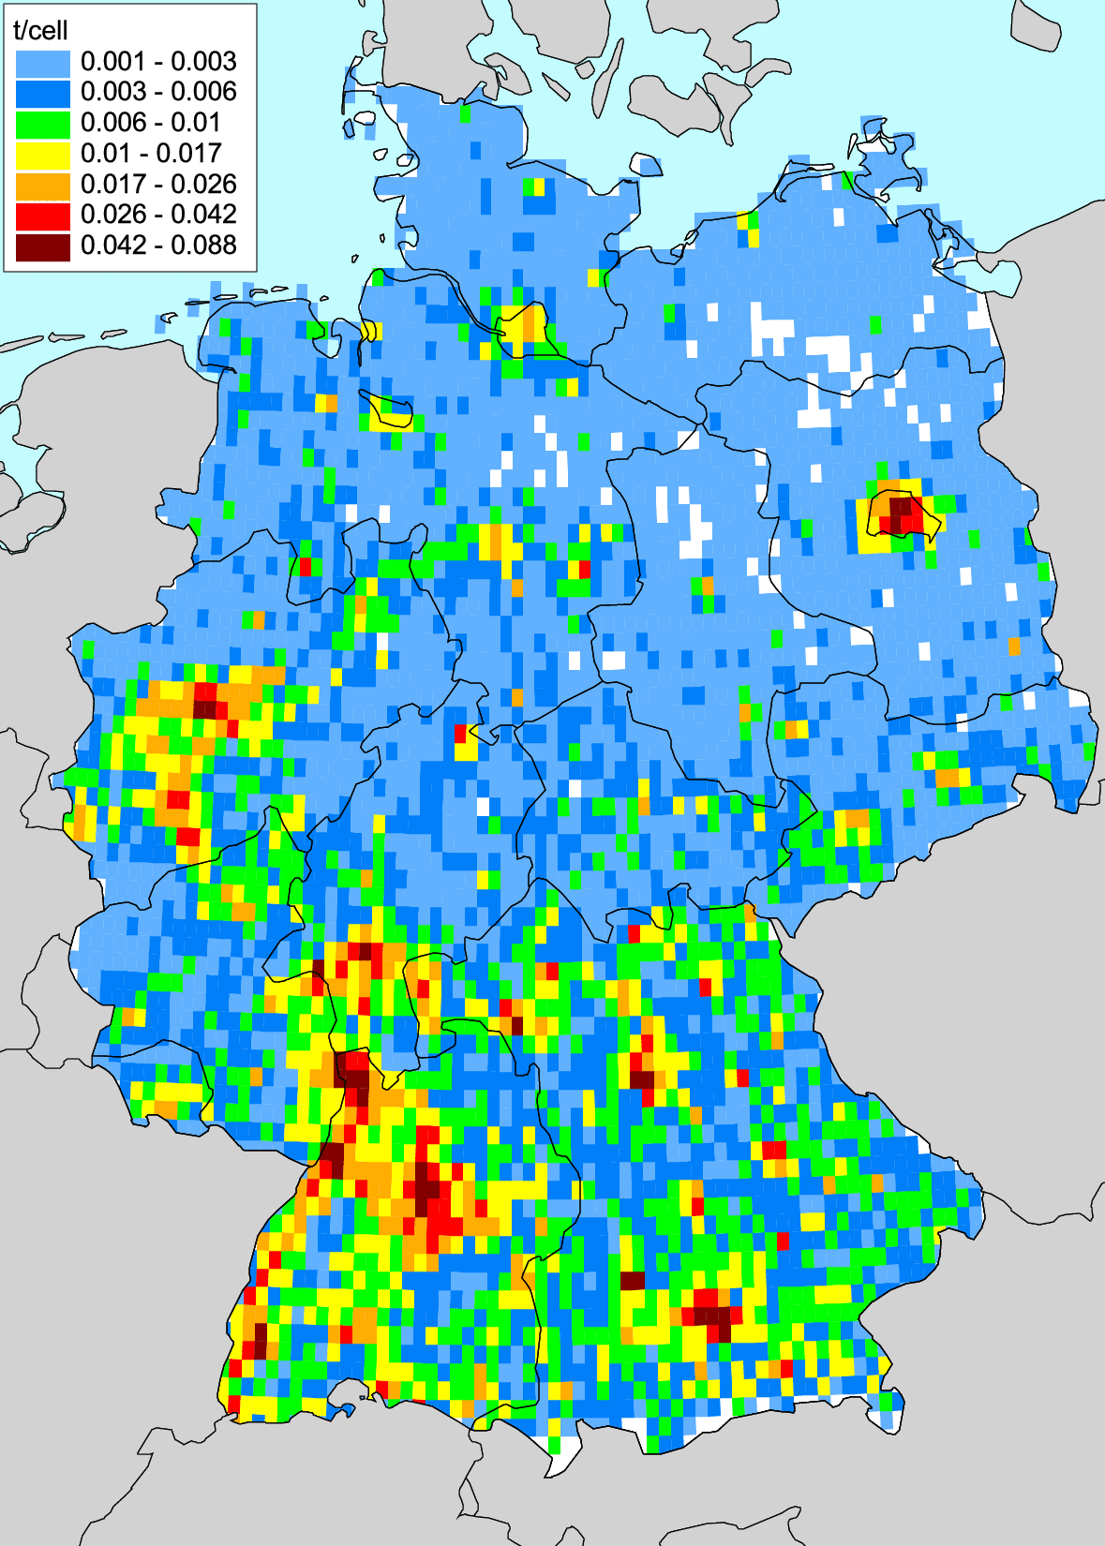
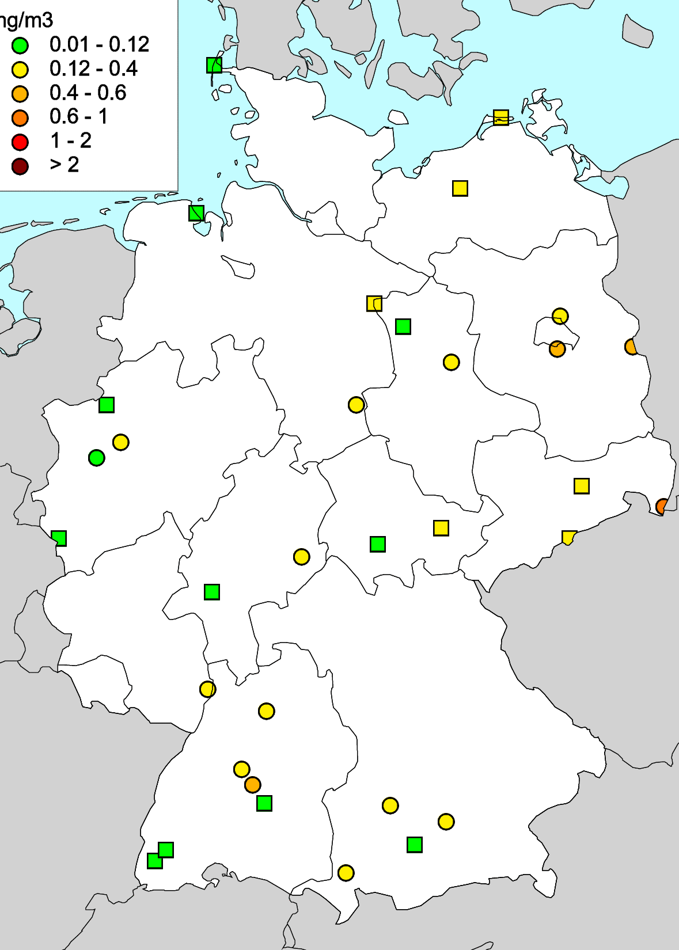
Analysis of reported B(a)P emissions: spatial distribution
Overestimation by the model of observed B(a)P concentrations in Germany
B(a)P emissions from Res Comb (CEIP)
Measured B(a)P in air (UBA)
Modelled vs Observed B(a)P air concentrations
Background suburban
Background rural
Official spatial distribution of B(a)P emissions is based on data for PM2.5 (CEIP)
This allocation of B(a)P emissions is not consistent with measured B(a)P concentrations
Model overestimates observed concentrations in western/southern parts of Germany
This subject is being discussed currently with emission experts from Germany

Slide 10
Country-scale study of B(a)P pollution for Spain/France
Objective of case study:
Analysis of uncertainties and improvement of assessment of B(a)P pollution levels in co-operation with national experts
Participated:
Experts – MSC-E, CIEMAT (Spain), INERIS (France)
Models – GLEMOS (MSC-E), CHIMERE (France), CHIMERE (Spain)
Country-specific study activities:
Analysis of national B(a)P emission data*
Inter-comparison of GLEMOS and CHIMERE (FR) model results*
Scenario modelling and analysis of sensitivity to changes of national B(a)P emissions
Analysis of sensitivity of model results to change of degradation/GP partitioning schemes
Fine resolution, sector-specific, and source-receptor modelling
EU02 (0.2°x0.2°)
FR005 (0.05°x0.05°)
SP005 (0.05°x0.05°)
Model domains
* These topics will be covered in presentations of national experts from Spain and France

Slide 11
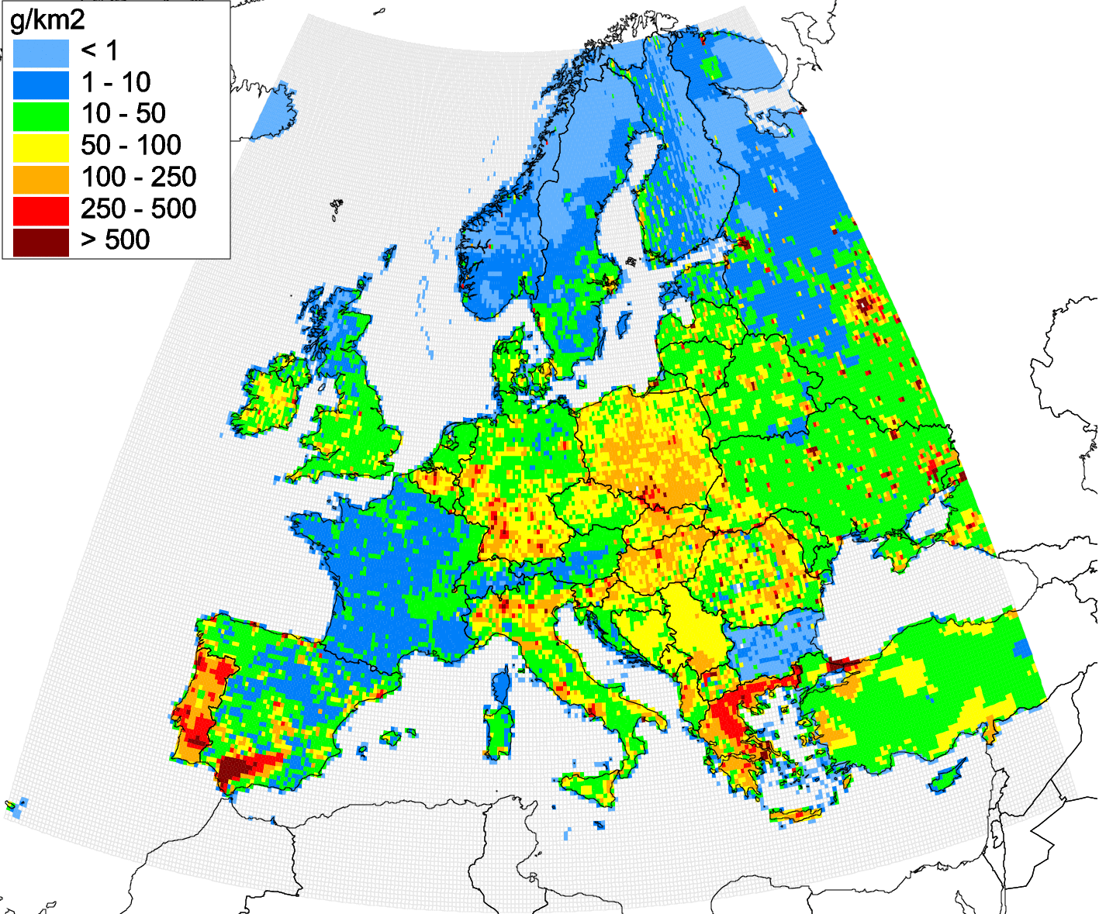
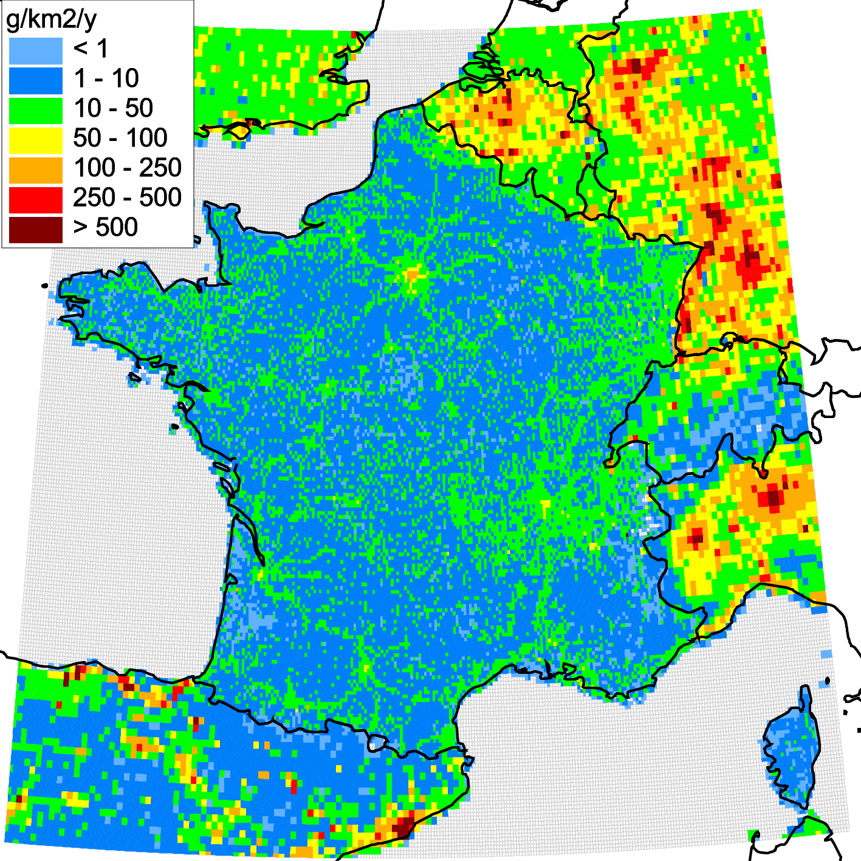
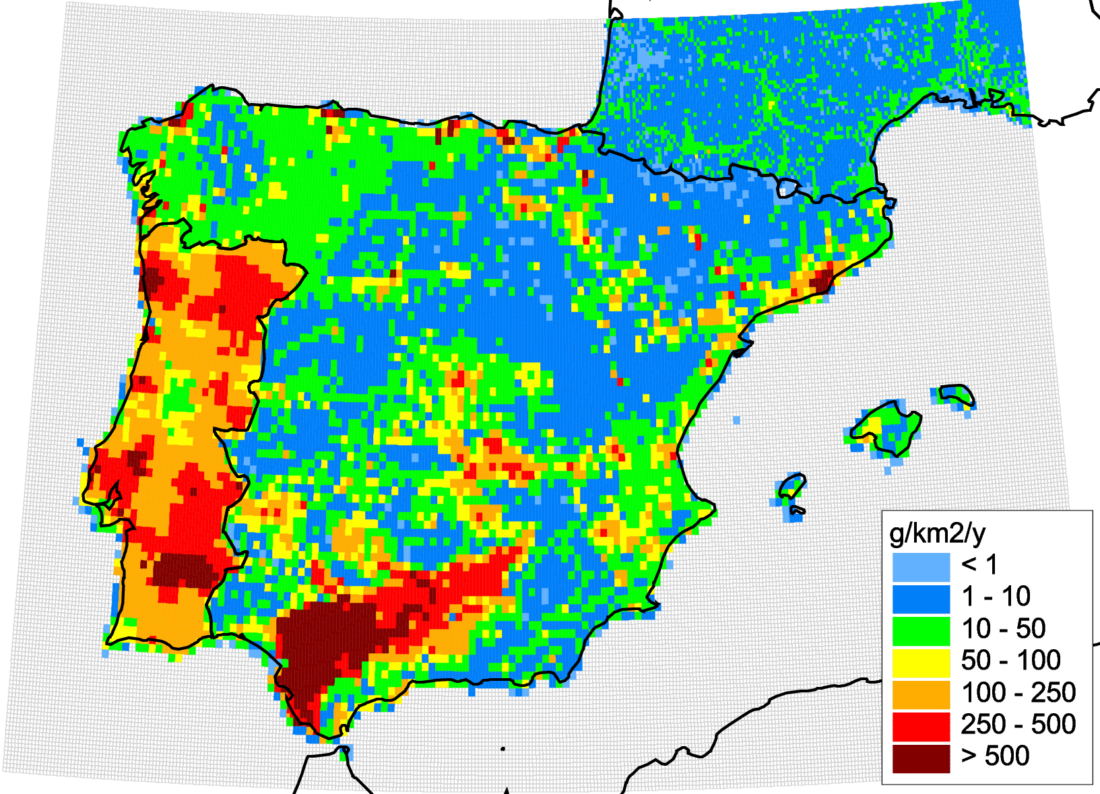
Preparation of B(a)P emissions for model assessment
Emission data used:
Spain - national inventory of 4PAHs emissions (0.1°x0.1°) for 2015
France - national inventory of B(a)P emissions (~7x7 km) for 2015
Other countries - officially reported gridded emissions (0.1°x0.1°) for 2015 (CEIP)
Emission data were prepared for SNAP sectors and regridded for specified modelling domains EU02, SP005, FR005
EU02 (0.2°x0.2°)
FR005 (0.05°x0.05°)
SP005 (0.05°x0.05°)
Annual B(a)P emission fluxes for 2015 generated for domains EU02, SP005, FR005

Slide 12
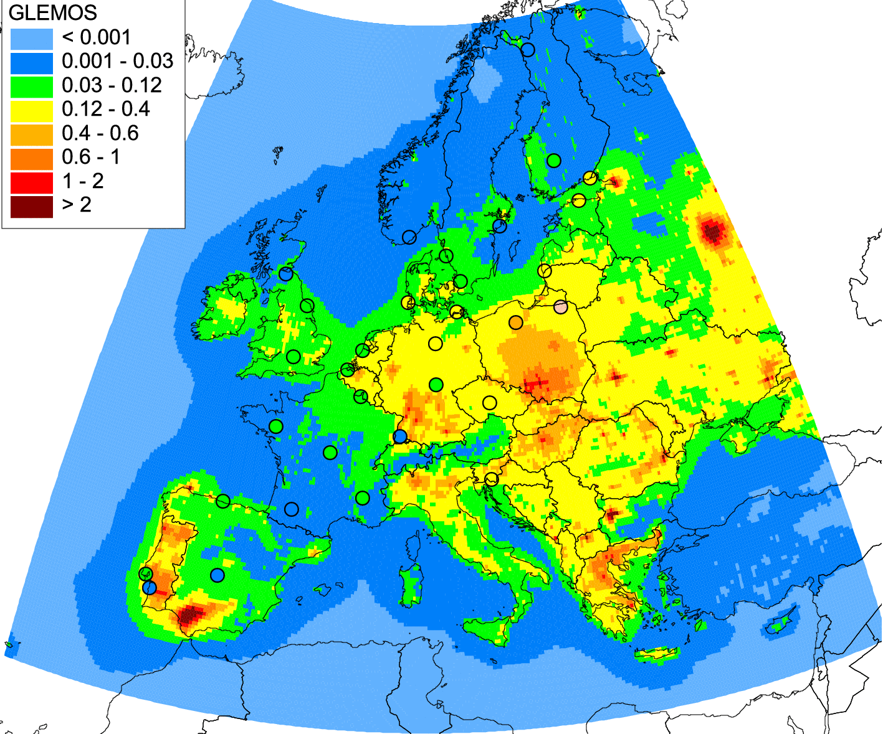
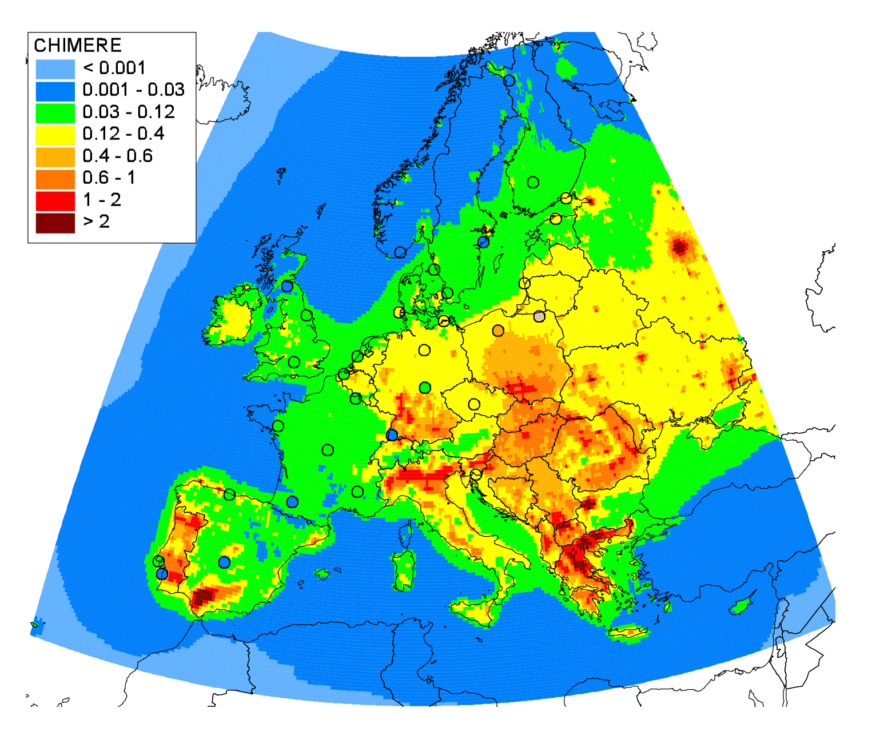
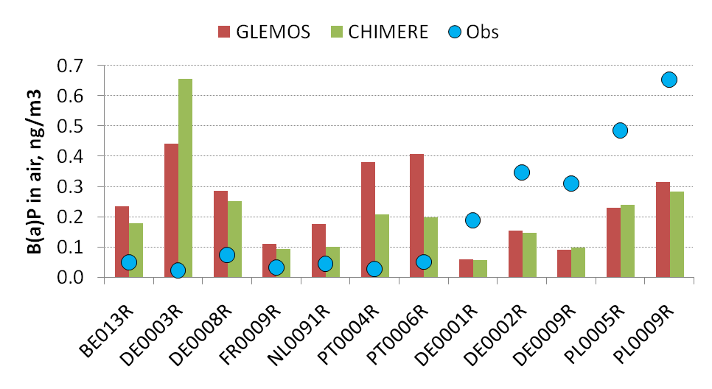
GLEMOS and CHIMERE modelling results for 2015
Annual mean modelled concentrations vs measurements of 31 EMEP sites
GLEMOS
CHIMERE
Comparison results:
Model | GLEMOS | CHIMERE
NMB, % | 2.71 | 0.64
Correlation | 0.25 | 0.28
In factor 2 | 39% | 32%
In factor 3 | 61% | 74%
Comparison results:
Low correlation
About 60% out of factor 2
Overestimation for BE, NL, PT, ES, northern FR, south-western DE
Underestimation for PL, northern DE

Slide 13
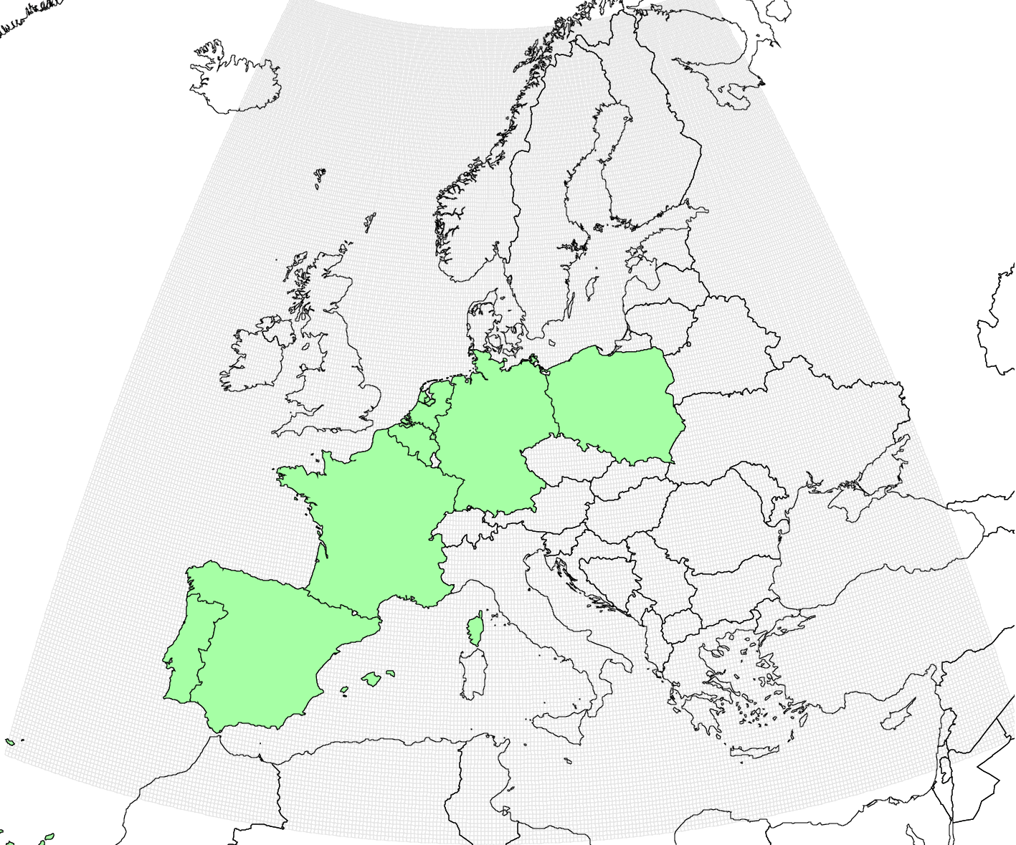
Experimental scenario of B(a)P emissions for modelling
Aim:
Explore possibility to improve B(a)P pollution assessment using experimental emission scenario
Evaluate sensitivity of model output to perturbations of B(a)P emissions in 7 selected countries
Selected countries
Approach:
Construct rough emission scenario applying scaling factors for emissions of selected countries based on assumptions of participated experts
Changes are made for Residential Combustion (FR,DE,PL,BE,NL) and Agriculture (ES, PT) sectors
Model runs: with official emissions (BASE) and scenario emissions (SCEN)
Assumptions used to define emission scaling factors:
BE, NL, DE: based on mean difference between modelled and measured concentrations
FR: suggested by national experts (INERIS)
ES: suggested by national experts (CIEMAT), also consistent with differences between TNO estimate and official emission
PL, PT: based on the differences between TNO estimates and official EMEP emissions

Slide 14
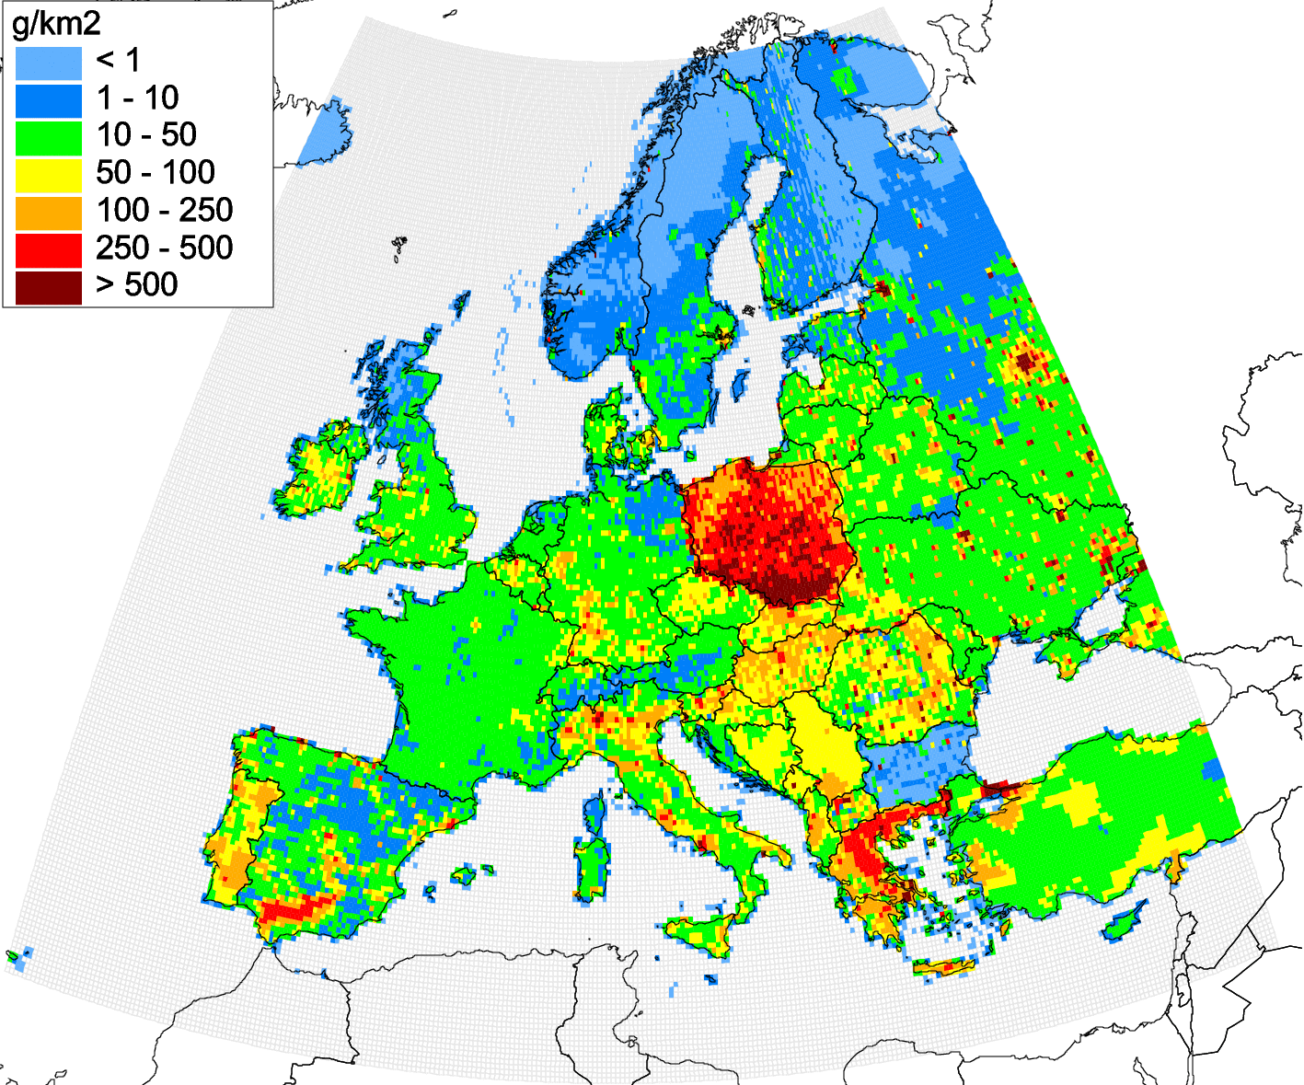
Definition of scenarios for model simulations
Definition of scenario emissions
138 t
Emission to change | Emission sector | Emission scale factor
Belgium | Res Comb | 0.5
Netherlands | Res Comb | 0.5
Germany | Res Comb | 0.5
France | Res Comb | 3.0
Poland | Res Comb | 4.0
Spain | Agriculture | 0.2
Portugal | Agriculture | 0.4
Changes of national emissions
BASE
SCEN
Spatial distribution of annual B(a)P emissions (2015)

Slide 15
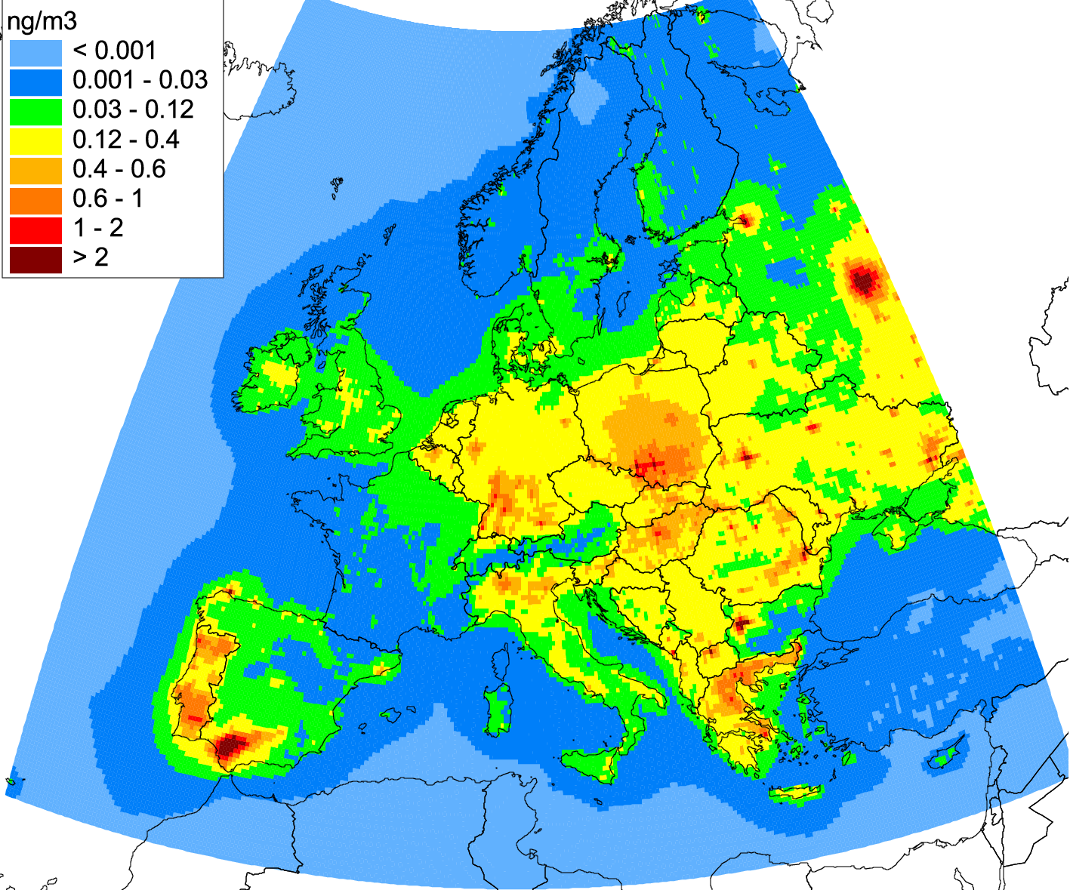
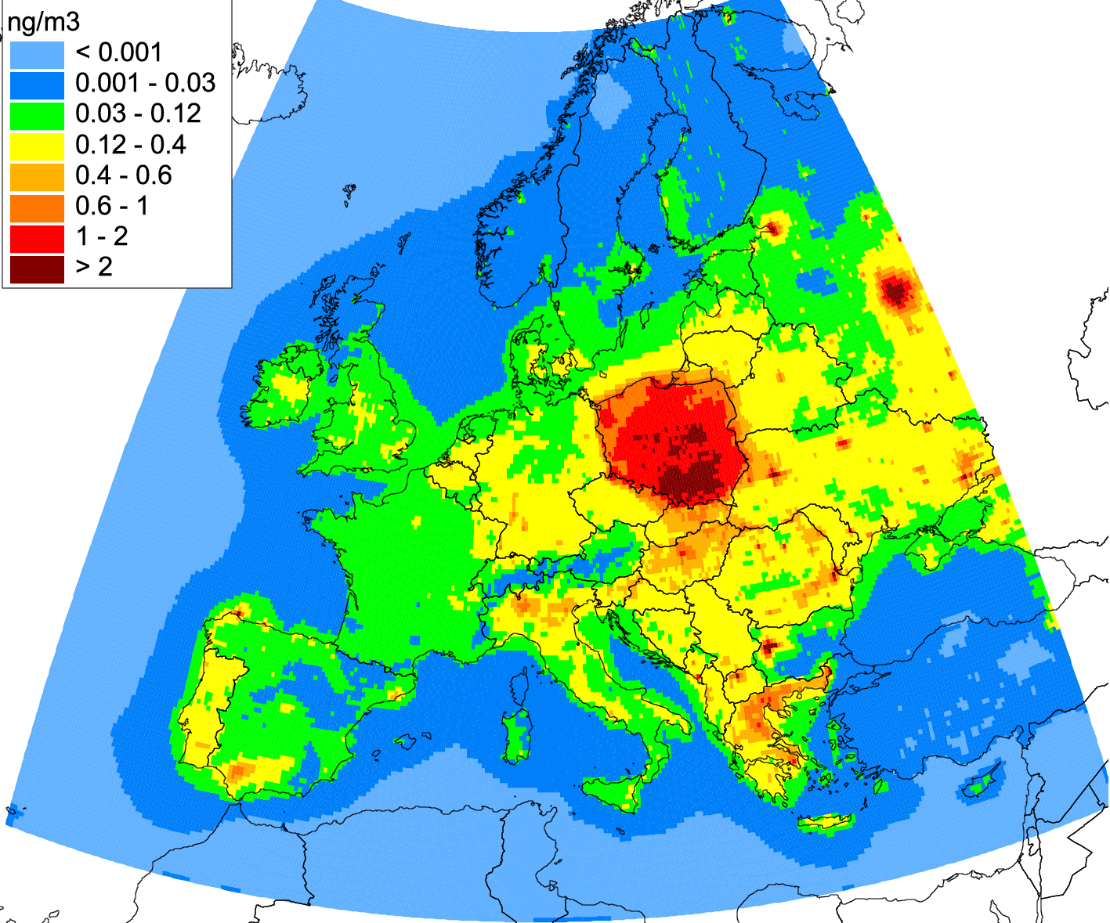
Evaluation of model results for scenario B(a)P emissions
Comparison of modelled and observed concentrations for EMEP and AirBase* sites
BASE (GLEMOS)
SCEN (GLEMOS)
Modelled B(a)P air concentrations for 2015
 | EMEP sites (30) |  | AirBase BR sites (82)
Scenario | BASE | SCEN | BASE | SCEN
NMB, % | -8.12 | 13.75 | -38.67 | -12.10
Corr | 0.35 | 0.81 | 0.43 | 0.82
* Background rural monitoring sites were selected for comparison

Slide 16
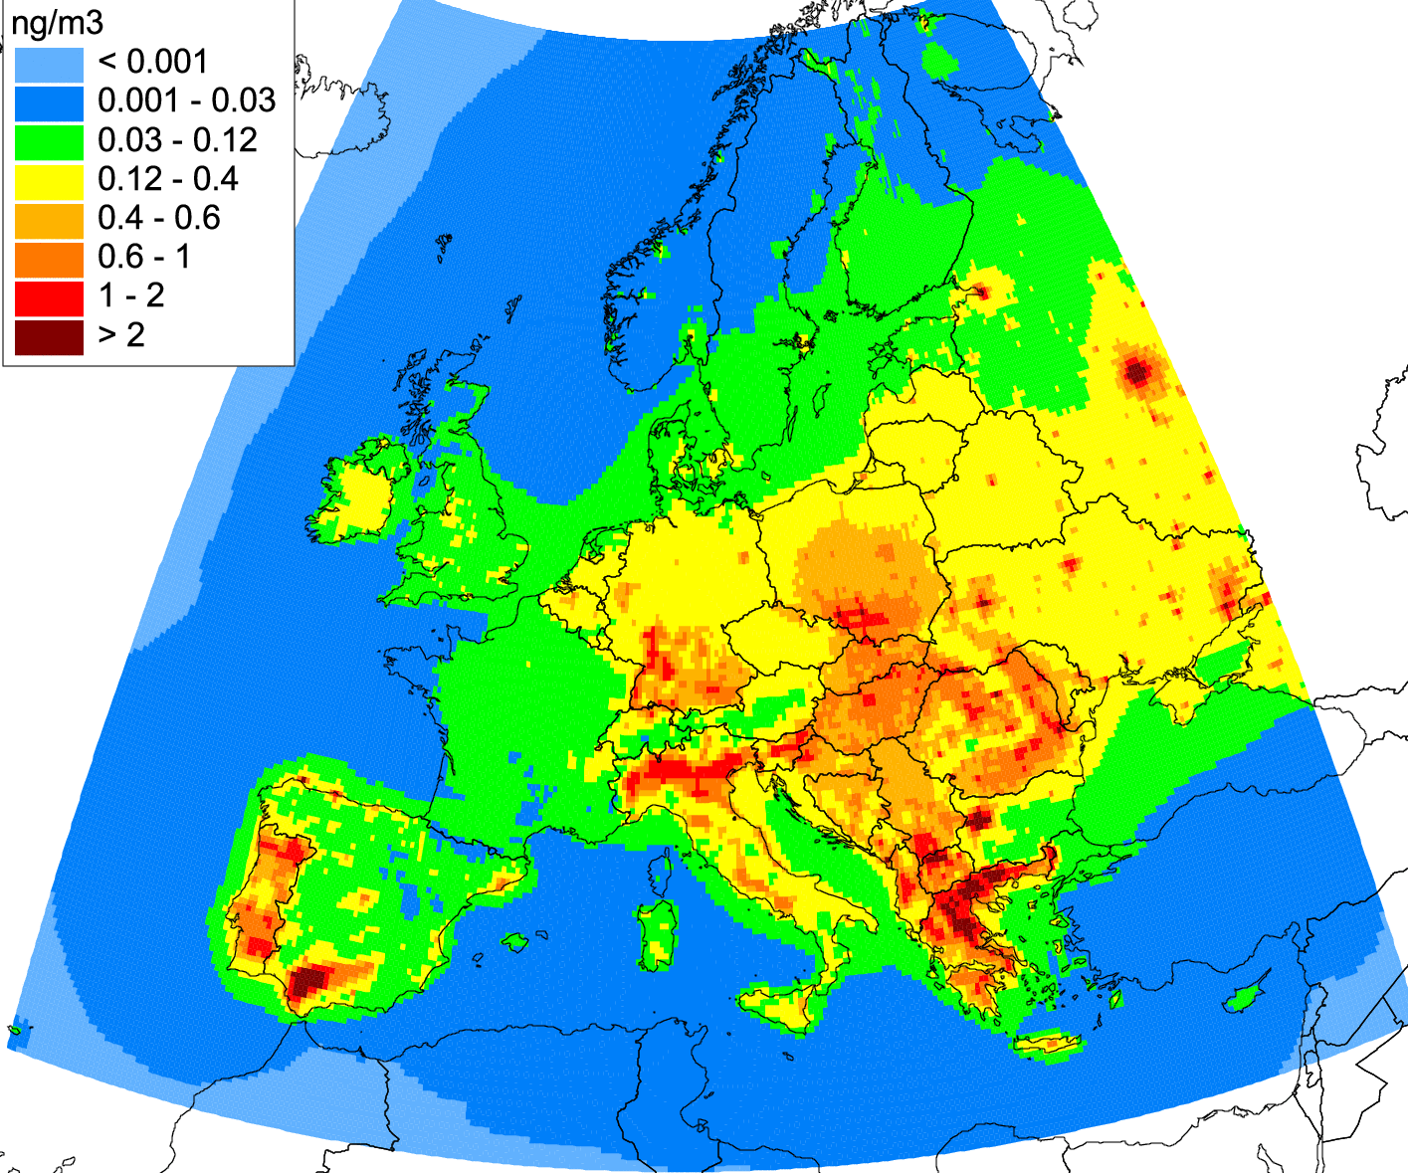
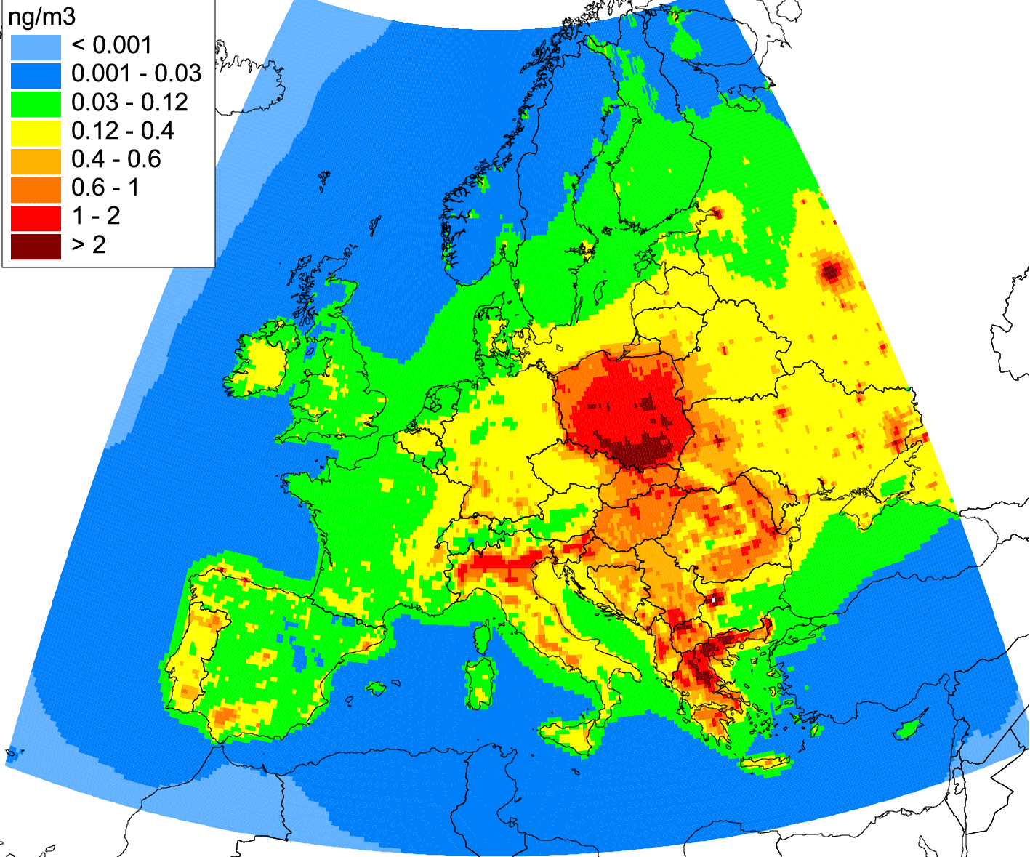
Evaluation of model results for scenario B(a)P emissions
Comparison of modelled and observed concentrations for EMEP and AirBase sites
BASE (CHIMERE)
SCEN (CHIMERE)
Modelled B(a)P air concentrations for 2015
 | EMEP sites (30) |  | AirBase BR sites (82)
Scenario | BASE | SCEN | BASE | SCEN
NMB, % | -15.75 | 16.02 | -27.80 | -2.24
Corr | 0.60 | 0.87 | 0.30 | 0.80
Better agreement with measurements is obtained with scenario emissions comparing to official emission data
Regression analysis of obtained results can provide refined coefficients of emission changes for selected countries

Slide 17
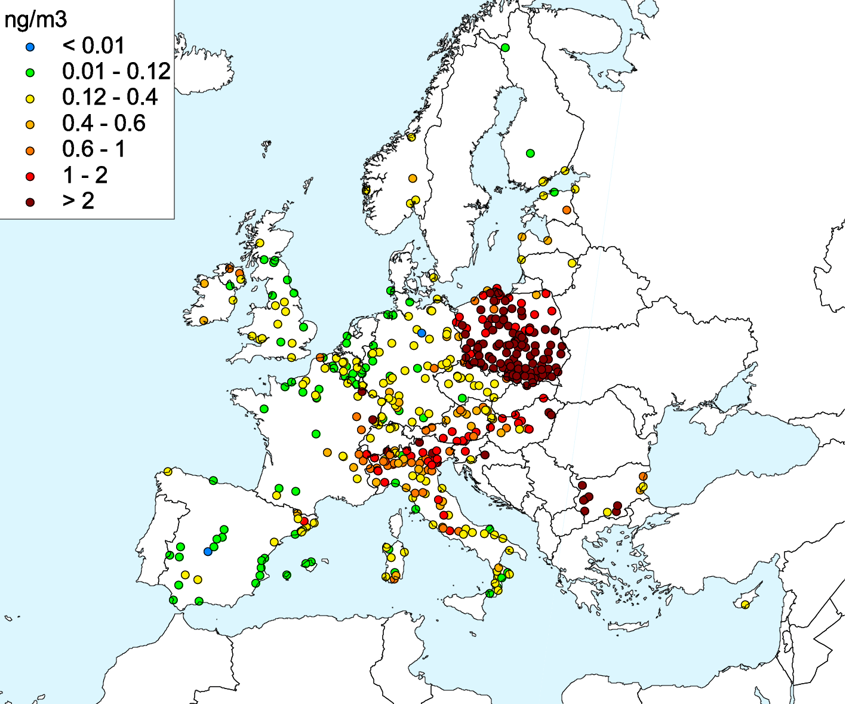
Evaluation of model results for scenario B(a)P emissions
Comparison of modelled air concentrations with measurements of AirBase sites
GLEMOS
Observed
CHIMERE
Modelled B(a)P concentrations for 2015
Observed B(a)P concentrations for 2015 (AirBase, background urban/suburban/rural sites)
Spatial distribution of modelled B(a)P concentrations in case of scenario emission better corresponds to measurements of background sites in countries selected for the analysis
However further analysis is required for other countries of Central and Southern Europe (e.g. HR, IT, SI)

Slide 18
Conclusions and further activities
Further work on the improvement of accuracy of POP pollution assessment requires analysis and reduction of uncertainties in the official emission data.
Air quality models can be valuable tools for the evaluation of reported emission data and their quality. This results can be used as additional information in the process of emission review.
Case study of pollution in Spain and France in co-operation with national experts provides important information for the refinement of national emissions and assessment of pollution levels.
Further activities within the B(a)P case study will include:
  sensitivity analysis of model results to changes of emissions,
  sensitivity to use of different parameterizations of degradation, deposition, and gas-particle partitioning processes,
  fine resolution modelling (including sector-specific and source-receptor modelling),
  analysis of B(a)P pollution levels in urban areas.
It is proposed to continue B(a)P pollution case study for other countries (e.g. Poland, Germany, Croatia).

