Slide 1




Overview of country-specific studies of heavy metal and POP pollution. Updated results on cadmium pollution in Poland
Ilia Ilyin, Oleg Travnikov, Olga Rozovskaya (EMEP/MSC-E)
Anna Degorska (IEP-NRI)
Marco Pandolfi (EGAR Group IDAEA-CSIC)
Milan Vana (CHMI)
19th TFMM, Geneva, May 2018

Slide 2
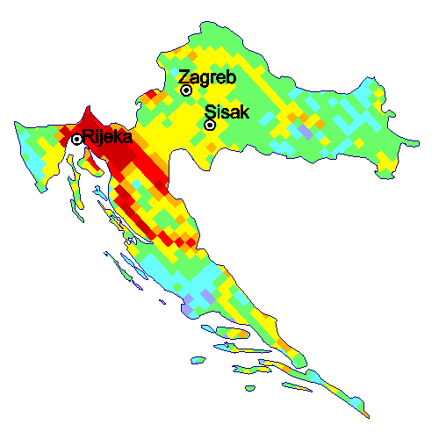
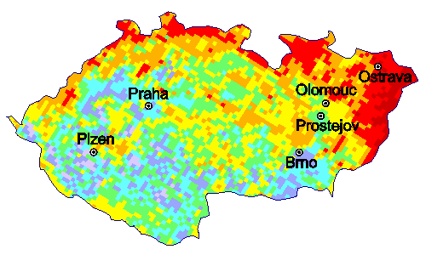
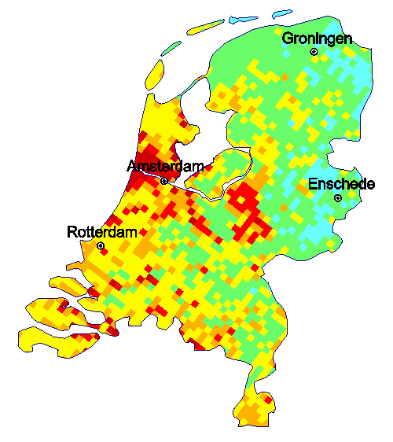
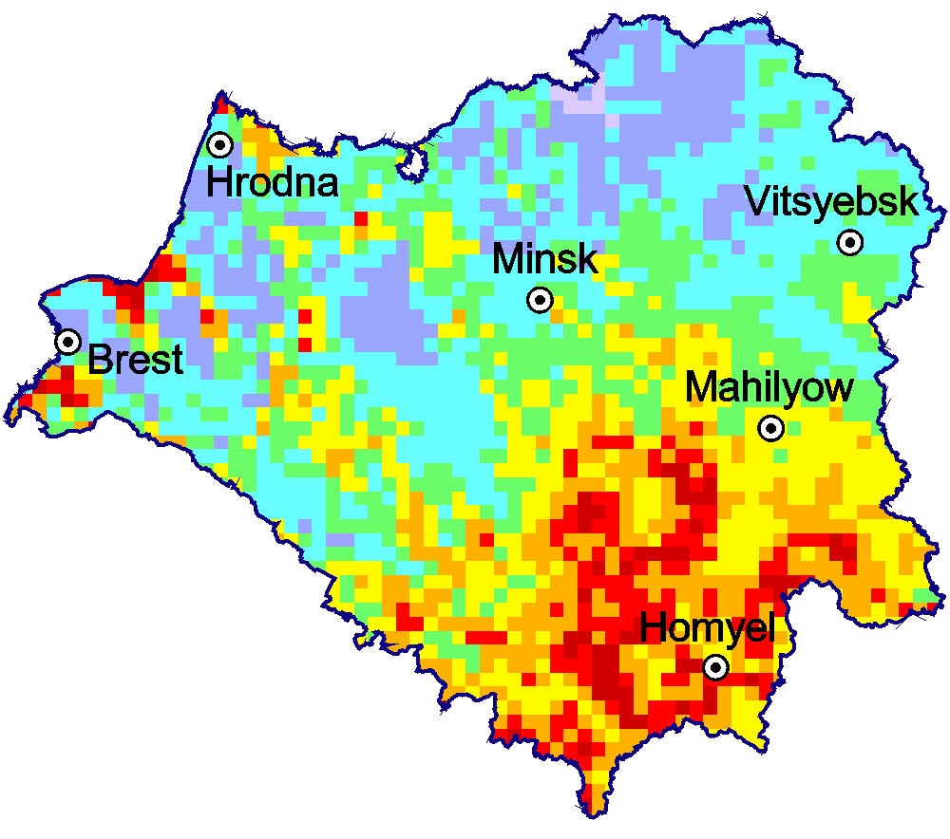
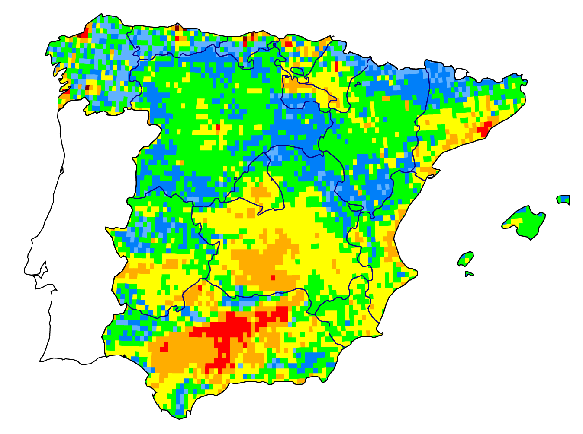
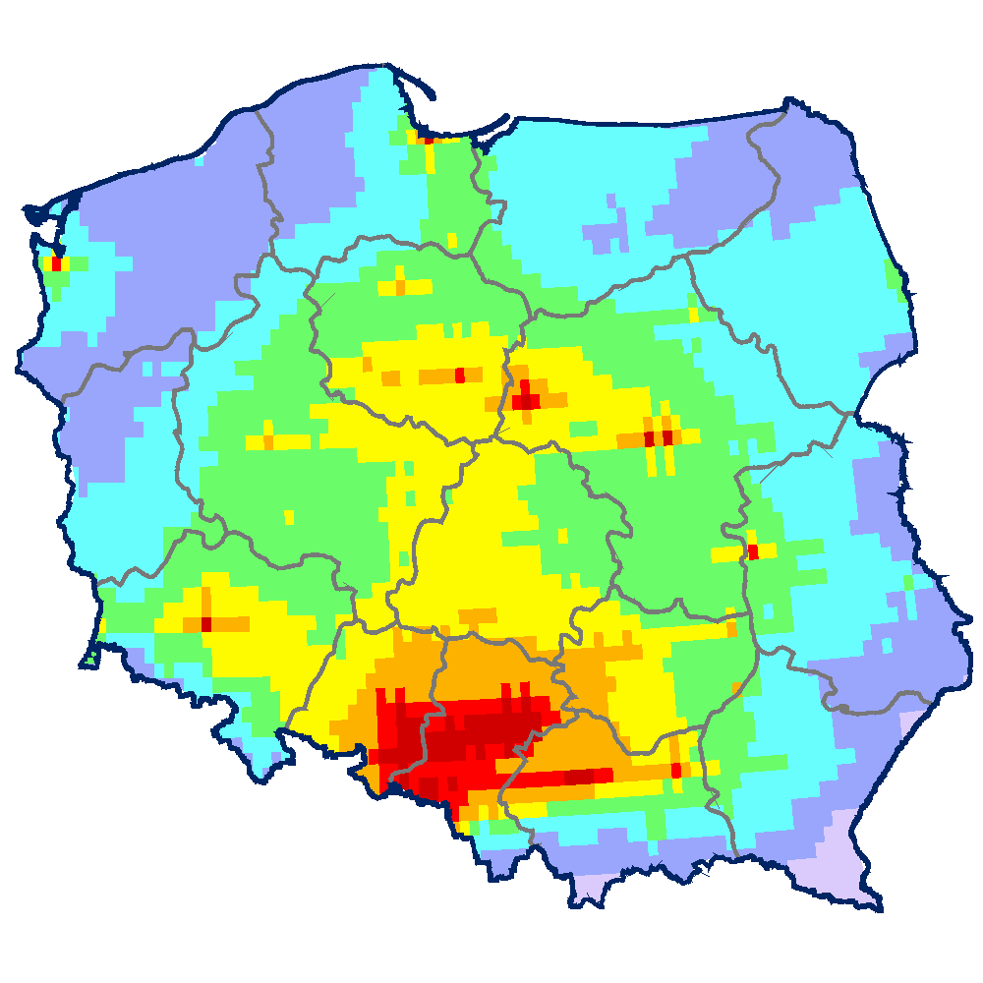
Case studies of HM and POP pollution in selected EMEP countries
Approach:
Evaluation of pollution levels in a country with fine spatial resolution involving variety of national data
National experts from countries: CZ, HR, NL, BY, UK, PL, ES, FR
Croatia
Czech Republic
Netherlands
Belarus
Spain
Poland
19th TFMM, Geneva, May 2018

Slide 3
Main outcomes of the country-specific studies
(will be summarized in special report)
Detailed pollution assessment on country scale
Contribution of main national and foreign sources of Cd deposition in the Czech provinces
Spatial distribution
Contribution of emission sectors
Influence of large point sources
S-R calculations for country’s provinces
Pollution in cities
….
19th TFMM, Geneva, May 2018

Slide 4
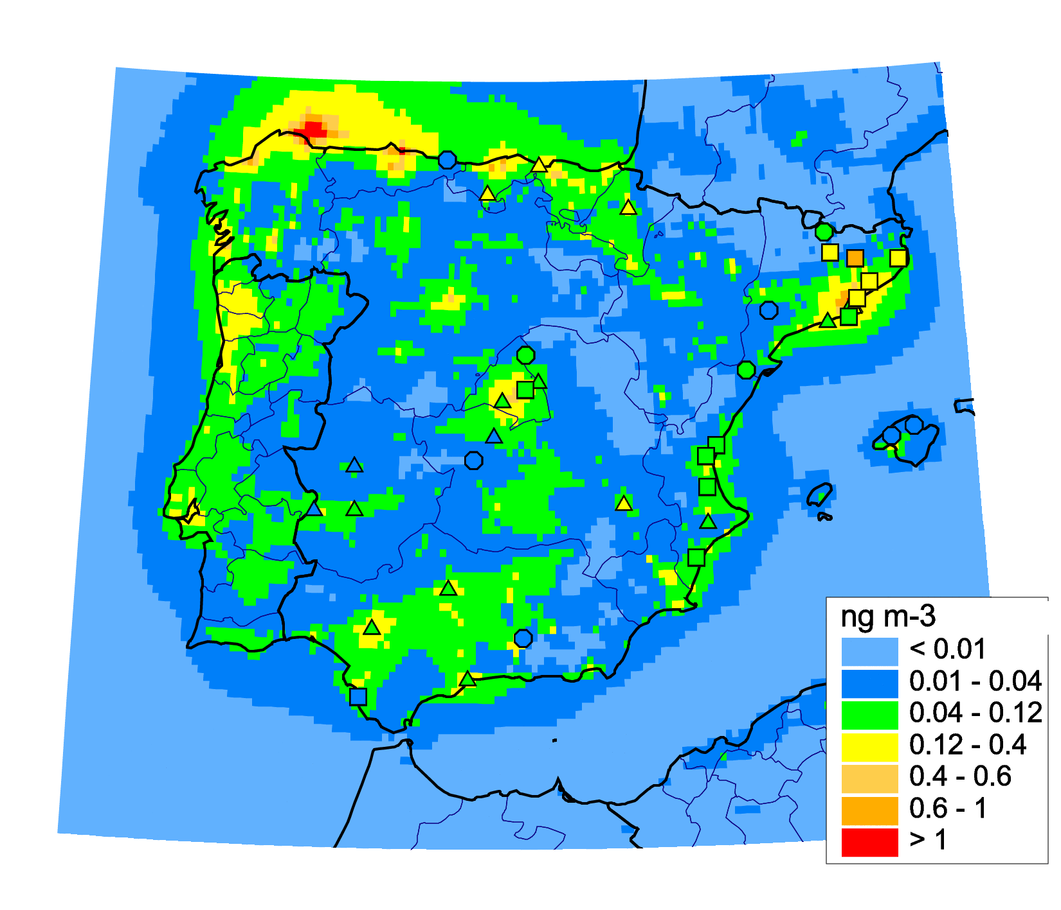
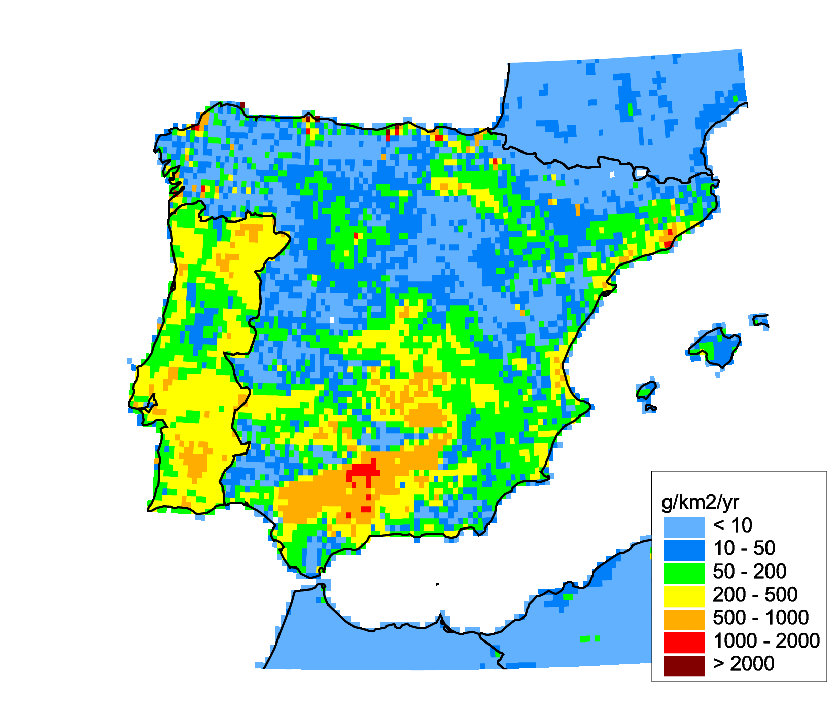
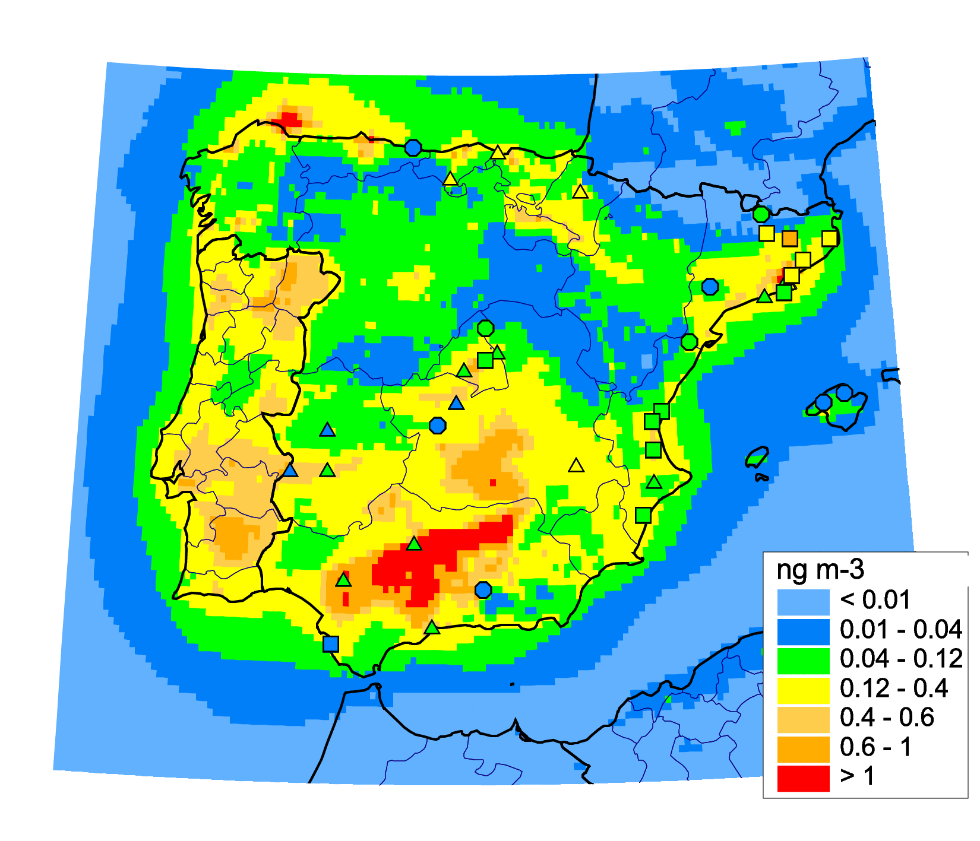
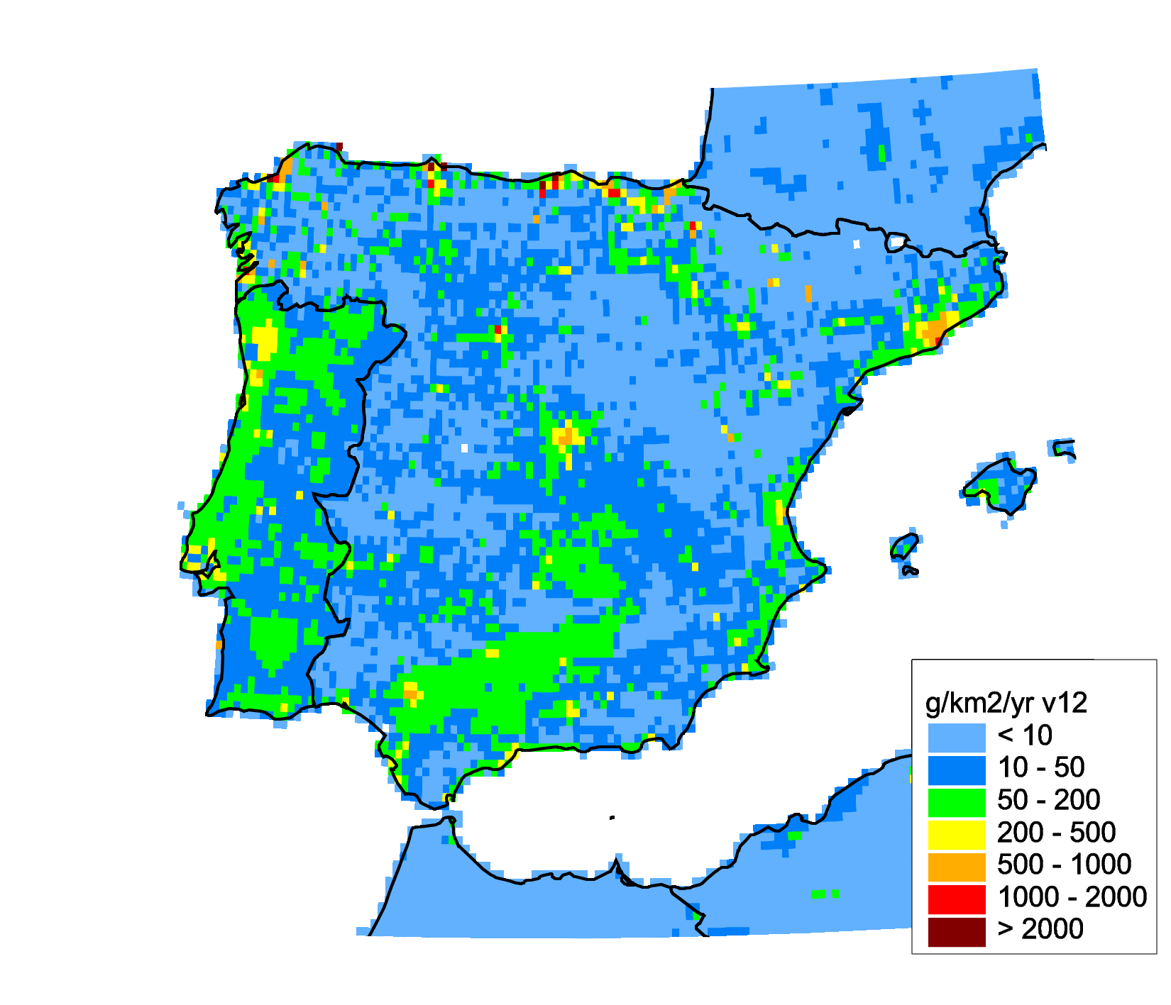
Main outcomes of the country-specific studies
(will be summarized in special report)
Evaluation of national emissions (Poland, Belarus, Spain)
Calculations using scenario emissions
Calculations using original emissions
B[a]P emissions
B[a]P concentration
Evaluation vs. measurements
Measurements
Measurements
Modelling (scenario)
Modelling (original)
19th TFMM, Geneva, May 2018

Slide 5
Main outcomes of the country-specific studies
(will be summarized in special report)
Model improvements and implications for the EMEP scale (effect of transition from coarse to fine grid, improved re-suspension, PAH degradation, …)
Effect of re-suspension improvement (on the base of the study for the Netherlands)
Model vs. Obs. (Netherlands)
Model vs. Obs. (EMEP region)
Observed
Modelled (improved re-suspension)
Modelled (original re-suspension)
Overall result of the case studies: improvement of assessment of pollution levels in the EMEP countries
19th TFMM, Geneva, May 2018

Slide 6
Country-scale pollution assessment for Poland
Outline
Collection of input data
Modelling
Joint analysis of the results
Preparation of country-specific information
(S-R matrices for voevodships, contribution of source categories, LPS , etc…)
Final report
19th TFMM, Geneva, May 2018

Slide 7
Country-scale pollution assessment for Poland
Outline
Collection of input data
Modelling
Joint analysis of the results (MSC-E and national experts)
- emission scenario
- pollution in cities
Preparation of country-specific information
(S-R matrices for voevodships, contribution of source categories, LPS , etc…)
Final report
19th TFMM, Geneva, May 2018

Slide 8
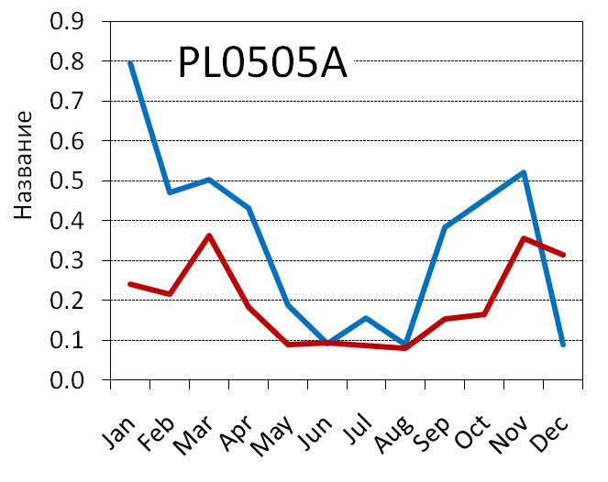
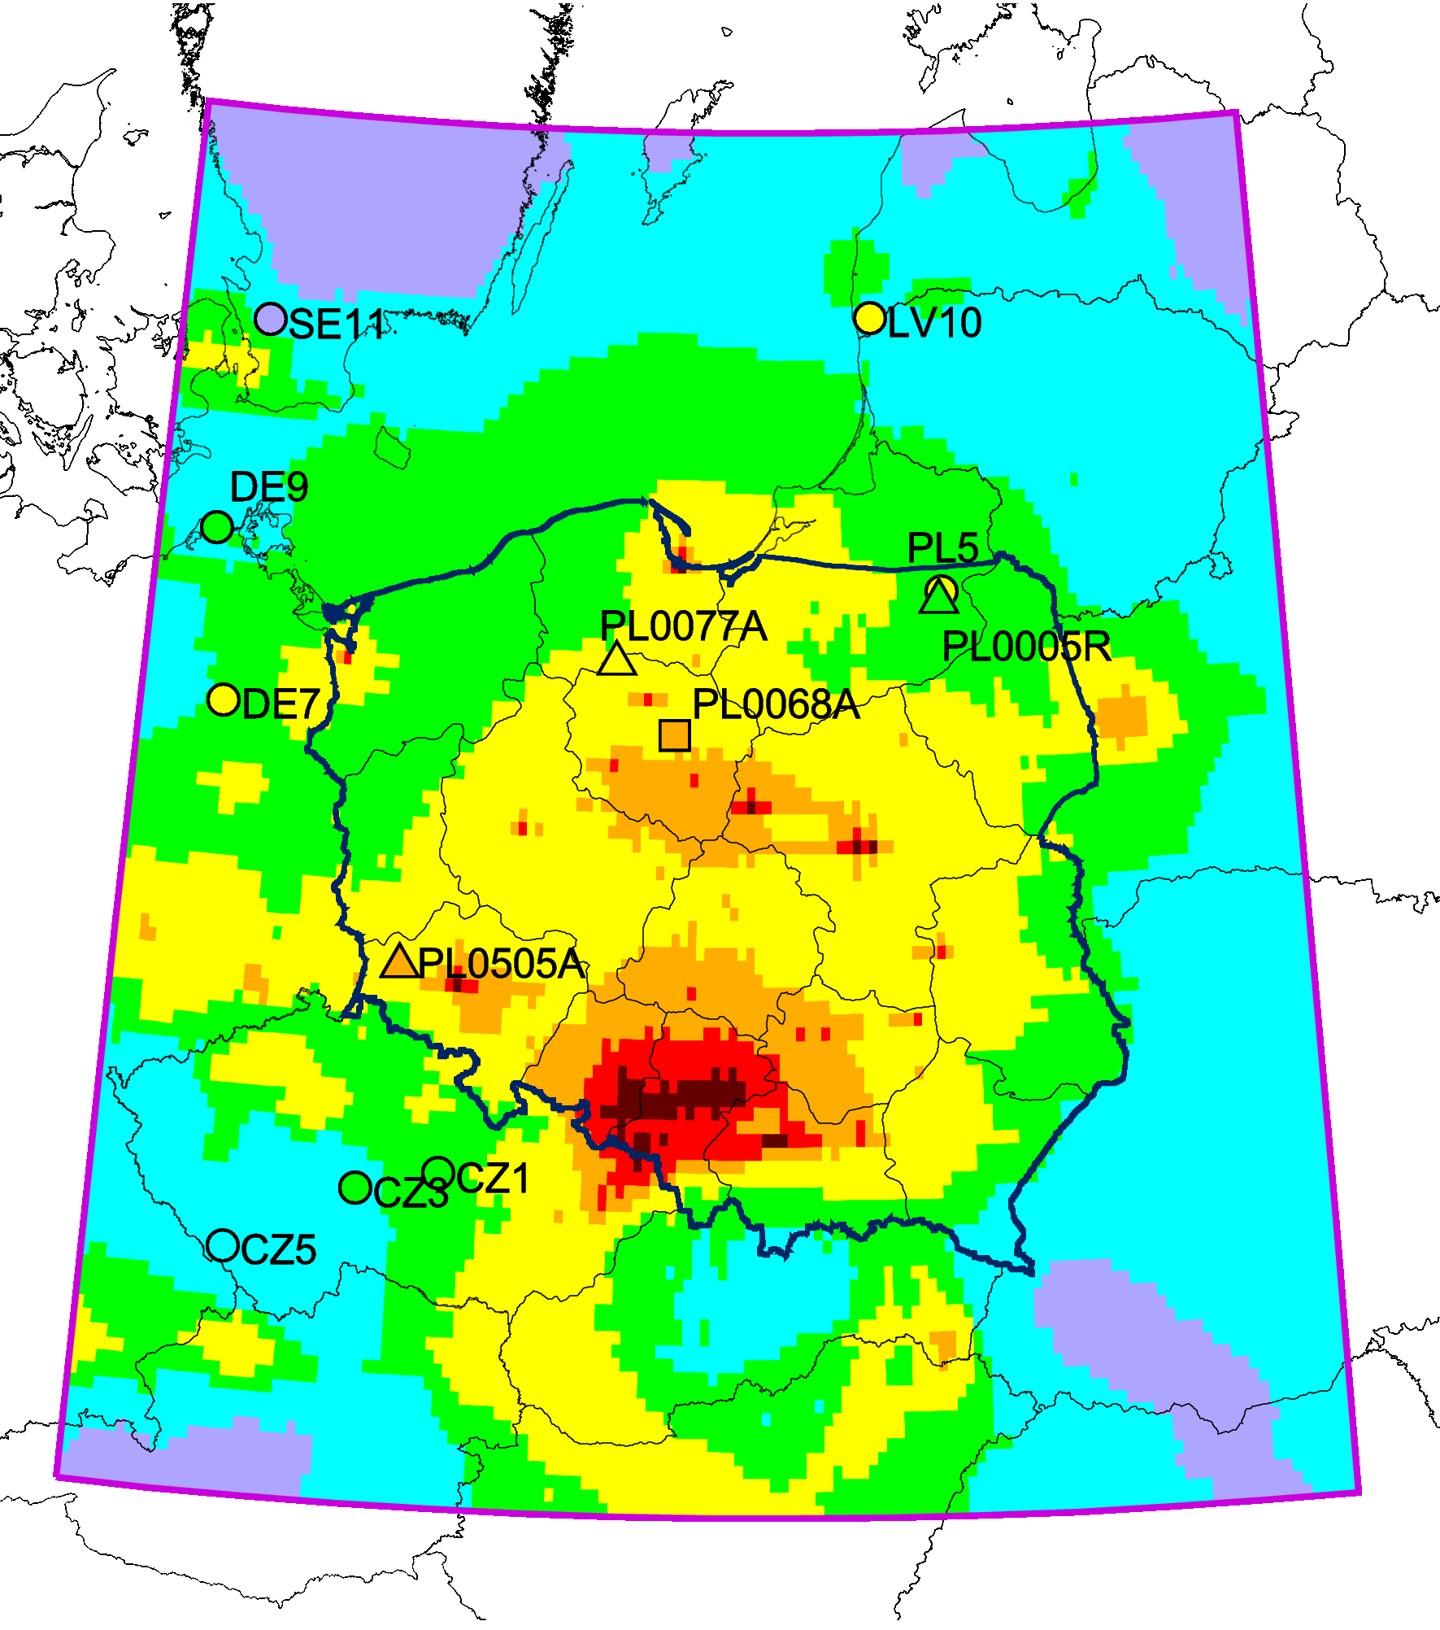
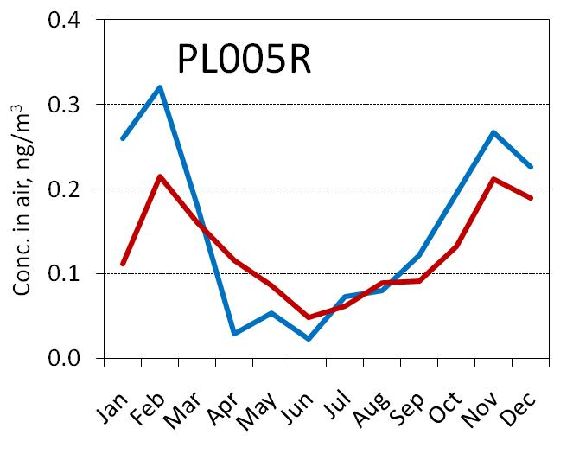
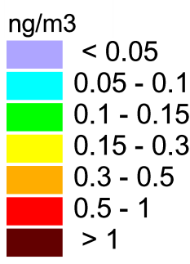
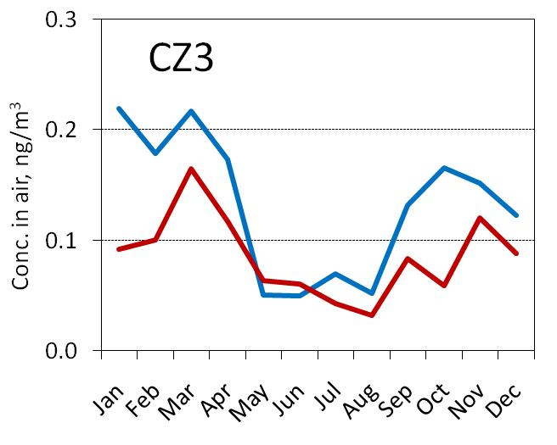
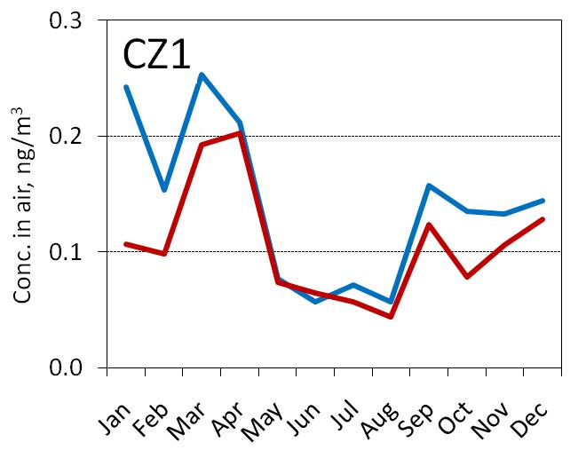
Modelled and observed monthly-mean Cd
concentrations in air in 2014
observed
modelled
19th TFMM, Geneva, May 2018

Slide 9
Preliminary analysis of possible reasons
Results of previous stages: Main factor is seasonal changes of emissions
Contribution of major sectors to Cd emissions in Poland
Seasonal variation of emissions
(TNO expert estimates)
2.0
18%
Residential combustion
1.5
Normalized emissions
1.0
0.5
Industrial emissions (B)
Residential combustion (C)
0.0
Jan
Feb
Mar
Apr
May
Jun
Jul
Aug
Sep
Oct
Nov
Dec
Others
Emission from sector residential combustion could be underestimated
9
19th TFMM, Geneva, May 2018

Slide 10
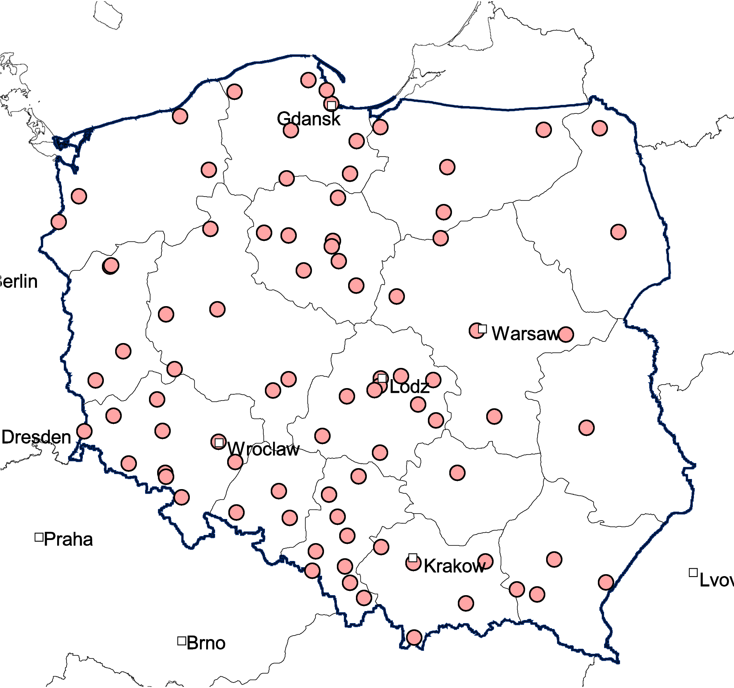
Formulation of emission scenario
Aim:
To improve agreement between modelled and observed pollution levels
Improvement of emission data in cooperation with nation experts
Method: Optimization
Stations in PL
Modelled concentration C_{i}:
A_{j}
-influence function ( from source-receptor matrix)
- emission in a province
Emission variation:
- variation coefficients
Least-square method:
Focused on sector “Residential combustion” in cold period (Jan-Mar and Oct-Dec)
Applied for each of 16 voivodships and neighboring countries
About 80 stations from Polish monitoring network were involved
10
19th TFMM, Geneva, May 2018

Slide 11
Scenario vs. original emissions in Poland: total values
Seasonal changes of Cd emission in Poland
Cd emissions in particular voevodships
Other sectors
Residential comb.
Other sectors
Residential comb.
Added to residential comb.
Total emission (original): 13.6 t
Total emission (scenario): 17.2 t
Emission change: 26 % ( overall uncertainty of PL emission: ~ 70% )
19th TFMM, Geneva, May 2018

Slide 12
Modelled and observed monthly mean Cd air concentrations
observed
modelled (original)
19th TFMM, Geneva, May 2018

Slide 13
Modelled and observed monthly mean Cd air concentrations
observed
modelled (scenario)
19th TFMM, Geneva, May 2018

Slide 14
Modelled and observed Cd concentrations in cold period at regional and suburban stations (EMEP, PL, CZ)
x2
1:1
Index | Original | Scenario
Mean Rel. Bias, % | -24 | -4
Rcorr | 0.79 | 0.83
RMSCE | 0.35 | 0.27
x2
scenario
original
The suggested scenario favoured improvement of Cd levels assessment in Poland
19th TFMM, Geneva, May 2018

Slide 15
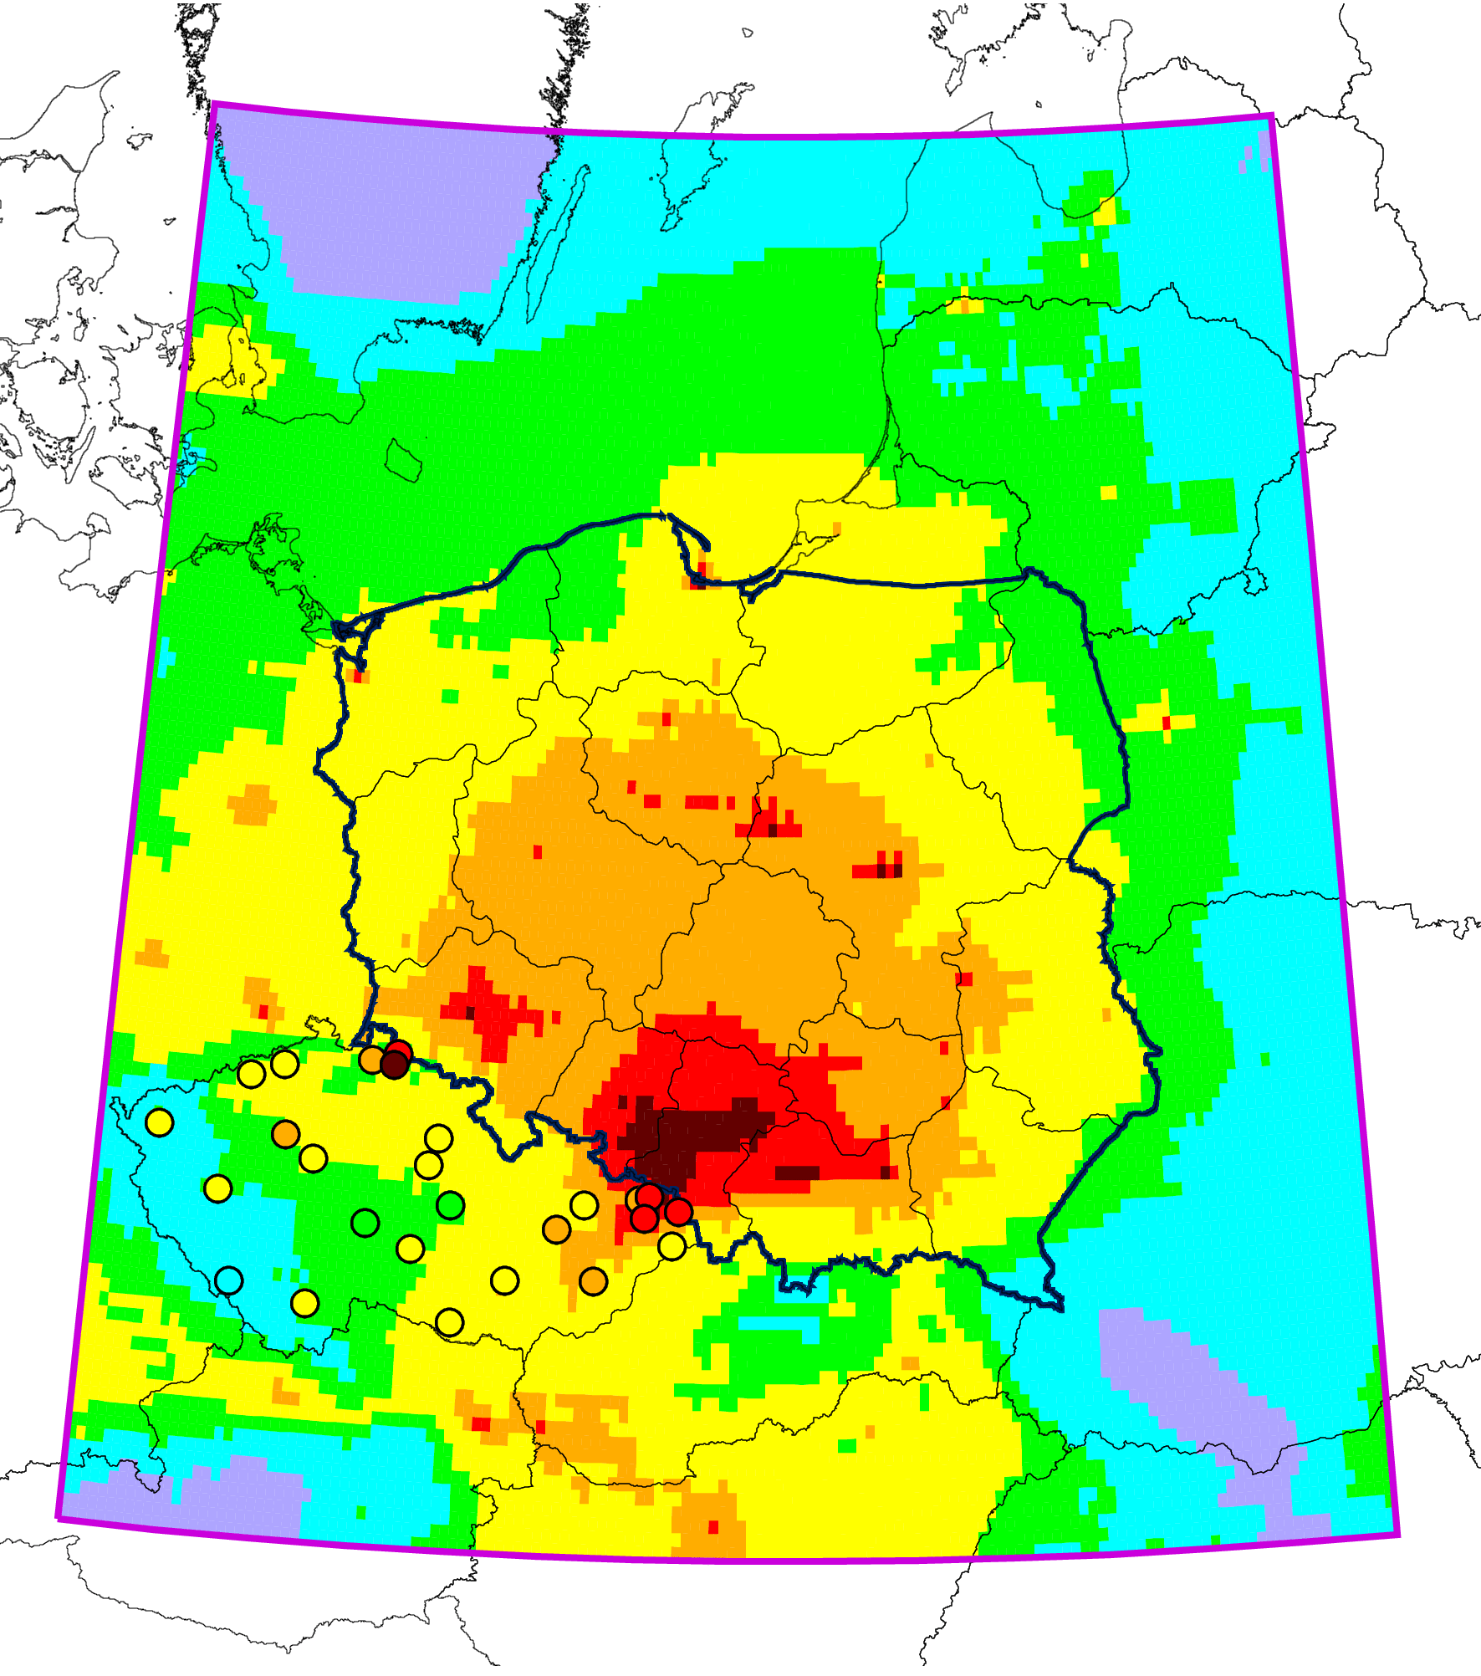
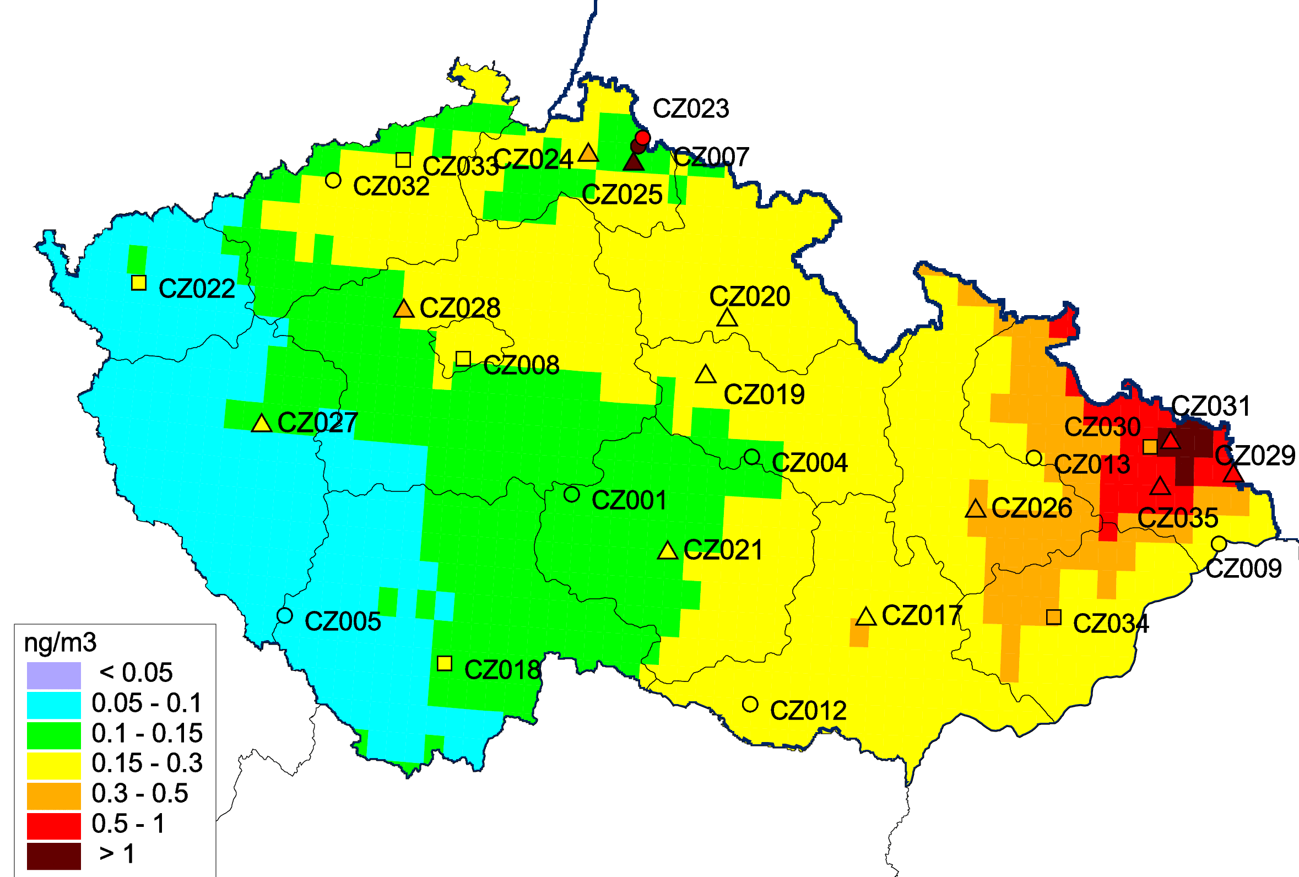
Modelled vs. observed results for stations in the Czech Republic (evaluation set)
Monthly mean Cd conc. (average over stations)
Cd air concentrations
Obs.
Mod. (scenario)
Mod. (original)
CZ stations were not included to produce emission scenario
Pollution assessment in neighbouring countries improved
19th TFMM, Geneva, May 2018

Slide 16
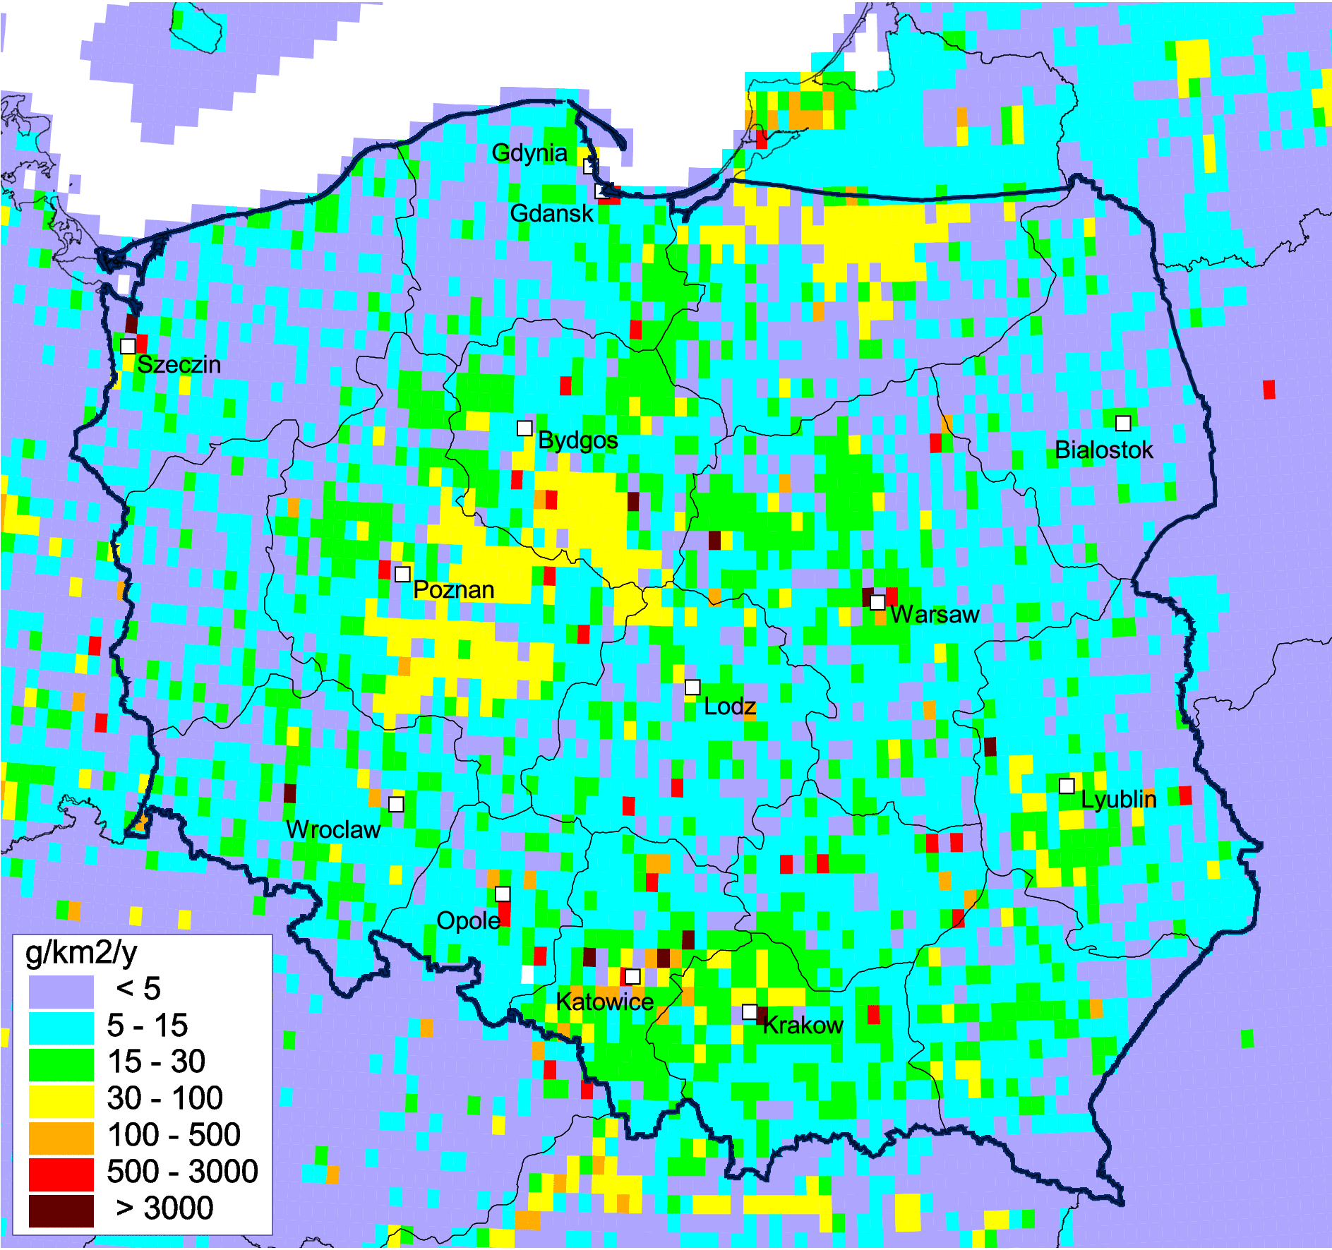
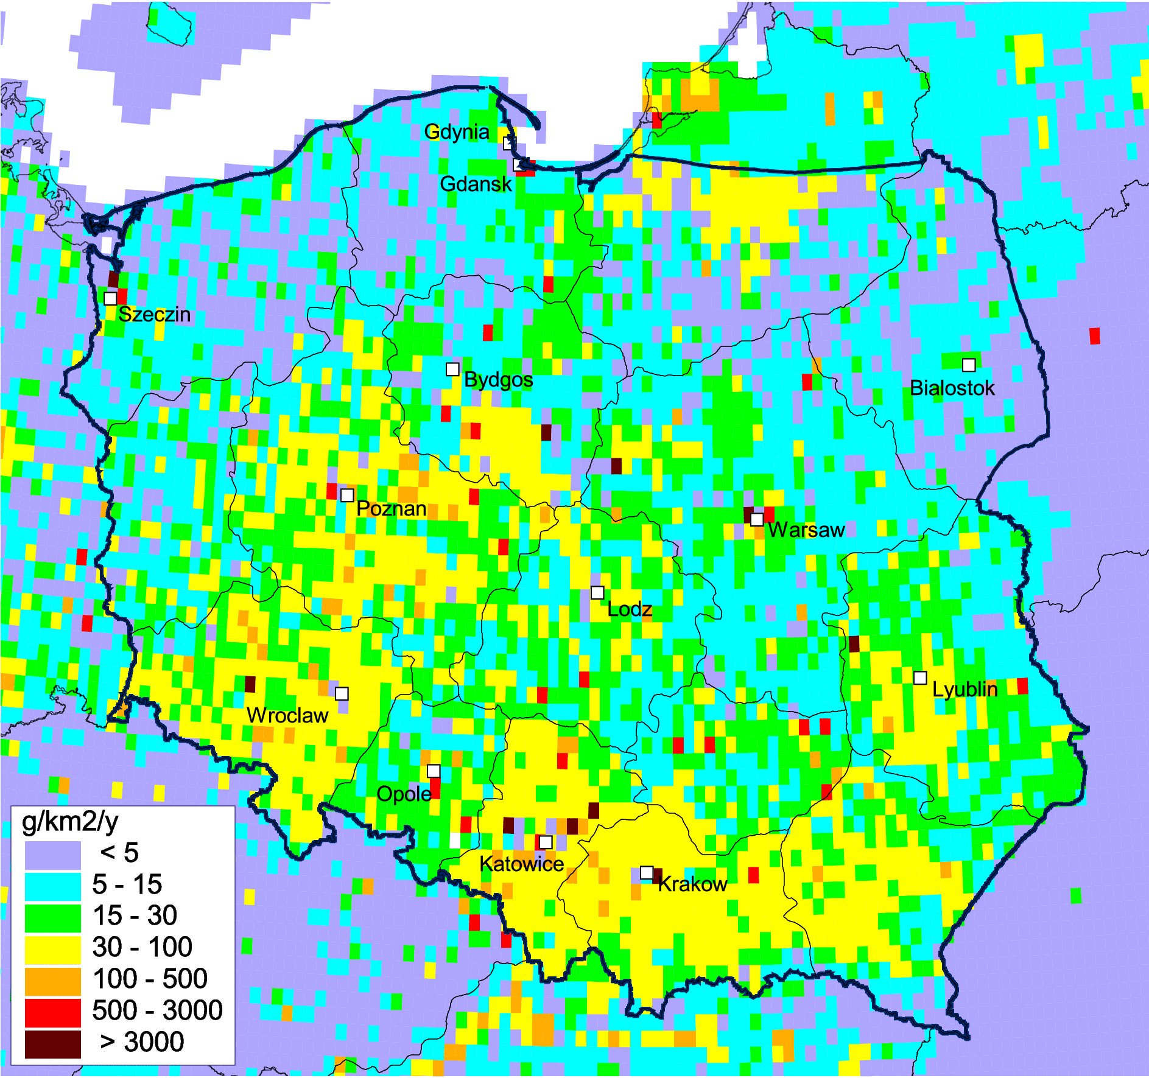
Scenario vs. original emissions in Poland: spatial distribution
Total emissions of Cd in 2014
Original
Scenario
Scenario assumes higher emissions mostly in the southern and south-western part of Poland.
Change of emission from residential combustion results to 26 % increase of total emission
19th TFMM, Geneva, May 2018

Slide 17
Country-scale pollution assessment for Poland
Outline
Collection of input data
Modelling
Joint analysis of the results
- emission scenario
- pollution in cities
Preparation of country-specific information
(S-R matrices for voevodships, contribution of source categories, LPS , etc…)
Final report
19th TFMM, Geneva, May 2018

Slide 18
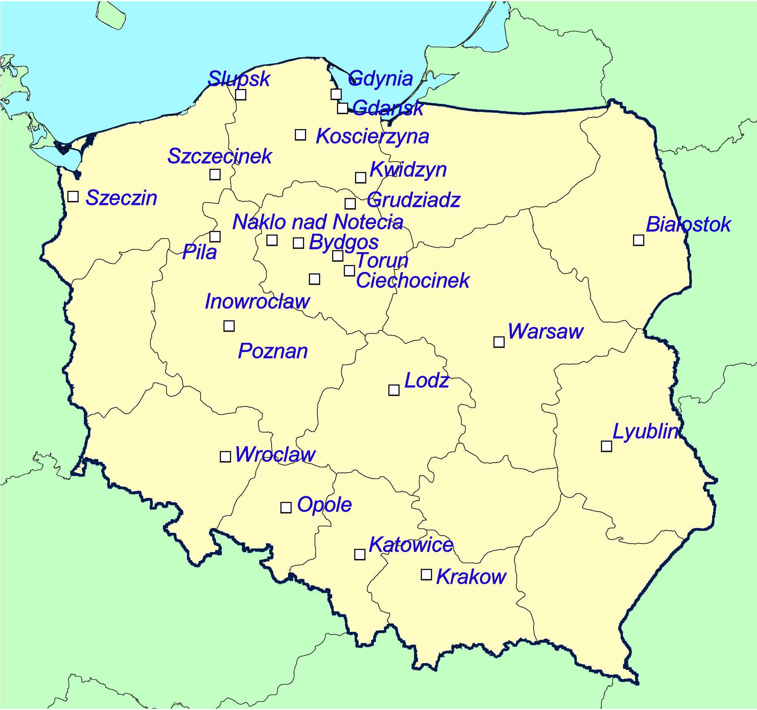
Evaluation of Cd pollution levels in urban areas
Purpose: Testing the ability of the model to reproduce levels in cities and, in particular, role of city sources (urban increment)
Cities of Poland involved to study
Approach: marking of ‘urban’ emissions and making S-R calculations.
C_{total} = C_{urban} + C_{external}
C_{total} – total concentration
C_{urban} – urban increment
C_{external} – sources outside cities
23 cities included
19th TFMM, Geneva, May 2018

Slide 19
Modelled vs. observed Cd levels in the selected cities
Averaged monthly mean concentrations
(23 urban background stations)
Index | Value
Mean Rel. Bias, % | - 9%
Spatial R_{corr} | 0. 71
Temporal R_{corr} | > 0.6 at 80% of stations
- 5th-95th percentile of obs. values
Whiskers: 5th-95th percentile of mod. values
In most of the selected cities the model reproduced the observed levels with sufficient quality
19th TFMM, Geneva, May 2018

Slide 20
Calculated Cd urban increments in Polish cities
(anthropogenic component)
Urban increment contributes from 1% to 70% of total Cd concentration in cities of Poland
Even in large cities (e.g, Warsaw, Krakow) contribution of external sources is 30-50%. In small cities these sources dominate
19th TFMM, Geneva, May 2018

Slide 21
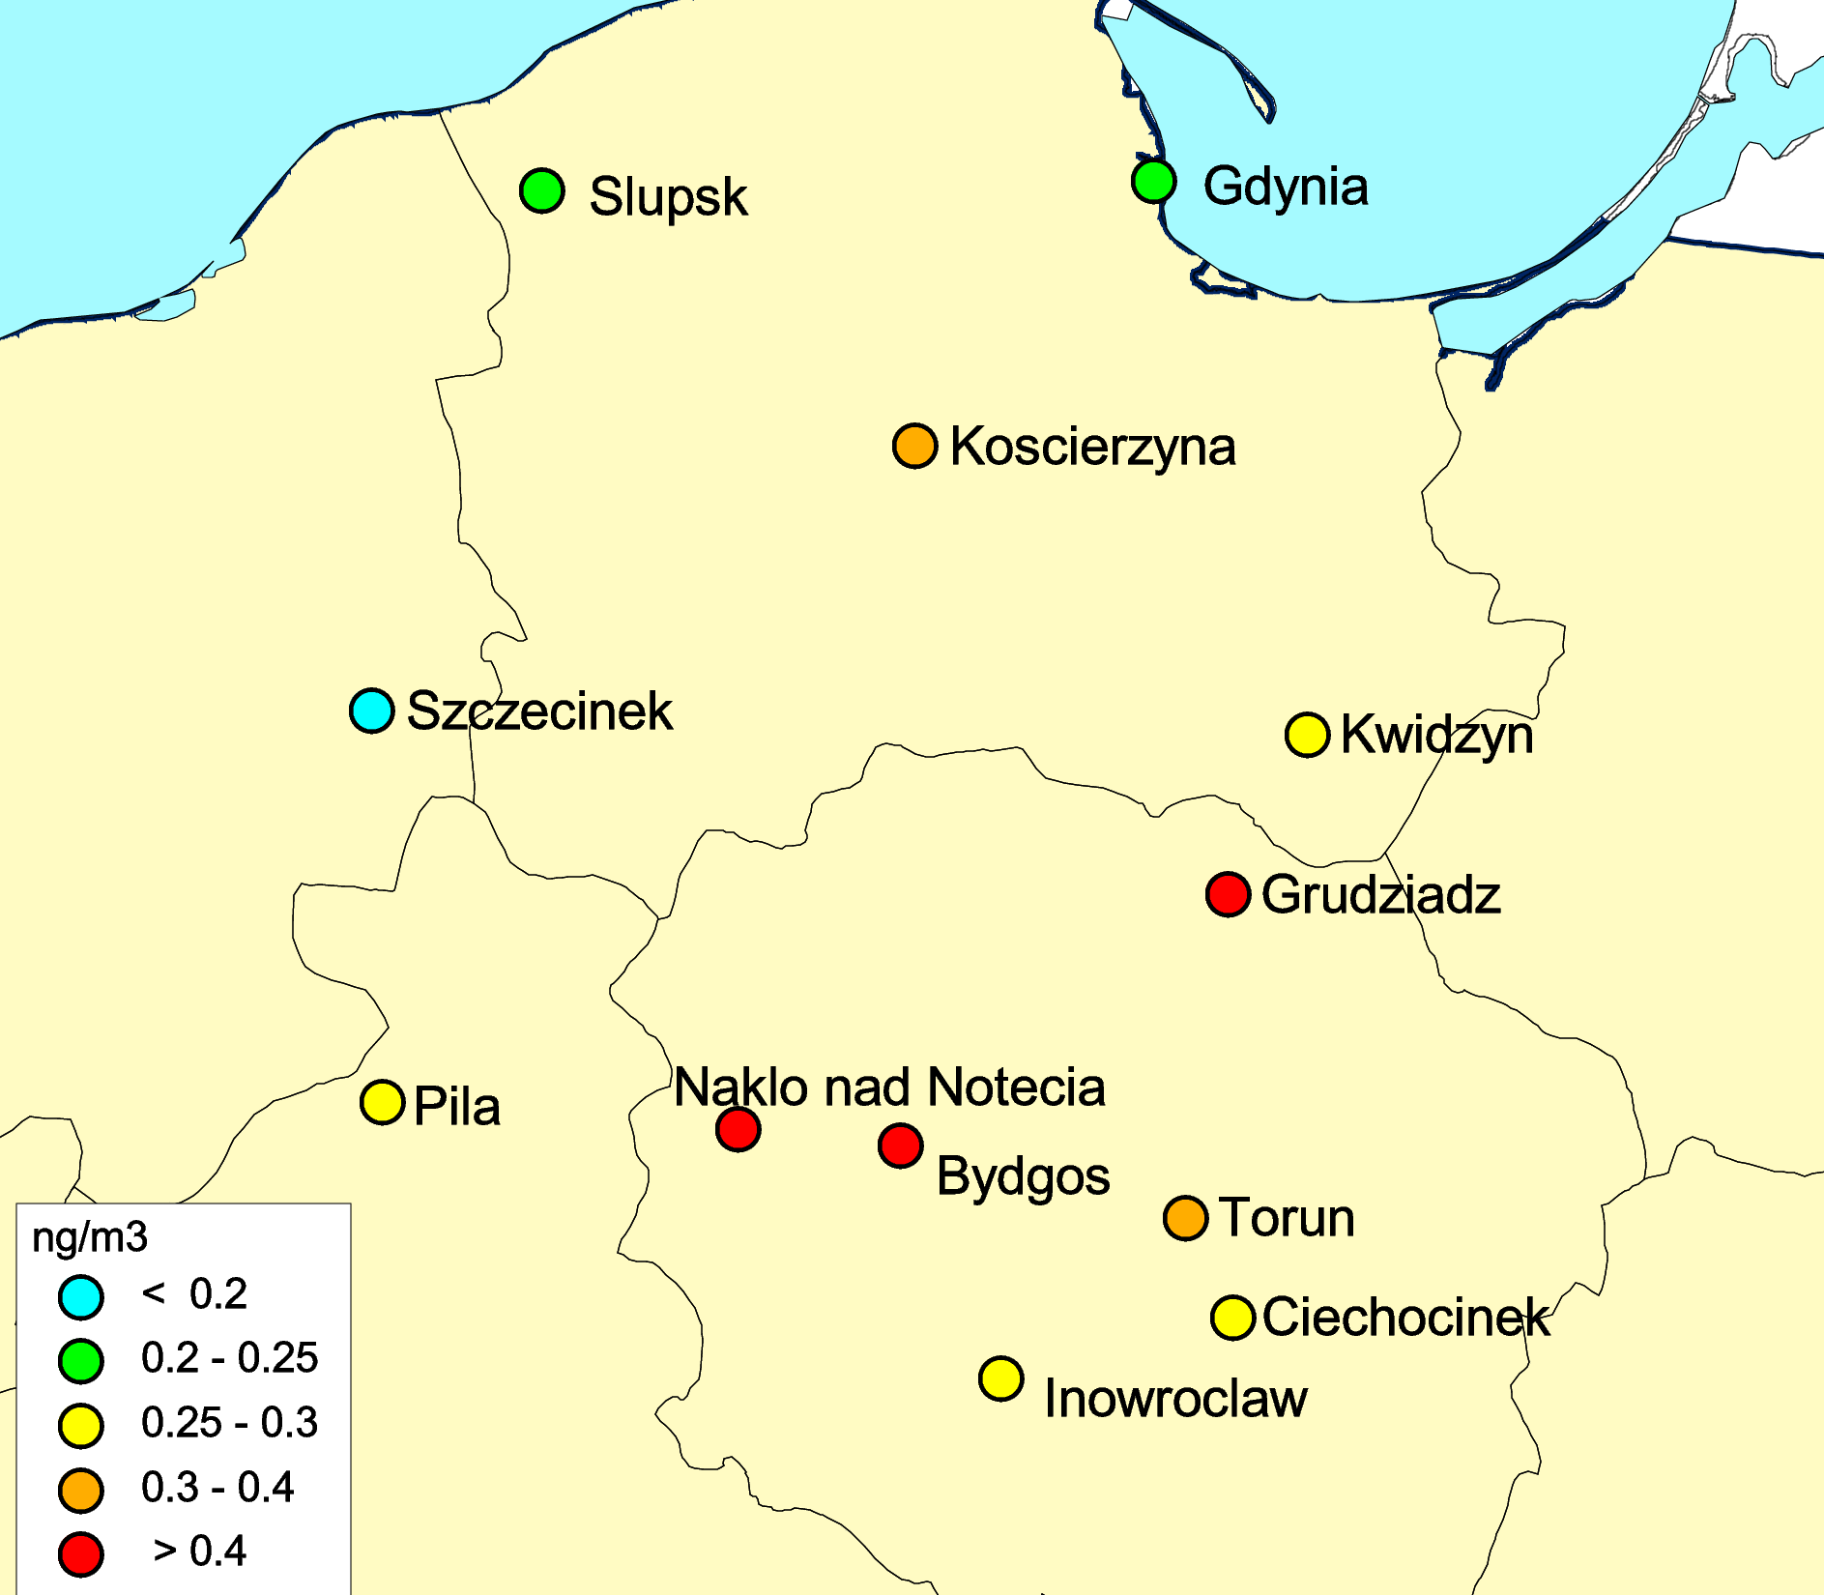
Evaluation of seasonal changes of urban increments
S-R modeling vs. measurement-based Lenschow approach (with contribution from Marco Pandolfi, Spain, EGAR Group IDAEA-CSIC)
Observed Cd air conc. in cities of north-western Poland
seasonal changes reproduced
seasonal changes missed
observed increment
modelled increment
19th TFMM, Geneva, May 2018

Slide 22
Evaluation of seasonal changes of urban increments
S-R modeling vs. measurement-based Lenschow approach (with contribution from Marco Pandolfi)
City emission
City emission
observed increment
Resid. Comb.
Resid. Comb.
Other sectors
modelled increment
Other sectors
19th TFMM, Geneva, May 2018

Slide 23
Cd emission sectors in the selected cities
Seasonal changes reproduced
Seasonal changes missed
Residential combustion
Other sectors
Emission data from sector ‘Residential combustion’ needs further improvement
19th TFMM, Geneva, May 2018

Slide 24
Country-scale pollution assessment for Poland
Outline
Collection of input data
Modelling
Joint analysis of the results
- emission scenario
- pollution in cities
Preparation of country-specific information
(S-R matrices for voevodships, contribution of source categories, LPS , etc…)
Final report
24
19th TFMM, Geneva, May 2018

Slide 25
Country-specific information on Cd pollution in Poland
19th TFMM, Geneva, May 2018

Slide 26
Country-specific information on Cd pollution in Poland
Pollution levels in particular provinces (voivodships)
Mean deposition fluxes to voivodships
19th TFMM, Geneva, May 2018

Slide 27
Country-specific information on Cd pollution in Poland
Pollution levels in particular provinces (voivodships)
Source-receptor relationships for Polish voivodships
Contributions of foreign and national emission sources to pollution in Polish voivodships
19th TFMM, Geneva, May 2018

Slide 28
Country-specific information on Cd pollution in Poland
Pollution levels in particular provinces (voivodships)
Source-receptor relationships for Polish voivodships
Contribution of emission sectors to pollution levels
19th TFMM, Geneva, May 2018

Slide 29
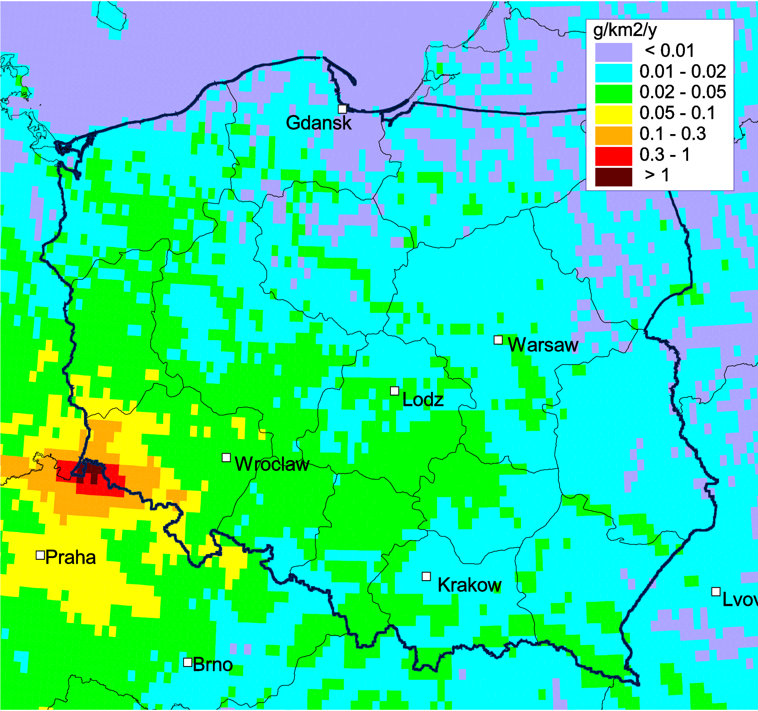
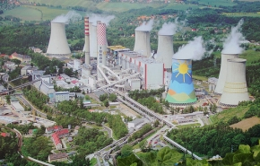
Country-specific information on Cd pollution in Poland
Pollution levels in particular provinces (voivodships)
Source-receptor relationships for Polish voivodships
Contribution of emission sectors to pollution levels
Pollution from particular Large Point Sources
Pollution in cities
Turów power station
19th TFMM, Geneva, May 2018

Slide 30
Conclusions
Identified underprediction of Cd levels in Poland and neighbouring countries in cold period was linked with possible underestimation of cadmium emission from sector ‘residential combustion’.
Suggested emission scenario assumes higher emissions in southern and south-western part of Poland in cold period. Compared to original emissions, annual scenario emission value in Poland is 26% higher.
Urban increment of Cd air concentrations in the selected Polish cities makes up from 1% to 70% of total Cd concentration in cities of Poland. Contribution from sources outside the cities is substantial.
Model can be used for evaluation of emission data in countries in close cooperation with national experts and the EMEP centres and the Task Forces
The usage of emission scenarios allows producing more realistic alternative results of pollution levels assessment, along with the results based on official emission data
19th TFMM, Geneva, May 2018

Slide 31
Future direction:
Continue cooperation with the EMEP countries on HM pollution (U.K.)
Evaluation of Hg levels in Germany, including source apportionment (global, regional local sources) and assessment of risks for ecosystems
Evaluation of Hg input to surface waters and catchment areas in Scandinavia (in cooperation with WGE/ICP-waters)

