Slide 1
Experience with the new 0.1°x0.1° EMEP emissions
Hilde Fagerli on behalf of MSC-W

Slide 2
Progress in MSC-W activities
Experience with the new (2017) 0.1°x0.1° EMEP emissions (H. Fagerli)
EMEP modelling organic aerosols (OA); experiences with semi- and interim- volatility OA (D. Simpson)
Progress in downscaling using uEMEP (B. Denby)
EMEP modelling of ozone and nitrogen deposition to ecosystems; recent activities (D. Simpson)
Twin site exercise

Slide 3
Overview
The effect of the new gridded emissions in 0.1°x0.1° long-lat resolution on model results
GNFR versus SNAP - temporal and height distribution of emissions
International shipping emissions - availability and challenges
How can CAMS81 contribute to EMEP work and vice versa

Slide 4
EMEP 0.1°x0.1° emissions and model results for 2015 – comparison to observations
22 countries reported sectoral gridded sectoral emissions in the new grid (0.1°x0.1° long-lat resolution)
Remaining areas: gap filled and spatially distributed by CEIP
Model runs performed using both 0.1°x0.1° (34 and 20 layers) and 50km x 50km emissions for 2015
Comparison to EMEP (background) and Airbase measurements (rural, suburban, urban, excluding traffic stations)
Why Airbase data?
- Because we do not expect to see that much change in the background (that is how the EMEP network was designed).
- We need a lot of data to look at the spatial distribution (EMEP not enough).

Slide 5
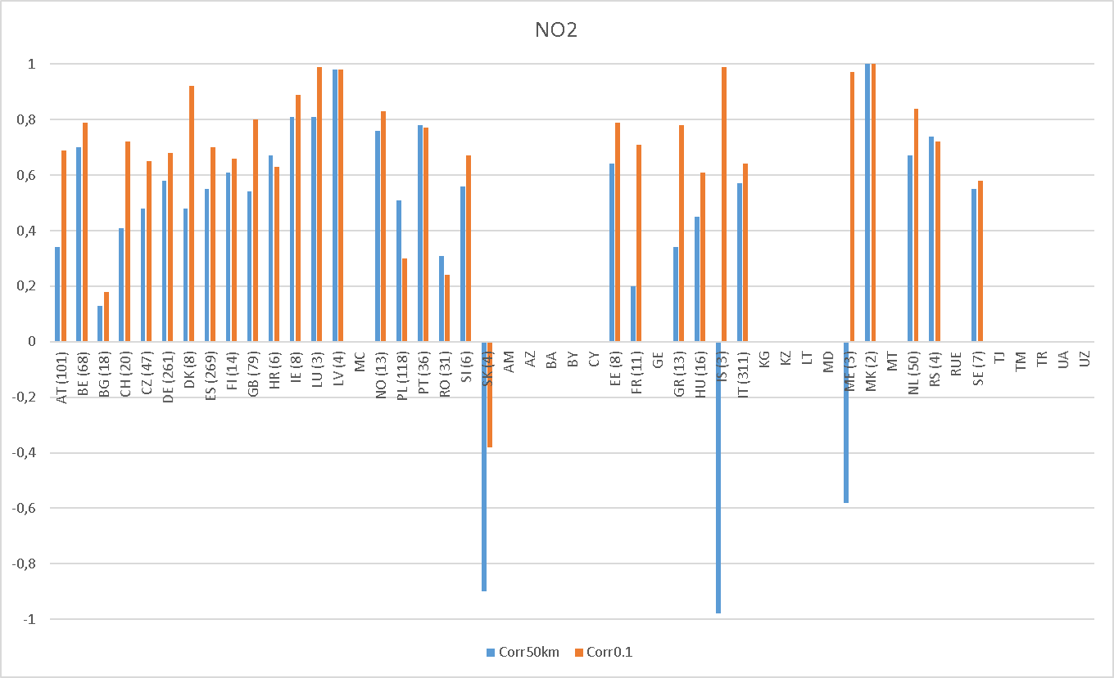
NO₂ – spatial correlation (mod-Airbase) within each country
Left of the green line: countries that reported in the new grid
Parenthesis: number of sites
Improved spatial correlation for NO₂
Some countries should be revised (e.g. BG, PL, RO)

Slide 6
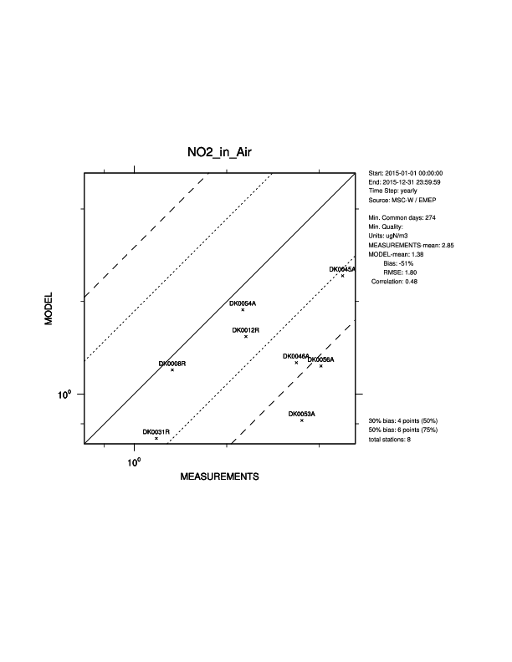
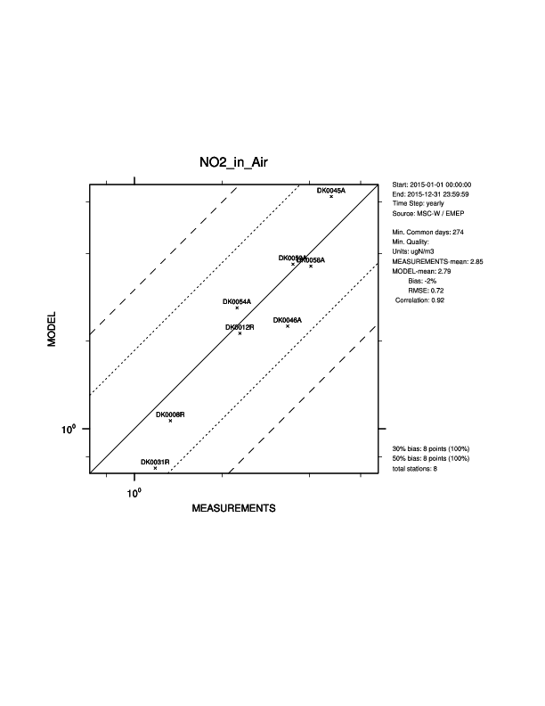
Denmark - a nice example
Old emissions (50kmx50km)
New emissions (0.1x0.1)

Slide 7
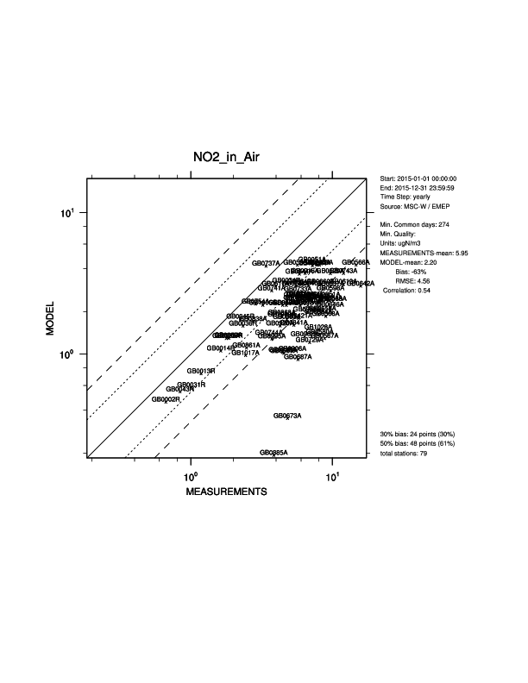
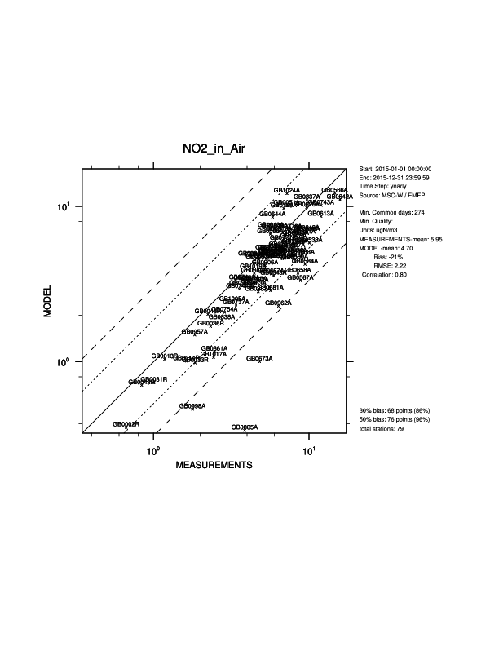
United Kingdom
Old emissions (50kmx50km)
New emissions (0.1x0.1)

Slide 8
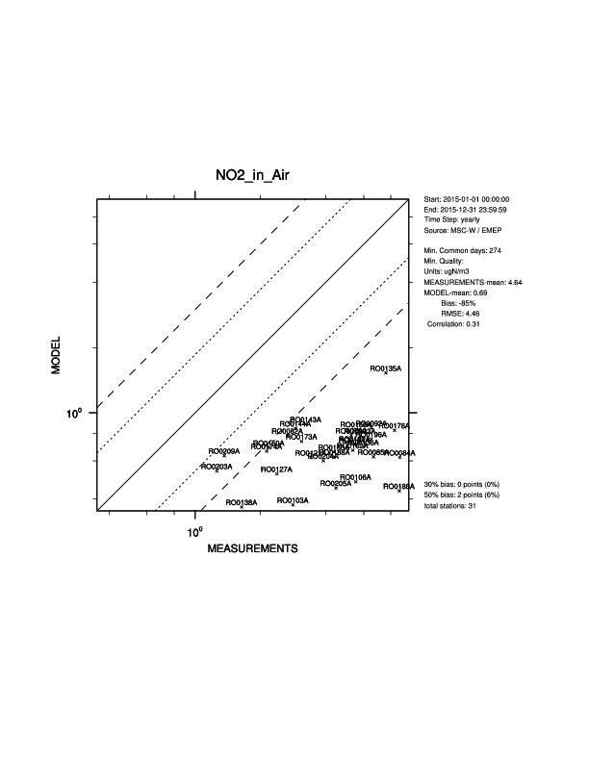
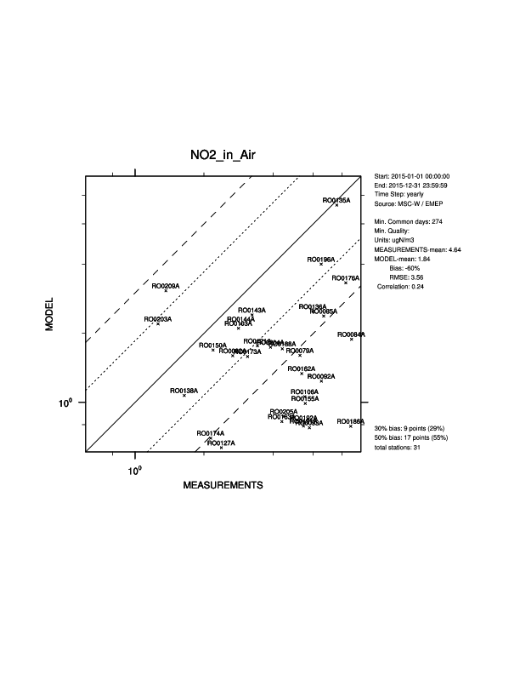
Romania
Worse spatial correlation, but better results for several stations. (Sources missing in gridding? Or non-representative stations?)
Feedback from the country would be very useful, (emissions, observations, local modelling).
Old emissions (50kmx50km)
New emissions (0.1x0.1)

Slide 9
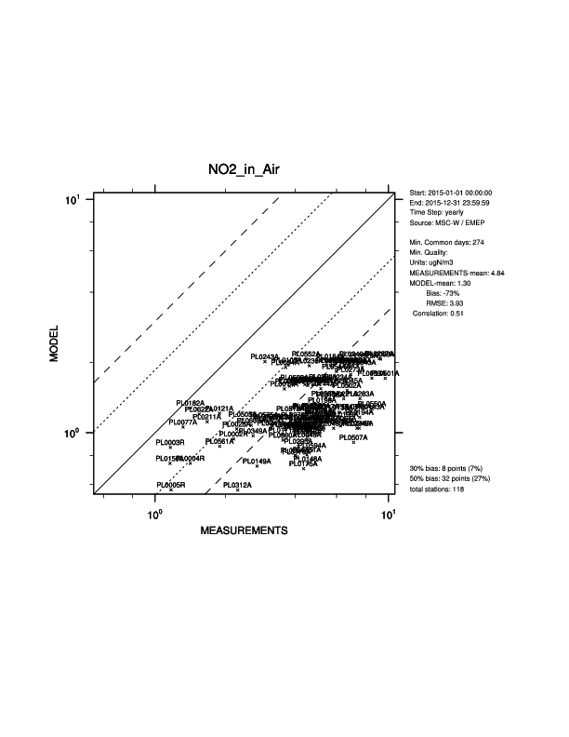
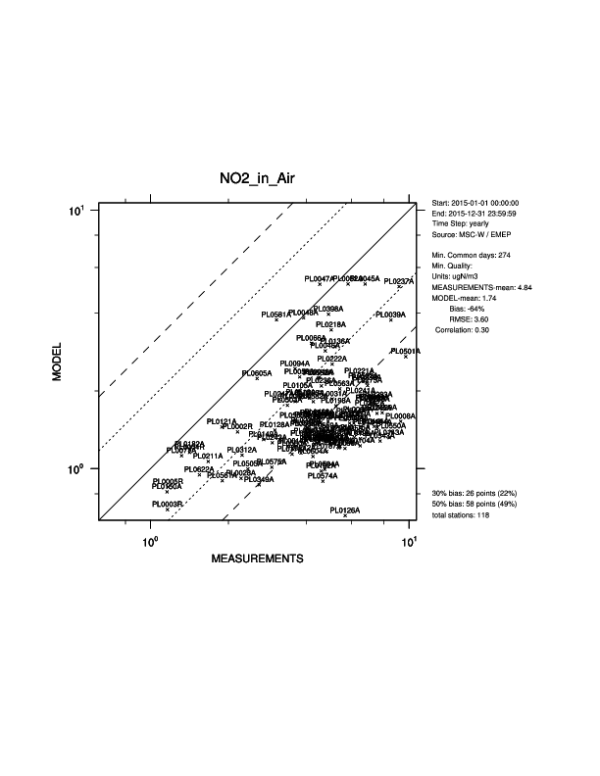
Poland
Worse spatial correlation, but better results for several stations (Sources missing in gridding? Or non-representative stations?)
Feedback from country would be very useful, emissions, observations, local modelling
Old emissions (50kmx50km)
New emissions (0.1x0.1)

Slide 10
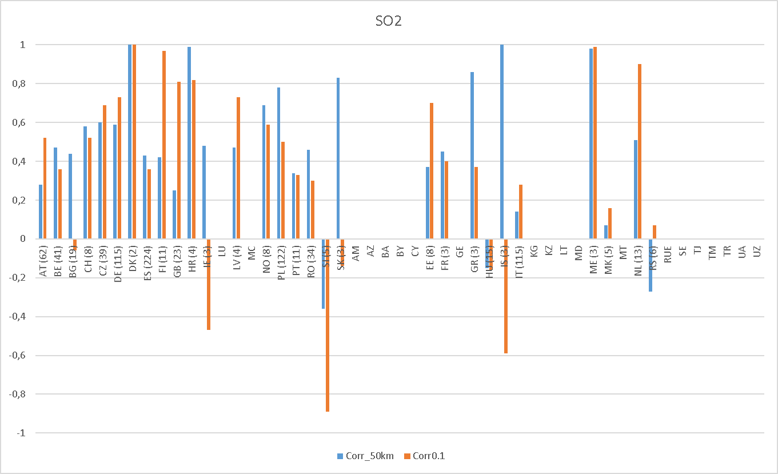
SO₂ – spatial correlation (mod-Airbase) within each country
Left of the green line: countries that reported in the new grid
Parenthesis: number of sites
It is more difficult to use surface observations of SO₂ to validate SO_{x} emissions since a large part of it arises from sources released higher in the atmosphere - mixed results

Slide 11
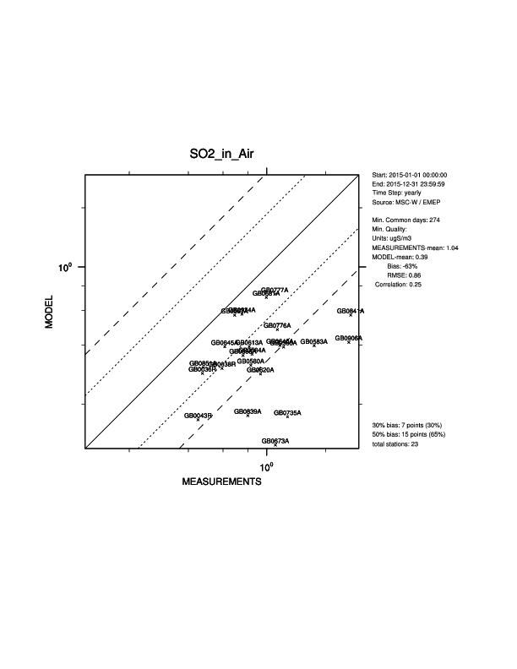
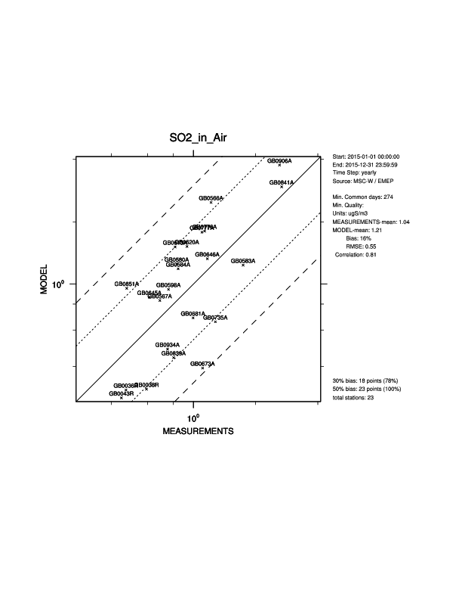
United Kingdom
Significant improvement
Old emissions (50kmx50km)
New emissions (0.1x0.1)

Slide 12
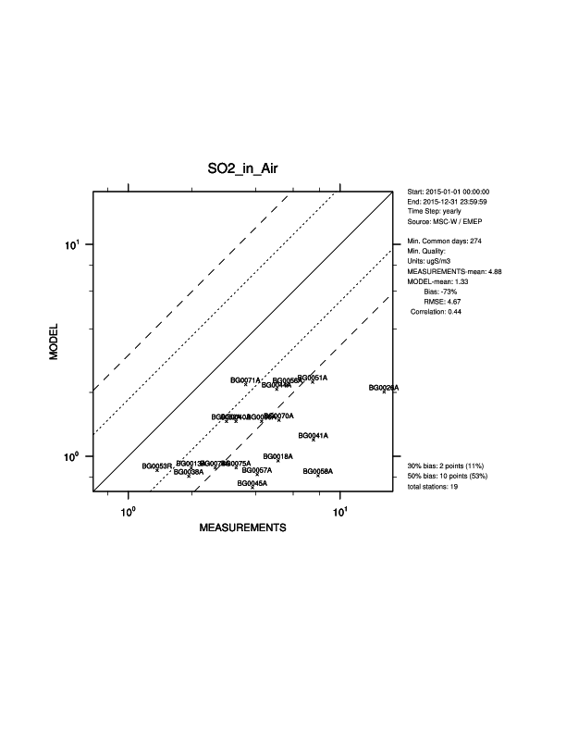
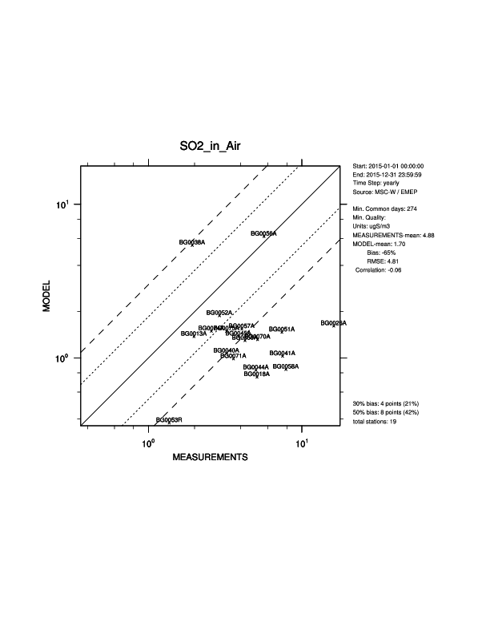
Bulgaria
Not much improvement
Old emissions (50kmx50km)
New emissions (0.1x0.1)

Slide 13
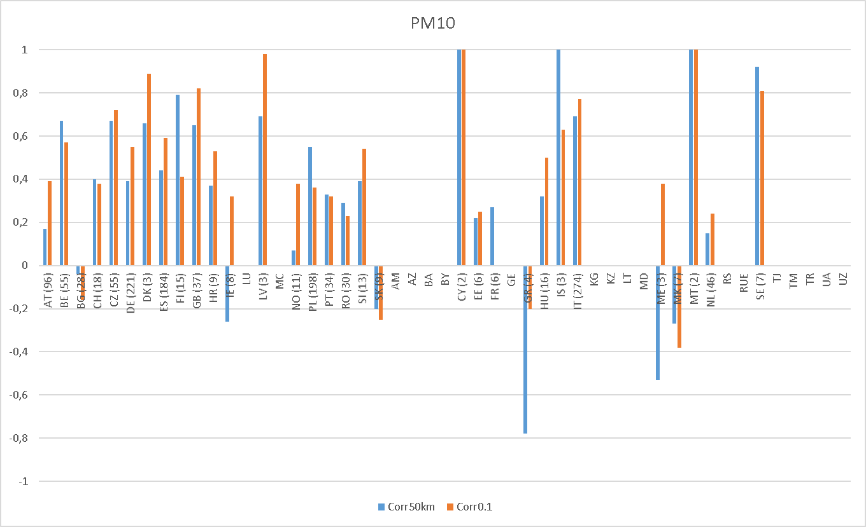
PM₁₀– spatial correlation (mod-Airbase) within each country
Left of the green line: countries that reported in the new grid
Parenthesis: number of sites
Improved spatial correlation in the majority of countries

Slide 14
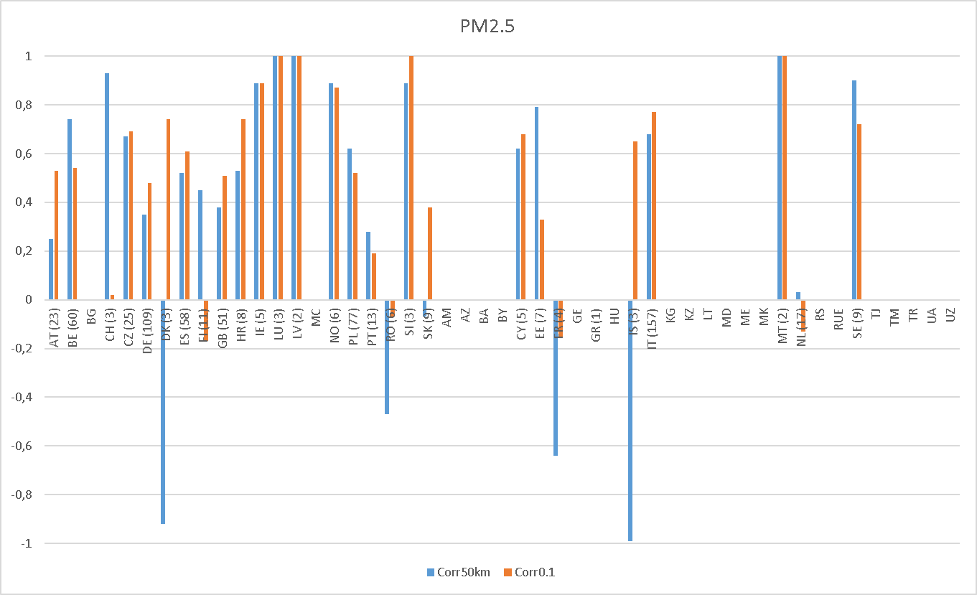
PM₂₅– spatial correlation (mod-Airbase) within each country
Left of the green line: countries that reported in the new grid
Parenthesis: number of sites
Improved spatial correlation in the majority of countries,
but more mixed results (and less measurements)

Slide 15
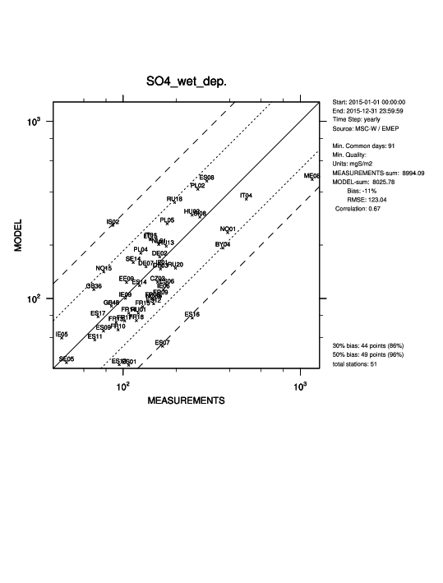
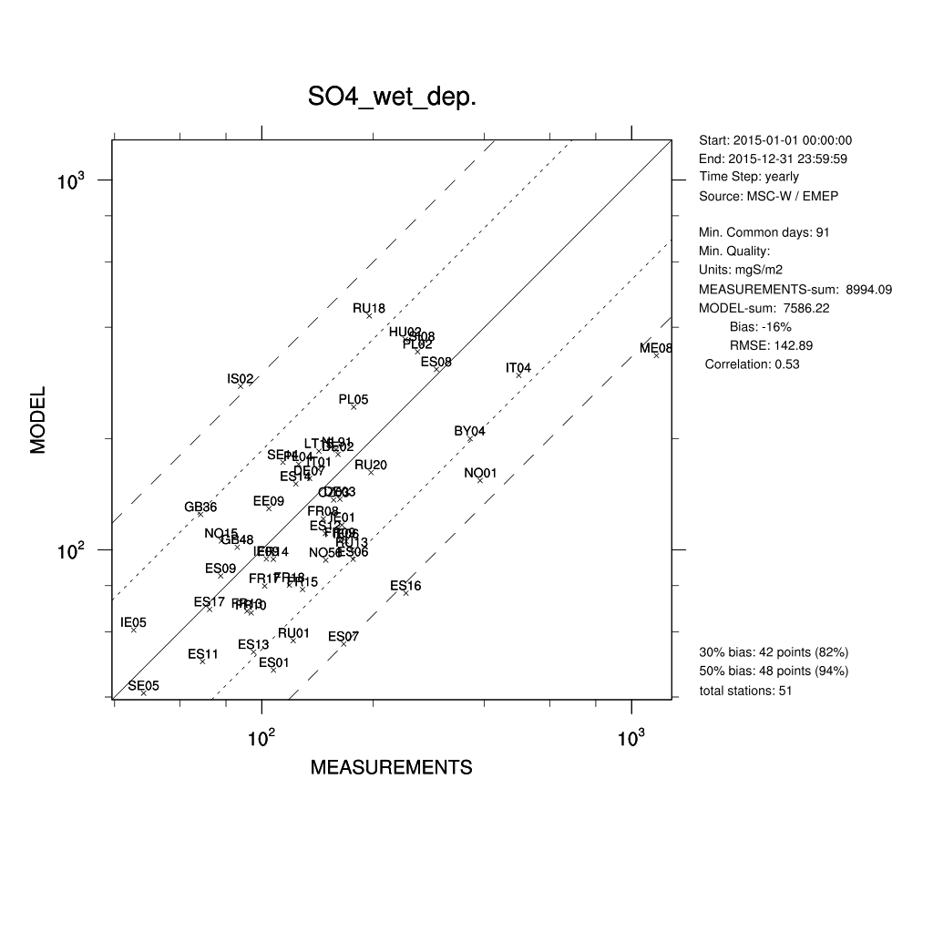
Improved wet deposition (S and ox. N)
0.1°x0.1°
50kmx50km

Slide 16
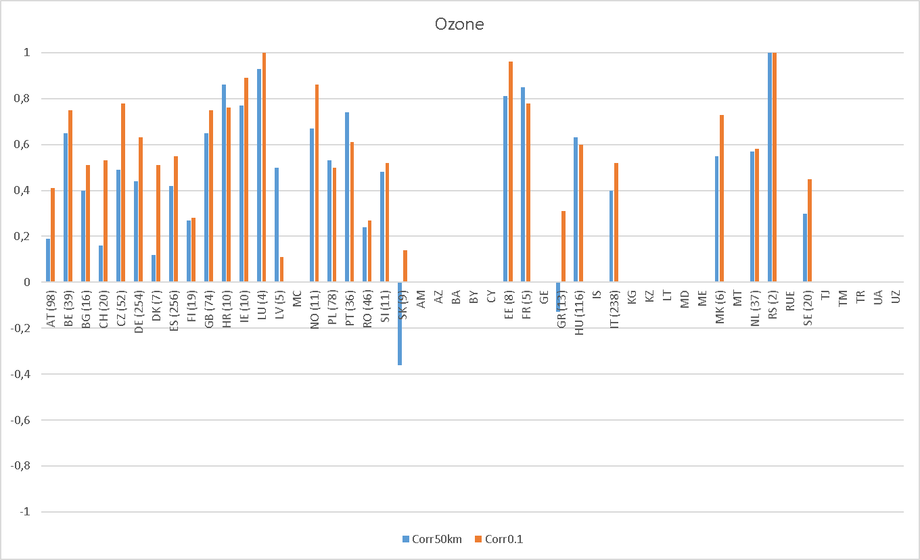
O₃ mean – spatial correlation (mod-Airbase) within each country
Left of the green line: countries that reported in the new grid
Parenthesis: number of sites
Large improvements in O₃ related to the NO₂ improvements
Improved spatial correlation for O₃ – titration effect
Better reflect long-term exposure and deposition

Slide 17
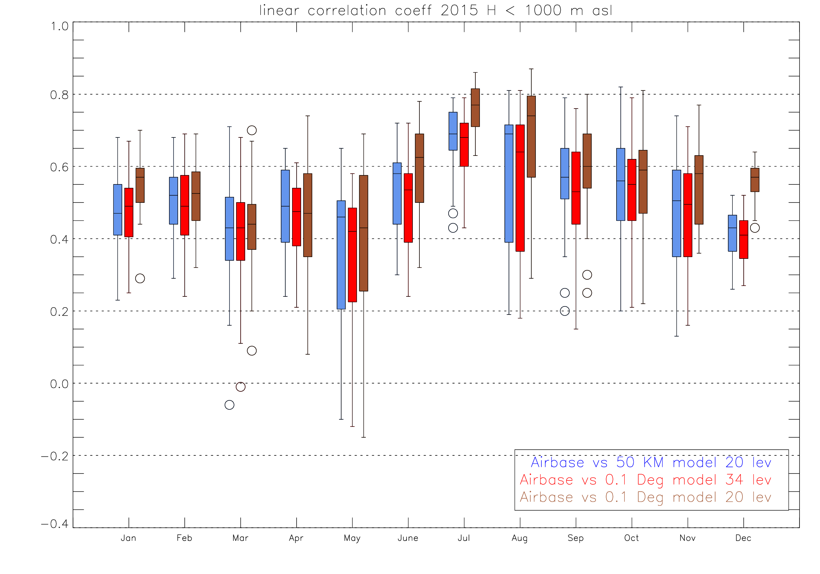
O₃ – the daily maximum running 8 hour concentration
Spatial linear correlation coefficient based on EMEP + Airbase rural data
EMEP 0.1°x 0.1° with 20 levels performs best for (almost) all months– look further into emission distribution, vertical exchange and definitions of the first model layer

Slide 18
Summary
Both the regridding done by the countries and by CEIP provide NO_{x} emissions that improves the model results for NO₂ (and O₃).
For SO₂ the results are more mixed, as expected.
Smaller improvements for PM, as expected.
Improved observation-model correlation for wet deposition (especially for SO_{x} and NO_{x})
For countries that have few observations it is difficult to interpret whether the new gridding is better than the old.
More knowledge about the national observation networks is necessary to judge the performance.
Some countries might benefit from revising their gridding, others should submit gridded data - feedback is very welcome (both with respect to observations, emissions, local modelling, local scientific expertise).
Modelling: revisit definition of first model layer and other assumptions
Notes:
Primary components (only NO₂ and SO₂ measured). For most secondary components (maybe except ozone), it is hard to judge whether the new gridding is better, because the life time is longer and the spatial distribution of the components to a large extent depend on other factors than the spatial distribution of emissions (chemistry, meteorology, dry & wet dep...)

Slide 19
GNFR versus SNAP
A ‘PublicPower’ (1)
B ‘Industry’ (3)
C ‘OtherStationaryComb’ (2)
D ‘Fugitive’ (4)
E ‘Solvents’ (6)
F ‘RoadTransport’ (7)
G ‘Shipping’ (8)
H ‘Aviation’ (8)
I ‘Offroad’ (8)
J ‘Waste’ (9)
K ‘AgriLivestock’ (10)
L ‘AgriOther’ (10)
M ‘Other’ (5)
SNAP 1 ‘Combustion in energy and transformation industries’
SNAP 2 ‘Non-industrial combustion plants’
SNAP 3 ‘Combustion in manufacturing industry’
SNAP 4 ‘Production processes’
SNAP 5 ‘Extraction & distribution of fossil fuels and geothermal energy’
SNAP 6 ‘Solvent and other product use’
SNAP 7 ‘Road transport’
SNAP 8 ‘Other mobile sources and machinery’
SNAP 9 ‘Waste treatment and disposal’
SNAP 10 ‘Agriculture’
SNAP 11 ‘Other sources and sinks’
Mapping of GNFR sectors to time factor, height distribution and emission split classes (originally defined for SNAP sectors). Better data are needed.

Slide 20
International shipping emissions in the EMEP area
For trend studies consistent shipping emissions are important
Discontinuities because of regulations, linear interpolation between years (or based on economic growth) is not sufficient
Change from TNO-MACC to FMI shipping emissions (in 2017)
Future: rely on CAMS? (MET, FMI, TNO, CEIP partners)
How to estimate shipping emissions in the past?
Difference between TNO-MACC ship emissions (2011) used in 2016 and FMI ship emissions (2015) used in 2017.
01.01.2015 SECA for Baltic Sea and North Sea (from 1% to 0.1% sulphur content)

Slide 21
How will CAMS81 contribute to EMEP work and vice versa?
CAMS81: Contract on emissions, under the Copernicus Atmosphere Monitoring Service
Partners: CNRS (coordinator), TNO, FMI, CUNI, MSC-W (MET Norway), CEIP (EAA), Chalmers, BSC, MPIC
European anthropogenic emissions: based on officially reported data, but enhanced/gap-filled by expert knowledge (TNO) and international shipping emissions (FMI) - in coordination with CEIP
Ship emissions for 2016 currently under review at TNO (to resolve the issue of double counting: distinction between inland/marine shipping is not the same as domestic/international) (FMI)
Time factors: detailed profiling for key pollutant source categories will be developed using meteo parameters and sector-specific statistics. The source categories that are envisaged to be selected include residential combustion, agriculture and road traffic (TNO)

Slide 22
Conclusions
Emissions in the new 0.1°x0.1°long-lat grid improve the model performance.
Further improvement is expected when more countries report gridded emissions in the new grid and/or revise their gridding.
More up-to-date temporal distribution of emissions should be developed (CAMS81, ...)
Shipping emissions are important, it is challenging to estimate emission trends based on the available data.
Several deliverables for the CAMS81 project can be useful for EMEP modelling.
Modelling: Look further into vertical resolution and boundary layer assumptions

Slide 24
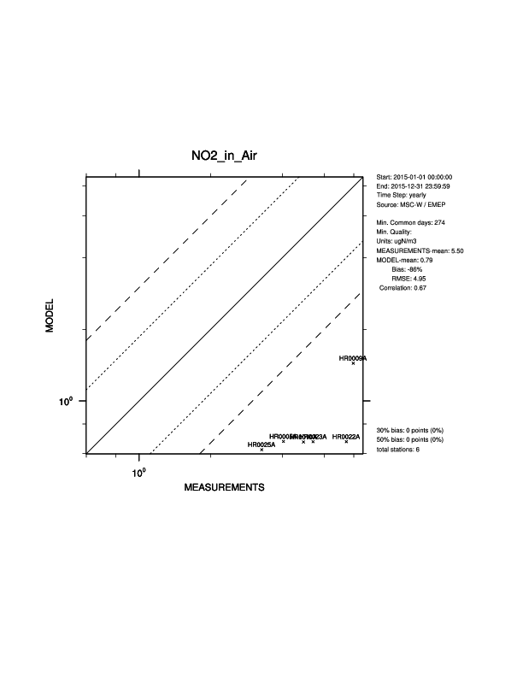
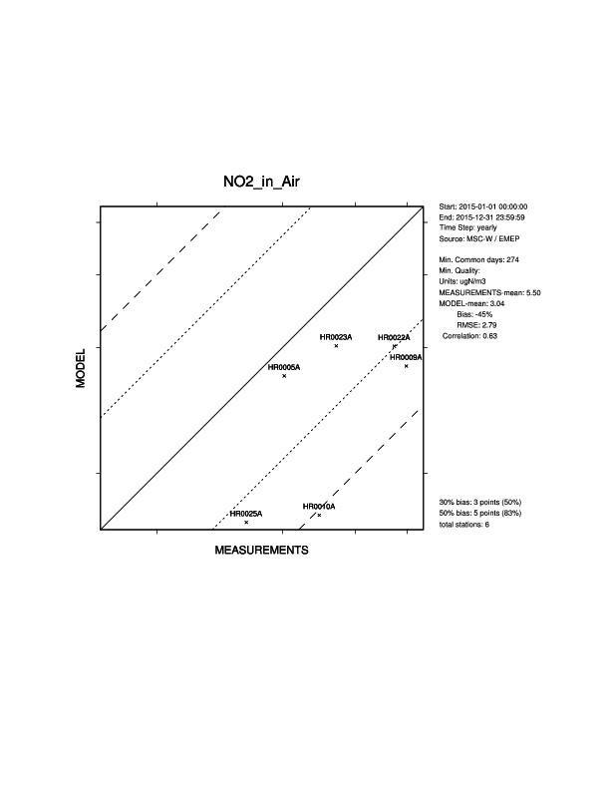
Croatia
Worse spatial correlation, but better results for several stations (Sources missing in gridding?)
Feedback from country would be very useful, emissions, observations, local modelling
Old emissions (50kmx50km)
New emissions (0.1x0.1)

Slide 25
How will CAMS81 contribute to EMEP work and vice versa? (contin’d)
BVOC: calculated with MEGAN model and ERA-interim meteo data for the period 2000-present (CUNI)
Soil-N (MET Norway)
Volcanic emissions: SO2 emissions provided by Chalmers University in coordination with the NOVAC network (2005-2016). Ash emissions provided by MET Norway in the case of a major eruptions in Europe
Natural emissions from oceans: DMS, OCS and halogens, based on what is available in the literature and recalculated using ECMWF meteorological parameters.

