Slide 1
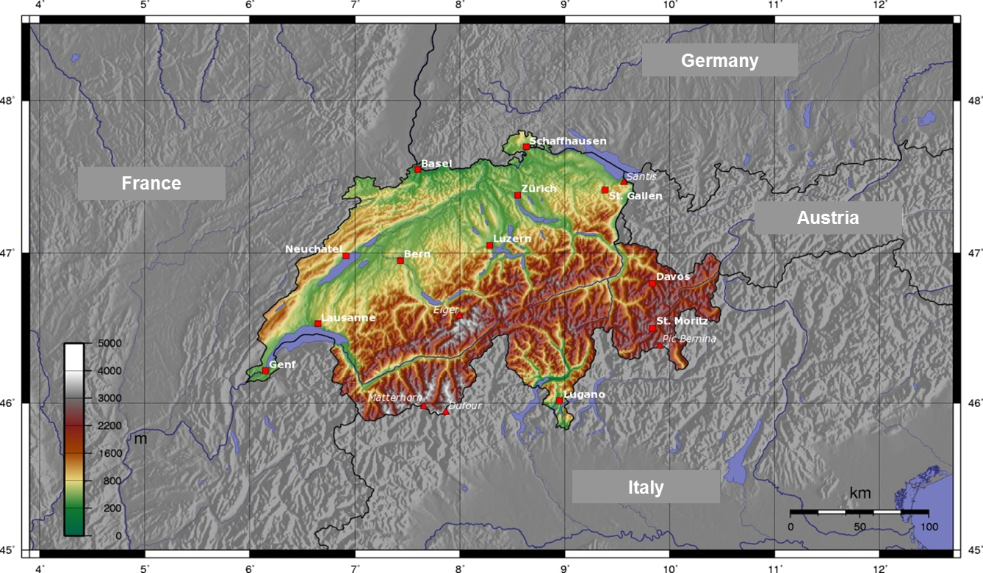
Welcome in Switzerland
On behalf of the Federal Office for the Environment FOEN

Slide 2
Swiss contribution to EMEP and the Air Convention
Air Pollution Control and Chemicals Division
Rudolf Weber
Federal Office for the Environment FOEN
May 2nd 2018

Slide 3
FOEN as part of the federal administration
Federal Government = Federal Council: 7 ministers
each head of a department
Foreign Affairs
Home Affairs
Justice and Police
Defence, Civil Protection and Sport
Finance
Economic Affairs, Education and Research
Environment, Transport, Energy and Communications
Empa
PSI
EPFL
FOE
FEDRO
FOT
FOCA
OFCOM
ARE
FOEN

Slide 4
Role of FOEN
Federal Office for the Environment FOEN
(Bundesamt für Umwelt BAFU)
Swiss federal government's designated centre of competence for the environment
It performs environmental monitoring
and has ministerial duties: Preparing legislation for the federal government
e.g. revision of Ordinance on Air Pollution Control,
adopted 11 April 2018 by Federal Council:
New air quality standard for PM2.5: 10 µg/m³ as annual mean

Slide 5
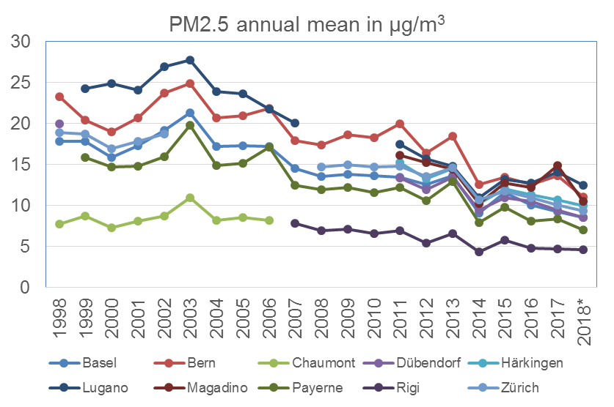
New AQ standard
New air quality standard for PM2.5: 10 µg/m³ as annual mean
* Last 12 months

Slide 6
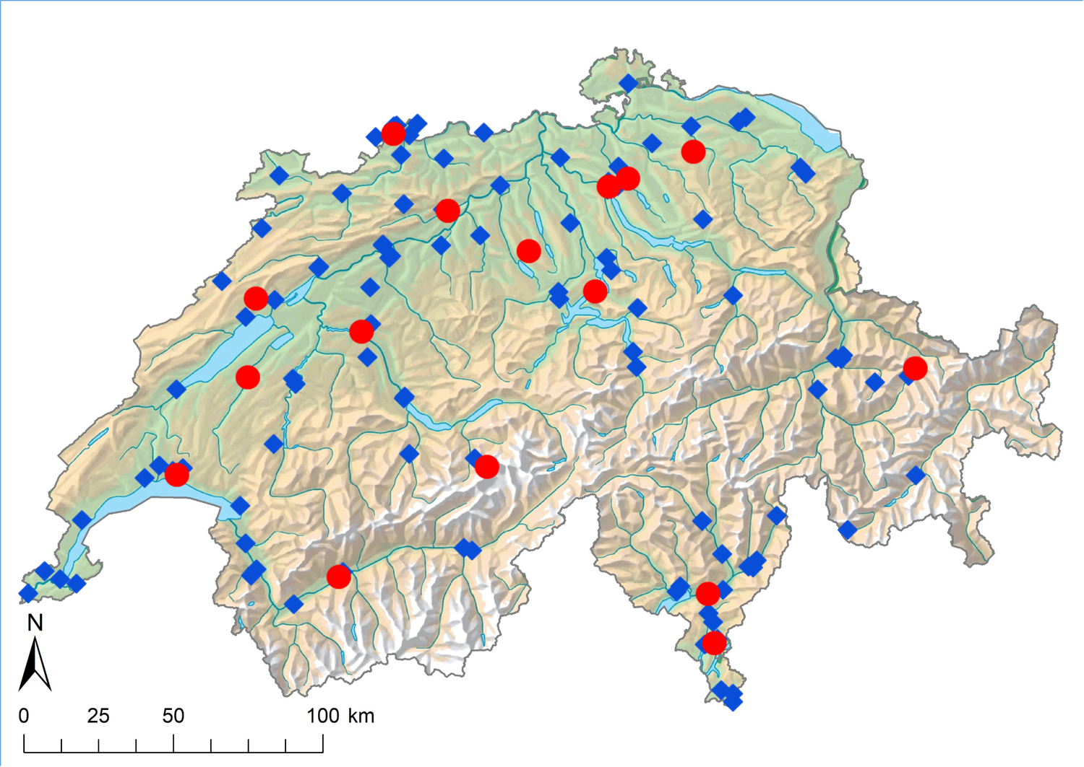
Monitoring of Air Quality
~ 100 monitoring stations, including
● 16 of the National Air Pollution Monitoring Network (NABEL)
Geneva

Slide 7
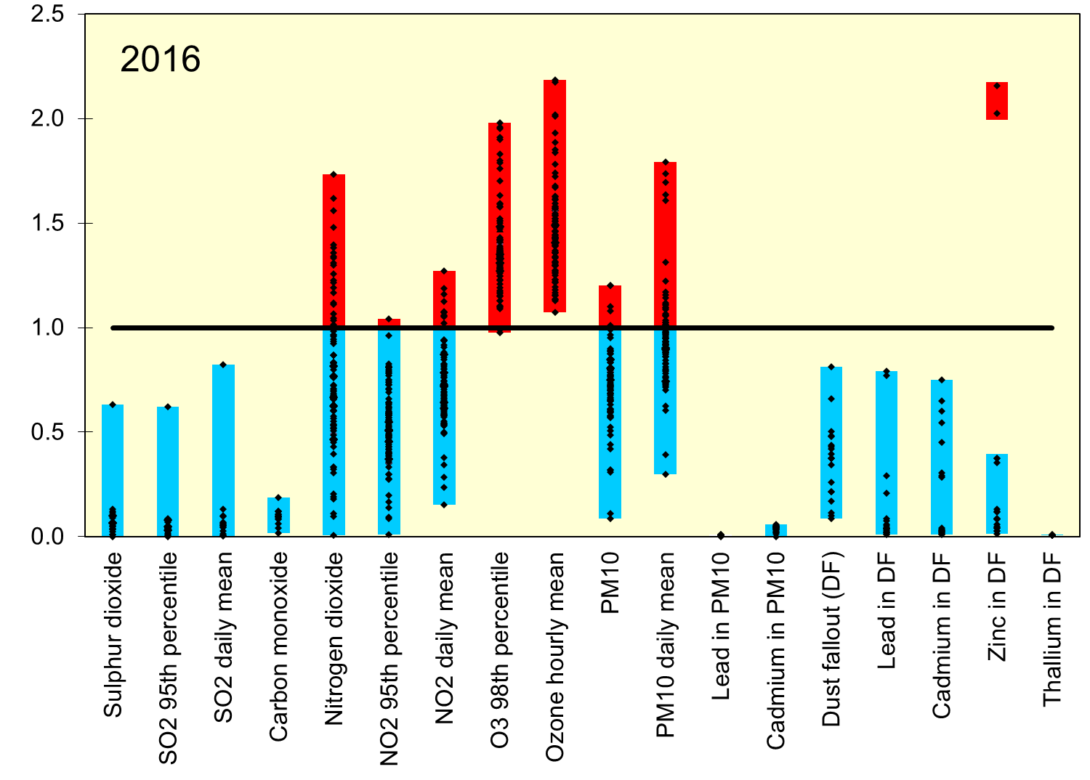
State of air quality in Switzerland
O₃
NO₂
PM10
Meas. Value / air quality standard
Swiss AQ standards

Slide 8
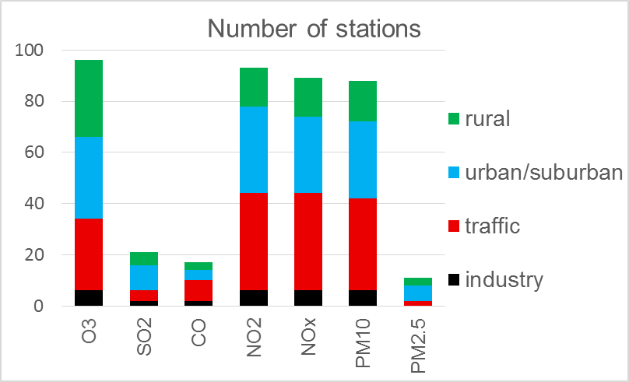
Type of station
All parameters measured at the two EMEP
level-1 sites
EMEP: 2 level-1 stations, 4 supplemental stations

Slide 9
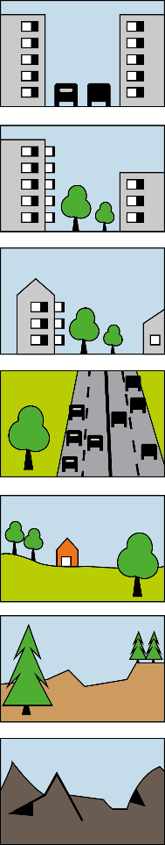
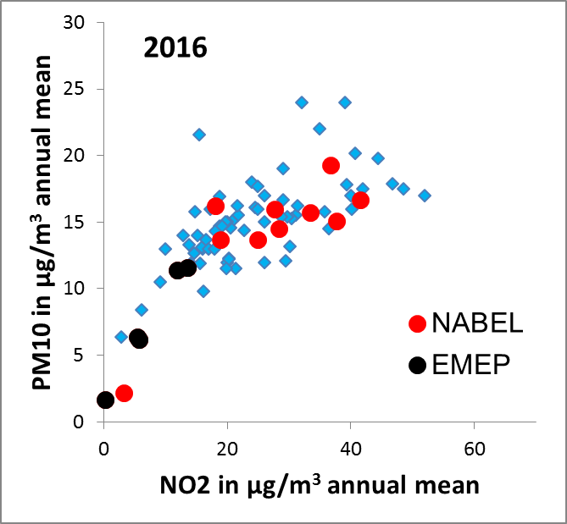
National Air Pollution Monitoring Network
Operated by Empa and FOEN
16 stations - covering various station types
Southern Switzerland
Street canyon
Urban
Suburban
Motorway
Rural
Rural > 100 m
Alpine
Traffic

Slide 10
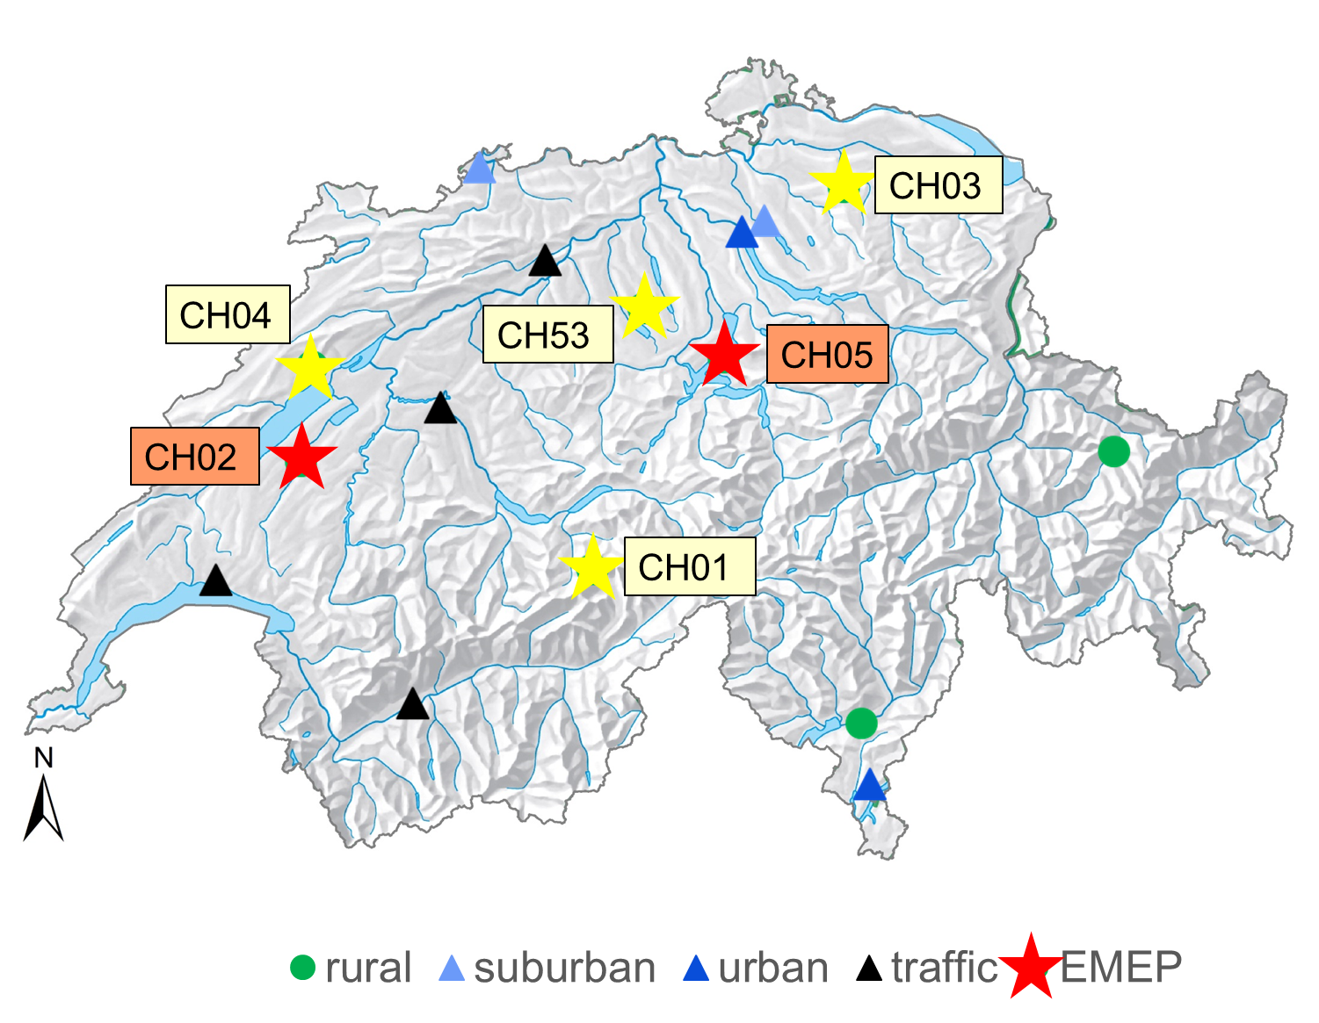
EMEP stations
2 level-1 sites with additional measurements
4 supplemental sites
NEW
(most rural sites)

Slide 11
EMEP stations
Switzerland’s Area: 41'285 km²
1 level-1 site required
Code | Station | Height a.s.l. | Start | Projects
CH02 | Payerne | 489 | 1973 | ACTRIS
CH05 | Rigi-Seebodenalp | 1031 | 1991 | ACTRIS
CH01 | Jungfraujoch | 3578 | 1973 | GAW, AGAGE, ICOS, InGOS, ACTRIS
CH03 | Tänikon | 539 | 1987
CH04 | Chaumont | 1137 | 1991
CH53 | Beromünster | 797 | 2017 | ACTRIS
AGAGE: Advanced Global Gases Atmospheric Experiment
GAW: Global Atmosphere Watch
GCOS: Global Climate Observing System
ICOS: Integrated carbon Observation System
ACTRIS: European Research Infrastructure for the observation of Aerosol, Clouds, and Trace gases
Ingos: Integrated non-CO2 Observing System

Slide 12
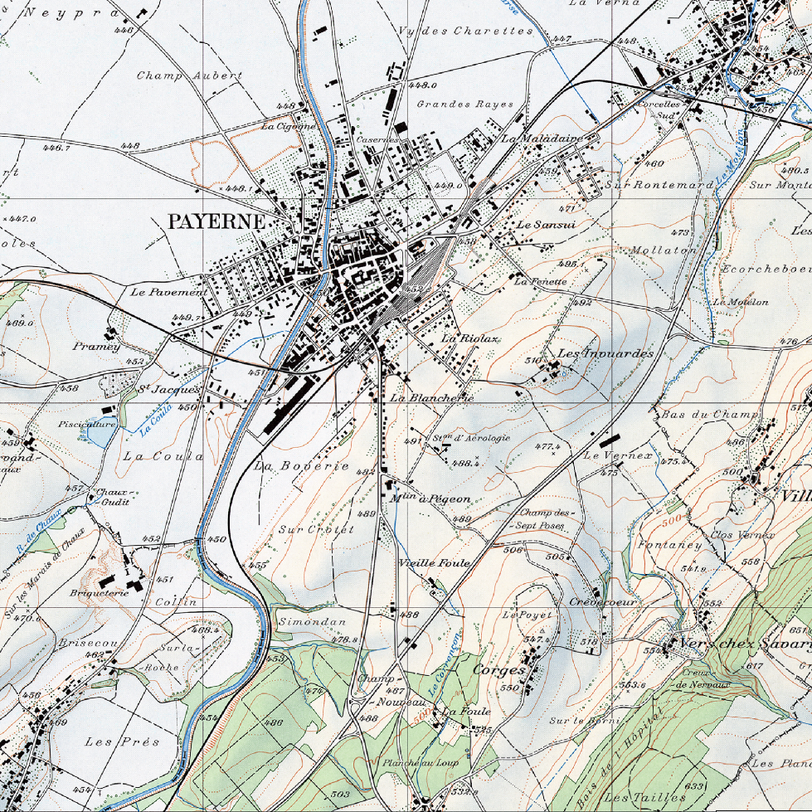
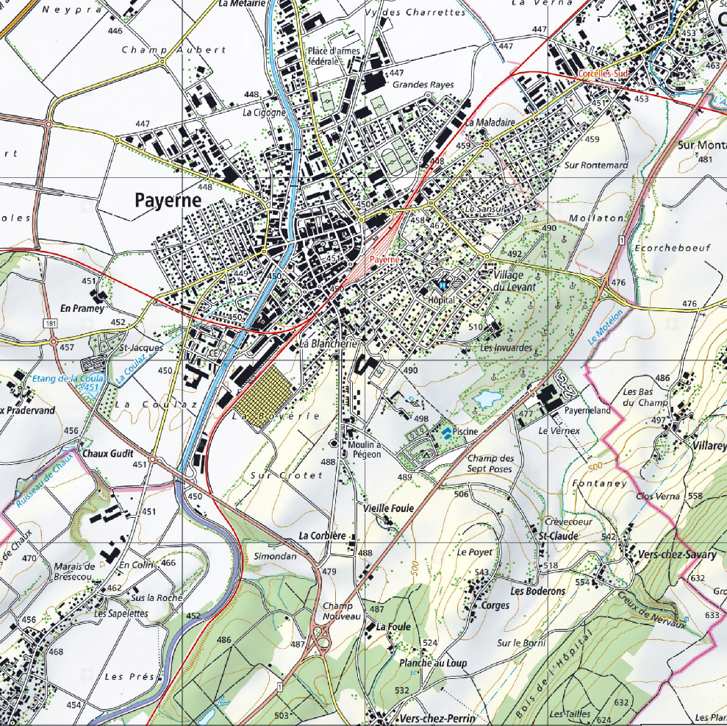
EMEP station Payerne, low altitude
1973
2017

Slide 13
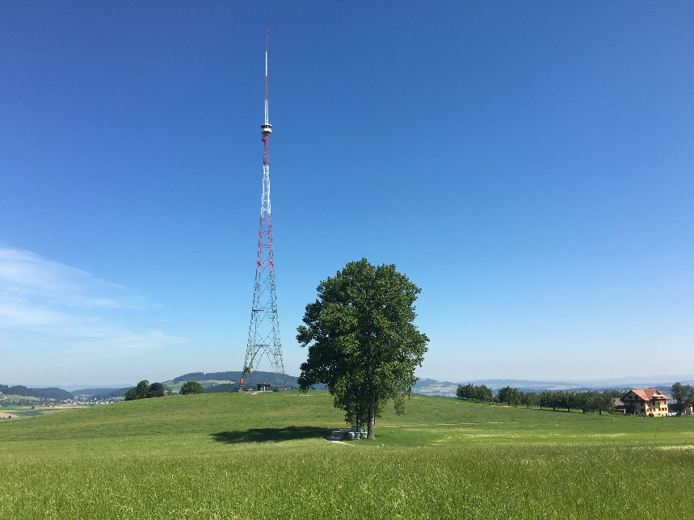
Regional/remote background
Low altitude station for twin sites (new project of chemical composition/source apportionment)
Higher altitude for background
Rigi-Seebodenalp on a mountain slope at 1000 m
New station: Beromünster
on hilltop at 800 m
VOC, greenhouse gases, minidenuder for N-comp.

Slide 14
Participation in IMPs
Intensive measurement periods of EMEP:
2006/2007 Payerne
2008/2009 Payerne, Jungfraujoch, Zürich
2012 Payerne
2012/2013 Payerne, Jungfraujoch
2017/2018 Payerne, Magadino
National projects:
Radiocarbon in EC/OC Payerne, Zürich and others
Chemical composition of PM and source apportionment
Payerne, Zürich and others, 1998/1999; 2008/2009; 2018/2019
Notes:
Rot & Gelb im Bericht 2016
LAE NABEL, Anfang 2017 gewechselt auf BRM
Grün
Blau in nächsten Messbericht?
BEM = Beromünster
GEF = Gelfingen
GWA = Grosswangen
SEM = Sempach

Slide 15
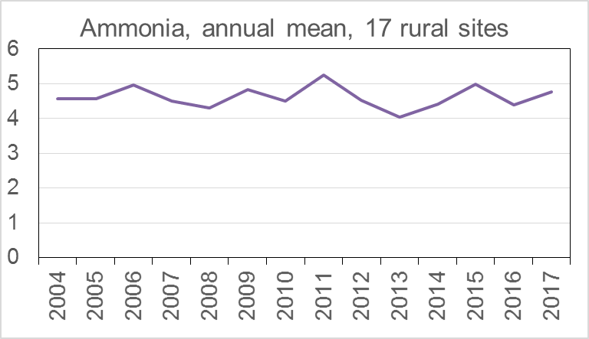
Ammonia measurements and modelling
Passive samplers; federal and cantonal sites
µg/m³

Slide 16
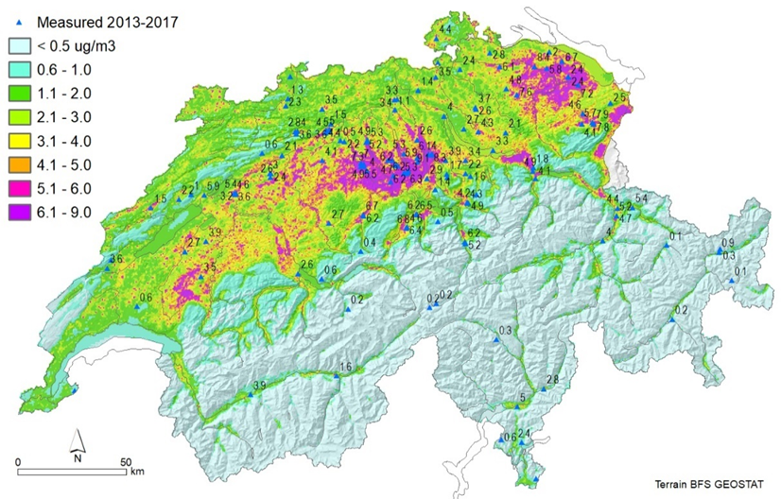
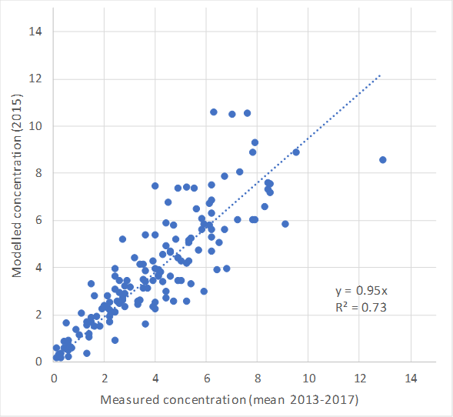
Ammonia measurements and modelling
Emissions + dispersion model
modelled
NH₃ concentration in 2015, 100 x 100 m² grid
measured
Notes:
Rot & Gelb im Bericht 2016
LAE NABEL, Anfang 2017 gewechselt auf BRM
Grün
Blau in nächsten Messbericht?
BEM = Beromünster
GEF = Gelfingen
GWA = Grosswangen
SEM = Sempach

Slide 17
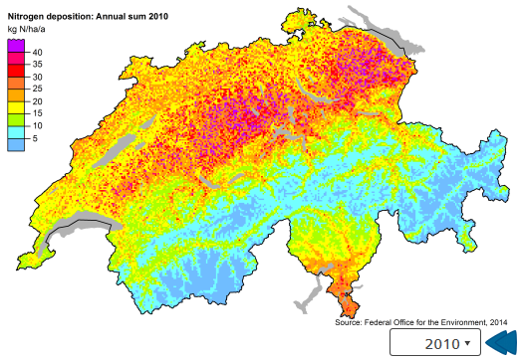
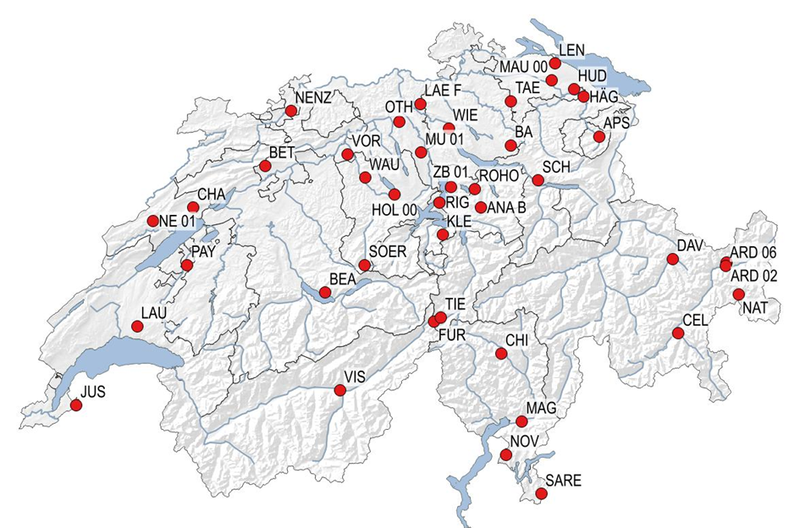
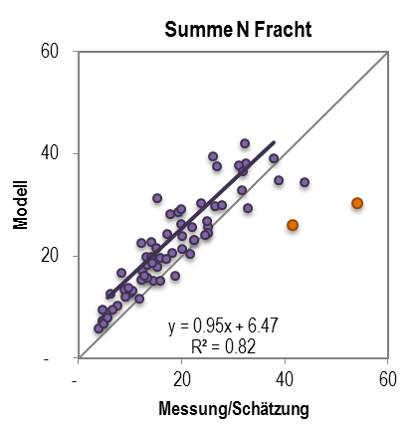
Deposition modelling
Based on NH₃-, NO₂-map, precipitation etc.
Nitrogen deposition
Measurement campaign 2014
Nitrogen deposition
Effect studies
Modelled
Similar for ozone flux
Measured/estimated
Notes:
Rot & Gelb im Bericht 2016
LAE NABEL, Anfang 2017 gewechselt auf BRM
Grün
Blau in nächsten Messbericht?
BEM = Beromünster
GEF = Gelfingen
GWA = Grosswangen
SEM = Sempach

Slide 18
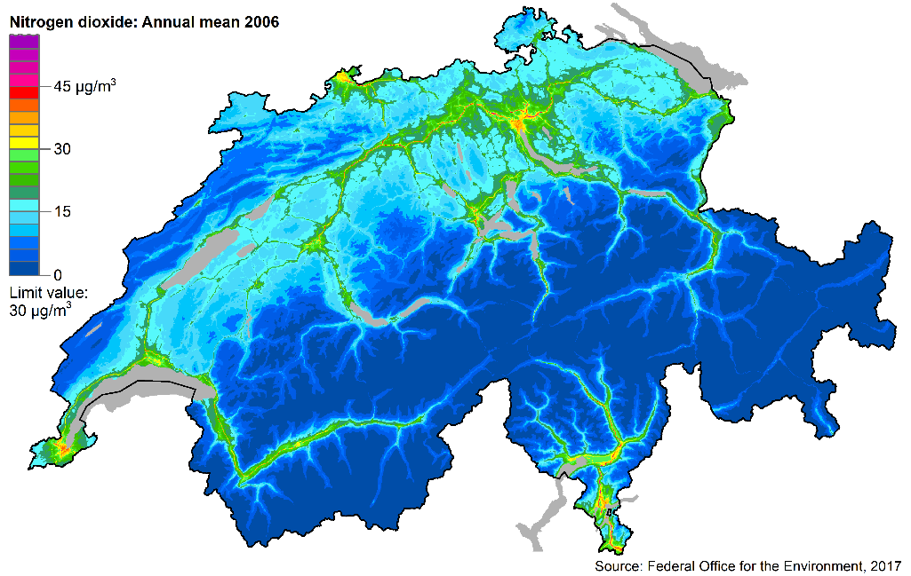
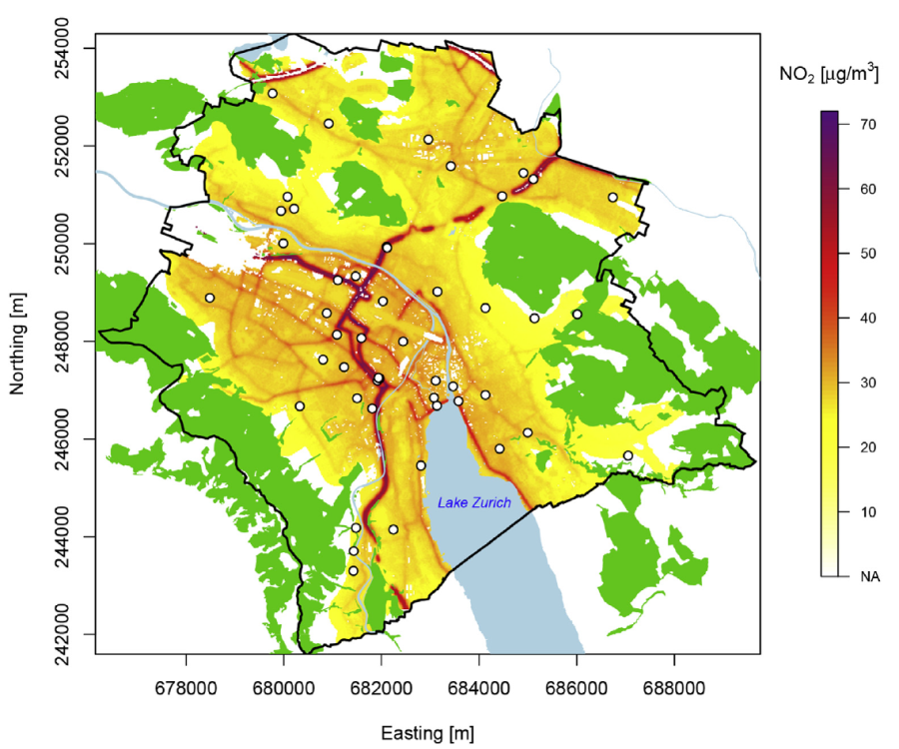
Urban modelling
NO₂ on the national scale
Urban scale
NO₂ annual mean in Zürich
Projects started at Empa:
Population exposure
hotspots
Notes:
Rot & Gelb im Bericht 2016
LAE NABEL, Anfang 2017 gewechselt auf BRM
Grün
Blau in nächsten Messbericht?
BEM = Beromünster
GEF = Gelfingen
GWA = Grosswangen
SEM = Sempach

Slide 19
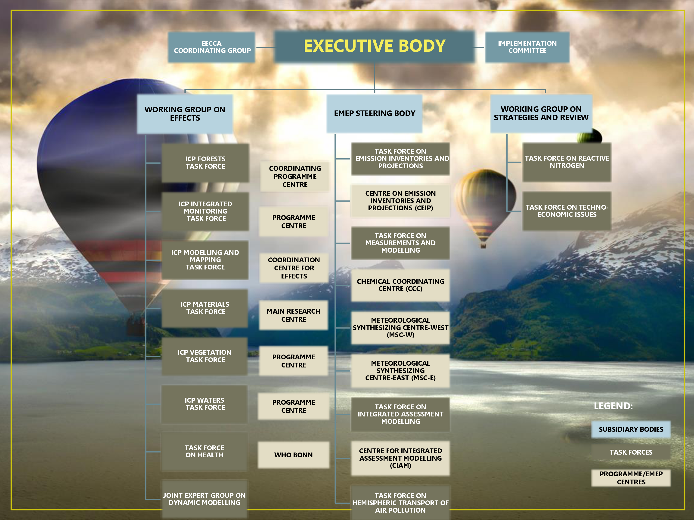
Several Swiss partners contribute to CLRTAP-work
WSL, IAP
FOEN
FOEN
TI, SUPSI
FOEN
Meteotest
Empa, PSI, EPFL, FOEN
Empa
Agroscope, WSL, FUB
Ticino
FOEN
SwissTPH
EKG

Slide 20
Summary
Monitoring:
EMEP stations integrated in National Monitoring Network
Need low altitude and higher altitude stations
Stations contribute to several projects like GAW, ACTRIS …
Modelling
Small-scale modelling complementing EMEP model
Participation in Eurodelta
Effect studies
In Swiss compartments like forests, alpine lakes, vegetation …

Slide 21
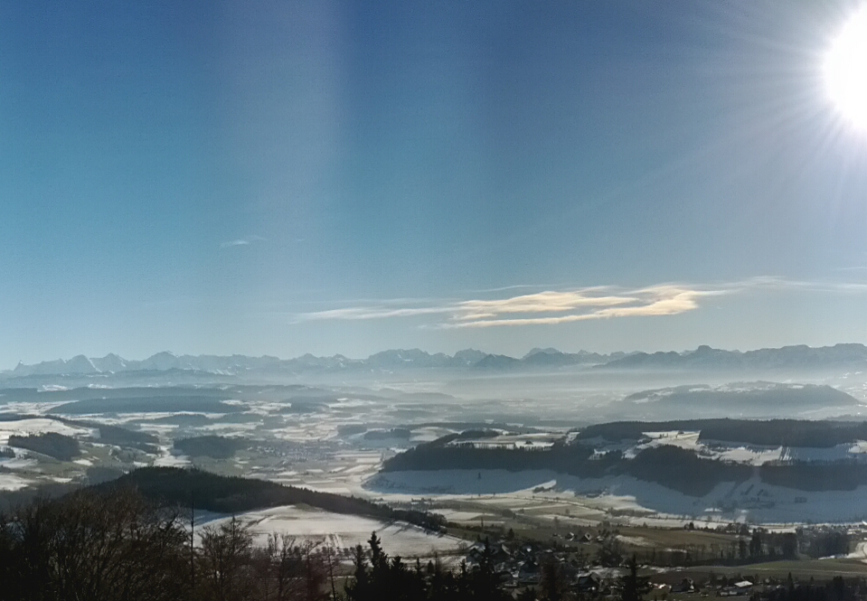
Thank you for your attention

