Slide 1


Welcome & introduction
TFMM co-chairs
Augustin Colette & Oksana Tarasova
19th TFMM annual meeting, 2-4 May 2018
World Meteorological Organisation, Geneva (Switzerland)

Slide 2
Welcome at WMO
Oksana Tarasova
  Co-chair of TFMM
  Chief of the Global Atmosphere Watch Programme of the World Meteorological Organisation

Slide 3
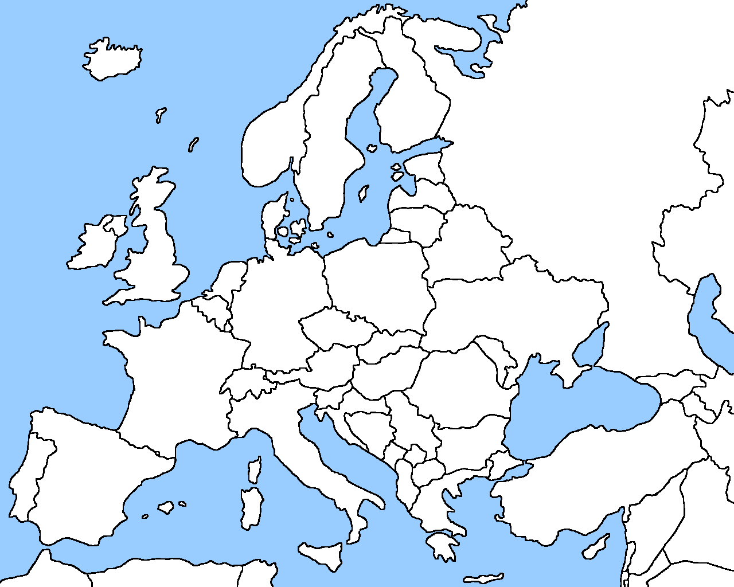
“TWIN SITES”
# | Topic | Deliverable | Status
1.1.1.2 | Long-range and urban air pollution (“Twin Sites”): assess the contribution of the long-range transport of air pollution to urban air quality by means of a combination of measurements and modelling | Synthesis report on long-range transport contribution to urban air quality for several areas in Europe (2018) Methodological report describing the optimal combination of models and observations, including discussion of the advantages and limitations | TFMM (led by Spain) with support from CAMS, CCC, JRC, MSC-W and WMO
Report on PM observations in ES, FR, CH, NL, DE
Technical workshop on how to model the LRT contribution to urban PM held in Paris Nov 2017 (TFMM, MSC-W, CIAM, JRC)
Thursday 9-11 am: Thematic session on long range transport and urban air pollution

Slide 4
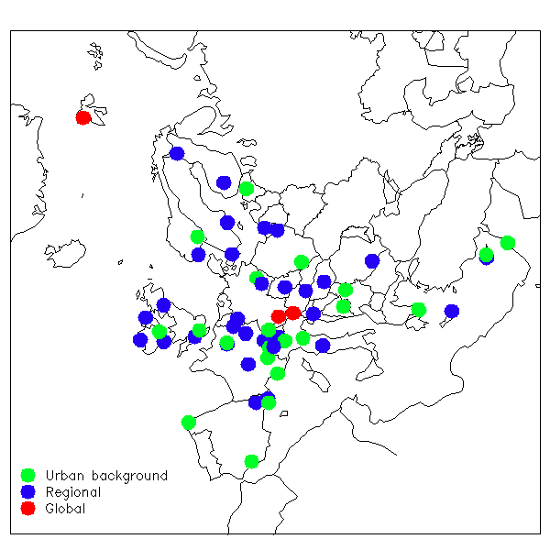
Equivalent Black Carbon FIELD Campaign
EMEP/ACTRIS/COLOSSAL
# | Topic | Deliverable | Status
1.1.1.2 | New EMEP field campaign focused on assessment of residential combustion to carbonaceous aerosols | Report and publications (2019) | CCC with TFMM plus cooperation with ACTRIS
1.1.1.7 | Carbonaceous aerosol (black, elemental and organic carbon) definition in the emission, modelling and monitoring work of the Convention | Factsheet (2018) | TFMM with support from CCC, MSC-W and WMO
EMEP/ACTRIS/COLOSSAL winter campaign
  Apportionment of equivalent black carbon (EBC) into fossil fuel (EBCff) and wood burning (EBCwb) combined with off line measurements of levoclucosan
  Perspectives: verification of BC Emissions inventories, future model intercomparison (?)
Friday 9-11 am: Thematic session on carbonaceous aerosols

Slide 5
Condensables / SVOC
# | Topic | Deliverable | Status
1.1.2.1 | Condensables: improve the representation of condensable semi-volatile organic compounds in PM emissions (see 1.1.1.6) | Report (2018) with guidance material on the inclusion of the condensable component in PM emissions reporting | TFMM and TFEIP with support from CEIP and MSC-W
Roadmap to define short/long term priorities being discussed between TFMM&TFEIP
Wednesday 17:10 Open discussion on modelling

Slide 6
Micro-sensors
# | Topic | Deliverable | Status
1.1.1.4 | Use of micro-sensors: guidance and recommendations | Position paper (2018) | TFMM in cooperation with CCC and WMO
WMO Statement on “Low cost sensors for the measurement of atmospheric composition: overview of topic and future applications”
Submitted to TFMM for comments in March, solicits endorsement of EMEP
Thursday 15:50 WMO/GAW statement on low-cost sensors for the measurement of atmospheric composition. Oksana Tarasova (WMO).

Slide 7
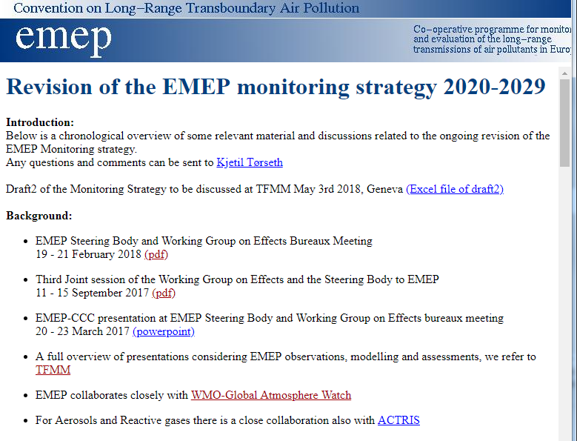
1.1 “Improving TOOLS”
# | Topic | Deliverable | Status
1.1.1.1 | Update the 2010-2019 EMEP monitoring strategy | Updated monitoring strategy (2019) | Lead by CCC with input from TFMM
See the proposed revision prepared by CCC and sent as background document of the meeting
Thursday 14:00-16:00: CCC Presentation + in depth discussion

Slide 8
1.1 “Improving TOOLS”
# | Topic | Deliverable | Status
1.2.1 | Country-scale assessment of HM and POP pollution (case studies) | A number of assessments are already planned: Spain, France (BaP 2018); Poland (cadmium, BaP 2018); | MSC-E in cooperation with TFMM and country experts
BaP Modelling in France and Spain
Cd Modelling in Poland (including contribution of LRT to urban air)
Wednesday 16:00-17:00: MSC-E update and national contributions

Slide 9
1.1 “Improving TOOLS”
# | Topic | Deliverable | Status
1.1.2.2 | Improving quality of the EMEP emission inventory: comparison with other references (CAMS and JRC tools) | Report in 2018 | CEIP in cooperation with MSC-W, MSC-E, TFMM plus CAMS and JRC
Comparison of MSC-W model performances depending on emission inventories, call for country feedback
Potential collaboration with the groups working on inverse modelling for the emission estimate (e.g. new GEIA activity)
15:30 Progress on MSC-W activities. Hilde Fagerli (EMEP MSC-W/Met Norway).

Slide 10
1.1 Improving tools
# | Topic | Deliverable | Status
1.1.3.2 | Ammonia: improve understanding of the cost-effectiveness of local versus regional agricultural emission control for protection of human health and ecosystems in Europe (see 1.1.1.5) | Synthesis report focusing on agriculture in 2019 Presentation of TFMM at TFIAM meeting in 2018 | TFIAM with support from TFMM and national experts (France and Netherlands)
Forthcoming LRTAP Ammonia Assessment Report (Led by Rob Maas, TFIAM)
14:50 Information sharing from the Task Force on Integrated Assessment Modelling with a focus on a forthcoming Ammonia Assessment Report. Rob Maas (TFIAM Chair)

Slide 11
1.1 Improving tools
# | Topic | Deliverable | Status
1.4.2 | Assess the complementarity of EMEP monitoring and observations undertaken by the ICPs. Facilitate the use of TFMM models for WGE community, for instance in terms of ozone fluxes or model-data fusion for deposition mapping Foster the use of PM composition at EMEP sites to better inform health impact assessments | Report and joint EMEP/WGE workshop (2019) | TFMM and WGE
Complementarity of monitoring strategies in the context of their revisions
Friday 10:00-12:00: Thematic Session on links between EMEP and WGE

Slide 12
Partnership
# | Topic | Deliverable | Status
1.1.4.1 | Global-regional modelling and evaluation | Ozone and particulate matter summary report (2018) Deposition workshop (2019) | TFHTAP, TFMM and MSC-W TFHTAP, TFMM, MSC-E, MSC-W, ICP Forests, ICP Vegetation and WMO
Deposition (S&N, O3) modelling and data fusion: WMO is establishing measurement-model fusion for total atmospheric deposition project

Slide 13
Partnership
# | Topic | Deliverable | Status
1.3.2 | Cooperation with CCAC and IPCC | Workshop in 2018 Strategy to harmonize reporting under the Convention with emission reporting and black carbon control strategies at the global scale (2019) | EMEP with support from TFEIP, TFHTAP, TFMM and IPCC for black carbon issues
IPCC is organizing expert meeting on SLCF in Geneva on 28-31 May 2018 to evaluate the feasibility to develop a global emission inventory for SLCF and to review existing methodologies for calculation of their radiative forcing
Saltsjöbaden VI recommandation: « Global air quality and earth observation network. For a broader approach to the global dimension, scientifically and as a basis for action, there is a need to develop a global harmonized monitoring network, preferably in an Earth System observation concept, including interactions with ecosystems but also emission inventories and projections”
First Global Conference on Air Pollution and Health organized by WHO on 30 October - 1 November 2018 at WHO Headquarters, Geneva, Switzerland (ambient air pollution is one of the topics)

Slide 14
Conference Dinner,
Thursday 3/5, 19:00 cafe Papon, Rue Henri-Fazy 1, Geneva

