Slide 1
J. Sintermann, AWEL
PM₁₀ trends in Switzerland using random forest models
Stuart K. Grange^{1,2}, David C. Carslaw^{1,3}, and Christoph Hueglin²
¹ Wolfson Atmospheric Chemistry Laboratories, University of York, York, UK
² Empa, Swiss Federal Laboratories for Materials Science and Technology, Dübendorf, Switzerland
³ Ricardo Energy & Environment, Harwell, Oxfordshire, UK

Slide 2
Introduction
Trend analysis of ambient air quality data is a common and important procedure
Air quality trend analysis is complicated because trend can be masked or even driven by changes in meteorology
Controlling for meteorology can be an important component of air quality trend analysis
Various methods have been used for meteorology adjustment/normalisation of air quality observations

Slide 3
Objectives
Present a meteorological normalisation technique which uses random forest (RF) to prepare air quality time series for robust trend analysis
Demonstrate the technique using daily PM₁₀ observations across Switzerland between 1997 and 2016
Details described in Grange et al. ACP (2018) https://www.atmos-chem-phys.net/18/6223/2018/
Functionality is available in the open source normalweatherr R package (https://github.com/skgrange/normalweatherr)

Slide 4
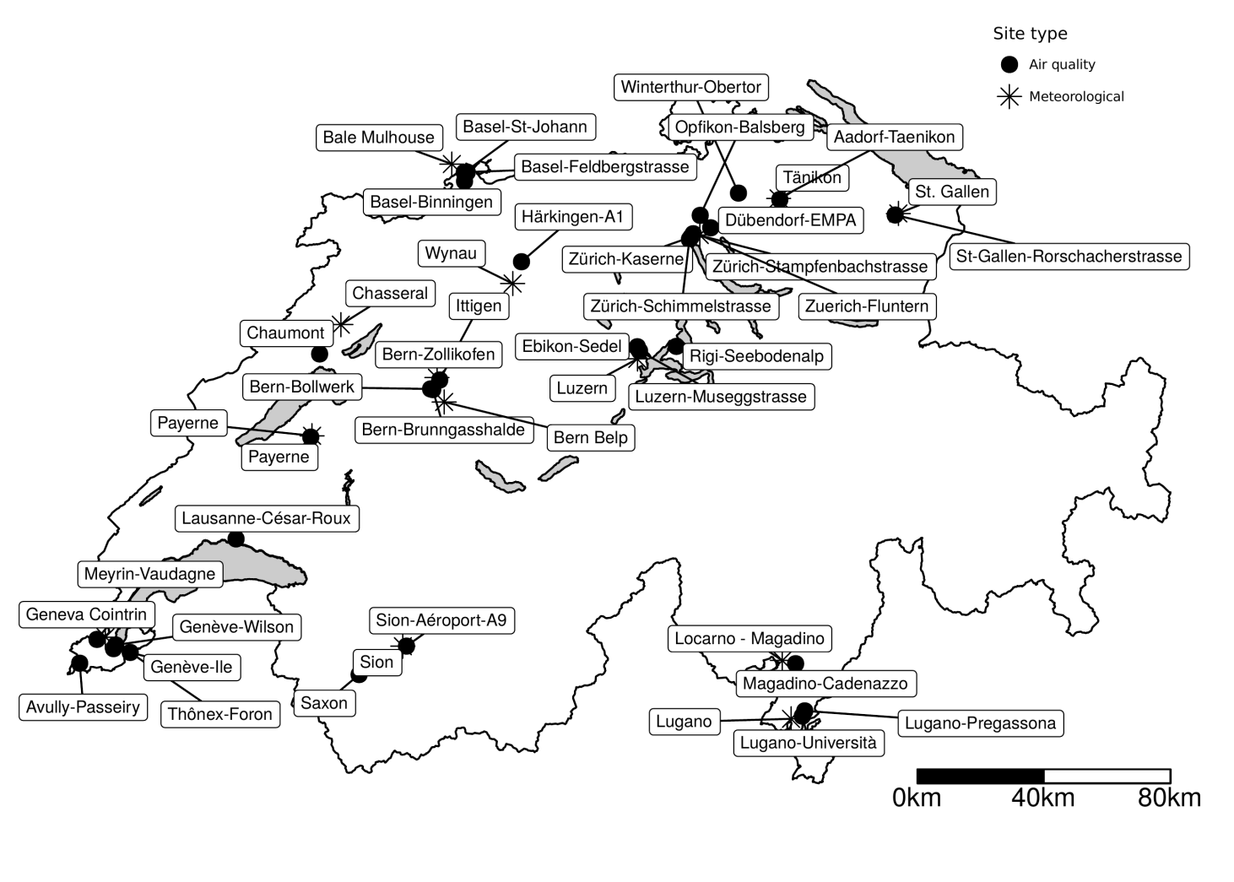
PM10 – observations from 31 sites
Map of the Swiss PM₁₀ and meteorological monitoring sites included in the analysis

Slide 5
Data
Daily PM₁₀ observations were sourced from smonitor* Europe, a database containing data from the European AirBase and air quality e-Reporting (AQER) repositories
Surface meteorological data including wind speed, wind direction, and temperature were sourced from the Integrated Surface Database (ISD) at NOAA https://www.ncdc.noaa.gov/isd
Synoptic scale circulation patterns were included into the models by using the CAP9 Swiss Weather Type Classifications (WTC)
Modelled boundary layer heights were derived from the ERA-Interim data
Clustered HYSPLIT back trajectories were used to represent six distinct air masses
* Grange, S. K., smonitor https://github.com/skgrange/smonitor

Slide 6
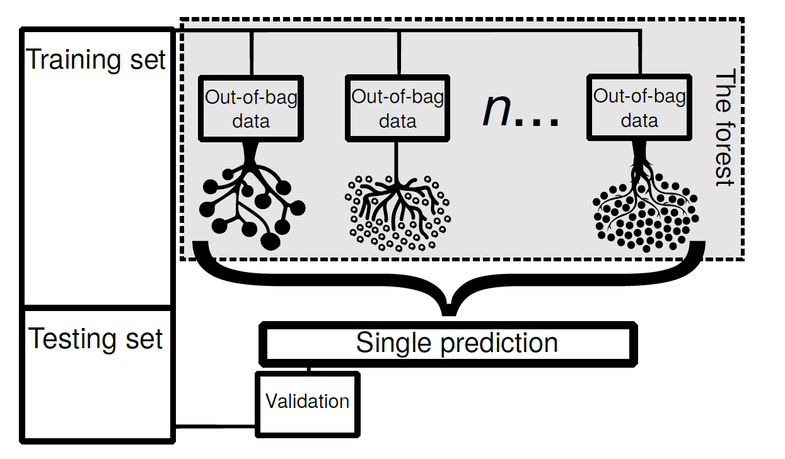
Modelling
RF models using PM₁₀ as the dependent variable for the 31 Swiss monitoring sites were grown
The explanatory variables were:
wind speed, wind direction, temperature,
synoptic weather pattern,
boundary layer height, air mass cluster,
a trend term, a seasonal term, day of the week.
Tuning of RF’s hyper parameters was conducted
n=300
80%
20%
Conceptual diagram of a random forest model

Slide 7
Meteorological normalisation
The models were used to predict every observed PM₁₀ concentration 1000 times (each site separately)
For every prediction, all the explanatory variables, except the trend term were randomly sampled and allocated to a PM₁₀ concentration
All predictions were then aggregated by the mean and this represented “average” meteorological conditions
The Theil-Sen estimator was used to calculate trends

Slide 8
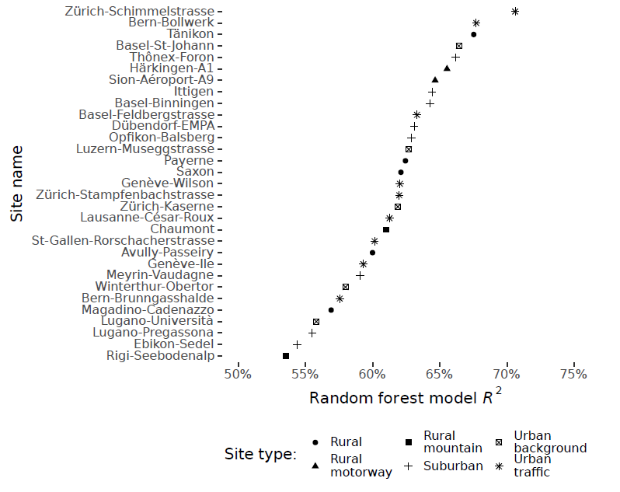
Model evaluation
The RF models performed well for most PM₁₀ monitoring sites
R² values ranged from 54 to 71 %
There was no clear pattern between performance and site type

Slide 9
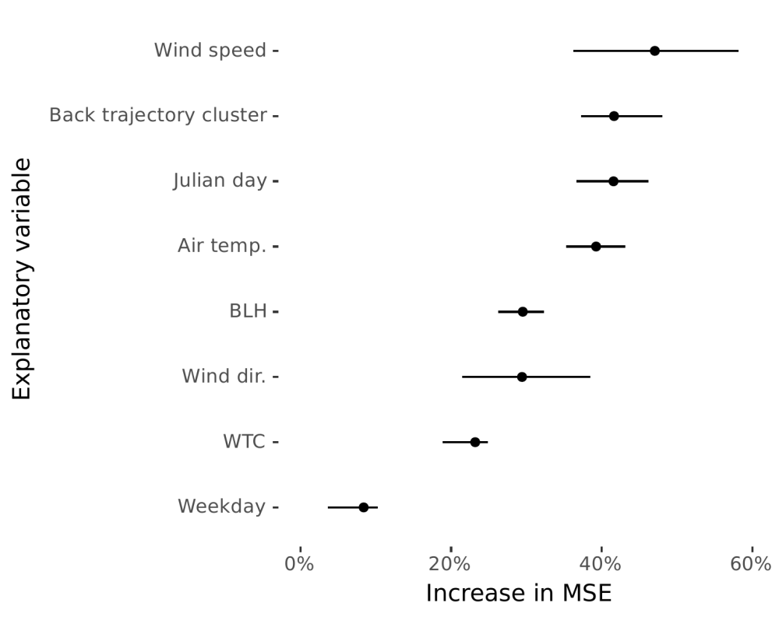
Model evaluation
Importance measures determined the relative contribution of input variables on the prediction of PM₁₀ concentration
Generally, wind speed was the most important variable
Importance measures for the 31 RF models. Dots represent the mean and lines represent the interquartile range

Slide 10
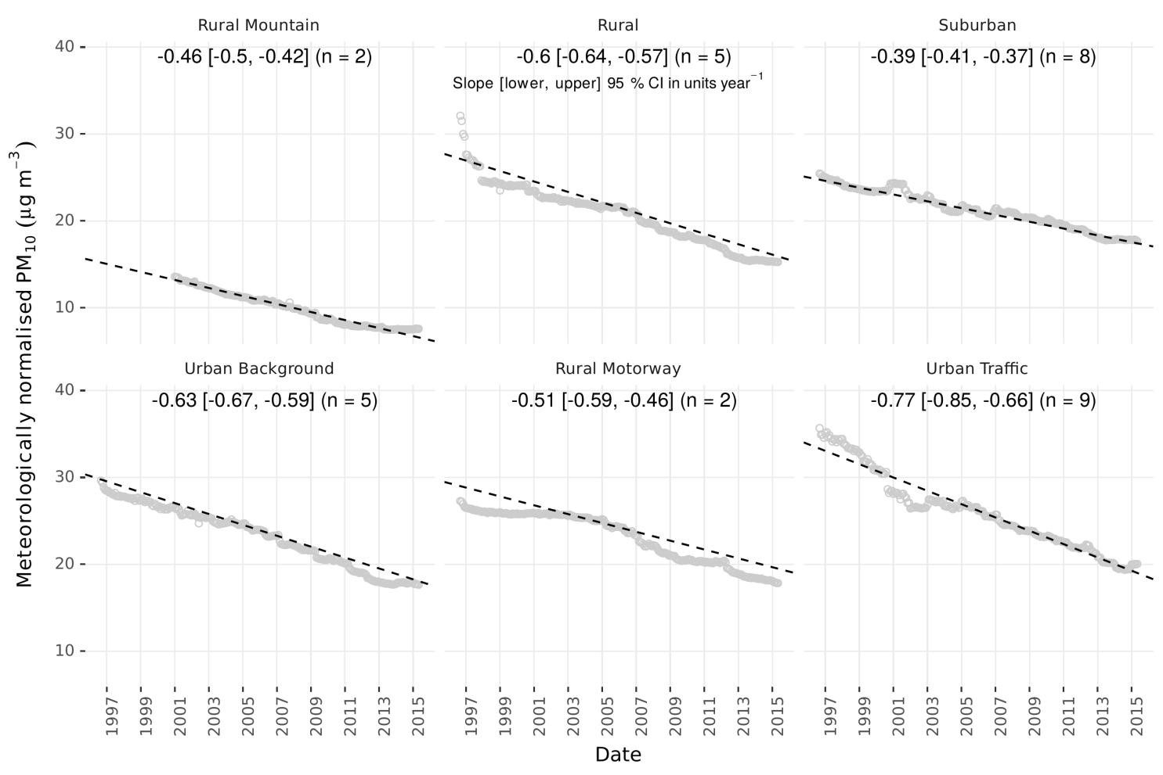
Trend analysis
Suburban sites decreased at the smallest rates which maybe because these sites are moving to a “more urban” classification
Urban sites demonstrated the greatest negative trend magnitudes
Similar to what has been reported in the past (Barmpadimos et al, ACP, 2011)
Meteorologically normalised PM₁₀ trends aggregated by site type

Slide 11
Explaining the variability
RF’s learning processes can be interpreted
Partial dependence plots demonstrate how the explanatory variables are being used for prediction

Slide 12
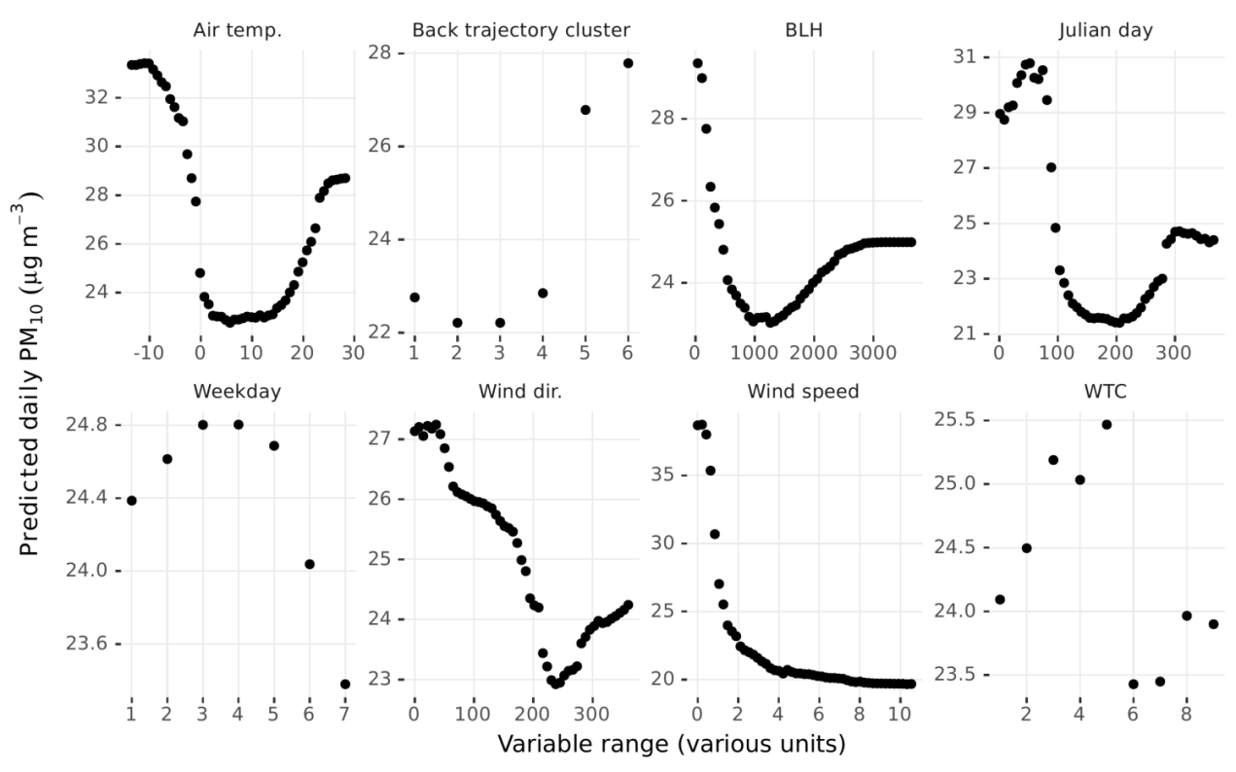
Explaining the variability
The seasonal component and air temperature partial dependencies were very similar and decision tree methods can handle such collinearity
Very local air masses as well as air mass sourced from Poland and Southern Germany were the most polluted
Boundary layer height: minimum PM₁₀ concentrations when BLH ≈ 1000 metres high but increase again when the BL is over 2000 meters
Weekdays were more polluted than weekends
PM₁₀ concentrations were inversely related to wind speed with a non-linear relationship
Partial dependence plots for the Zürich-Stampfenbachstrasse RF model

Slide 13
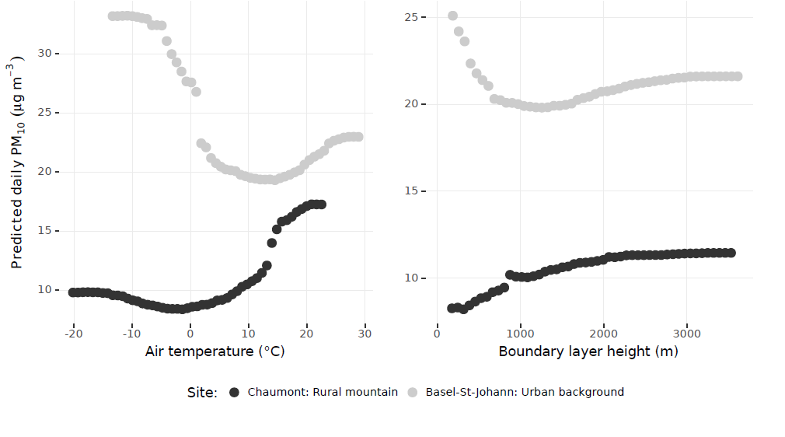
Dependencies on BLH suggests presence ot two regimes
conditions which favour convective mixing, transportation, and generation of secondary aerosol e.g. sulphate
A poor dispersive environment
during wintertime

Slide 14
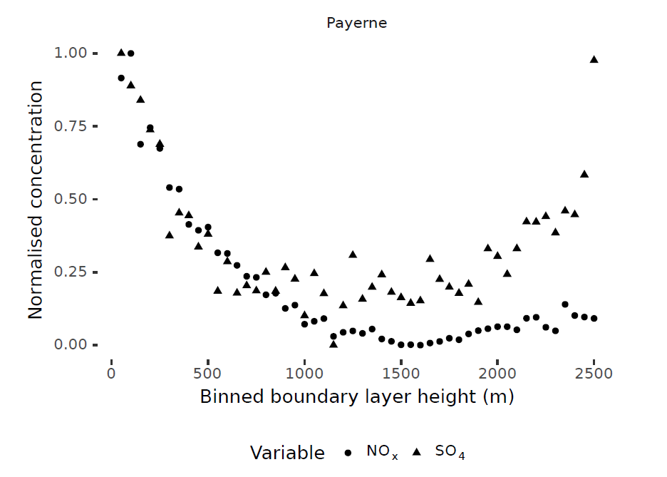
Dependencies on BLH suggests presence ot two regimes
Payerne: Rural (low altitude)

Slide 15
Conclusions
Controlling for meteorology can be an important component of air quality trend analysis
We presented a meteorological normalisation technique which uses predictive RF models
The technique was tested with daily PM₁₀ observations across Switzerland between 1997 and 2016
Significantly decreasing trends ranged from -0.09 to -1.16 µg m⁻³ year⁻¹
The RF models allow determination of physical and chemical processes influencing ambient PM₁₀ concentrations
- Two regimes resulting in elevated PM₁₀ concentrations were suggested
For a full discussion see Grange et al. ACP (2018)
Functionalitiy available in the normalweatherr R package

Slide 16
Thank you !
References
smonitor. https://github.com/skgrange/smonitor.
normalweatherr. https://github.com/skgrange/normalweatherr.
Grange, S. K., et al. (2018). https://www.atmos-chem-phys.net/18/6223/2018/
Acknowledgements
S.K.G thanks Anthony Wild with the provision of the Wild Fund Scholarship.

