Slide 1
Low cost sensors for the measurement of atmospheric composition: overview of topic and future applications
Editors: Alastair Lewis, Erika von Schneidemesser and Richard Peltier
WMO-No. 1215
ISBN 978-92-63-11225

Slide 2
Authors
Lead authors: Candice Lung, Prof Rod Jones, Christoph Zellweger, Ari Karppinen, Michele Penza, Tim Dye, Christoph Hüglin, Prof Zhi NING, Roland Leigh, David Hagan, Olivier Laurent, Greg Carmichael
Contributing authors: Michel Gerboles (EU), Pierpaolo Mudu (WHO), Sean Khan (UN Environment), Ron Cohen, Oksana Tarasova, Drew Gentner, Jesse Kroll, Eben Cross, Xavier Querol Carceller, Gufran Beig

Slide 3
Approach
Based on peer-reviewed publications through 2017
Applications of sensors, definitions, sensor performance, evaluation exercises and facilities, quality assurance , conclusions and recommendations
Covers:
  Reactive gases or other air pollutants including NO, NO₂, O₃, CO, SO₂, and total VOCs.
  Long-lived greenhouse gases: CO₂ and CH₄
  Airborne particulate matter (PM)

Slide 4
Covered technologies
Electrochemical method
Metal oxide
Photo-ionization detectors (PID)
Optical (light scattering, NDIR)

Slide 5
Discussed applications
Application
Research in the atmospheric sciences
Long-term global change
Air Quality compliance / regulation
Air Quality management
Public Information
Personal exposure
Low-cost sensors and their application in the atmospheric sciences therefore need to be considered not only in terms of the technical performance of individual devices but the supporting framework that can successfully support their use for specific kinds of tasks.

Slide 6
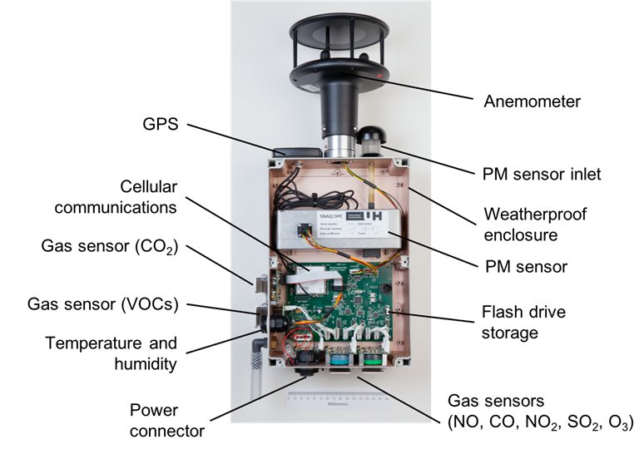
Sensor vs sensor system
(courtesy of Rod Jones University of Cambridge, UK)

Slide 7
Evaluation activities for low-cost sensors
Near exponential growth in interest in low-cost sensors
  Mainly regulatory and citizen science, lesser extent in academia
Performance evaluation projects evaluating quality of the data produced by air sensors by comparing sensor systems against reference instruments in the laboratory and in the field.
Complementary to this, demonstration projects have explored how the use these sensor systems may give new insight into atmospheric processes.
There are many interested users and performance and demonstration projects have engaged governmental organizations, research groups, city departments, and community groups all seeking to understand how LCS may be used.

Slide 8
It’s complicated…
Sensor type | Pollutant | Known issue (effect) with sensors
Electrochemical | Ozone (O₃) | Relative humidity Temperature Cross-sensitivity of oxidizing gases (e.g. NO₂, H₂S, Cl₂) Long term stability (ageing or drift)
 | Nitrogen Dioxide (NO₂) | Relative humidity Temperature Cross-sensitivity of oxidizing gases (e.g. O₃, H₂S, Cl₂) Long term stability (ageing or drift) Relatively long start-up time to sensor stabilization
 | Sulphur Dioxide (SO₂) | Relative humidity Temperature Cross-sensitivity of reducing gases (e.g. NO₂, H₂S) Long term stability (ageing or drift)
 | Carbon monoxide (CO) | Relative humidity Temperature Cross-sensitivity of reducing gases (e.g. H₂S, SO₂, CH₄, Alcohols, NH₃[MG1] , etc.) Long term stability (ageing or drift)
Metal oxide | Ozone (O₃) | Response time > 5 min Sensor response is not linear Relative humidity Temperature Long term stability (drift) Varying baseline after re-start
 | Nitrogen Dioxide (NO₂) | Response time > 5 min Sensor response is generally not linear Relative humidity Temperature Short and long-term stability(drift) Varying baseline after re-start
 | Sulphur Dioxide (SO₂) | Relative humidity Temperature Cross-sensitivity of reducing gases (e.g. H₂S)
 | Carbon monoxide (CO) | Relative humidity Temperature Cross-sensitivity of reducing gases (e.g. CH₄, Alcohols, NH₃, etc.)
 | Carbon Dioxide (CO₂) | Relative humidity Temperature Cross-sensitivity of reducing gases (e.g. CO)
Photo-ionisation detectors (PID) | Total Volatile Organic Compounds (VOCs) | Relative humidity Temperature All VOCs with Ionization Potential lower than the lamp output are detected (e.g. benzene, toluene, ethylbenzene, xylene, esters, alcohols, ketones, etc.)
Optical (light scattering, NDIR) | Particulate Matter (PM1.0, PM2.5, PM10) | Relative humidity (creates overestimate of PM) Harsh environments (high humidity and high temperature) decrease the accuracy of the sensors. Stability of the flow of the sensor that alters the quantity of particles being sampled and modifies the distribution of PM. For example, low flow (or velocity) may prevent the heavy particles from entering into the sensor. Density, colour, shape and refractive index of PM
 | Carbon Dioxide (CO₂) | Relative humidity (it is not a gaseous interferent in IR, while humidity may alter the optical beam) Temperature Pressure

Slide 9
Application Summary
LCS Application | Qualitative Opinion as of 2017
Research in Atmospheric Science | Just beginning to be useful
Long Term Global Change | Not quite ready – long term stability of LCS still in question
Air Quality Compliance/regulation | Not yet – sensors usually do not follow regulatory requirements for measurement equivalence
Air Quality Management | Yes, an early application area for LCS systems
Public Information/Citizen Science | Yes, an early application are for LCS systems. Especially useful for educational purposes
Proxy for Human Exposure | Emerging field; useful for qualitative results only.

Slide 10
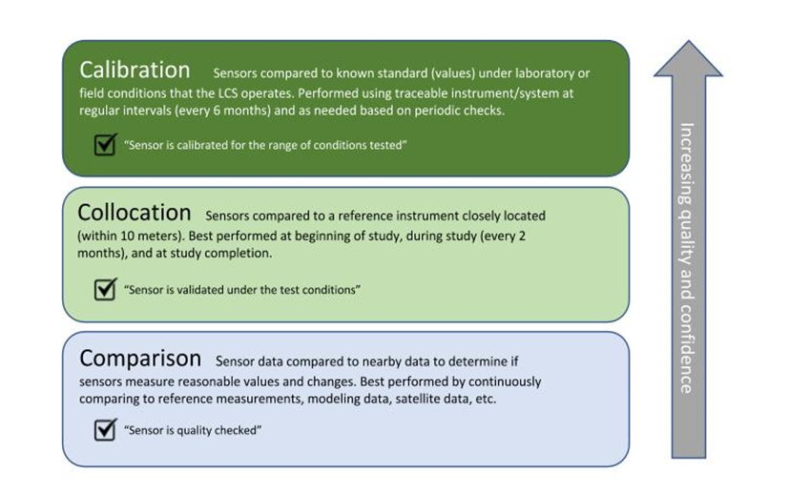
Calibration and Quality Assurance/Quality Control of LCS
Important factors to consider are temperature, relative humidity, and cross-sensitive gas species (can be found in data sheets and in literature) for gas-phase sensors, and relative humidity, composition, size distribution, and optical properties for particle sensors.

Slide 11
What about the data?
Lacking QA, the data are not useful.
Co-location in field and lab sometimes (often?) lead to different results.
Citizen science can lead to wrong conclusions without proper guidance.
Machine learning important, but at what point does a LCS become a model variable and stop being a sensor?

Slide 12
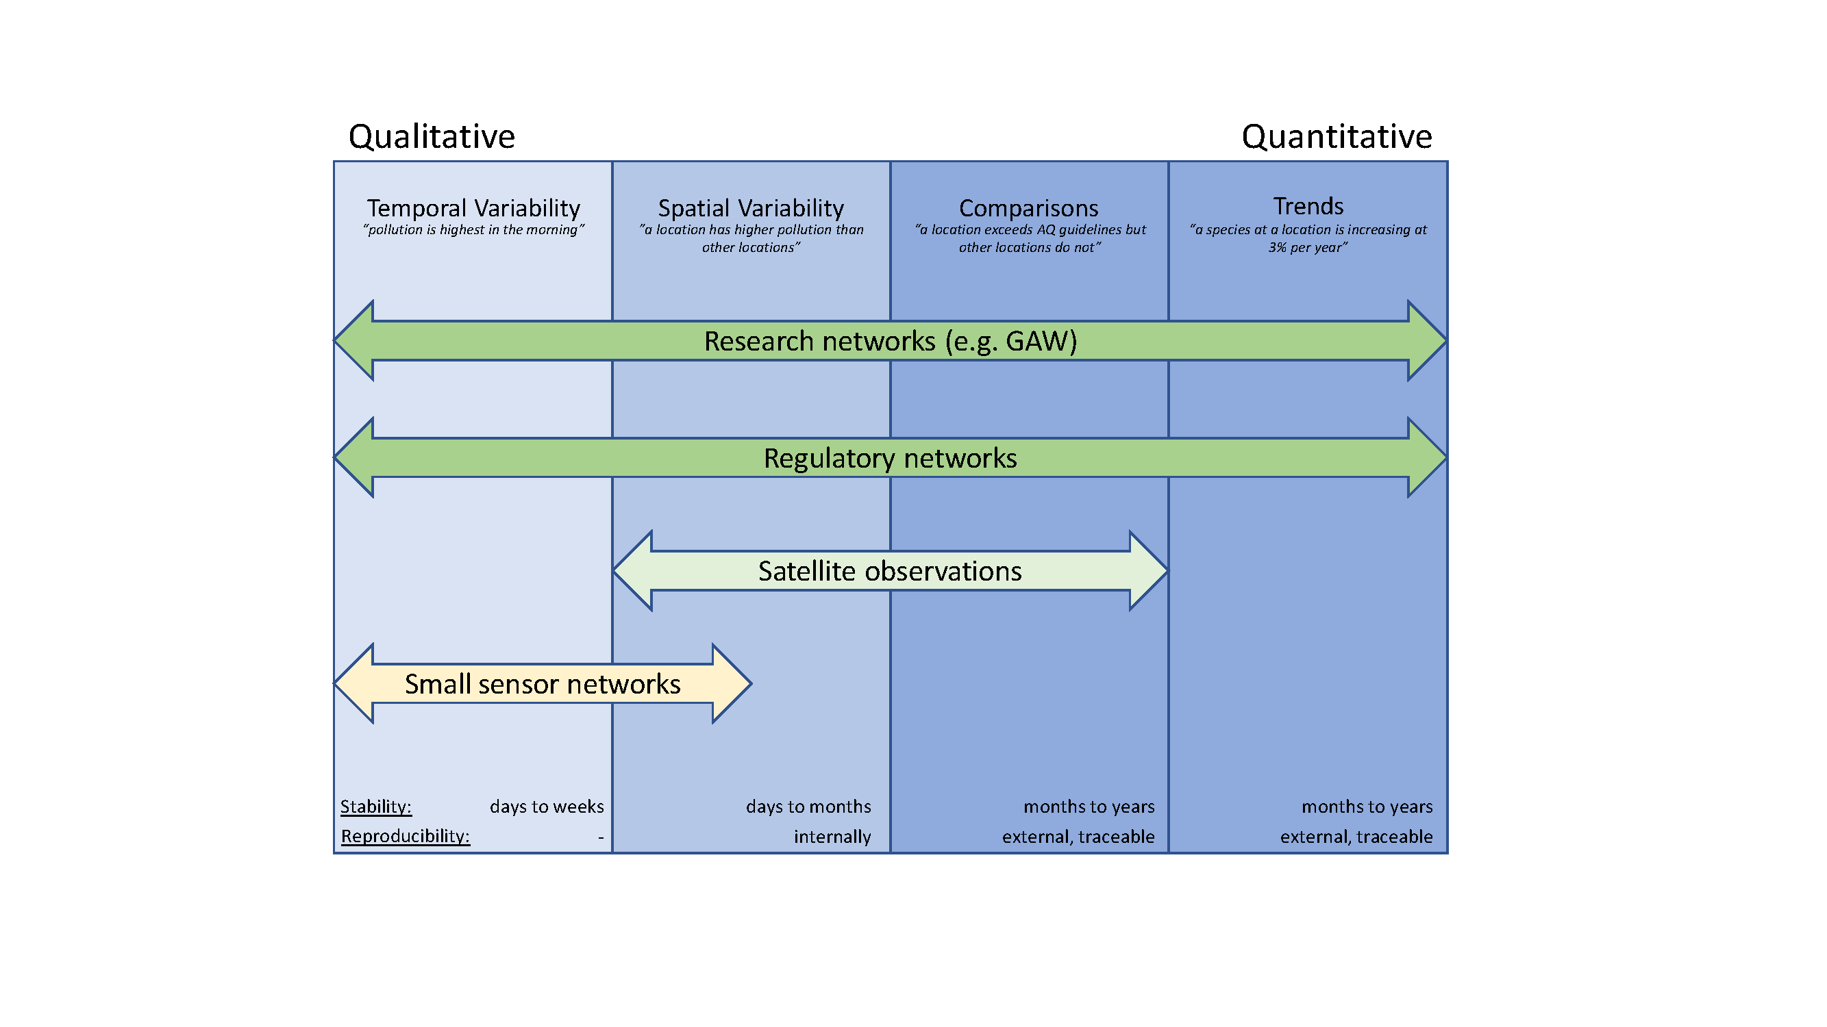
Where sensors seem to fit best
(now, at least)

Slide 13
LCS Document Conclusions
Can LCS measure… | Literature-based Conclusions
…Temporal Variability | Useful for short-term trends (hours to days to months)
…Spatial Variability | Useful, as long as sensors report reproducible measurements across different sensors
…Concentration Dependence | Limited evidence, because it requires comparison against long term trends; quantitative insufficiency.
…Personal Exposure | Not suitable for quantitative assessment.
…Long Term Trends | Not suitable

Slide 14
For manufacturers and systems providers
Manufacturers should provide information on the characterization of sensors and sensor system performance, in a manner that is as comprehensive as possible, including results from in-field testing.
More information on sensor lifetimes and degradation over extended periods of time is needed
Where algorithms and data manipulations are used to improve data quality, the basic principles of this should be made clear to the user.

Slide 15
For users and operators of LCSs
Users of LCS should have a clearly-defined application scope and set of questions they wish to address prior to selection of a sensor approach.
The user community should continuously evaluate LCS performance through verification and/or comparisons performed under real-world conditions ideally through ambient field deployments against reference instruments and report those results openly
There is a need to develop harmonized standards and guidelines for sensor performance evaluation.
Demonstration and research projects should where possible strive to include within LCS networks locations or nodes where several identical sensor systems are co-located together.
Adopt and utilize best-practices for data management and documentation of associated data regarding implementation conditions.

Slide 16
For the broader community who may use LCS data
Renewed efforts are needed to enhance engagement and sharing of knowledge and skills between the data science community, the atmospheric science community and others to improve LCS data processing and analysis methods.
Adoption of open access and open data policies to further facilitate the development, applications, and use of LCS data is essential.
Continue to support (with data, advice, resources) activities that improve validation and/or verification for LCS and consider expanding to a wider range of environmental and pollution conditions.

Slide 17
Resources to Consider
AQ-SPEC (http://www.aqmd.gov/aq-spec)
OpenAQ (http://www.openaq.org)
Various established sensor networks (see WMO Document 1215 for more information)
To share your experience, publications and related meetings please use the LCS forum
https://wmoairsensor.discussion.community/

