Slide 1
Update EMEP4NL in the Netherlands
Eric van der Swaluw, Wilco de Vries, Roy Wichink Kruit, Ferd Sauter, Addo van Pul
(RIVM, The Netherlands)
In cooperation with EMEP & CEH

Slide 2
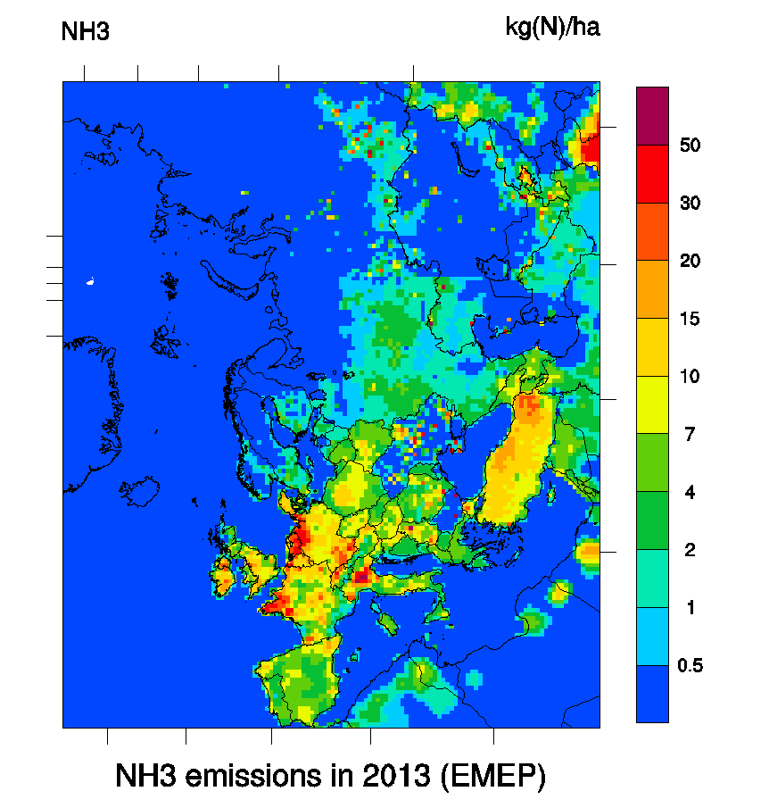
Why EMEP4NL in the Netherlands?
Reason is ammonia issues in the Netherlands:
2/3 of N-deposition;
Large scale exceedances of CL
Contribution to PM
Trends in ammonia concentrations and emissions

Slide 3
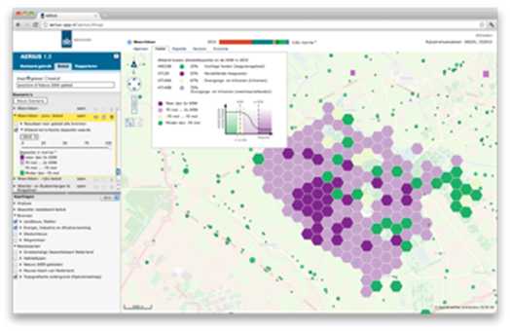
Often local spatial issues;
thousands of sources;
at 100 m scale
Calculations with OPS-model
Meteo statistics (classes)
Linearized processes (chemistry parameterized)
EMEP4NL as reference model

Slide 4
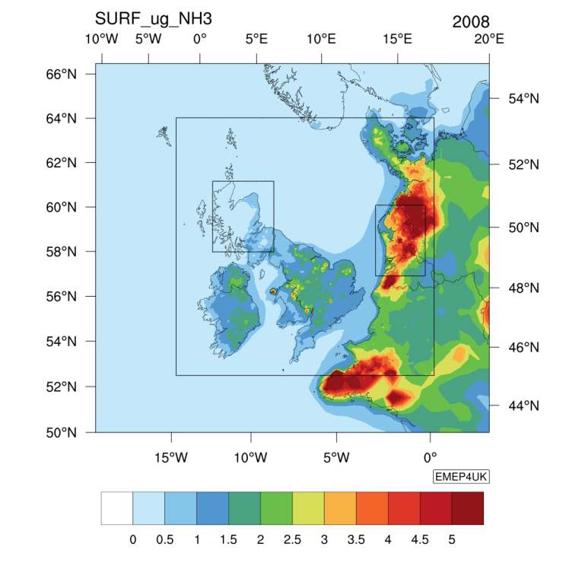
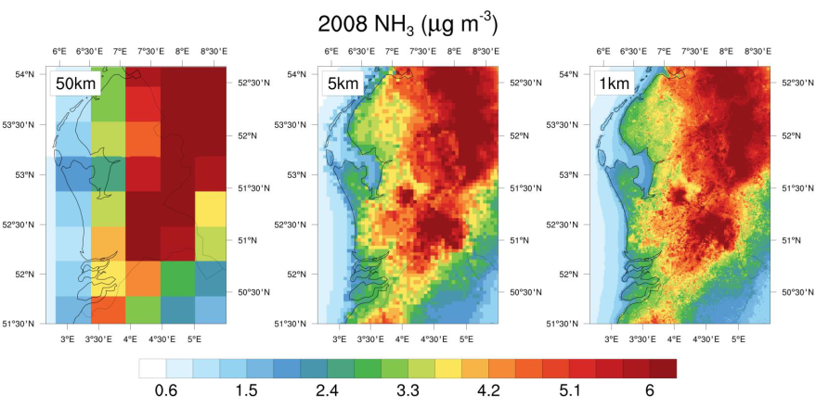
The EMEP4UK model
Eulerian model with a high horizontal resolution
EMEP4UK model: ~1km resolution
ECLAIRE conference 2015
Massimo Vieno, CEH

Slide 5
The EMEP4NL
Set up
Emissions
Meteo
Comparison with measurements
Plans

Slide 6
Setting up EMEP4NL: horizontal resolution
Layer 1: 34 x 56 km
Layer 2: 11 x 19 km
Layer 3: 3.8 x 6.2 km
Layer 4: 1.3 x 2.1 km
Notes:
Layer 2 wordt niet doorgerekend met EMEP

Slide 7
Setting up EMEP4NL: vertical resolution
0 meter
50 meter
92 meter
184 meter
324 meter
522 meter
781 meter
1106 meter
1503 meter
Notes:
21 vertikale lagen tot een hoogte van 15 km

Slide 8
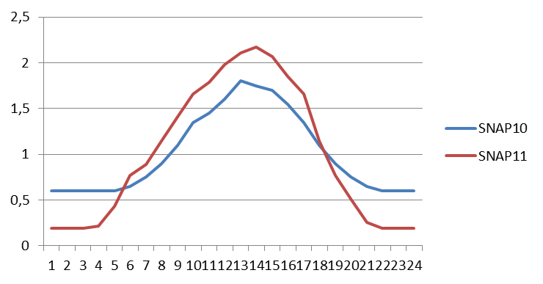
Emission factors for NH₃
SNAP10: factor = 1+0.0294*( T_{month} – T_{year} ) (like in OPS-LT)
SNAP11: factor like in OPS-ST
Notes:
SNAP11: aanwending en SNAP10: de rest … stallen & OPS maand versie en OPS jaar versie vrijwel geen verschil op jaarcijfers

Slide 9
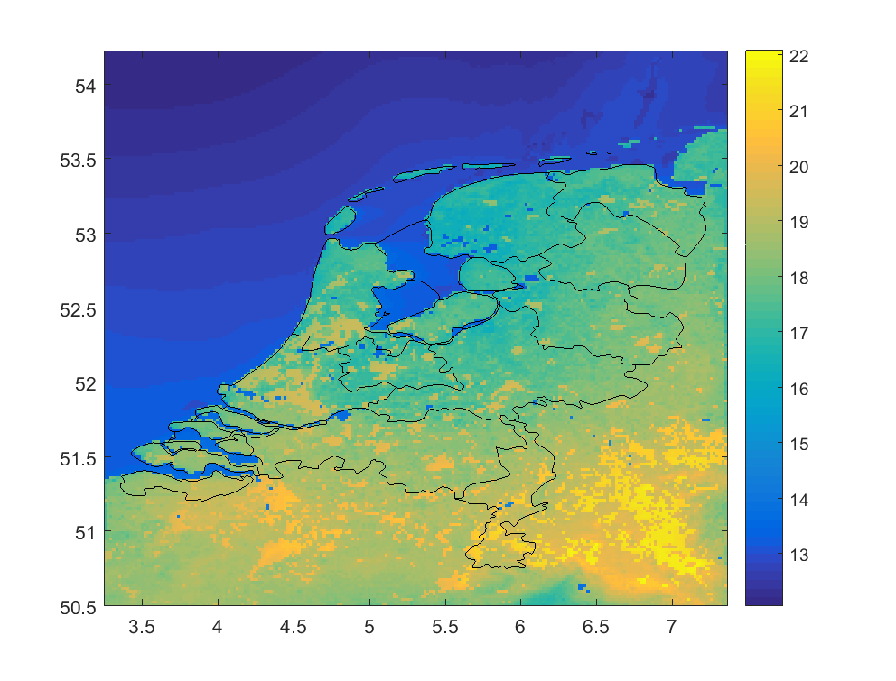
WRF model is used to drive EMEP model
WRF version 3.8
ECMWF reanalysis
Calibrate every 6 hours
2006-2015 available

Slide 10
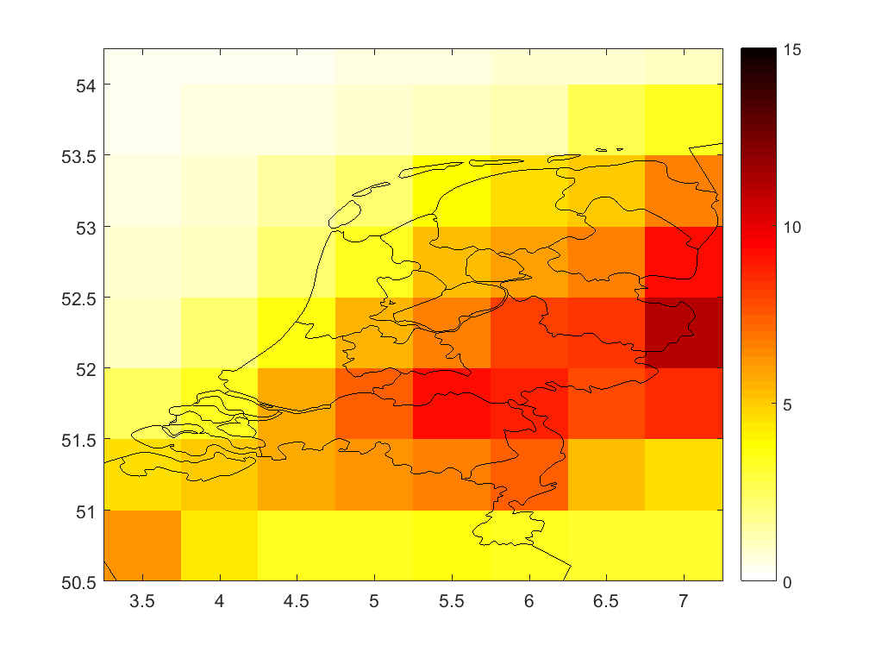
Ammonia concentration annual averaged
34 x 56 km
Notes:
Ammoniak jaar concentratie gemiddeld van 2014

Slide 11
Ammonia concentration annual averaged
3.8 x 6.2 km

Slide 12
Ammonia concentration annual averaged
1.3 x 2.1 km
Notes:
Hier zitten dus NLDse emissies in (lees GCN)

Slide 13
Ammonia concentrations
Calculation minus measurement
Calibration=1.08
2σ = 88%
Notes:
Alle MAN en LML stations: gemiddeld over periode 2006-2015: berekening gekalibreerd

Slide 14
Ammonia concentrations
Calculation minus measurement
Calibration=0.79
2σ = 67%

Slide 15
Trend in ammonia
Normalized trends like in van Zanten et al. (2017)
--- 0.11 %/yr
--- -0.25 %/yr
--- -1.15 %/yr

Slide 16
Ammonium concentrations
Calibration=1.06
2σ = 25%
Calibration=1.27
2σ = 63%

Slide 17
Trend in ammonia
NH₄
(in µg/m³)
--- -0.10 µg/m³/yr
--- -0.07 µg/m³/yr
--- -0.08 µg/m³/yr

Slide 18
Wet deposition NH_{x}
Calibration=1.3
2σ = 40%
Calibration=1.00
2σ = 35%

Slide 19
Trend in wet deposition
wet NH_{x}
(in mol/ha)
--- -3.5 mol/ha/yr
--- -5.7 mol/ha/yr
--- -2.0 mol/ha/yr

Slide 20
Conclusions on trends and spatial representation
EMEP and OPS runs for 2006-2015 at 1 km resolution over the Netherlands
NH₃ performance is comparable for OPS and EMEP for spatial distribution
NH₄ performance is better with EMEP than for the OPS-model for spatial distribution
Trend analysis of both components are roughly the same for EMEP and OPS
BUT details of the difference in ammonia trends with OPS and EMEP need further investigation

Slide 21
Further plans
Update chemistry scheme OPS with parameterization from EMEP model results
Use uEMEP (pres. Bruce Denby) in the Netherlands for NH₃
Analyses influence of emission patterns and deposition parameterizations on conc. & dep.
Influence of NH₃ emission on PM_{2.5} concentrations in the Netherlands (pres. Rob Maas)

