Slide 1
Modelling and measurements activities at ENEA
Mihaela Mircea
on behalf of colleagues from Atmospheric Pollution Laboratory (INAT)
Italian National Agency for New Technologies, Energy and Sustainable Economic Development (ENEA )
https://met.sspt.enea.it/people
https://impatti.sostenibilita.enea.it/en
www.enea.it
19th TFMM Meeting – 2-4 May 2018, Geneva, Switzerland

Slide 2
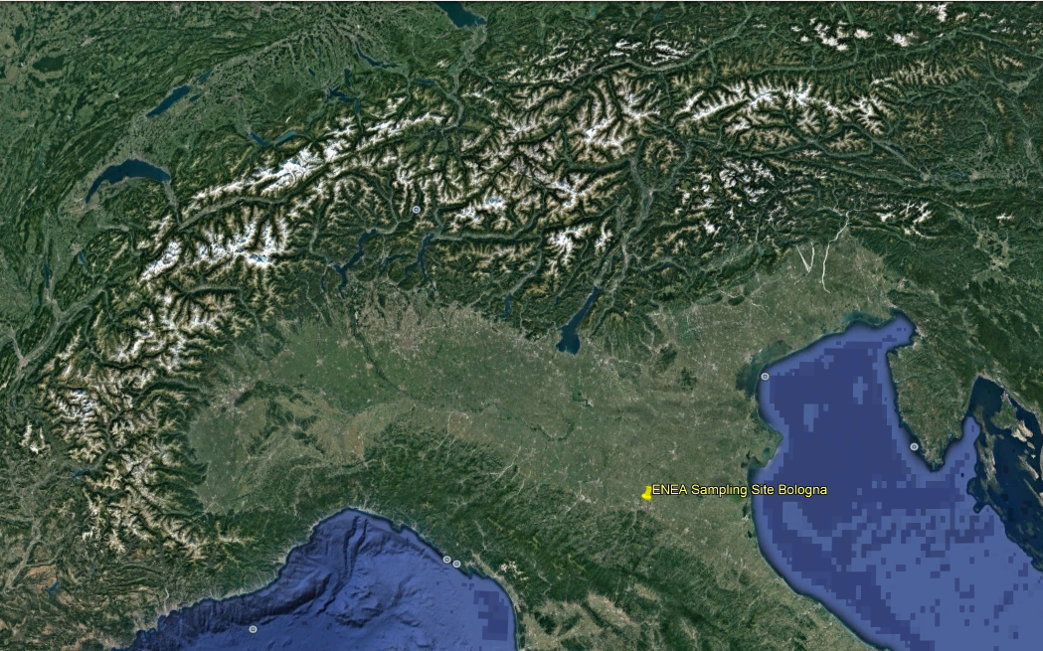
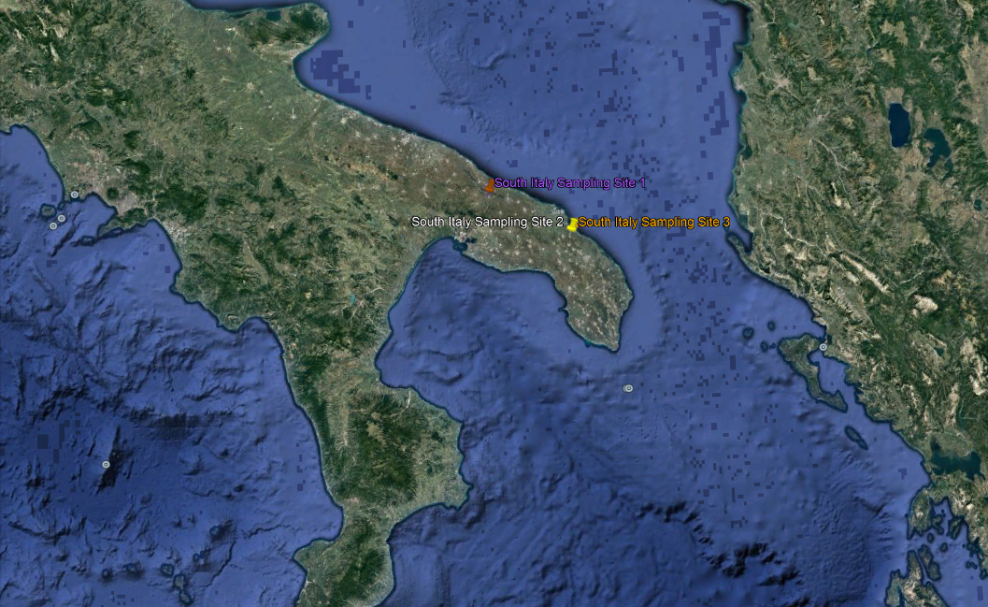
Experimental activities
laboratory measurements of aerosol chemical composition
laboratory measurements of tracers
online measurements of aerosol chemical composition
source apportionment analysis
cell exposure to environmental conditions
ENEA: 2011; 2012; 2017; 2018
2015

Slide 3
Modelling Activities
participate at TFMM inter-comparison exercises and at FAIRMODE activities
assess air quality at national level every five years according to AQ Directive 2008/50/EU and Italian Legislative Decree 155/2010
perform air quality studies for power plants, industries, etc.
assess impact of nature-based solutions on air quality
national air quality national forecast
evaluation of national air quality in climate scenarios
elaborate emission and air quality scenarios in support to national air quality plans
investigate impact of air pollution on ecosystems, human health, materials and cultural heritage
develop air quality modelling system (AMS-MINNI)

Slide 4
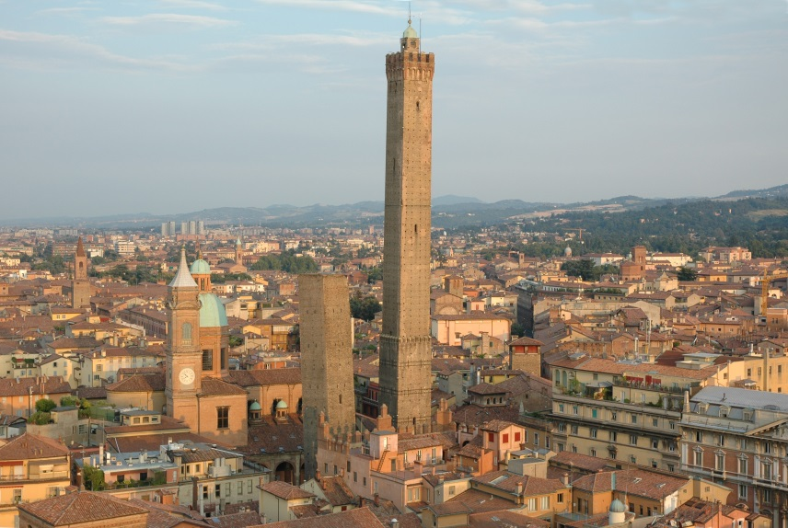
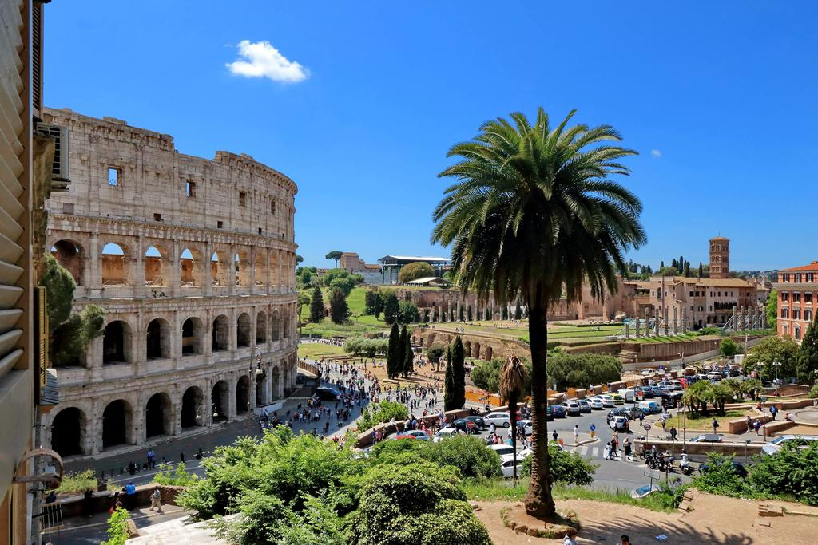
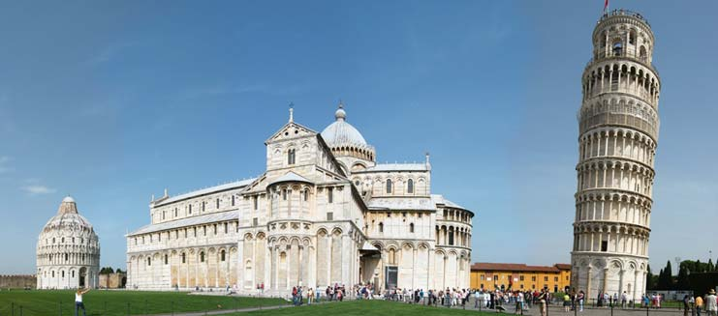
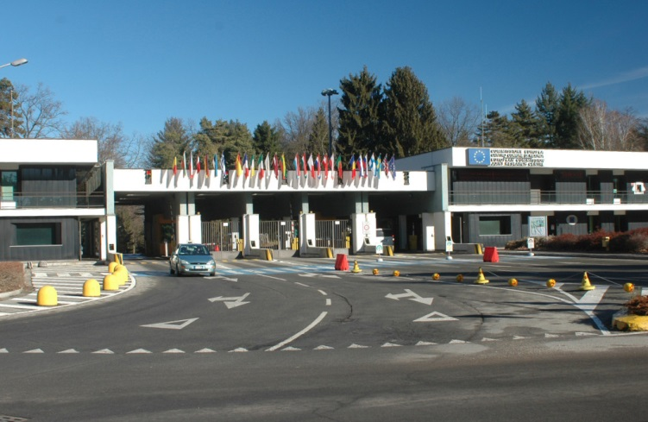
Regards from INAT!
mihaela.mircea@enea.it
19th TFMM Meeting – 2-4 May 2018, Geneva, Switzerland

Slide 5
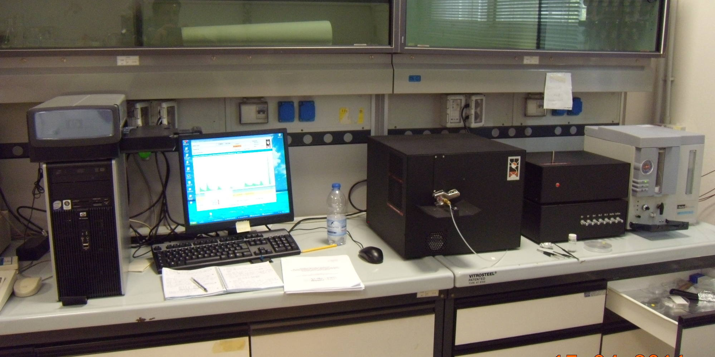
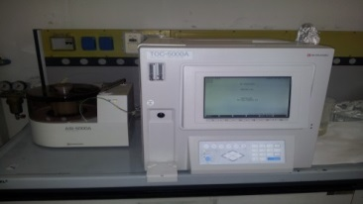
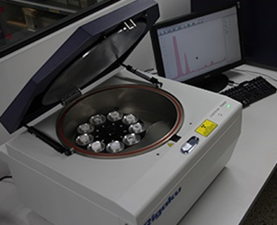
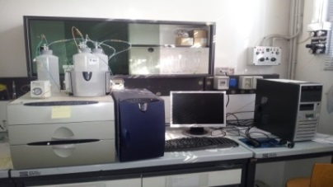
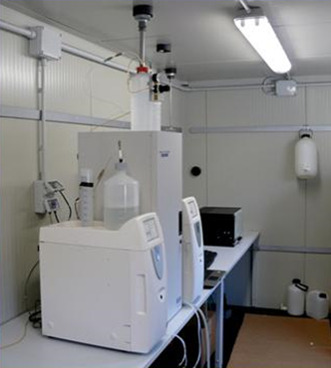
Laboratory measurements of aerosol chemical composition
particulate matter: PM₁₀, PM_{2.5,} PM₁;
carbonaceous aerosol fractions: TC, EC, OC, CC, WSOC;
trace elements and metals: Na, Mg, Al, Si, K, Cu, Ca, Ti, V, Cr, Mn, Fe, Co, Ni, Zn, As, Rb, Se, Br, Sr, Mo, Pd, Ag, Sn, Sb, Te, La, W, Pt, Au, Tl, Bi, Cl, Ba, Pb, S, Cs, Ce.
water soluble inorganic ions: Cl⁻, NO₂⁻, NO₃⁻, SO₄²⁻, Na⁺, K⁺, NH₄⁺, Ca²⁺, Mg²⁺;
Laboratory instruments:
Sunset Laboratory OC/EC Lab. Analyzer
Shimadzu TOC-5000
Rigaku ED-XRF spectrometer
Dionex ICS3000 HPAEC (High Performance Anion-Exchange Chromatography) for Water Soluble Inorganic Ions:
Anions: Dionex ICS-1100 , AS9-HC(250x4mm)
Cations: Dionex ICS- 1100, CS12A (250x4mm)
Sampling of PM_{10,} PM_{2.5,} PM₁:
LVS-FAI HYDRA Dual Sampler (PM₁₀, PM_{2.5}, PM₁)
High Volume Andersen sampler (PM₁₀, PM_{2.5} )

Slide 6
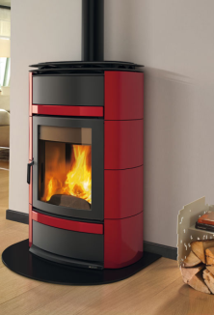
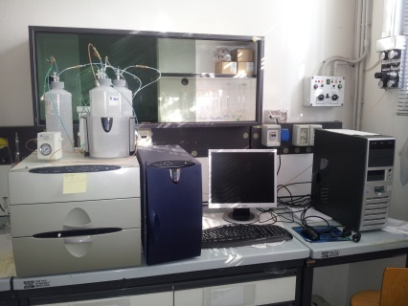
Laboratory measurements of tracers
Specific markers to improve the evaluation of biomass burning contribution to PM: Levoglucosan, Mannosan, Galactosan.
Levoglucosan ⇒ Cellulose and hemicellulose pyrolisis (T > 300°C)
Mannosan and Gallattosan ⇒ hemicellulose pyrolisis (T > 300°C)
Analytical Method: HPAEC-PAD (High Performance Anion Exchange Chromatography equipped with Pulsed Amperometric Detection)
EMEP/ACTRIS/COLOSSAL intensive measurement period –winter 2018:
Inter-laboratory comparison ACTRIS: Levoglucosan and its isomers 2017-2018 (2 Standard Solutions + 4 PM samples)
PM samples from Bologna urban background site provided by ISAC-CNR
Manuscript on “Integration of Source Apportionment and Macro Tracer methods for quantification of Woody Biomass Burning contribution to PM10”, submitted to Journal of Aerosol Sciences

Slide 7
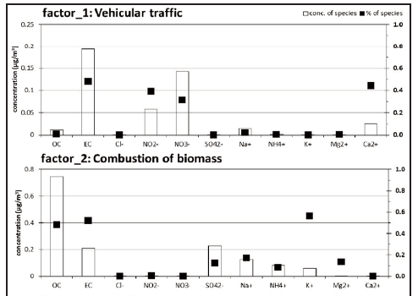
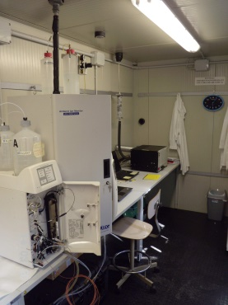
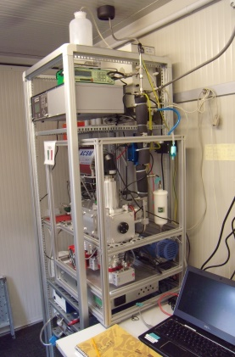
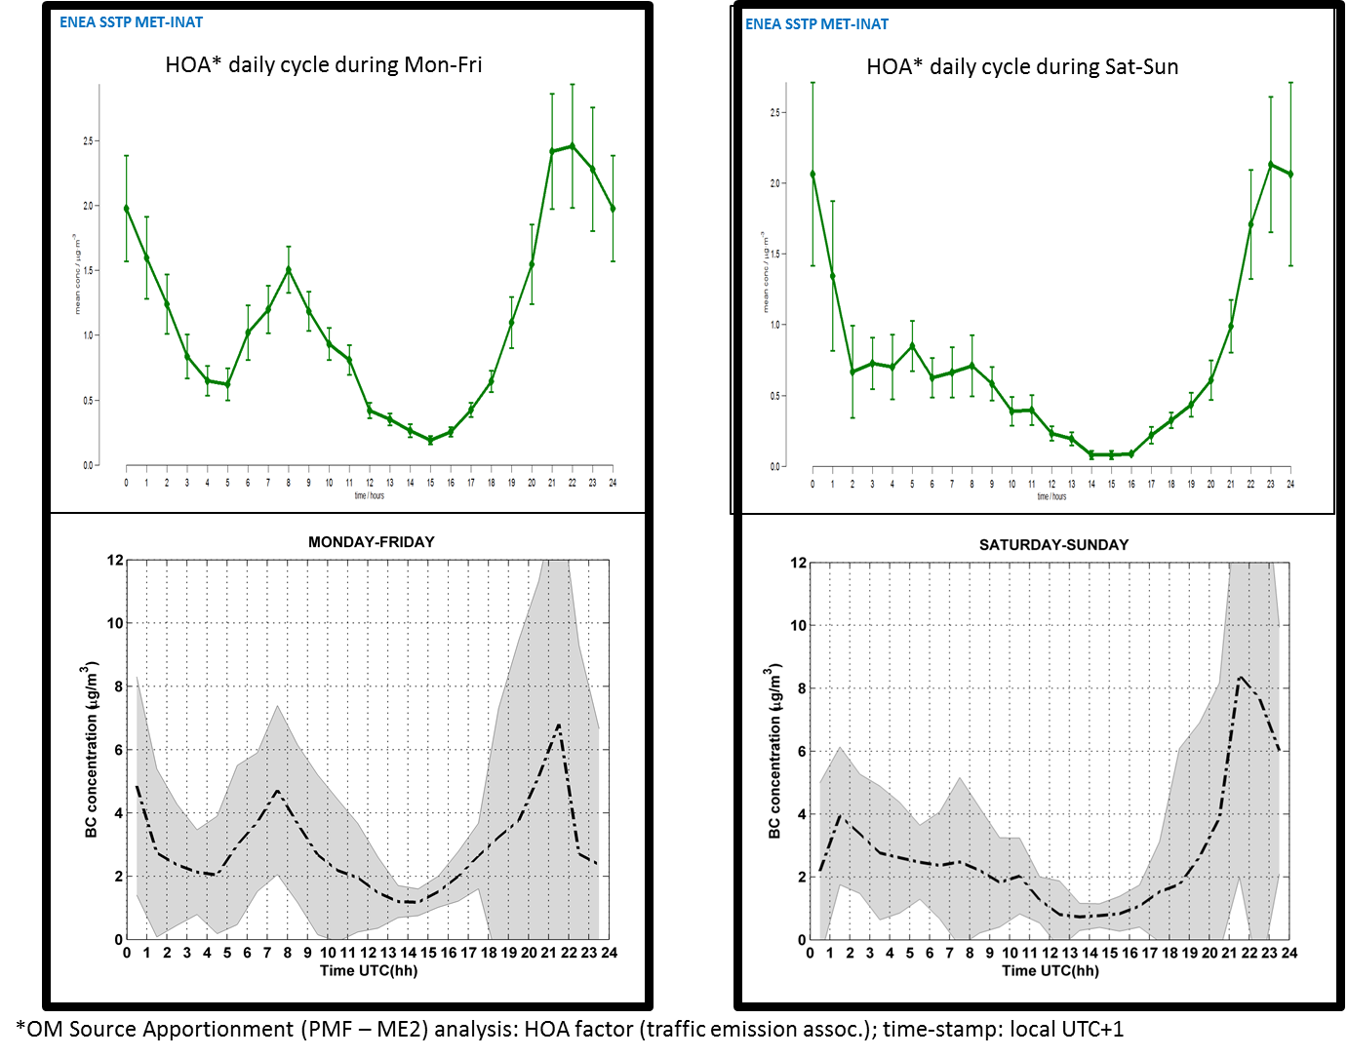
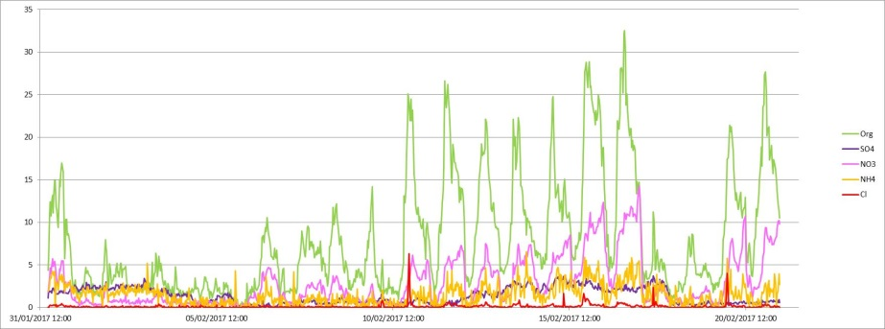
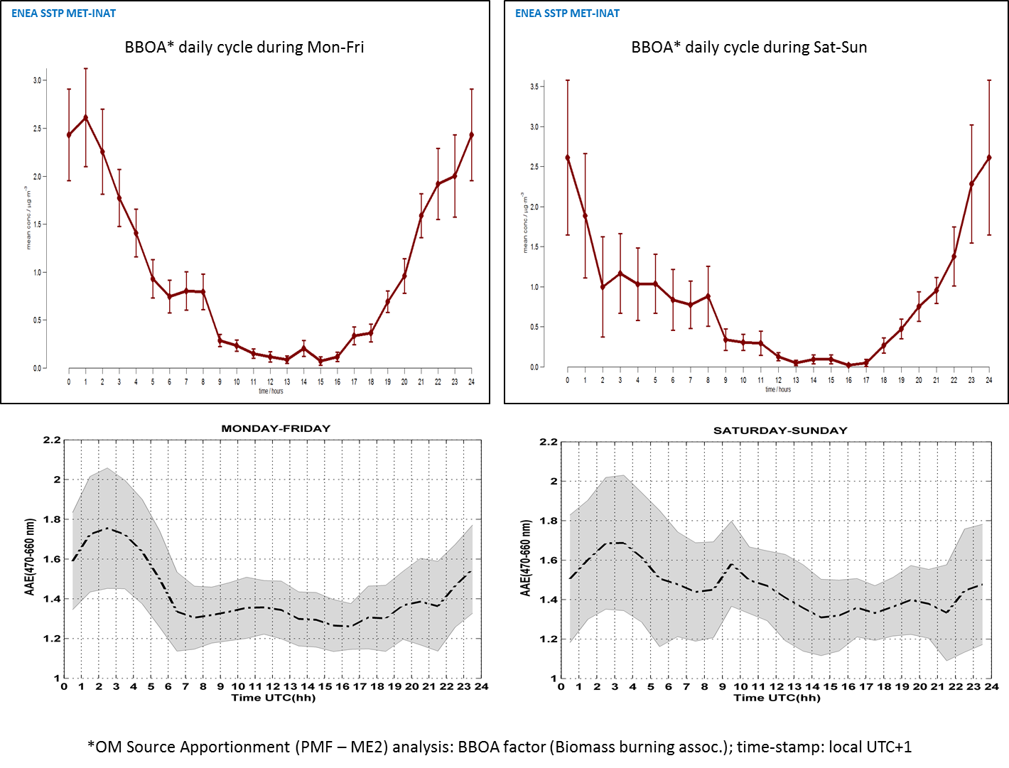
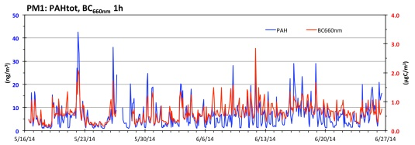
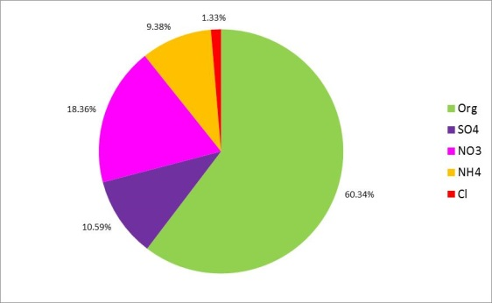
Online measurements of aerosol chemical composition
PM chemical characterization with high-time resolution monitors
Source identification and source apportionment
ACSM (main components of non-refractory PM1)
Sunset OC/EC Analyzer
AIM URG-9000D (cations and anions)
Identification of sources
Sources daily cycles
Sources contribution
Bressi et al. (2016, ACP)

Slide 8
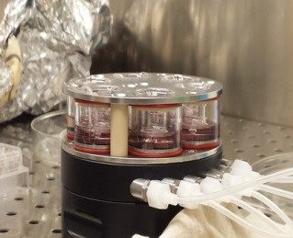
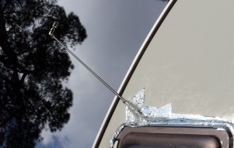
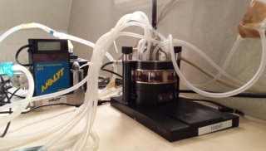
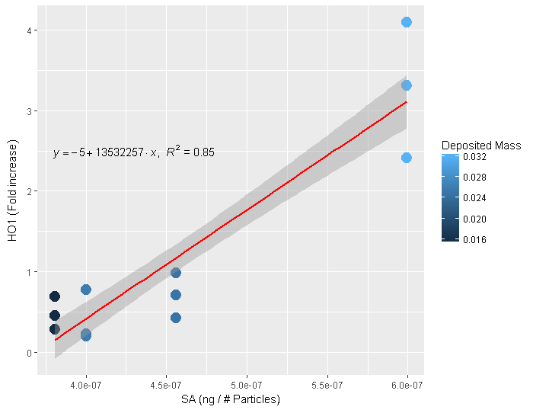
Air-liquid interface (ALI) exposure of lung cells under environmental condition
Real time measurement of PM physical (SMPS) and chemical properties (ACSM, EC/OC, URG-Ions)
Selection of in vitro model for lung epithelia relevant for air pollution
Direct exposure with cyclones for cutting the same aerodynamic diameter with real time measurements
Culturing at ALI of in vitro models and transfer in the exposure apparatus.
Exposure protocol may be selected in term of length of exposure (few hours to 24hour), repeated in time (in accordance to the in vitro model selected).
Carbonaceous Aerosol in Rome and Environs (CARE) Project 2017
Costabile et al. (2017, Atmosphere)
Gualtieri et al. subbmitted 2018
Identification of new descriptors of PM-related biological effects at environmental relevant doses of exposure.

Slide 9
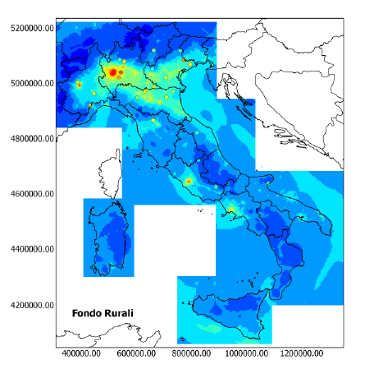
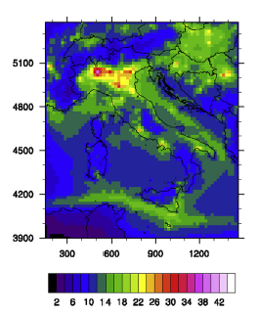
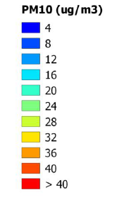
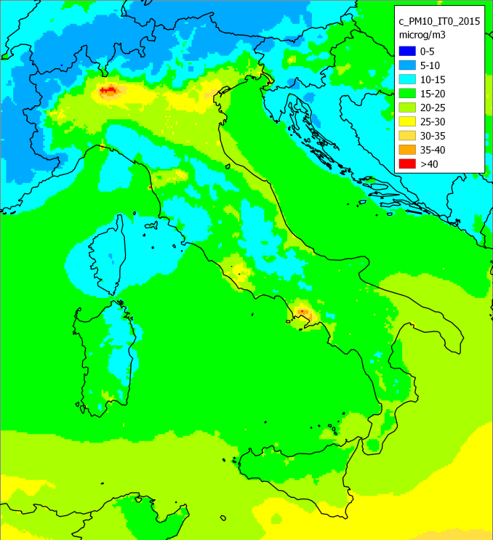
Assess air quality at national level
Annual concentrations PM10
2005
2010
2015
Simulated pollutants:
O₃, NO₂, SO₂, PM10, PM2.5
HM: As, Cd, Ni, Pb, Hg
PAHs: Benzo(a)pirene, Benzo(b)fluorantene, Benzo(k)fluorantene, Indeno(1,2,3-cd)pirene
Mircea et al. (2014, Atm.Env.)
Ciancarella et al. (2016, Technical Report ENEA)

Slide 10
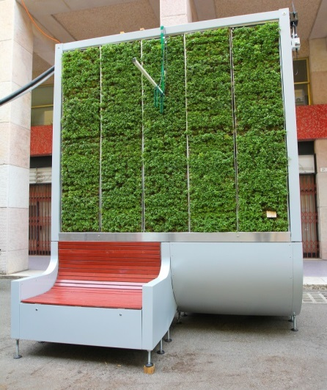
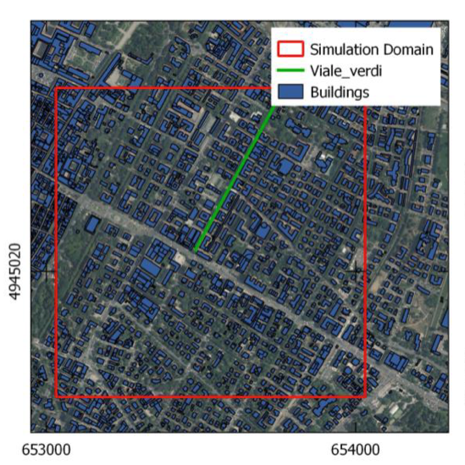
Assess impact of nature-based solutions on air quality
PMSS (Parallel Micro-SWIFT-SPRAY) Application at Urban Scale
PROJECT: URBESS :Nature Based Assessment Tool For Smart And Sustainable Urban Planning, Pathfinder Project:
EIT Climate – KIC
Meteo, landuse, obstacle description
Case study: Modena
Viale Verdi
PSWIFT
Emissions
High resolution 3D wind, temperature and turbulence fields
PSPRAY
Citytree, a green infrastructure to abate air pollution by deposition on vegetated panels
3D pollutant concentration field
MG.Villani, M.Adani, L.Ciancarella, F.Russo, L.Vitali, 2017, Report: URBESS – Nature Based Assessment Tool For Smart And Sustainable Urban Planning, Feasibility from an air quality model point of view.

Slide 11
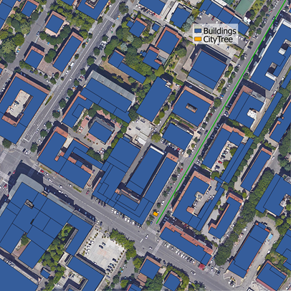
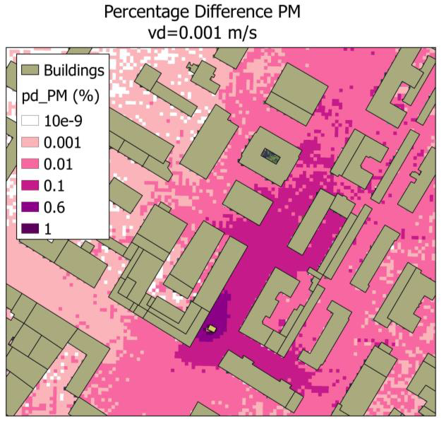
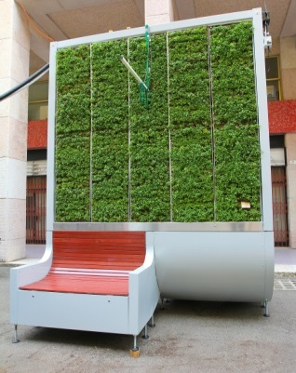
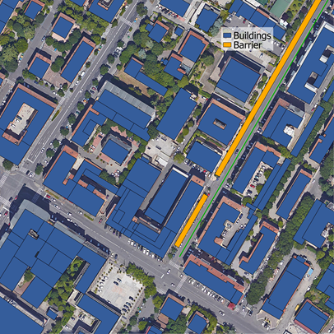
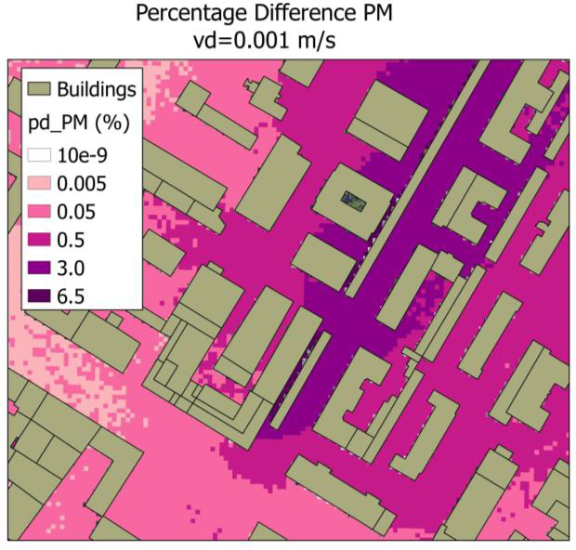
Assess impact of nature-based solutions on air quality
URBESS –PMSS set-up: & main findings
Simulation domains
Δ% in PM
The shape of the region of influence changes widely if a single CT or a CT barrier are considered.
The shape of the region of influence does not depend on the deposition velocity.
Case study 1:
Single City-tree (CT)
Case study 2:
City-tree Barrier
(~153 CT)

Slide 12
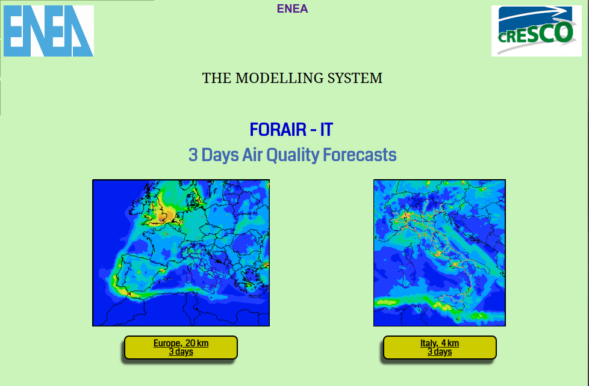
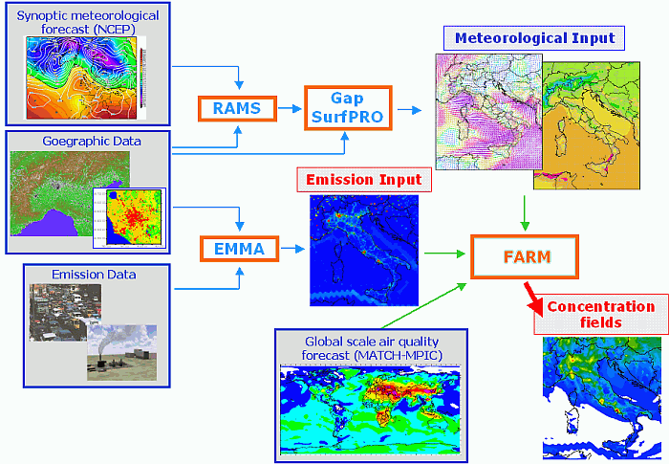
National air quality forecast
Meteo: GFS, United States weather service (NCEP)
BCs: Global Air Quality forecast MACC-Copernicus
Emissions - Italy: ISPRA 2010
Emissions - Europe: TNO 2005 EMEP
ForAir_IT runs on ENEA CRESCO – HPC Computing Infrastructure
http://www.afs.enea.it/project/ha_forecast/index.html

Slide 13
Evaluation of national air quality in climate scenarios
2010: RCM vs. WRF
RCM-FARM: 20 km vs. WRF-FARM: 50 km (EURODELTA)
RCM (Giorgi et al., 2012), WRF(Stegehuis et al., 2015)

Slide 14
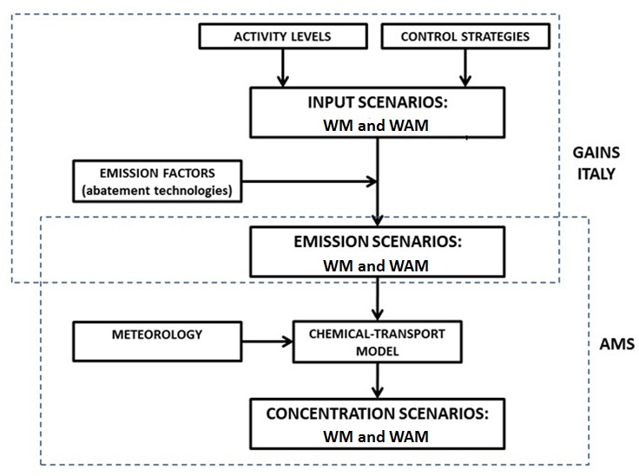
ENEA and The National Air Pollution Control Programme for the NEC Directive
The new National Emission Ceilings (NEC) Directive entered into force in December 2016. Emission reduction commitments for the year 2020 and 2030 respect to the base year 2005 for SO₂, NO_{X}, PM2.5, NMVOC and NH_{3.}
ENEA provide Technical support to MATTM (Italian Ministry for Environment, Land and Sea) that is responsible for: coordination, strategical assessment and policies selection
ENEA: elaborate the WM (With Measure) and WAM (the With Additional Measures) emission and AQ scenarios for the years 2020 and 2030.
14
http://www.minni.org/
14

Slide 15
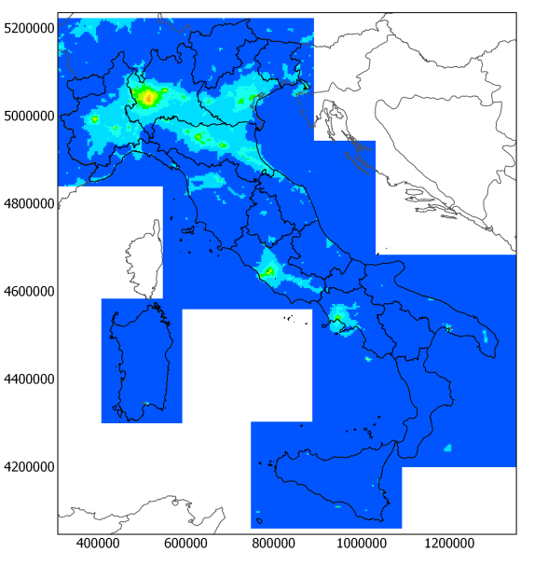
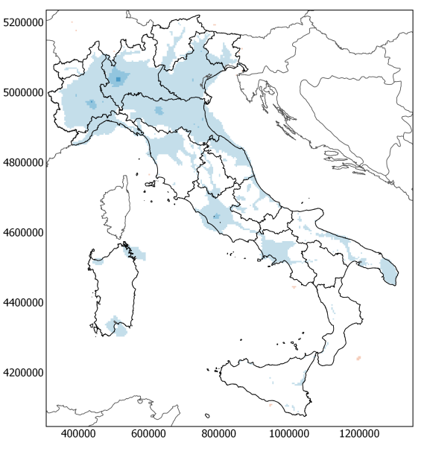
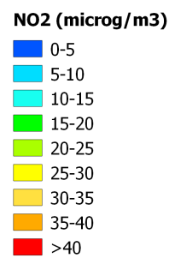
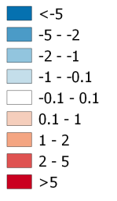
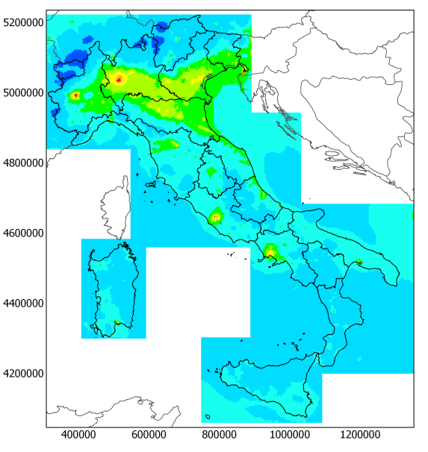
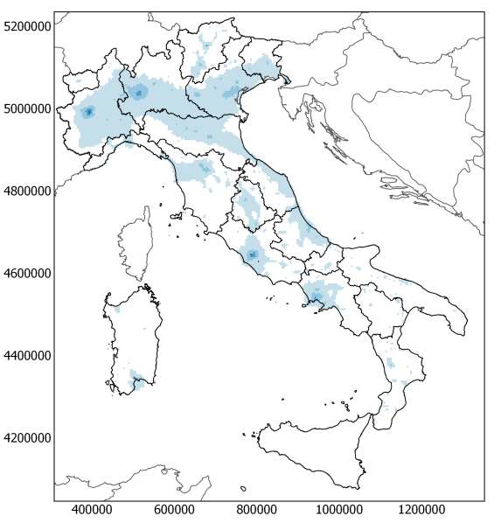
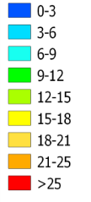
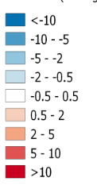
Evaluation of mitigation measurements for 2030
PBA
PBA - CLE
2030 results:
Emission and AQ scenarios
(NO₂ and PM2.5 – yearly average)
NO₂
2030 - kt | SO₂ | NO_{X} | PM2.5 | NMVOC | NH₃
CLE - 2005 (%) | -73.56% | -63.71% | -30.03% | -42.60% | -11.66%
PBA - 2005 (%) | -73.67% | -65.33% | -44.41% | -45.83% | -17.53%
NEC target 2030 - 2005 (%) | -71% | -65% | -40% | -46% | -16%
PM2.5
PBA- National Po Basin Agreement (2013)
CLE- Current Legislation
15
D’Elia et al., 2018, Atmospheric Pollution Research,
doi: 10.1016/j.apr.2018.03.002

Slide 16
Investigate the impact of air pollution on ecosystems
-develop/improve metrics used for ozone risk assessment to European forests
-perform evaluation studies with improved plant phenomenology, taking into account soil moisture stress, stomatal conductance, etc.
Collaborate with INERIS for further developments and applications, in particular to estimate O₃ impact on ecosystems using the output of EURODELTA Trends exercise
Anav et al. (2016, GCB)

Slide 17
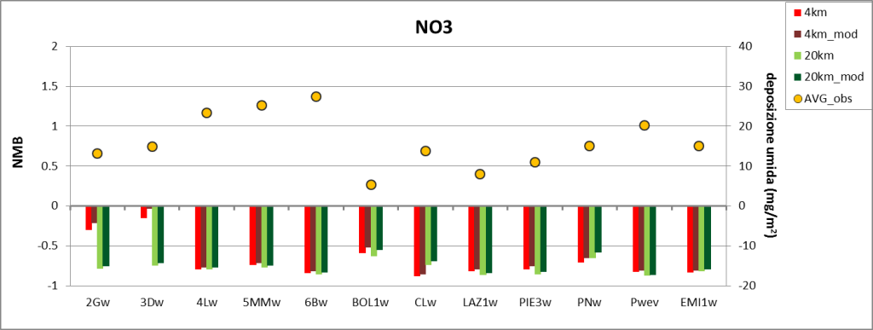
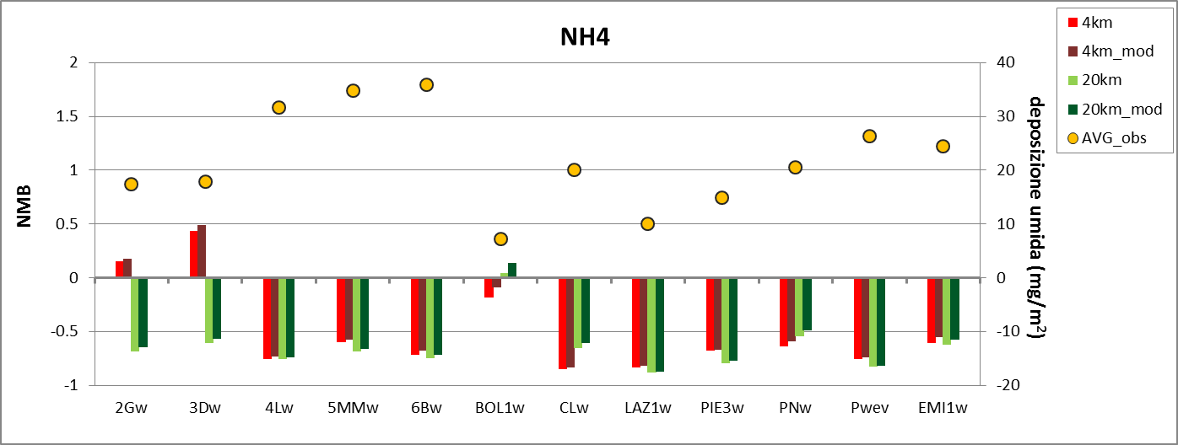
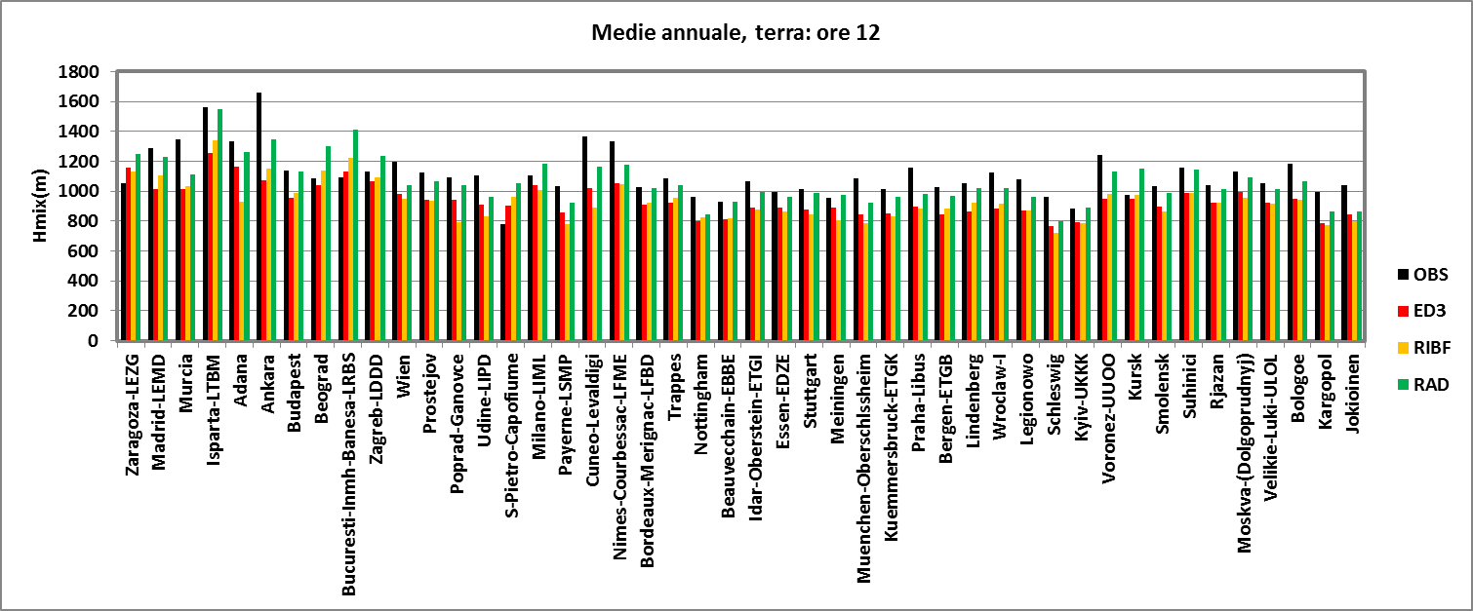
Develop air quality modelling system (AMS-MINNI)
improve the wet deposition approach
improve etimations of PBL height
improve biogenic emission model

