Slide 1
Dispersion modeling application for urban air impact assessment: a case study
S.Kakareka, S.Salivonchyk
Institute for Nature Management,
Minsk, Belarus
19th Task Force on Measurement and Modelling Meeting
Geneva, Switzerland, 2-4 May 2018

Slide 2
Goal
analysis of possibilities of AERMOD application for air impact assessment in Belarus (on an example of PM10 for a medium-size city)
Tasks (included into presentation):
1. Site description and sources of PM10 emission parametrization
2. Meteorological parametrization
3. Dispersion modelling
4. Discussion
5. Verification
6. Conclusions and ways forward

Slide 3
Rationale
outdated methodological basis of air impact assessment and dispersion modelling (local scale) in the former SU countries;
approved dispersion models are too laborious for application at a city level, poorly account meteorology, do not account many emission sources;
other models application is necessary.
AERMOD model of US EPA was tested on an example of PM10 for a medium-size city of Belarus (appr. 70 thous. inhabitants).

Slide 4
Main stages
- Modelling domain selection, gridding
Emission sources data collection
Sources parametrization and grouping according to the stack height, flue gas speed, temperature etc.
- Sources grouping according to their location
- Determination of meteorological and landscape parameters for industrial sites which impact the dispersion
- Modelling of PM10 maximum concentrations of different averaging periods
- Verification of results

Slide 5
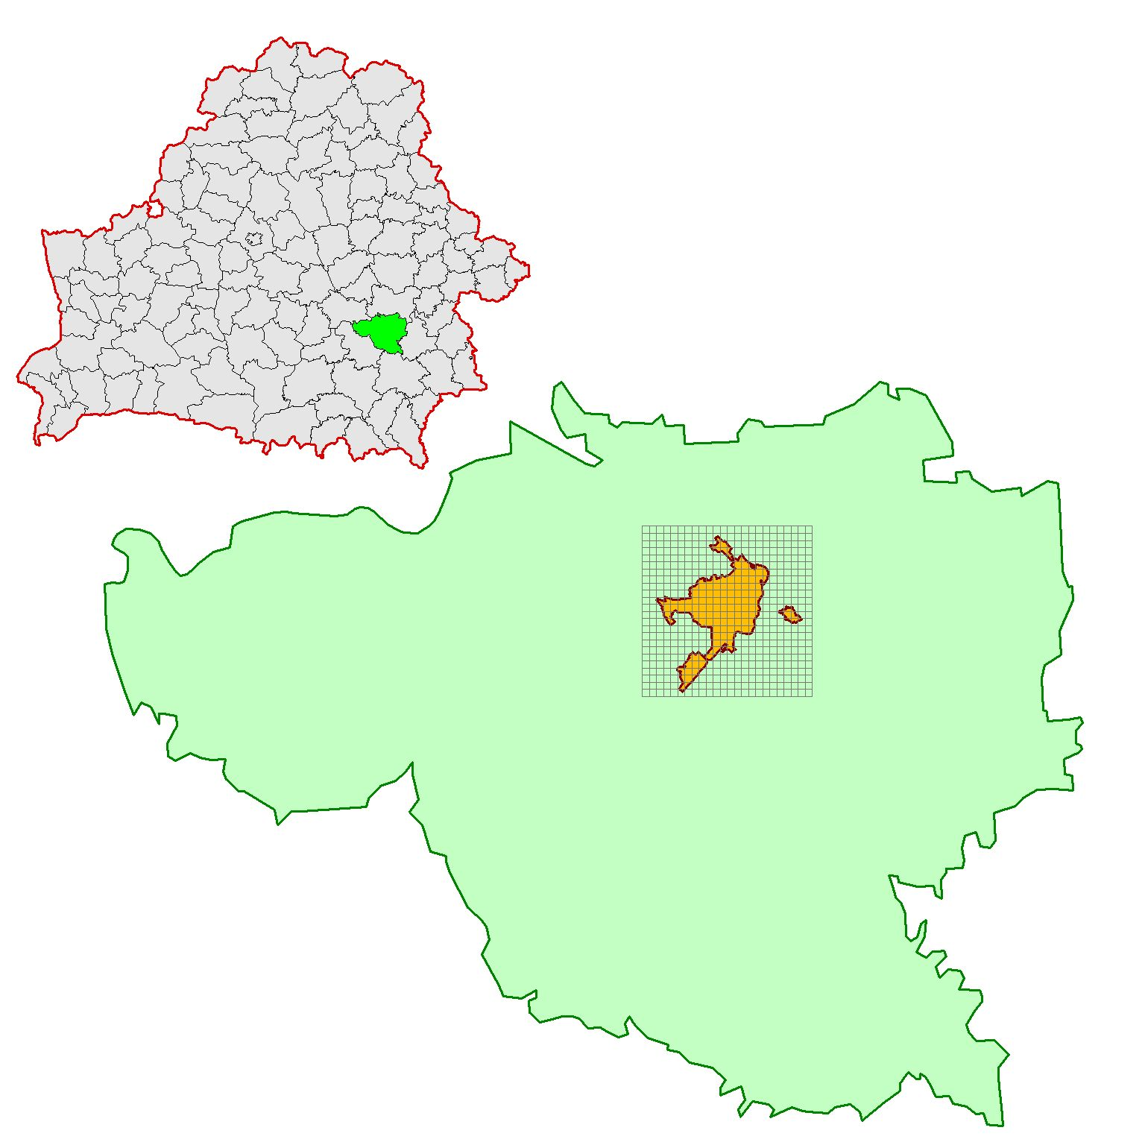
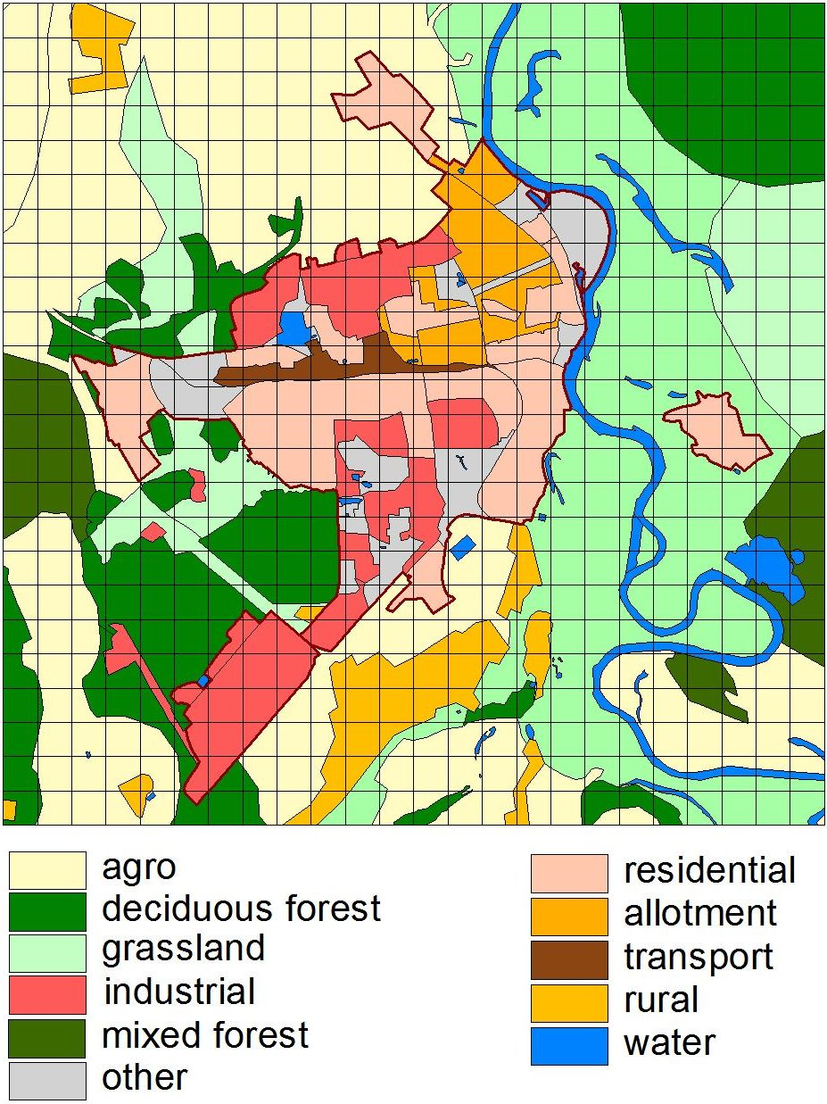
1. Site description and sources of PM10 emission parametrization
Site location and description
Zhlobin city, 0.5x0.5 km grid
BELARUS
Zhlobin district

Slide 6
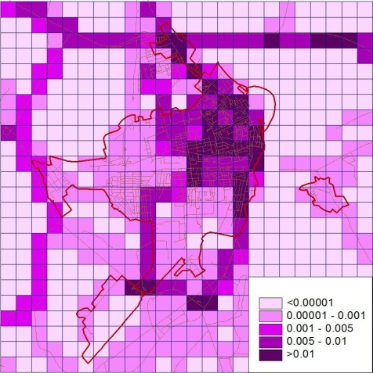
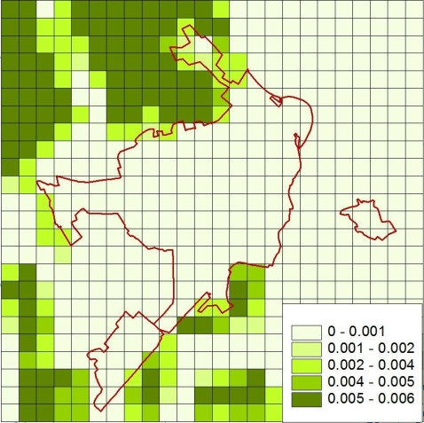
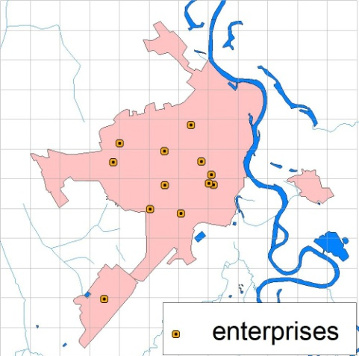
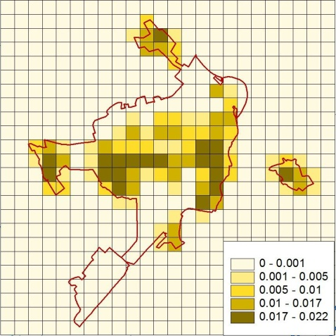
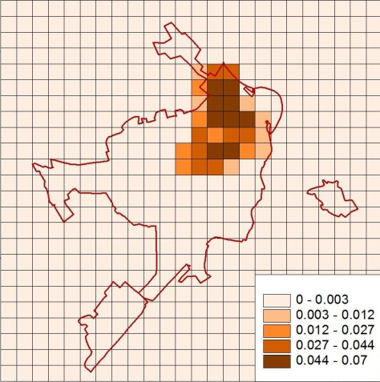
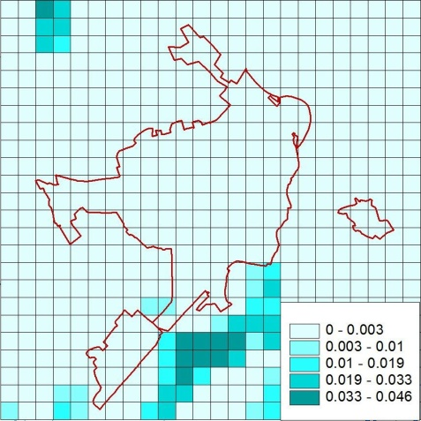
Emission assessment
PM10 emission for the city domain was assessed as a share in national sector emissions accounting number of population, area of domain, road length etc.
PM10 emission by source sectors
Road transport
Agriculture
Sources sector | Emission, t/year | %
Industry | 405,1 | 88,6
Residential sector:
Single-storied | 25,1 | 5,5
Multi-storied | 0,6 | 0,1
Rural | 13,3 | 2,9
Road transport | 6,6 | 1,4
Agriculture | 6,3 | 1,4
Total | 457,0 | 100,0
Industry
Single-storied residential
Multi-storied residential
Rural settlements

Slide 7
Emission sources parameterization
All sources of PM10 emission of the city were considered as of 2 types: point and area.
Point sources
Industrial enterprises were considered as a set of stationary point sources and described by the following parameters:
Location (UTM coordinates)
PM10 emissions rate, g/s (QS)
Stack inside diameter, m (DS)
Stack gas exit temperature, K (TS)
Stack gas exit velocity, m/s (VS)
Source height, (HS)
For parametrization of PM10 emissions sources facilities data was used, supplemented by available data from other datasets. On the whole 25 point sources at 13 enterprises were allocated.

Slide 8
Area sources
Road transport, agriculture, residential sector in the city and its environs were described in model as area sources using the following parameters:
Location (X,Y UTM coordinates)
Length of side of area source, m (Yinit)
PM10 emissions rate, g/(s*m²) (Aremis)
Length of side of area source, m (Xinit)
Source release height, m (Rhelght)
Orientation angle relative to N, deg (Angl)
Fraction of particle mass emitted in fine mode less then 2.5 microns and representative mass mean particle diameter in microns are used for calculation of PM10 deposition according to Method 2.

Slide 9
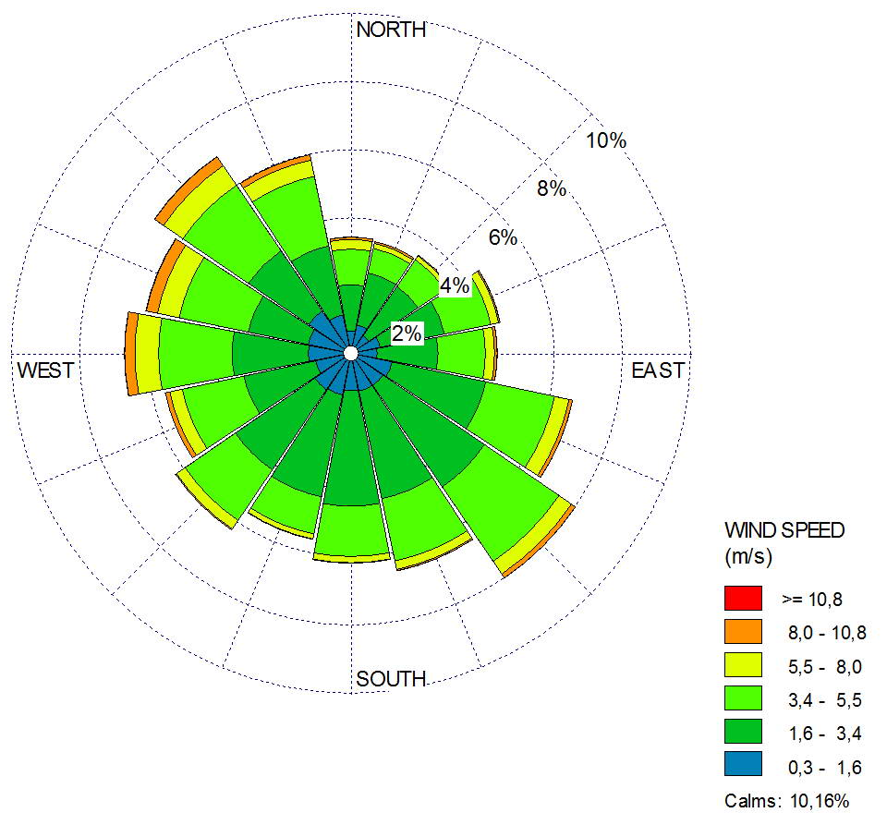
2. Meteorology
The following information for the AERMOD Meteorological Preprocessor was used :
SURFACE data for Minsk meteorology station (WMO 268500)
UPPER AIR SOUNDING data for Gomel station (WMO 330410)
Data collected in NOAA National Centers for Environmental information were used:
Integrated Surface Hourly Data Base (3505) ftp://ftp.ncdc.noaa.gov/pub/data/noaa/
Radiosonde Database Access https://esrl.noaa.gov/raobs/
AERMET Meteorological files were available for 5-year period (from 2012 to 2016). However, due to long calculating procedure, most of the results were performed on the basis of 1-year meteorological file, preferably 2015, since for this year statistical data for the city was compiled.
Built using WRPLOT ViewTM,
Lakes Environmental Software

Slide 10
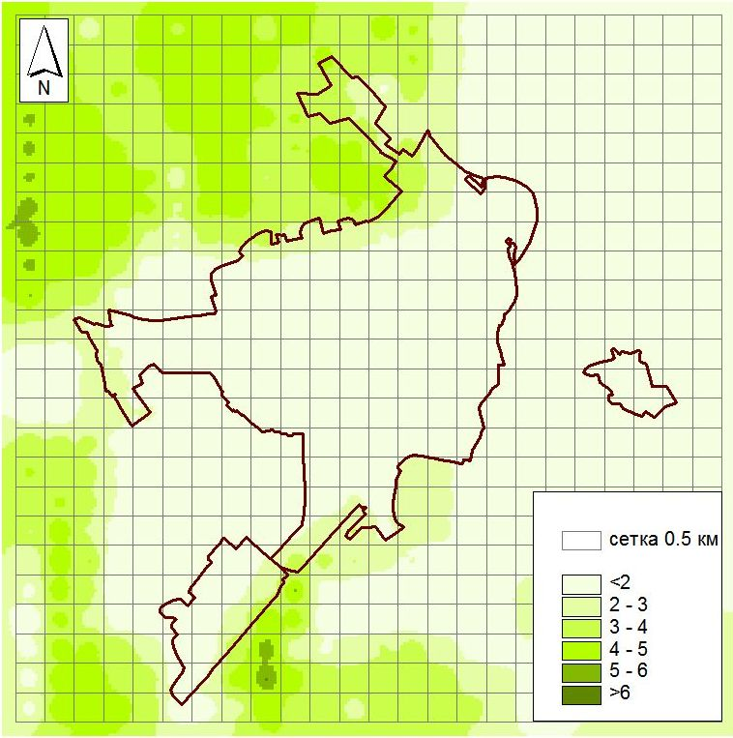
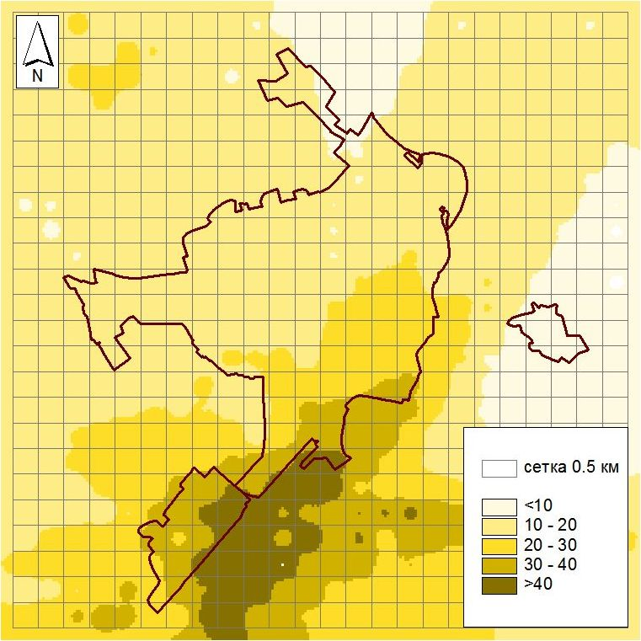
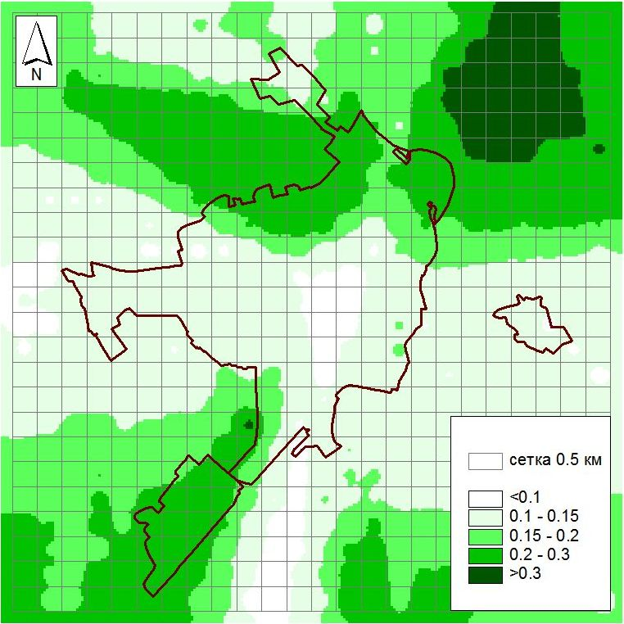
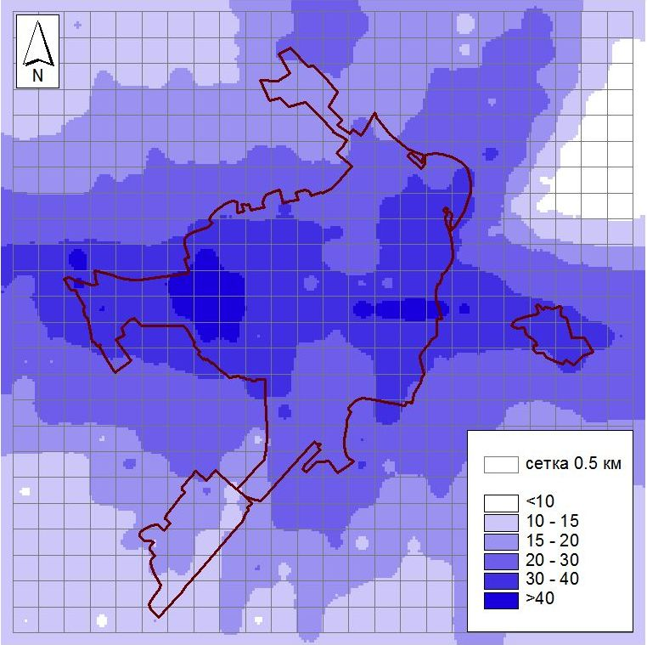
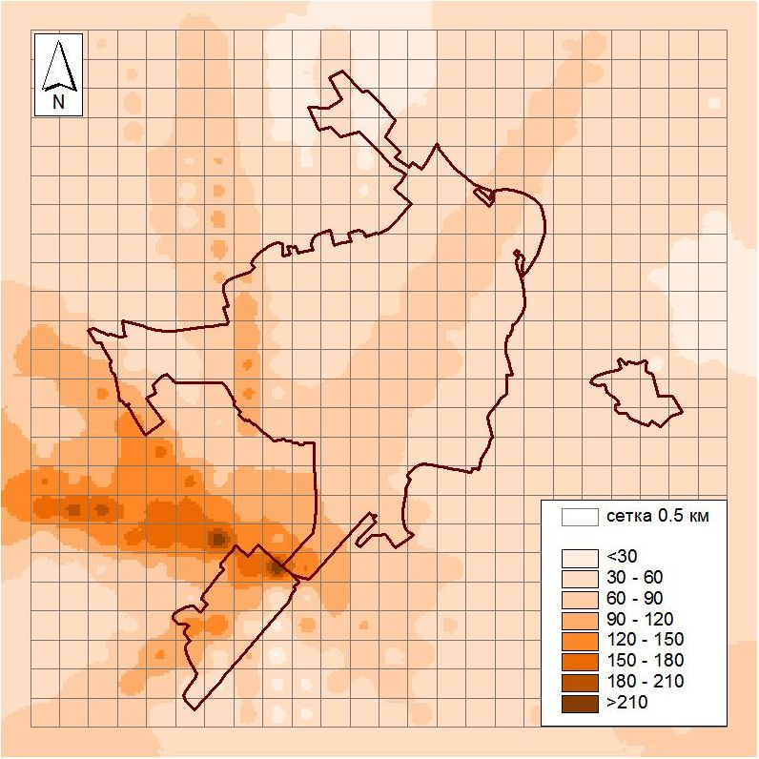
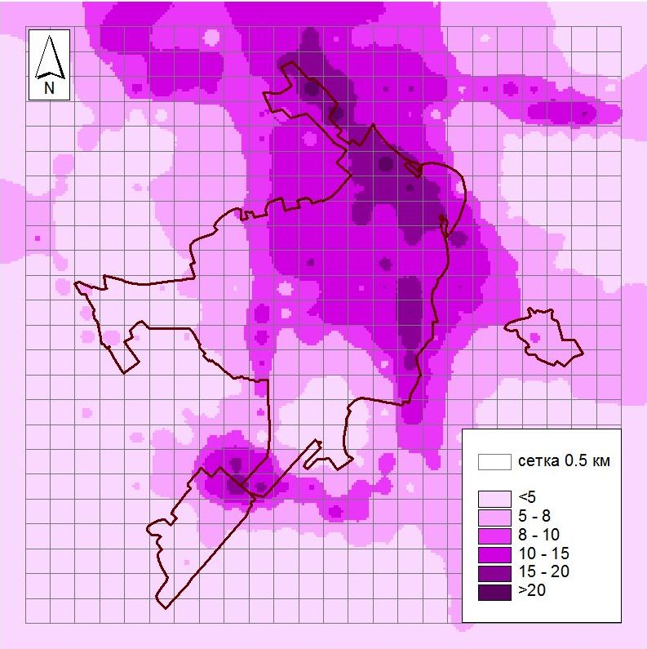
3. Modelling results
Maximum hourly PM10 air concentrations from different type of sources, µg/m³
agriculture
residential sector (rural)
residential sector (multi-storied)
residential sector (single-storied)
industry
road transport

Slide 11
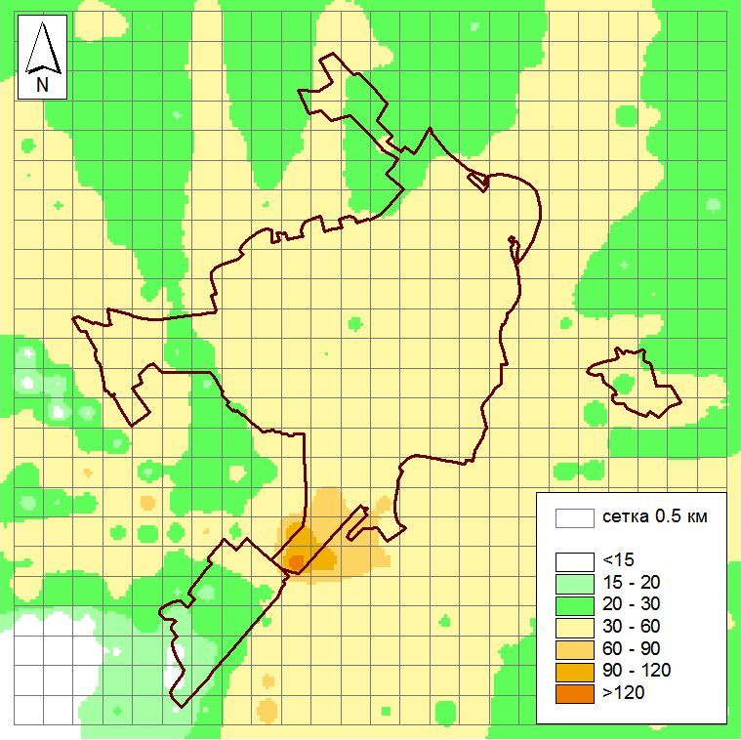
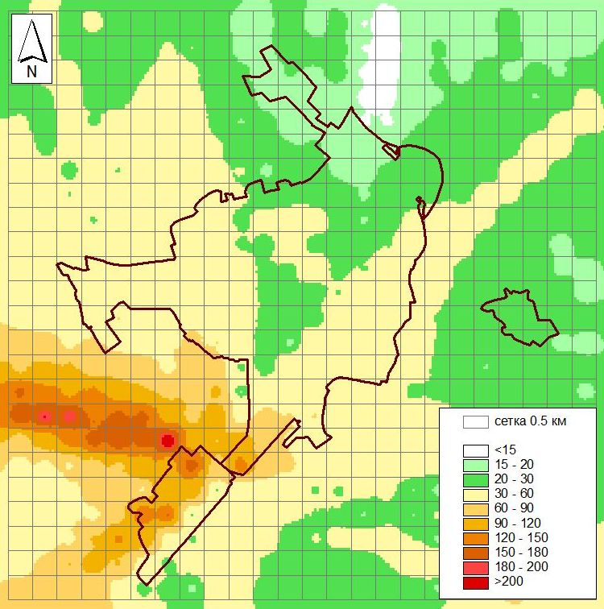
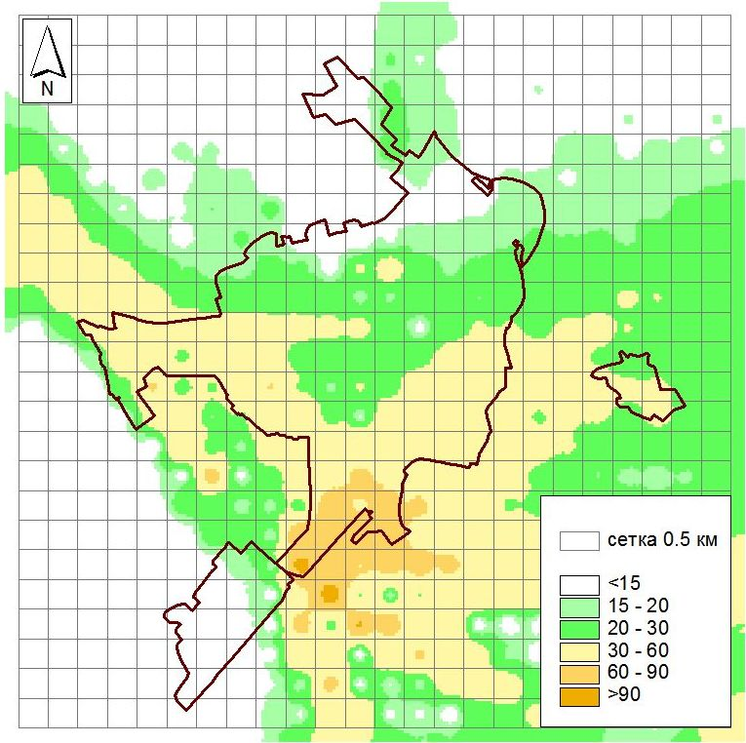
Maximum hourly PM10 air concentrations from all sources in different periods of year, µg/m³
Jan
Mar
Jun

Slide 12
4. Discussion
According to the calculation results, the highest concentrations of PM10 are more likely in the southern part of the city. The zone of the highest concentrations of PM10 in the annual calculation cycle stretched there NW and is apparently associated with low wind speeds, which are most often caused by winds of the SE direction. The location of the zones varies in different periods of the year and is determined by the combination of the meteorological conditions of a particular month, which determine the conditions for scattering of pollutants. Of the several 2015 periods for which calculations were made, the worst situation was recorded in March. In July and January 2015, conditions for dispersion of PM10 were more favorable.

Slide 13
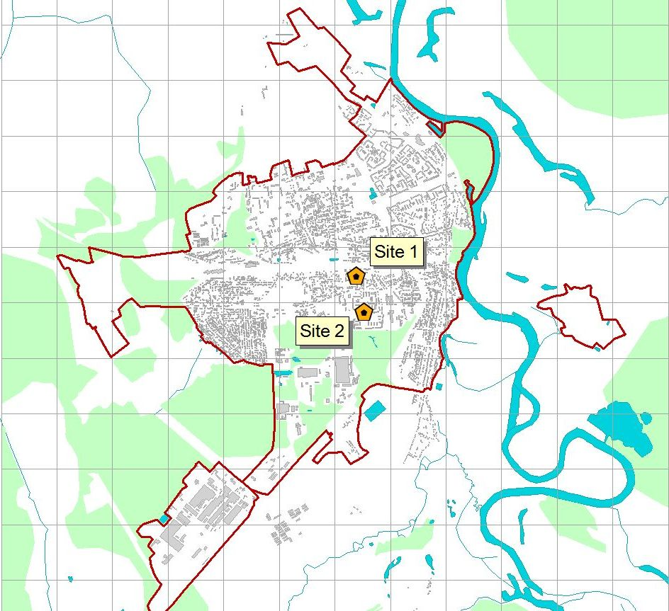
5. Verification
The calculated maximum and average monthly and measured average monthly values of PM10 concentration were compared with NSMOS air monitoring measurement results for the period from 2011 to 2014.
In general, the observations at monitoring site fit between the average and the maximum values obtained by the modelling. Though at Site 2, located in the southern part of the city, observed monthly mean PM10 values are higher compared with the monthly averages obtained by the model.

Slide 14
- first steps were made for urban dispersion modelling using stationary Gaussian model; - problems to be solved for more effective dispersion modelling: - lack of data on stationary and mobile emission sources (non-accounted sources, inter-annual variations etc.); - account of background levels, regional/transboundary contribution; - secondary aerosols, chemical transformations accounting; - lack of meteorological data (gaps filling …); - further modelling/measurement exercises (NOx, ammonia, VOC); - deposition modelling and sampling; - proposals for MNREP authorities on wider air pollutants dispersion modelling.
Conclusions and ways forward

Slide 15
Thank you for your attention!

