Slide 1

Progress in downscaling using uEMEP
Norwegian Research Council
Bruce Rolstad Denby, Peter Wind, Hilde Fagerli, Michael Gauss, Matthieu Pommier

Slide 2
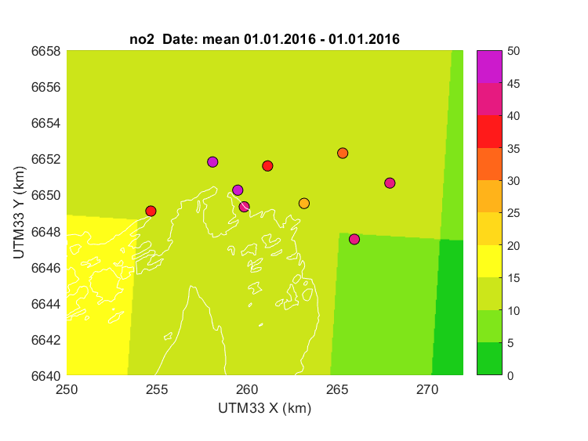
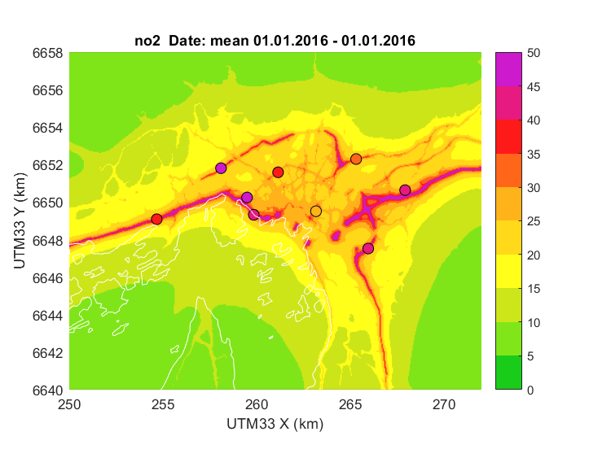
What downscaling with uEMEP does
Oslo annual mean NO₂ uEMEP (50 m)
Oslo annual mean NO₂ EMEP (0.1º)

Slide 3
Overview
Regional scale CTM’s now span many scales, e.g. EMEP is used on the global scale and down to 1 - 2 km (EMEP4UK, EMEP4NO)
Even so, these models cannot resolve local near source gradients (e.g. roads) and cannot be validated by stations near to sources
However, it is possible to cover large regions at high resolution using downscaling or redistribution techniques built into, or appended to, the regional models
Such methods are often referred to as kernel techniques as they redistribute high resolution proxy or emission data based on a moving kernel (really just a Gaussian dispersion model)
Application of these methods reveal the discrepancies between local and regional emission inventories
In order to span all scales in future modelling then these emission discrepancies need to be removed

Slide 4
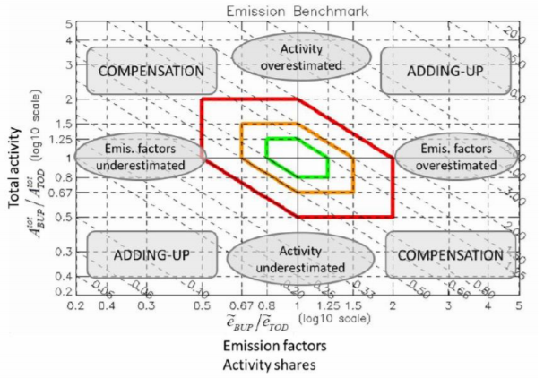
Recent activities in kernel downscaling
Theobold et al. (2016) 1 km sub-grid within EMEP 50 km but did not account for local or non-local contributions
Maiheu et al. (2017) European wide kernel downscaling (125 m) for traffic emissions using Chimere and OSM road network data
Sherpa city. European wide user interface (in development) kernel downscaling using Chimere and OSM road network data
FAIRMODE emission comparison maps have shown discrepancies across Europe in top down and bottom up emissions
… and uEMEP
Theobald, M. R., sub-grid model for improving the spatial resolution of air quality modelling at a European scale, GSimpson, D., and Vieno, M.: A eoscientific Model Development Discussions, 2016, 1–22, doi:10.5194/gmd-2016-160, URL http://www. geosci-model-dev-discuss.net/gmd-2016-160/, 2016.
Improved Methodologies for NO2 Exposure Assessment in the EU (2017) Maiheu Bino, Wouter Lefebvre, Heather Walton, David Dajnak, Stijn Janssen, Martin Williams, Lisa Blyth, Sean Beevers. EC Report no.: 2017/RMA/R/1250. http://ec.europa.eu/environment/air/pdf/NO2%20exposure%20final%20report.pdf

Slide 5
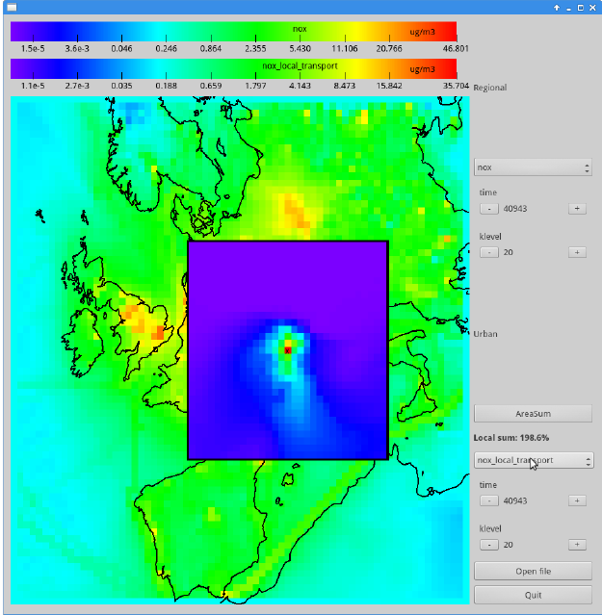
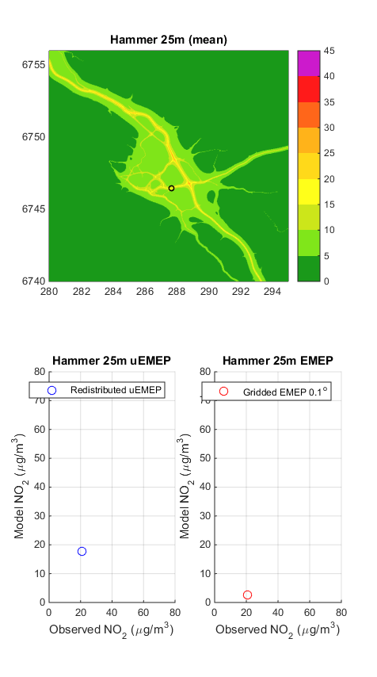
uEMEP
uEMEP (urban EMEP) consists of two parts
A method for calculating the local contribution of emission sources to the gridded concentrations, known as local fraction, has been developed (lf-uEMEP)
A method for downscaling the local fraction contribution from EMEP to high resolution sub-grids of ~50 m. Achieved by redistribution or replacement of emissions and Gaussian dispersion modelling (ds-uEMEP)
Can be applied on both hourly and annual data and at all EMEP resolutions (e.g. 0.1º and 2.5 km)

Slide 6
Local fractions in EMEP (lf-uEMEP)
Built into the EMEP model, source concentration fluxes are followed through the model domain to the surrounding grids
With this we know the fractional contribution to each grid from all the neighbouring grids, e.g. 5 x 5 or 20 x 20 surrounding grids
Knowing this we can calculate source contributions to or from the surrounding grids
And/or use this information to downscale only the local source contribution within an EMEP grid

Slide 7
Example calculations for Norway
NO₂ annual mean 2015

Slide 8
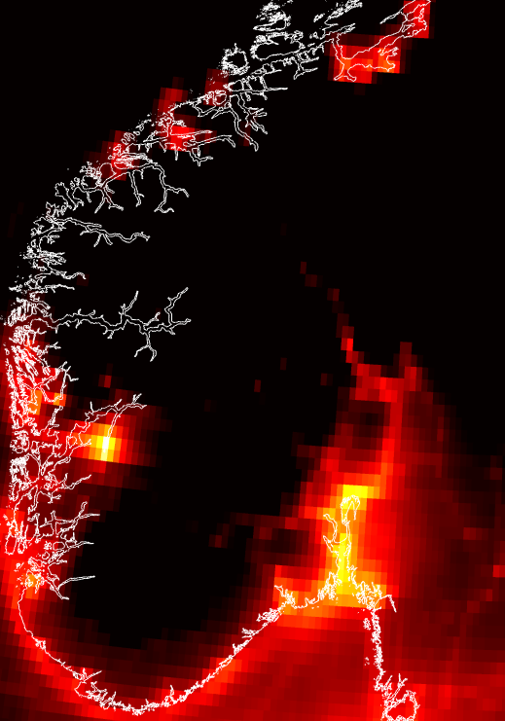
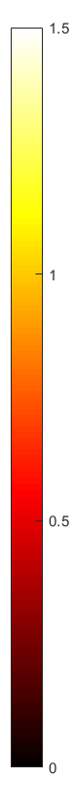
Annual mean NO₂ concentrations for Southern Norway
uEMEP calculation for traffic and shipping at 250 m
EMEP 0.1º
uEMEP 250 m
Scale is logarithmic (log₁₀) from 1 to 30 ug/m³

Slide 9
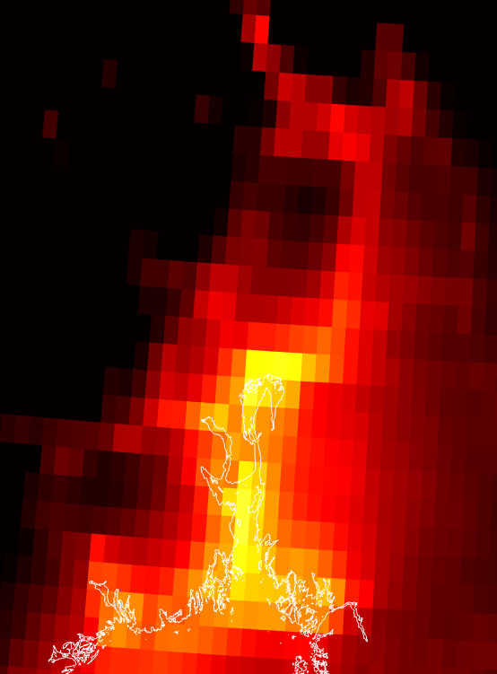

Annual mean NO₂ concentrations for Oslo region
uEMEP calculation for traffic and shipping at 100 m
EMEP 0.1º
uEMEP 100 m
Scale is logarithmic (log₁₀) from 1 to 30 ug/m³

Slide 10
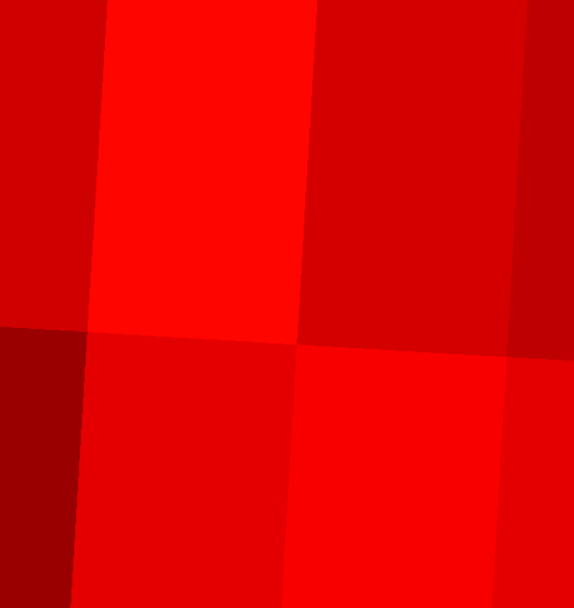
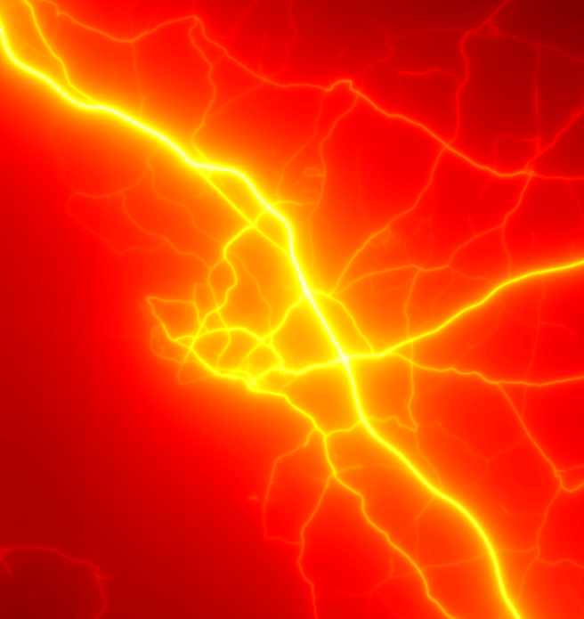
Annual mean NO₂ concentrations for Hamar
uEMEP calculation for traffic and shipping at 25 m
EMEP 0.1º
uEMEP 25 m
Scale is logarithmic (log₁₀) from 1 to 30 ug/m³

Slide 11
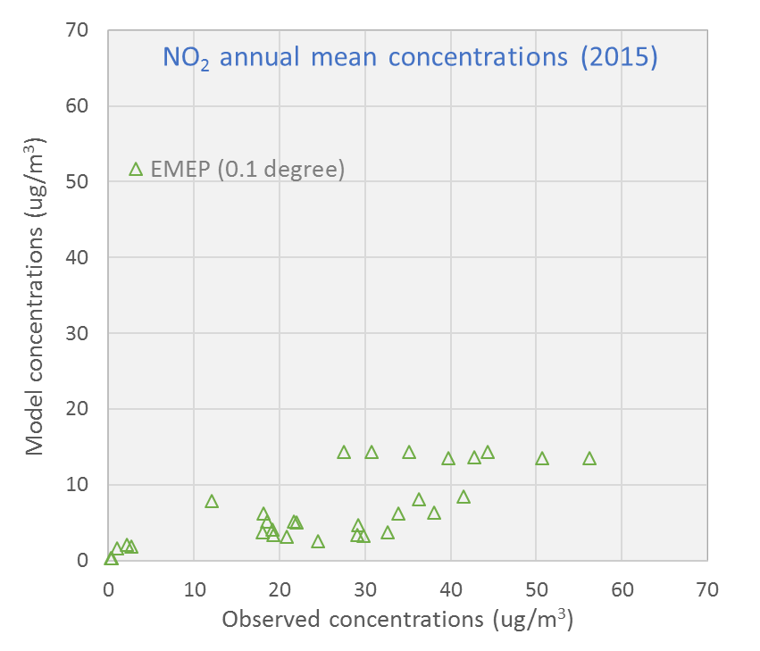
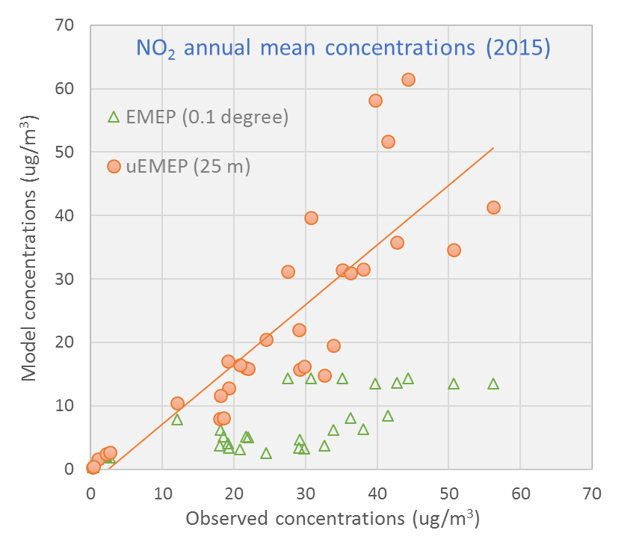
Annual mean NO₂ Airbase stations Norway
Comparison EMEP (0.1º) and uEMEP (25m)

Slide 12
Example of forecasting in Norway
EMEP (CAMS) using two alternative downscaling methods

Slide 13
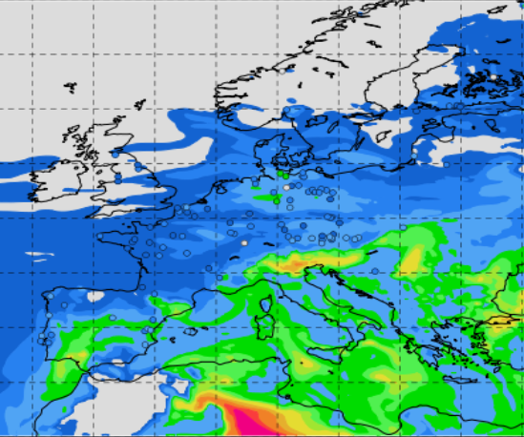
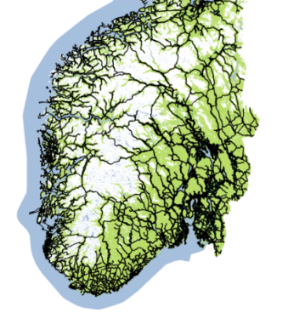
uEMEP setup for forecasting
EMEP is used in the same configuration as for CAMS forecasts with TNO-MAC3 emissions
Hourly calculations are downscaled using uEMEP for all monitoring sites in Norway at 25 m resolution
Two cases are shown, both where the local contribution from EMEP is removed and replaced by sub-grid dispersion calculations:
  Using bottom-up traffic and shipping emissions independent of TNO emissions
  Using TNO emissions but redistributed in space with traffic and shipping proxy emissions

Slide 14
Forecast downscaling of NO₂ using uEMEP with CAMS.
All stations in Norway (37) time series

Slide 15
Forecast downscaling of NO₂ using uEMEP in CAMS. Average over stations and forecast period
uEMEP= 20.1 ug/m³
EMEP = 8.2 ug/m³
OBS = 18.6 ug/m³
R²=0.55
A. Bottom-up sub-grid emissions
If TNO emissions were consistent with bottom-up emissions then these two calculations would be the same
uEMEP= 20.7 ug/m³
R²=0.40
B. Redistributed TNO emissions (using sub-grid proxy emissions)

Slide 16
A summary of uEMEP results
The local fraction calculation in lf-uEMEP can be used for downscaling but also for source allocation within local regions
lf-uEMEP is part of the latest open source EMEP/MSC-W code (https://github.com/metno/emep-ctm)
The downscaling part of uEMEP (ds-uEMEP) can be applied on annual data (rotationally homogenous Gaussian model) or hourly data (standard Gaussian plume)
Can currently be applied anywhere in Norway (have complete proxy emission data set for traffic and shipping) for NO₂
Best results are obtained when national bottom-up emissions are used
Redistribution of TNO emissions for NO₂ provides similar results but with poorer spatial and temporal correlation
Bottom-up emissions are not consistent with TNO emissions

Slide 17
A general summary
What is the advantage of uEMEP?
Given appropriate emission/proxy data then large regions can be modelled at high resolution (country, continent)
It makes local scale modelling available for regional modellers allowing ‘scale closure’ for regional models
Can be validated for all station types
It clearly reveals discrepancies between regional and local emissions and will help, in the long run, to reduce these inconsistencies
What is an appropriate emission database for this application?
An appropriate emission database is one that can be aggregated or disaggregated consistently at all scales, that includes not just emissions but the underlying data used to make the emissions

Slide 18
Application in the twin site study
The local fraction calculation (lf-uEMEP) can be used to directly calculate the city contribution from primary emissions to the region surrounding the city as well as the nearby contribution to a city
Does not provide, as yet, an estimate of the secondary contribution
Can be used now, everywhere
The downscaling part of uEMEP (ds-uEMEP) can be used to estimate local source contributions within a city to any particular monitoring site
Can tell us how representative a site is for the CTM calculation
Requires proxy data for the sources which is not available everywhere

Slide 19

Thank you

Slide 20


A brief overview kernel downscaling methodology
Local
Use CTM to calculate local grid (ls-uEMEP)
Local
Non-local
Determine the local CTM grid by volume integration of the sub-grid
Non-local
CTM grid concentration
Remove local CTM grid
Distribution kernel based on Gaussian dispersion
CTM grid emission
Redistribute CTM to sub-grid emission
Non-local
Dispersion local proxy/emission sub-grid
Sub-grid proxy data (activity data)
Add resulting local sub-grid to nonlocal CTM
Bottom up sub-grid emission

Slide 21
Advantages of the kernel methodology
The gridded CTM concentration can be conserved, out of respect for regional modellers
If the removal of the local CTM contribution is properly done then all double counting is avoided
Instead of using CTMs as boundary conditions then local models can be laid seamlessly on top of existing CTMs allowing large regions to be modelled at high resolution
For seamless application then the aggregated CTM grid emissions should be the same as the sub-grid distribution
Only appropriate for non-reactive primary emissions (NO₂ post processing possible)

Slide 22
Example for traffic in Oslo using ls-uEMEP (NO_{x})
2 day forecast average at 2.5 km resolution
Total NO_{x} concentration
Fractional contribution from surrounding grids
Total fraction from all surrounding grids
Total local contribution from traffic

Slide 23
Downscaling ds-uEMEP
Standard Gaussian models are applied on either annual mean or hourly data to disperse sub-grid emissions or proxy data
These are then used to either replace the calculated ls-uEMEP concentration or to redistribute it
Three examples will be shown:
  The sub-grid Gaussian dispersion is volume integrated over the EMEP grid and the sub-grid concentrations are normalised and redistributed at surface level (preserves volume average grid concentration)
  The EMEP gridded emissions are redistributed over the sub-grid emission data and the sub-grid dispersion replaces the EMEP local source contribution (preserves volume average grid concentration only if dispersion and advection is the same)
  Independent emissions are used and the sub-grid dispersion replaces the EMEP local source contribution (does not preserve volume average grid concentrations)

Slide 24
Example for forecast in Oslo using ds-uEMEP (NO_{x})
2 day forecast average at 2.5 km resolution
EMEP NO₂ concentration (2.5 km)
1. Redistribution of ls-uEMEP (100 m)
2. Replaced ls-uEMEP using redistributed EMEP emissions
3. Replaced ls-uEMEP using independent emissions

Slide 25
Forecast downscaling of PM_{2.5} using uEMEP with CAMS.
All stations in Norway (33) time series

Slide 26
Forecast downscaling of PM_{2.5} using uEMEP in CAMS
Average over stations and forecast period
uEMEP= 4.7 ug/m³
EMEP = 4.6 ug/m³
OBS = 4.7 ug/m³
R²=0.19
A. Bottom-up sub-grid emissions
uEMEP= 6.8 ug/m³
R²=0.21
B. Redistributed TNO emissions (using sub-grid proxy emissions)

