Slide 1
TFMM “Twin Site” Modelling the contribution of long range pollution to urban air
19th TFMM Meeting, Geneva May 3rd 2018
A. Colette, F. Couvidat, (INERIS),
H. Fagerli, M. Pommier (Met Norway)

Slide 2
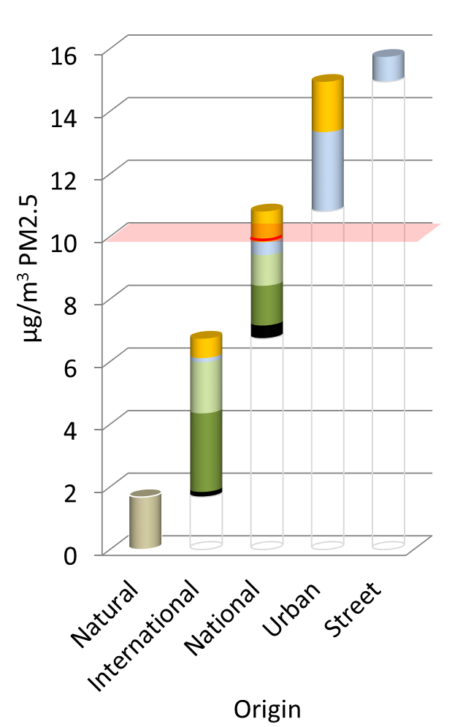
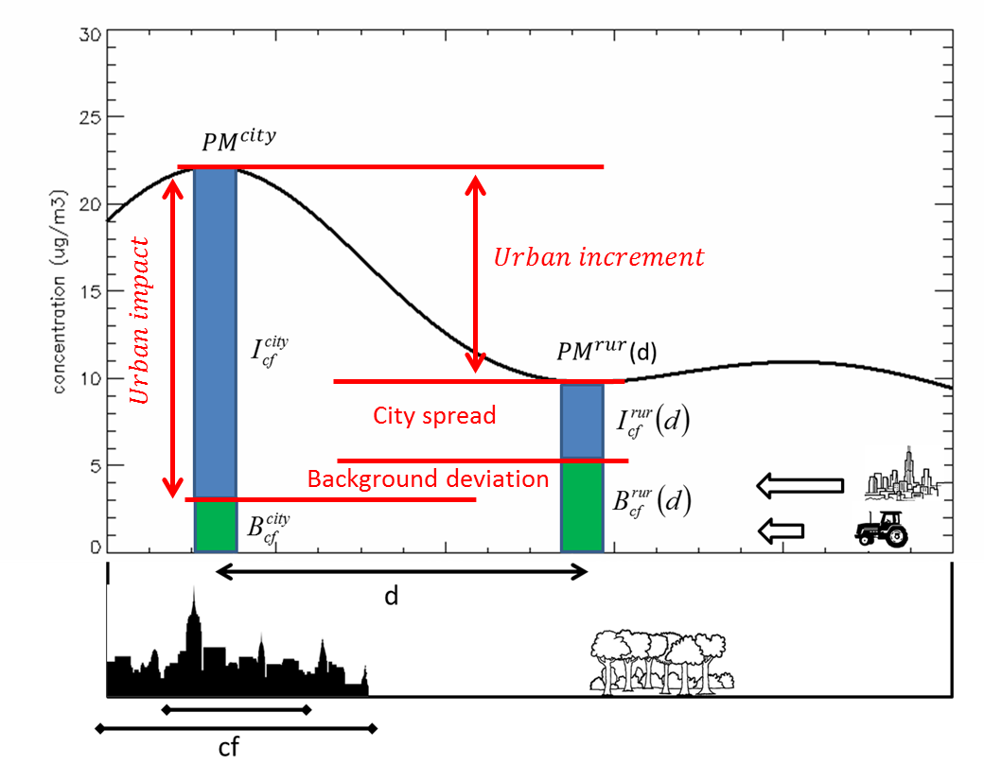
Urban and Long range air pollution
Methodologies available to assess the local/non-local contribution to urban air:
Observations:
Lenschow method and derivatives, applied to PMF or concentrations
Integrated assessment models:
GAINS and Sherpa source allocations
Validating/Comparing models and observations
the various available methodologies are not straightforward to compare
Inconsistent definition of city masks
compensation of city spread and city contribution
We focus here on the (well posed) comparison of
Chemical analyses of PM at pairs of urban/remote sites
High resolution CTM results

Slide 3
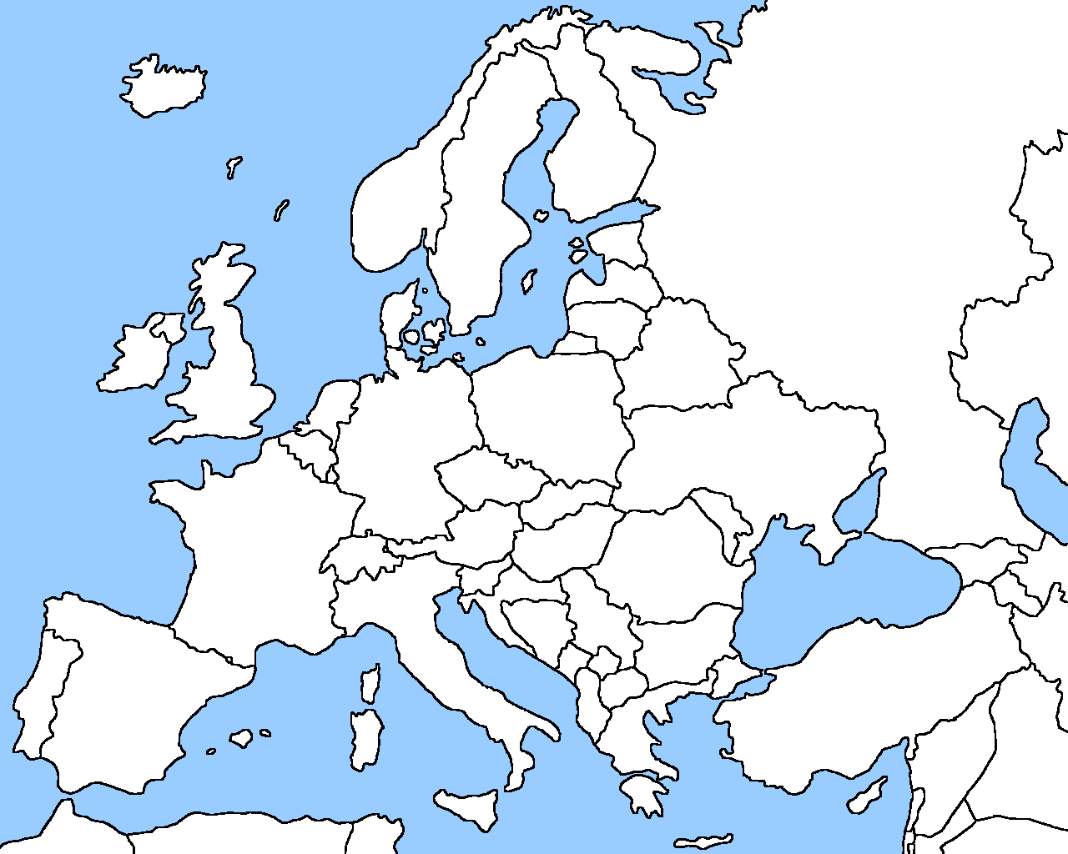
Observations
Available sites
Spain: Barcelona (UB), Montseny (RB), Montsec (Mountain)
Switzerland: Zurich-Kaserne (urban background), Payerne (rural).
France: Revin (RB), Lens (UB), Roubaix (traffic).
Germany: Leipzig (traffic-urban)/Melpitz (regional)
Netherlands: Schiedam (urban ~Rotterdam) / Hellendoorn (rural)
Chemical species
Observed :
PM₁₀, PM_{2.5}, Al, Ca , K, Na, Mg, Fe, Mn, Ti, V , Ni , Cu , As, Rb, Sr, Sb , Pb , SO₄²⁻, NO₃⁻, Cl⁻, NH₄⁺, EC, OC
Subset for the comparison with models:
SO₄²⁻, NO₃⁻, NH₄⁺, Dust, Sea Salt, OM, EC
The remaining fraction is mainly water

Slide 4
CTM involved in the analysis
High resolution CTM over the whole Europe
Chimere
Simulation (underlying Sherpa): 7km for 2009 with either INERIS or JRC inventory
EMEP
Emep MSCW 2017 Report (0.1x0.1 deg, 37 layers for 2015 with 2015 EMEP 0.1 emissions)
Emep underlying Sherpa, (0.1x0.1 deg 20 layers) for 2014 with 2014 emissions (JRC)
Chemical comparison
Observations: SO₄²⁻, NO₃⁻, NH₄⁺, Dust, Sea Salt, OM, EC
Chimere has SOA + PPM (roughly 30/70%), to be compared to OM+EC
Emep is lacking Dust and Sea Salt in some outputs

Slide 5
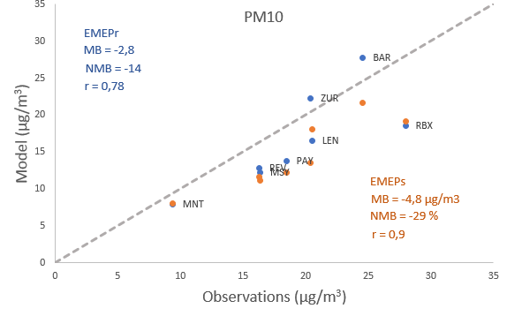
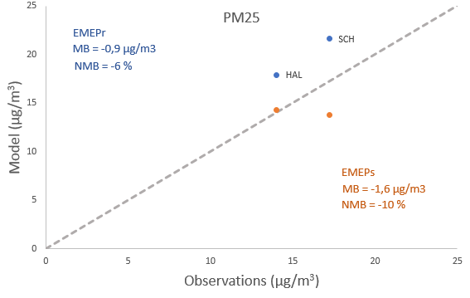
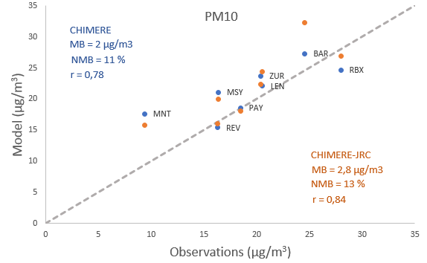
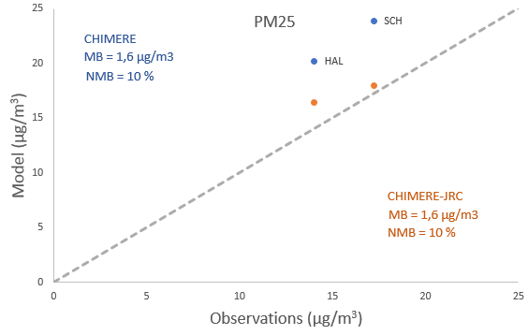
PM₁₀ and PM_{2.5} scatterplots
Models included:
EMEPr: MSCW Report
EMEPs: Sherpa basecase
CHIMERE: Sherpa basecase
CHIMERE-JRC: Sherpa basecase, with JRC inventory
Similar performances at most stations

Slide 6
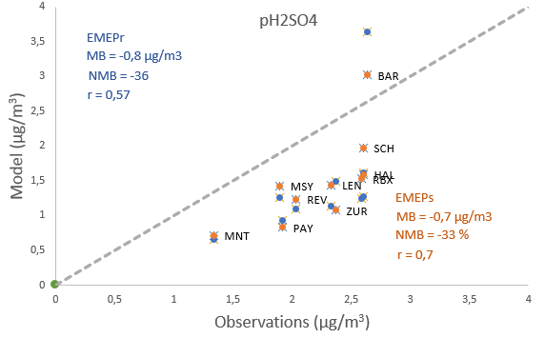
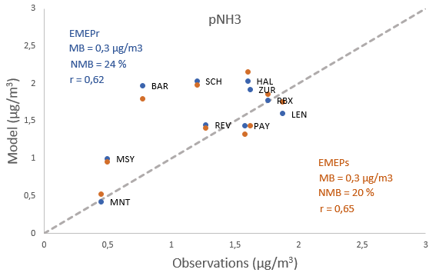
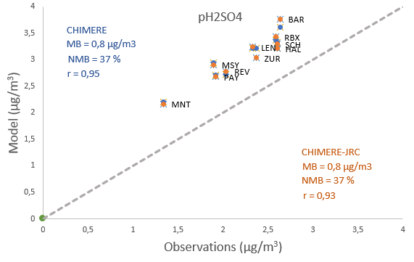
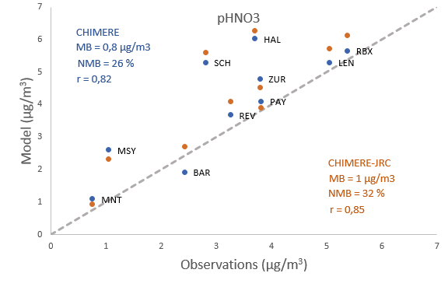
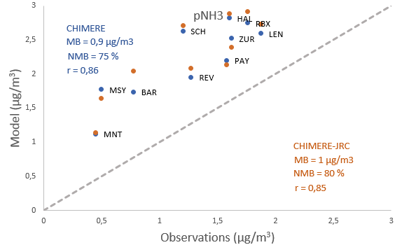
SIA scatterplots
The main difference is for sulphates

Slide 7
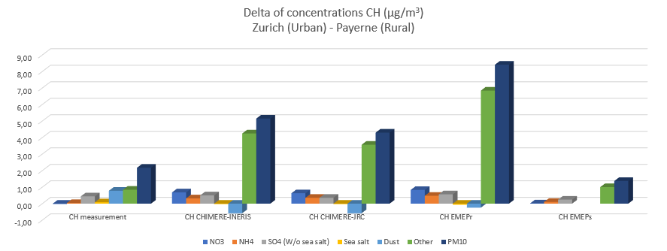
Increment: Switzerland
Large overestimation of PM₁₀ increment due to « other » (=EC+OM), except for EMEP-Sherpa
SO4 gradient well captured by all models
All models except EMEP-Sherpa have an increase of NO3&NH4 in urban area which is not in the measurements

Slide 8
Increment: The Netherlands
Fairly good agreement for PM₁₀ increment, except for EMEP-Sherpa that has a lower « other » increment, therefore a net decrement in PM₁₀
Decrement of NH₄NO₃ in urban area, well captured by all models

Slide 9
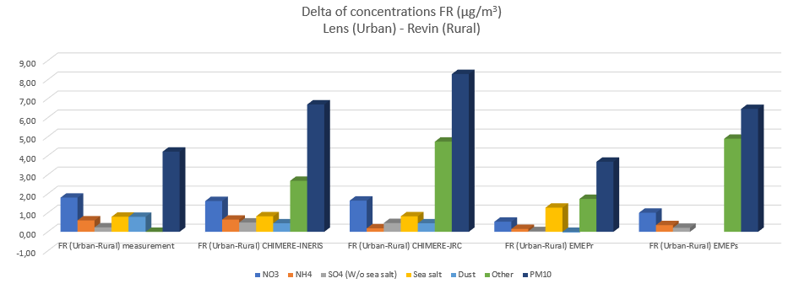
Increment: FRance
Strong overestimation of EC+OM increment for all models
Good agreement for inorganics (especially for CHIMERE)

Slide 10
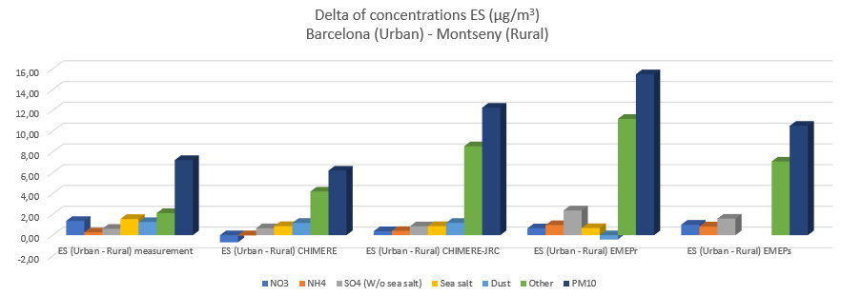
Increment: Spain
Chimere lacks coarse nitrate formation therefore the opposite « urban nitrate » increment
Overestimate of OM+EC increment in all models

Slide 11
EC+OM increments
Scattered CTM performances across models for EC+OM gradients:
+ overestimate
- underestimate
Ok: good capture
 | CHIM-Ineris | CHIM-JRC | EMEP-Report | EMEP-Sherpa
CH | + | + | + | ok
NL | ok | ok | ok | -
FR | + | + | + | +
SP | ok | + | + | +

Slide 12
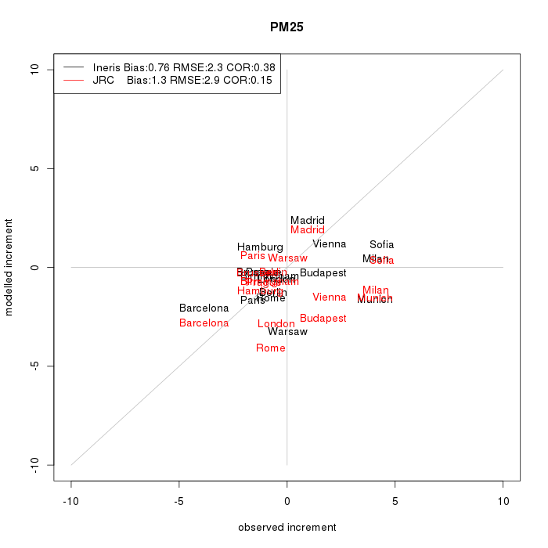
PM₁₀ Urban increment
Observed and modelled urban-rural gradients for PM₁₀/PM₂₅ airbase sites of major European cities
Urban: < 0.5 deg
Background >0.5 and < 2 deg
Only Chimere represented:
The JRC inventory tends to overestimate the increment compared to the INERIS (EC4MACS) inventory

Slide 13
conclusion
Preliminary conclusions (work in progress)
The CTMs capture well the gradients of SIA, except one instance of urban coarse nitrate (SP)
Urban increment dominated by carbonaceous aerosols (EC+OM), except for NL where the decrement of NH4NO3 is substantial
Scattered CTM performances across models for EC+OM gradients:
Next steps
Include more CTMs
Scale dependency, alternative EMEP results
Better handling of interannual variability

