Slide 1
On the validity of the incremental approach to calculate the impact of cities on air quality Philippe Thunis JRC- C5 TFMM - Geneva May 2018

Slide 2
Motivation: Compare available methods to quantify the impact of city emissions on its own air pollution? What is the urban / regional split?
Two main methods are compared:
Incremental approach (mod or obs) → Urban increment
The urban increment is fixed by the spatial concentration gradient between observed/modelled pairs of stations
Scenario based (mod only) → Urban impact
The urban impact is determined by switching off emissions over a given urban area with an air quality model (CTM)
More details in Thunis (2018): On the validity of the incremental approach to estimate the impact of cities on air quality, Atmospheric Environment, 173, 210-222

Slide 3
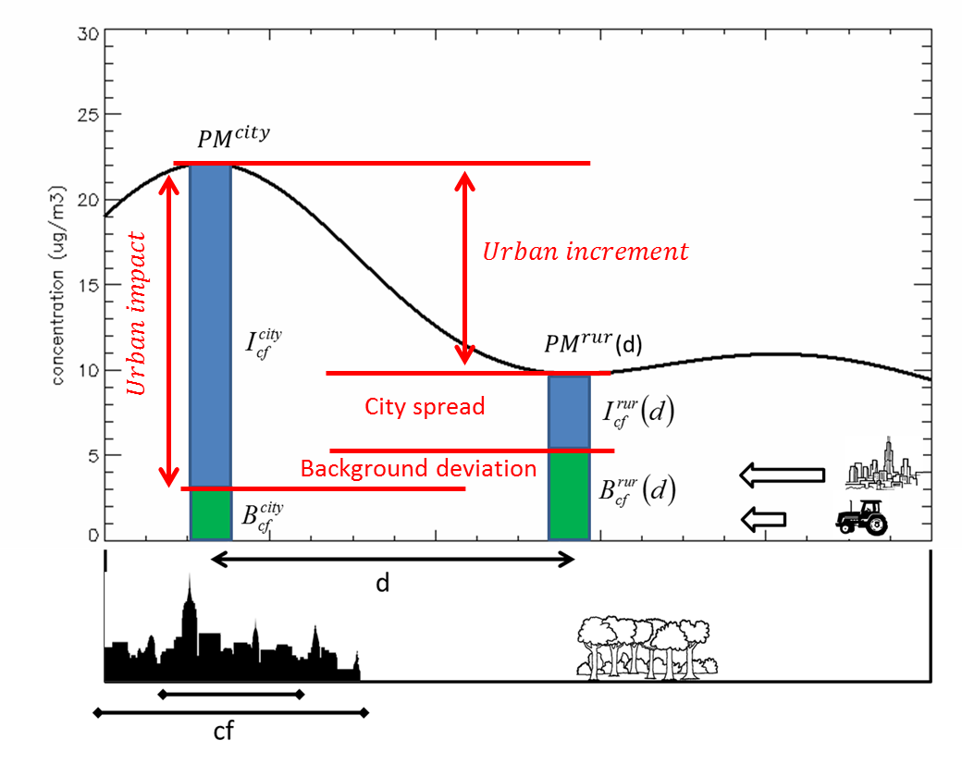
By construction, the urban impact is equal to the urban increment when two conditions are met (“Lenschow assumptions”):
City emissions do not influence the rural location (city spread = 0)
Background concentrations (obtained when city emissions are switched off) are equal at the city and rural locations (background deviation = 0)

Slide 4
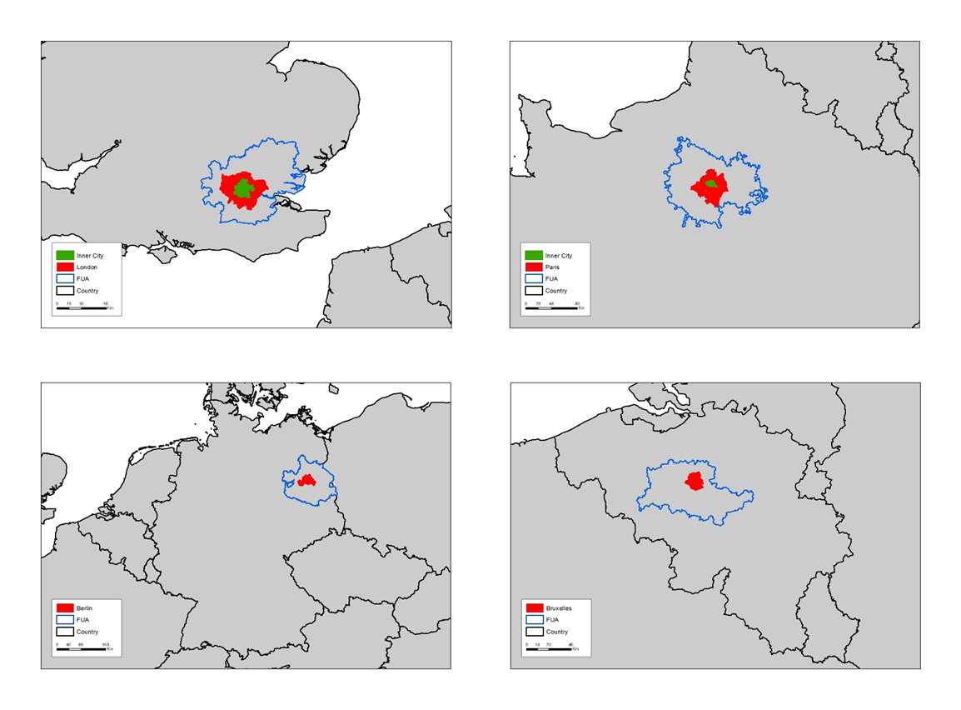
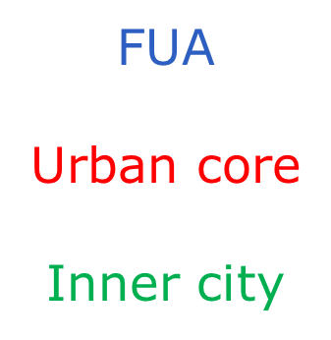
SHERPA assessment in 4 cities
SHERPA-CHIMERE has been used to assess how these two components (city spread and background deviation) vary with:
London
Paris
distance between the stations pair
size of the city
city
pollutant (NO₂ and PM_{2.5})
Berlin
Brussels

Slide 5
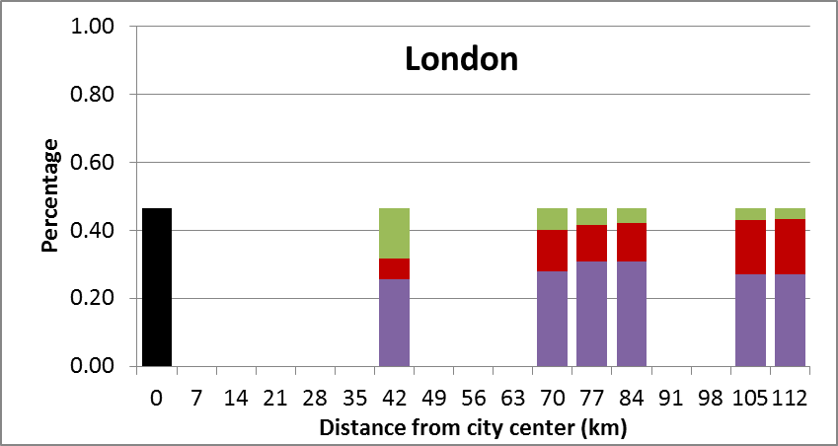
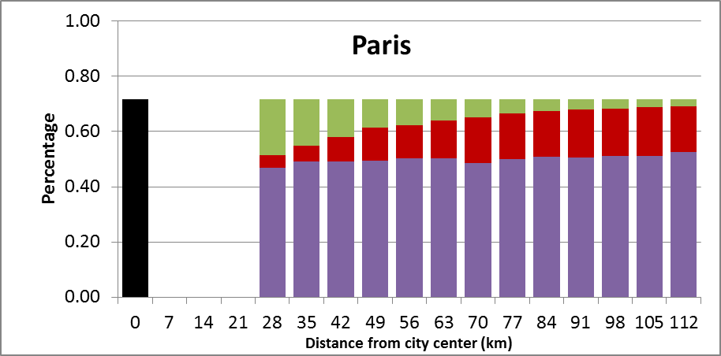
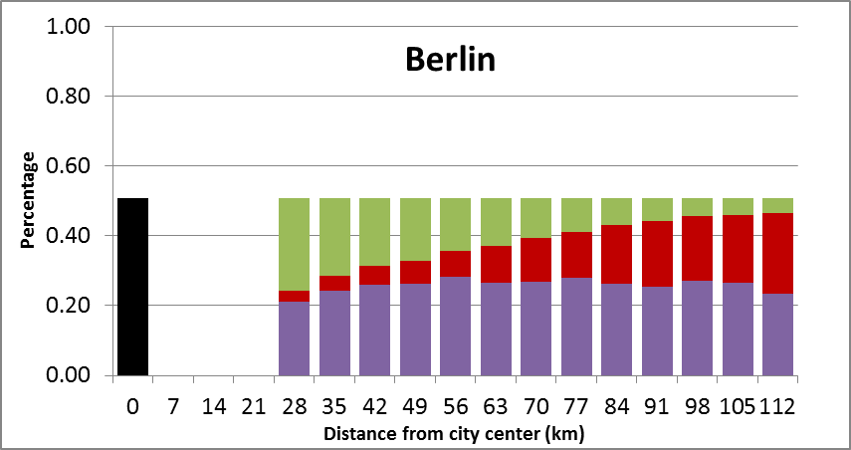
Comparison of the urban increment and urban impact for large city sizes (FUA)
Urban impact
Background deviation
Urban increment
City spread
City extension (where emission are switched off)
Notes:
Missing bar: using a threshold on ratio in PPM emissions compared to urban emissions (to filter out non-rural areas)

Slide 6
Conclusions
For PM_{2.5}, given their long residence time in the atmosphere, the SHERPA-CHIMERE results indicate that for large and medium size cities, no pair of locations can be found that fulfill both criteria
➔ The incremental approach leads to an underestimation of the city impact by 30 to 50% in some cities.
Given that the urban impact is very sensitive to city size and location, it does not look as a good proxy for estimating the urban impact.
But the urban increment can be a useful approach to evaluate CTMs and in particular assess how they reproduce the urban/regional spatial gradients.

