Slide 1
Evaluation of the contribution of long-range air pollution to urban areas with GAINS
Gregor Kiesewetter
Air Quality and Greenhouse Gases Program
IIASA
Laxenburg, Austria
TFMM Meeting, Geneva, 3 May 2018

Slide 2
PM station calculations in GAINS
purpose: estimate station compliance under different policy scenarios in the context of the revision of the EU Air pollution strategy / NEC directive
Allows for PM source apportionment
Approach: combination of modelling and observations. Model itself is not representative of local conditions.
Traffic hotspots
PM_{2.5}
?
Urban increment
?
Regional background
Lenschow et al (2001)

Slide 3
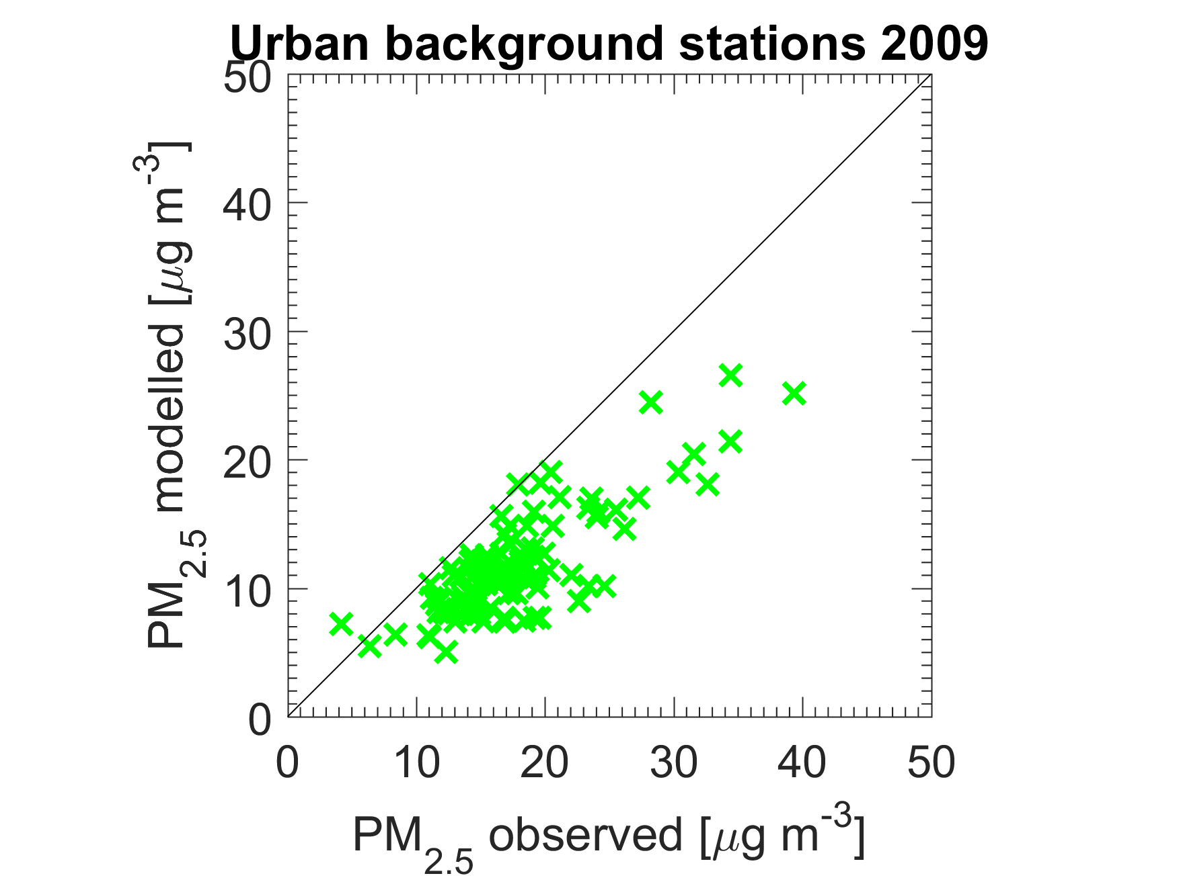
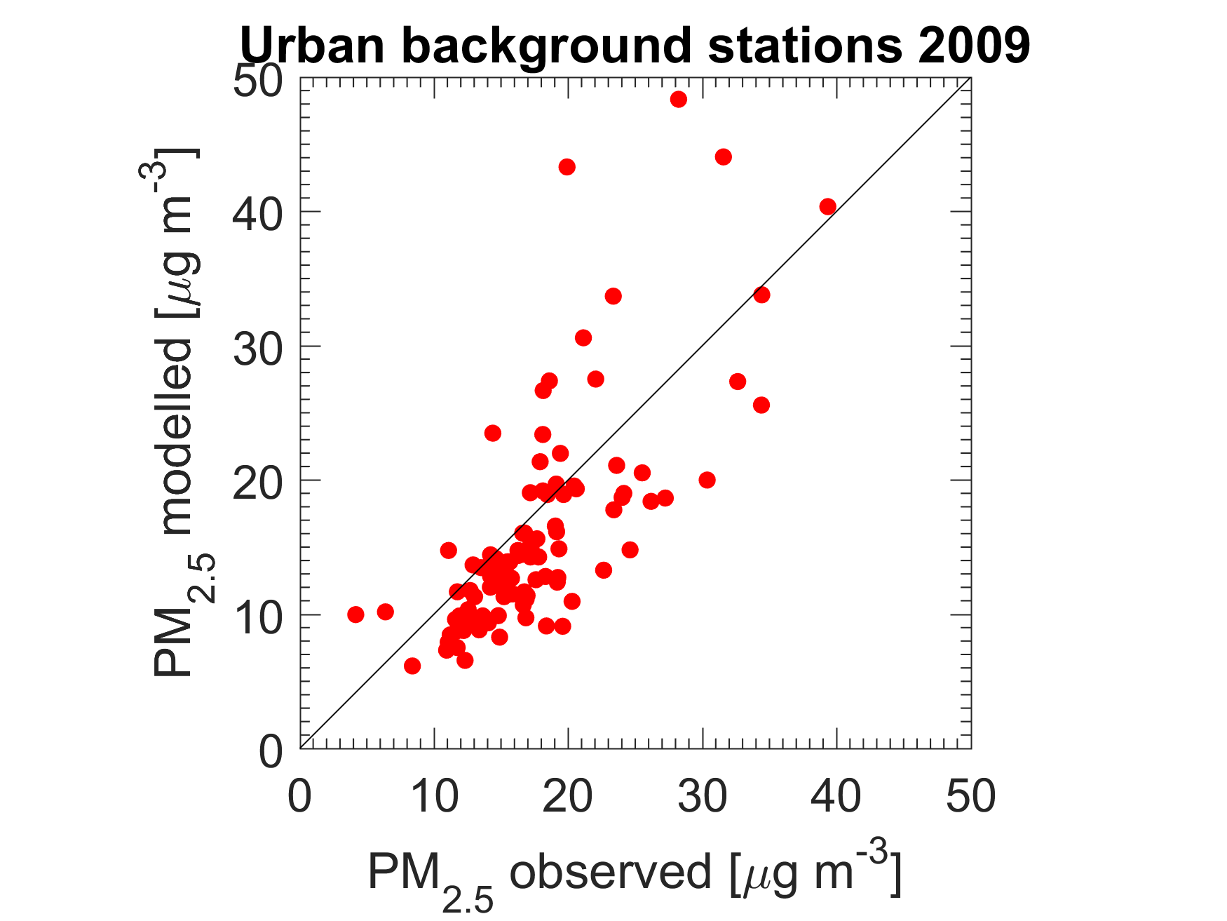
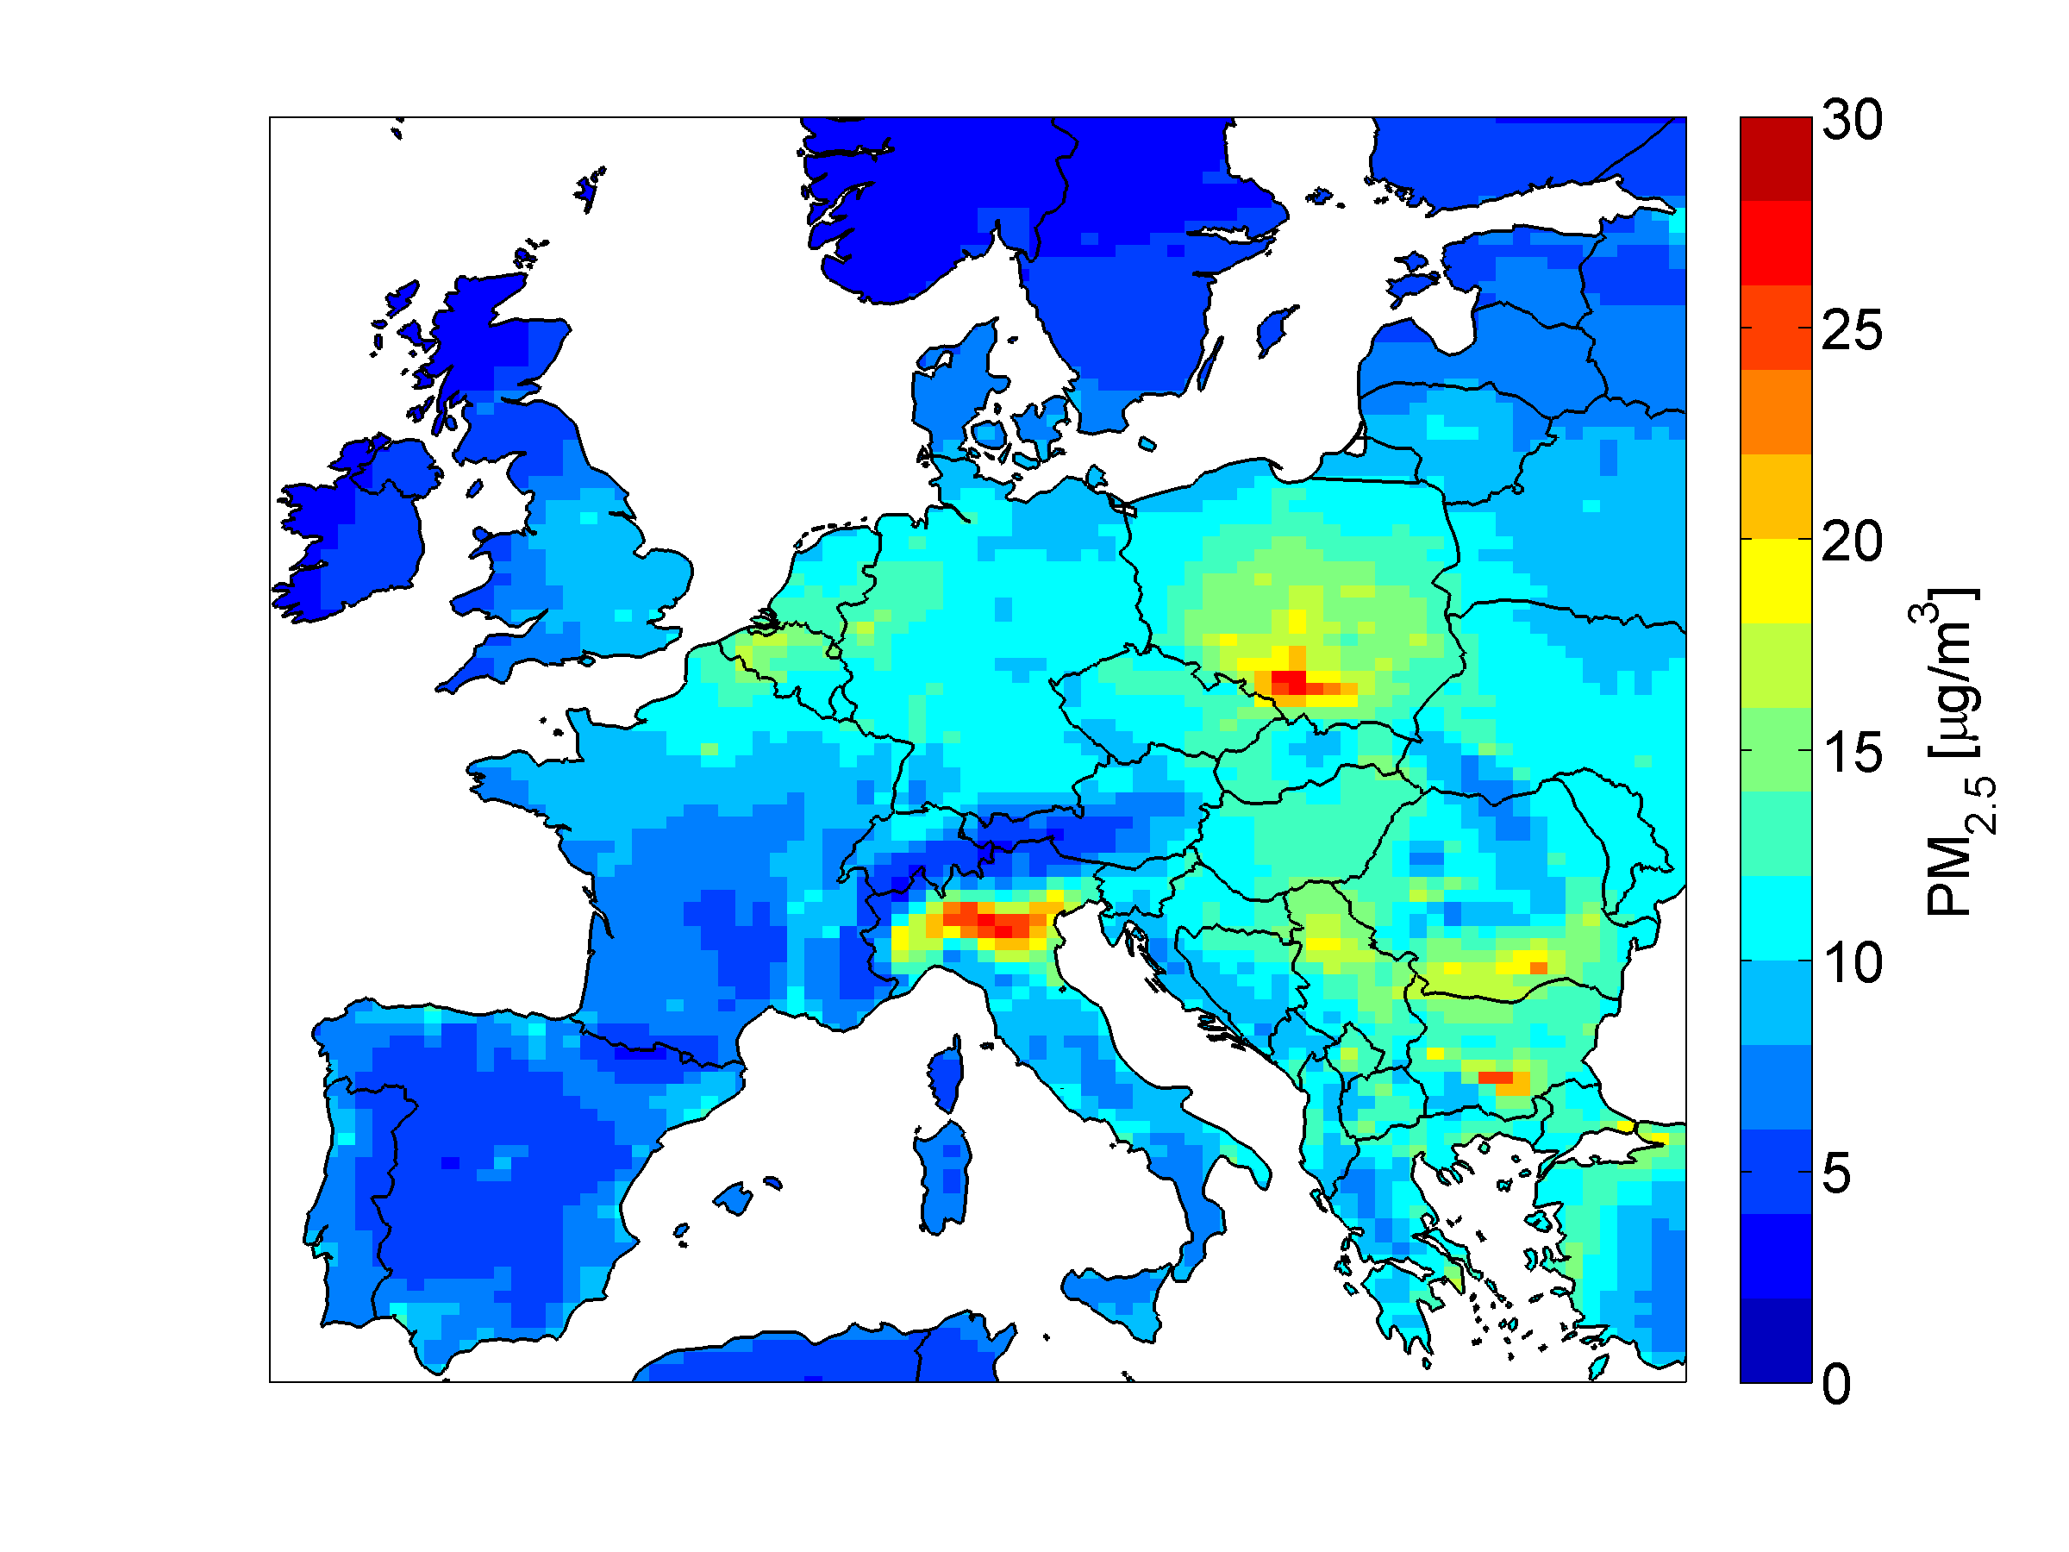
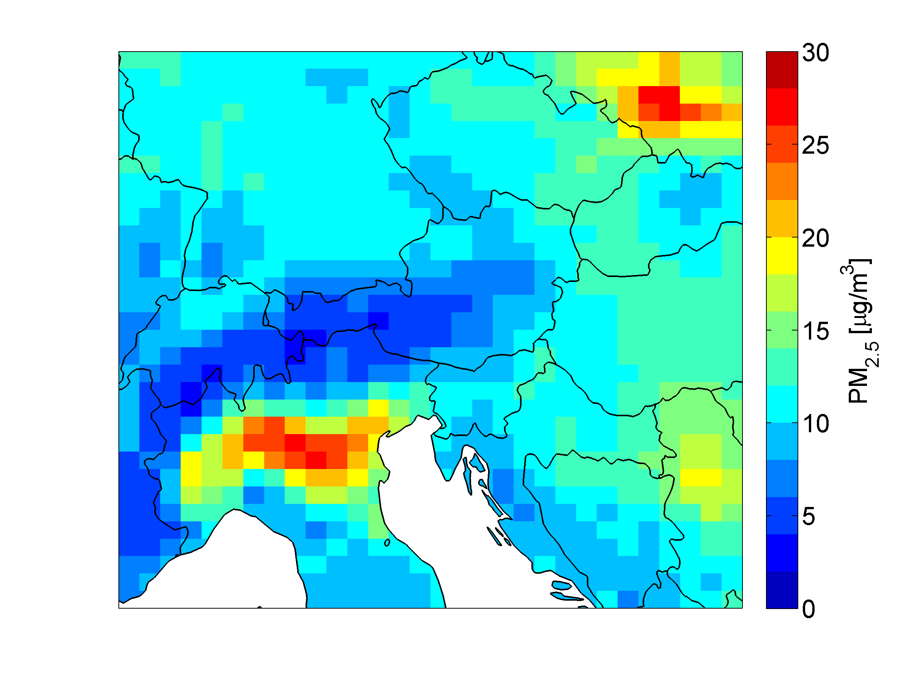
Modelling the (urban) background
“28 x 28 km” linear transfer coefficients from EMEP model: country to grid
“7 x 7 km” run from CHIMERE model: use subgrid pattern for downscaling
“28km” resolution (transfer coeff.)
“7km” resolution (+urban polygons)
Kiesewetter et al. (ACP 2015, Env Modell Softw 2015)

Slide 4
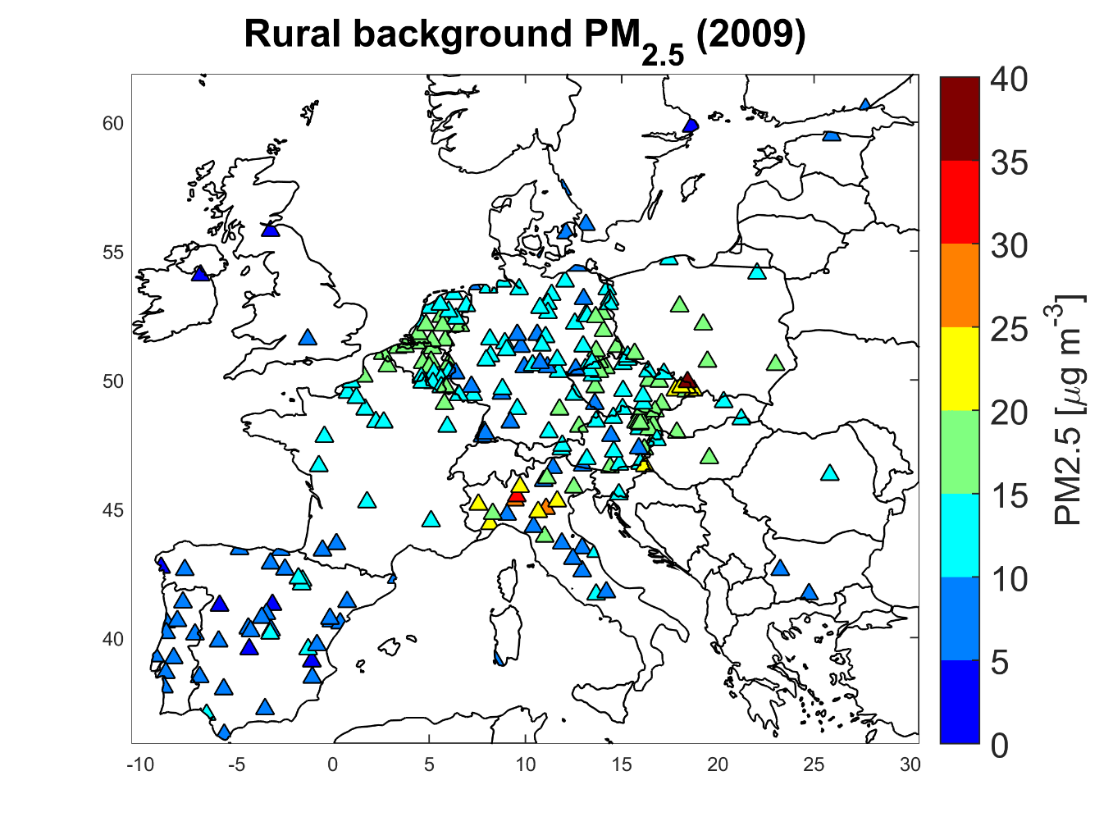
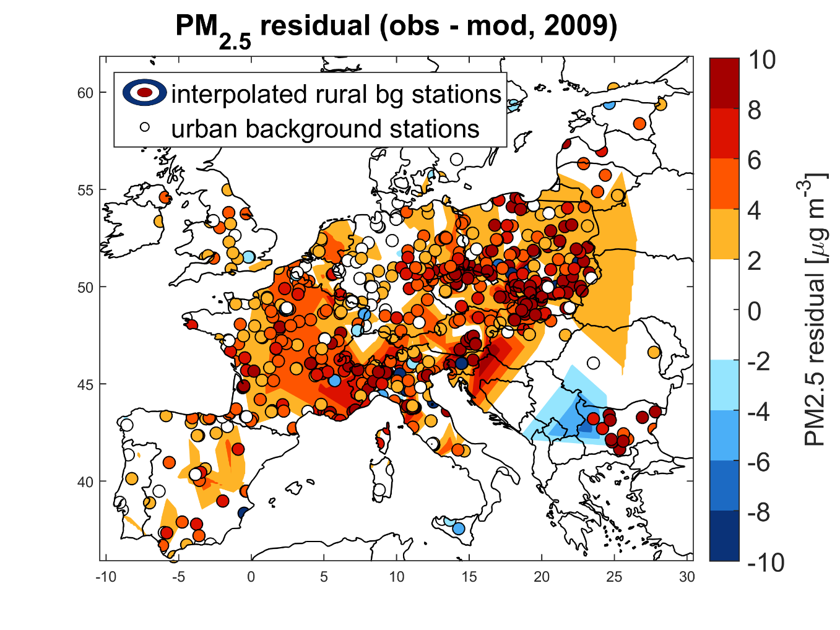
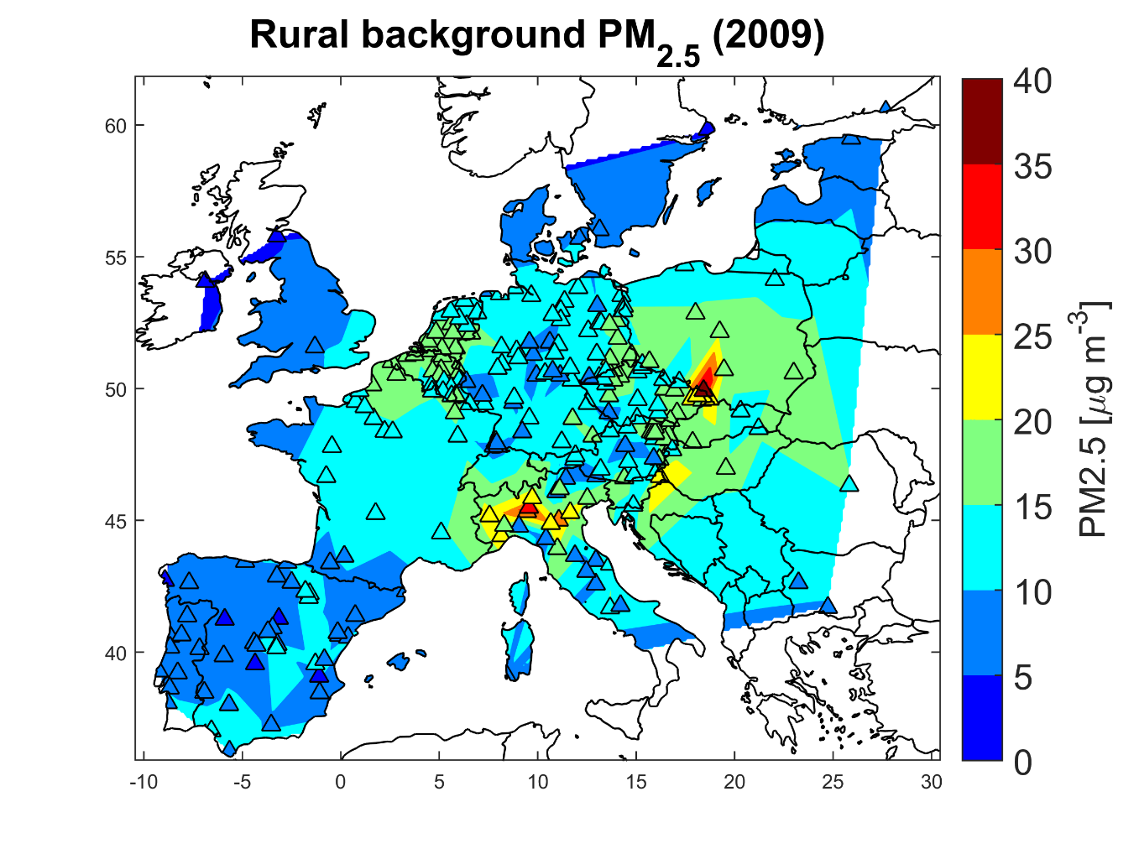
Towards source apportionment
Regional background
How much of the residual is natural, regional, and local?
Interpolated rural background is a first good proxy (+extra rules)
Interpolate residual at rural background stations to split residual into regional and local component

Slide 5
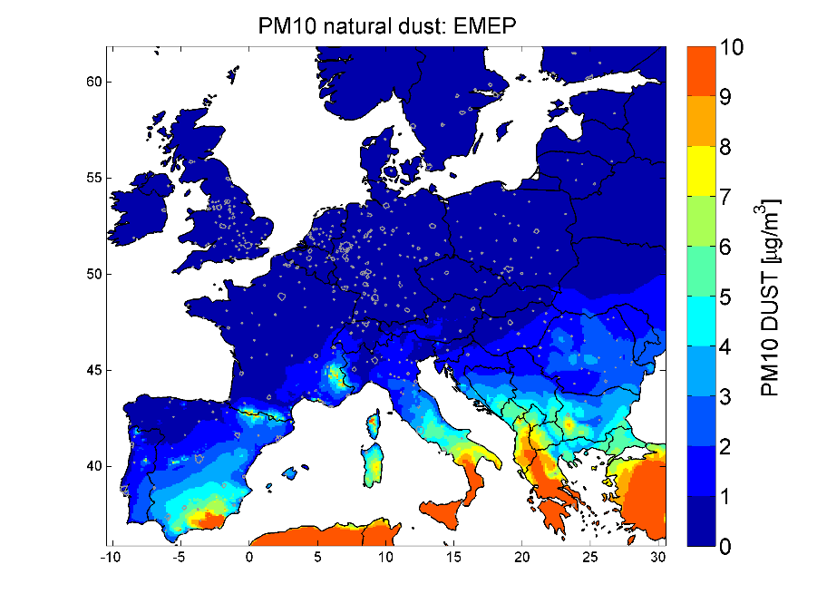
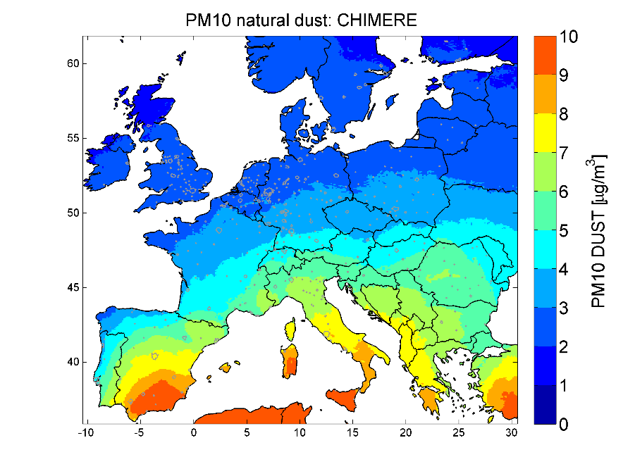
1. Split residual into regional and local
Modelled PM2.5 → Re-attribution → Source attribution
roadside
residual
Local
Regional
Natural
Sectoral attribution proportional to local PPM emissions
Sectoral attribution proportional to modelled concentrations @28km res
7km /
urban polygon
PPM
28km
national
SIA
SOA
transboundary
EMEP dust

Slide 6
2. Determine regional background level
Modelled PM2.5 → Re-attribution → Source attribution
roadside
Street
Urban background
residual
Local
Regional
Natural
PPM
Urban
7km
Regional background
=min(obs. rural bg, mod. 28km)
PPM
national
National
28km
SIA
SOA
trbd
Transboundary
EMEP dust
Natural

Slide 7
3. Split PPM into regional and local (SIA & SOA def. regional)
Modelled PM2.5 → Re-attribution → Source attribution
roadside
Street
Urban background
residual
Local
Regional
Natural
PPM
Urban
7km
PPM
Local
Regional
Regional background
PPM
PPM
national
National
28km
SIA, SOA
SIA
SOA
trbd
PPM, SIA, SOA
Transboundary
EMEP dust
Dust, sea salt
Natural

Slide 8
3. Attribute residuals to (known) emissions
Modelled PM2.5 → Re-attribution → Source attribution
Street
Urban background
PPM
Urban
PPM
Regional background
PPM
National
SIA, SOA
PPM, SIA, SOA
Transboundary
Dust, sea salt
Natural

Slide 9
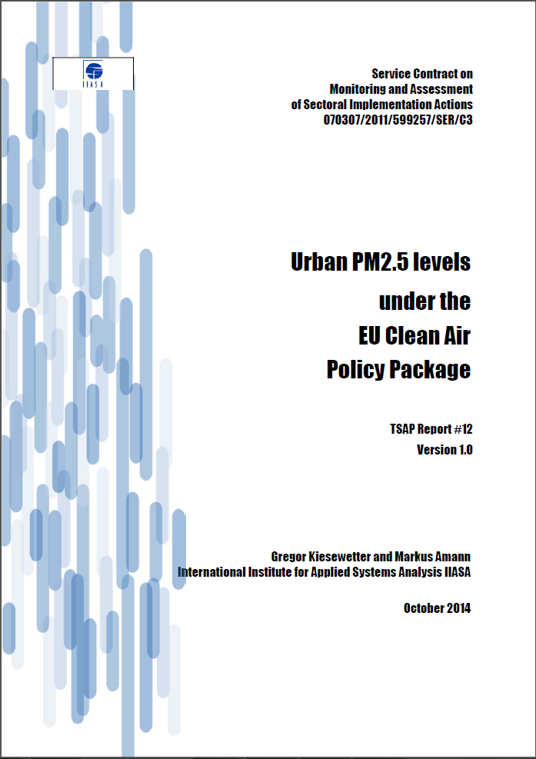
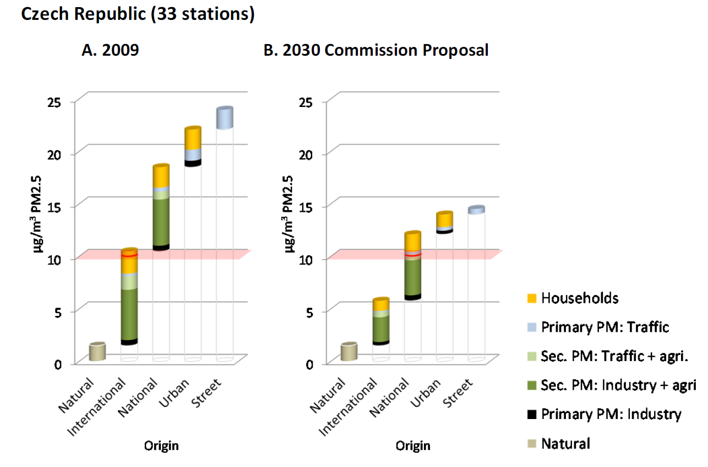
Source attribution covers ~1900 AirBase stations
So far used mainly for country average statements

Slide 10
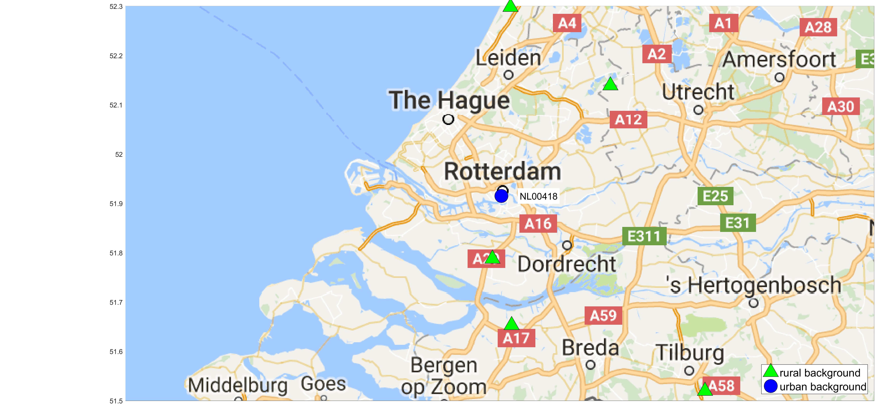
PM source apportionment: Rotterdam, 2009
stations:
NL00418 Rotterdam-Schiedamsevaart
obs.
mod.
Rotterdam
Lens
Regional background = rural backgound

Slide 11
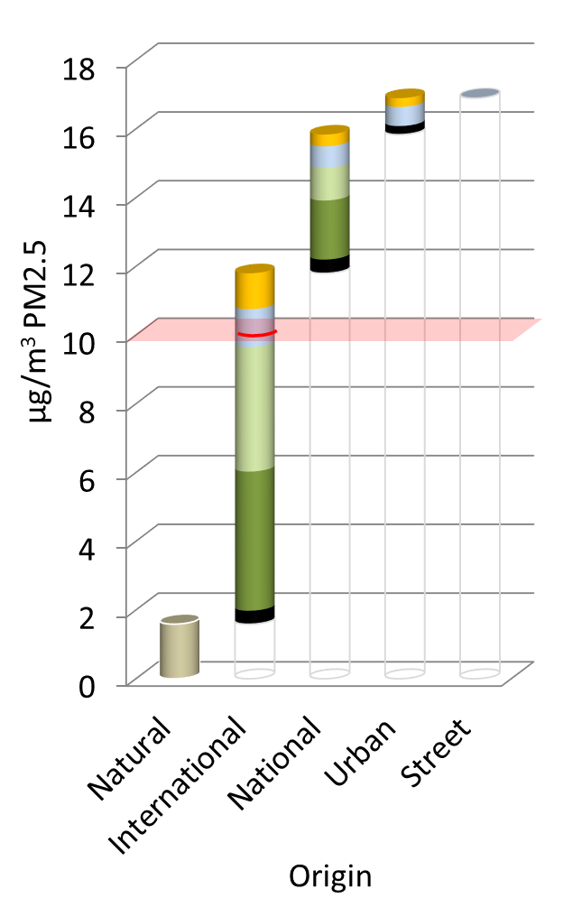
PM source apportionment: Rotterdam, 2009
stations:
NL00418 Rotterdam-Schiedamsevaart
NL00418

Slide 12
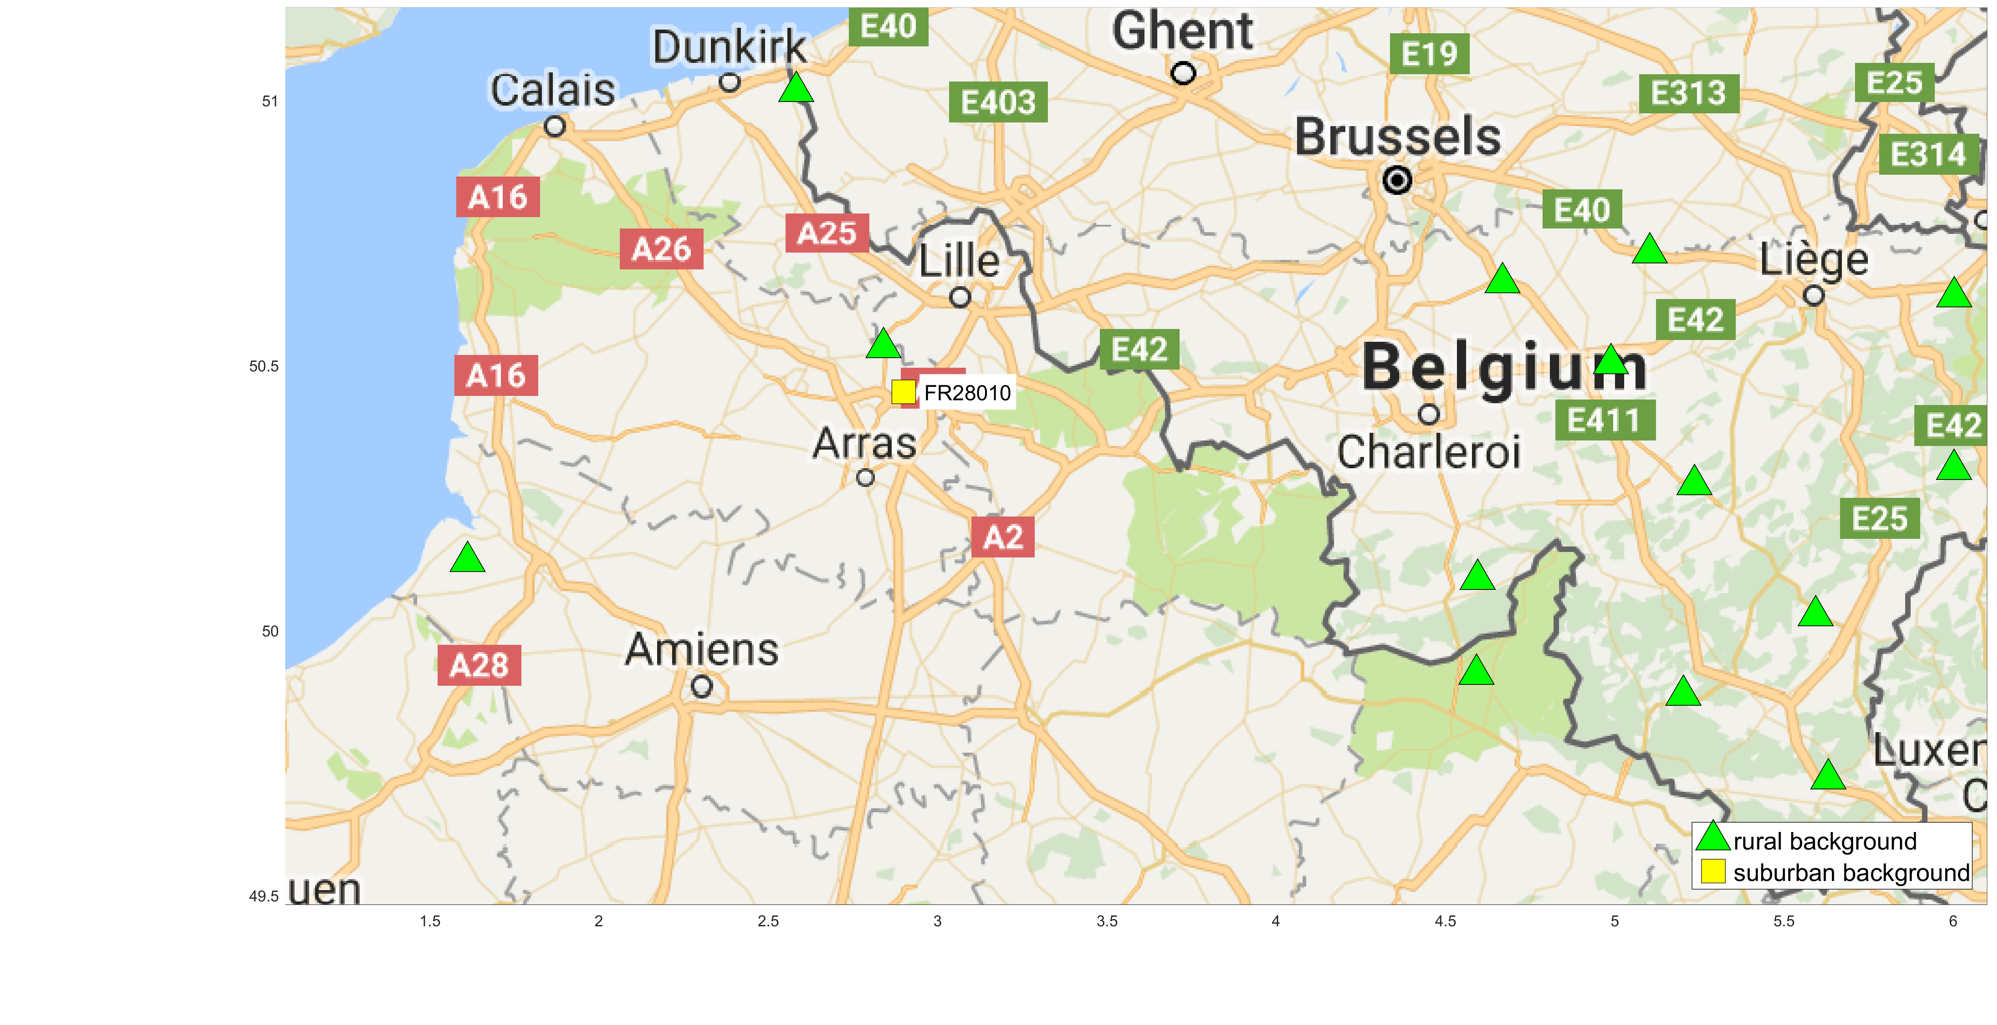
PM source apportionment: Lens, 2009
stations:
FR28010
FR28002
Regional background < rural backgound

Slide 13
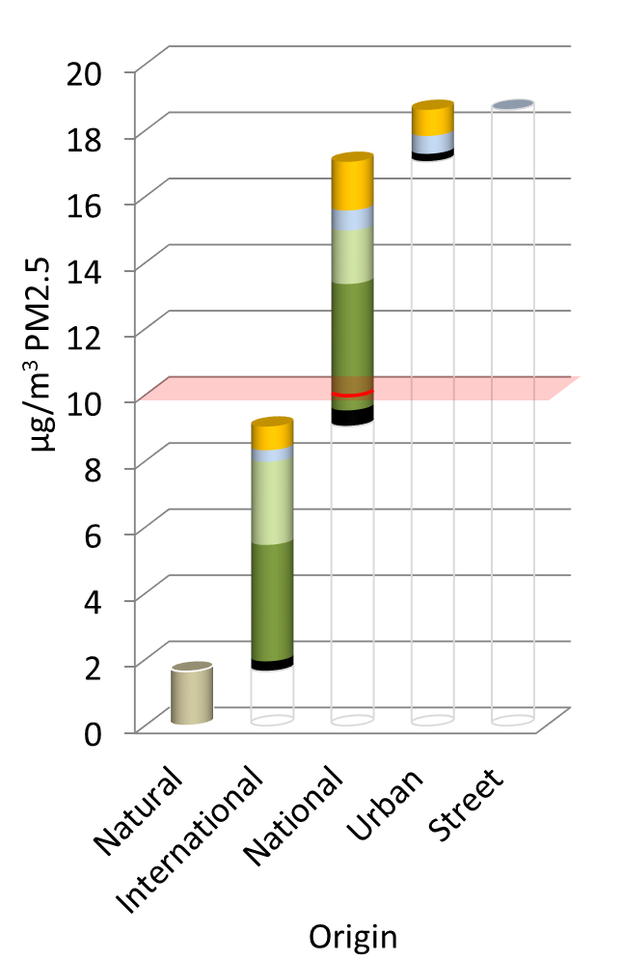
PM source apportionment: Lens, 2009
stations:
FR28010
FR28002
Lens average

Slide 14
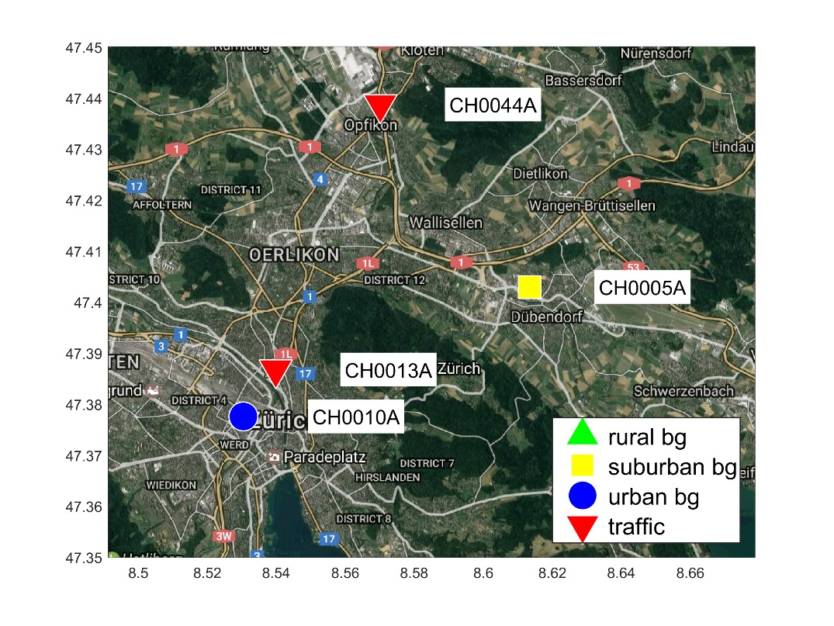
PM source apportionment: Zurich, 2009
stations:
CH0010A (Zürich-Kaserne, uB)
CH0013A (Zuerich-Stampfenbergstr)
CH0005A (Dübendorf-EMPA, sB)
CH0044A (Opfikon-Balsberg, sT)
Regional background < rural backgound

Slide 15
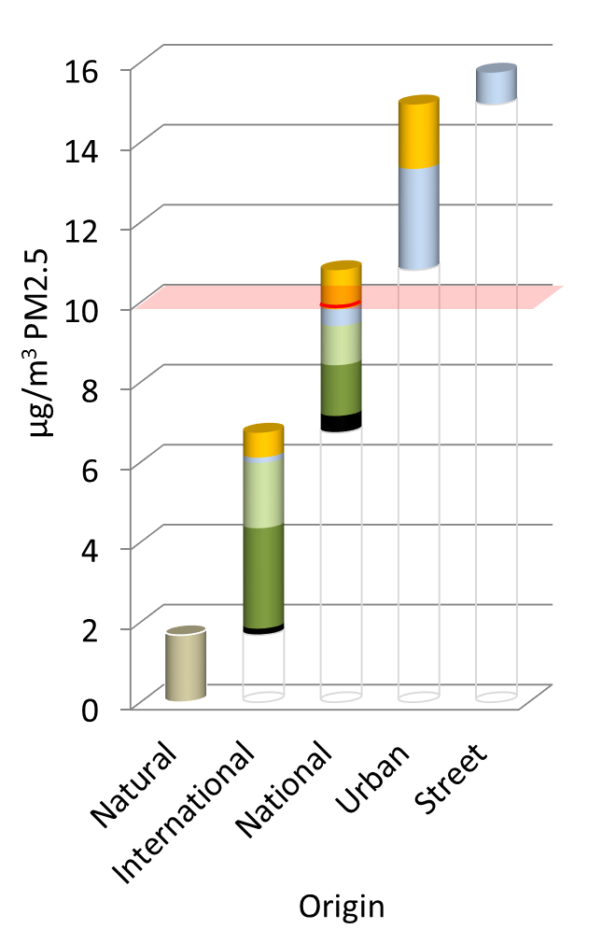
PM source apportionment: Zurich, 2009
CH0013A
stations:
CH0010A (Zürich-Kaserne, uB)
CH0013A (Zuerich-Stampfenbergstr)
CH0005A (Dübendorf-EMPA, sB)
CH0044A (Opfikon-Balsberg, sT)

Slide 16
Conclusions & limitations
Sectoral – spatial source apportionment of PM at monitoring sites, identifying contributions from transboundary, national and local origin, different source sectors and pollutants
Coverage of GAINS approach: ~1900 AirBase stations in the EU and Switzerland
Method relies on distribution and quality of observations in the base year (2009). This influences also the definition of urban increment vs regional background.
⇒ Results for individual stations need to be scrutinized carefully
Meteorology corresponds to annual mean of 2009, changes over time only with emissions. Challenging when compared to observations over a different time period.
GAINS emphasizes the local low-level PPM sources in the urban increment, while SIA is attributed to regional origin
Definition of the urban area matters.

Slide 17
Backup slides

Slide 18
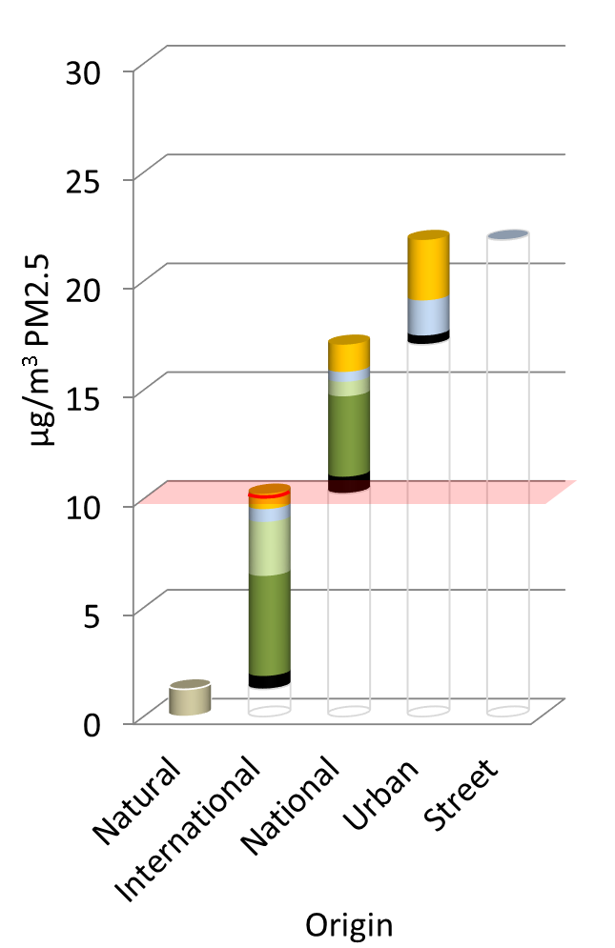
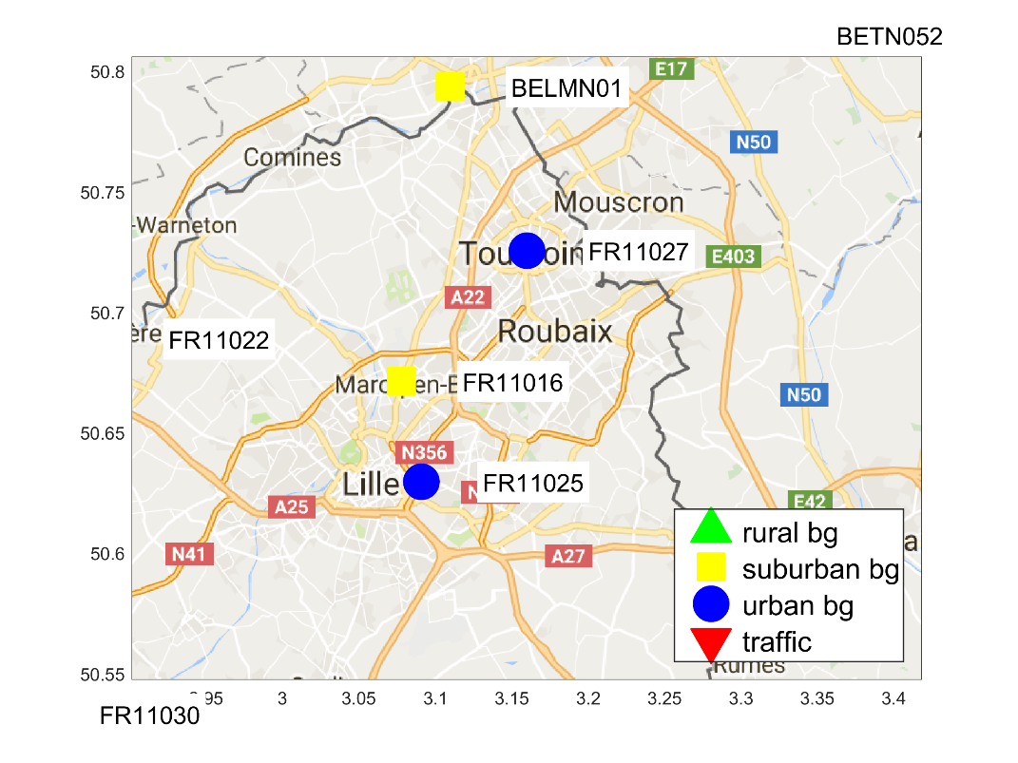
PM source apportionment: Roubaix/Lille, 2009
stations:
FR11016 (Marcq CTM, sB)
FR11027 (Tourcoing Centre, uB)
FR11025 (Lille Fives, uB)

