Slide 1
Atmospheric deposition measurements in France from EMEP and ICP Forest programs
Assessment of trends and ecosystem impacts
Aude Bourin¹, Stéphane Sauvage¹, Patrice Coddeville¹, Manuel Nicolas², Simon Rizzetto³, Anne Probst³
¹ IMT Lille Douai, Univ. Lille, SAGE - Département Sciences de l'Atmosphère et Génie de l'Environnement, 59000 Lille, France
² Office National des Forêts, Direction Forêts et Risques Naturels, Département R&D, Boulevard de Constance, F-77300 Fontainebleau, France
³ Toulouse University; INP, UPS; EcoLab (Laboratoire écologie fonctionnelle et environnement), ENSAT, Avenue de l’Agrobiopole F-31326 Castanet Tolosan, France
19th Annual Meeting of Task Force on Measurements and Modelling 2 - 4 May 2018, Geneva

Slide 2
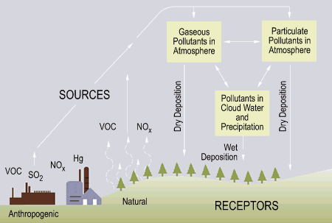
Atmospheric deposition
removal process of pollutant in air
Nitrogen and sulfate species participating in acidification & eutrophication

Slide 3
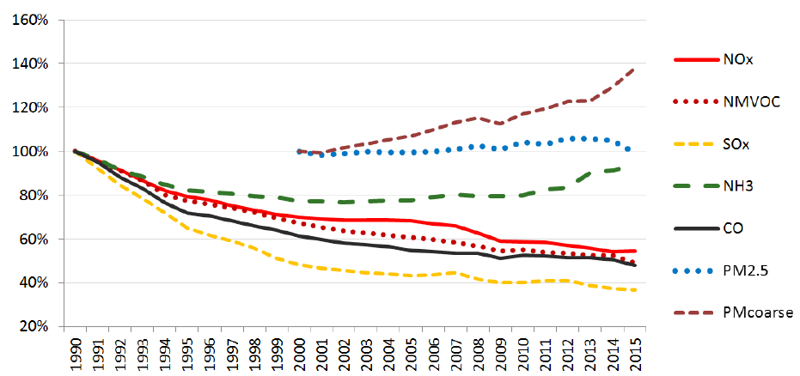
Emission in the EMEP Area
Percentage from 2000 baseline
EMEP Status Report 2017
large efforts to reduce pollutant emissions
8 protocols ratified
Strong decrease of sulphur dioxide, decrease in nitrogen oxides but ammonia remain stable

Slide 4
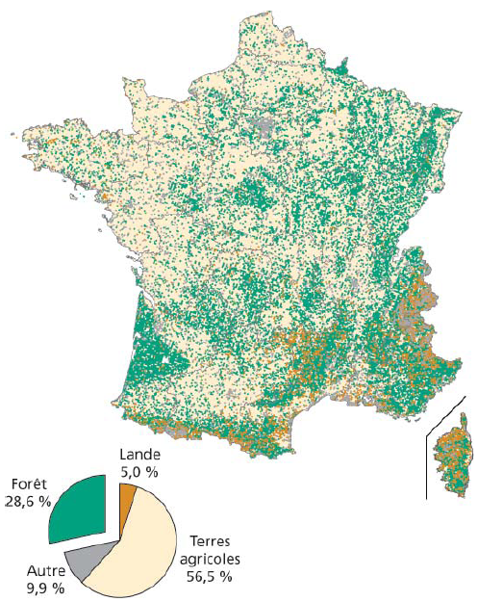

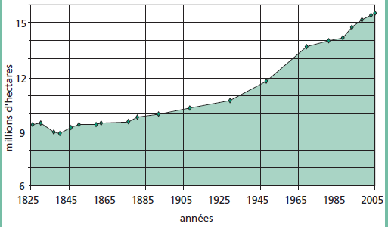
Forest ecosystems in France
~30% of the soil occupation
constant growing since the last century

Slide 5
Sensitivity of forest to AD
Critical load (CL) approach and their exceedances :
Steady State Mass Balance 0-20cm
Base cation deposition to calculate CL
acidity
eutrophication
biodiversity
CCE Status Report 2017
Yearly call for data from CCE to national focal point
Exceedances based on modelled deposition data

Slide 6
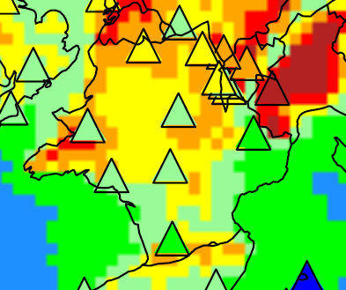
AD modelled vs observations
EMEP MSC-W mod. vs obs.
NH₄⁺ yearly wet deposition (2012 for ex.)
Important differences in spatial distribution
Located nearby NH₃ emission sources
Key role in evaluating the potential sensitivity to acidification and eutrophication
1000
700
500
350
200
100
50 µgN/m²
Joint MSC-W & CCC Report, Supplementary material to EMEP Status Report 1/2014

Slide 7
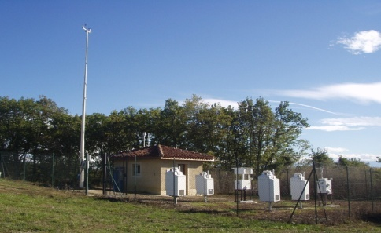
Background monitoring stations
Peyrusse-Vielle (Gers – South West of France)
MERA network EMEP program
[1989, …) Coord. : IMT Lille Douai
9 stations with daily wet-only collectors
Notes:
7

Slide 8
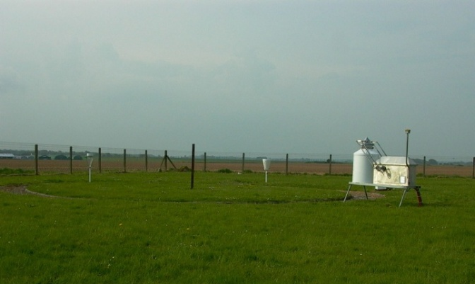
Background monitoring stations
Abbeville (Somme – North West of France)
BAPMON network GAW program
[1978-2007] Coord. : Météo France
3 stations with weekly wet-only collectors
Notes:
8

Slide 9
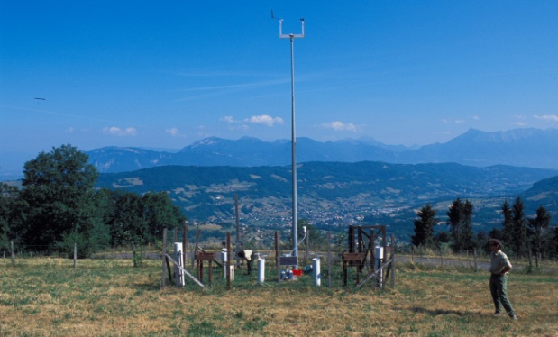
Background monitoring stations
SP38HCT (Isère – South-East of France)
CATANEAT subnetwork of RENECOFOR network ICP Forests Program
[1993, …) Coord. : Office National des Forêts
27 stations with monthly bulk collectors
Notes:
9

Slide 10
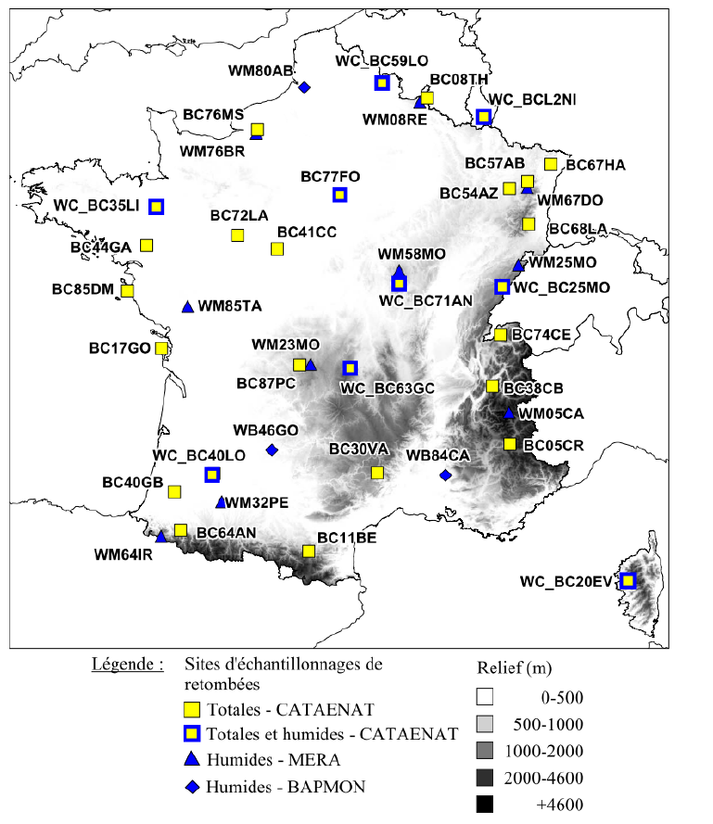
Background monitoring stations
Networks
MERA
RENECOFOR bulk
RENECOFOR wet & bulk
BAPMON
Altitude (m)
Data investigated jointly at the country scale
Well distributed, various climatic influences encountered
Notes:
10

Slide 11
Data quality control
Data comparability ?
Data check: suspected values flagging, harmonization of censured values (<DL)
2) Uncertainty estimate: ISO GUM approach
Sampler
Sampling efficiency (Wet)
Rainfall
contamination
Deposition
Sample Conservation
analysis
⇨ co-located measurements, specific studies, Lab intercomparison results
Notes:
11

Slide 12
Data quality control
Relative uncertainty in species concentration measurement
MERA/EMEP

Slide 13
Data quality control
Relative part of uncertainty components (Wet only AD in 1990-1997 on a MERA/EMEP site)

Slide 14
Long term trends on the 1993-2015 period
Theoretical basis of Mann-Kendall test for trend detection and Sen slope estimator for change rate estimate can be found in the literature (Mann, Econometrica (13), 1945, Marchetto et al., Atm.Env. (64), 2013)
sscSO₄²⁻ concentrations, mgS/L
NH₄⁺ concentrations, mgN/L
From Coddeville et al., 2017 Pollution Atmosphérique + Malherbe, Bourin, et al., 2016 rapport d’étude LCSQA
Decrease of sulfur and nitrogen (NO₃⁻ not shown) concentrations in precipitation

Slide 15
Long term trends on the 1993-2015 period
Theoretical basis of Mann-Kendall test for trend detection and Sen slope estimator for change rate estimate can be found in the literature (Mann, Econometrica (13), 1945, Marchetto et al., Atm.Env. (64), 2013)
Decrease of deposition fluxes for all ions, even for calcium

Slide 16
Estimate AD spatial distribution
Geostatistical approach: Ordinary Kriging of AD with external drift
External drift :
Rainfall measurements
provided by Météo France, ~3200 weather sites
Estimation of predictive models :
3 periods from 1993 to 2008
performances verified by cross validation

Slide 17
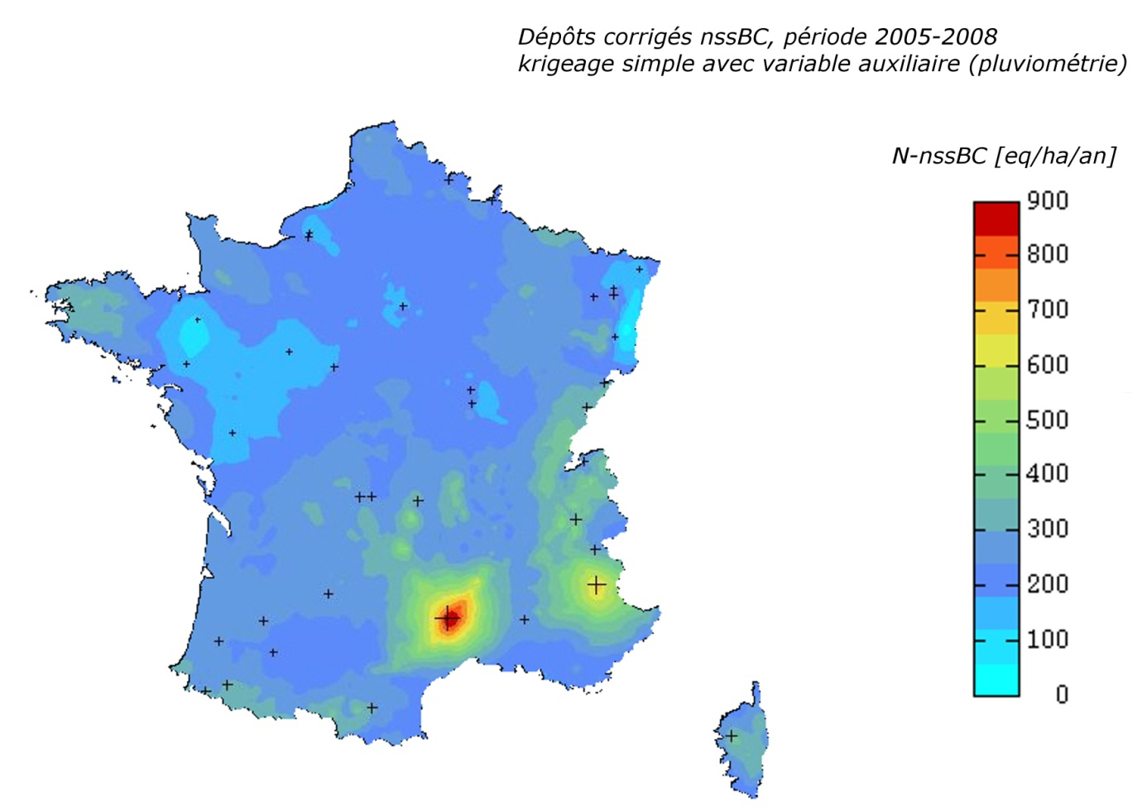
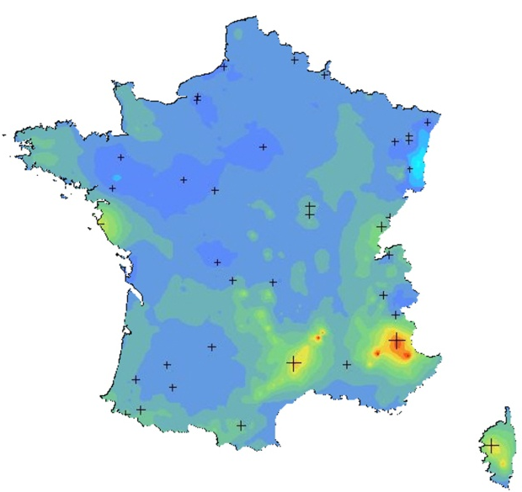
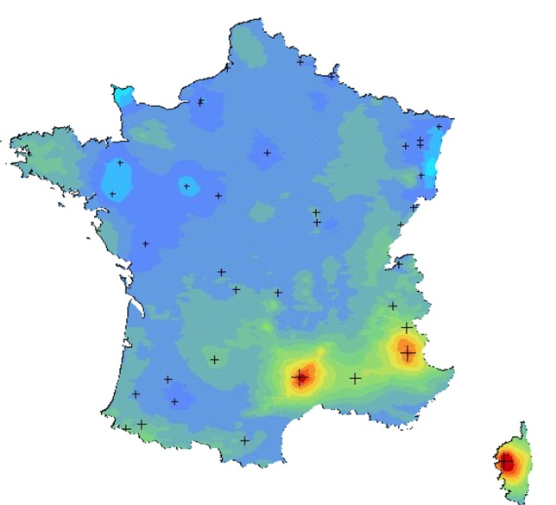
Estimate AD spatial distribution
non sea salt BC ^{eq/ha/yr}
900
700
400
100
1993-1998
1999-2004
2005-2008
Mountain & Southern France (Ca²⁺ dep.)
Not homogenous trends across France, western part decreases
Linked to Ca²⁺ from resuspension / Saharan dusts and to decrease of SO₂ emissions

Slide 18
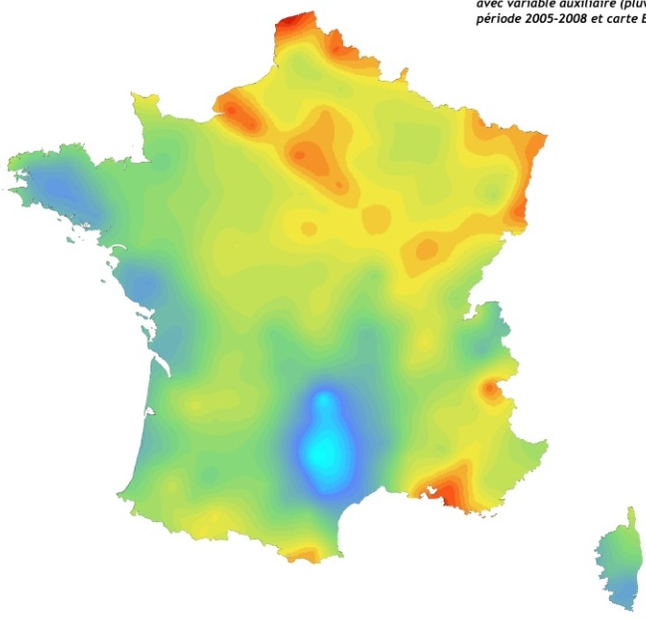
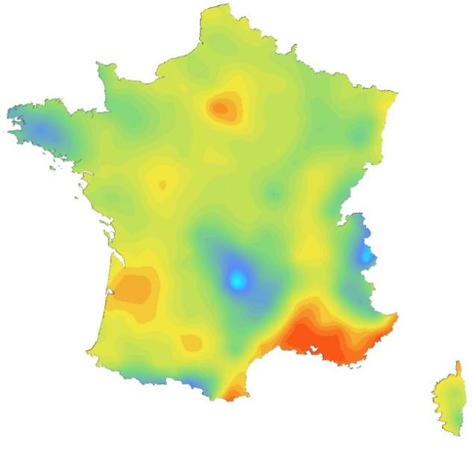
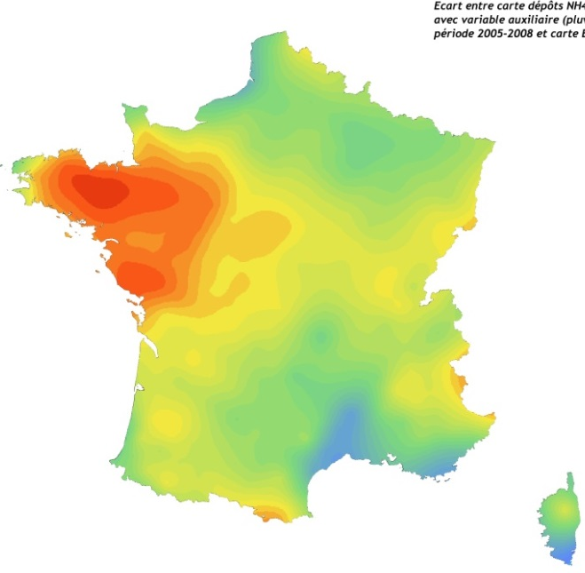



Comparison of AD maps
obs. vs mod. by EMEP MSC-W
2005-2008
(modelled EMEP- observed ) / modelled EMEP
SO₄²⁻
NO₃⁻
NH₄⁺
0.8
0.9
0.6
0.6
0.8
0.4
0.4
0.7
0.2
0.2
0.6
0.0
0.5
-0.2
0.0
0.4
-0.2
0.3
-0.4
-0.4
0.2
-0.6
-0.6
0.1
-0.8
-0.8
0.0
-1.0
-0.1
-1.0
-0.2
Local differences (either positive or negative)
Overestimation for atmospheric deposition (NH₄⁺ western France)

Slide 19

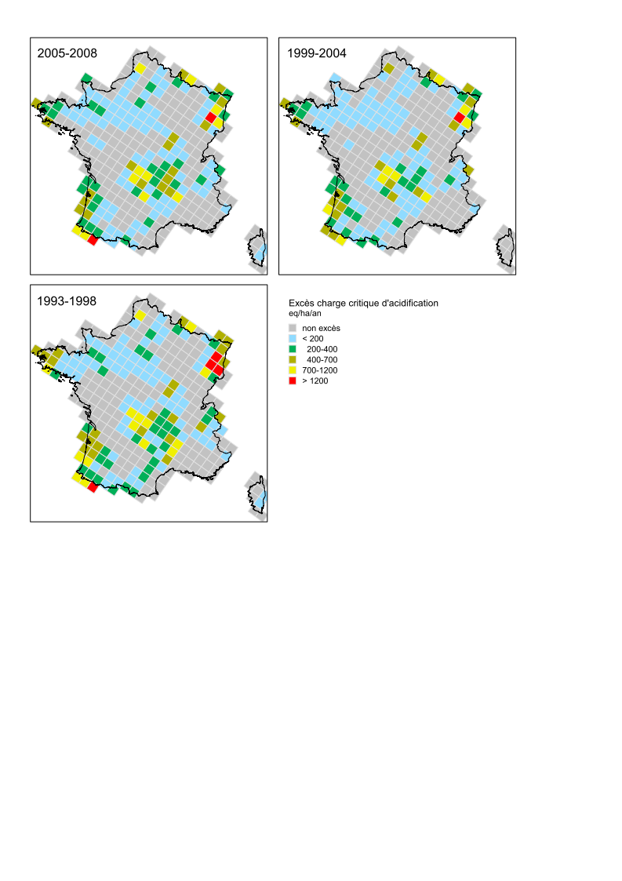
Exceedance of CL of acidity
influence of AD trends
Exceedance of acidity (eq/ha/yr) = ADobs – CL_{aci}
no excess
French forests are sensitive to acidifying deposition
Spatio-temporal trend of area sensible to AD : decrease period 1 to period 2 then increase to period 3 (↘S / N but ↘ BC)
Corrective factor (forest canopy) involved important changes in potential ecosystem sensitivity to S and N deposition

Slide 20
Main conclusions
Consistent data from long-term monitoring networks
Complementarity of the 2 networks : provide AD maps as assessment tools for modelled AD and for ecosystem impact studies
Spatial and temporal trends of bulk and wet-only AD in France for the last two decades reflects the success of clean air policies for S
AD of nitrogen is still problematic and pollutant emissions still need to be reduced
Although AD has decreased for the last 30 years, exceedances of critical loads of eutrophication (not shown) and acidity were reported in a growing number of ecosystems due to a concomitant decrease in the base cation deposition as a whole

Slide 21
Atmospheric deposition measurements in France from EMEP and ICP Forest programs
Assessment of trends and ecosystem impacts
Thank you for your attention
Aude Bourin¹, Stéphane Sauvage¹, Patrice Coddeville¹, Manuel Nicolas², Simon Rizzetto³, Anne Probst³
¹ IMT Lille Douai, Univ. Lille, SAGE - Département Sciences de l'Atmosphère et Génie de l'Environnement, 59000 Lille, France
² Office National des Forêts, Direction Forêts et Risques Naturels, Département R&D, Boulevard de Constance, F-77300 Fontainebleau, France
³ Toulouse University; INP, UPS; EcoLab (Laboratoire écologie fonctionnelle et environnement)
ENSAT, Avenue de l’Agrobiopole F-31326 Castanet Tolosan, France
aude.bourin@imt-lille-douai.fr
19th Annual Meeting of Task Force on Measurements and Modelling 2 - 4 May 2018, Geneva

