Slide 1

Modelled deposition of N and S in Europe: Evaluation, effects of changes in emissions and implications for habitat protection. Links with TF-HTAP and WGE
Marta García Vivanco , Mark. R. Theobald, Héctor García-Gómez, Juan Luis Garrido
CIEMAT – SPAIN
Marje Prank, Wenche Aas, Mario Adani, Ummugulsum Alyuz, Camilla Andersson, Roberto Bellasio, Bertrand Bessagnet, Roberto Bianconi, Johannes Bieser, Jørgen Brandt, Gino Briganti, Andrea Cappelletti, Gabriele Curci, Jesper H. Christensen, Augustin Colette, Florian Couvidat, Kees Cuvelier, Massimo D'Isidoro, Johannes Flemming, Andrea Fraser, Camilla Geels, Kaj M. Hansen, Christian Hogrefe, Ulas Im, Oriol Jorba, Astrid Manders, Mihaela Mircea, Noelia Otero, Maria-Teresa Pay, Luca Pozzoli, Efisio Solazzo, Svetlana Tsyro, Alper Unal, Peter Wind and Stefano Galmarini
CONVENTION ON LONG-RANGE - TRANSBOUNDARY AIR POLLUTION
19th Task Force on Measurement and Modelling Meeting
Geneva (Switzerland), 2-4 May 2018

Slide 2
Outlines
Evaluation of wet deposition (14 model systems)
Influences of hemispheric transport (reductions in emissions)
Deposition and ecosystems
AQMEII3/HTAP
EURODELTA/TFMM
AQMEII3/HTAP
4. Dry deposition
AQMEII3/HTAP
EURODELTA/TFMM
WGE

Slide 3
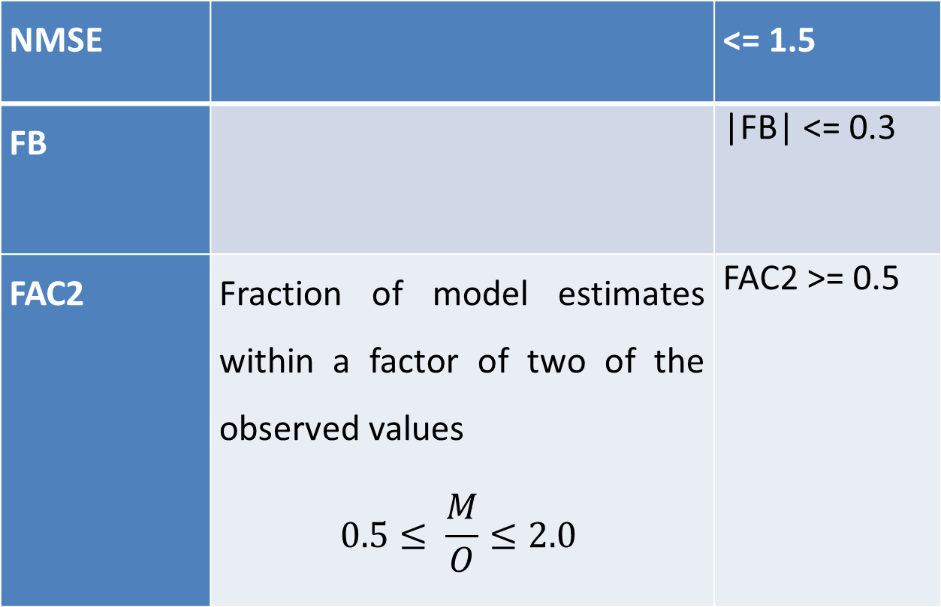
Evaluation of wet deposition
Chang and Hanna (2004)
NMSE |  | <= 1.5
FB |  | |FB| <= 0.3
FAC2 | Fraction of model estimates within a factor of two of the observed values $$0.5≤ \frac{M}{O}≤2.0$$ | FAC2 >= 0.5

Slide 4
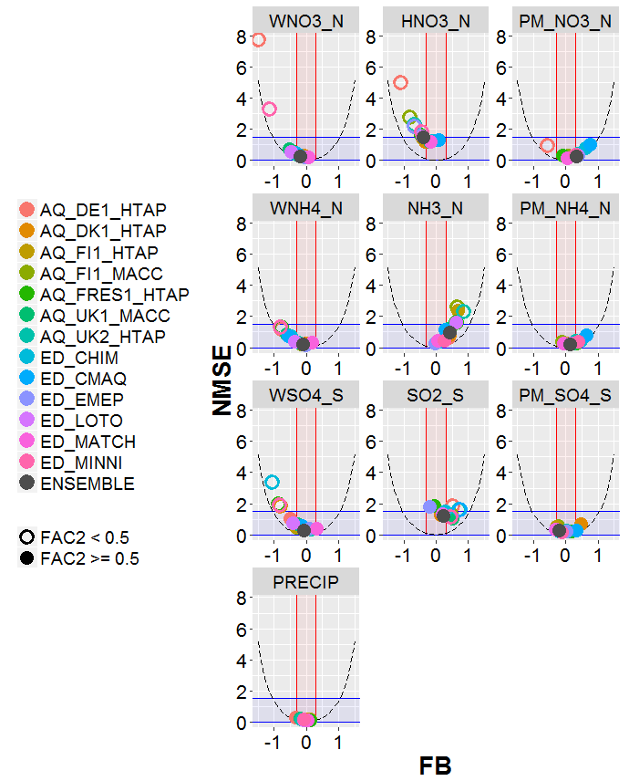
Evaluation of wet deposition
14 air quality models (7 models as part of AQMEII3, 7 models participating in EDT)
OX N
. FB, NMSE and FAC2 from annual values of wet deposition, concentration and precipitation at all available sites.
. Shaded areas correspond to areas meeting the acceptance criteria of Chang and Hanna (2004) (blue for NMSE, red for FB). Parabolic dashed lines indicate the theoretical minimum NMSE for a given value of FB.
Better model performance is indicated by points that fall within the blue and red shaded areas and with filled circles.
RED N
S
FB
Ensemble: average of models passing the scores
NMSE <= 1.5
|FB| <= 0.3

Slide 5
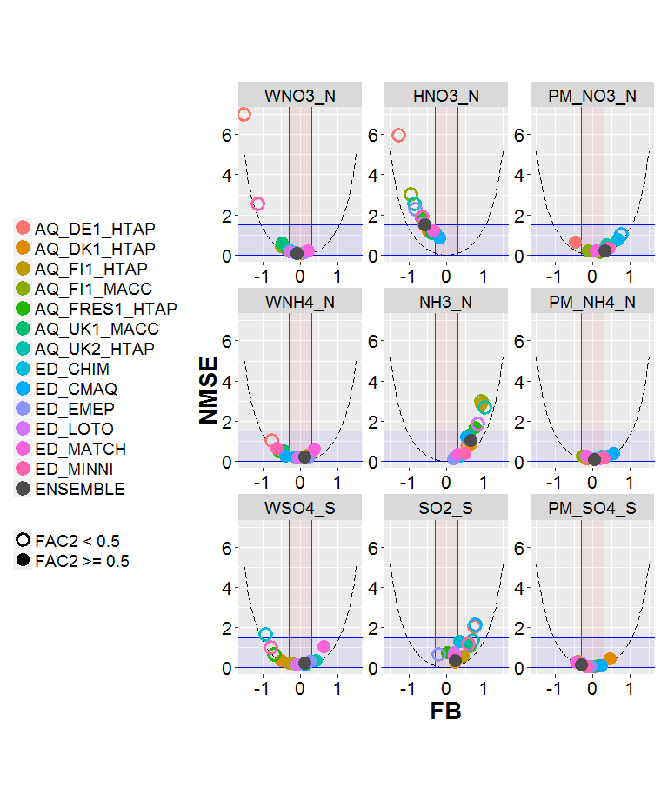
. Statistics from annual values (accumulated deposition or average means for air concentration)
. Sites with simultaneous measurements of the three related pollutants (e.g. HNO3, PM_NO3 and WNO3)
. Shaded areas correspond to areas meeting the acceptance criteria of Chang and Hanna (2004) (blue for NMSE, red for FB). Parabolic dashed lines indicate the theoretical minimum NMSE for a given value of FB.
Better model performance is indicated by points that fall within the blue and red shaded areas and with filled circles.

Slide 6
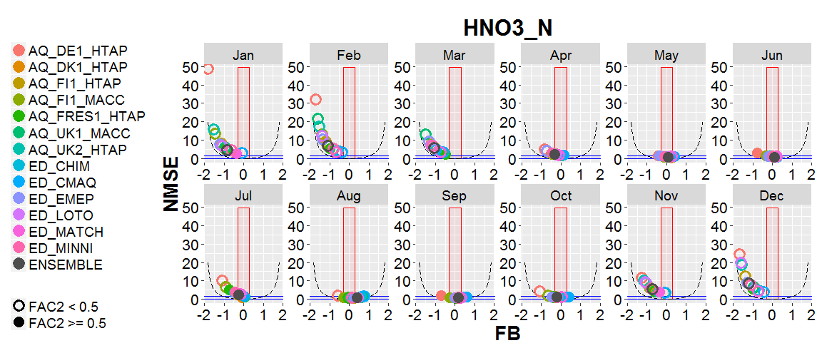
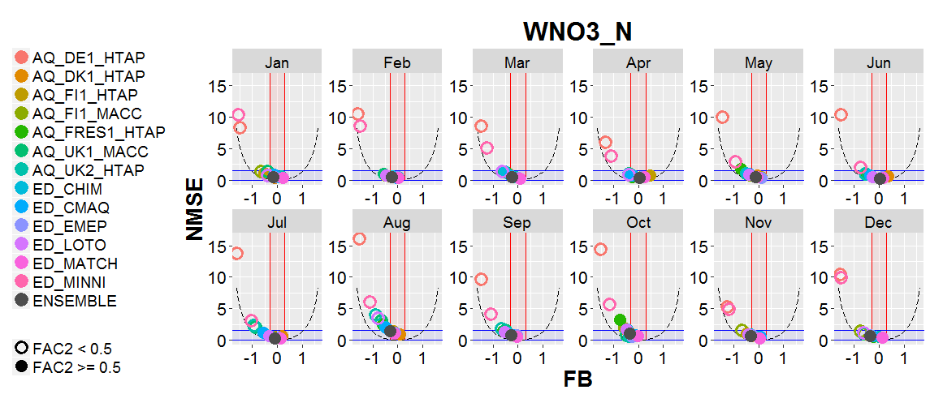
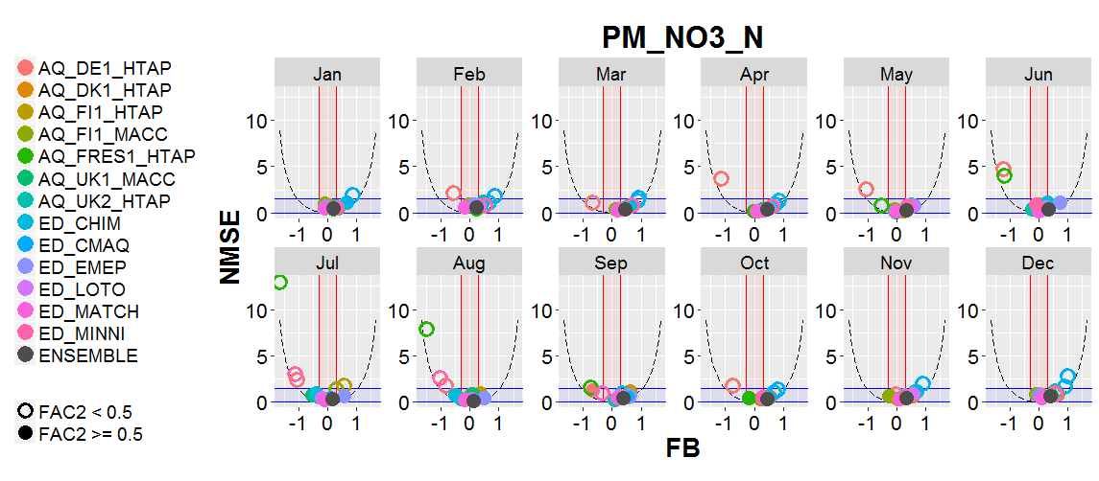
A tendency to underestimate HNO3 (specially in winter with a tendency to overestimate nitrates: too high gas2particle conversion?) Many factors involved. Model performance must be explained for each model and situation.

Slide 7
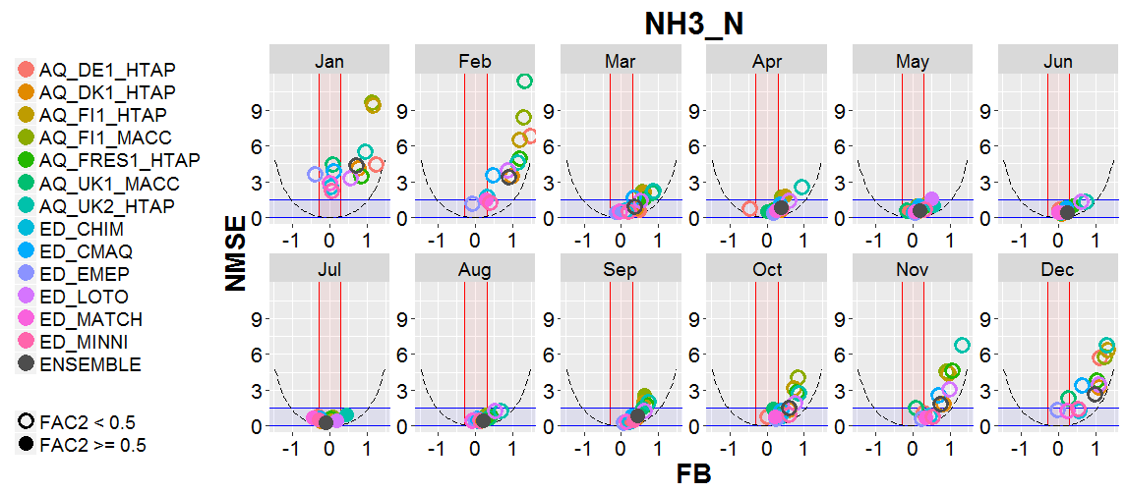
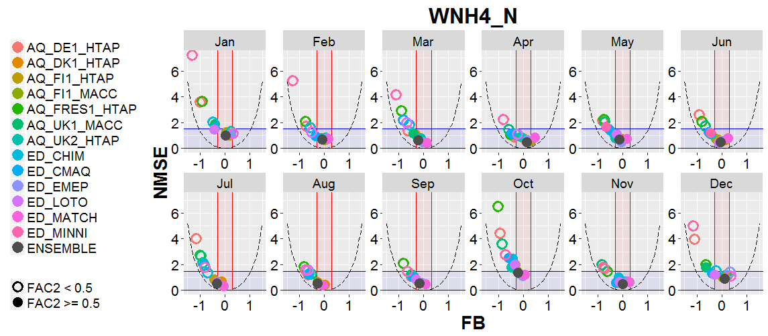
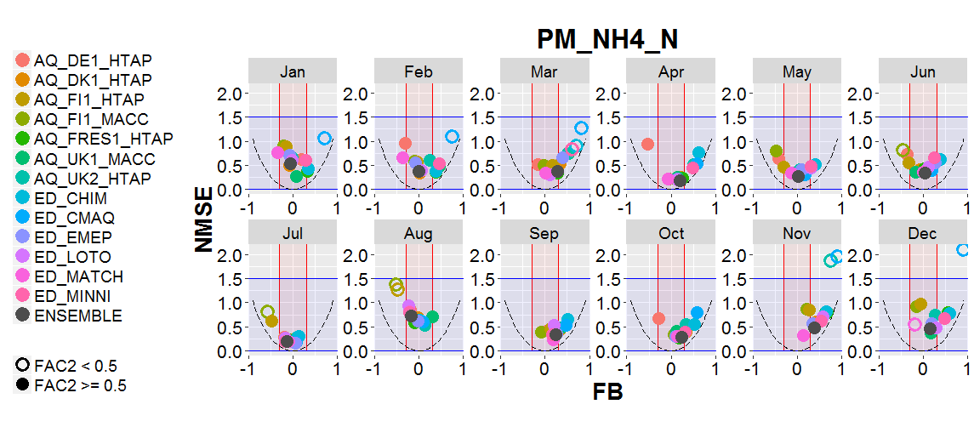
Many models seem to have an underestimated wet removal efficiency (especially for the gas phase)

Slide 8
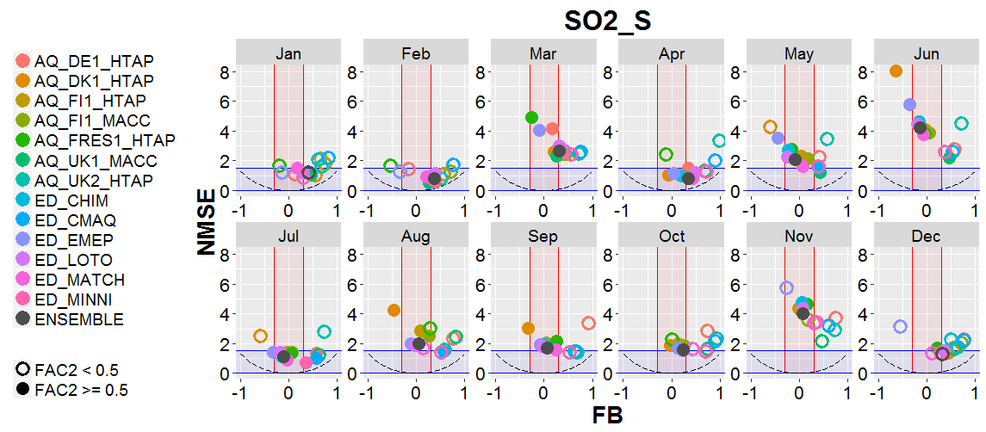
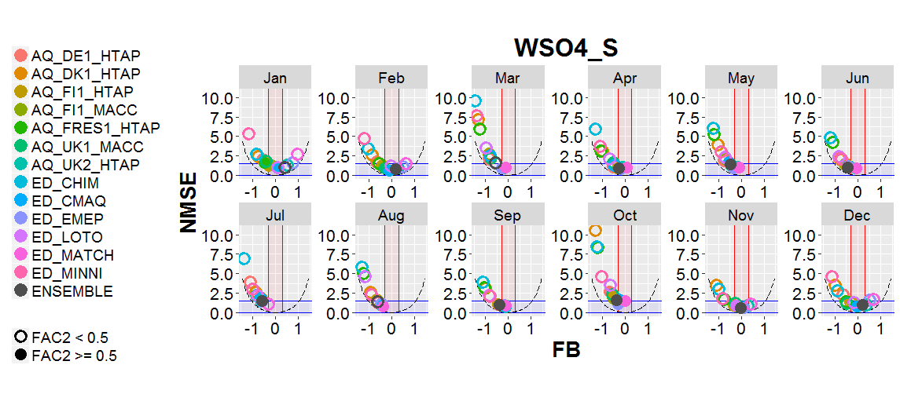
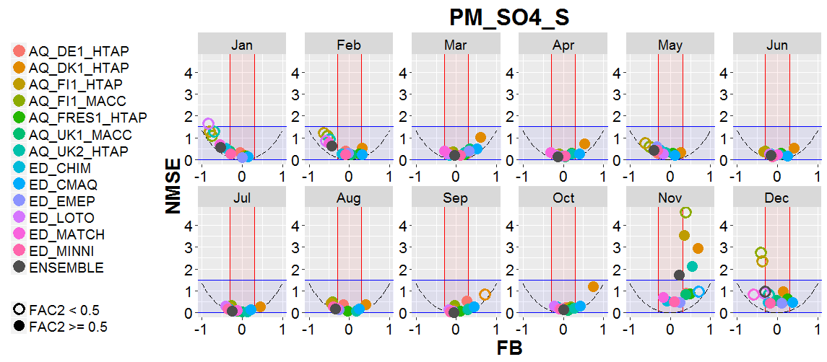

Slide 9
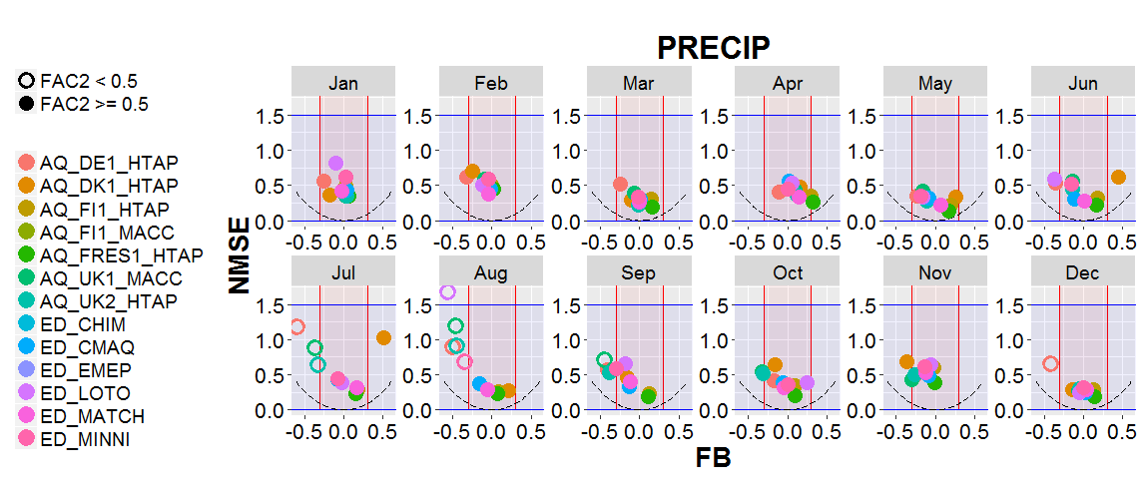

Slide 10
Influences of hemispheric transport
FI1-MACC ONE AQMEII/HTAP MODEL MEETING THE SCORES
  European emissions are by far the main contributor to deposition in Europe.
  Eastern area emissions out of Europe: visible in the Eastern part of Europe (we do not see a 20% of reduction of N deposition when reducing 20% for EU, but we see it for GLO).
  A decrease of emissions in North America: very small decrease and confined to the western part of the domain (a bit more impact on S deposition).
GLO
EU
NAM
  A fairly linear relationship between reductions in emissions and changes in deposition rates of N and S (approximately 20% reduction in N and S deposition in Europe found when emissions at a global scale are reduced by 20%)

Slide 11
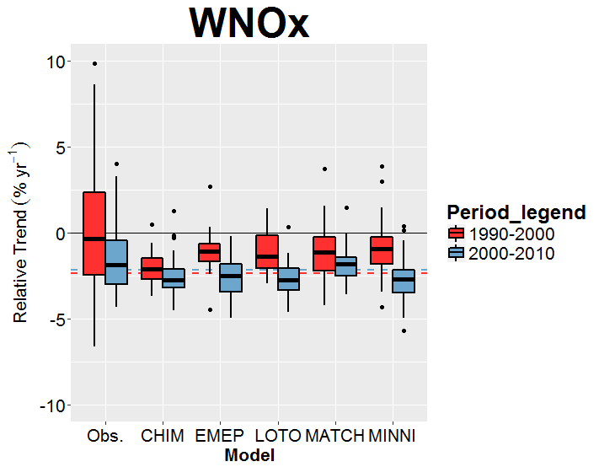
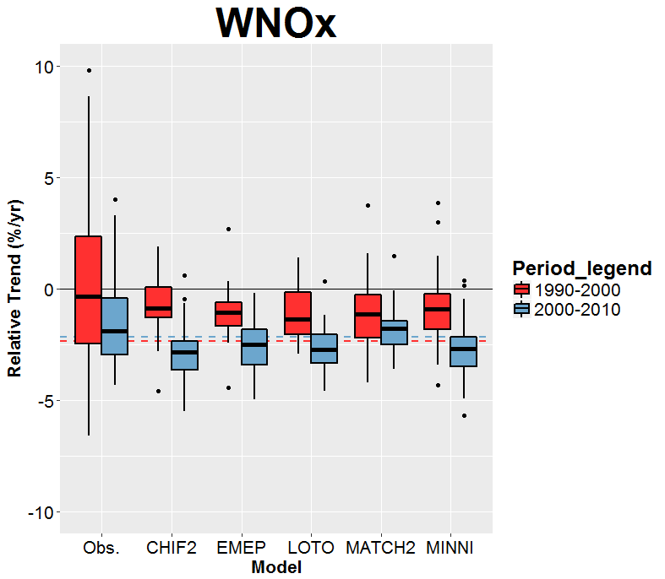
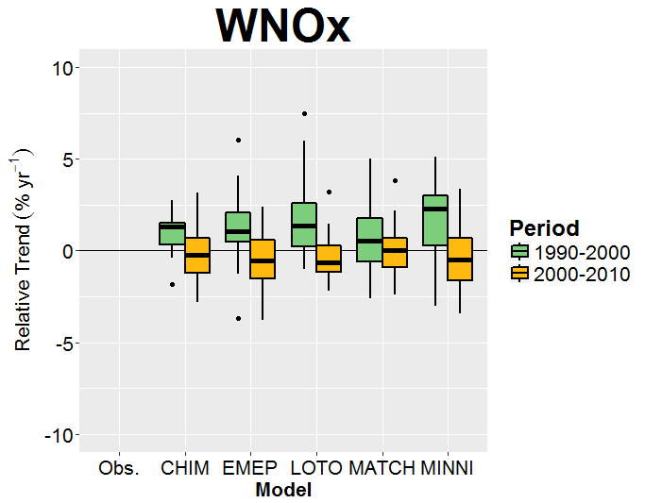
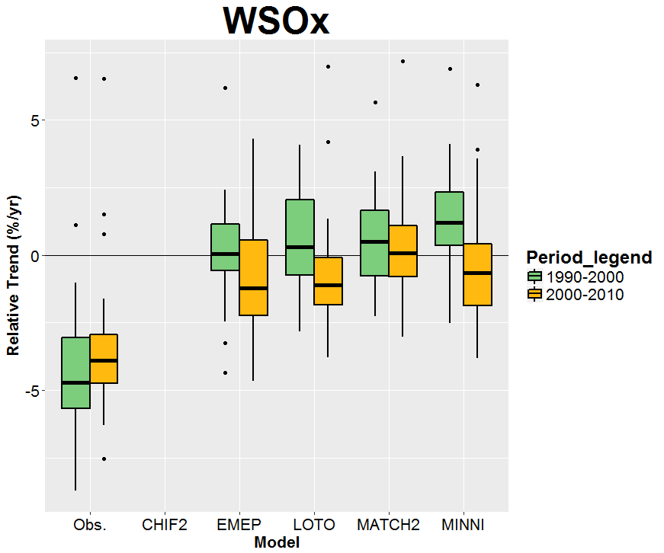
Boxes: deposition
Lines:emissions
Notes:
10-year Sen’s slope divided by the emissions at the start of the 10-year period. Same as the method to estimate relative wet deposition (MK).

Slide 12
Effect of the reduction of 20% of emissions at global scale (GLO), in Europe (EUR) and in North America (NAM), according to AQ_FI1_MACC (%, left, mgN/m2, right)on the S deposition in Europe
GLO
EU
NAM
(all the) Models do not include all the natural processes; for example, sulfate are not always considered in sea salt emissions. The impact of this on the interaction ammonium-sulfates-nitrates is not characterized.

Slide 13
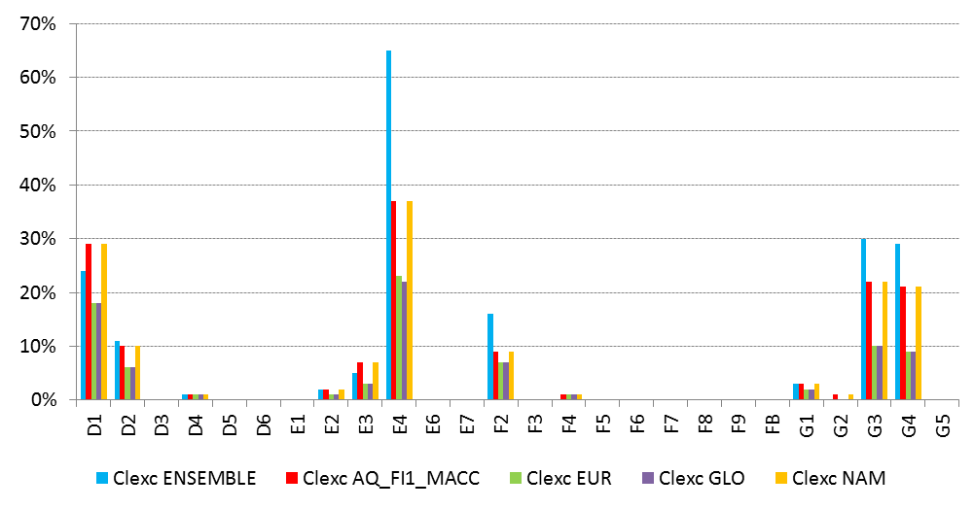
Deposition and ecosystems
Proportion of habitat area for which the critical load is exceeded for major terrestrial habitat classes within the Natura 2000 network for the base case 2010 (ensemble and AQ_FI1_MACC) and for the EUR, GLO and NAM cases (AQ_FI1_MACC)
Critical Loads from the most recent revision of the convention, published by Bobbink and Hetteling in 2011. Every habitat type was linked with a Critical Load, no variation was performed in these CL regarding geographical, climatic or soil variables.
Reductions in European emissions: -> substantial decreases in the protected habitat areas with critical load exceedances
No change was found, on average, when reducing North American emissions, in terms of average values per habitat

Slide 14
Habitat group | EUNIS code | Habitat class | Natura 2000ª | Receptors ^{b}
Peatlands | D1 | Raised and blanket bogs | 1.9% | 2.9%
 | D2 | Valley mires, poor fens and transition mires | 0.2% | 0.1%
 | D3 | Aapa, palsa and polygon mires | 2.1% | 1.1%
 | D4 | Base-rich fens and calcareous spring mires | 0.1% | 0.1%
 | D5 | Sedge and reedbeds | 0.5% | 0.3%
 | D6 | Inland saline and brackish marshes and reedbeds | < 0.1% | < 0.1%
Grasslands | E1 | Dry grasslands | 0.5% | 0.1%
 | E2 | Mesic grasslands | 14.1% | 9.8%
 | E3 | Seasonally wet and wet grasslands | 1.8% | 0.8%
 | E4 | Alpine and subalpine grasslands | 1.3% | 1.3%
 | E6 | Inland salt steppes | 0.5% | 0.1%
 | E7 | Sparsely wooded grasslands | 1.3% | 0.4%
Shrublands | F2 | Arctic, alpine and subalpine scrub | 2.7% | 3.9%
 | F3 | Temperate and Mediterranean-montane scrub | 3.6% | 3.1%
 | F4 | Temperate shrub heathland | < 0.1% | < 0.1%
 | F5 | Arborescent and thermo-Mediterranean brushes | 2.7% | 2.4%
 | F6 | Garrigue | 0.6% | 1.1%
 | F7 | Spiny Mediterranean heaths | 1.1% | 1.1%
 | F8 | Thermo-Atlantic xerophytic scrub | 0.3% | 0.0%
 | F9 | Riverine and fen scrubs | < 0.1% | < 0.1%
 | FB | Shrub plantations | 0.8% | 0.3%
Woodlands | G1 | Broadleaved deciduous woodland | 25.1% | 23.4%
 | G2 | Broadleaved evergreen woodland | 1.2% | 0.4%
 | G3 | Coniferous woodland | 20.7% | 25.6%
 | G4 | Mixed deciduous and coniferous woodland | 9.4% | 14.2%
 | G5 | Early-stage woodland and semi-natural stands | 7.6% | 7.5%
EUNIS classification of the most-likely habitat from the European Environmental Agency, presented in a grid of 100 meters resolution.

Slide 15
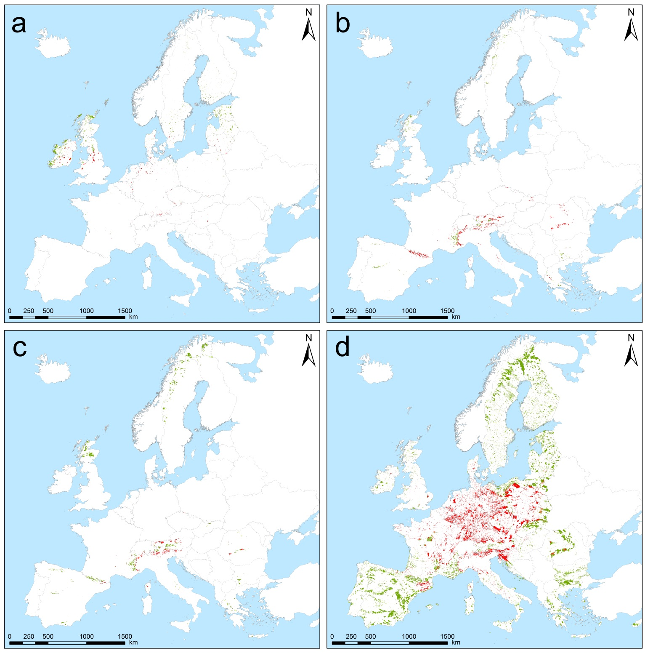
Habitat distribution and location of CL_{exc} for the most threatened habitat classes:
a
b
a: D1 “raised and blanket bogs” and D2 “valley mires, poor fens and transition mires”
b: E4 “alpine and subalpine grasslands”
c: F2 “artic, alpine and subalpine scrub”
d: G3 “coniferous woodlands” and G4 “mixed deciduous and coniferous woodlands”).
The surface areas showing a CL_{exc} are represented in red; areas with no CL_{exc} are represented in green.
c
d

Slide 16
Results from HTAP model exercise (AQMEII-3)
Title: Modelled deposition of nitrogen and sulfur in Europe estimated by 14 air quality model-systems: Evaluation, effects of changes in emissions and implications for habitat protection
Authors: Marta G. Vivanco^{1,} Mark. R. Theobald¹, Héctor García-Gómez¹, Juan Luis Garrido¹, , Marje Prank^{2,3}, Wenche Aas⁴, Mario Adani⁵, Ummugulsum Alyuz⁶, Camilla Andersson⁷, Roberto Bellasio⁸, Bertrand Bessagnet⁹, Roberto Bianconi⁸, Johannes Bieser¹⁰, Jørgen Brandt¹¹, Gino Briganti⁵, Andrea Cappelletti⁵, Gabriele Curci¹², Jesper H. Christensen¹¹, Augustin Colette⁹, Florian Couvidat⁹, Kees Cuvelier¹³, Massimo D'Isidoro⁵, Johannes Flemming¹⁴, Andrea Fraser¹⁵, Camilla Geels¹¹, Kaj M. Hansen¹¹, Christian Hogrefe¹⁶, Ulas Im¹¹, Oriol Jorba¹⁷, Astrid Manders¹⁸, Mihaela Mircea⁵, Noelia Otero¹⁹, Maria-Teresa Pay¹⁷, Luca Pozzoli^{6,20}, Efisio Solazzo²⁰, Svetlana Tsyro²¹, Alper Unal⁶, Peter Wind^{21,22} and Stefano Galmarini²⁰

Slide 17
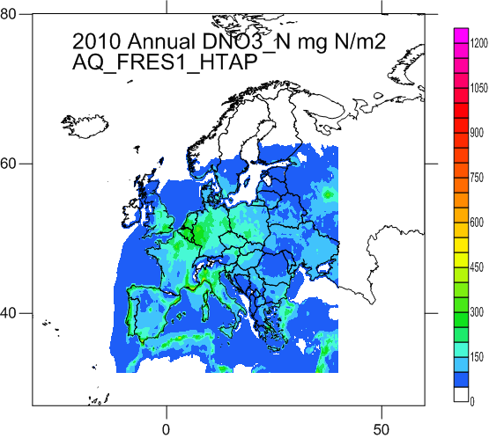
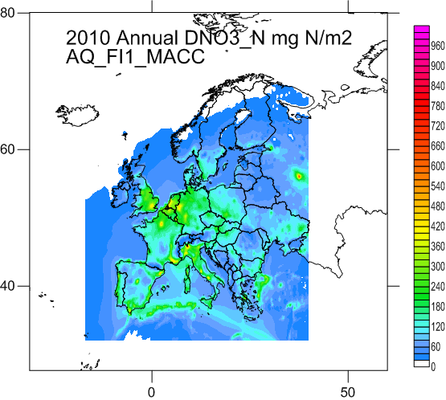
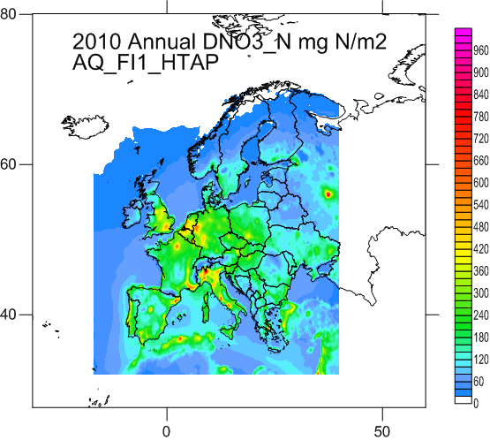
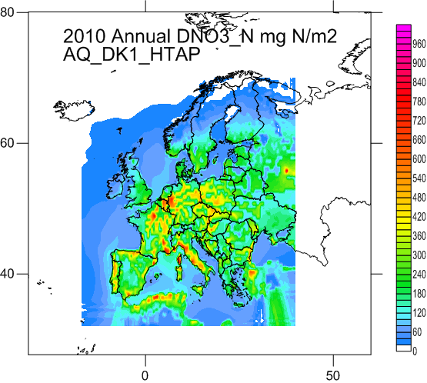
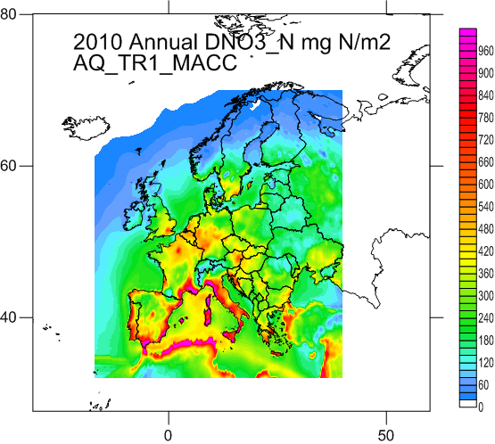
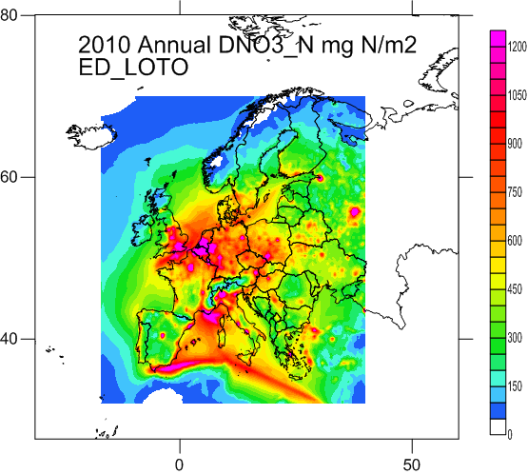
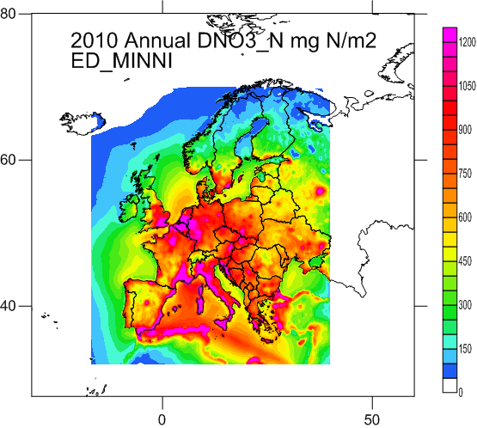
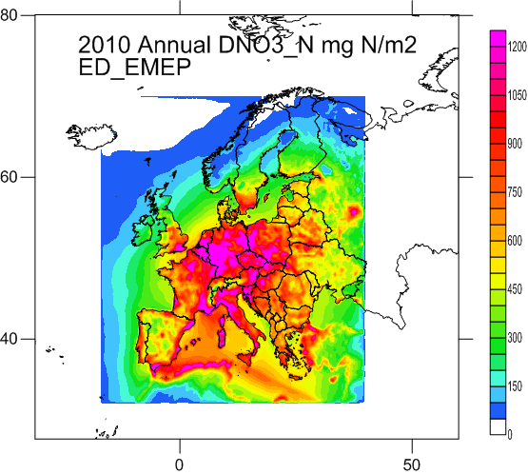
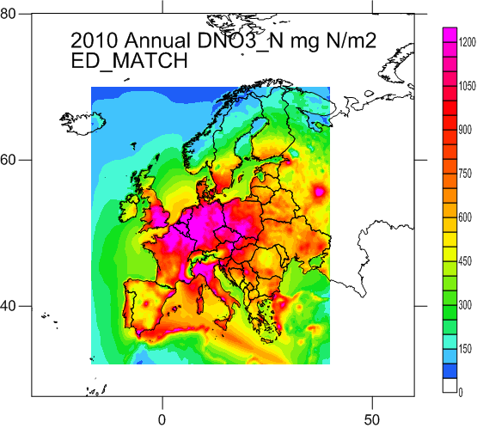
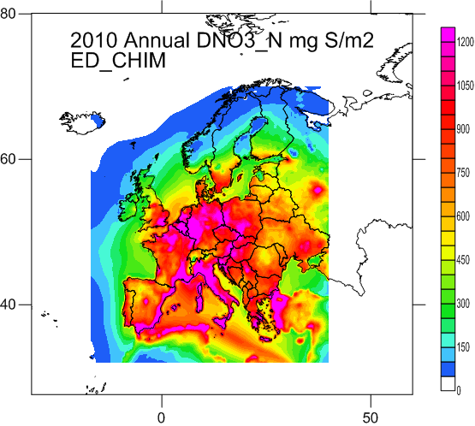
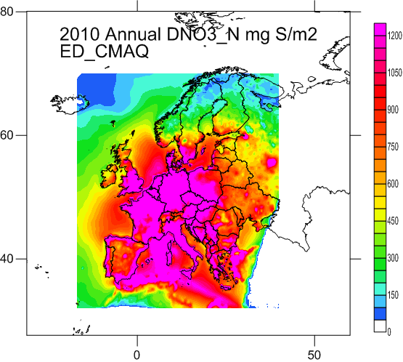
4. Dry deposition
(Vivanco et al., 2017, 2018: wide variability between models; no evaluation → high uncertainty in model results. Efforts to evaluate DD (for ecosystem impacts the total, wet + dry is considered)

Slide 18
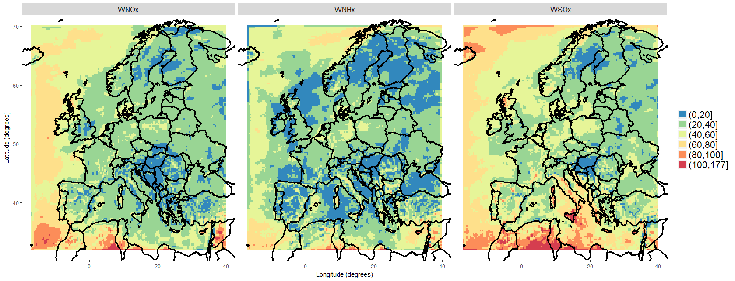
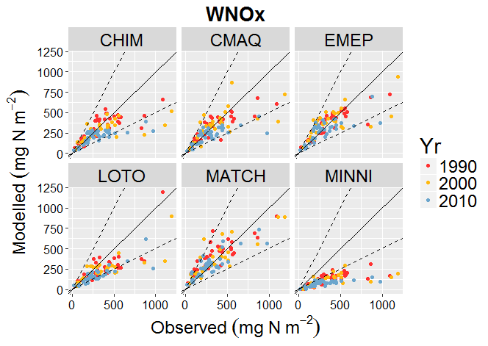

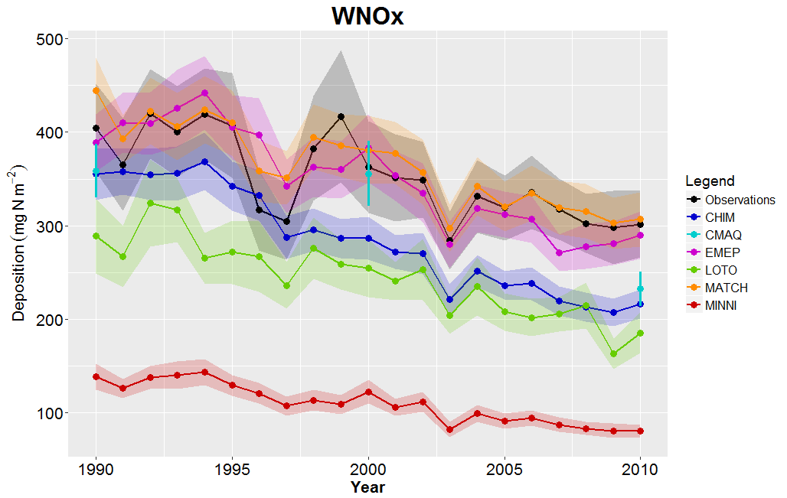
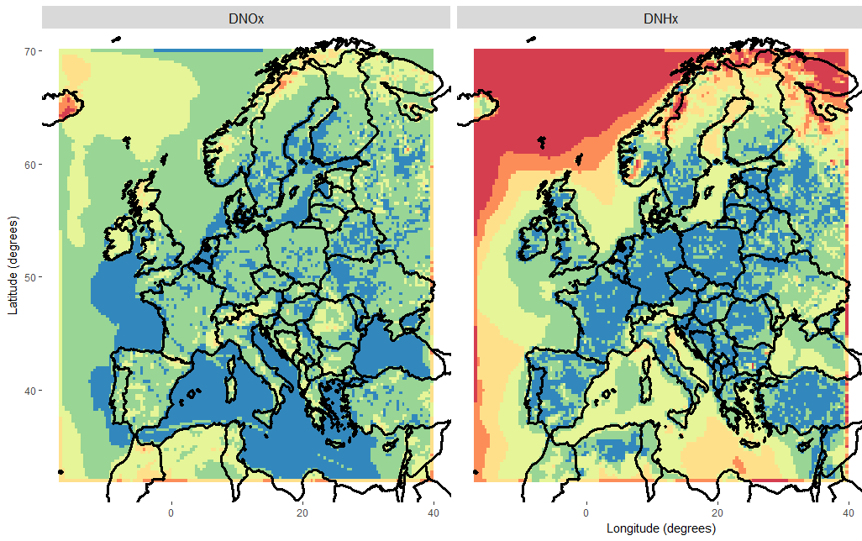
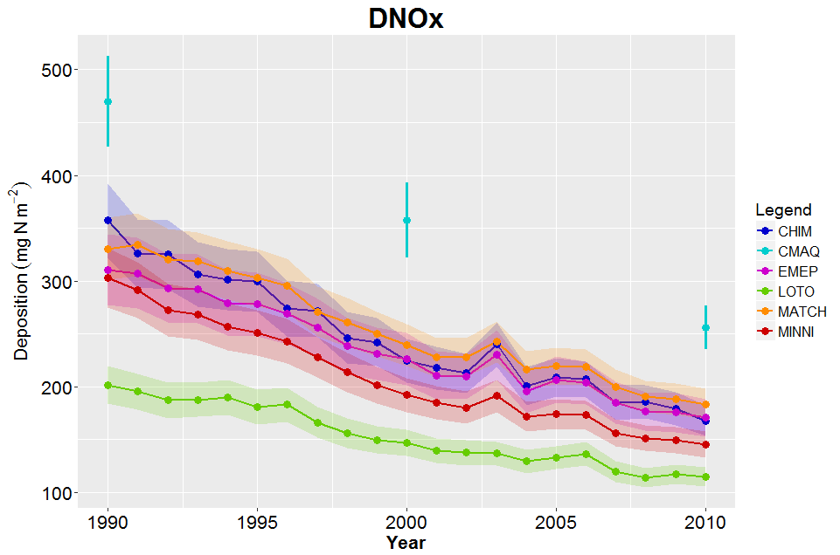
What about dry deposition?
Coefficient of variation for wet deposition
Can evaluate
Time series (wet deposition)
Oxidised N
Reduced N
e.g. Oxidised N
Coefficient of variation for dry deposition
Time series (dry deposition)
Oxidised N
Reduced N
e.g. Oxidised N
Not easy to evaluate
4 Models: CHIM, EMEP, LOTO, MATCH
3 Models: EMEP, LOTO, MATCH
Notes:
This to be combined with your slide on spatial variability

Slide 19
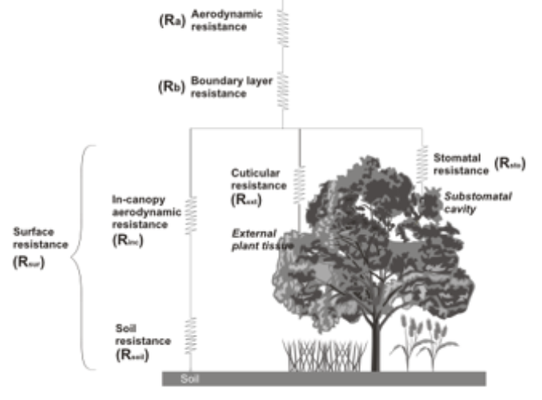
Compare with dry deposition estimated using inferential models?
“Despite the presence of large uncertainties, inferential dry deposition estimates remain the best available for assessing long term dry deposition on global and regional scales” (Vet et al., 2014)
Example of an inferential modelling scheme
On-going work, by Mark Theobald, CIEMAT
Similar or identical to schemes used in the CTMs
..but use observed meteorology and atmospheric concentrations
(DO3SE model)
Comparison with CTM estimates, therefore, allows us to assess whether differences are due to the modelled meteorology, modelled concentrations, deposition parameterisations or other factors

Slide 20
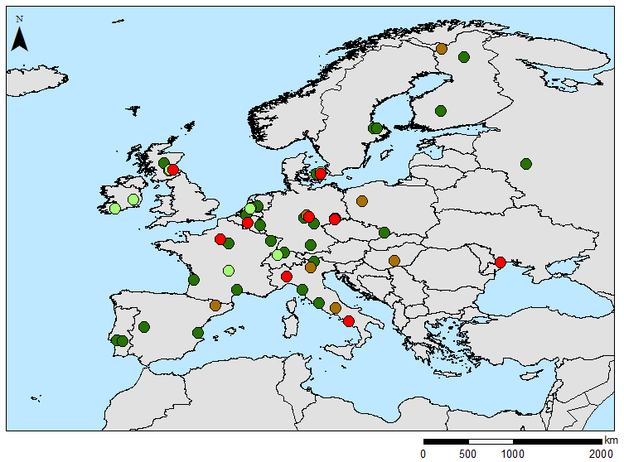
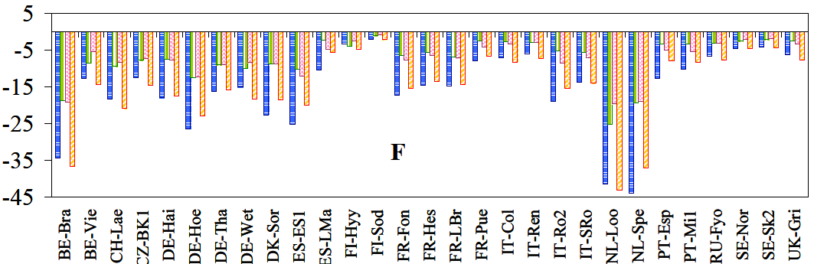
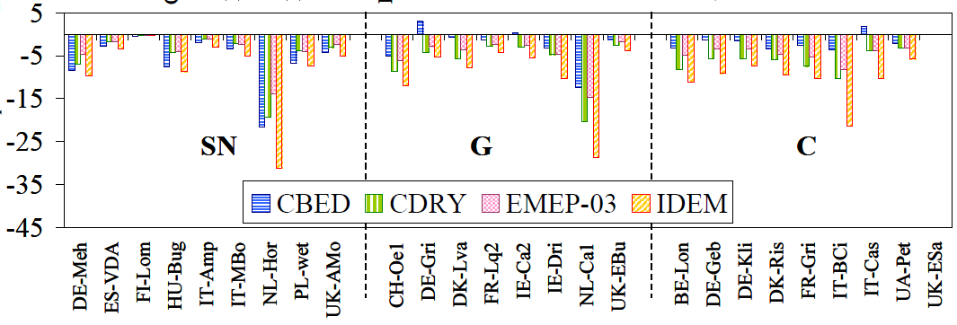
NitroEurope inferential network
Measurements of:
Micrometeorology (30 min):
  Wind speed, turbulence, heat fluxes, humidity, temperature, precipitation, etc.
  Canopy height, leaf area index
  Atmopheric concentrations (monthly):
    NH₃, HNO₃, NO₂, NH₄⁺, NO₃⁻
55 sites
Forest (29)
Grassland (8)
Semi-natural (9)
Crops (9)
inferential model estimates from measurement data for the period 2007-2008
Annual dry N deposition estimated by four different inferential models
Forest sites
Other land use types
Flechard, C. R., et al. "Dry deposition of reactive nitrogen to European ecosystems: a comparison of inferential models across the NitroEurope network." Atmospheric Chemistry and Physics 11.6 (2011): 2703-2728.
Notes:
Note: One of the inferential models is called EMEP-03 because it is the old dry deposition parameterisation of the EMEP model (version rv3.1)

Slide 21
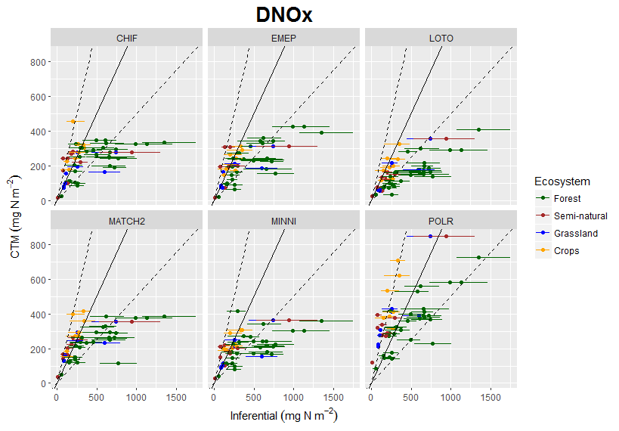
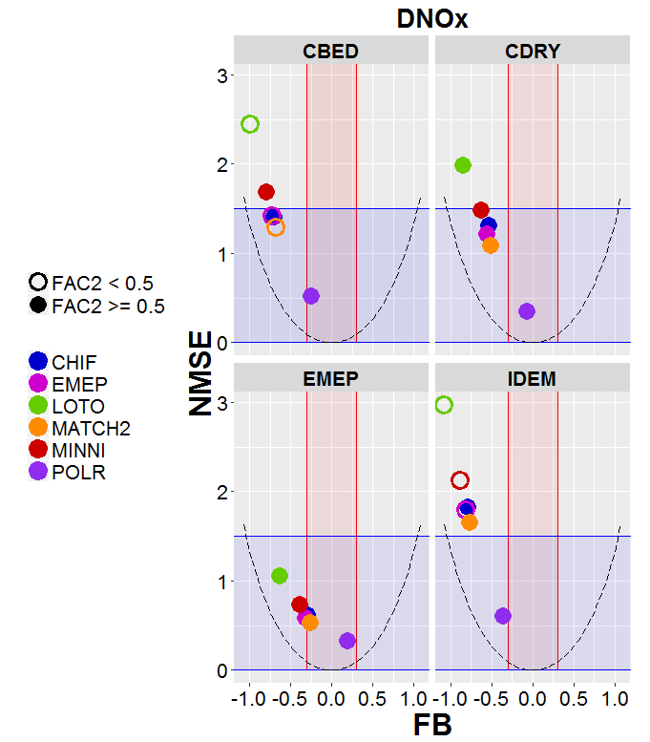
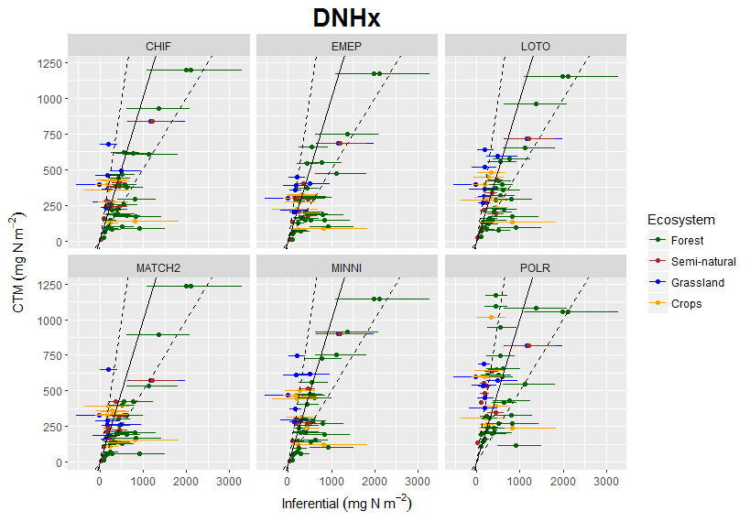
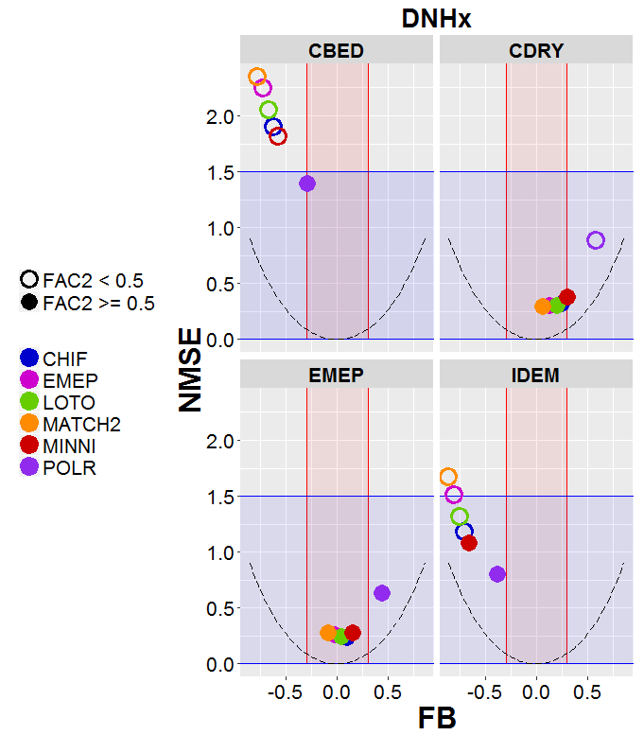
Preliminary evaluation of EDT models (annual dry N deposition)
CHIM
EMEP
LOTO
CBED
CDRY
MATCH
MINNI
POLR
EMEP-03
IDEM
CHIM
EMEP
LOTO
CBED
CDRY
MATCH
MINNI
POLR
EMEP-03
IDEM
Notes:
Scatter plots show the CTM dry deposition estimate versus the inferential model estimates (min, mean and max of the four models for each site)
Smile plots show that:
DNOx: CTMS estimate lower dry deposition estimates (except POLR), mainly as result of lower values for forest sites (could be due to the fact that CTM estimates are for the entire grid square but forest sites will have a higher deposition velocity than the grid square average)
DNHx: CTMS estimate lower dry deposition rates than two of the inferential models and similar (or higher) rates than the other two
More analysis is needed (e.g. comparisons of mod vs meas meteorology/concentrations, analysis of land-cover specific model estimates, etc.) to understand why

Slide 22
Thank you!

