Slide 1
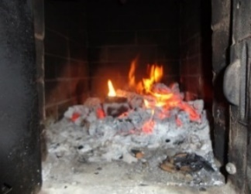
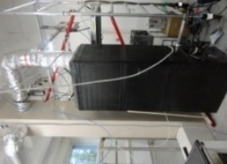
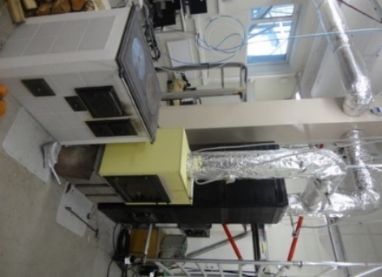
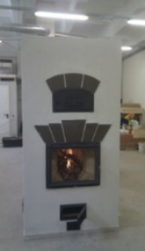
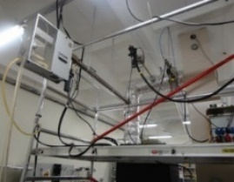
Black carbon measurement campaigns in Estonian residential heating areas
E. Teinemaa¹, H. Keernik^{1,2,4}, M. Maasikmets^{1,3}, H-L. Kupri^{1,2}
¹Estonian Environmental Research Centre; ²Tallinn University of Technology; ³Estonian University of Life Sciences; ⁴Tartu Observatory

Slide 2
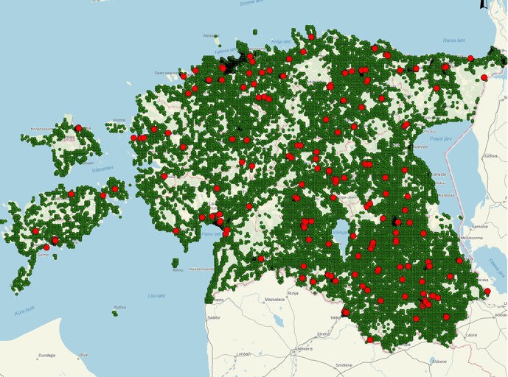
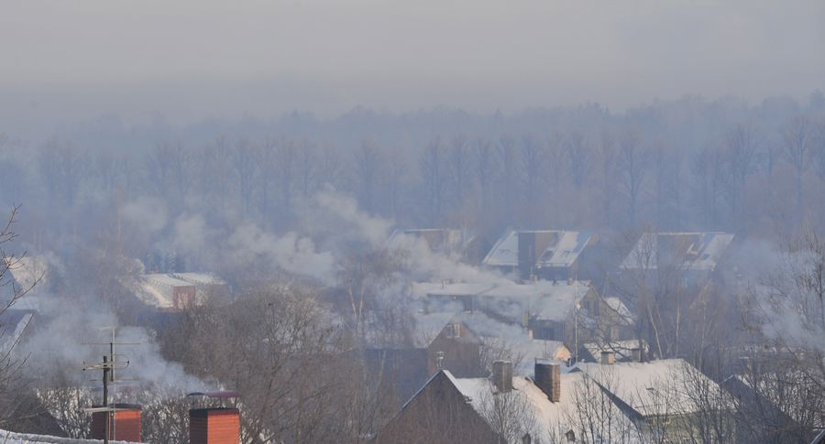
Introduction
About 2/3 of total PM, POP and PAH emission in Estonia is attributed to residential wood combustion (RWC)
Wood logs and wood chips account >90% of the fuel used for residential heating
Typical masonry heaters (hand made) are used in >50% of Estonia’s residential households

Slide 3
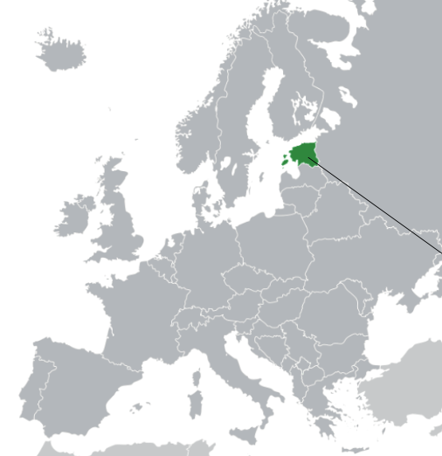
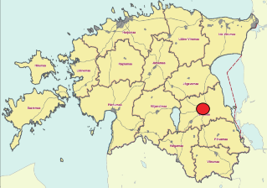
Introduction
In Tartu (2nd largest town in Estonia) the levels of PM2.5 have been high during cold season and B(a)P is exceeding target value 1 ng/m³
Notes:
It is also an ACTRIS site

Slide 4
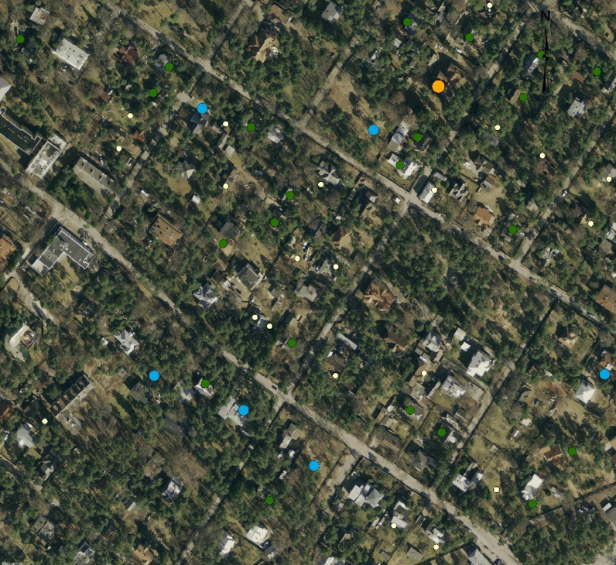
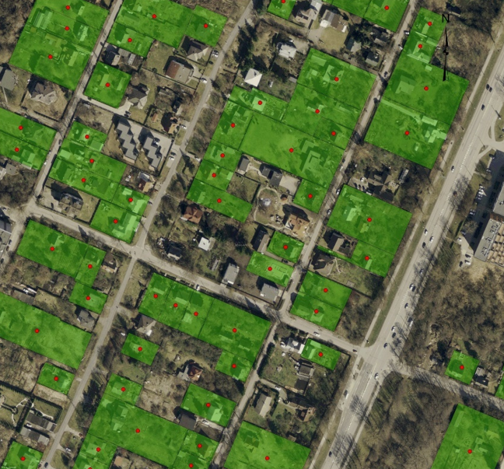
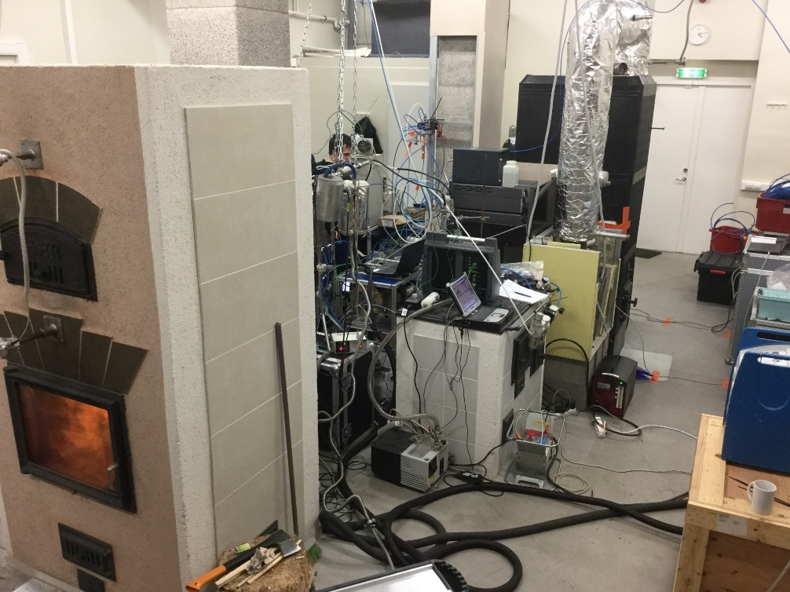
Assessment of emissions
Data from construction register (heated area and heating system) and cadastral registry (coordinates) was used to compile emission database
Typical energy consumption in Estonian residential houses is 200-300 kWh/m²
PM2.5, BC and BaP emissions (g/s) were calculated for each household
Emission factors from earlier laboratory studies were used (Maasikmets et al. 2016, Teinemaa et al. 2013)

Slide 5
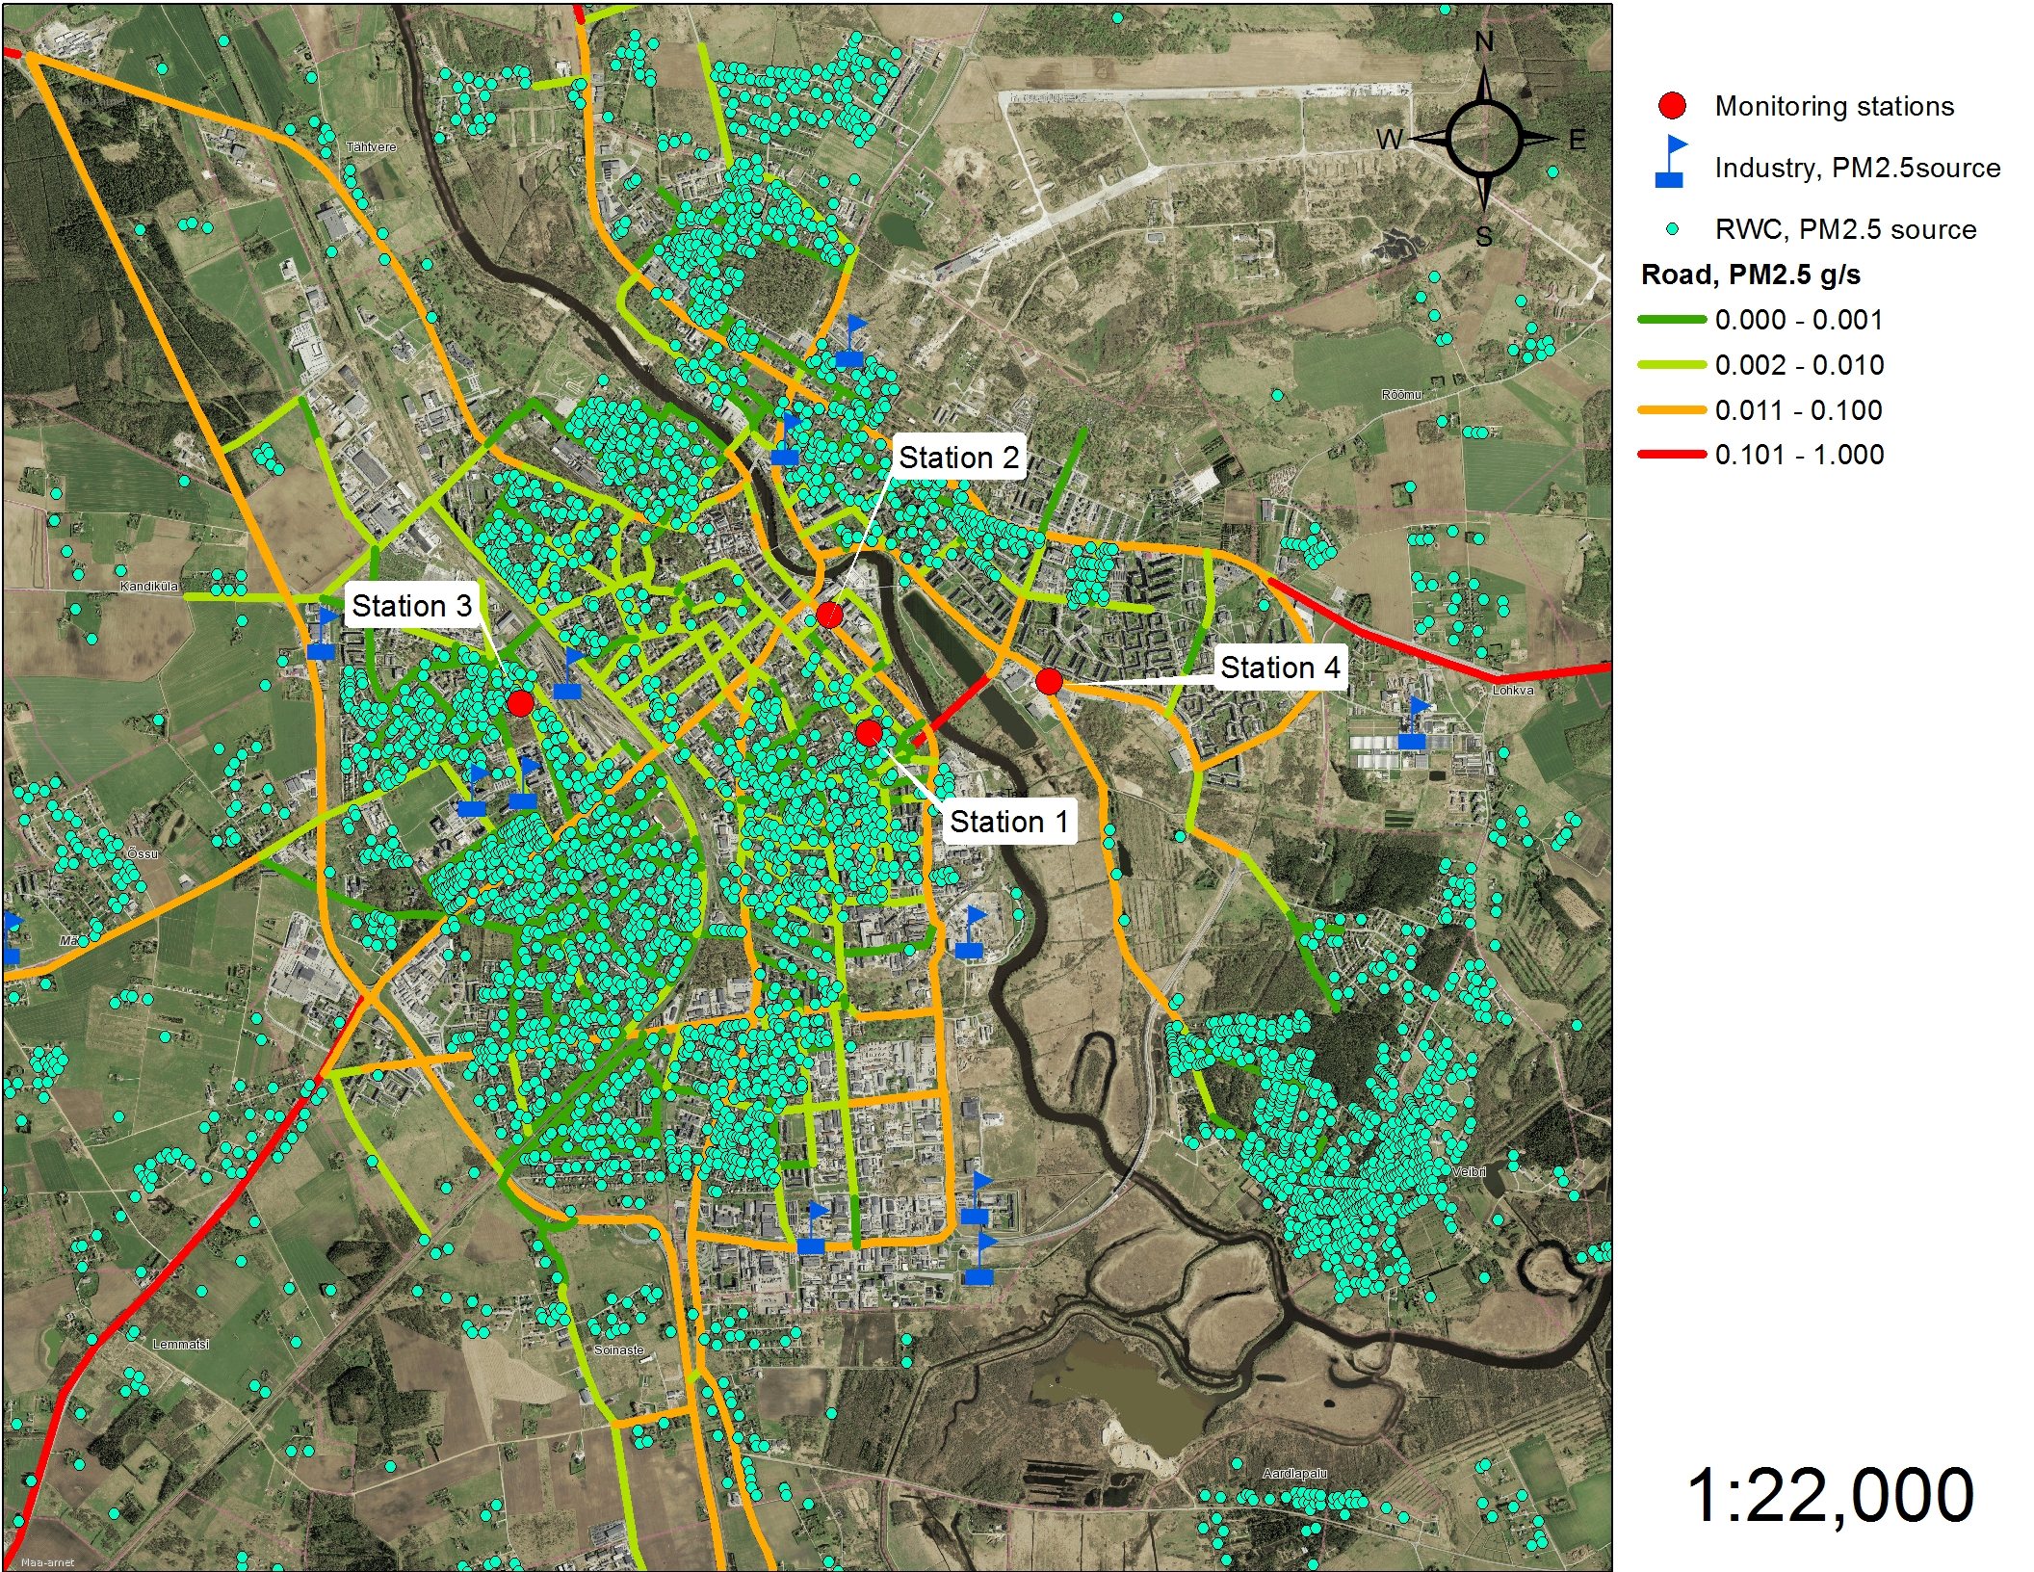
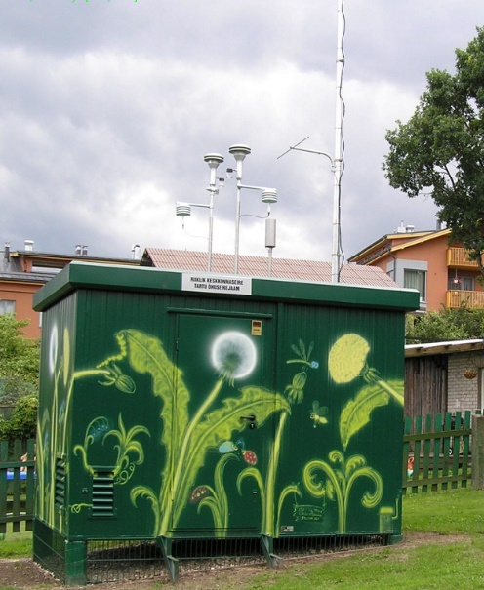
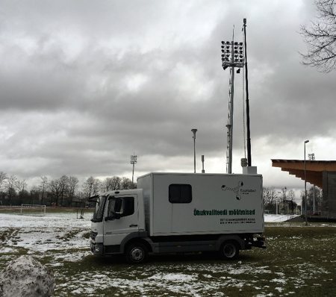
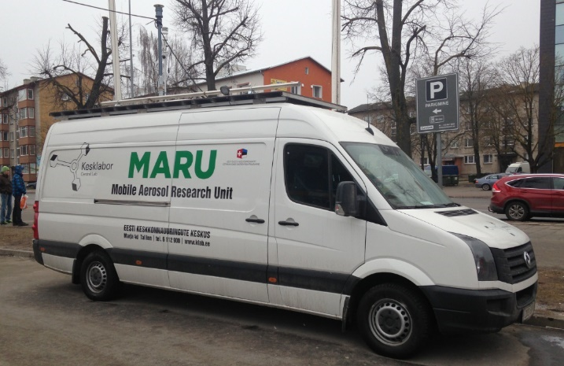
Measurement campaigns
Station 6
Station 1
Four separate measurement campaigns are carried out since 2013 in Tartu
2013/2014 – Station 1, Station 2 and Station 3
2014/2015 – Station 4
2016/2016 – Station 5
2017/2018 – Station 6
Station 3
Station 4
Station 2
Station 5
Tartu stn
5

Slide 6
Measurements
Filter analysis
EC/OC (Sunset lab)
BC (Magee SootScan OT21)
Heavy metals - Al, As, Sb, Cd, Co, Cr, Mn, Mo, Ni, Pb,
Se, V, Fe, Zn, Cu (ICP-MS)
PAH - acenaphthene, acenaphthylene, anthracene, fluoranthene, fluorene, naphthalene, phenanthrene, pyrene, benz[a]anthracene, benzo[b]fluoranthene, benzo[k]fluoranthene, benzo[ghi]perylene, benzo[a]pyrene, chrysene, dibenz[a,h]anthracene, and indeno[1,2,3-cd]pyrene (GC-MS)
Levoglucosan (GC-MS)
Terephtalic acid
Stationary station
BC (ethalometer AE33)
ACSM (Aerodyne)
EC/OC (Field Sunset)
PM10 sampling Digitel DHA-90
PM10/PM2.5 with BAM 1020
CO, NOx, SO2, O3
Ambient air measurements with mobile stations
BC (ethalometer AE33)
PM10 sampling Digitel DHA-90
PM10/PM2.5 with BAM 1020
CO, NOx, SO2, O3

Slide 7
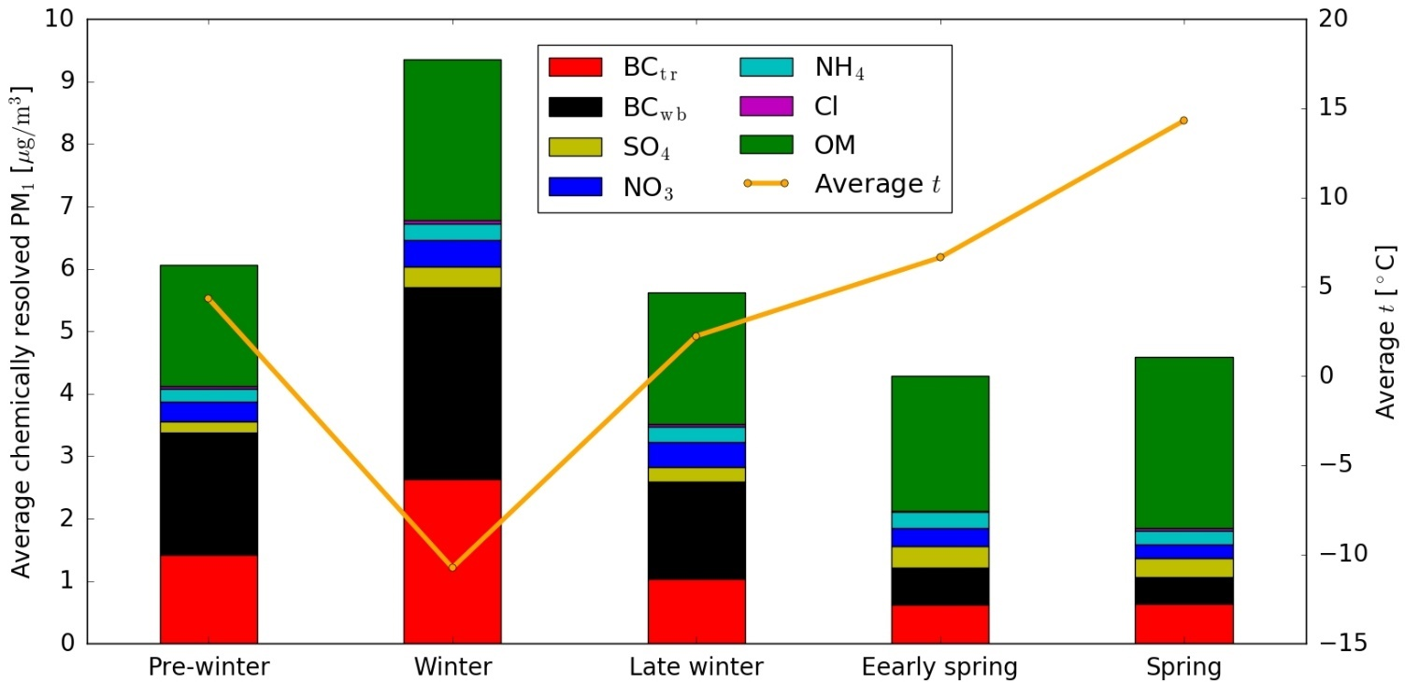
ACSM results for 2016 campaign
BC_{tr} , BC_{wb} concentrations increase with low temperatures. Compared to springtime, BC_{tr} and BC_{wb} concentrations in winter are 4 and 7 times higher, respectively
Chemical composition of NR submicron aerosols is dominated by OM (69 – 78% of the total NR aerosol concentration).
BC_{tr} increase in winter due to cold start of cars

Slide 8
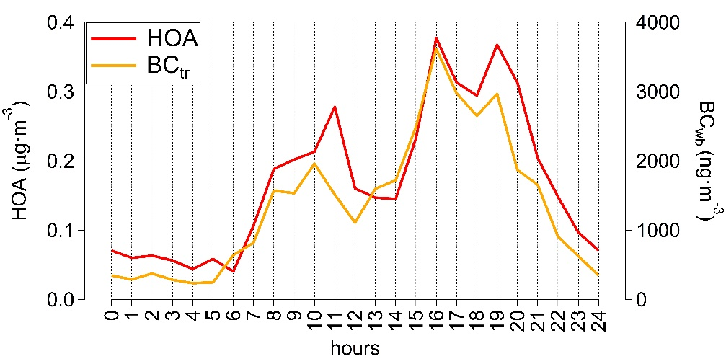
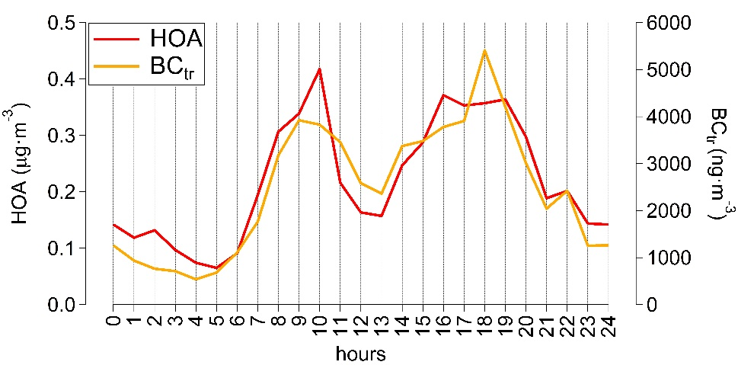
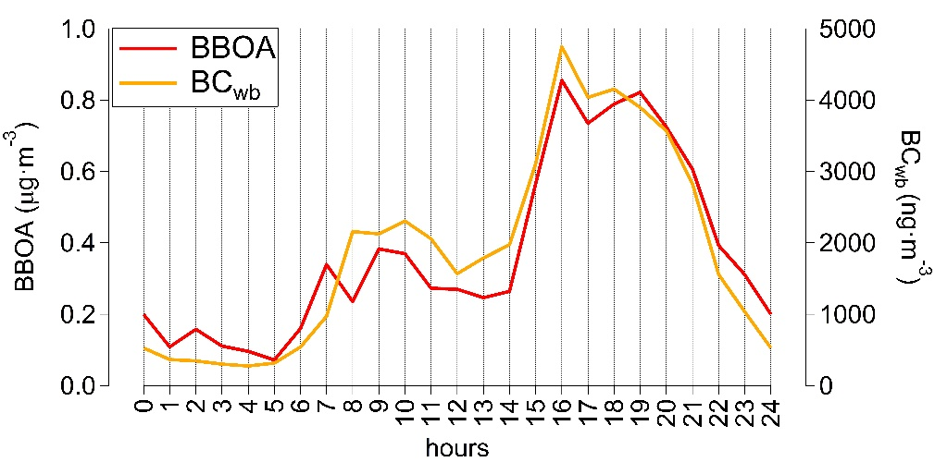
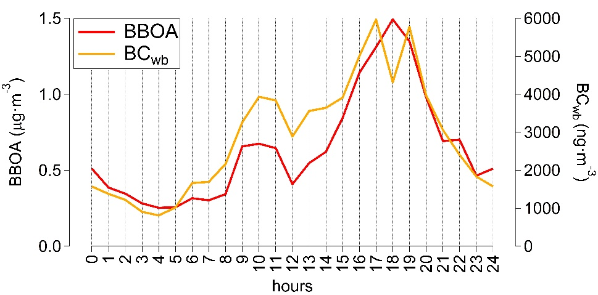
Pre-winter and winter
14 days, very high BC_{tr} and BC_{wb} concentrations (up to 20 μg) on 12th and 13th of January – great impact on average diurnal variation

Slide 9
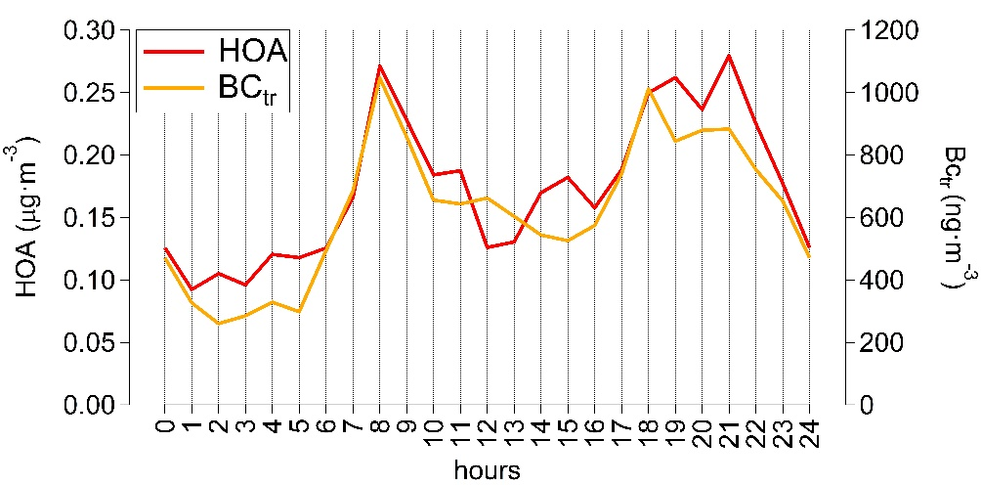
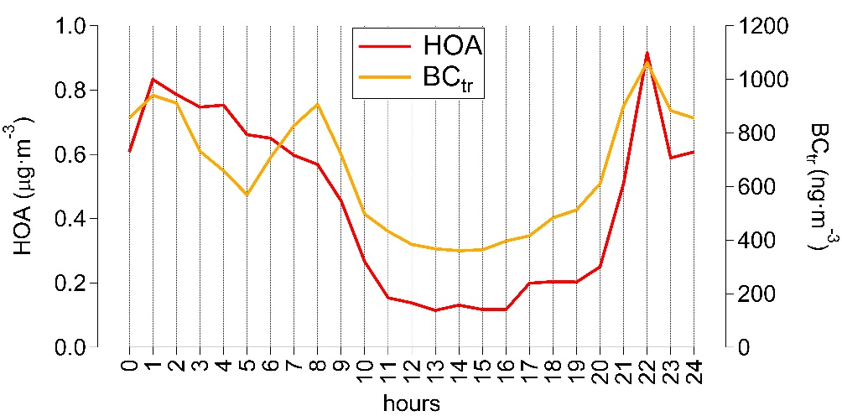
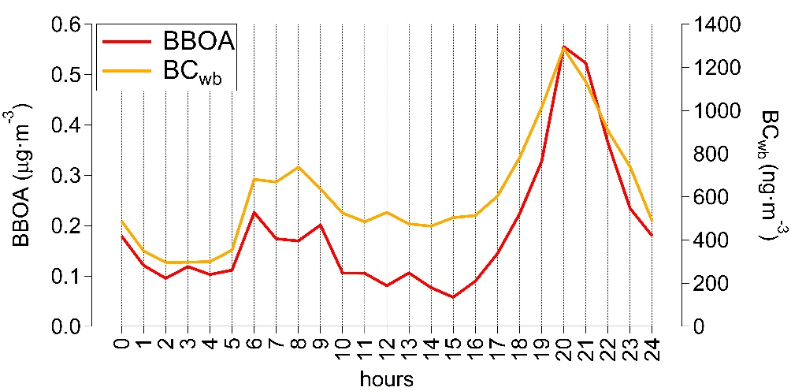
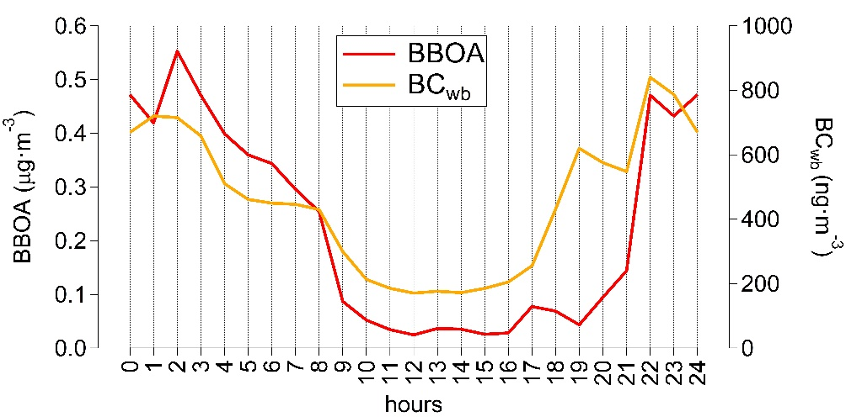
Early spring and spring
Strong and persistent inversions in the beginning of spring have produced unusual diurnal cycles of HOA and BBOA

Slide 10
Dispersion modelling
Diurnal and monthly variation of the emissions was based on measured BC_{wb} results – both for PM2.5 and BaP emission databases
Dispersion modelling was used to calculate levels of PM2.5, BC and BaP using ensemble of two different dispersion models (SMHI Gauss, SMHI Grid).
The dispersion modelling results were compared against measurements
Tartu station
2016
Tartu station
2017

Slide 11
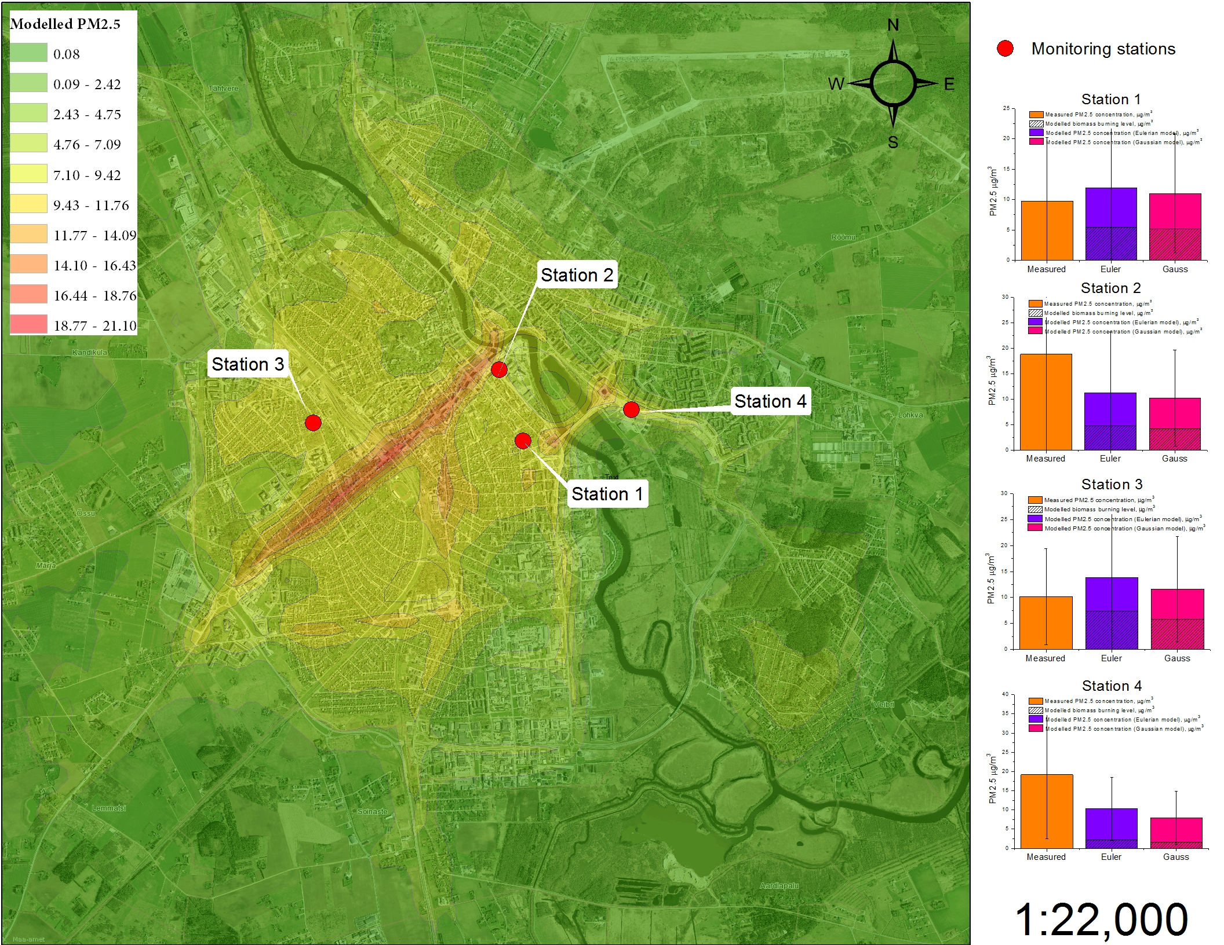
Station 1
Station 3
Station 2
Tartu stn

Slide 12
BC_{wb} and BaP
 | Correlation R²
January | 0.93
February | 0.90
March | 0.94
April | 0.75
May | 0.75
June | 0.73
July | 0.56
August | 0.81
September | 0.80
October | 0.99
November | 0.98
December | 0.88
Gas-phase BaP attributes approximately 7-9% of the total BaP

Slide 13
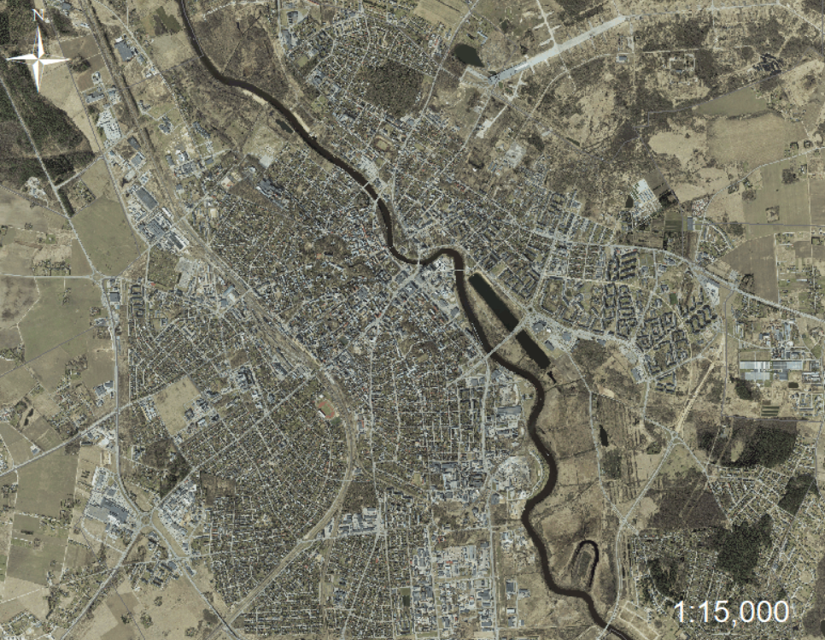
BC_{wb} and BaP
Mobair – 0.83
Tartu station – 0.88
Mobair
Tartu

Slide 14
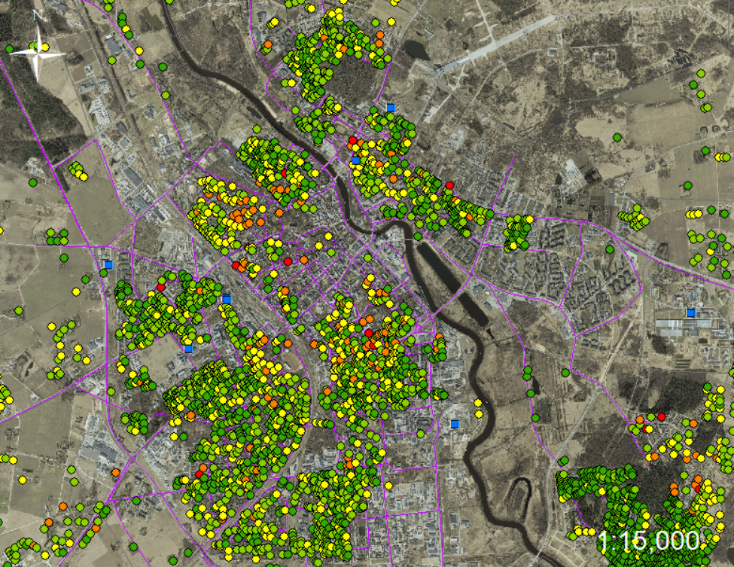
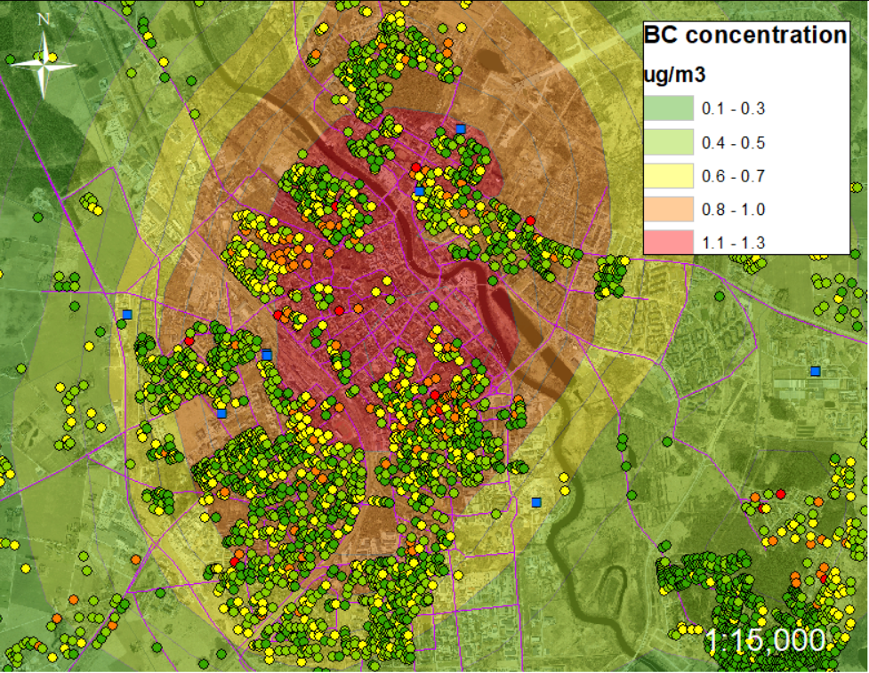

Slide 15
Ongoing tasks
BC and EC/OC offline filter analysis
PAH and HM filter analysis
Levoglucosane and terephtalic acid analysis
Time variation for the residential heating
Temperature probes were installed to chimneys in Tartu to register actual heating times
Traffic flows and BC emissions are not well described in current EDB
Regional pollution is assessed using nearby rural station but better approach is needed

Slide 16
Conclusions
Elevated levels of PMx and B(a)P are mainly related to the local emissions from the residential heating in Tartu
A good correlation between terephthalic acids, heavy metals, PAH’s, PM2.5, PM10 and BC concentrations
Packaging waste burning in household heaters and stoves might be an important issue in some RWC areas
Ethalometer BC_{wb} can be used to predict PAH concentration in residential areas
BaP emission databases compiled for other cities and modelling is validated through BCwb measurements

Slide 17
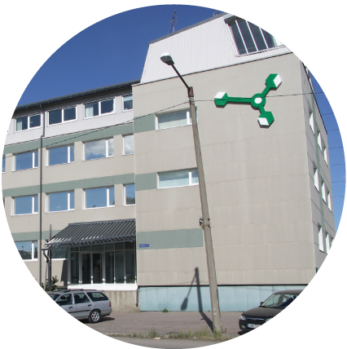
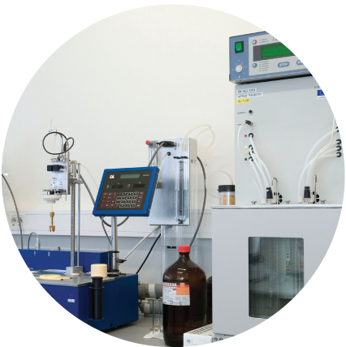
Thank you for your attention!

