Slide 1
EMEP/ACTRIS/COLOSSAL intensive measurement period Des 2017 – March 2018
Wenche Aas, EMEP/CCC

Slide 2
Backround
A demand of high time resolution and on-line information on aerosol particles from specific sources
substantial focus on BC and its sources (wood burning in particular)
increasing number of multi wavelength aethalometers employed in Europe
Good timing to test the source apportionment approach from these instruments

Slide 3
GOAL
To quantify EBC_{ff} and EBC_{bb} by multi wavelength aethalometer measurement, and to validate this approach using concurrent off-line measurements of the wood burning tracer levoglucosan (and EC, OC, TC) for a wider part of Europe.
To provide a harmonized data set for model validation
To initiate regular monitoring of EBC_{ff} and EBC_{bb}, and reporting of such data to EBAS.

Slide 4
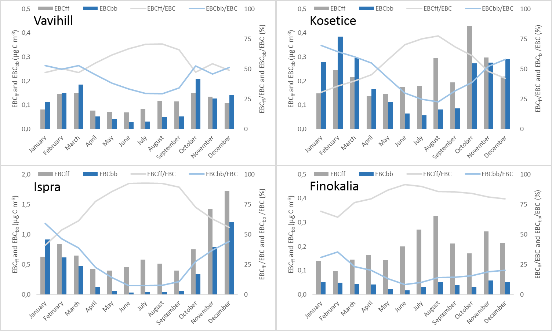
Feasibility study (PMF analysis) Equivalent Black Carbon (EBC) from fossil fuel (FF) and biomass burning sources (BB)
blue: BB, grey: FF

Slide 5
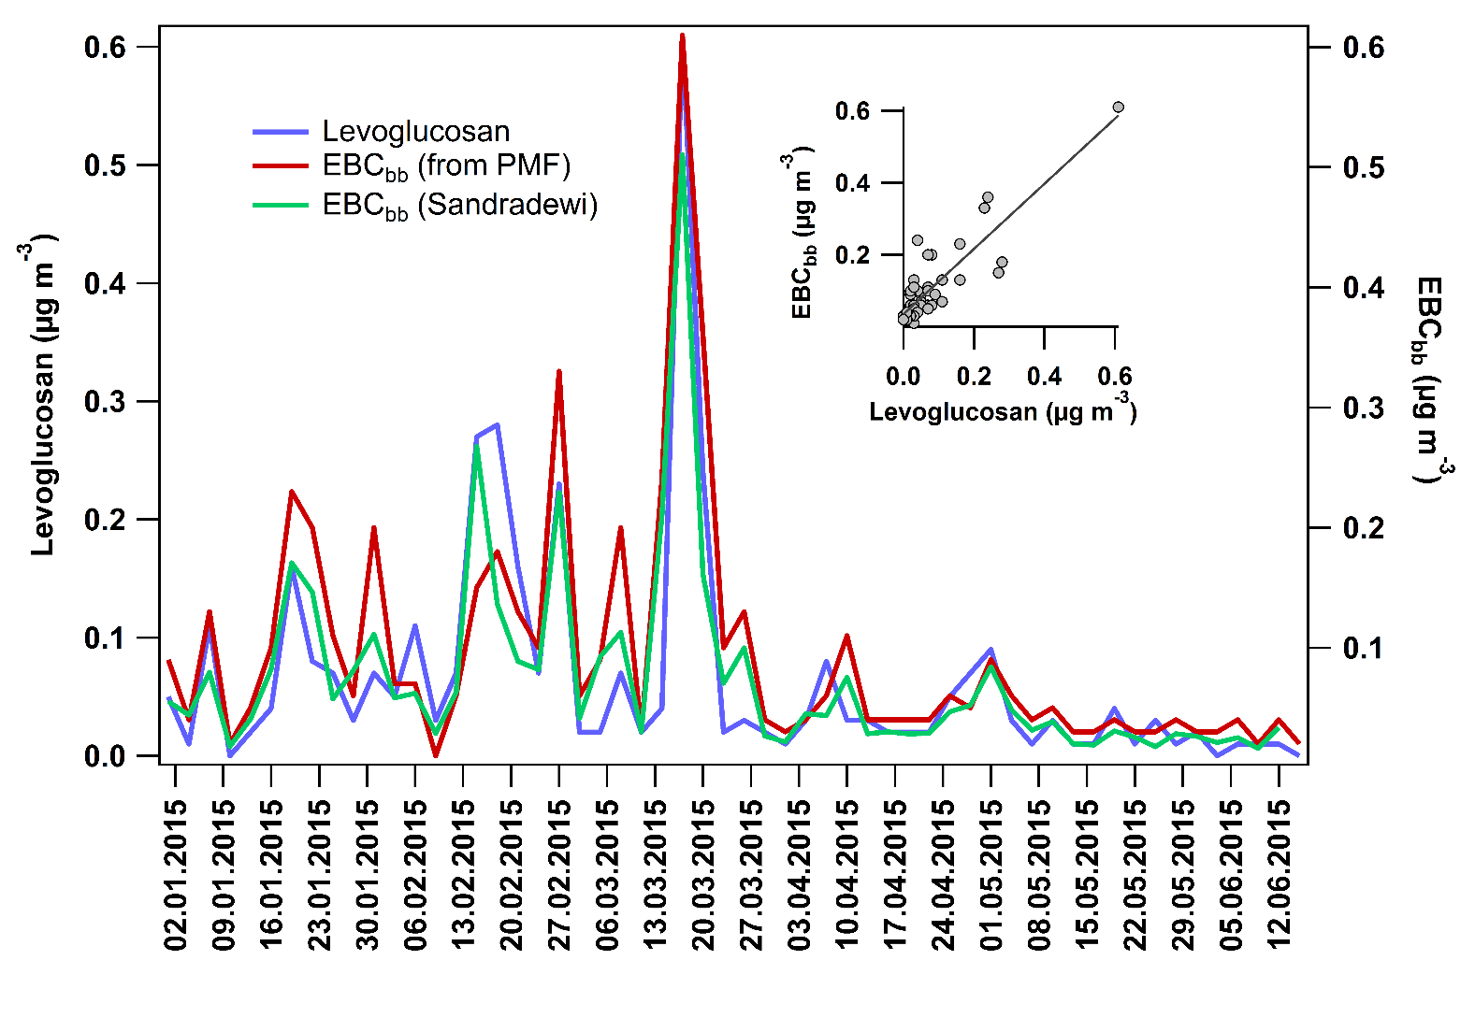
Validation of multi-wavelength PMF approach using data from levoglucosan
(Vavihill 2015

Slide 6
Setup
Include as many sites as possible to get good European spatial coverage incl different site characteristics
All sites have measured:
multi-wavalength athalometer (AE31,32,33)
and a filter sampler for off line EC/OC and levoglucosan analysis for validation (analysis can be done in external lab)
Same size fraction
Timing
Winter (dec 2017-march 2017). Or part of whole period.
At least 25 - 30 filter samples with levoclucosan and EC/OC

Slide 7
Additional studies and analysis
MAAP to better link EBC to an abs. coefficient (Nicolas Bukowiecki, PSI)
ACSM for source apportionment also of OM (COLOSSAL)
¹⁴C to better constrain fossil from wood burning (Bern, Lund…)
Organic tracers to better constrain sources (ACTRIS)

Slide 8
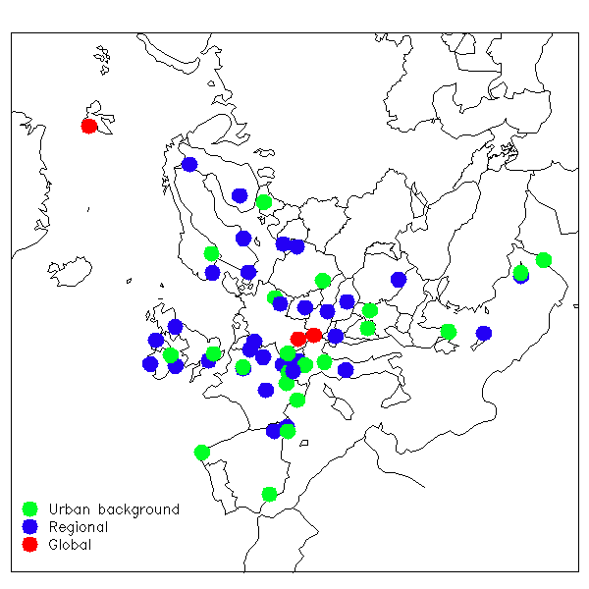
Sites
22 Countries. 57 sites (not all confirmed)
whereof 22 urban
several sites in the Alps
Additional measurements
18 sites with ACSM
12 with MAAP
tracers unclear
¹⁴C , to be decided (5-6 sites)

Slide 9
Coverage
Very good geographical coverage (south-north and East west)
Good spread in site characteristics:
From remote to urban
Large variations of sites with influence of different sources to EBC: coal, biomass, peat, fossil fuel.

Slide 10
Levoclucosan ILC for labs participating in the campaign, and beyond (ACTRIS)
Conducted by IGE Grenoble ( Jean Luc )
19 participants (labs)
17 different EU countries
Methods:
8 with IC-PAD
2 with LC-MS
8 with GC-MS
1 still not answered…
Waiting for 4 results. Will be finalised the coming months

Slide 11
Next steps
Reporting of data before 1 june 2018
Instructions has been sent out
Very important that everyone report in correct format. New template for AE33 developed
Decide which sites will be offered sponsored 14C analysis (4-5)
To be discussed at the COLOSSAL meeting in Bucharest 24-28 September.
First results on PMF
Coordination with ACTRIS and COLOSSAL, incl MAAP and MAAP measurements
F.

