Slide 1
FLEXTRA and EBAS
The EMEP database (EBAS) is located at
http://ebas.nilu.no
The FLEXTRA Trajectories are located at
http://www.nilu.no/trajectories/

Slide 2
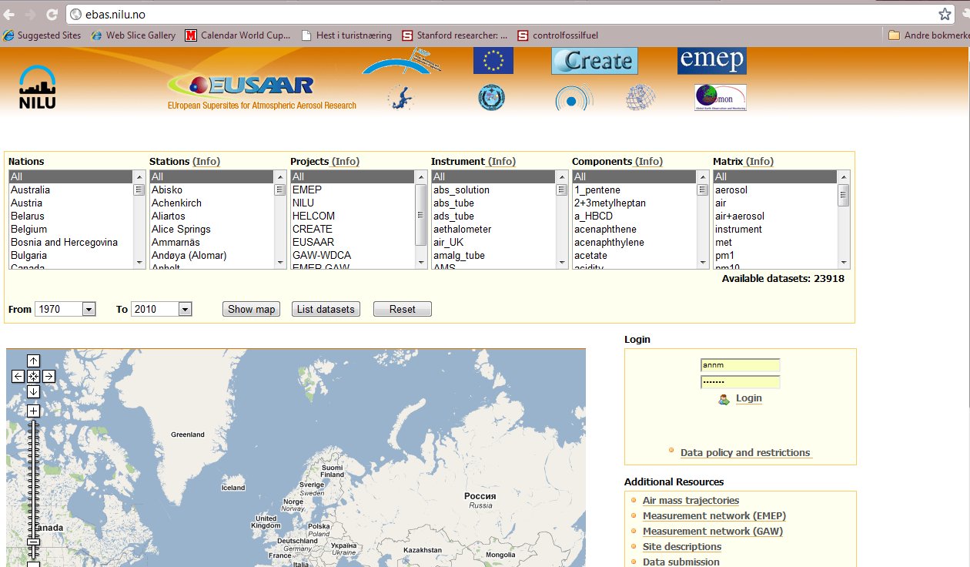
EBAS

Slide 3
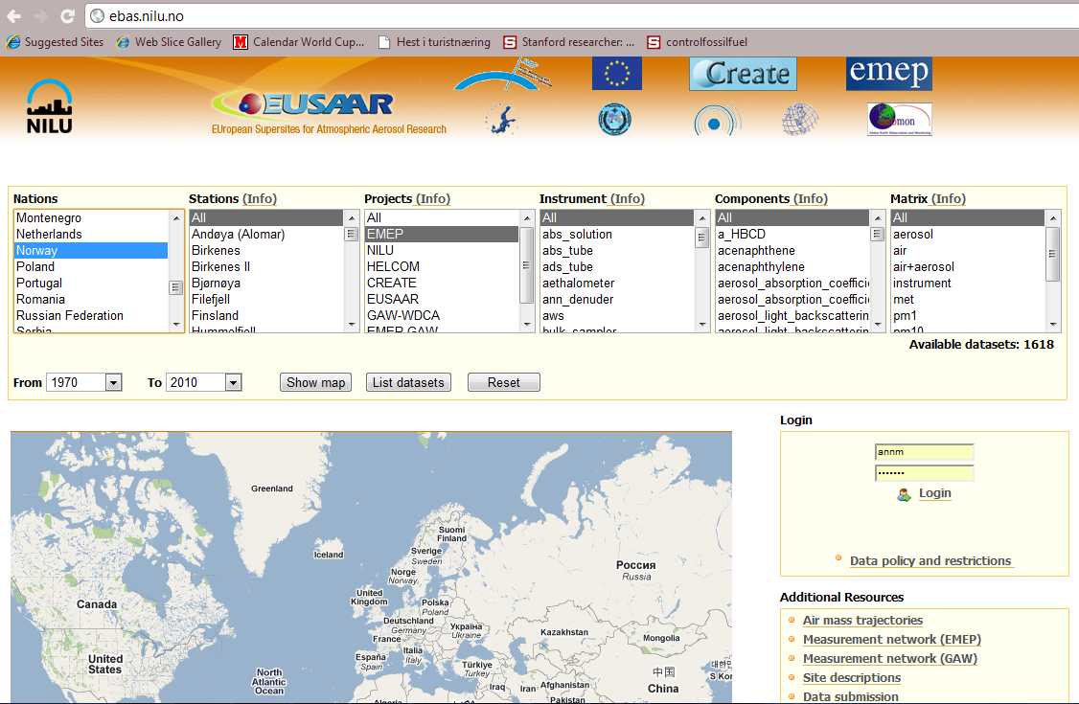
EBAS

Slide 4
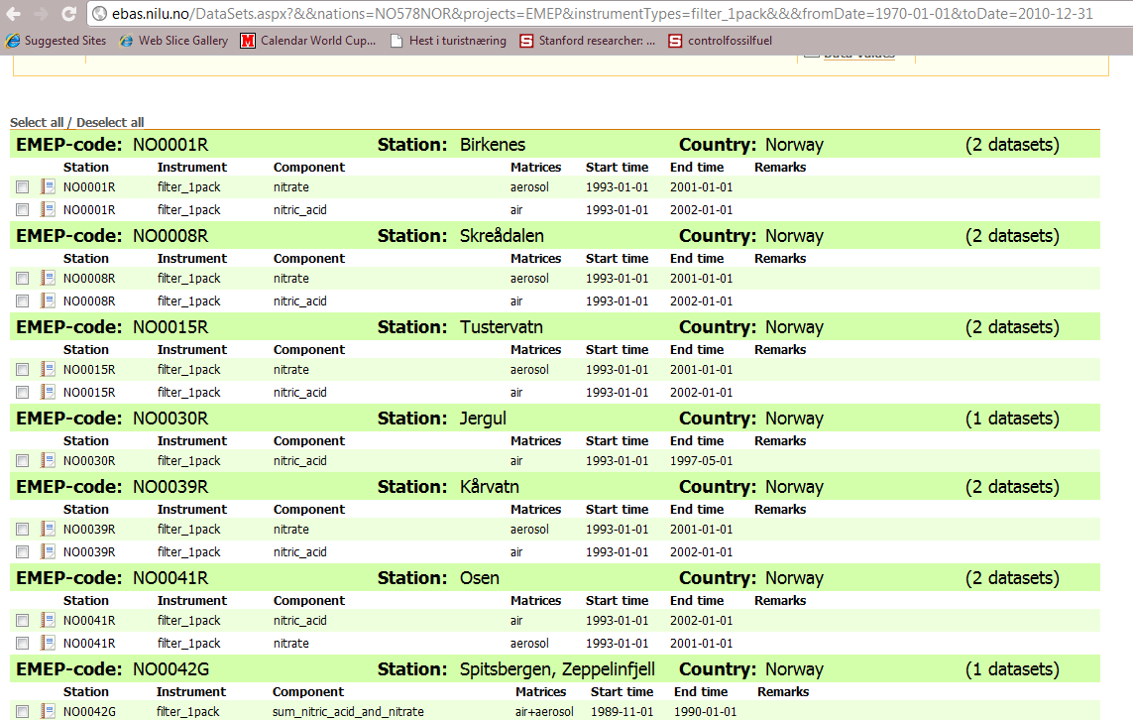
EBAS

Slide 5
EBAS

Slide 6
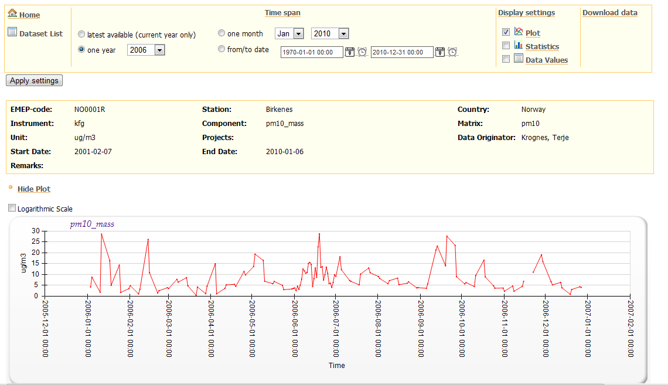
EBAS

Slide 7
FLEXTRA
http://www.nilu.no/trajectories/
Flextra trajectory plots are made four times a day for each location. There are currently plots for 322 locations from 1996 until present date minus three days. Each trajectory spans 7 days in time. There are 3 trajectories in each plot with three different heights at arrival. Height above sea level at arrival is indicated by the legends in the upper right corner of each plot. Height along the trajectories is indicated by colour (colour/height scale in the lower left corner of the plot). Each 3-hour interval along the trajectorie path is indicated by a small legend, each 24-hour interval by a big legend.

Slide 8
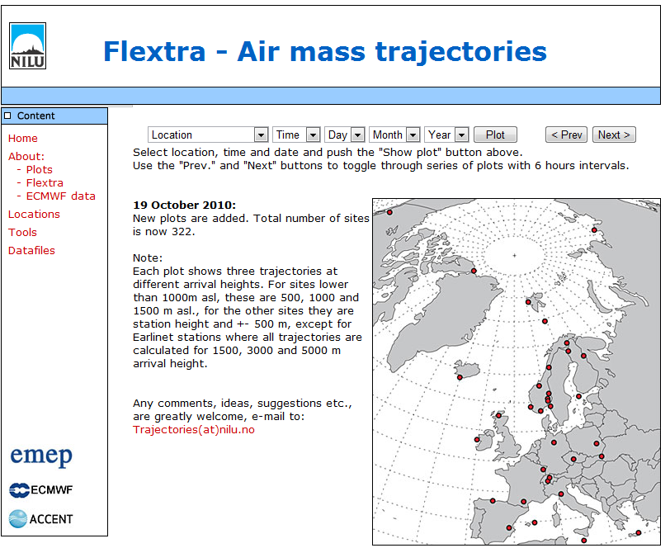

Slide 9
