Slide 1
NILU – making a difference for the environment

Slide 2
NILU’s organisation
Managing Director
Tromsø
Research Director
Administration
Deputy Director
Urban
Environment and Industry
(INBY)
Centre for
Ecology and
Economics
(CEE)
Monitoring and Instrumentation
Technology
(MIT)
Environmental
Chemistry
(MILK)
Software and Hardware solutions
(SHADE)
Atmospheric
and Climate
Research
(ATMOS)
NILU UAE
Abu Dhabi United Arab Emirates

Slide 3
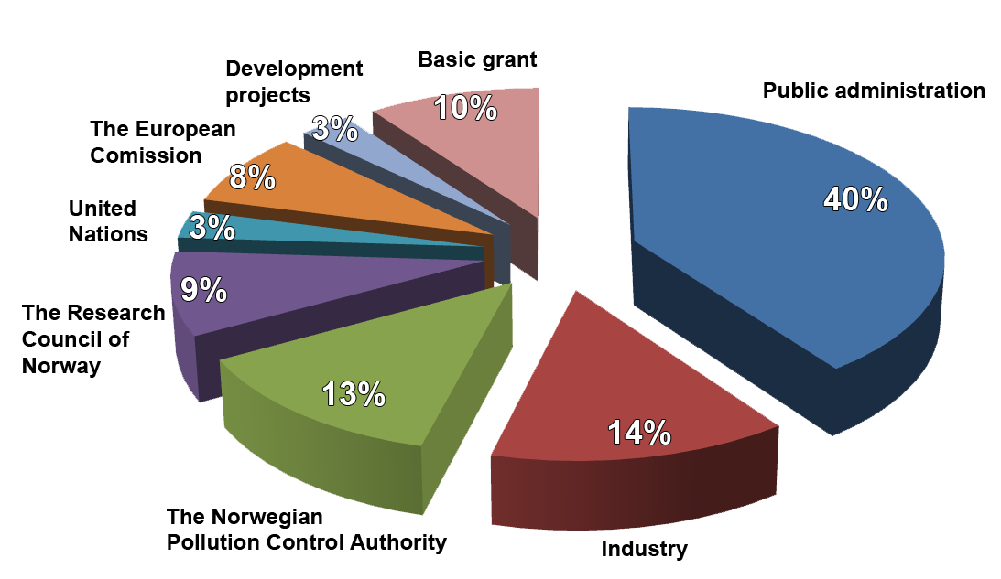
NILU’s key figures
Founded in 1969
Independent foundation from 1986
Annual turnover 184.4 MNOK
192 employees
56 scientists with a PhD

Slide 4
Work areas
Atmospheric composition
GHG and climate change
Ozone layer depletion and UV radiation
Long range transport of air pollution
Urban and industrial pollution
Aerosols and particulate matter
Chemicals and their environmental effects
Health effect studies
Ecological economics

Slide 5
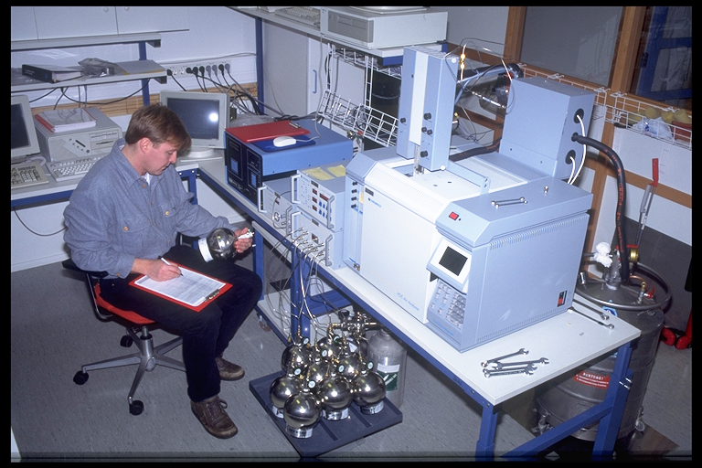
Accredited laboratories
Chemical laboratory
Organic lab
Inorganic lab
Instruments and IT - Data transfer and handling - Instrument development - Reference laboratory

Slide 6
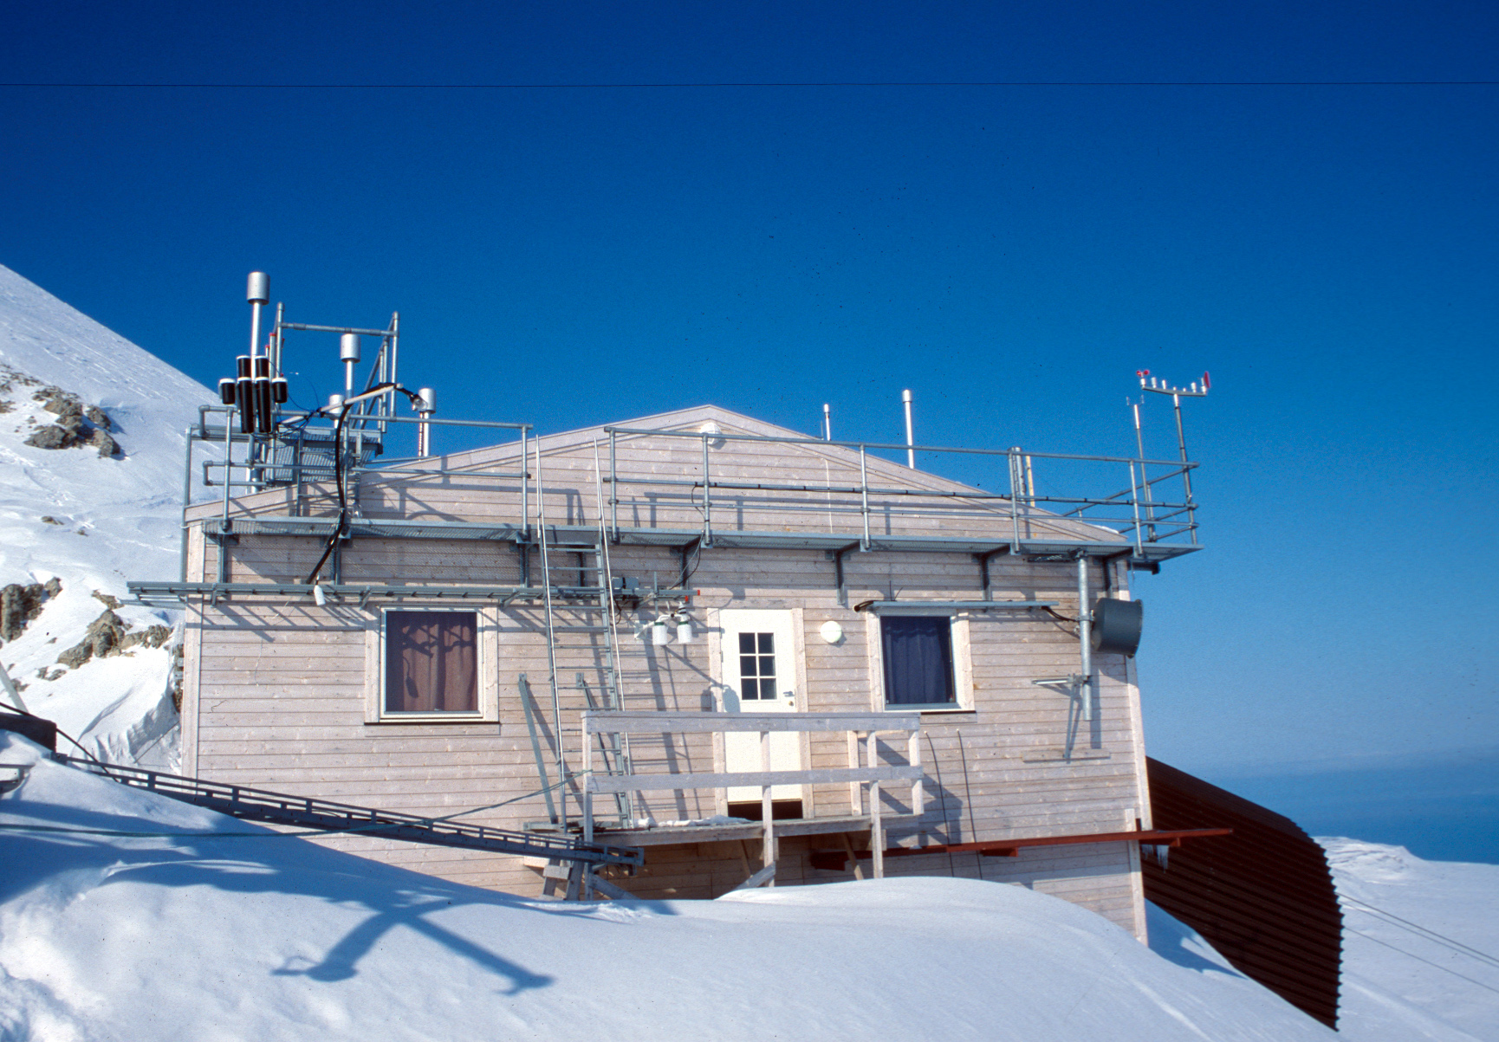
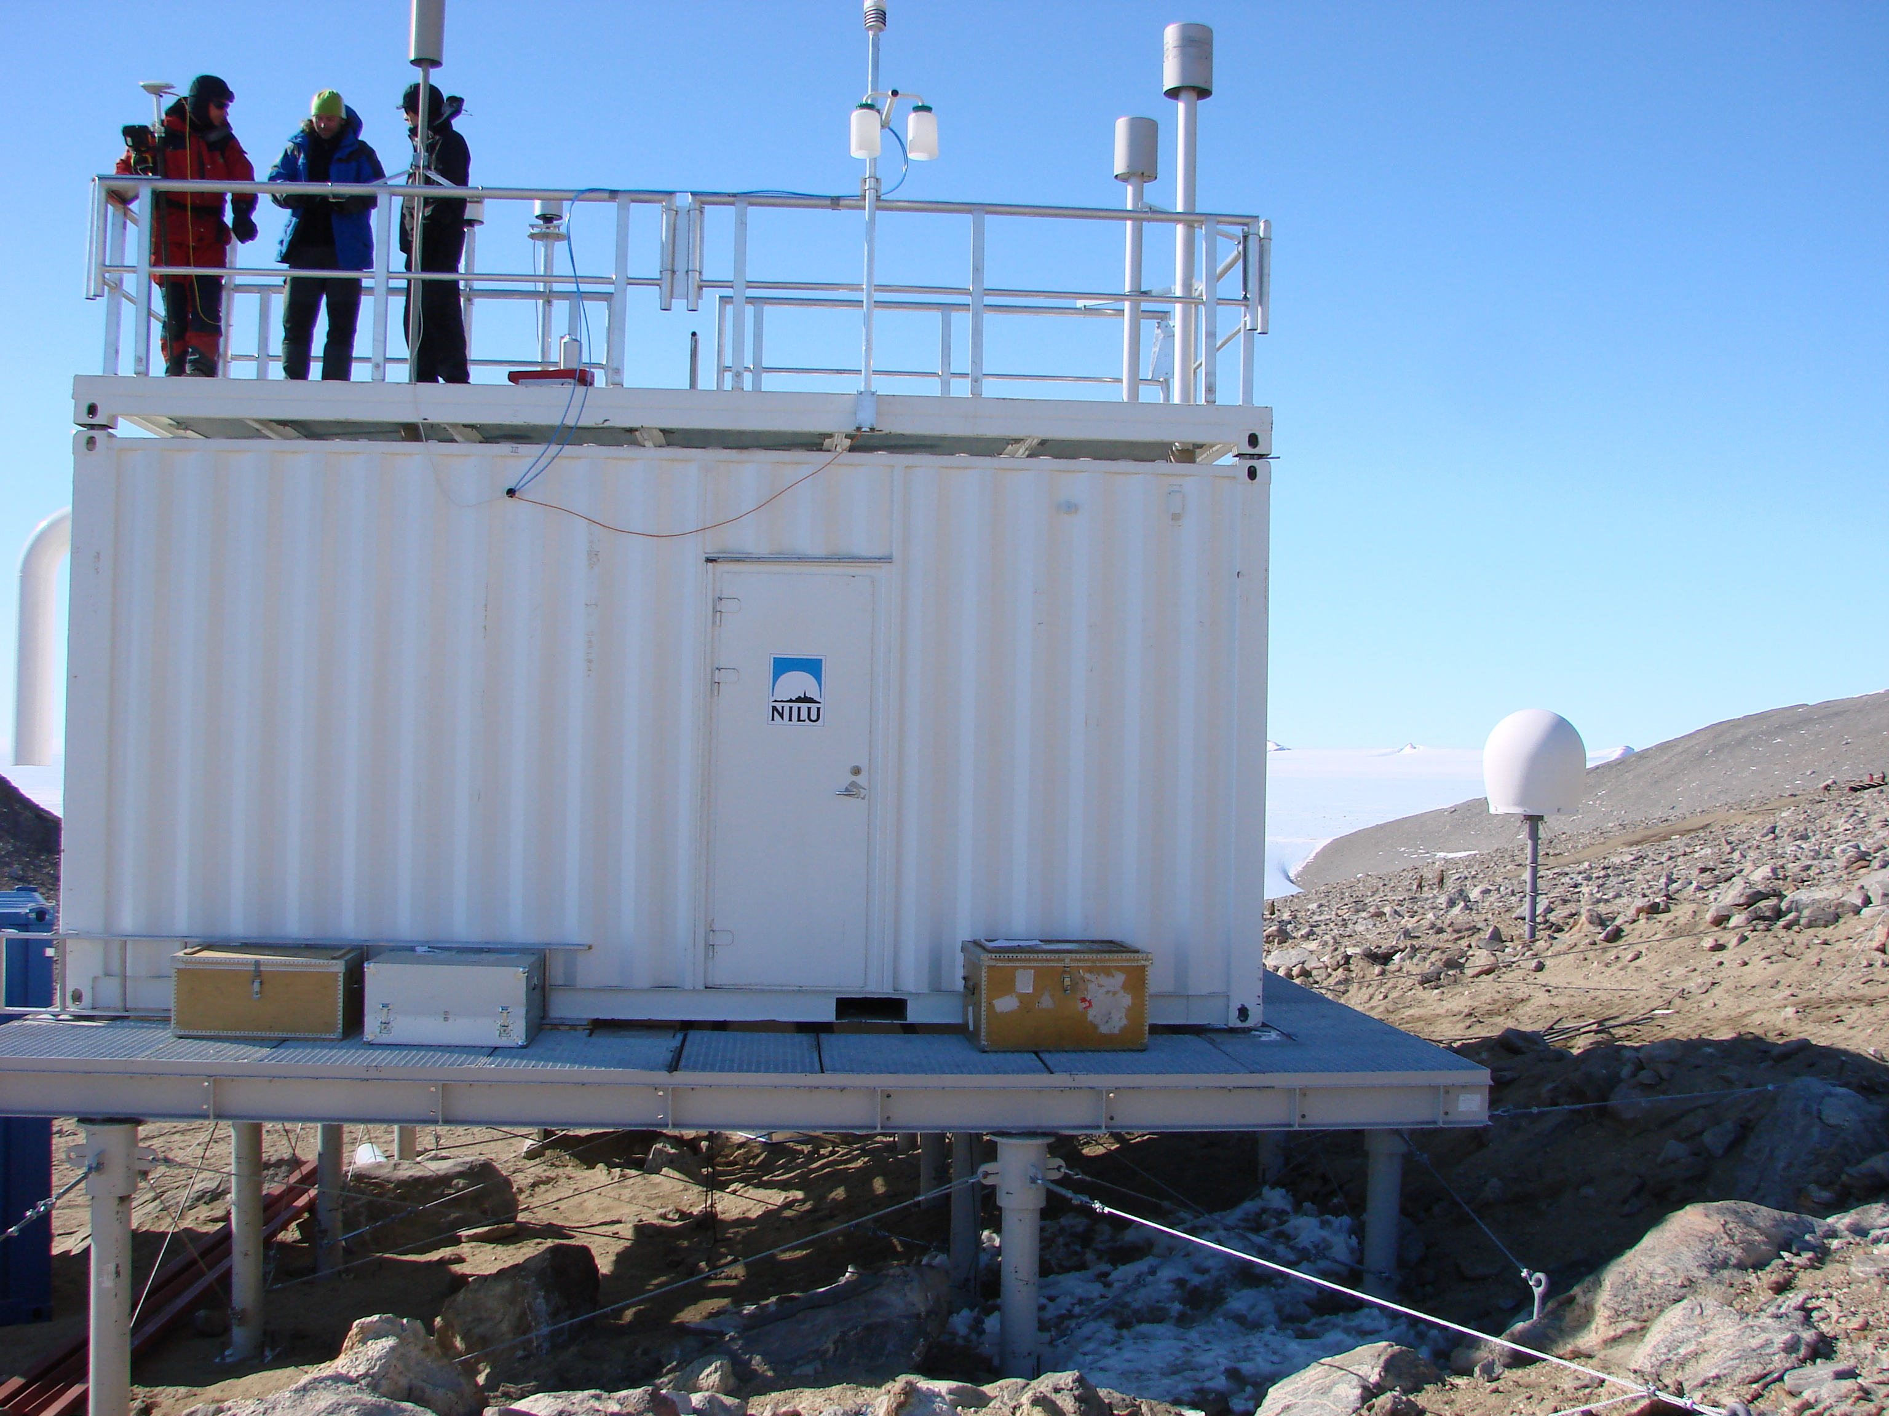
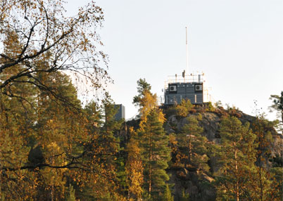
NILU from pole to pole
NILU monitors climate change, global air quality and air pollution transport pathways
Zeppelin in the Arctic
Troll in the Antarctica
ALOMAR and Birkenes in Norway
Supplying researchers all over the world with important data

Slide 7
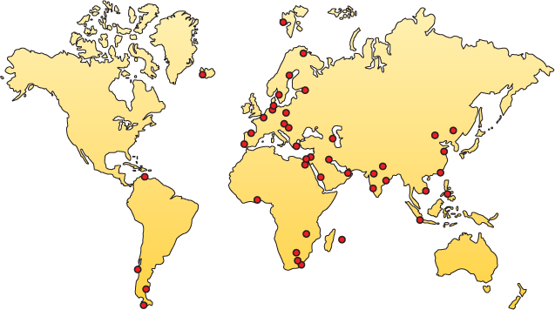
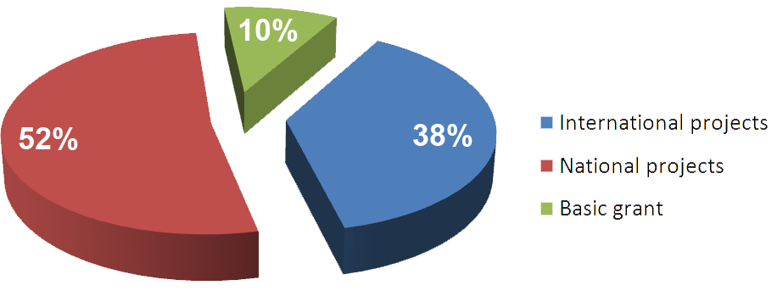
International activity
2010

