Slide 1
The EMEP programme
Objectives and QA/QC
Wenche Aas

Slide 2
Goal of this course
Submit 2009 data to EMEP
Improve the data quality
Increased involvement in EMEP
Improve the communication between us
To better know each others problems and needs
Seeds for further cooperation and new projects
Enjoy the stay and the company ☺

Slide 3
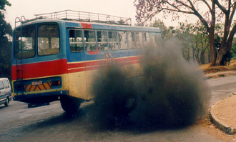
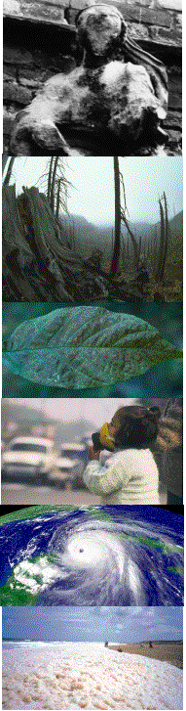
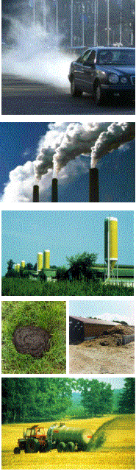
Air pollution and impacts
Receptors
Cultural heritage
Ecosystems
Crops
Humans/animals
Climate
Estuaries
Atmospheric transport
and chemistry
.
.
.
.
.
.
.
.
.
.
.
.
gases
+
aerosols
Deposition losses
Mobile, industrial
and non-point sources
Notes:
Sources: wide range
Various

Slide 4
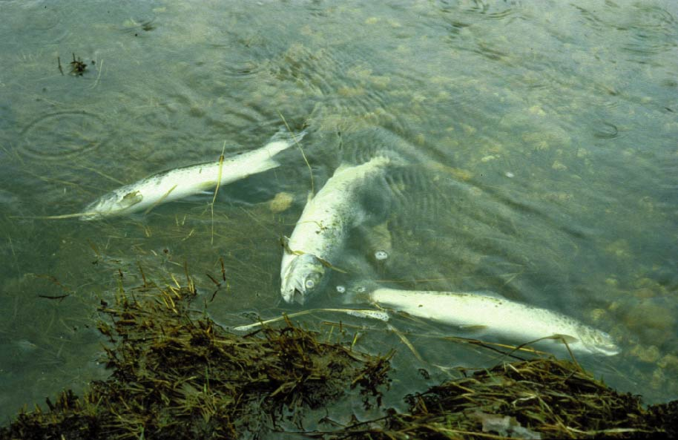
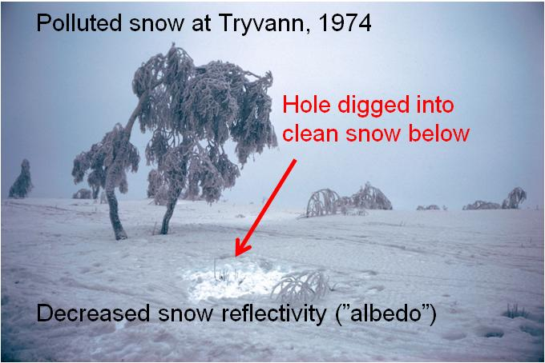

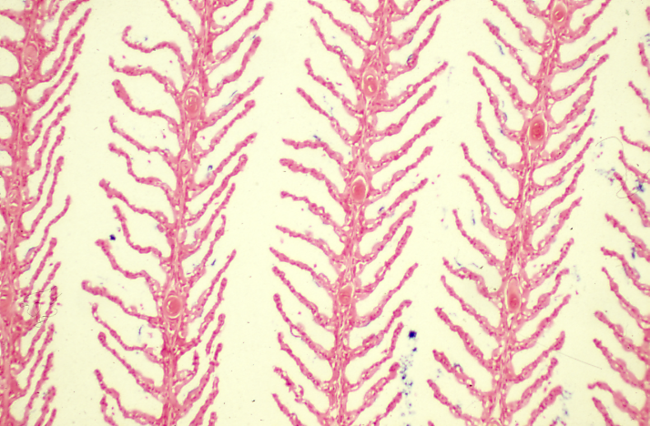
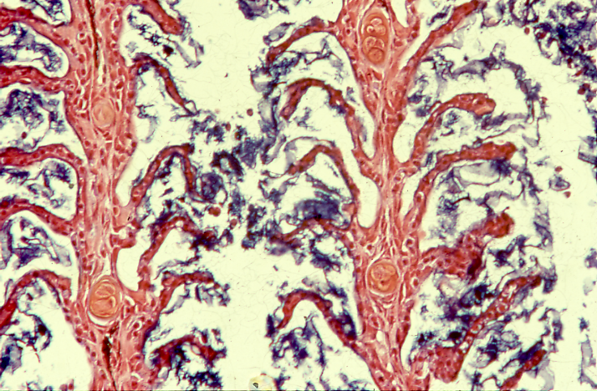
Long Range Transport of Air Pollutants
Gills - not damaged
Gills - damaged
Notes:
Since 1979 the Convention on Long-range Transboundary Air Pollution has addressed some of the major environmental problems
through scientific collaboration and policy negotiation. The Convention has been extended by eight protocols that identify specific measures to be taken by Parties to cut their emissions of air pollutants.
Lost fish stocks: important exapmle of inetractiosn between sceins and policy that works
Monitoringng networks establish both for research and controll!

Slide 5
UN-ECE Convention on Long-Range Transboundary Air Pollution ( 51 Parties)
- 8 Specific protocols, where the first is
European Monitoring and Evaluation Programme (EMEP) (42 Parties)
The EMEP vision;
To be the main science based and policy-driven instrument for international cooperation in atmospheric monitoring and modelling activities, emission inventories and projections, and integrated assessment to help solve transboundary air pollution problems in Europe

Slide 6
Protocols to the Convention
1999 Gothenburg Protocol to Abate Acidification, Eutrophication and Ground-level Ozone;
1998 Aarhus Protocol on Persistent Organic Pollutants (POPs)
1998 Aarhus Protocol on Heavy Metals
1994 Oslo Protocol on Sulphur
1991 Geneva Protocol on Volatile Organic Compounds
1988 Sofia Protocol on Nitrogen Oxides
1985 Helsinki Protocol on Sulphur
1984 Protocol on Long-term Financing of the Cooperative Programme for Monitoring and Evaluation of the Long-range Transmission of Air Pollutants in Europe (EMEP); 43 Parties.

Slide 7
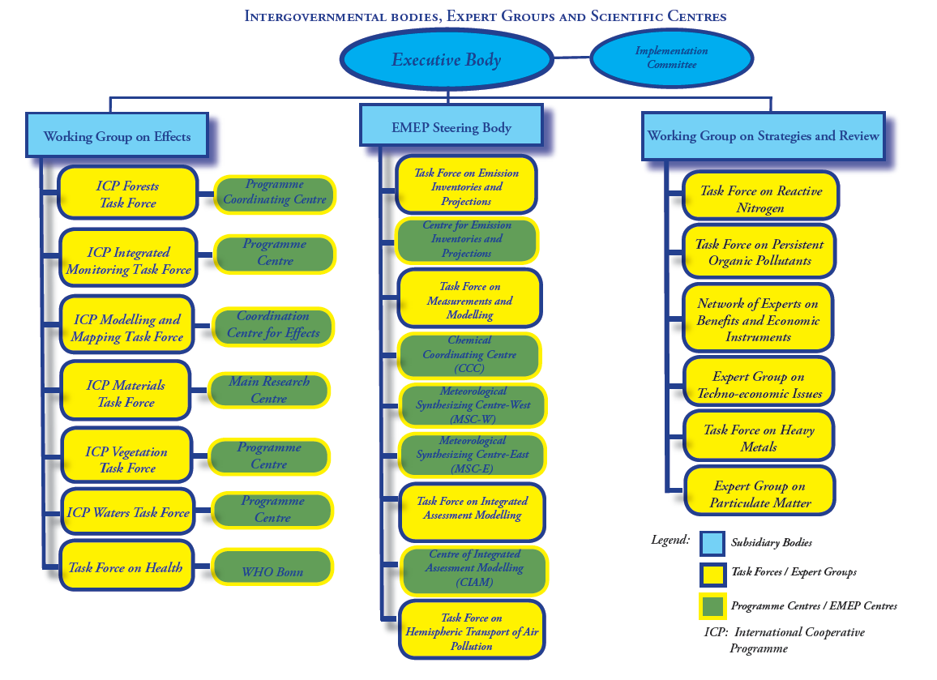
TFMM
CCC
HTAP

Slide 8

EMEP Monitoring strategy
http://www.unece.org/env/documents/2009/EB/ge1/ece.eb.air.ge.1.2009.15.e.pdf

Slide 9
Monitoring programme:
Level 1
Main ions in precipitation and in air
heavy metals in precipitations
ozone
gas particle nitrogen ratios (low cost)
PM₁₀ and PM_{2.5} mass
meteorology
at ca 125 sites
Level 2, supersite (joint EMEP/GAW)
PM composition (EC/OC, mineral dust)
Aerosol physical and optical properties
CH₄
Tracers (CO and halocarbons)
POPs
Heavy metals in air and aerosols
VOC
+ all level 1 activities
20-30 sites
Both levels are mandatory by all Parties

Slide 10
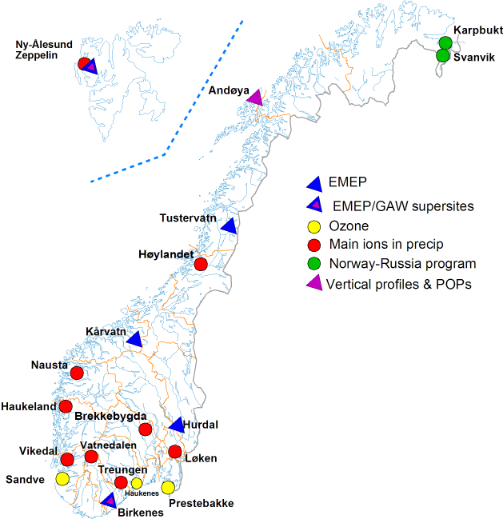
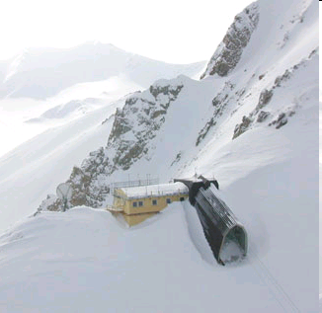
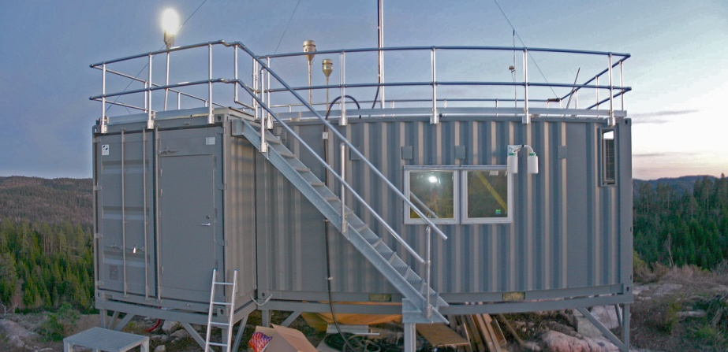
Norwegian rural sites, 2010
Zeppelin
Birkenes

Slide 11
EMEP monitoring programme, Level 1 –core EMEP sites
Observations contribute to the assessment of atmospheric transport and deposition of key parameters relevant for acidification, eutrophication, photochemical oxidants, heavy metals and particulate matter

Slide 12
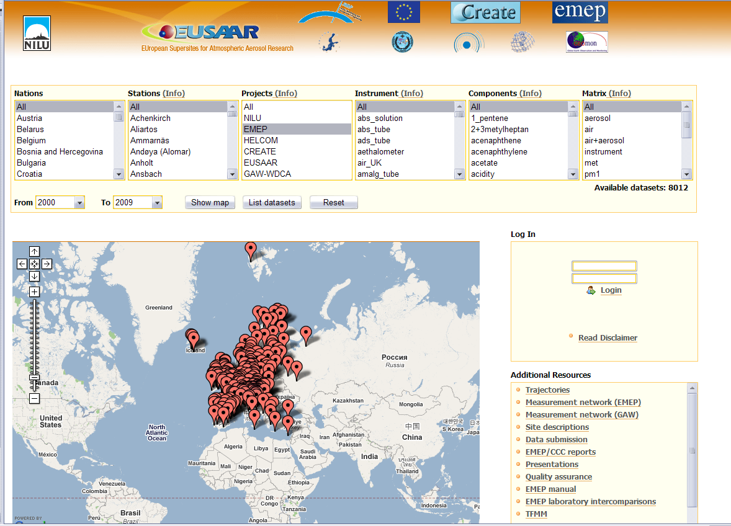
ebas.nilu.no

Slide 13

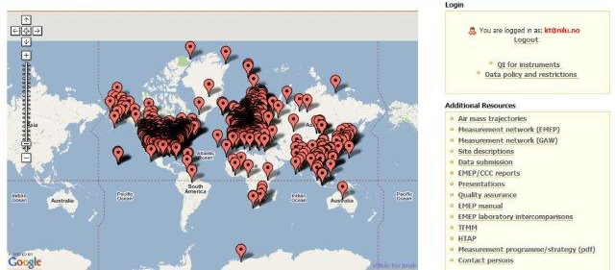
HTAP – Global database
The most comprehensive data compilation ever made (?)
Data from a large number of programmes and projects can be downloaded in one harmonized format
Data access: “restricted, simplified procedure”
Evaluation in progress
www.htap.org
Password protected:
http://ebas.nilu.no/

Slide 14
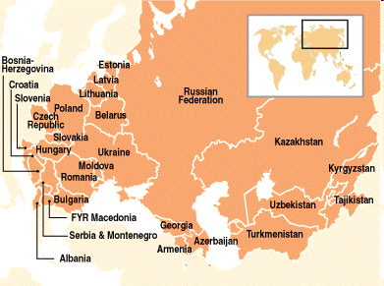
EMEP sites in the EECCA region
KZ: Borovoye
MD: Leovo
GE: Abastumani
Az: during 2011
AR: Amberd

Slide 15
Air pollution and impacts
Aerosols
Aerosols
Notes:
Complexity:
Understabnd emissions
Natural variability
On Issues sources and trace gases: Interactions
Feedback

Slide 16

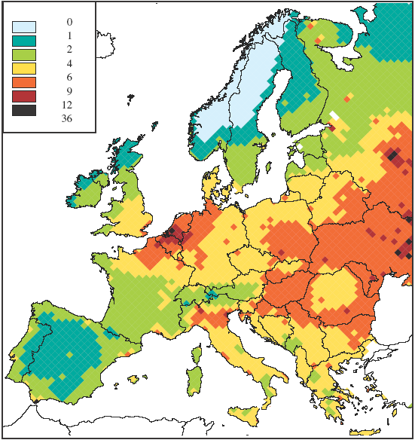
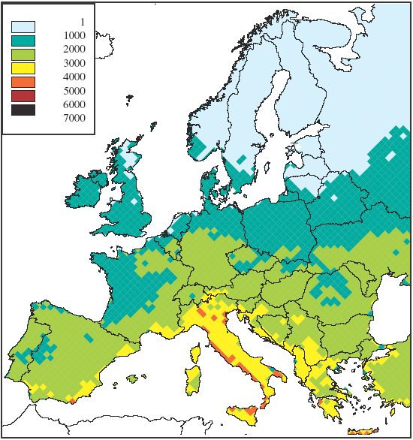
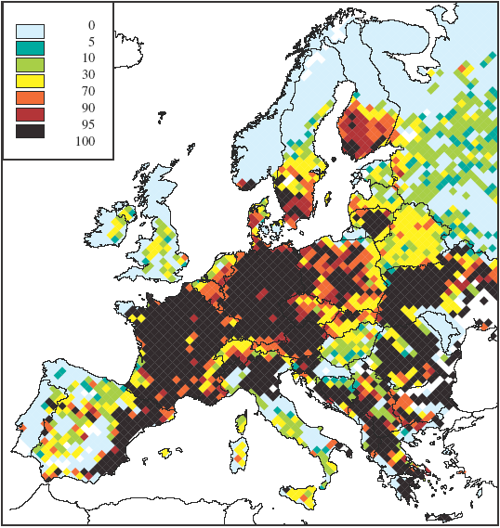
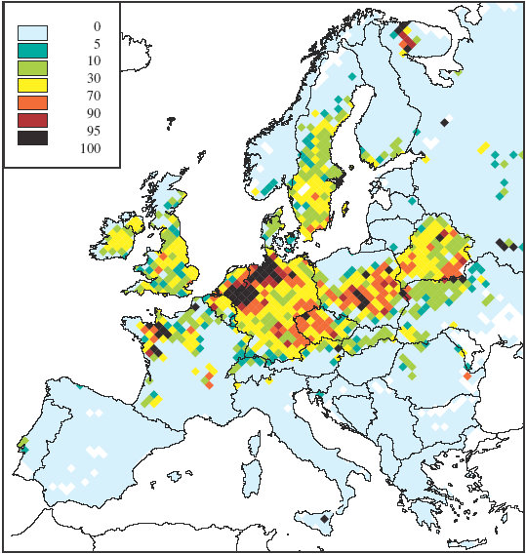
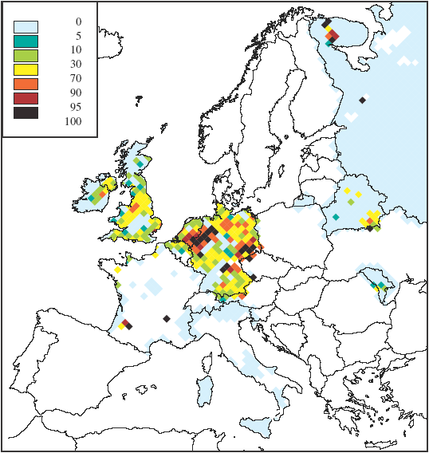
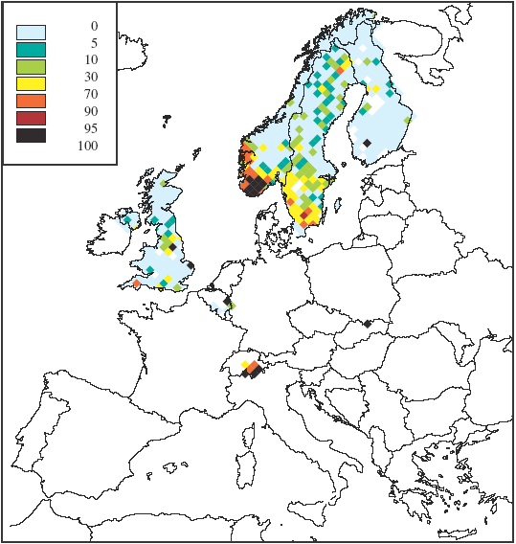
Projections for 2020
Light blue = no risk
Health - PM
Health+vegetation - ozone
Vegetation – N dep.
Forests – acid dep.
Semi-natural – acid dep.
Freshwater – acid dep.
Notes:
Det vil fortsatt være store utfordringer innenfor langtransportert luftforurensninger fremover. Partikler og ozon som helseproblem og nitrogen eutrofiering er et stort problem, og mer fokus må rettes mot ammoniakkutslipp i Europa. Og selv om ikke fokuset er stor på sur nedbør lenger så vil dette fortsatt være et miljøproblem, særlig i Norge.

Slide 17
Aerosols, urban vs background levels
Illustration from Berlin where almost 50% of the PM₁₀ concentration comes from the regional background
PM [µg/m³]
Urban areas
countryside
40
35
Traffic, local sources
30
25
urban background
20
regional background
15
10
hemispheric/natural background
Ref: Martin Lutz, Senate Department for Urban Development Berlin
Notes:
Total sources important! Regional and hemispheric background!

Slide 18
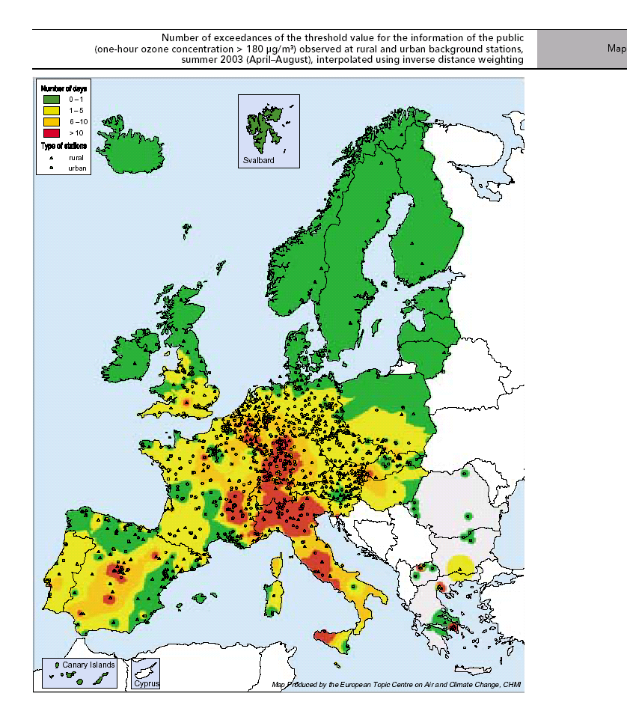

Ozone concentration and health issues in relation to warmer climate?
ETC/ACC
Summer 2003
Notes:
I tillegg er jo ozon et helseproblem, spesielt i sentralEuropa. Her ser vi eksempel fra tørkesommeren i 2003, klima påvirker dannelsen av ozon,

Slide 19
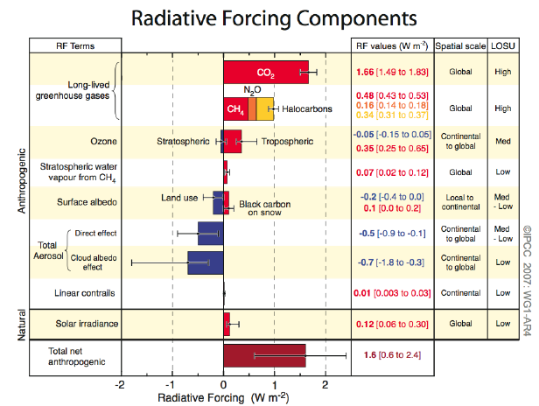
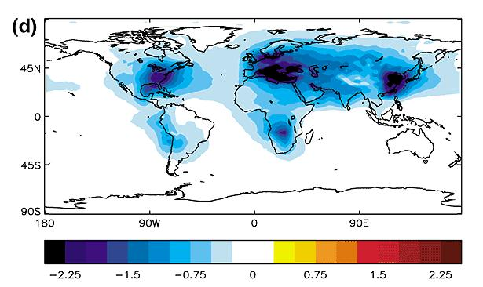
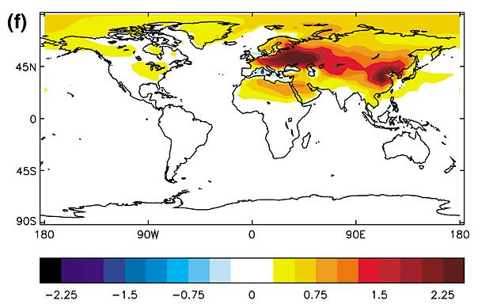
High uncertainty in both direct and indirect effect of aerosols on the climate
Radiative forcing by sulphate and by carbonaceous material

Slide 20
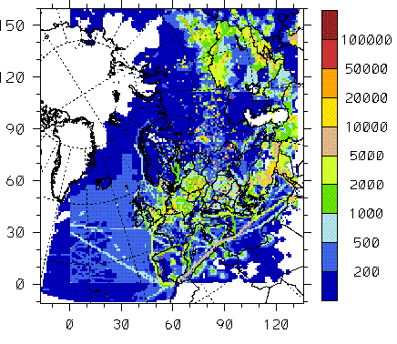
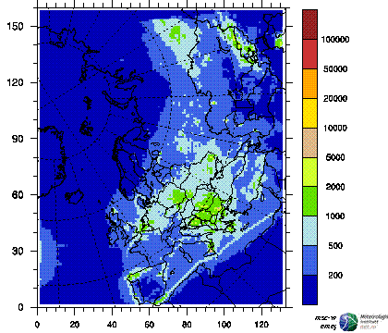
Spatial distribution of sulphur, 2007
SO₂
SO₄ in aerosols
SO₄ in precip
Total S deposition model
S ox emissions

Slide 21
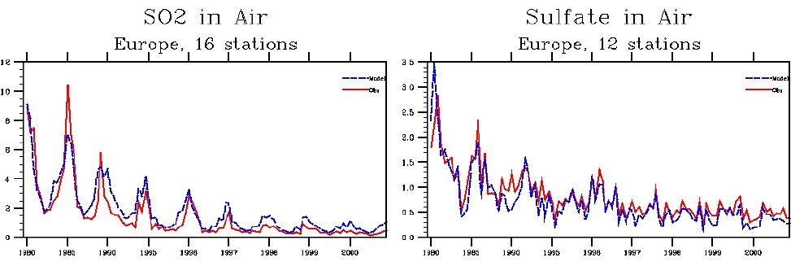
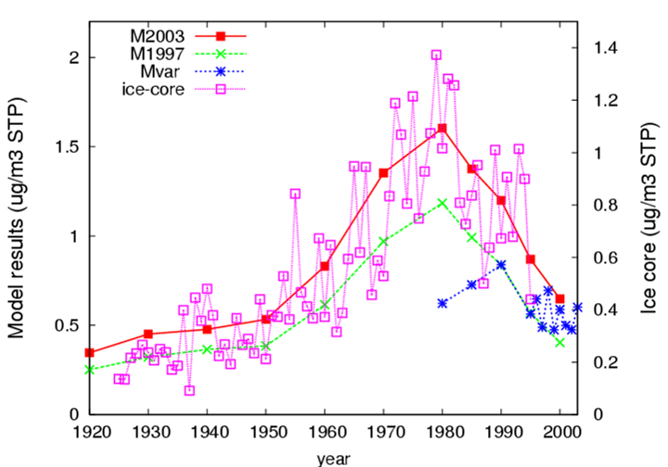
Long-term changes in sulphur
Notes:
Old model could not do this

Slide 22
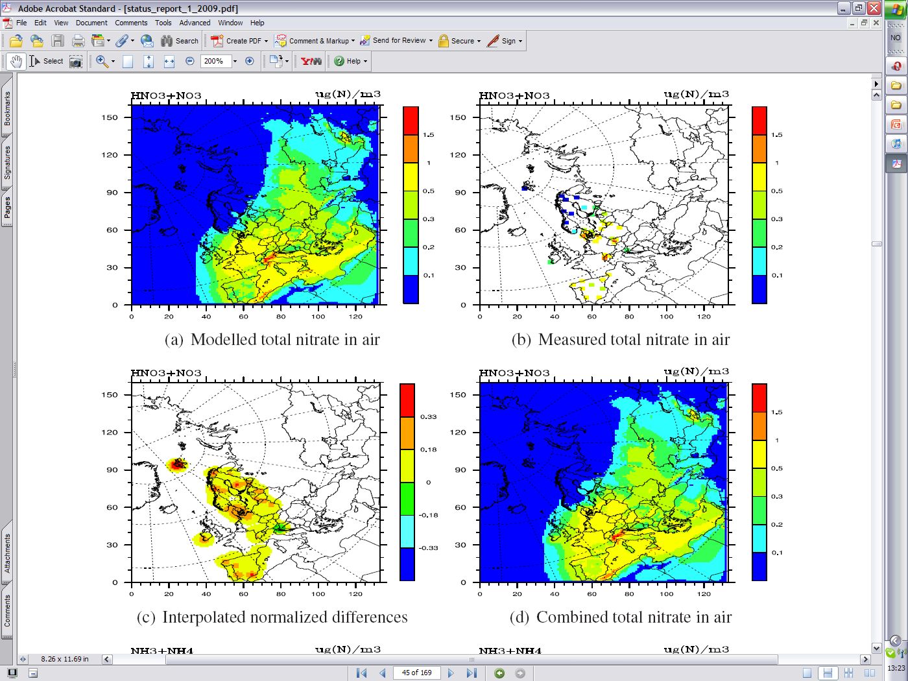
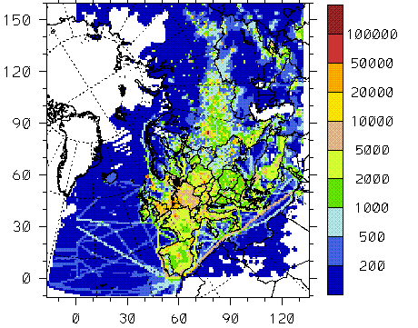
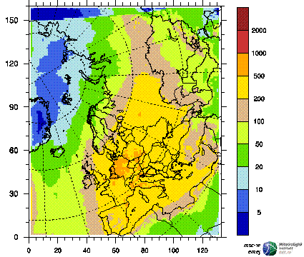
Spatial distribution of ox. nitrogen, 2007
NO₂
NO₃ in precip
HNO3 + NO₃ in air
Tot N ox deposition model
NO_{x} emissions

Slide 23
Trends in EMEP obs. (1990 -2008)
20 sites with N in air and 33 sites with S,N in precip and S in air
Emission
reduction
61%
25%
25%
Nonlinearity in trends due to:
Change in chemical composition in air. Less (NH₄)₂SO₄ and more NH₄NO₃. Shift in equilibrium between HNO₃ + NH₃ = NH₄NO₃
Change in oxidation capacity of the atmosphere

Slide 24
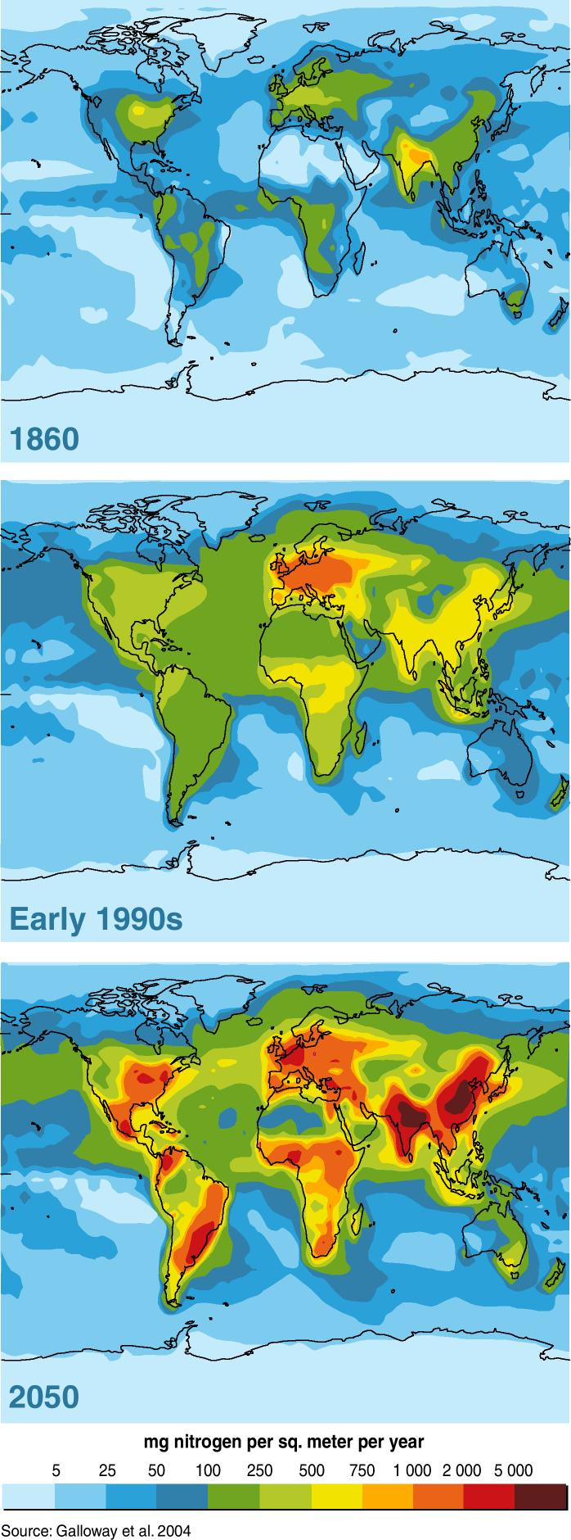
Atmospheric Nitrogen Deposition
Past and Present
mg N m⁻² yr⁻¹
Millennium assessment
Dentener, 2004; Galloway et al., 2004
Nitrogen is an increasing problem globally though regional differences.
  Eutrofication, Biodiversity, production of ozone, climate forcing, particulate matter
Notes:
Perspective
Incerase:
Agriculture and forestry: NH3, Combustion:Nox

Slide 25
Data quality objectives
10% accuracy or better for oxidized sulphur and oxidized nitrogen in single analysis in the laboratory
15% accuracy or better for other components in the laboratory
0.1 units for pH
15-25% uncertainty for the combined sampling and chemical analysis
90% data completeness of the daily values

Slide 26
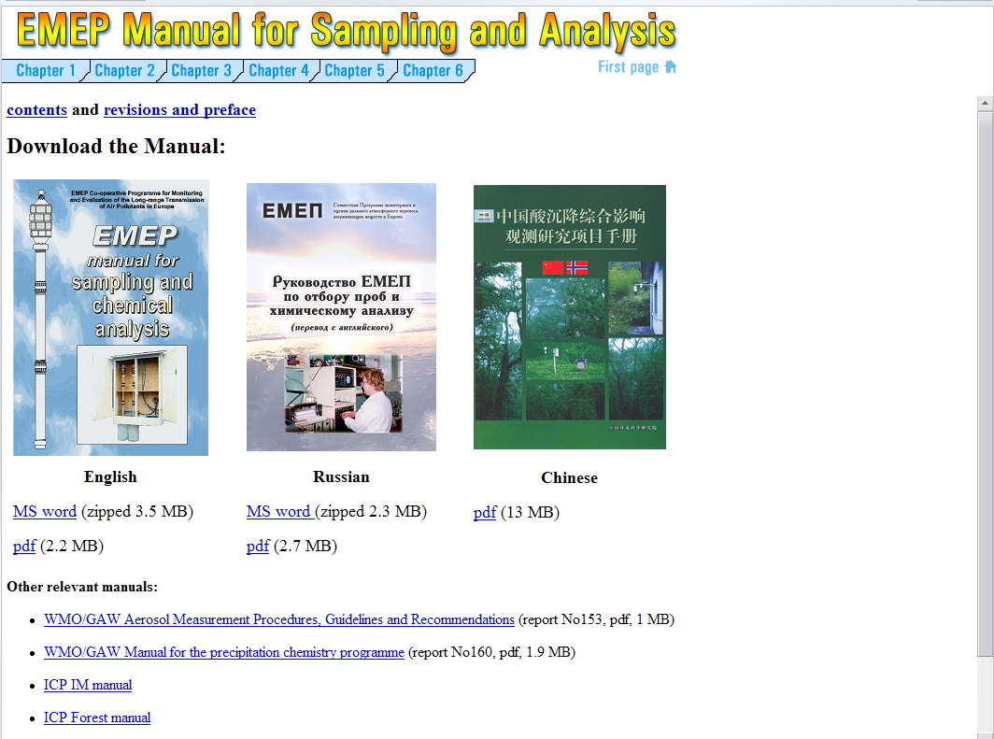
http://tarantula.nilu.no/projects/ccc/manual/index.html
WMO
ICP

Slide 27
Sources of uncertainties
Sampling and analytical method
  Detection limit
  Interference
  Instrument drift, calibration
  Positive or negative artefact
Sampling procedure
  Contamination
  Temperature and period for storage
  Transport
Representativity.
  Local farming (NH₃)
  Nearby roads (NOx; O₃)
  Dust (PM, Ca..)
  Local heating (SO₂, PM, EC/OC)
Lab- and field intercomparison
Ion balance plot
Field inter-comparison; model comparison
Repr. studies, i.e passive sampling. Model comparison

Slide 28
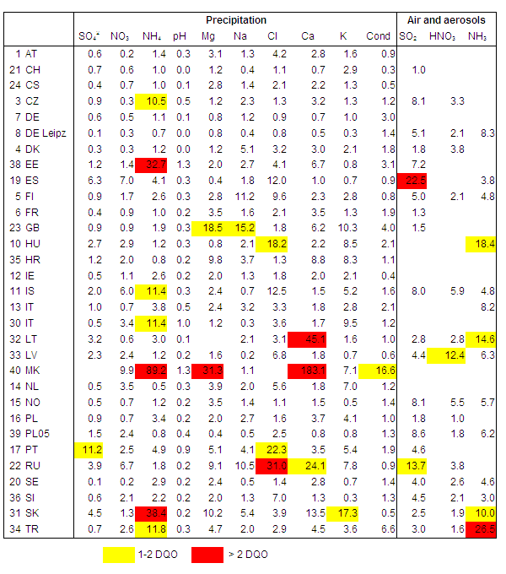
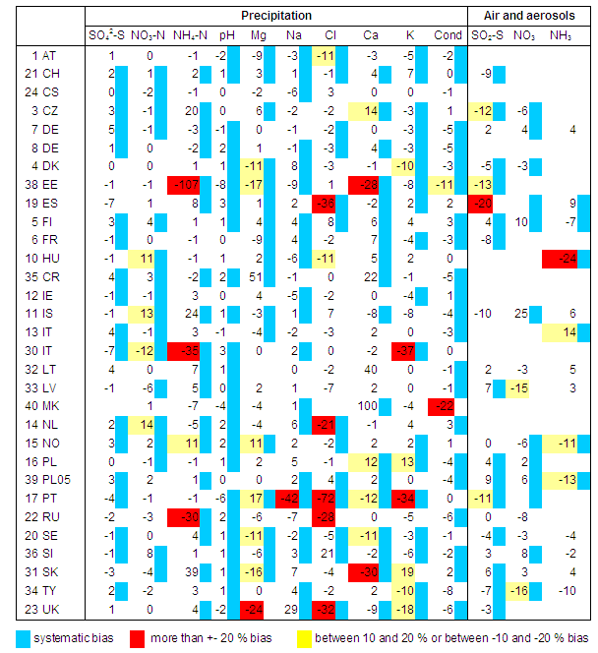
Lab intercomparisons annually
Spread: 2RSD %
Bias: RB %

Slide 29
Field intercomparison (i.e. SO₂ )
Preila (LT) using filterpack
Zarra (ES) , abs (H202) and monitor
TCM ain Germany (historic data) at DE09 (left and DE03 (right)

Slide 30
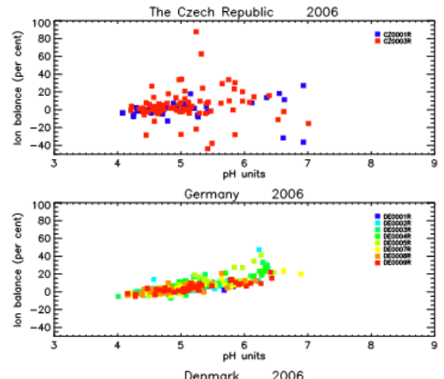
Ion balance plot

Slide 31
Measurement and model intercomparison
??
ES
NO

Slide 32
Uncertainties in trends
SO₂
SO₄ in air

Slide 33
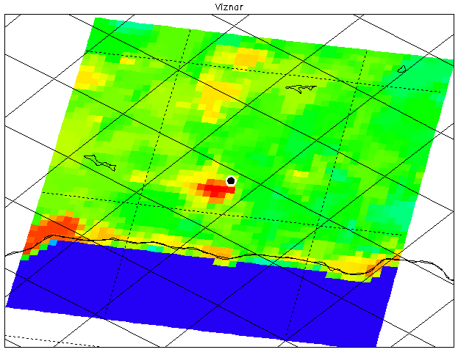

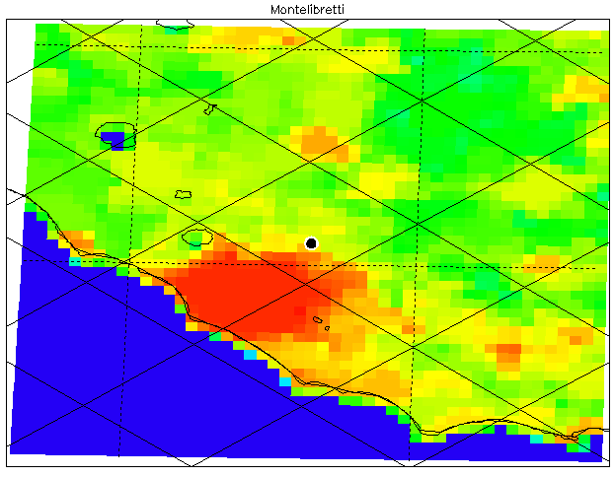
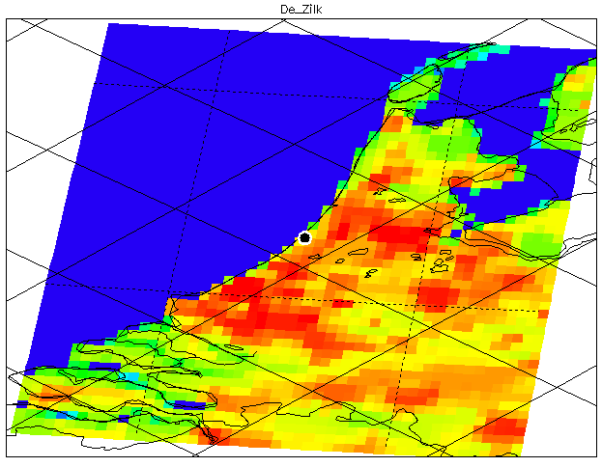
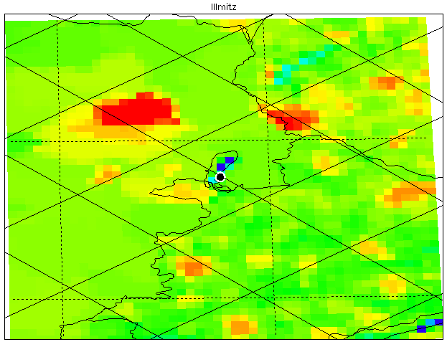
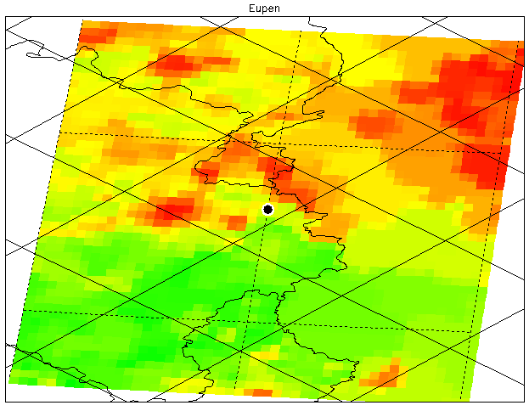
Representativity, NO₂
ES07
Comparing EMEP model and obs. in light of population density
IT01
NL91
BE32
AT02

Slide 34
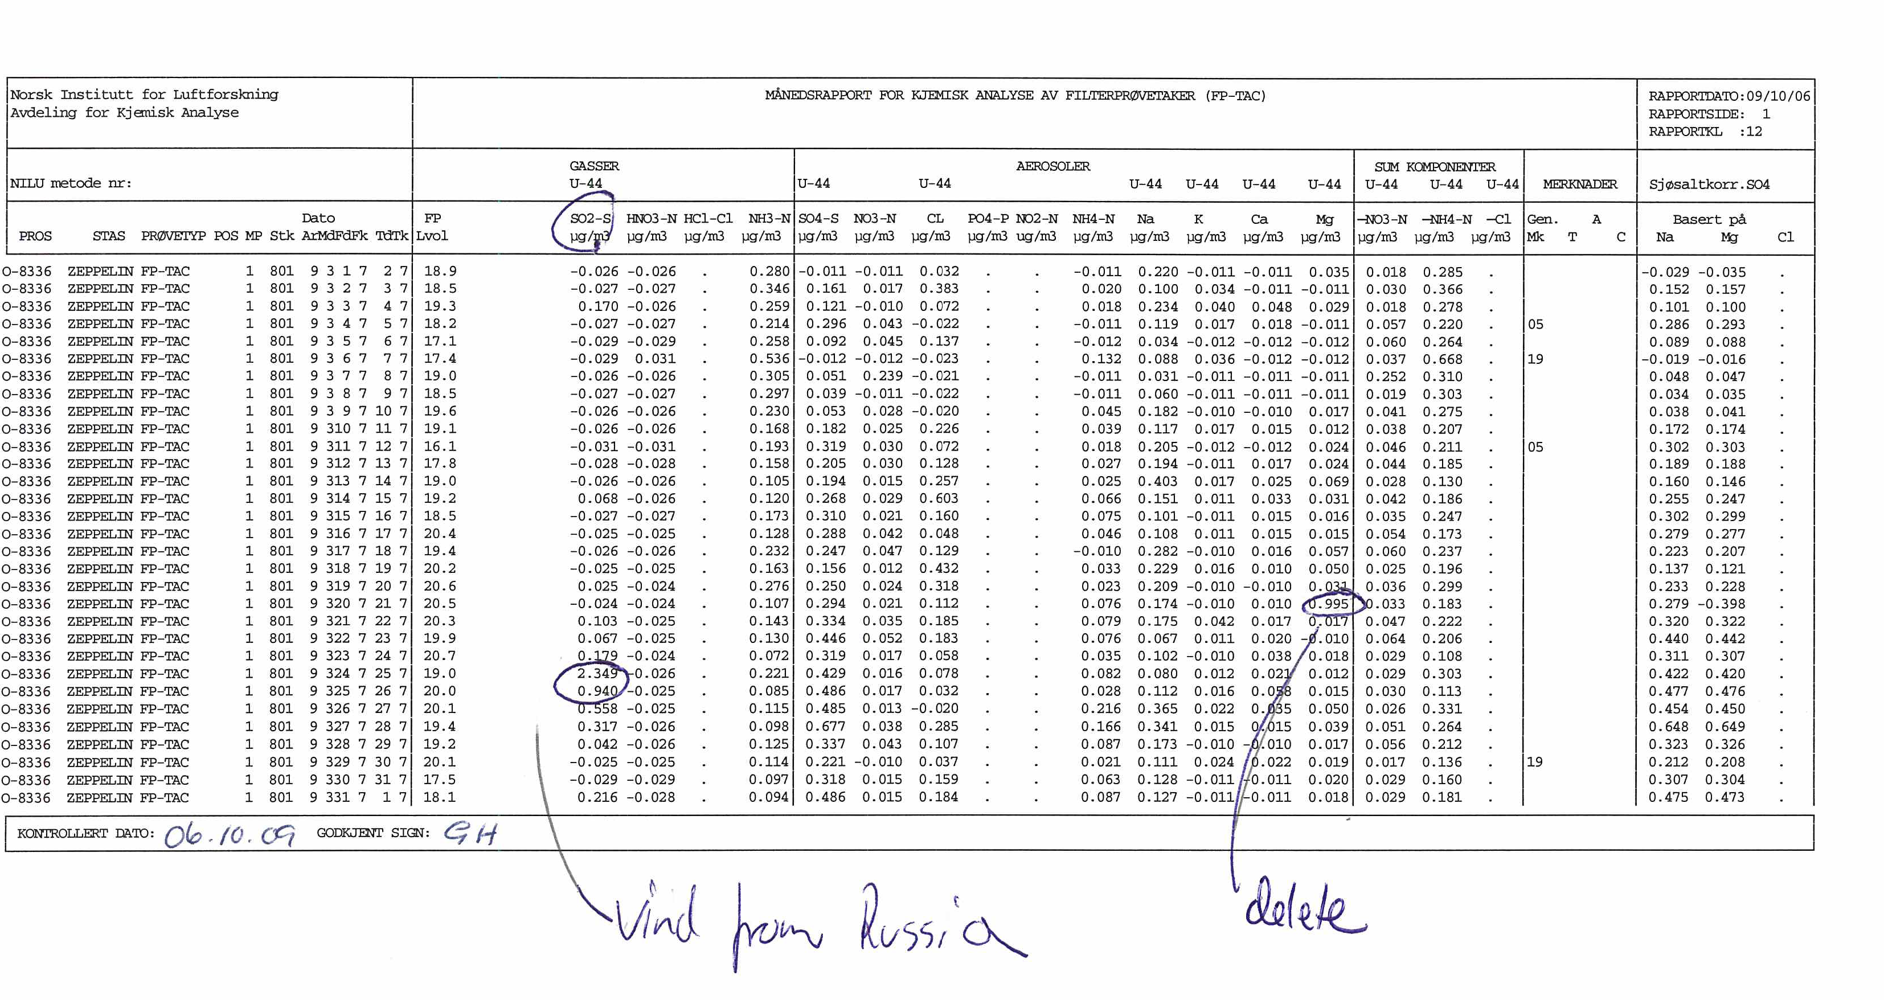
Evaluation of the data, outliers (1)

Slide 35
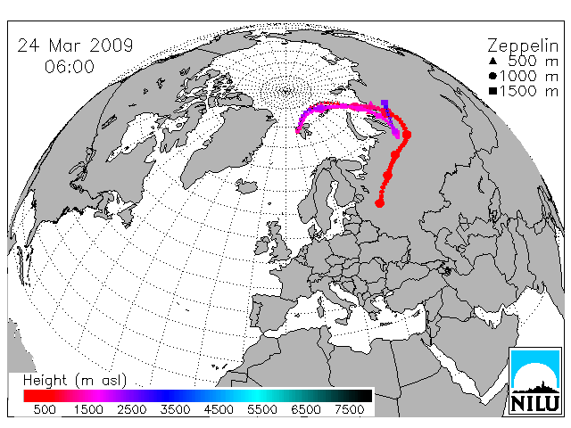
Use trajectories to check episodes
Date
SO2
OK data.
LRT episode
http://tarantula.nilu.no/trajectories/index.cfm

Slide 36
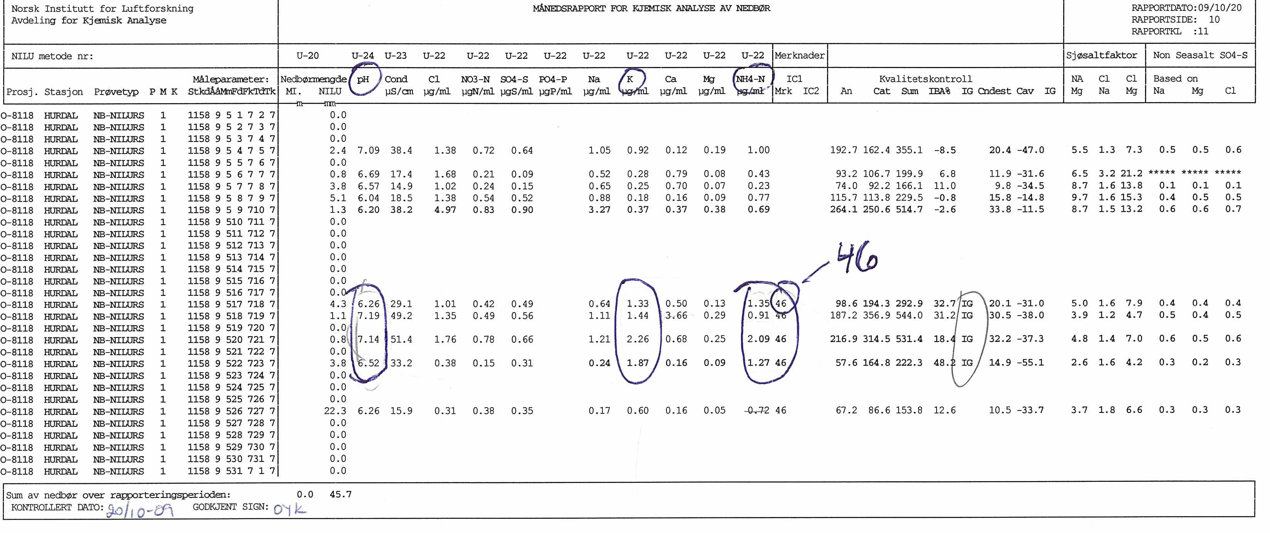
Evaluation of the data, outliers (2)

Slide 37
Use information of ion balance test and flag:
Flags
46: From station keeper: dust found in collector
IG: Outside ion balance criteria, reanalysis of samples
Delete pH. K and NH4

Slide 38
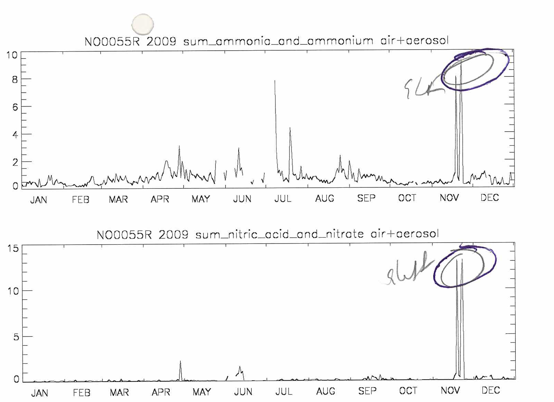
Evaluation of the data, outliers (3)
Important to plot data in timeseries to visualise/detect outliers

Slide 39
Summary
The measurements in EMEP is the core activity in the Programme
  Model evaluation/validation
  Compliance monitoring and trend analysis
  Assessment of status and identification of sources
  Involvement of the Parties
High or known quality is the trademark
  Waste of money and time with poor data
  Good sites and labs usually experience spin of effect –i.e new research projects etc

