Slide 1
Quality Control
Some examples from NILU

Slide 2
Main “enemies” of reliable analytical results
Deviations from true value
Excessive variability
How to keep control:
Certified Reference Materials
Laboratory intercomparisons
How to keep control:
Daily pipette check
Daily scale check
Blank control
Control samples
Control charts
Notes:
At NILU we have control samples and charts for
Scales: control plumbs lots? , control filters
Pipettes:

Slide 3

Pipette no |  | Volum | Approved area |  |  | Approved precision
 |  | (ml) | (g)
1 |  | 0.100 | 0.098 | 0.102 |  | 1.00 %
 |  | 0.050 | 0.049 | 0.051 |  | 2.00 %
 |  | 0.010 | 0.009 | 0.011 |  | 5.0 %
2 |  | 1.000 | 0.994 | 1.006 |  | 0.40 %
 |  | 0.500 | 0.497 | 0.503 |  | 0.50 %
 |  | 0.100 | 0.098 | 0.102 |  | 1.0 %
Notes:
precision
presicion

Slide 4
Blank control
Sample type Purpose
Calibration blank Instrument background signal
Matrix blank Contamination control
Filter blank Contamination control
Field blank Sample handling control

Slide 5
Field blank
Notes:
Field blank is a sampler that is prepared as the ordinary samplers, sent to the sampling site, stored with the other samplers and sent back to the lab without being exposed. The sample is then analysed together with the exposed filters. The field blank samples are showing the contribution from sample handling and is the basis for computation of method LOD.

Slide 6
Control sample
Independent of the calibration standards
Stable
Matrix matched
The control samples are mainly used to monitor the precision, but if the control sample is traceable to a CRM, it can be used as a measure for accuracy of the method.
Notes:
Control samples must be made from a different stock than the calibration standards.
The control samples are mainly used to control the precision, but
if the control sample is traceable to CRM, it can be used as a measure for accuracy.
In NILUs Ionchromatography analysis we use to control samples to verify the calibration curve. One is in the low concentration area and the other on in the middle of the curve

Slide 7
IC: Typical sequence of analysis
Tube No Sample Id Sample definition
1-3 Blank Calibration Blank
4-12 Standards Calibration standards
13 QS (K1) Unknown
14 Water Unknown
15 QS (K2) Unknown
16-46 Samples Unknown
47 QS (K1) Unknown
48 Water Unknown
49 QS (K2) Unknown

Slide 8
Ionchromtograph 1, Chloride, QC –sample K2

Slide 9
Out-of-control process
QS outside alarm limit: Results not approved
Actions: Check calibration, standards, instrument, software etc and reanalyze all samples
2. > 10 QS in a row outside warning limit:
  Do as above!
3. Look for trends
Notes:
Trends may be caused by: Detorirating column, need for maintanance, etc.

Slide 10
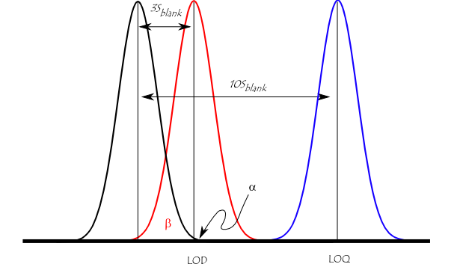
Limit of detection
Notes:
The figure illustrates the relationship between the blank, the limit of detection (LOD), and the limit of quantification (LOQ) by showing the probability density function for normally distributed measurements at the blank, at the LOD defined as 3 * standard deviation of the blank, and at the LOQ defined as 10 * standard deviation of the blank. For a signal at the LOD, the alpha error (probability of false positive) is small (1%). However, the beta error (probability of a false negative) is 50% for a sample that has a concentration at the LOD (red line). This means a sample could contain an impurity at the LOD, but there is a 50% chance that a measurement would give a result less than the LOD. At the LOQ (blue line), there is minimal chance of a false negative.

Slide 11
Limit of detection
Instrument LOD
(3*s) for 10 or more repetitive measurement of instrument noise or blank
(3*s) for y-intercept from 8- 10 calibration curves
Method LOD
3 times std. dev for 10 or more repetitive
measurement of procedure blank(3*s)
Notes:
Most analytical instruments produce a signal even when a blank (matrix without analyte) is analyzed. This signal is referred to as the noise level. The IDL is the analyte concentration that is required to produce a signal greater than three times the standard deviation of the noise level. This may be practically measured by analyzing 8 or more standards at the estimated IDL then calculating the standard deviation from the measured concentrations of those standards.

Slide 12

Thank you for your time!

