Slide 1
Reasoning behind the PM10, EC/OC and levoglucosan analysis at your sites.-
One year with measurements

Slide 2
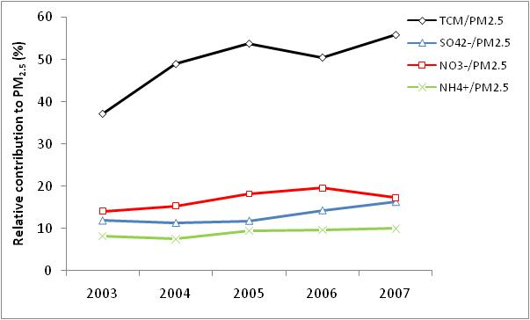
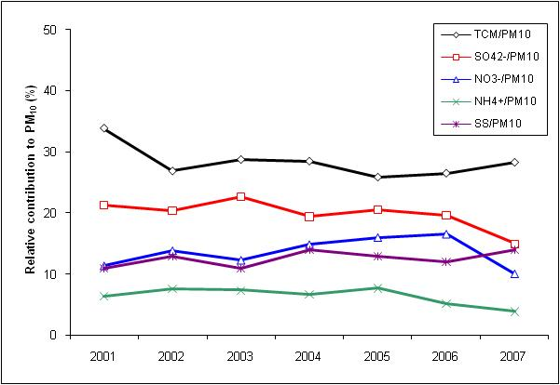
Chemical composition of PM
Ispra, IT
Carbonecous matter is a major component in aerosols.
Many different sources
Birkenes, NO
.

Slide 3
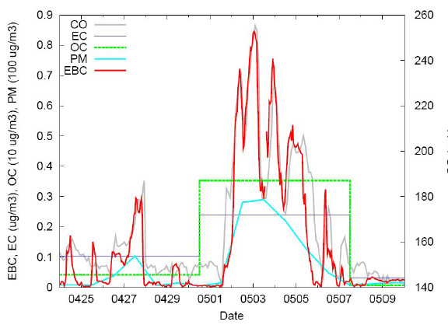
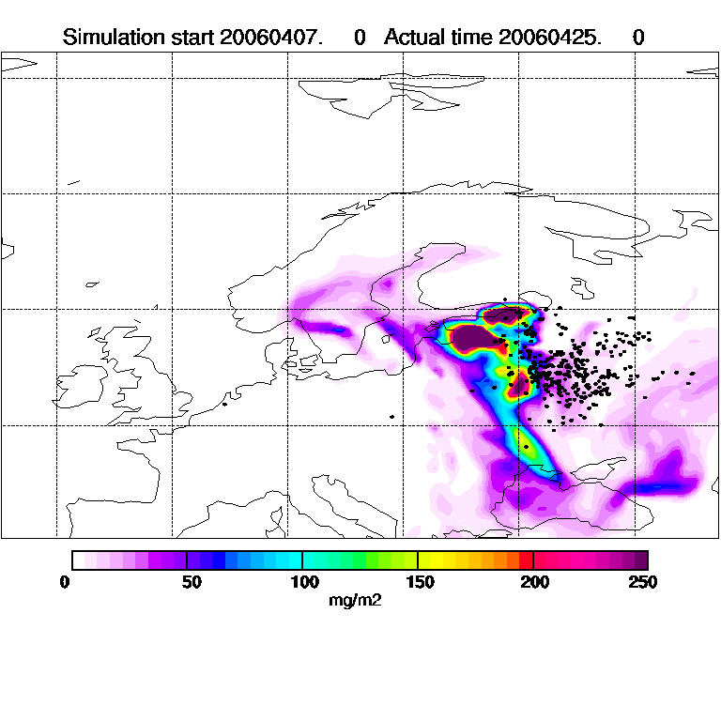
Extreme episode, may 2006
CO, PM, O₃ and AOT were record high
Biomass burning as an important source of carbonaceous matter

Slide 4
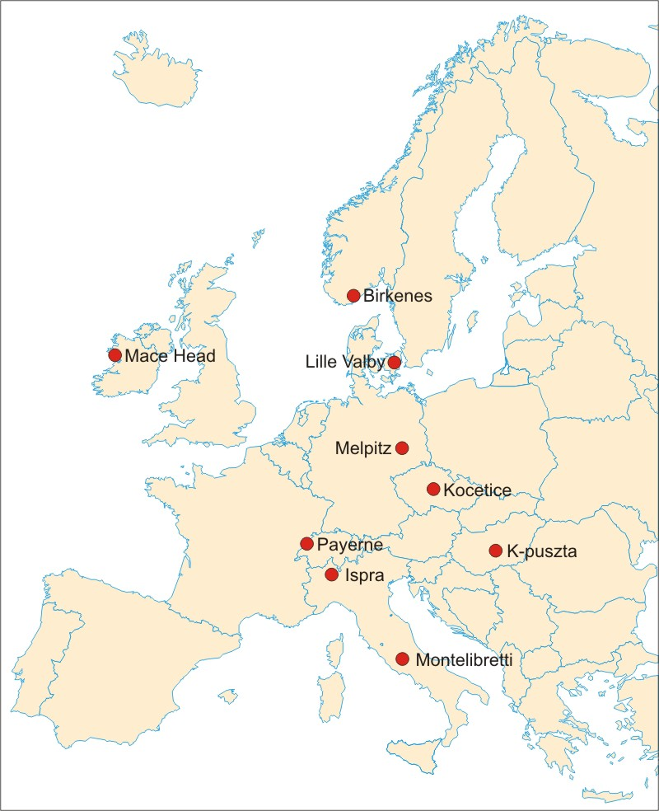
EMEP intensives 2008/2009
Carbonaceous matter
17 Sep – 16 Oct 2008
25 Feb – 26 Mar 2009

Slide 5
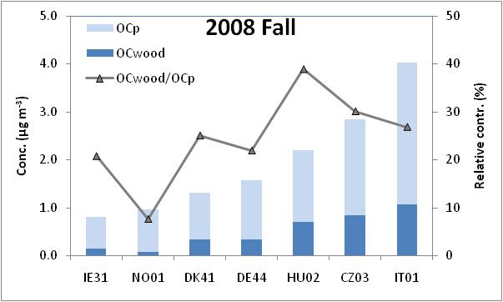
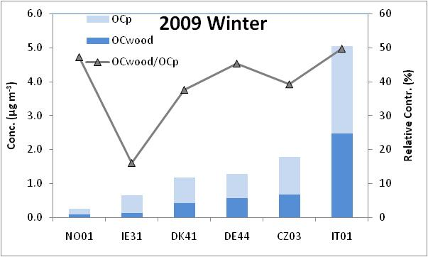
Results
OCp and Levoglucosan
OCp = particulate OC. Front – backup filter, conservative OC estimate
OC wood from levoglucosan analysis
increasing concentrations along a Southern and Eastern transect.
Notes:
Preliminary remarks:
These preliminary results show that there is a substantial variation in the concentration of OC_{p} amongst the various sites, ranging over one order of magnitude during the winter period. The spatial variation corresponds to that reported for the EMEP EC/OC campaign conducted in 2002 and 2003. Although associated with a level of uncertainty the results indicate that wood burning emissions are a substantial contributor to OC_{P} levels at European rural background sites in fall and in particular in winter.

