Slide 1
Measurements - progress in relation to data provision
“The key goal is to improve the availability of observations for EMEP and others use, and in structuring and sustaining efforts across the EMEP domain in relation to regional scale observations”
EMEP TFMM, Larnaca, 13 may 2010
Kjetil Tørseth & Wenche Aas

Slide 2
Monitoring
Implementation of monitoring strategy
  Level 1 “under pressure” in some countries
  Level 2 and level 3 in good progress
  National structuring in good progress
  Successful campaigns
Some Parties are now submitting also historical time series of “new parameters”
NRT-issues more mature
EC/OC protocol developed through EUSAAR
NOxy and CO guidelines in progress by WMO

Slide 3

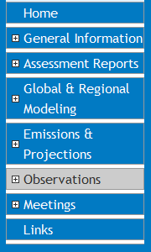
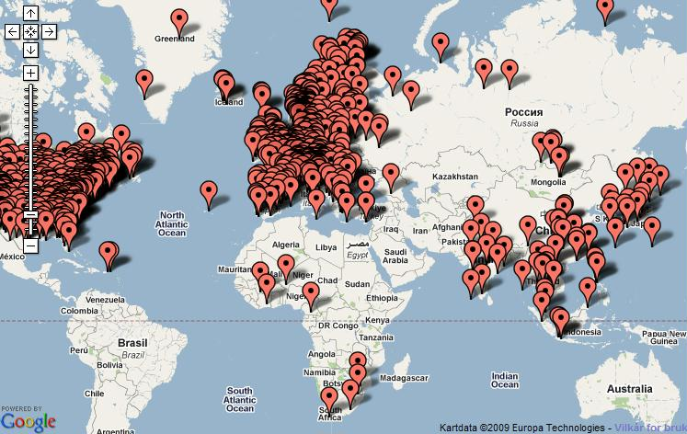
HTAP – Global database
The most comprehensive data compilation ever made (?)
Data from a large number of programmes and projects can be downloaded in one harmonized format
Data access: “restricted, simplified procedure”
Evaluation in progress
www.htap.org

Slide 4
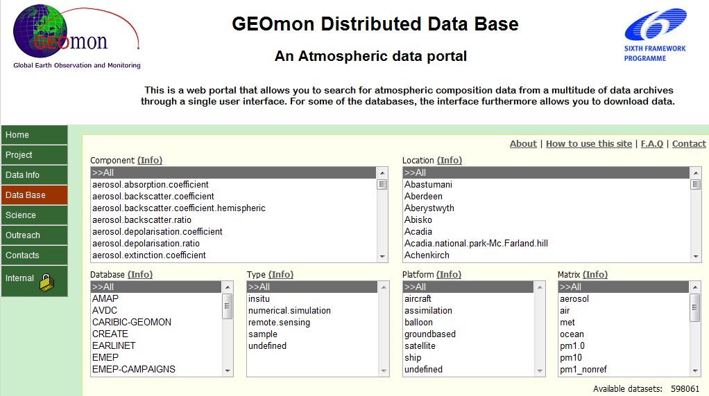
www.geomon.nilu.no

Slide 5

Data dissemination – atmospheric composition
“coordinating initiatives”
“complexity of monitoring”
Research
Infrastructures
EUSAAR
IMECC
EARLINET ASOS
ACTRIS
ICOS
IAGOS
SIOS
GENESI-DR
++++
Research projects
EUCAARI
NITROEUROPE
CARBOEUROPE
IPY
++++
GEOMON
GDDC, One stop shop
In-situ vs Sat RS
NRT+RD-data
COST
ES0602
ESA
Promote
GECA
GEO-GEOSS
AI- Pilots
GEO Tasks
“external/legal steering”
WMO GAW
IGACO
WDCs-
WIGOS-WIS
AMAP
HELCOM
OSPAR
Monitoring
Assessments
DG Ent; GMES
GEMS
MACC
-> Core Service
EEA
AQFD
Airbase
NRT-web
GAS in-situ coordination
EEA-EMEP feasibility study
EMEP
Monitoring strategy
TF-HTAP
NRT initiative
EEA-EMEP feasibility study
“Data providers”
Official databases for EC-directives and International Conventions
National authorities and national focal points
Research projects (IPY, EUCAARI, NitroE, CarboE, +++
Research institutions (reference labs, research infrastructures etc.)
Individual scientists

Slide 6
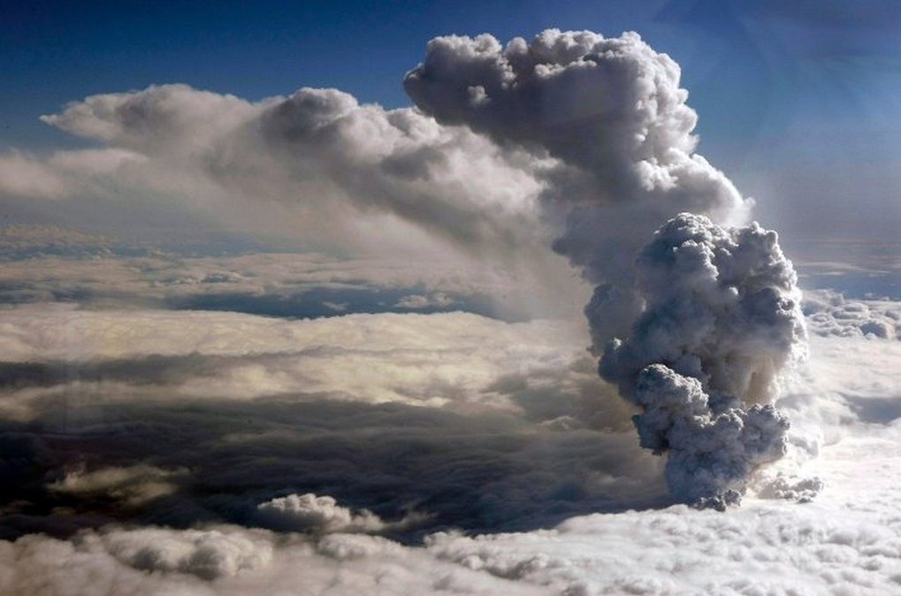
The importance of NRT-data illustrated by the volcanic eruption at Iceland
Method | Satellite | Research aircraft | Aircraft | UAS | Surface remote sensing | In-Situ surface
IR spectroscopy
UV-VIS spectroscopy
Lidar
AOD
Aerosol optical properties
Aerosol size distribution
Aerosol mass concentration
Aerosol chemical composition
Dry deposition
Wet deposition

Slide 7
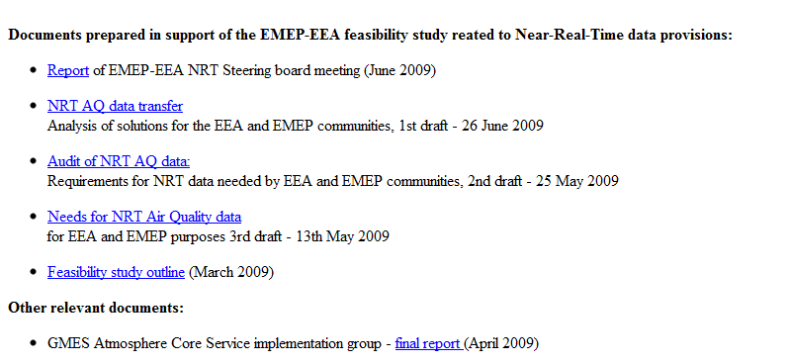
Collaboration with EEA on the NRT feasibility study
Documentation at CCC-website
D1-D3 reports, Workshop in Copenhagen summer 2009
EMEP bureau meeting March 2010

Slide 8
4 alternative principles of operation
Current system continues (continuation of the present ad hoc solution) | - Continuation of NRT data flow agreements set up today - New data sharing agreements may be necessary - New centralising systems may be introduced to focus on specific areas
One central node for collection of NRT AQ data for EEA, EMEP, GMES and other purposes | - EEA collects and disseminates all NRT data on AQ - EEA then have to create a true European Data Centre (including the EMEP demand) as well as process additional necessary auxiliary data and metadata - Similar procedures might need to be established for other networks
Network (Thematic) specific nodes for collection of NRT AQ data | - For EEA and EMEP this would imply that there are two organisations that collect their own data (“AIRBASE data” from EEA and Supersite data from EMEP). - Data may be shared between the two centres whenever needed - EEA data flow could be similar as current solution (regional and national data providers) - EMEP data flow should possibly be directly from stations to NILU (due to harmonised QA procedures)
Decentralized system where every data provider provides NRT AQ data to everybodys | - All data providers make their data available through a common harmonised system - Instead of sending data to one or more centralised nodes each national/regional AQ agency make their data available - GTS/WIS is an opportunity to be explored but would require collaboration with national meteorological agencies in order to qualify data providers to upload their data Decentralisation also requires that data have a place to be stored and it can only take place after standards are in place, i.e. it might first require centralisation and harmonization.

Slide 9
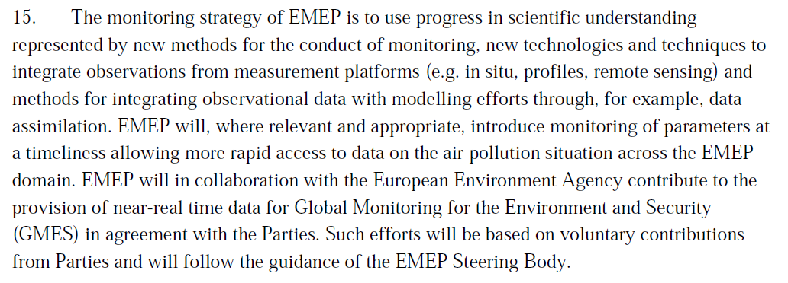

Slide 10
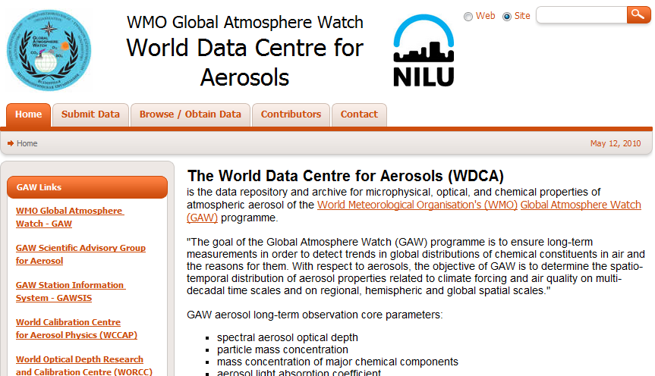
GAW WDCA Near-Real-Time Data Collection and Dissemination of Advanced Aerosol Parameters
www.gaw-wdca.org

Slide 11
NRT of research type data
The parameters covered,
  aerosol scattering & backscattering coefficient (by integrating nephelometer)
  aerosol absorption coefficient (by (multi –angle) absorption photometer)
  particle size distribution (by differential / scanning mobility particle sizer)
  aerosol optical depth (by precision filter radiometer) (to be added in 2010)
require careful quality assurance to be useful, some also advanced processing methods (inversion) to obtain the desired property.
Not all stations have the know-how in house to meet the desired quality for all parameters. In these cases, know-how is often shared offline between GAW stations for regular data reporting.
In order to meet uniformly high data quality standards for near-real-time data:
the data is processed (e.g. inversions applied, calibration periods removed) at the data centre.
the data is automatically sanity checked (boundary check) upon submission.

Slide 12

More Features, Credits
Data ownership and project association clearly visible in data files and web interface.
In order to allow users to assess the data quality of their instruments, also instrument status variables (e.g. supply voltages, sample flows, pressures, temperatures) are accessible.
Data providers (”instrument owners”) may flag data sequences invisible to other users if they consider data quality doubtful.
The WDCA near-real-time infrastructure was
developed through the EU FP6 project EUSAAR
in collaboration with the stations:
  Cabauw, Netherlands (TNO)
  Mace Head (National University of Ireland, Galway)
  Puy de Dôme (Laboratoire de Météorologie Physique, Université Clermont-Ferrand)

Slide 13
Data formats used for NRT data collection
4 data levels and pertaining file formats have been defined:
All format definitions use EBAS NASA-Ames format: NASA-Ames 1001 format with additional specifications accomodating GAW required metadata (ASCII based, user friendly).
Format is generic and easily adapted to new parameters / instruments.
Level 0:
annotated raw data
format instrument specific
Level 0 → 1:
process to target parameter
(apply calibration, inversion)
remove invalid data
Level 1:
final parameter
original temporal res.
format property specific
Level 1.5:
hourly averages
includes variability info
format property specific
Level 1 → 1.5:
aggregate hourly averages
include percentiles
(measure of atm. variability)
Level 1.5 → 2:
quality check by human eye
Level 2:
hourly averages
quality assured by human
eye
Level 0 is used for NRT data reporting.
Level 2 is used for regular (annual) data reporting.

Slide 14
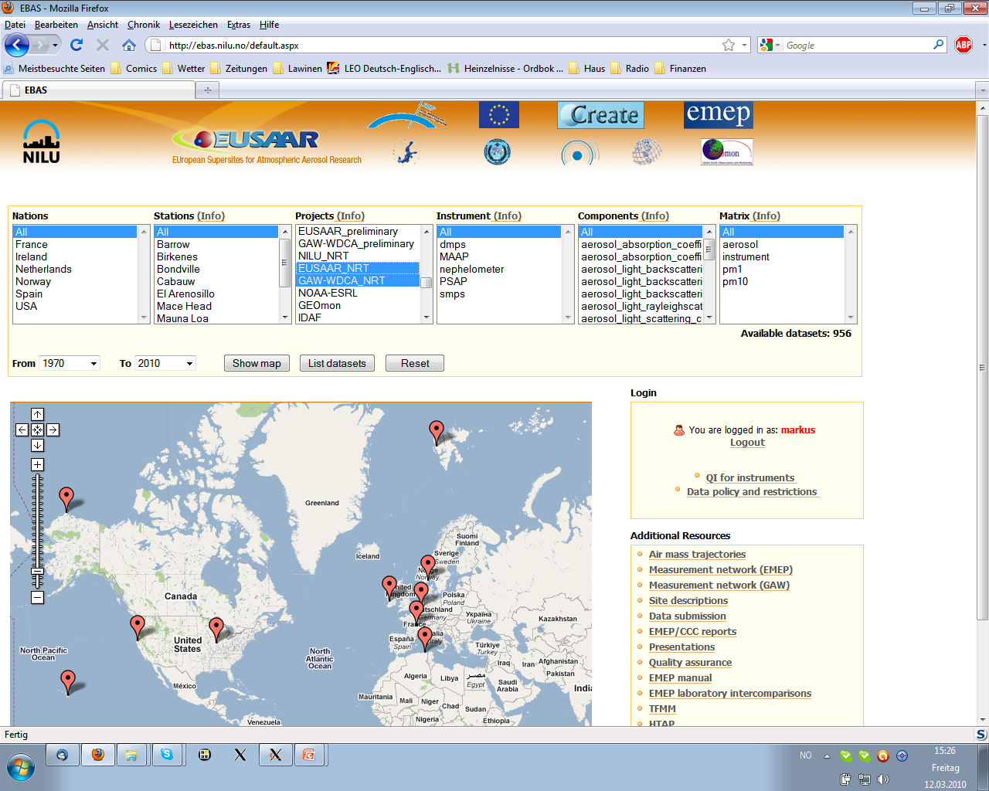
The WDCA and EUSAAR NRT web interface

Slide 15
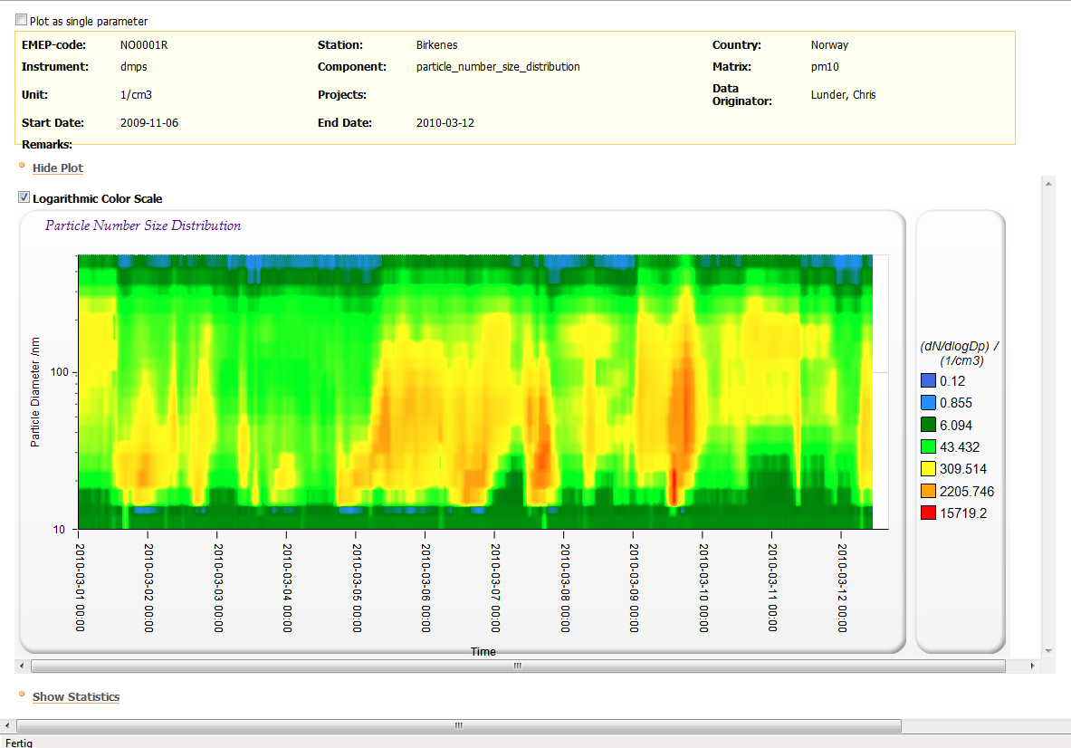
Example 1: NRT Data of Particle Size Distributiona at Birkenes (Norway)
data owner

Slide 16
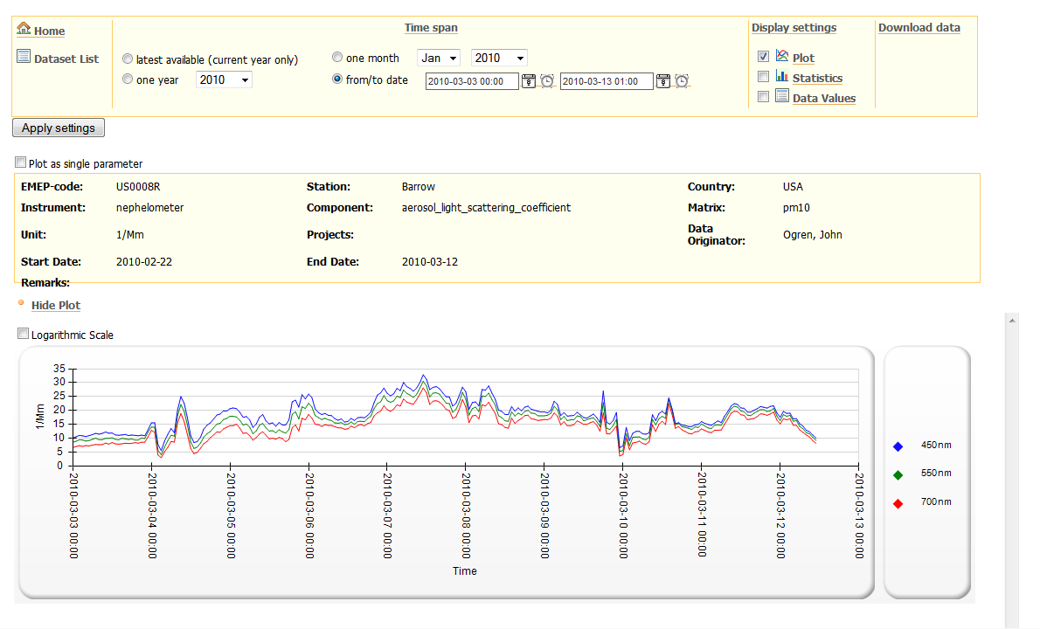
Example 2: NRT Data of Particle Scattering Coefficient at Barrow (Alaska)

Slide 17
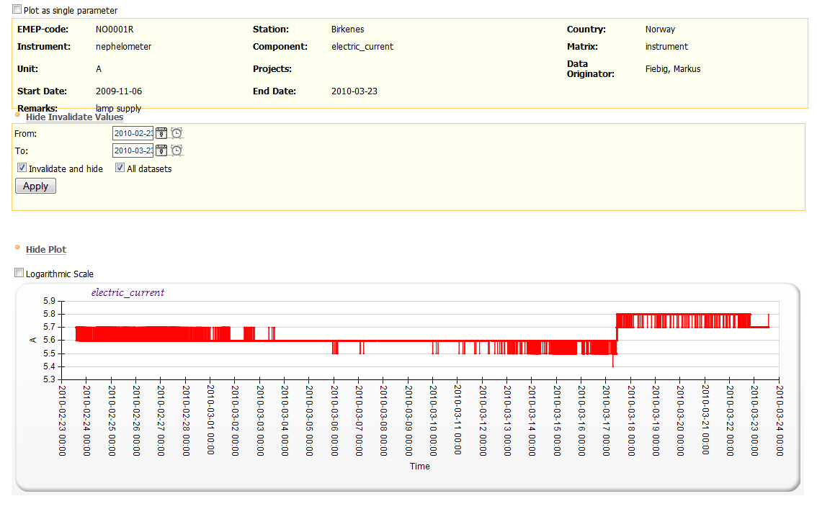
Example 3: Invalidation Tool for Instrument Owners

Slide 18
ACTRIS
Aerosols, Clouds, and Trace gases Research Infrastructure Network
Type of funding scheme: Combination of Collaborative Projects and Coordination and Support Actions for Integrating Activities
Work programme topics addressed: FP7-INFRASTRUCTURES-2010-1
Support to existing research infrastructures
Integrating Activities
INFRA-2010-1-1.1.16: Research Infrastructures for Atmospheric Research
Integrating the key ground-based facilities for long-term observation of aerosols, cloud-aerosol interactions, and trace gases in Europe

Slide 19
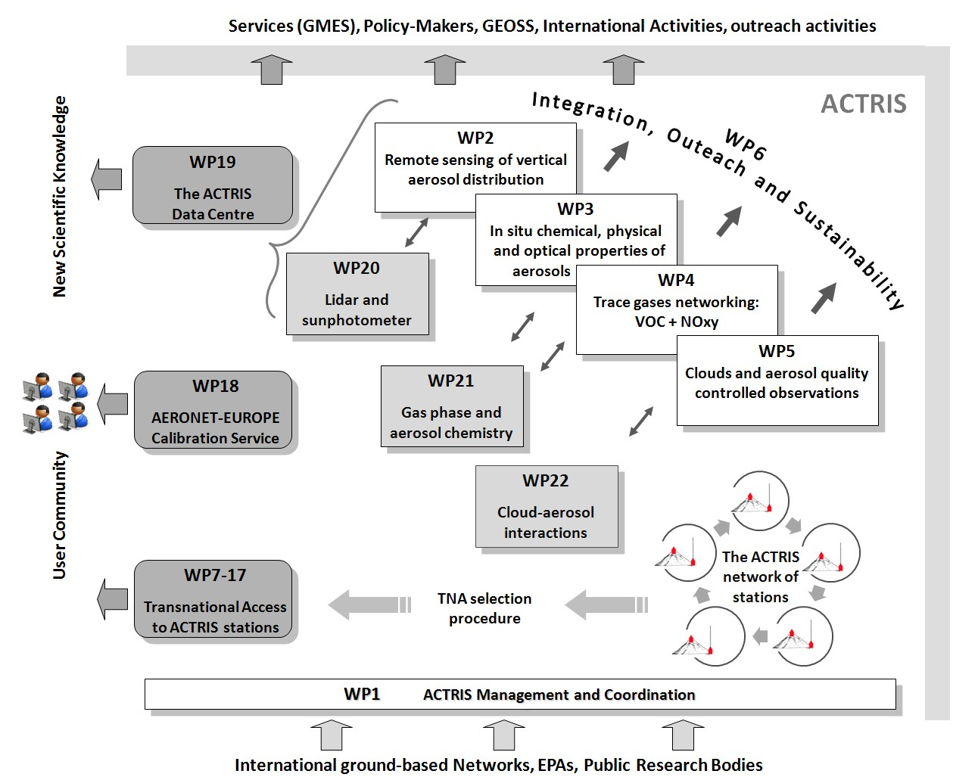

Slide 20
Map of measurement sites contributing to ACTRIS
Please note:
ACTRIS will deliver useful contributions also to those not being partners !
ACTRIS do not fund the measurements, this has to be covered by national funding !
Actris partners have committed to EMEP/GAW

