Slide 1
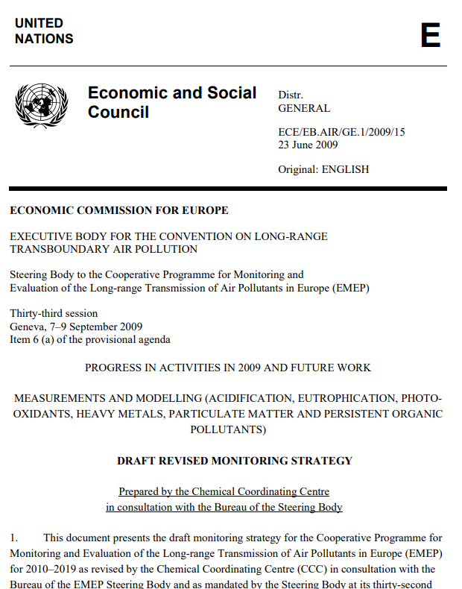
EMEP Monitoring strategy 2020-2029
Kjetil Tørseth, EMEP-CCC
EMEP-SB, Sept, 2018
Max 10 pages
General text (objecives, coordination, organization, compliance/implementation/evolution
Specifications

Slide 2
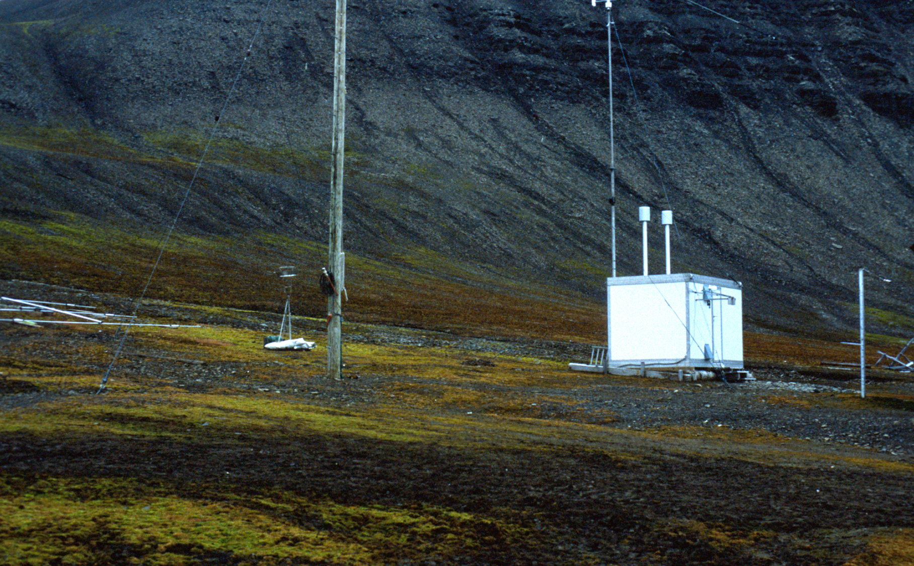
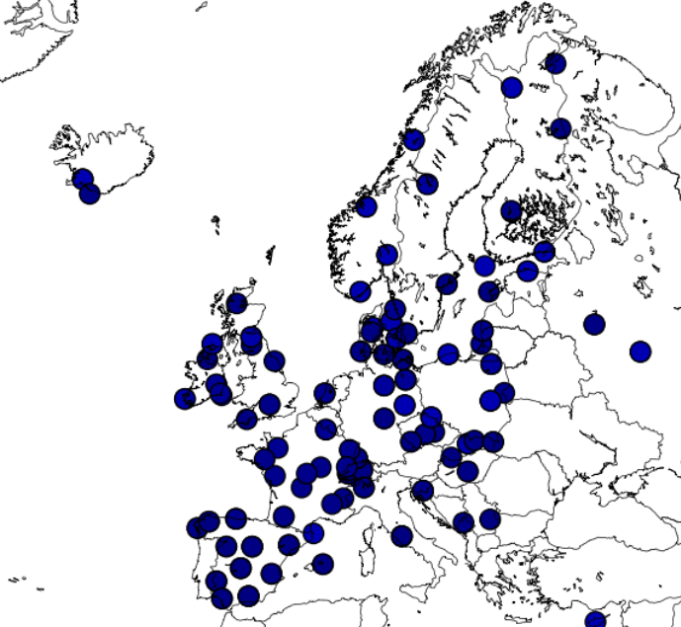
EMEP monitoring - where are we?
42 countries
346 individual stations
85 different instrument types
more than 460 different components/variables
resulting in about 50.000 datasets!

Slide 3
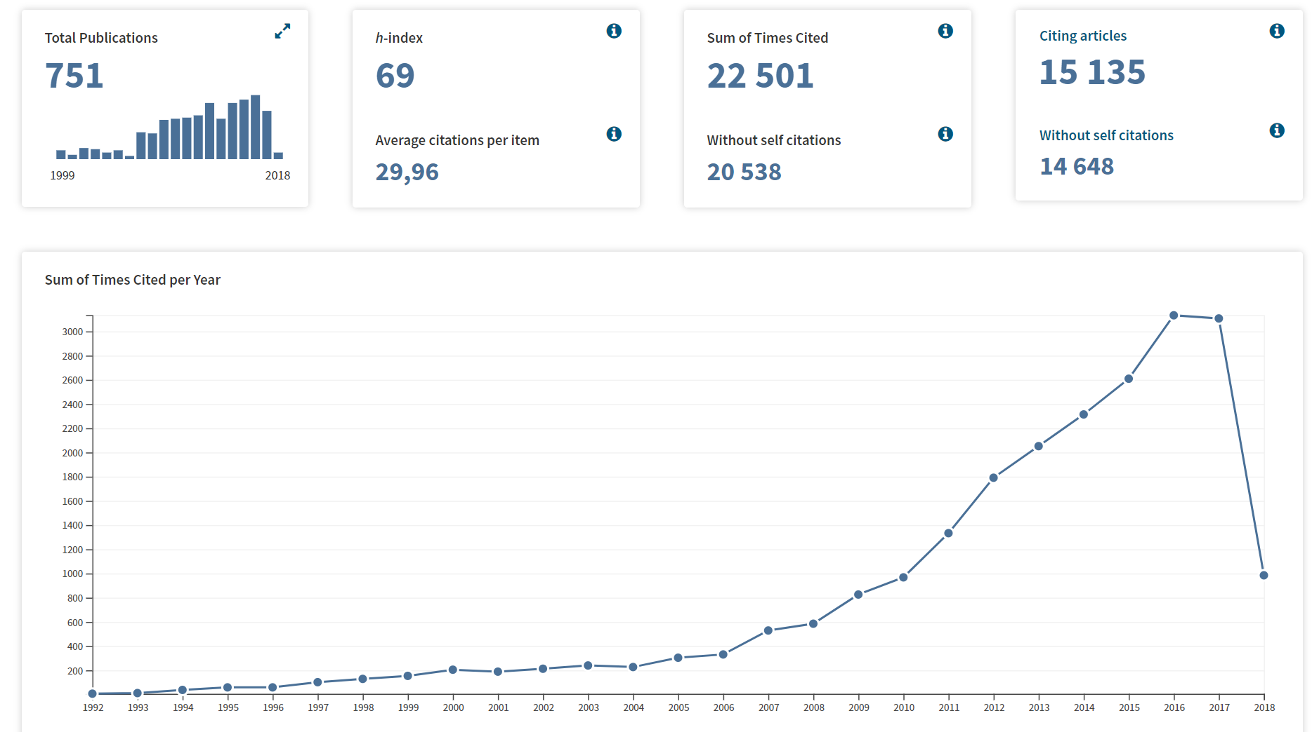
EMEP in «Title», «topic» or «funding»

Slide 4
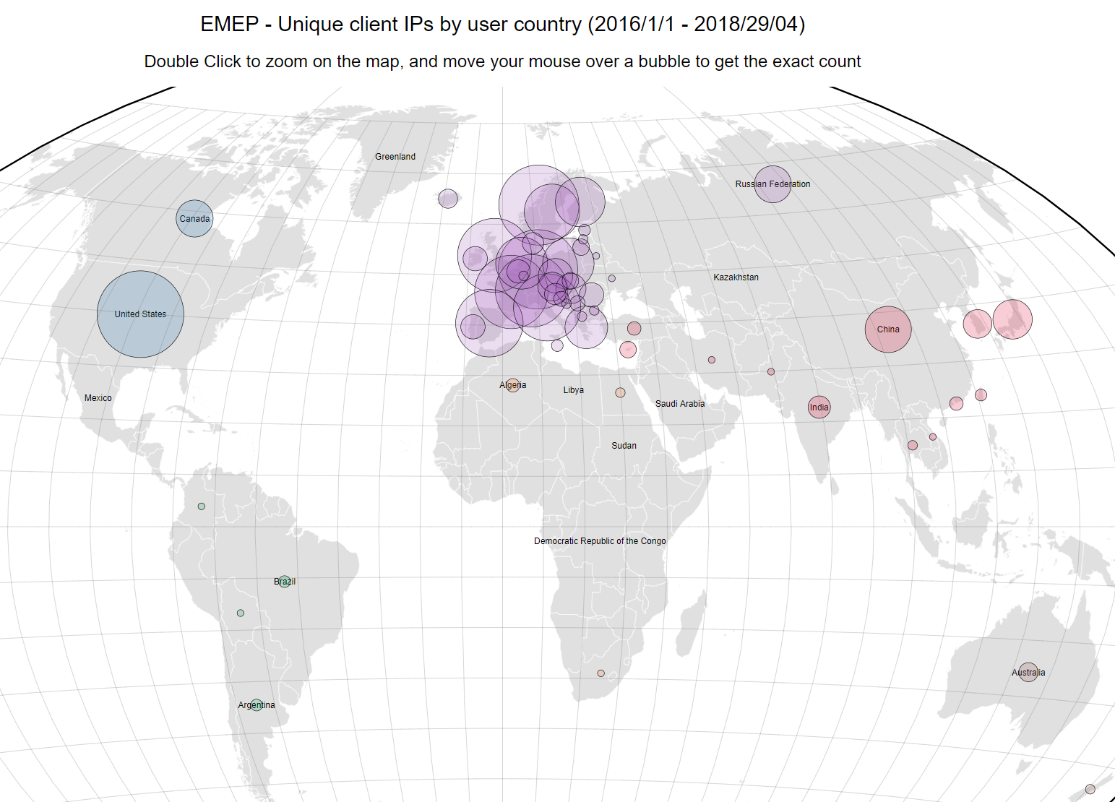

Slide 5
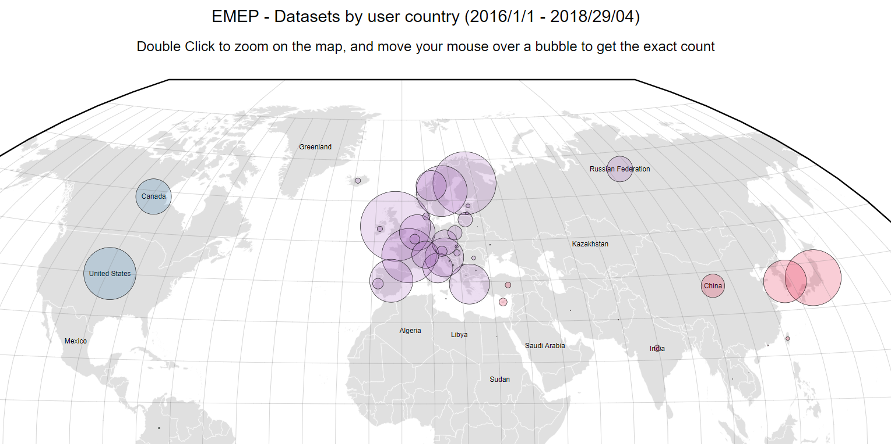
UK: 140.000

Slide 6
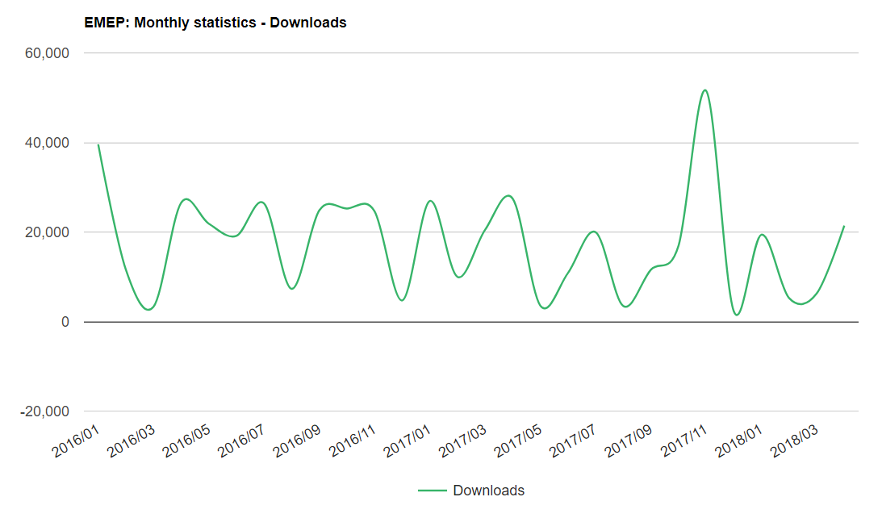
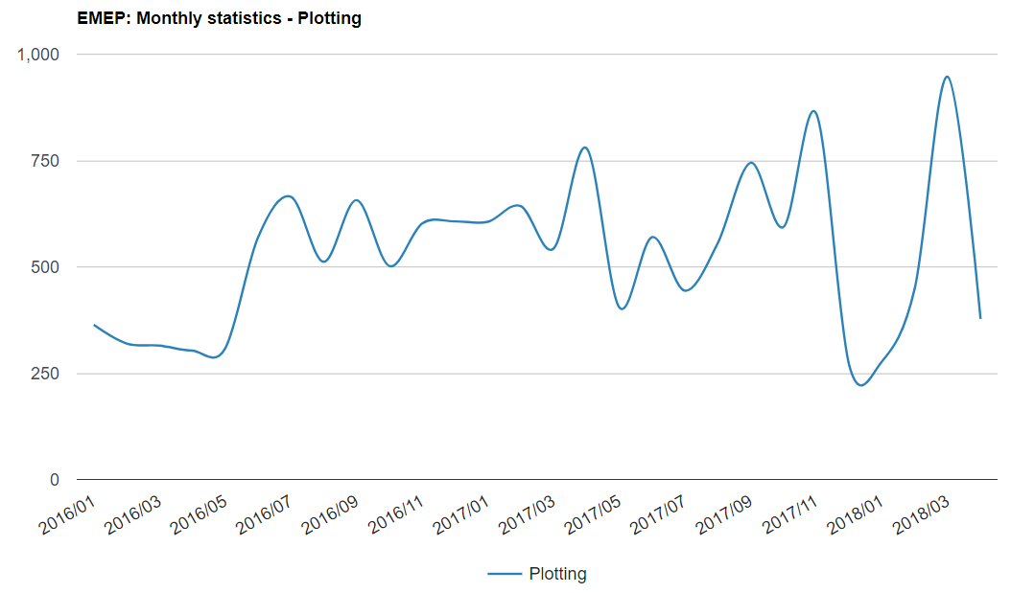
~1000 individual users per month

Slide 7
Basis;
Major revisions not seen necessary (follows major revision of 2004->)
(level approach, multi-topic, no new thematic areas beyond the five currently considered)
Defines important measurands and their temporal/spatial resolution
Does not address methods in any detail, but still measurement methods (capabilities/limitations) have important impacts on the approach
Harmonization with other initiatives still very important
Regional vs local measurements, links to AQD
Feasible and engaging
Ambitious in scope, relaxed in compliance (not opposite)
Secure long-time series

Slide 8
Timeline:
Continuous communication with funding agencies, measurement community and data users
Technical requirements
Consultations with EMEP Steering Body/EMEP TFMM
Updates reflecting status of WMO-GAW, ACTRIS, other…
Internal workshop at NILU
Draft1 sent to MSC-W and MSC-E
Draft2 for TFMM May 3rd, 2018, special session at TFMM
Written input and comments by June 2018
Draft3 available August 2018
Strategy text
First draft prepared by EMEP-CC, available August 2018

Slide 9
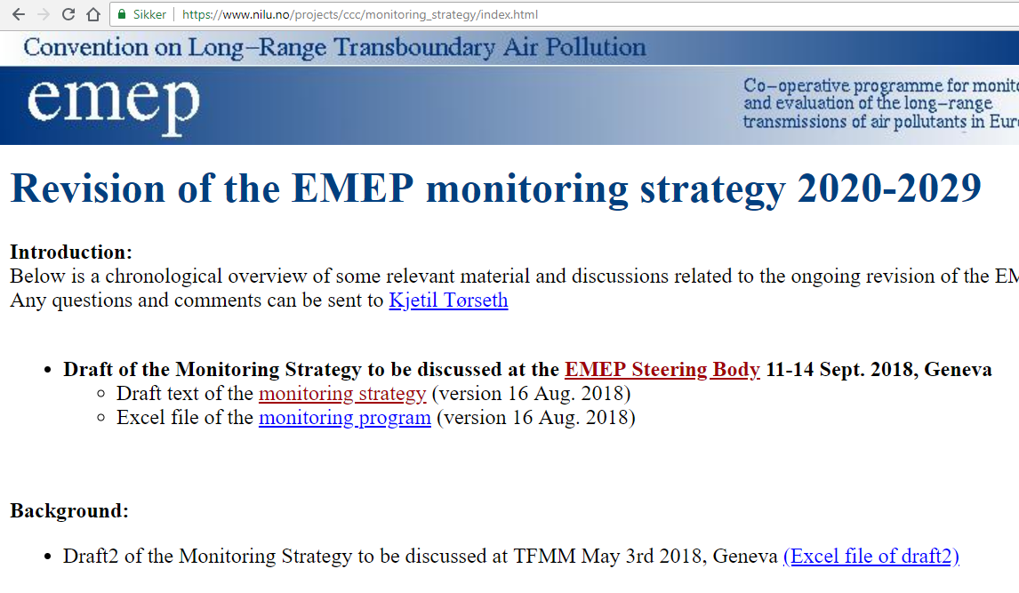

Slide 10
table listing specifications…(excel-file) will not be presented in detail here

Slide 11
Presentation of Strategy text updated to reflect status quo wrt formal issues rewritten to clarify typical questions raised more clearly formulated In essence – only minor changes

Slide 12
Introduction
Intro
Main objectives of EMEP
Observations «services to policy»
Scales and relation to other initiatives
Previous versions

Slide 13
General objectives and requirements
6. Consistent and continued monitoring
7. General needs (spatial, temporal, co-located, affordable…)
8. Topical linkages and multi-disciplinarity
9. EMEP as the core information provider within the EMEP region, local-global, satellite and other data, GEOSS/Copernicus
10. Integrated approach (SLCPs, Carbon- Nitrogen cycles)

Slide 14
Coordination and cooperation
11. The use of other relevant data
12. Listing of key collaborative programmes
13. The relation to science and state-of-the-art methods

Slide 15
Specification of the monitoring program 2020-2029
14. Defines «three levels»
15. Level 1
16. Level 2
17. Level 3
18. General specification of the levels
19. Excel file with detailed listing
20. Co-location and exceptions
21 Temporal resolution
22. Spatial resolution
23. Data quality
24. Open data

Slide 16
Implementation and further evolution
25. Request Parties to implement
26. Regions with few sites
27. National priorities
28. Emerging needs

Slide 17
Remarks
Level 1, largely engages governmental agencies and institutes and is based on long-term funding. Standardized methods and data products. QAQC internal, partly overlap with EU-Directives based monitoring. Data reported to EMEP.
Level 2, do also rely in research institutes/universities, close links to RI-initiatives. Standardized methods and data products, external QAQC may occur. Data reported to EMEP.
Level 3, typically research oriented. Often no standard methods or QAQC systems in place. Often no permanent long-term comittment. Also other locations and «representativeness» than at Level 1 and level 2. Data reported to EMEP, but with exceptions (national network data)

Slide 18
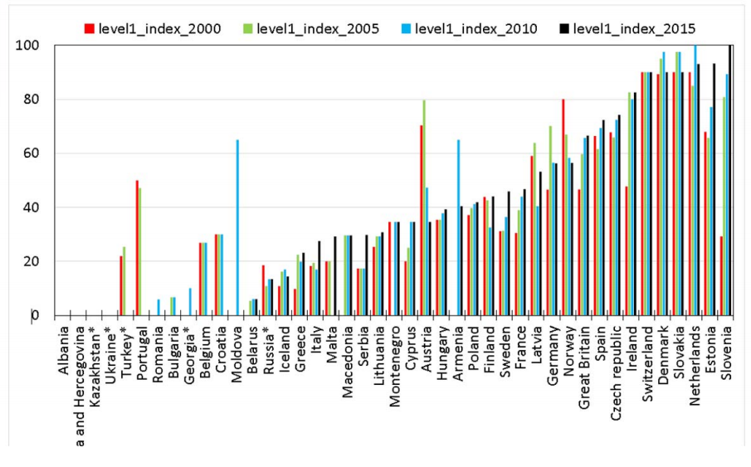
Levels and site densities
No change suggested to «level-approach»
Regionally representative sites (rural/remote)
Target site densities
«Implementation index» will remain an «in-official» measure

